Slide 1

A COVID 19 STUDY
UNDERSTANDING THE PREDICTORS OF DEATH RATE DURING THE COVID 19 PANDEMIC

Slide 2



INTRODUCTION
The covid 19 pandemic had a huge effect on the world.
A lot of lives were lost.
A lot of businesses were shut down.
Relationships between countries were strained.
Hospital resources were stretched to the limit.
A lot of money was spent on purchasing vaccines and covid tests.

Slide 3

Objectives
The goal of this study was to learn how the world could have responded better to this pandemic.
Specifically, the study aims to find predictors of death rate at a group level.
Key Decision makers may be able to use the findings of this study to help guide their decisions if there was to be another pandemic.

Slide 4
Methodology
Data was collected from a github repository belonging to ourworldindata.org.
The repository can be found at the following link: https://github.com/owid/covid-19-data
The data was taken at group level including features like Deaths per day and Number of Covid Tests.
The scope of the study was limited to the united states.
The Data science method was used which included the steps of wrangling, exploratory data analysis, pre-processing, and modelling.
For each step of the data science method, there is a jupyter notebook.
The project can be found at: https://github.com/Thaps/DataScienceGuidedCapstone

Slide 5
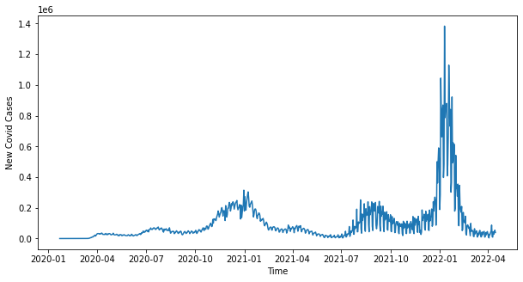
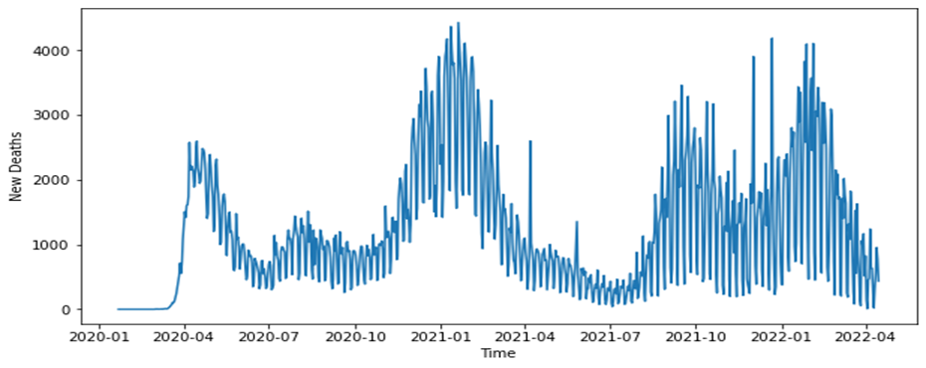
Exploratory data analysis
New Covid cases over time
New deaths over time

Slide 6
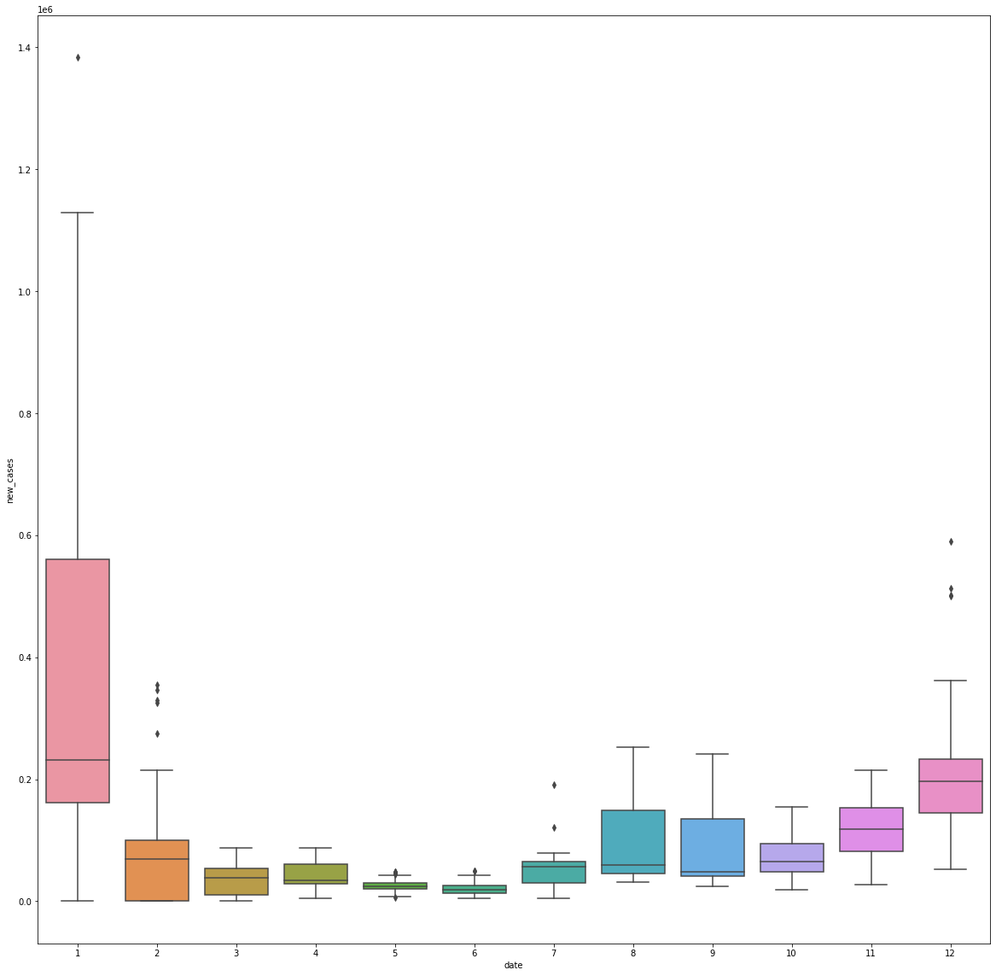
Distribution of covid deaths across months from February 2020 to April 2022.

Slide 7
Exploratory data analysis – time series analysis
It is clear that there tended to be more covid deaths during the festive period and early January than any other time of the year.
This may have been because there tends to be more movement during festive period as people go home to spend time with their families.
It also may be because people are more likely to engage in risky behavior like disregarding social distancing protocol during festive holiday.

Slide 8
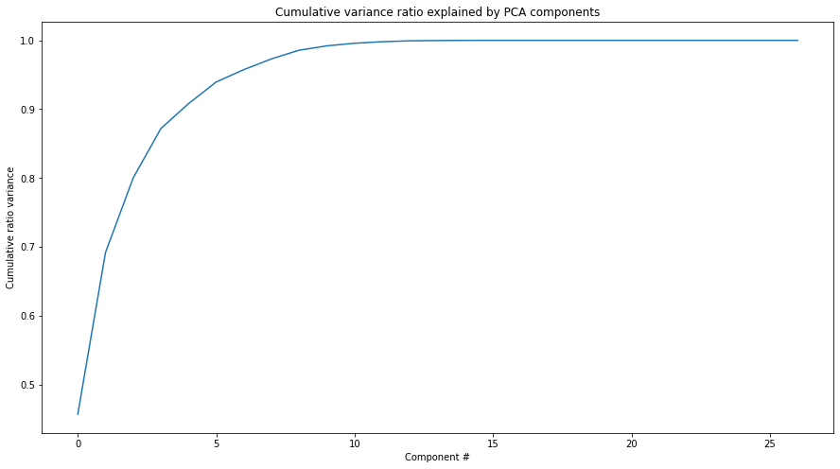
Exploratory Data Analysis – principal components analysis
Principal components analysis was performed on the data to see whether there were specific features responsible for a large part of the variance in the data.
The first 2 components accounted for about 69% of the variance. The first 5 over 90%.
It was found that the features that had the most impact were stringency index, hospital patients per million, total tests, and people vaccinated per hundred.

Slide 9
Data pre-processing and modelling
In order to prepare the data for modelling, the data was scaled around the mean. This is expected to improve the performance of the model since all the data will be sitting on the same scale.
The data was split into 25% test data and 75% training data.
Death rate was the target variable and all other variables were used as response variables.
Furthermore, cross-validation was used during the modelling in order to ensure that the results of modelling were a true representation of the models ability to predict death rate.
The data was modelled using a linear regression model since there were a lot of linear properties in the data. Python sklearn’s linearregression model was used.

Slide 10
Modelling performance
The results of predicting the test data using the linear regression were as follows:
Mean Squared Error: 0.383
R2 Score: 0.646
The r2 score performs better than the mean though it is not very high. But it does indeed indicate that death rate can be predicted to a reasonable degree using the list of predictor variables.

Slide 11

conclusion
The stringency index which is a scale of the level of restriction imposed on the population, is among the highest predictors for the death rate.
The nature of this correlation is not clear though. But it does seem that imposing curfews and lockdowns did have an effect on death rate.
People vaccinated per hundred also had an effect on death rate. Although the boosters do not seem to have had much of an effect.
In future, it would be good to find a dataset with more interesting features. For example, information at individual levels such as the demographics of the individuals who have tested positive or died. Also whether or not they had underlying conditions.
It would also be interesting to study this data set at a macro level. To see how different results were for different countries based on their response to the disease.
there is still a lot to explore in terms of how there could have been a better response to the pandemic.

