Slide 1

Still – Daily meditation tracker
Presented By:-
Amit Thapliyal
21001602005
MCA(2021-23)

Slide 2
Key learnings
Django/Django rest framework
MERN Stack
React Native
PostgreSQL, MySQL, MongoDB
Database architecture
Chakra UI
Microservices
AWS (EC2,IAM,S3,RDS,Amplify)
Deployment tools like PM2,Nginx,Gunicorn,SSH,
CI/CD with github actions

Slide 3
Overview of Project
Still is a web based application which is a 66 days meditation tracker that provides audio based meditation to their user.
The journey of a user is divided into several levels and it encourages the user to perform daily meditation without skip by introducing daily notification along with the streak resetting.
This app introduces features like
Custom reminders
International timezone support
Daily notifications and reminders
Share progress
Whatsapp Cloud messaging

Slide 4
Objectives:-
Cultivating Mindfulness: The project seeks to foster a culture of mindfulness by encouraging individuals to incorporate meditation into their daily lives.
Establishing Consistency: A key goal of the project is to help users establish a consistent meditation routine. Through reminders and notifications, the platform aims to support users in maintaining their practice and ensuring that meditation becomes an integral part of their daily lives.
Enhancing Well-being: The ultimate objective of the project is to enhance users' overall well-being. By integrating meditation into their lives, users can experience reduced stress, improved focus, increased self-awareness, and a greater sense of inner peace and balance.
Accessibility and Convenience: The project aims to make meditation accessible to a wide range of users. By providing a web-based platform, it ensures that individuals can engage in meditation practice from anywhere, at any time, using their preferred devices.

Slide 5
Tech Stack Used:-
React.js – A popular frontend library to develop user friendly, highly reusable UI components and write complex logic at frontend.
Django/Django Rest Framework – The backend framework for building RESTful APIs, it has built-in ORM (Object-Relational Mapping) capabilities, routing system, and powerful templating engine to build secure, maintainable, and high-performance backend solutions.
Redis – Message broker for developing cron jobs (Background task workers)
MySQL – Relational database
AWS – AWS cloud provider is used for hosting purposes and PaaS
Other Tools – Nginx, Pm2, Gitlab

Slide 6
Key features:-
Session Tracker:-
There are multiple levels of the entire journey of still in which the most basic one is 5 days streak, where on each day a new video and audio will become available to the user.
The user is only able to view the video/audio of their perspective day only
If the user misses the practice the next day he can continue or if he misses two days then entire streak will get reset and the user need to restart again to build that consistency
Restart Tracker :-
The restart tracker can only be initiated by the user once he clicks on the unique link that he receives.
On triggering the restart code, The schedules will again recalculated and the user can start again the same process

Slide 7
Whatsapp notification:-
This application leverages the whatsapp cloud api to send notification directly into the user’s contact for much better engagement.
The application generates a dynamic template and send them as a body to whatsapp cloud api to trigger the message that need to send
Half time / Custom Reminders:-
The application generates a half time reminder to all the user who hasn’t completed the practice till 5:00 pm
It also provides the ability to the user to set their own time to practice
Once they set a time they will receive whatsapp notification if the user didn’t completed the practice for the day till that time
Daily dose audios:-
The application has some extra audios other than main audio that are available from the Level – 1of the journey.
These audios will be available on an incremental based, one audio will be present from day 1 to day 7, then one more audio gets unlocked after day 7 and so on

Slide 8
Progress/Journey:-
This application records the journey of the user where the user can view where they are in their still journey
Along with journey there is progress that is recorded on each 10th day starting from mandala
This progress can be shared to other individuals via web share api.
International timezone support:-
One of the unique feature of the application is that it sends out notification daily at 5:00 am irrespective where the user is located i.e, the user is in USA will receive notification when their local timezone hits 5:00 am in the morning and same goes for the Indian user as well.

Slide 9
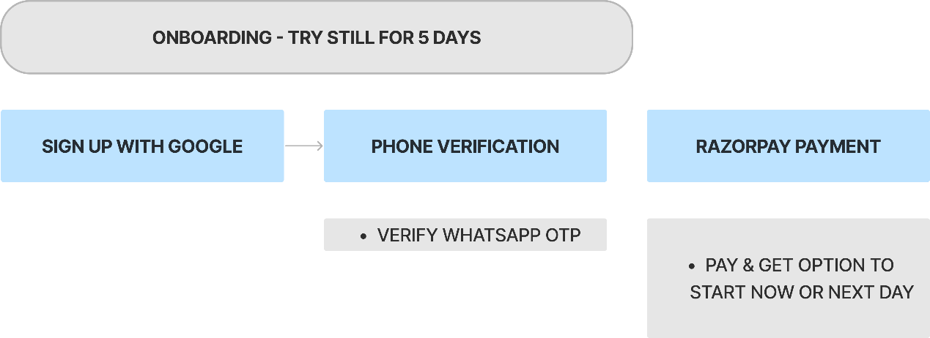
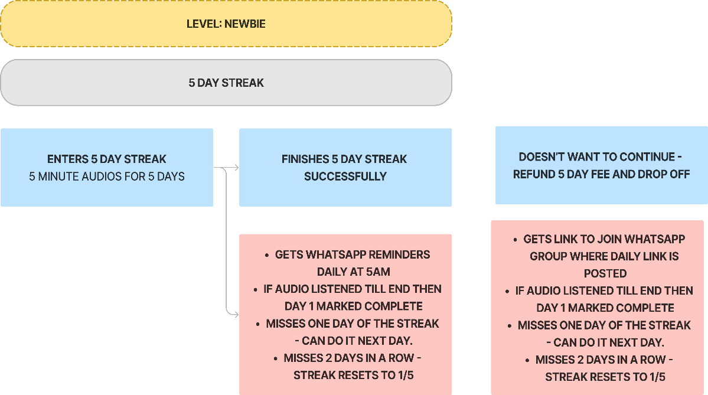
Flow Design

Slide 10
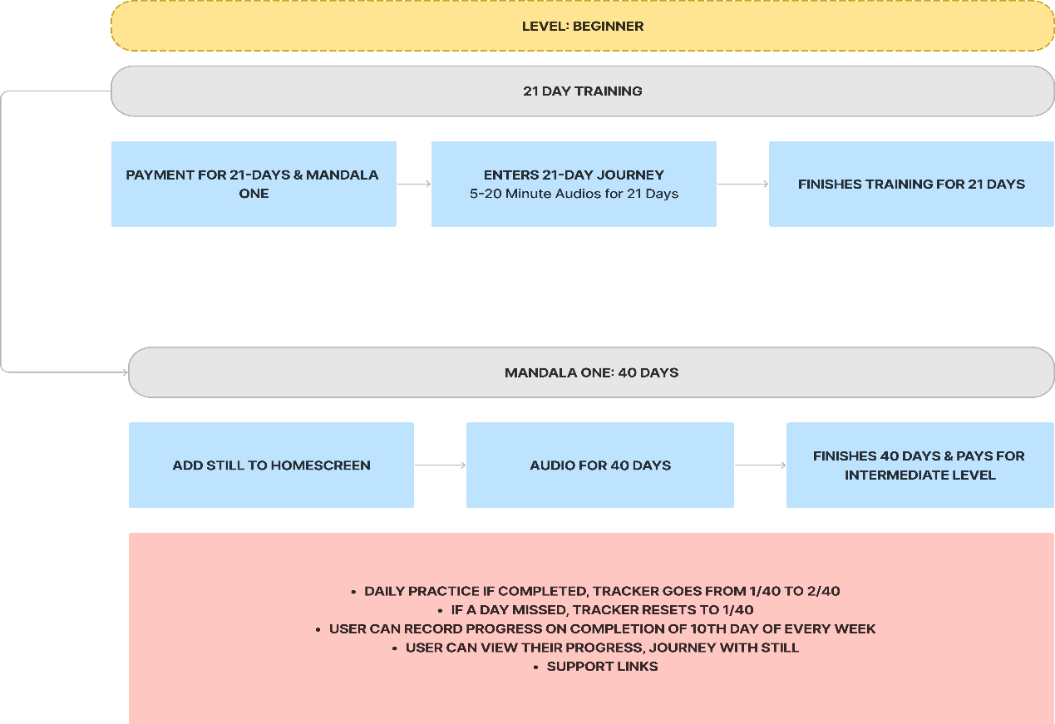

Slide 11
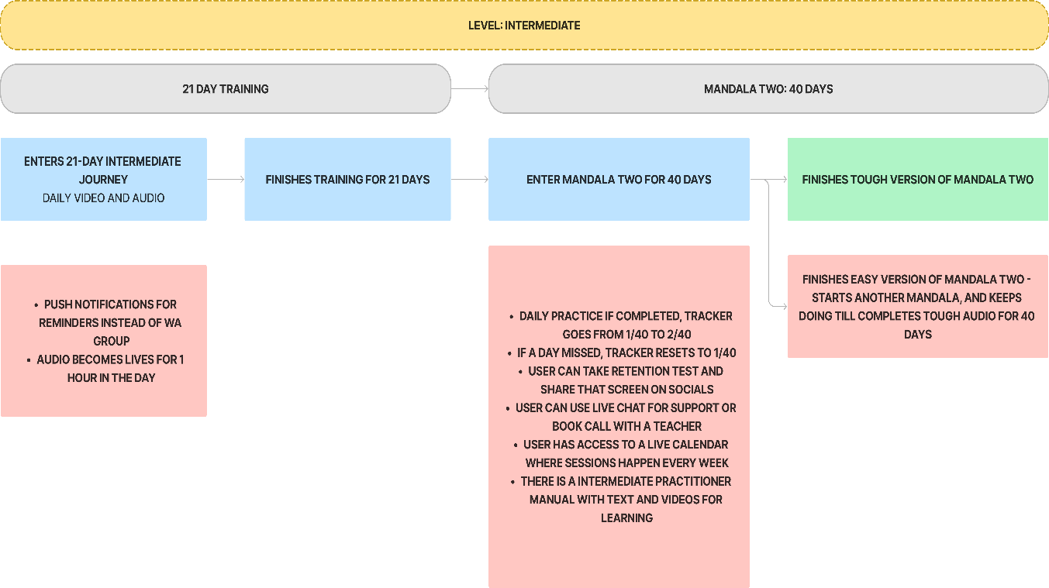

Slide 12
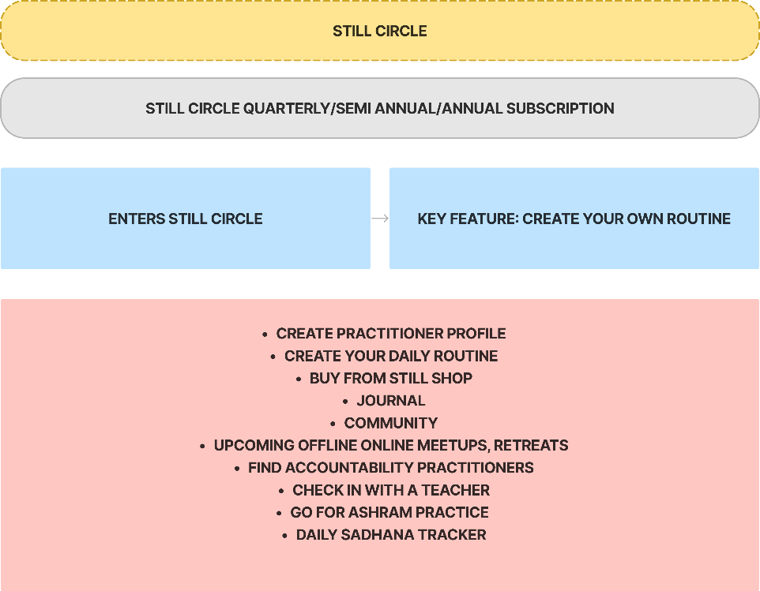

Slide 13

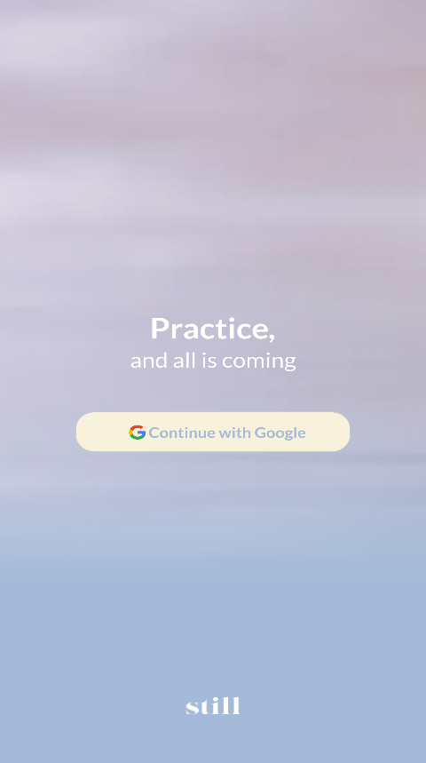
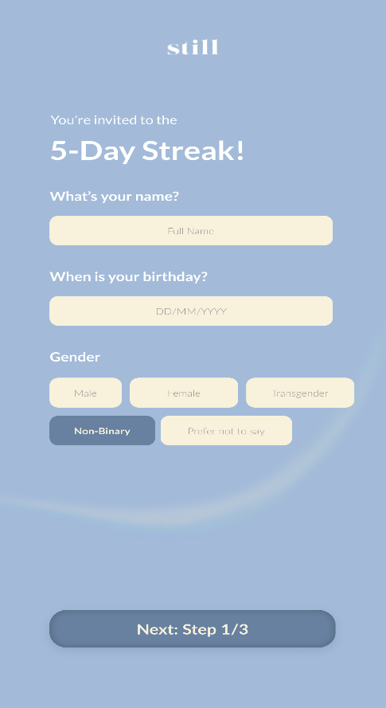
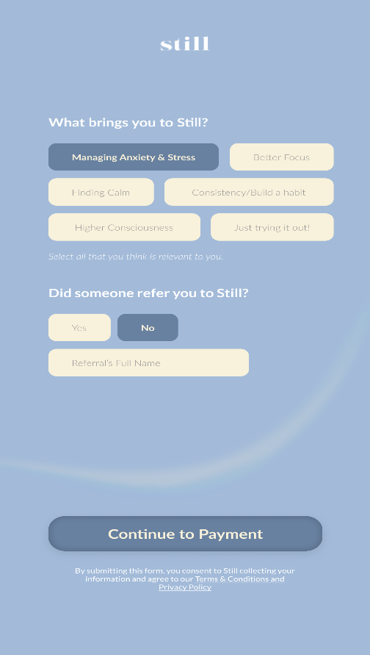
Onboarding

Slide 14
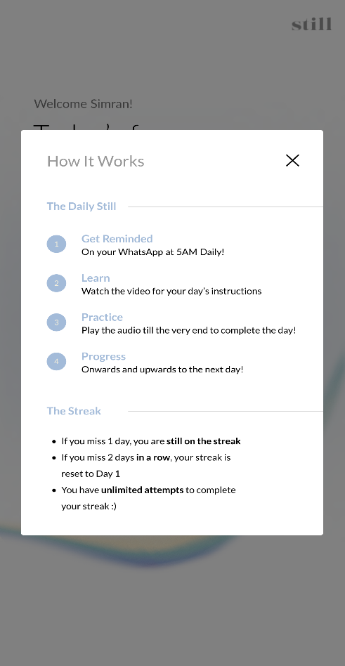
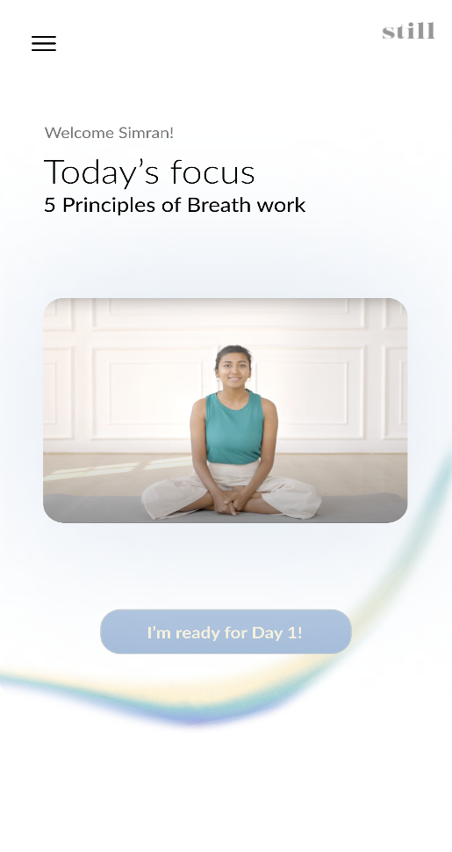
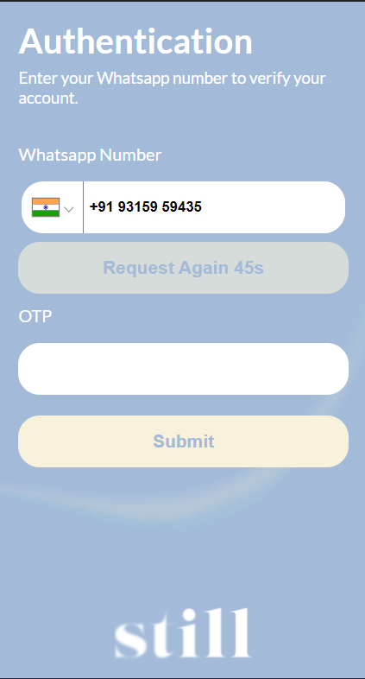
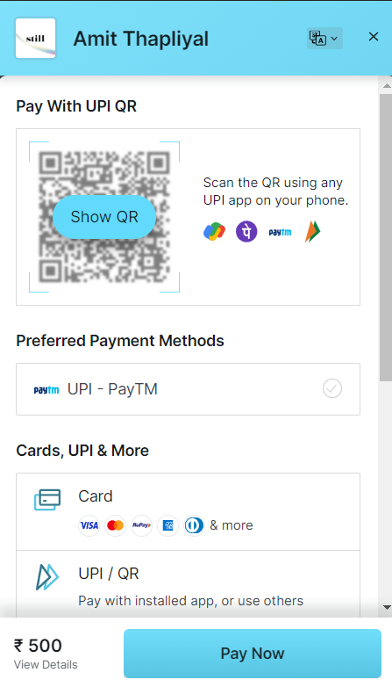
OTP/Payment/Popups

Slide 15
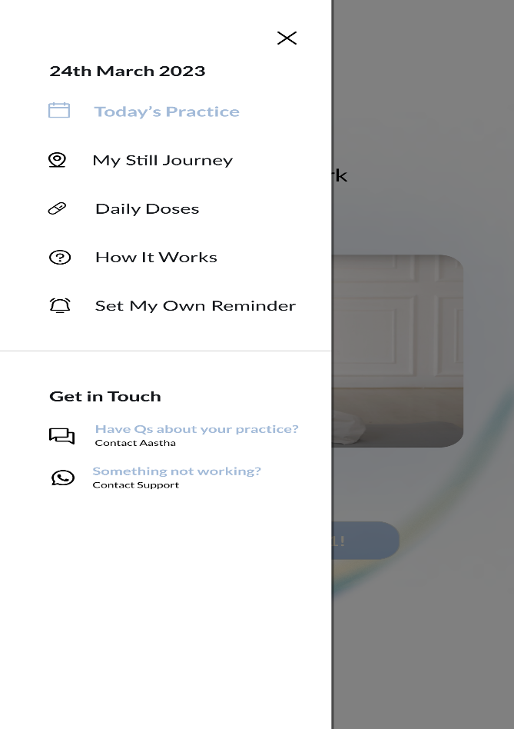
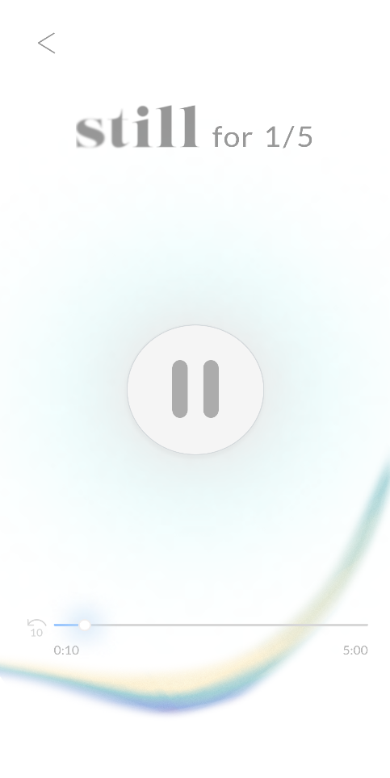

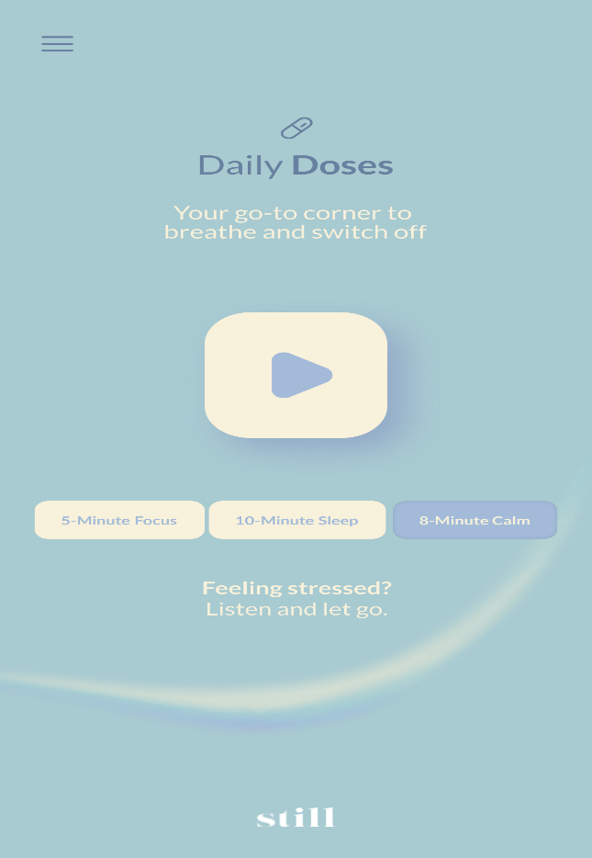
Session audios/Daily doses

Slide 16
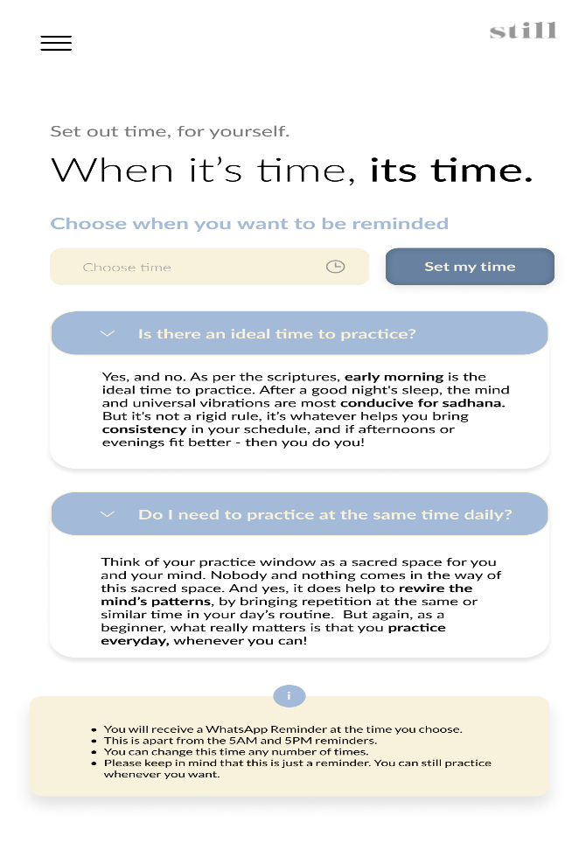
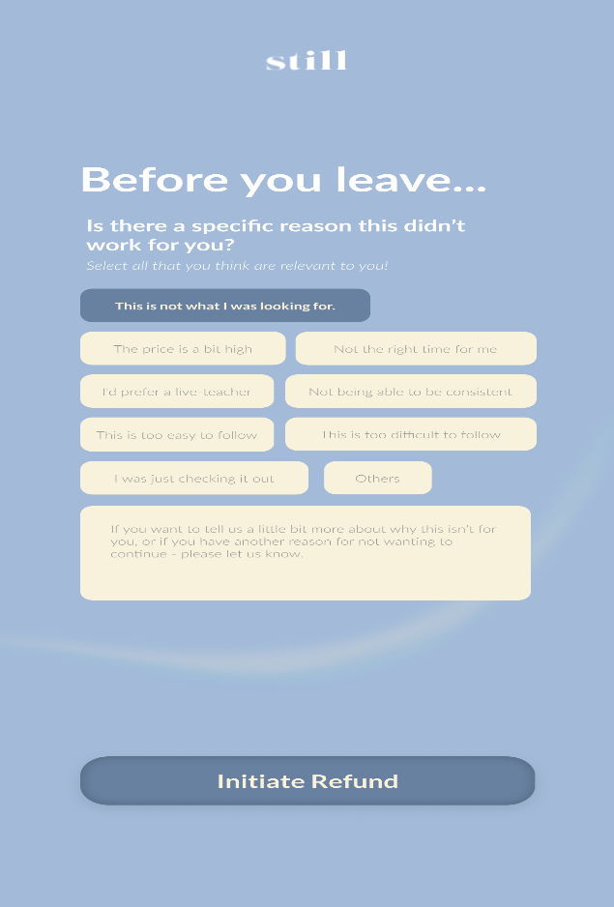
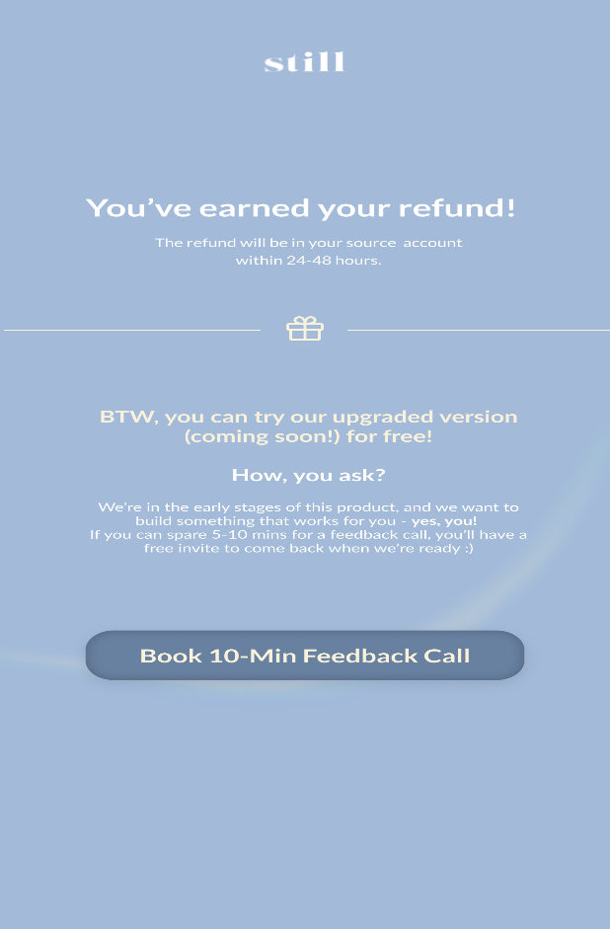
Custom reminder/Offboarding

Slide 17
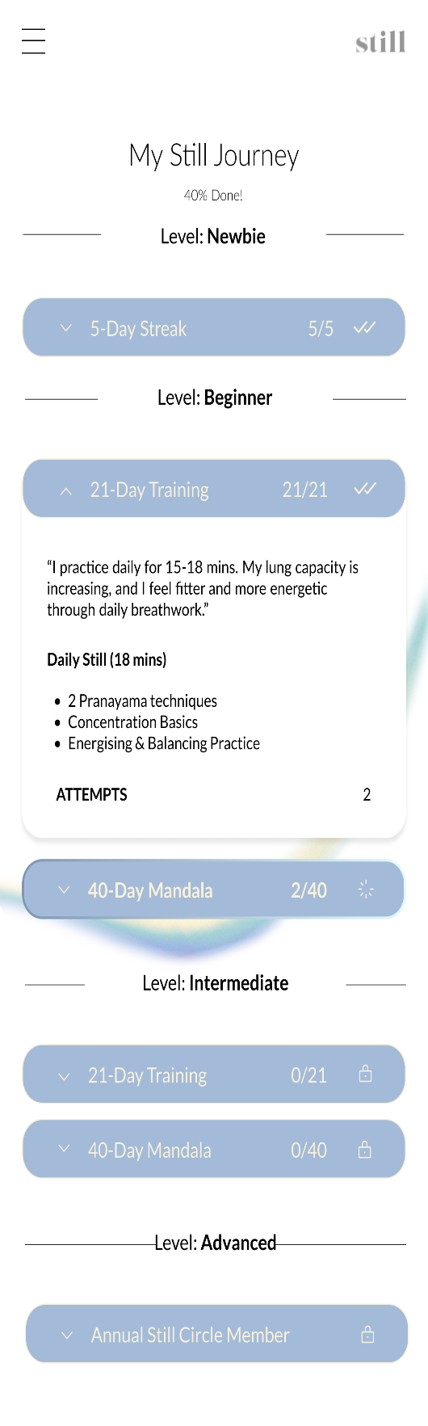
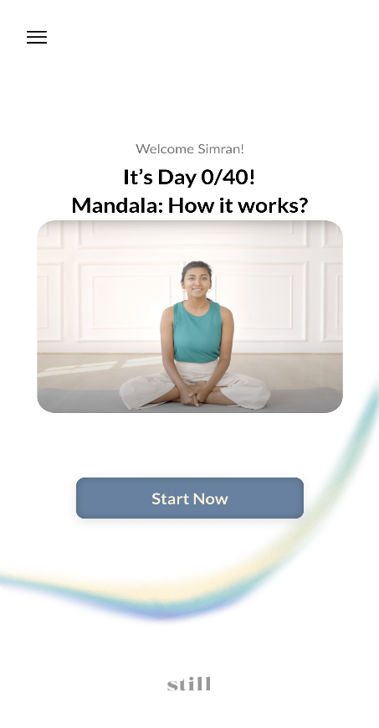
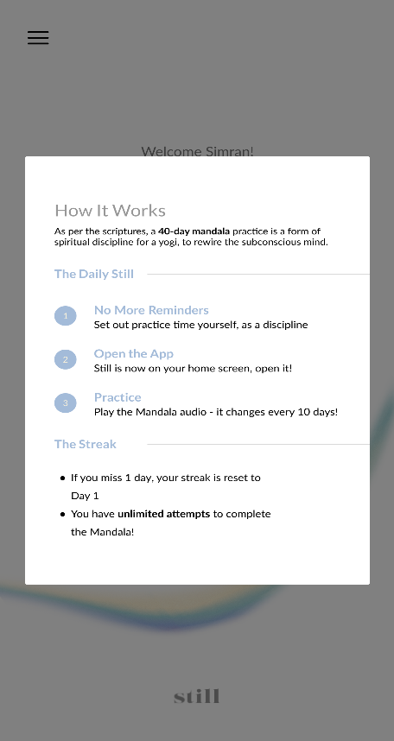
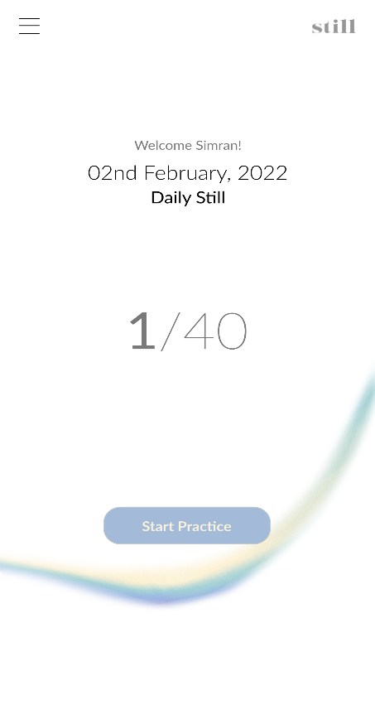
Mandala tracker/ Journey

Slide 18
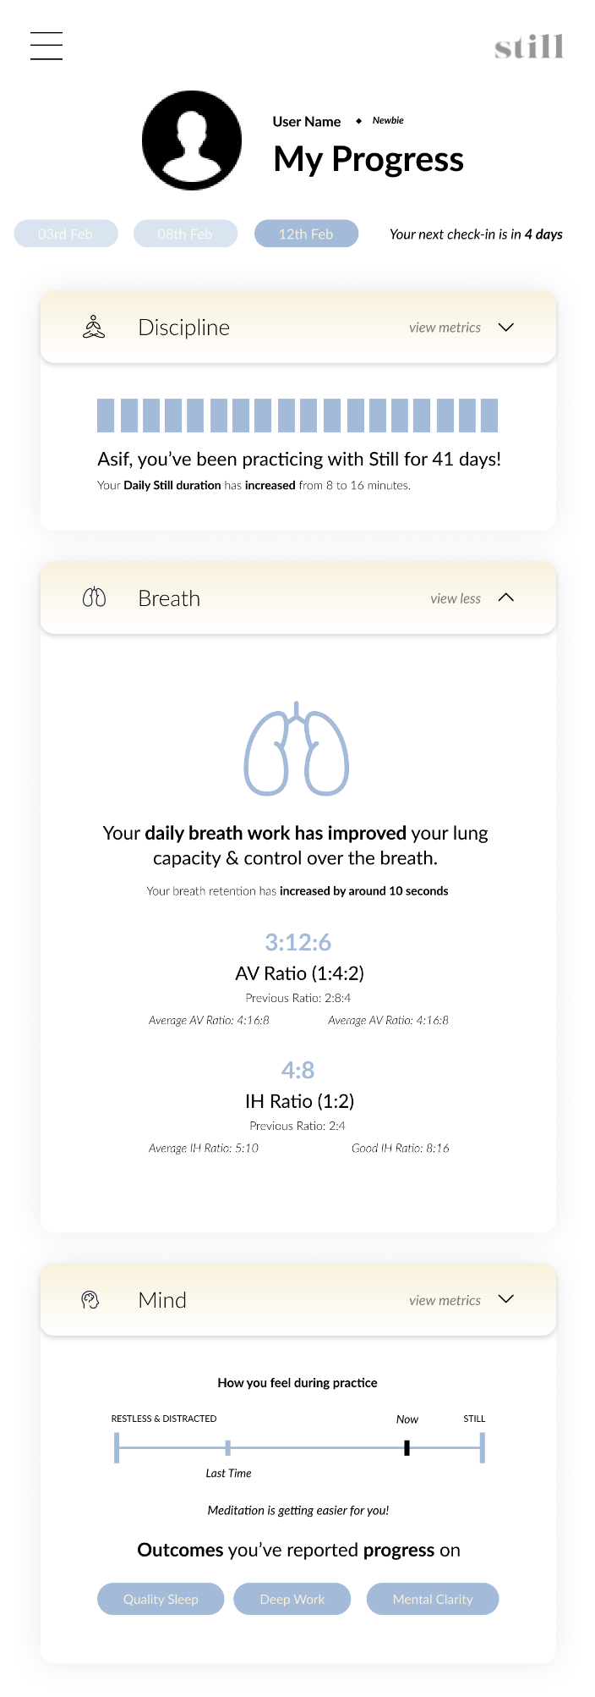
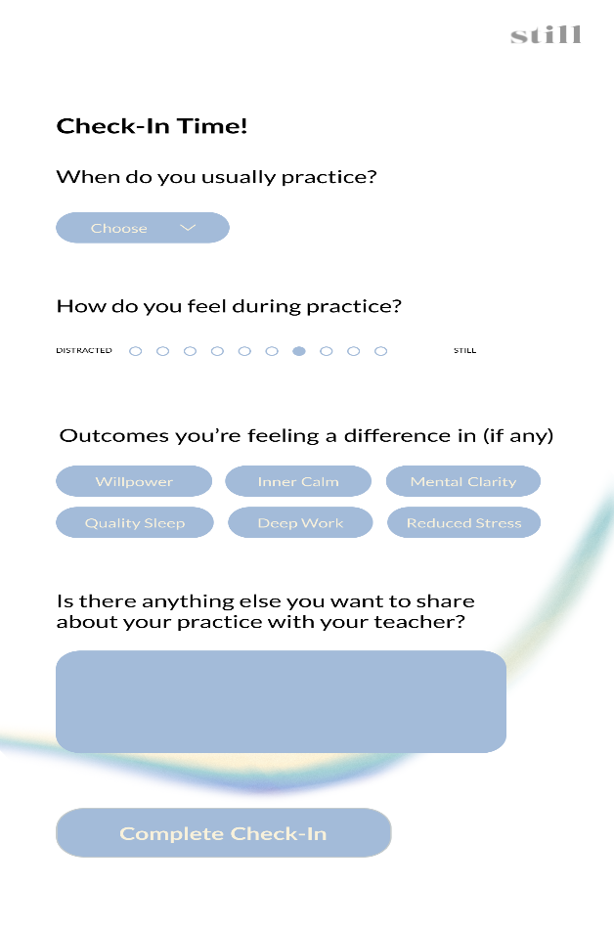
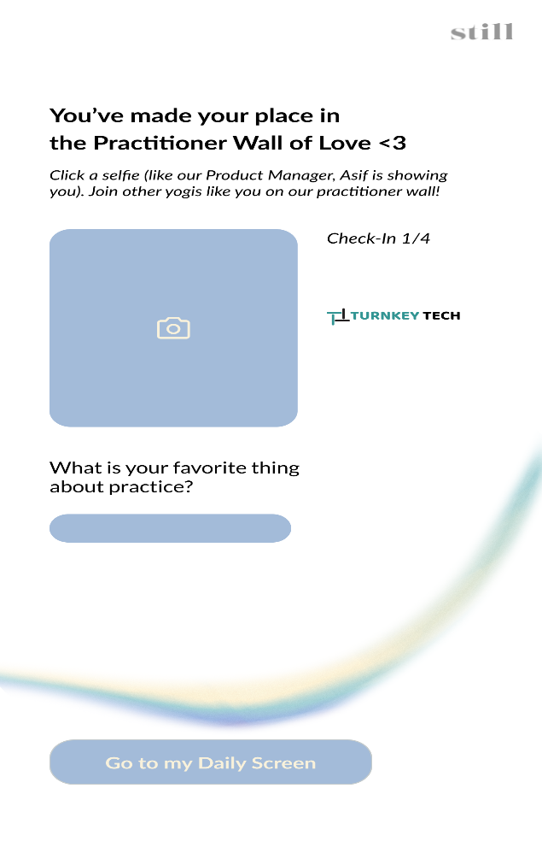
Progress

