Slide 1

BACSE202 · Fall Semester 2026
PolyVote
A Multi-Tenant, Ranked-Choice Election Platform with a Tamper-Evident Audit Trail
Review 3 · Final Project Review · Guide: Dr. Katari Balakrishna
S.No | Name | Register No
1 | Tharakesharasu Thennarasu | 25BCE2699
2 | Pawan Durga Karthik | 25BCE2712
3 | Shivam Malge | 25BCE0386
BACSE202 – Database Systems | Review 3 | Fall Semester 2026 · Slide 1
Notes:
Good morning, sir, and everyone. This is Review 3, the final review of PolyVote, our ranked-choice election platform with a tamper-evident audit trail. Review 1 presented the design and Review 2 showed the working system. Today we show the completed system: a MongoDB Atlas ledger, a keyed hash chain, a second authentication factor using emailed one-time codes, public hosting, and an evaluation that tests our claims instead of asserting them. We will also show a short live demonstration of the version with email verification switched on.

Slide 2
REVIEW 3 · WHERE WE STAND
What we submitted, what we built, what is new today
SUBMITTED
FEEDBACK
NEW TODAY
Reviews 1 and 2
At Review 2
This review
Design, schema, ER and data-flow diagrams, literature; then a working React + FastAPI system, instant-runoff tally, hash-chained receipts and a live tamper test.
Confirm the voter with a second factor (OTP or face ID); finish MongoDB and hosting; show that the design is an improvement, not just a build.
Atlas ledger, keyed chain, extended sweep, emailed one-time code, public link and QR, and 47 executable test scenarios with benchmarks.
47
Left open by choice: Oracle with PL/SQL and roles, the POSITION entity, and a true cloud platform. SQLite stays for this project.
Today: recap, new features, evidence, feature-by-feature comparison, privacy, limits, publication plan.
test scenarios
BACSE202 – Database Systems | Review 3 | Fall Semester 2026 · Slide 2
Notes:
A quick map of where we are. Review 1 was the design; Review 2 was the working system. At the end of Review 2 we received three pieces of feedback: add a second factor to confirm that the person voting is the person whose credentials are used, finish the MongoDB and hosting items, and show that the design is genuinely better rather than just built. Today answers all three, backed by forty-seven executable test scenarios. What remains open is deliberate: Oracle with PL/SQL and roles, the POSITION entity and a true cloud platform; we have kept SQLite for this project.

Slide 3
PICKING UP FROM REVIEW 2
Review 2 left a short list; two new features lead it
REVIEW 2 ENDED WITH
NEW: EMAIL OTP
NEW: QR VOTING
• About 75% of the scope built and demonstrated.
• Open: MongoDB Atlas, hosting, injected-ballot detection.
• Faculty feedback: confirm the voter with a second factor.
• Deferred on purpose: Oracle with PL/SQL, POSITION entity.
A correct password is no longer enough.
A 6-digit code is emailed to the voter, valid 5 minutes, one use, 3 guesses.
Answers the Review 2 comment.
Scan, sign in, vote.
The vote page shows a QR code for the public link, so any phone opens the ballot in seconds.
Works with the emailed code on the same phone.
BACSE202 – Database Systems | Review 3 | Fall Semester 2026 · Slide 3
Notes:
We pick up exactly where Review 2 ended. At Review 2 we were at about seventy-five percent, with MongoDB Atlas, hosting and injected-ballot detection still open, and the faculty comment that we should confirm the person voting is the person whose credentials are used. Two new features lead this review. First, the emailed one-time code: a correct password is no longer enough, because a six-digit code goes to the voter's email, valid for five minutes, usable once, with three guesses. Second, QR voting: the vote page shows a QR code for the public link, so any phone can open the ballot in seconds, and the same phone can receive the emailed code. The rest of the deck shows how they work, the evidence, and how this compares with similar systems.

Slide 4
RESPONSE TO FEEDBACK
Each Review 2 comment has a concrete answer
Comment at Review 2 | What we did | Evidence
Confirm the voter: OTP or face ID | Emailed one-time code after the password; separate verification database; admin outbox | 14 of 14 OTP tests pass
Finish MongoDB | Ledger now in MongoDB Atlas, unique-index concurrency control, file fallback, migration script | 25 blocks migrated; live health endpoint
Host it online | Public HTTPS link through a tunnel; QR code on the voter page for phones | Cast a ballot from a phone
Prove it is better | 47-scenario executable suite run on the Review 2 design and the final design | 6 of 13 to 12 of 13 attacks caught
Weak spots we knew about | Injected ballots, forged receipts, rewritten chains, renamed candidates | Each has a test and a fix
Where we say "future work", it is because the design needs something we cannot add honestly in one semester, and we say what.
BACSE202 – Database Systems | Review 3 | Fall Semester 2026 · Slide 4
Notes:
This slide is the direct response to the Review 2 comments. The second factor became an emailed one-time code with its own database and fourteen passing tests. MongoDB is done and live on Atlas. Hosting is a public HTTPS link with a QR code, so a phone can vote. And to prove the design is better, we built a forty-seven scenario suite and ran it against both the Review 2 design and the final one. The weaknesses we knew about, such as injected ballots, forged receipts and renamed candidates, each have a test and a fix. Where we still say future work, we explain why.

Slide 5
THE WHOLE PROJECT · WHY IT EXISTS
Small elections need ranked results and proof
THE PROBLEM
THE GOAL
THE METHOD
Small elections today
What PolyVote does
Database first
Clubs, councils and classes use form tools or one-table apps: one password per voter, results held by whoever has access, and no way to show that a vote was not edited afterwards.
Run ranked-choice (instant-runoff) elections for many organisations, keep ballots anonymous in storage, and make later tampering detectable with checks anyone can rerun.
Rules live in the database (trigger, CHECK, UNIQUE, foreign keys); a second store holds a keyed hash-chain ledger; an executable suite attacks the design and reports what it catches.
47
executable test scenarios
12 of 13
tampering attacks caught automatically
3
separate stores: election, verification, ledger
BACSE202 – Database Systems | Review 3 | Fall Semester 2026 · Slide 5
Notes:
Before the new material, the whole project in one slide. The problem: small elections at clubs, councils and classes usually run on form tools or one-table apps, with one password per voter and no way to show afterwards that a vote was not edited. The goal: ranked-choice, instant-runoff elections for many organisations, with ballots kept anonymous in storage and tampering made detectable by checks anyone can rerun. The method: a database project first. The rules live in the database itself; a second store holds a keyed hash-chain ledger; and an executable suite attacks the design and reports what it catches. The three numbers at the bottom come from the evaluation later in this deck: forty-seven test scenarios, 12 of thirteen tampering attacks caught automatically, and three separate stores.

Slide 6
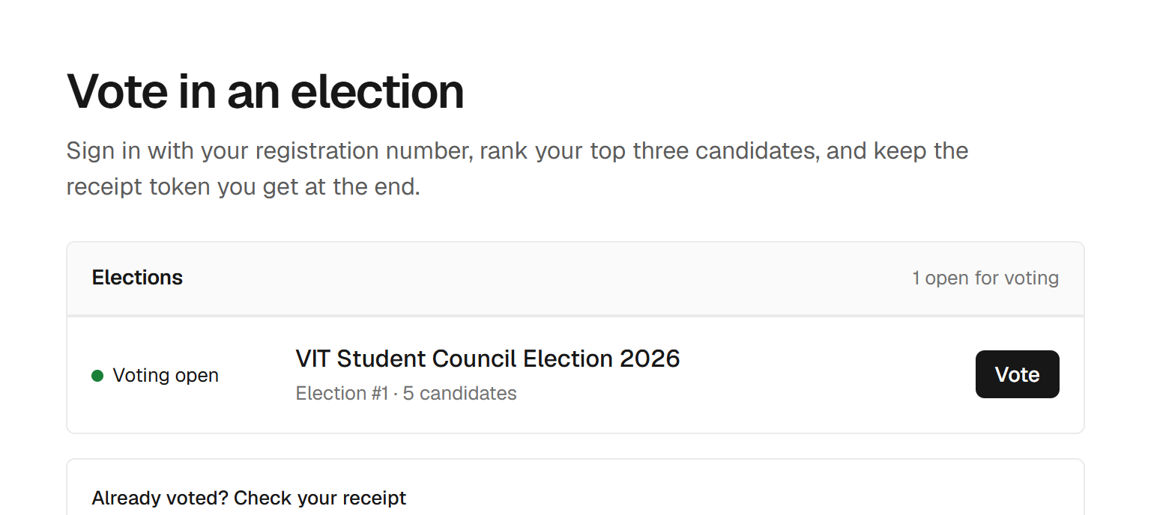
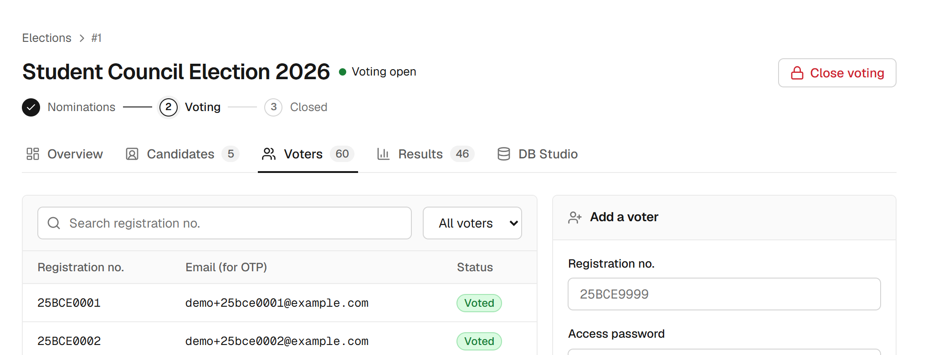
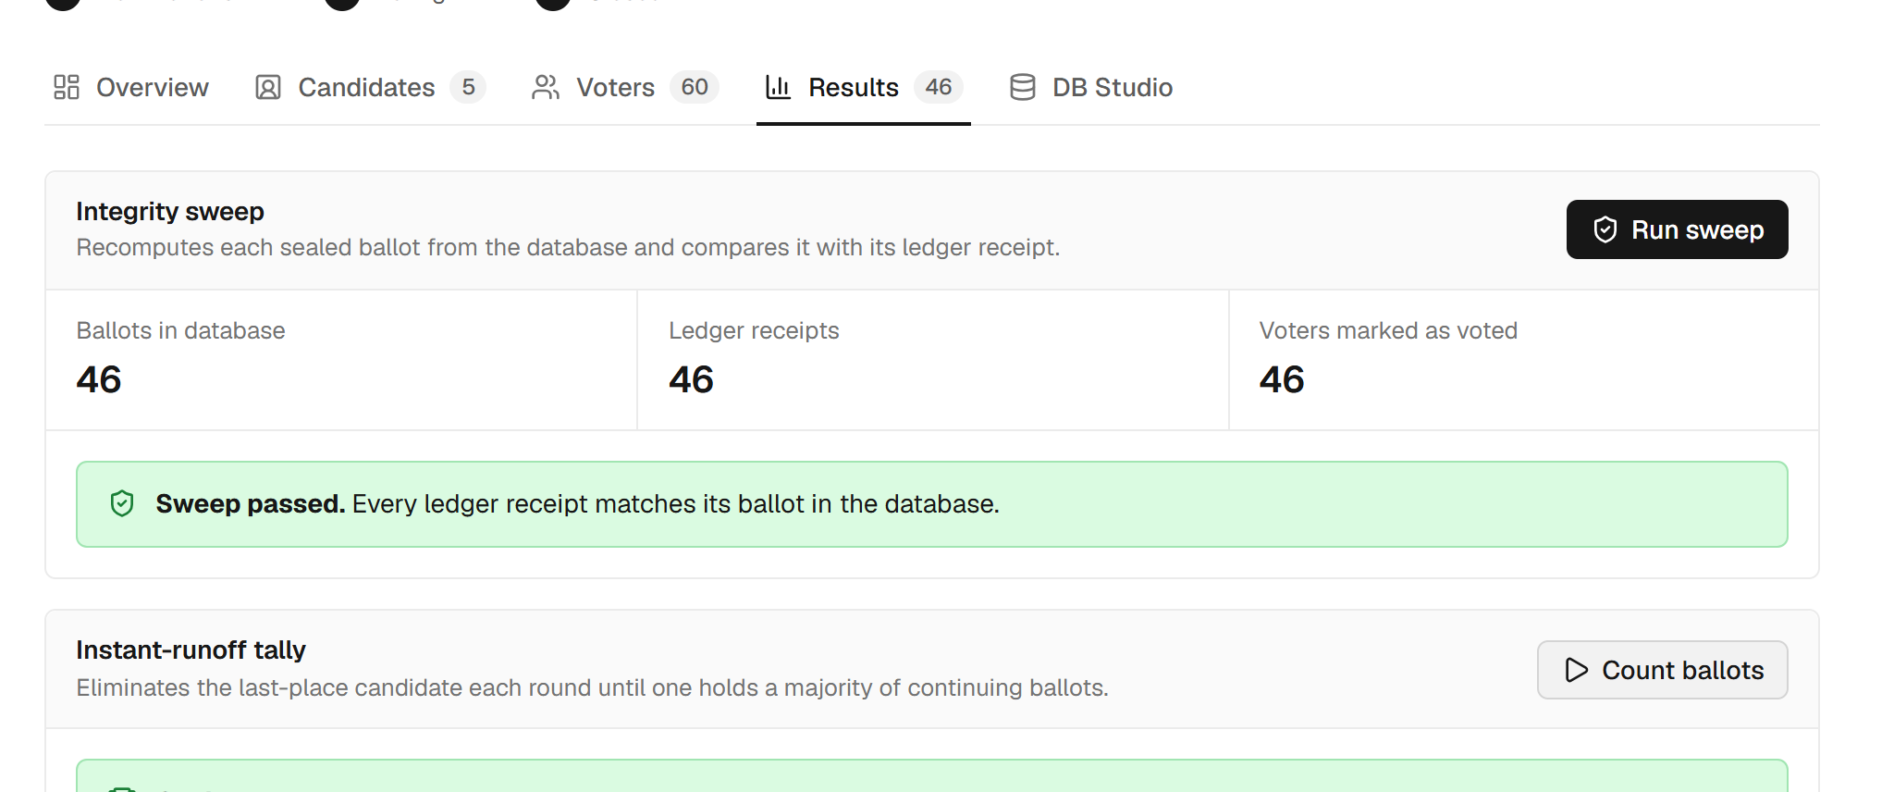
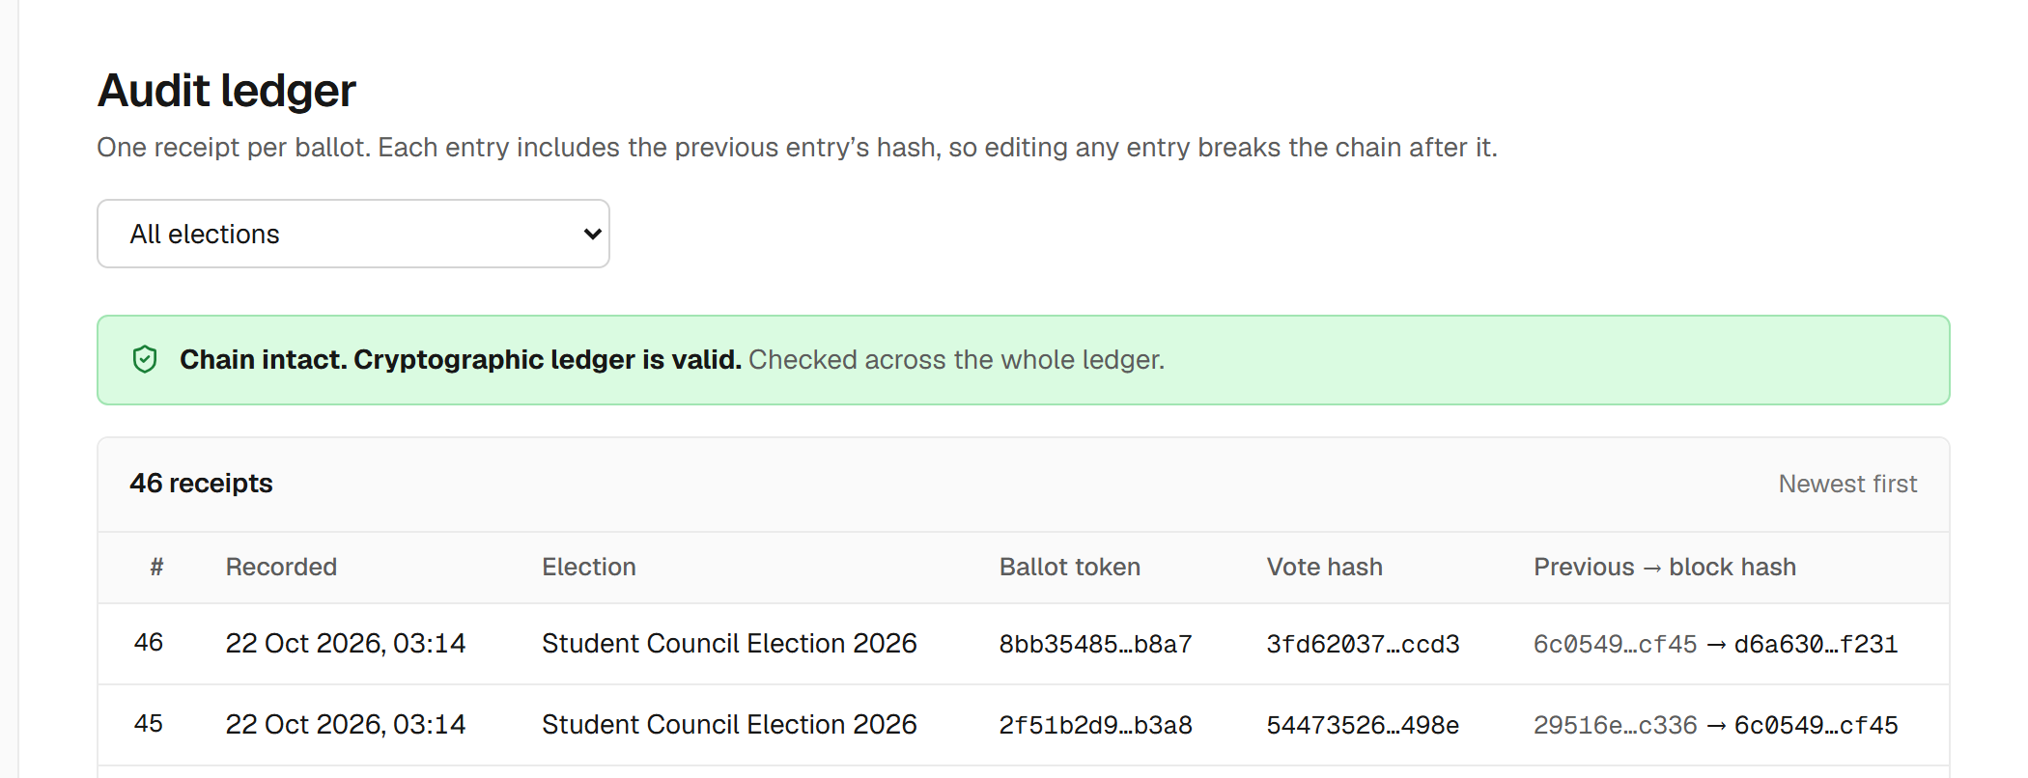
THE WHOLE PROJECT · WHAT IT DOES
The whole system in four screens
Voter site: open elections, receipt check, plain-language features
Admin: voter roster with the email used for the one-time code
Admin: integrity sweep (46 / 46 / 46) and the instant-runoff tally
Admin: audit ledger, chain intact, 46 receipts
BACSE202 – Database Systems | Review 3 | Fall Semester 2026 · Slide 6
Notes:
The whole system in four screens, all from the real running application. Top left, the voter site: open elections, the receipt check and a plain-language summary of what the system does. Top right, the administrator roster: each voter has a registration number and an email address, which is only used to send the one-time code. Bottom left, the results page: the integrity sweep, with ballots, receipts and voted flags all at forty-six, and below it the instant-runoff tally. Bottom right, the audit ledger: one receipt per ballot, each linked to the one before, with a green banner when the whole chain verifies.

Slide 7
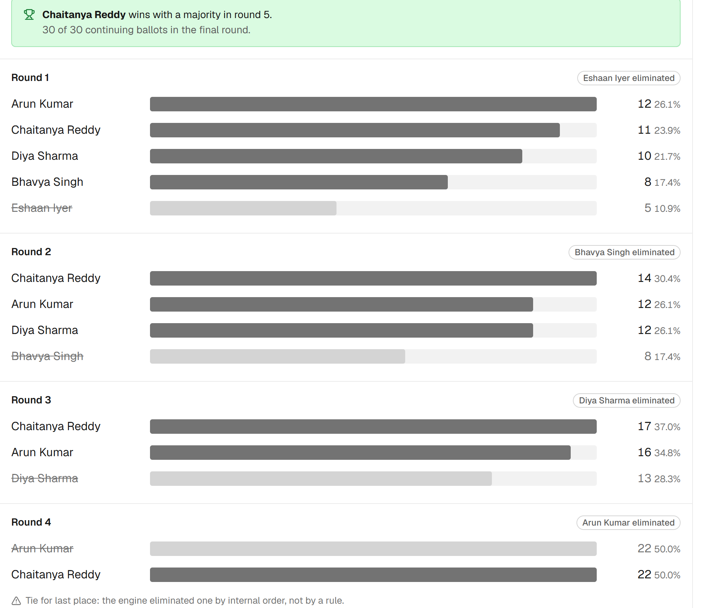
THE WHOLE PROJECT · COUNTING
Instant-runoff counting, round by round
• Rank: each voter ranks up to three candidates.
• Count: first choices are counted; a majority of continuing ballots wins.
• Eliminate: otherwise the last-place candidate drops out and those ballots move to their next choice.
• Repeat: until someone holds a majority.
• Shown in full: every round, with counts and percentages, so anyone can follow the result.
• Edge case, flagged: round 4 here is a 22 to 22 tie; the engine eliminated one candidate by internal order and says so on screen. A published tie rule is future work.
BACSE202 – Database Systems | Review 3 | Fall Semester 2026 · Slide 7
Notes:
How counting works, using the demo election: forty-six ballots, five candidates. Each voter ranks up to three. The engine counts first choices; if nobody holds a majority of the continuing ballots, the last-place candidate is eliminated and those ballots move to their next choice, and so on. The screenshot shows every round with counts and percentages. In round four there was a twenty-two to twenty-two tie for last place; the engine broke it by internal order and the page says so in a warning line. We do not hide this: a published tie rule, and a statistical audit, are listed as future work. The winner, Chaitanya Reddy, reaches a majority in round five.

Slide 8
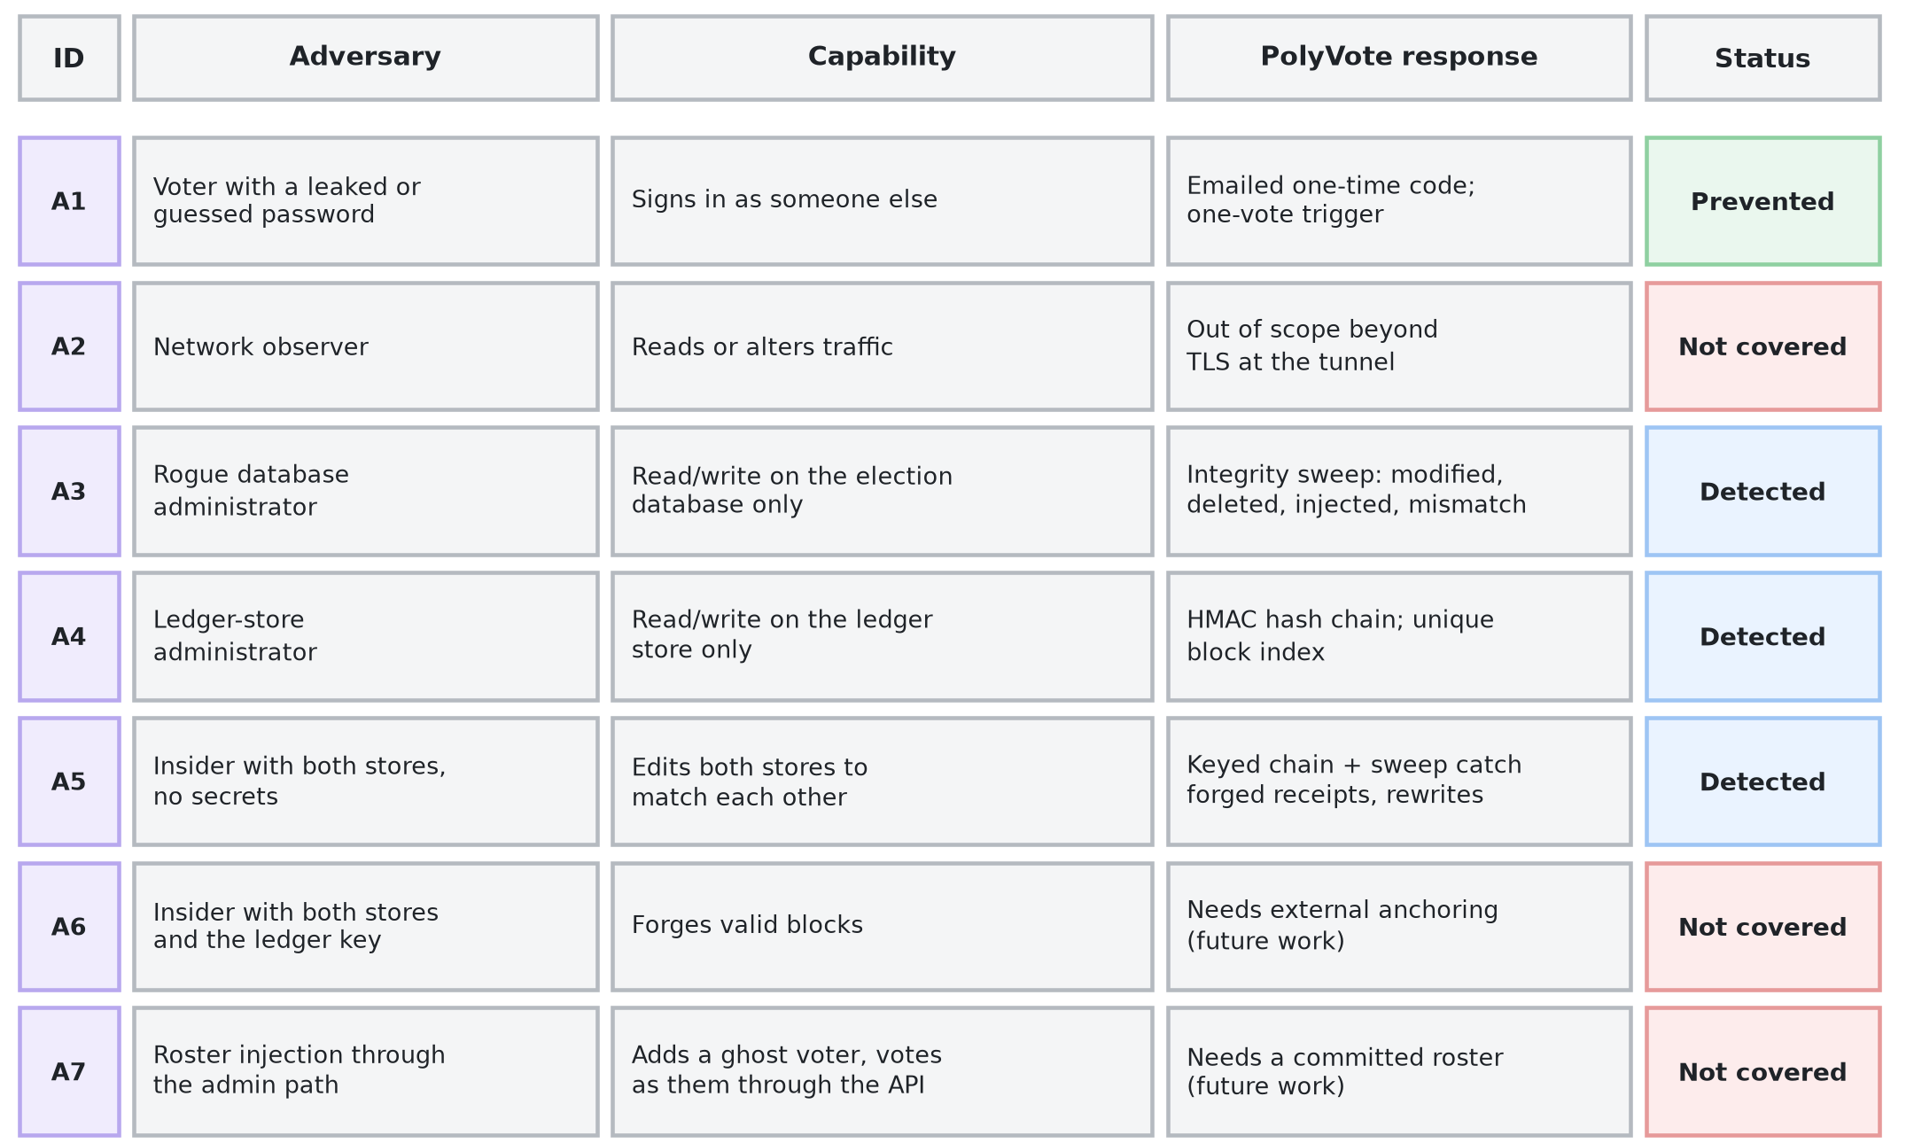
THREAT MODEL
Who the attacker is, and who we do not stop
Detected means found by an auditor running the checks, not blocked in real time.
BACSE202 – Database Systems | Review 3 | Fall Semester 2026 · Slide 8
Notes:
A security claim means nothing without a threat model, so we start there. Seven adversaries, ordered by capability. A voter with a leaked password is stopped by the emailed code. A rogue database administrator and a ledger-store administrator are detected by the sweep and the keyed chain. An insider with both stores but no secrets is detected, because they cannot recompute the keyed chain. Three are not covered: a network observer, beyond the tunnel's encryption; an insider who also holds the key; and roster injection through the admin path. We say so now rather than have it found later.

Slide 9
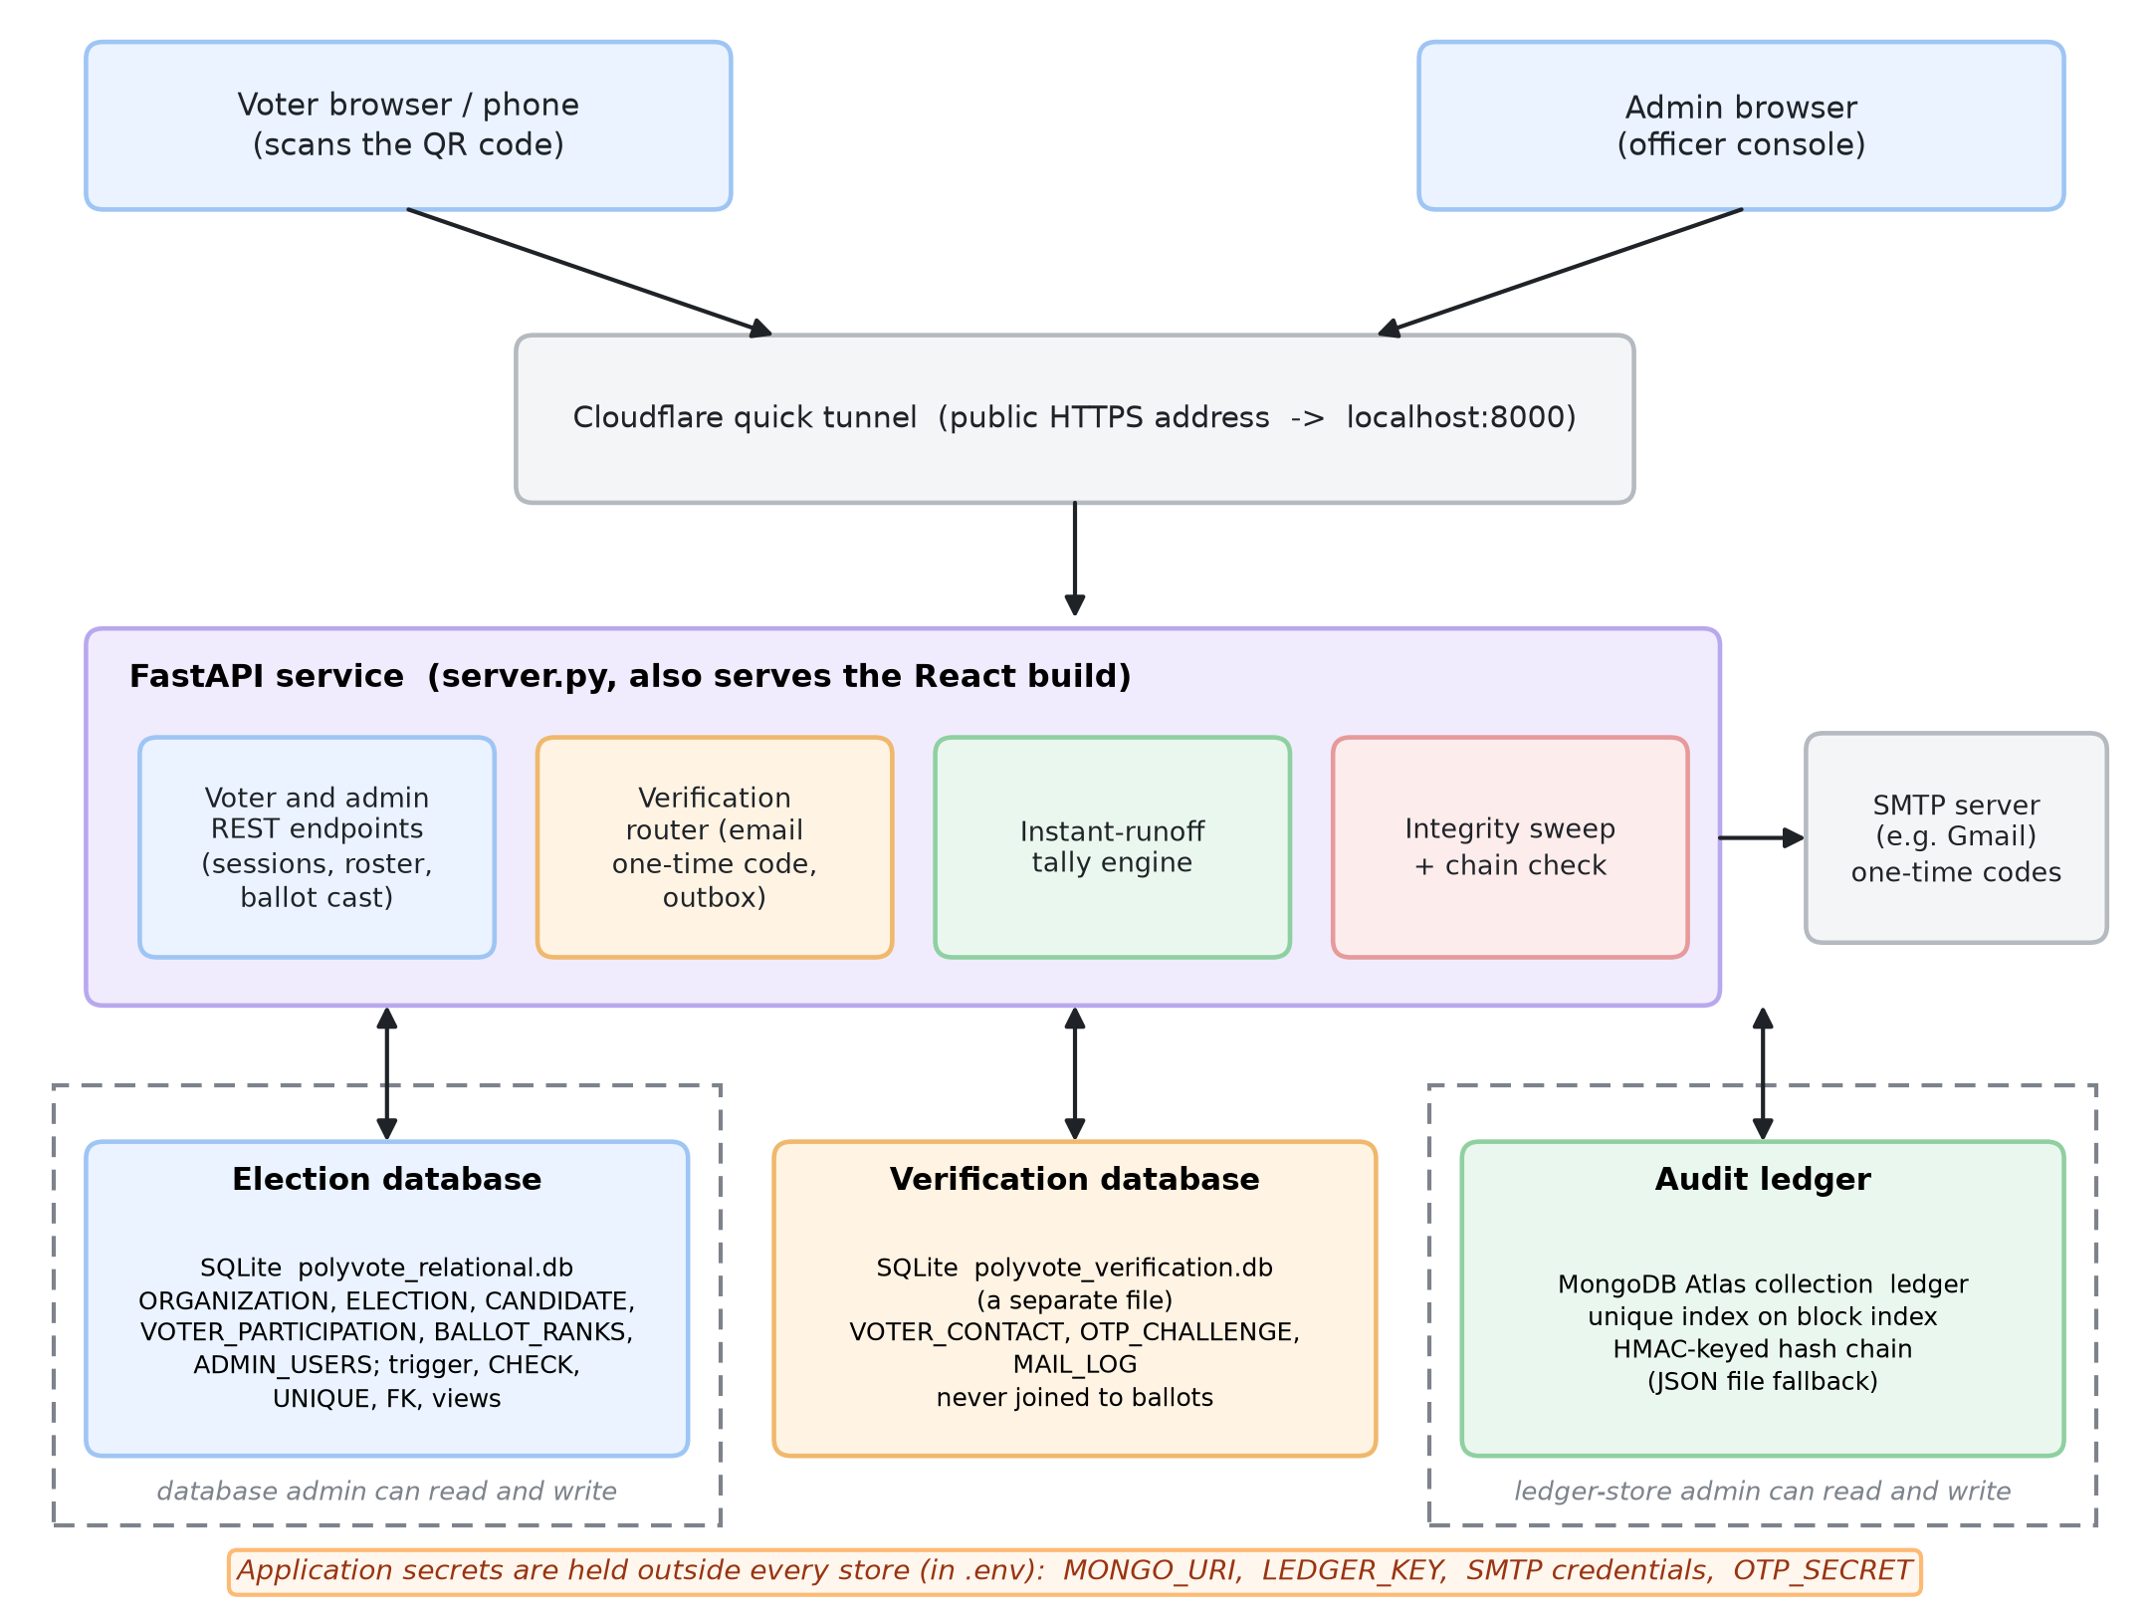
FINAL ARCHITECTURE
Three stores, separated by what each is trusted with
• Election DB: roster, candidates, anonymous ballots.
• Verification DB: emails and one-time codes, a separate file, never joined to ballots.
• Ledger: MongoDB Atlas, HMAC chain.
• Secrets: in .env, outside every store.
• An administrator of one store cannot touch the others.
BACSE202 – Database Systems | Review 3 | Fall Semester 2026 · Slide 9
Notes:
The architecture. One FastAPI service that also serves the React app, exposed through a tunnel. Behind it three stores. The election database holds the roster, candidates and anonymous ballots. The verification database is a separate file that holds voter emails and one-time-code challenges, and it is never joined to ballots. The ledger is a MongoDB Atlas collection. Secrets live in an environment file outside all three. The point of the separation is that an administrator of one store cannot touch the others; only the application host sees all three, which is why host compromise is outside our model.

Slide 10
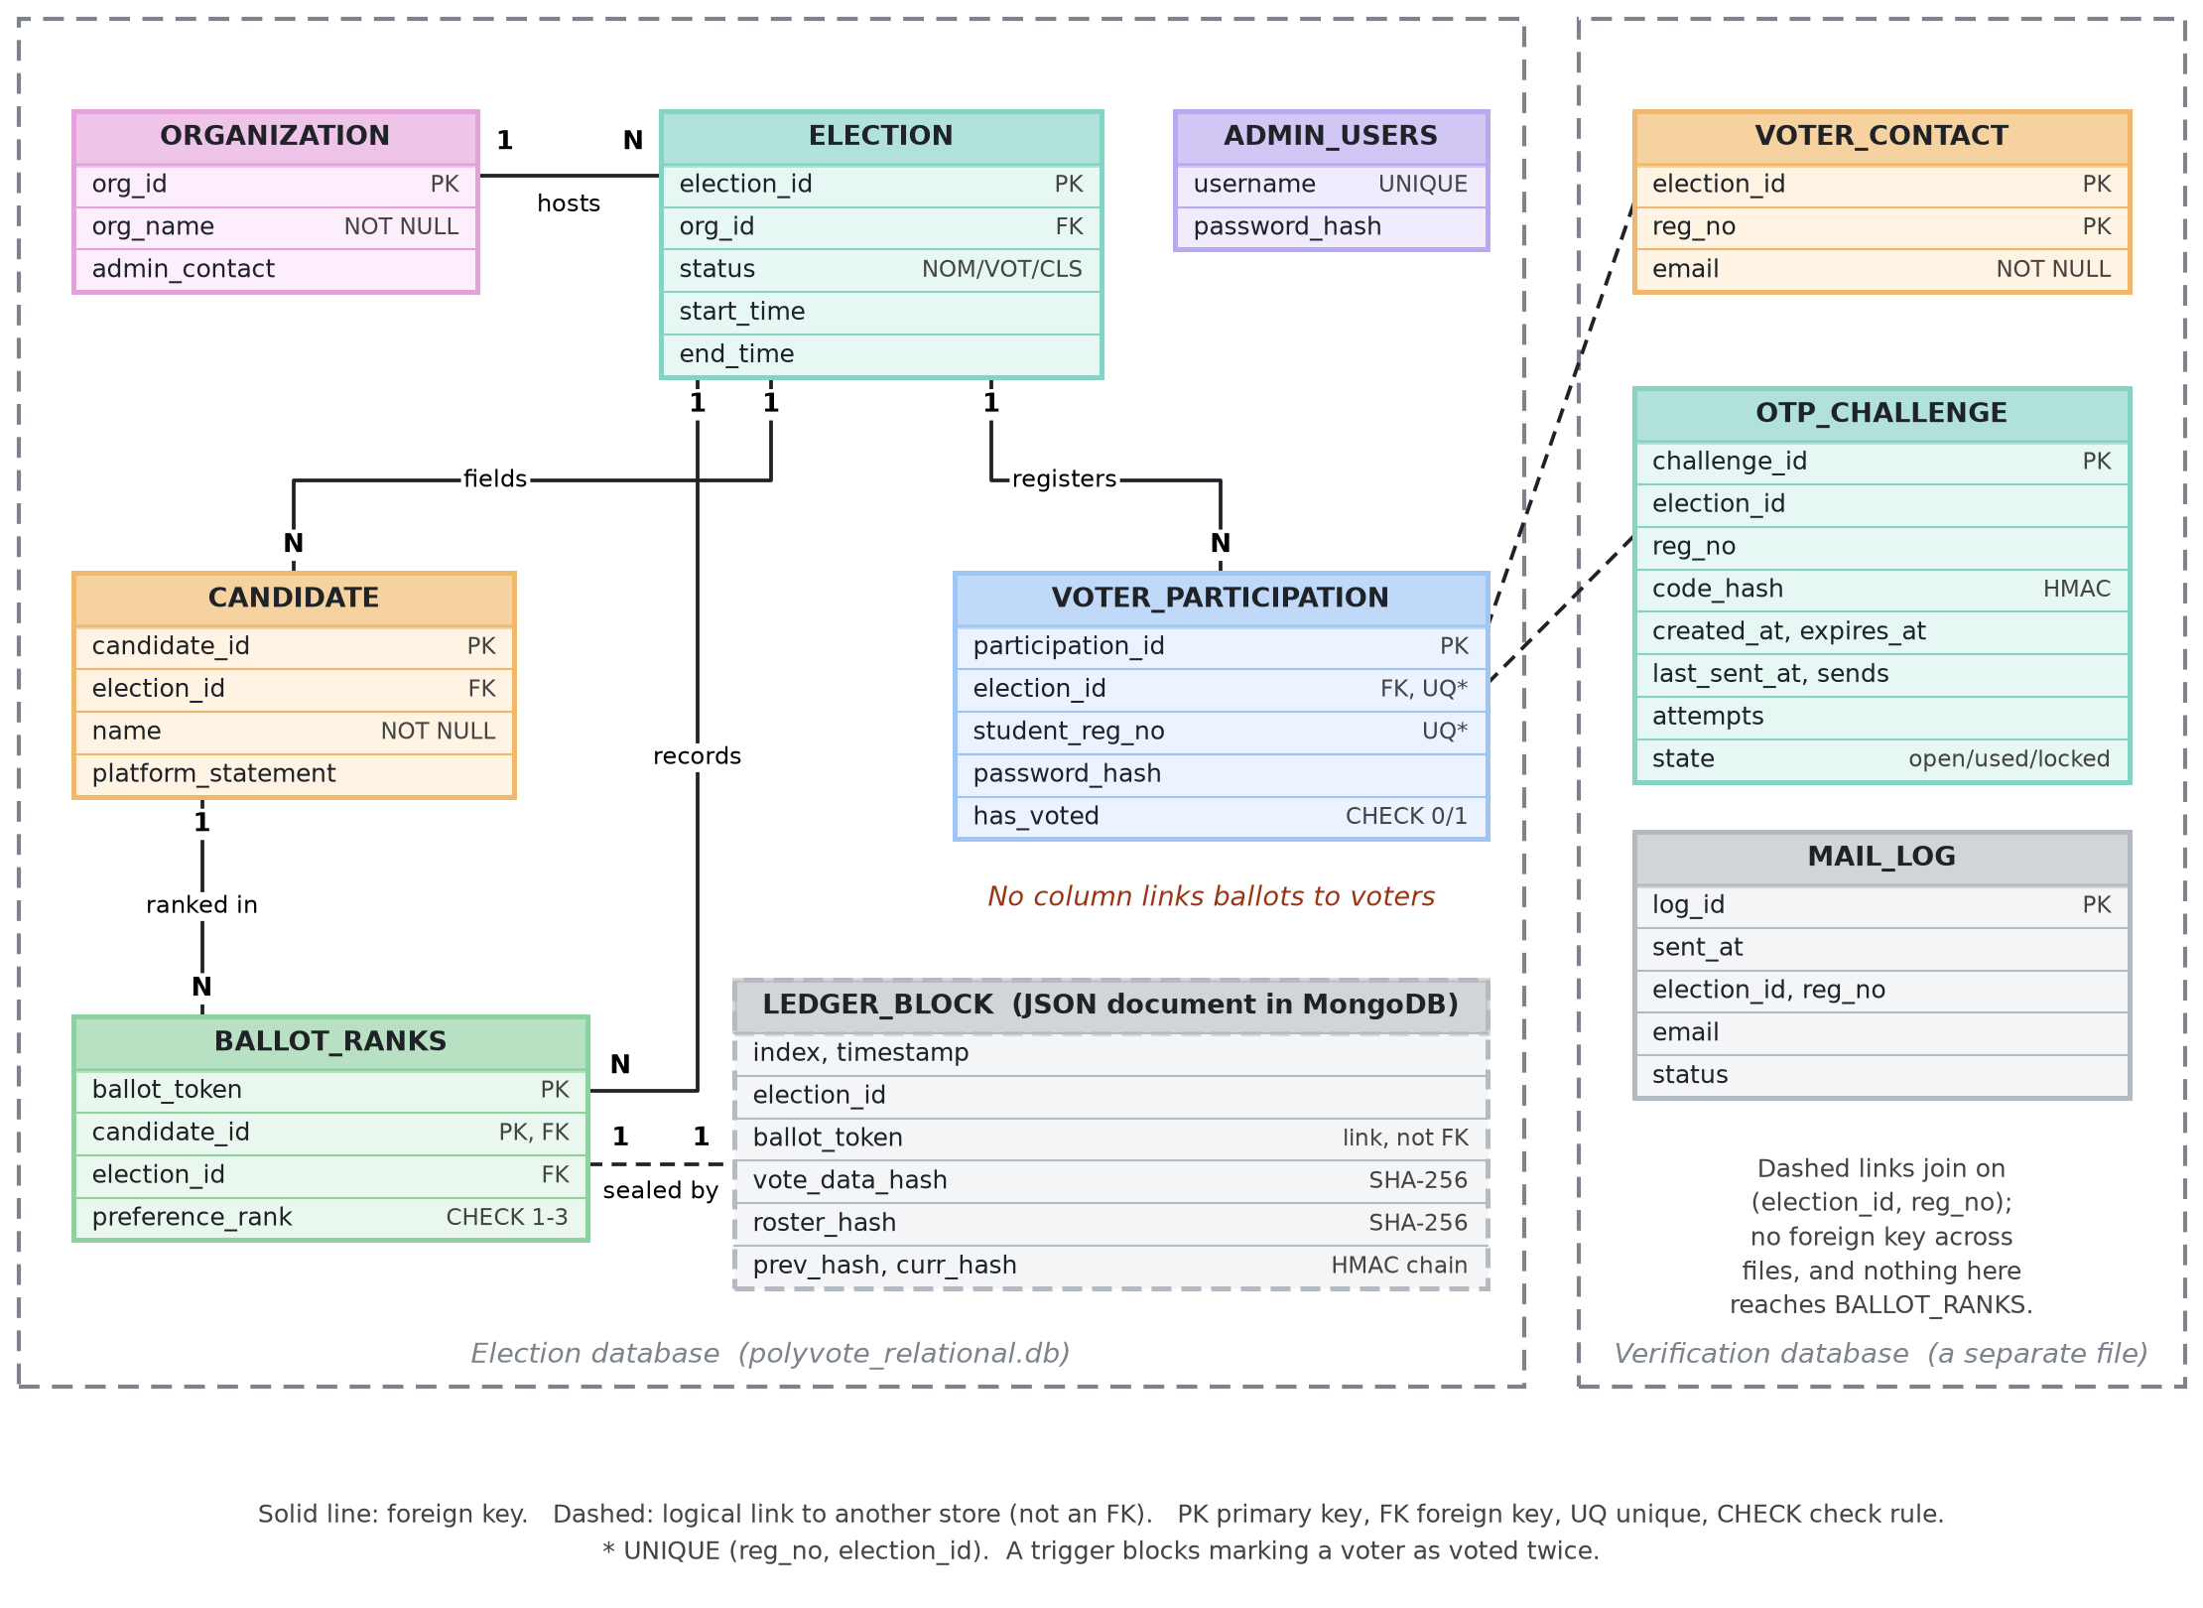
DATA MODEL
Data model: election, ledger and verification stores
• Shared multi-tenant schema, scoped by election.
• No column links a ballot to a voter.
• Candidate roster hash sealed in the ledger.
• Emails live in a different file; no key reaches ballots.
• Trigger, CHECK, UNIQUE, FK enforce the rules.
BACSE202 – Database Systems | Review 3 | Fall Semester 2026 · Slide 10
Notes:
The updated ER diagram. The left frame is the election database, unchanged in structure from Review 2 apart from what it protects. The dashed box is a ledger block, a JSON document linked to a ballot by its token, not by a foreign key. The right frame is new: the verification database with voter contacts, challenges and a mail log. Notice there is deliberately no line from it to the ballot table. A voter's email can never be joined to a ballot.

Slide 11
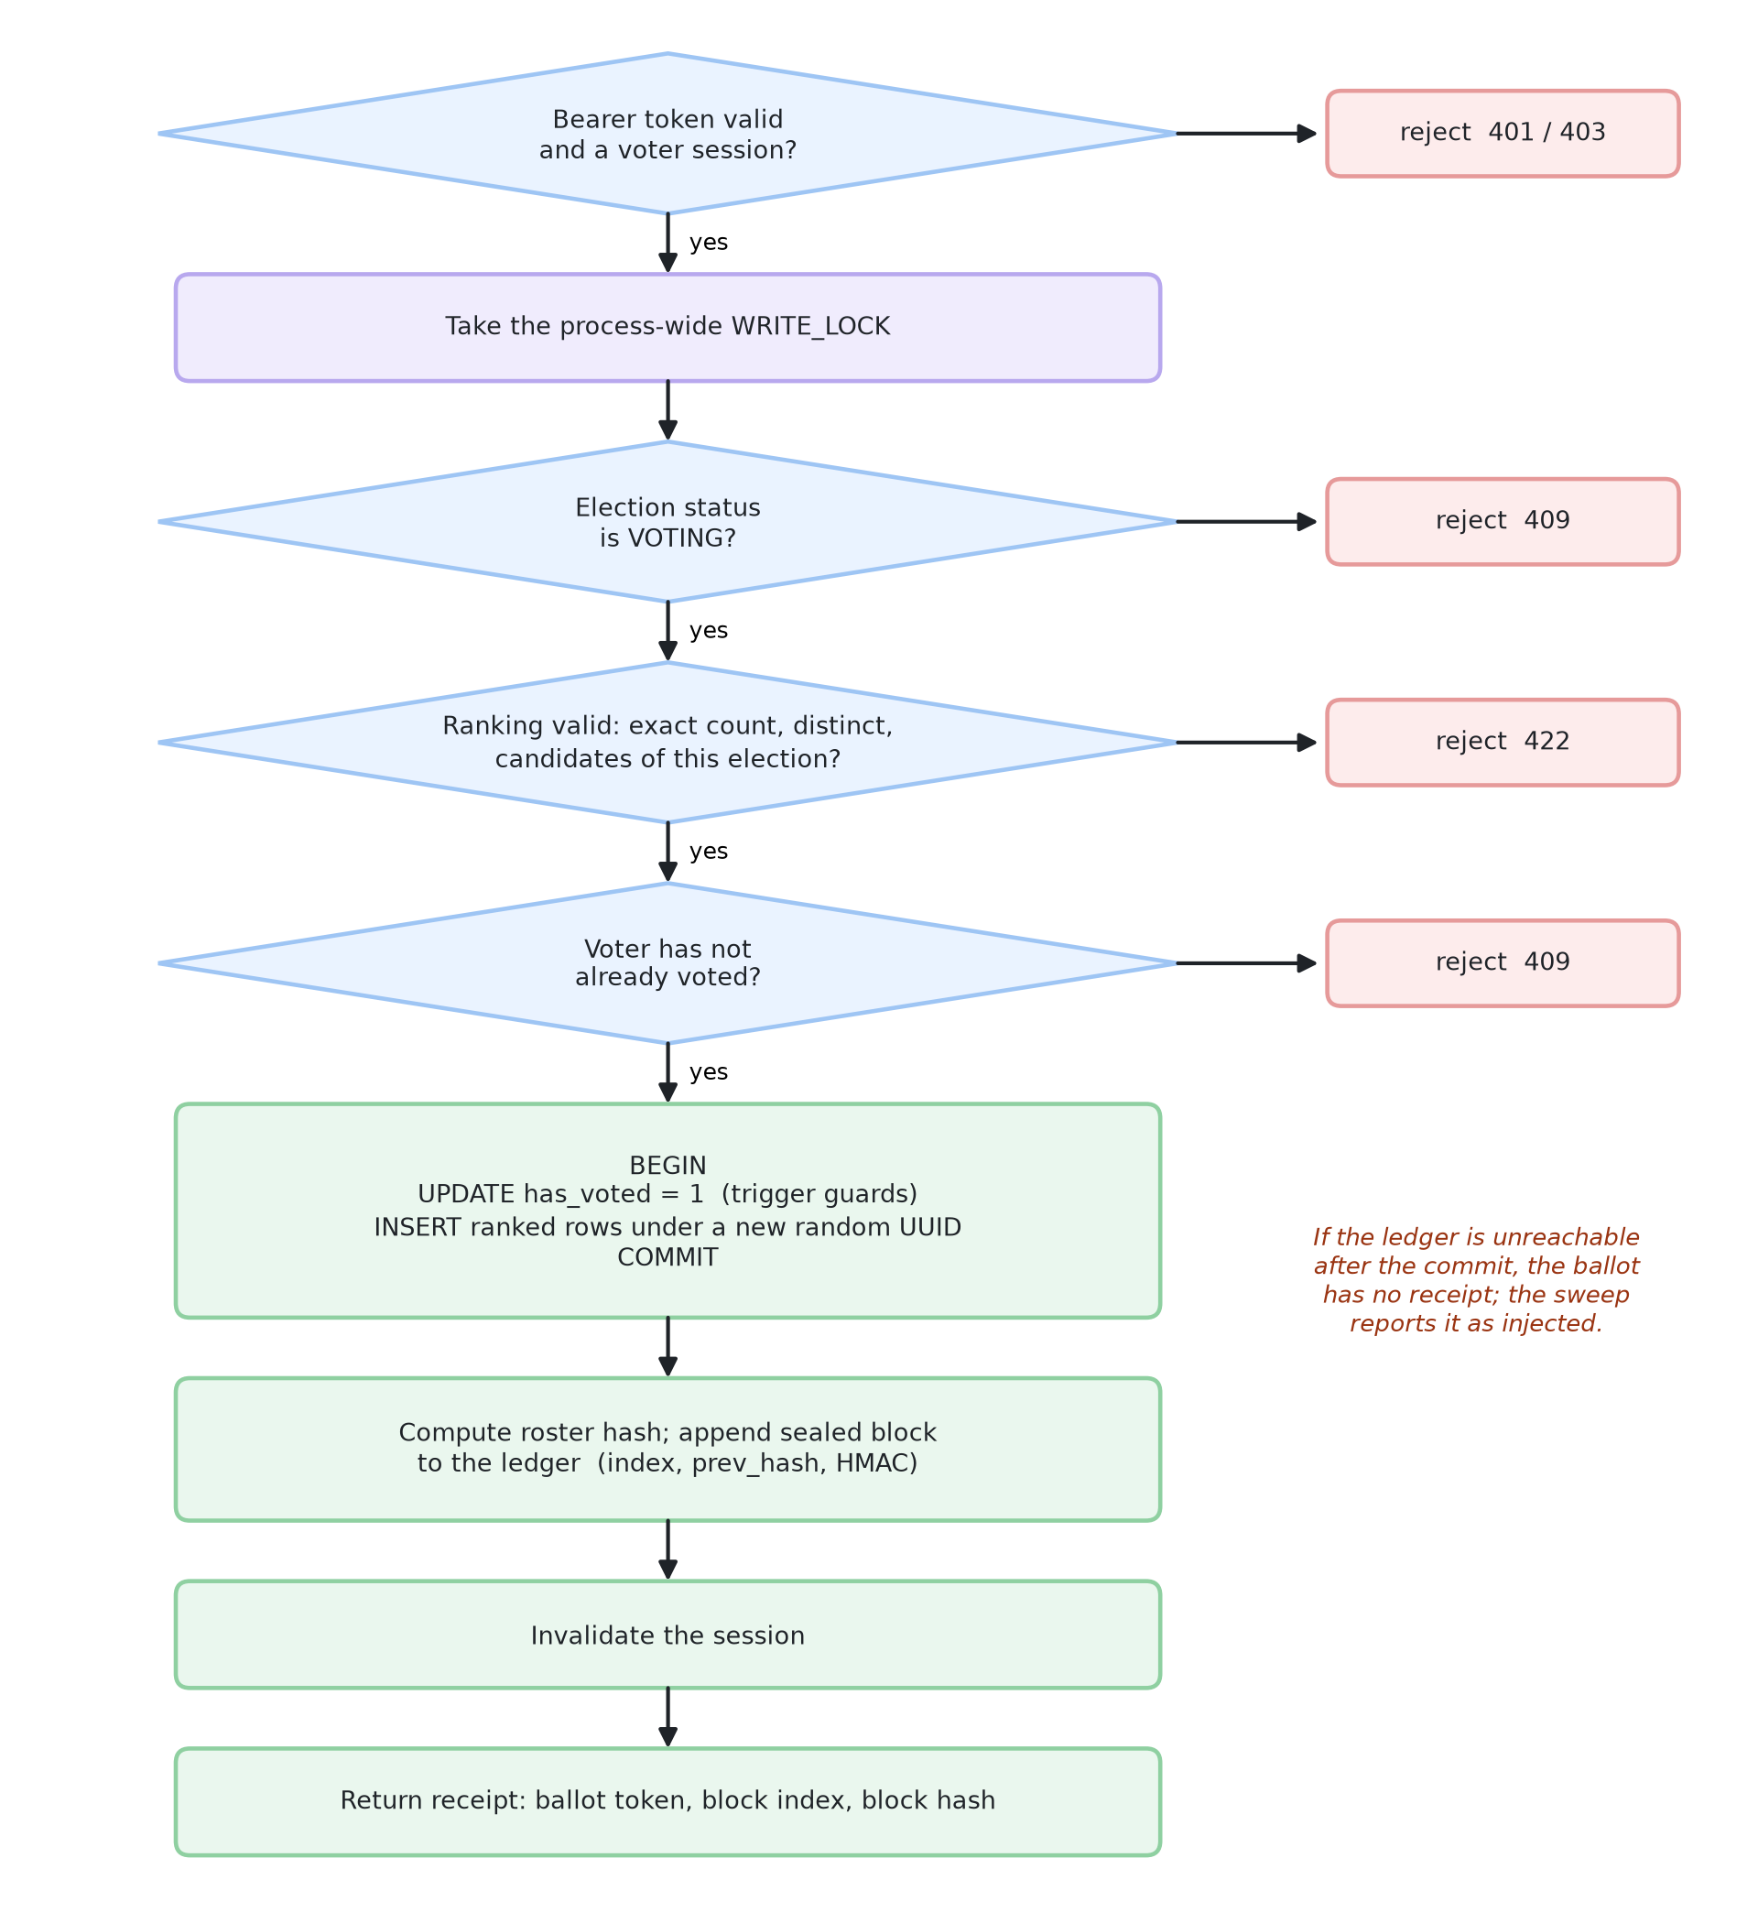
CASTING A BALLOT
One serialised, transactional path touches every structure
• Serialised: a write lock plus the voted flag, checked inside the transaction.
• Atomic: flag and ballot rows commit together or not at all.
• Anonymous: the ballot is stored under a random token.
• Sealed: then a block with the ranks hash and roster hash joins the ledger.
• Fails visibly: if the ledger is down after commit, the sweep reports a ballot with no receipt.
BACSE202 – Database Systems | Review 3 | Fall Semester 2026 · Slide 11
Notes:
Casting a ballot is the one path that touches everything, so it is serialised. After authentication the server takes a write lock, checks the election is open, validates the ranking and confirms the voter has not voted. In one transaction it sets the voted flag and inserts the ranked rows under a random token. Then it appends a sealed block to the ledger and invalidates the session. The ledger append happens after the commit; if the ledger were unreachable at that instant, the ballot would exist without a receipt, and the sweep reports exactly that. We chose the variant that fails visibly.

Slide 12
KEYED AUDIT LEDGER
Keyed chain: rebuilding it needs the secret key
Block 1
Block 2
Block 3
prev_hash links each block to the one before it.
ballot_token, vote_data_hash,
roster_hash, prev_hash
ballot_token, vote_data_hash,
roster_hash, prev_hash
ballot_token, vote_data_hash,
roster_hash, prev_hash
curr_hash = HMAC(key, block)
curr_hash = HMAC(key, block)
curr_hash = HMAC(key, block)
• Review 2: curr_hash was plain SHA-256. An attacker who can write the store can edit a ballot and recompute every later hash.
• Final: curr_hash is HMAC-SHA-256 under LEDGER_KEY, held outside the database and the ledger store. Without the key the rebuilt chain fails verification.
• Roster hash: every block also seals the candidate list, so renaming candidates after voting is detected.
• Backward compatible: blocks written before the key existed still verify (LEDGER_LEGACY_UNTIL).
• Limit: whoever holds the key can still forge blocks; that needs an external witness (future work).
BACSE202 – Database Systems | Review 3 | Fall Semester 2026 · Slide 12
Notes:
This is the key idea of the integrity story. Each block holds the ranks hash, the roster hash, the previous block's hash and its own hash. In Review 2 the block hash was plain SHA-256, so someone who could write the store could change a ballot and recompute every later hash. The chain was consistent but not authenticated. Now the block hash is an HMAC under a secret key held outside both stores. An attacker without the key can rebuild a chain, but it fails verification at the first block. Older blocks still verify. The limit is stated on the slide: whoever holds the key can still forge, which needs an external witness.

Slide 13
INTEGRITY SWEEP
Five rules compare the database with the ledger
Rule | Detects | How | New?
1 Modified | A ballot whose ranks changed | Recompute ranks hash; compare with the receipt | Review 2
2 Deleted | A sealed ballot missing from the database | Receipt exists with no ballot rows | Review 2
3 Injected | A ballot with no receipt | Ballot rows exist with no block | New
4 Roster changed | Candidate names altered after voting | Current roster hash differs from the sealed hash | New
5 Count mismatch | Flags, ballots, receipts disagree | Compare the three counts for the election | New
Plus the chain check: recompute every block's link and hash across the whole ledger. The chain check finds edits inside the ledger; the sweep finds edits to the database.
BACSE202 – Database Systems | Review 3 | Fall Semester 2026 · Slide 13
Notes:
The sweep recomputes the state of an election from the database and compares it with the ledger. Rules one and two were in Review 2. Rule three finds a ballot in the database that has no receipt. Rule four compares the current candidate names with the sealed hash. Rule five compares voter flags, ballots and receipts. The chain check, which verifies every block, is separate and complementary: it finds edits inside the ledger, while the sweep finds edits to the database.

Slide 14
MONGODB ATLAS LEDGER
A real document store with its own concurrency control
• Collection: each block is one document in polyvote.ledger.
• Unique index on block index: two writers cannot both claim the next slot, so the chain cannot fork.
• Append cost: reads only the last block and inserts one document, so it does not grow with the chain.
• Fallback: no connection string, or Atlas unreachable, and it uses the local file; /api/health shows which.
• Migration: a script copies the old blocks and verifies the chain; it refuses to overwrite a non-empty collection.
• Secrets: the connection string lives in .env, never in the code or the repository.
Live health check
{"backend":"mongodb",
"detail":"mongodb
(polyvote.ledger)",
"sealing":"hmac-sha256"}
Editing any block in Atlas (for example a vote_data_hash) makes the Audit ledger page show "Data tampered at block N".
BACSE202 – Database Systems | Review 3 | Fall Semester 2026 · Slide 14
Notes:
MongoDB. Each block is a document in a collection with a unique index on the block position. That index is our compare-and-swap: two simultaneous writers cannot both take the same slot, so the chain cannot fork. Appending reads only the last block and inserts one document, so the cost does not grow with the chain. If no connection string is set, or Atlas is unreachable, the system falls back to the local file, and the health endpoint says which backend is active. A migration script moved our existing blocks and verified the chain. The connection string lives only in the environment file.

Slide 15
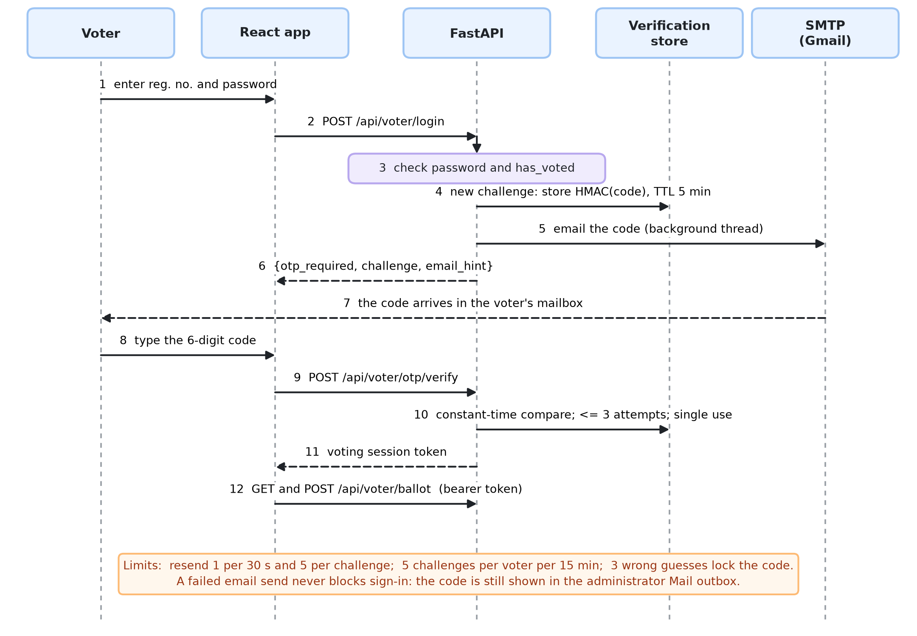
EMAIL ONE-TIME CODE
A correct password no longer opens a ballot on its own
BACSE202 – Database Systems | Review 3 | Fall Semester 2026 · Slide 15
Notes:
The second factor. The voter enters the registration number and password. If they are right, the server does not issue a session; it issues a challenge, generates a six-digit code, stores only a keyed hash of it, and emails the code from a background thread so the page never waits on the mail server. The voter types the code, the server compares it in constant time, checks the attempt count and the single-use flag, and only then issues the voting session. A failed email never blocks sign-in because the code is also visible in the administrator outbox.

Slide 16
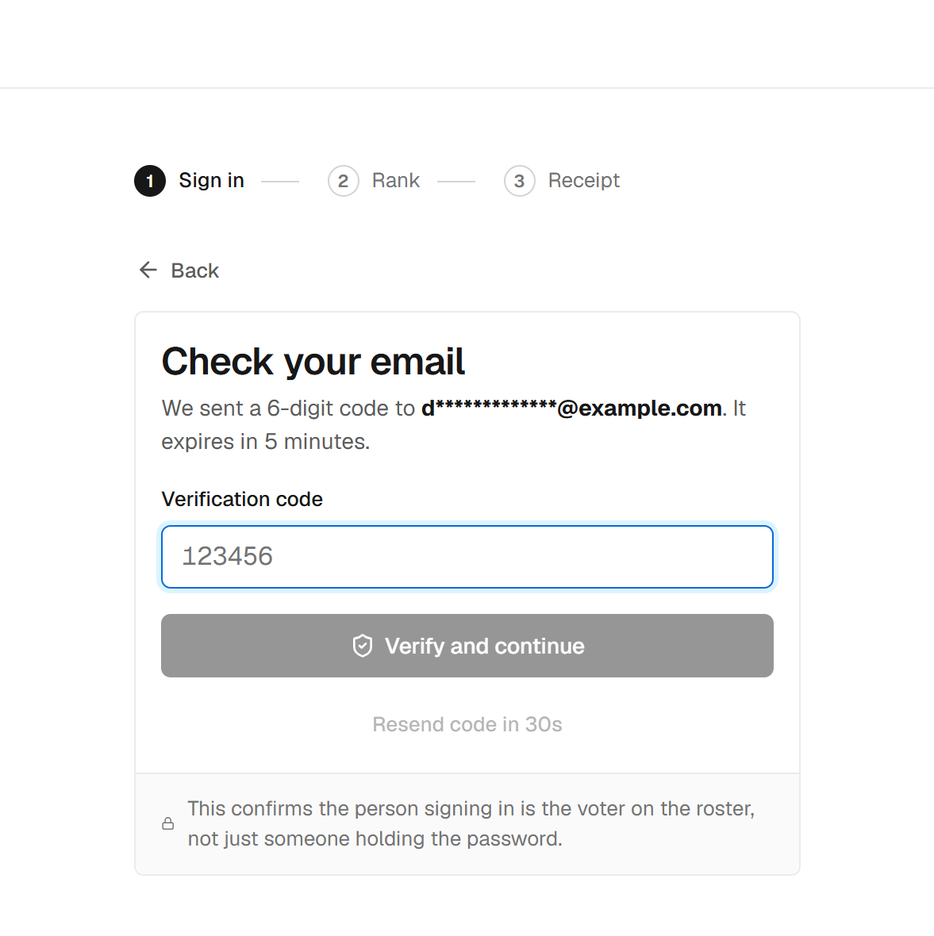
EMAIL ONE-TIME CODE · DESIGN
Small choices that make it hold up
Choice | Value
Code | 6 digits from a secure generator
Stored as | HMAC of challenge and code
Valid for | 5 minutes, single use
Guesses | 3 per code, then locked
Resend | 1 per 30 s, 5 per challenge
Challenges | 5 per voter per 15 min
Delivery | SMTP; failure never blocks sign-in
Where emails live | Separate database
The voter sees only a masked address.
BACSE202 – Database Systems | Review 3 | Fall Semester 2026 · Slide 16
Notes:
The choices that make it hold up. Codes come from a cryptographically secure generator, so they are unpredictable. Only an HMAC of the code is stored, so the database never holds a usable code. A code lasts five minutes, works once, and allows three guesses. Resends are limited, and so are new challenges per voter, so a resend cannot be used to keep guessing. Emails live in their own database. A test found a real bug here, which we will show in the evaluation.

Slide 17
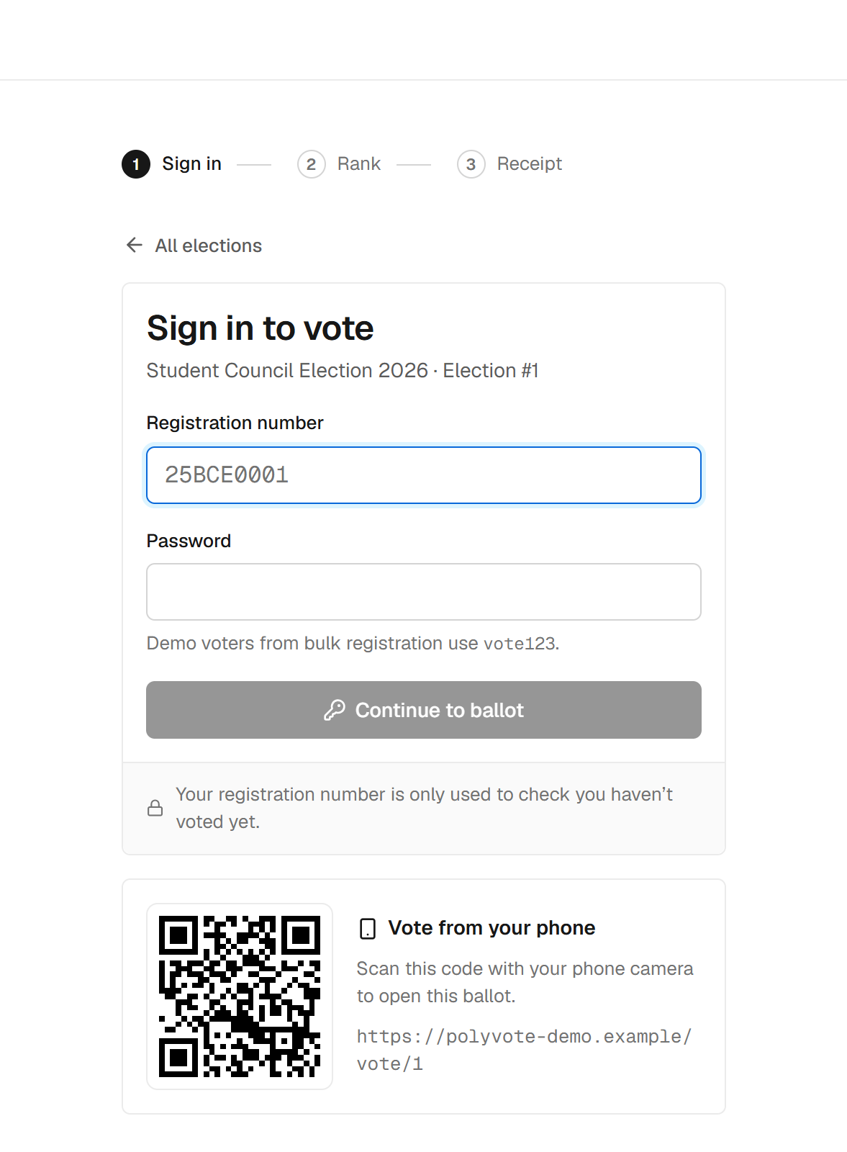
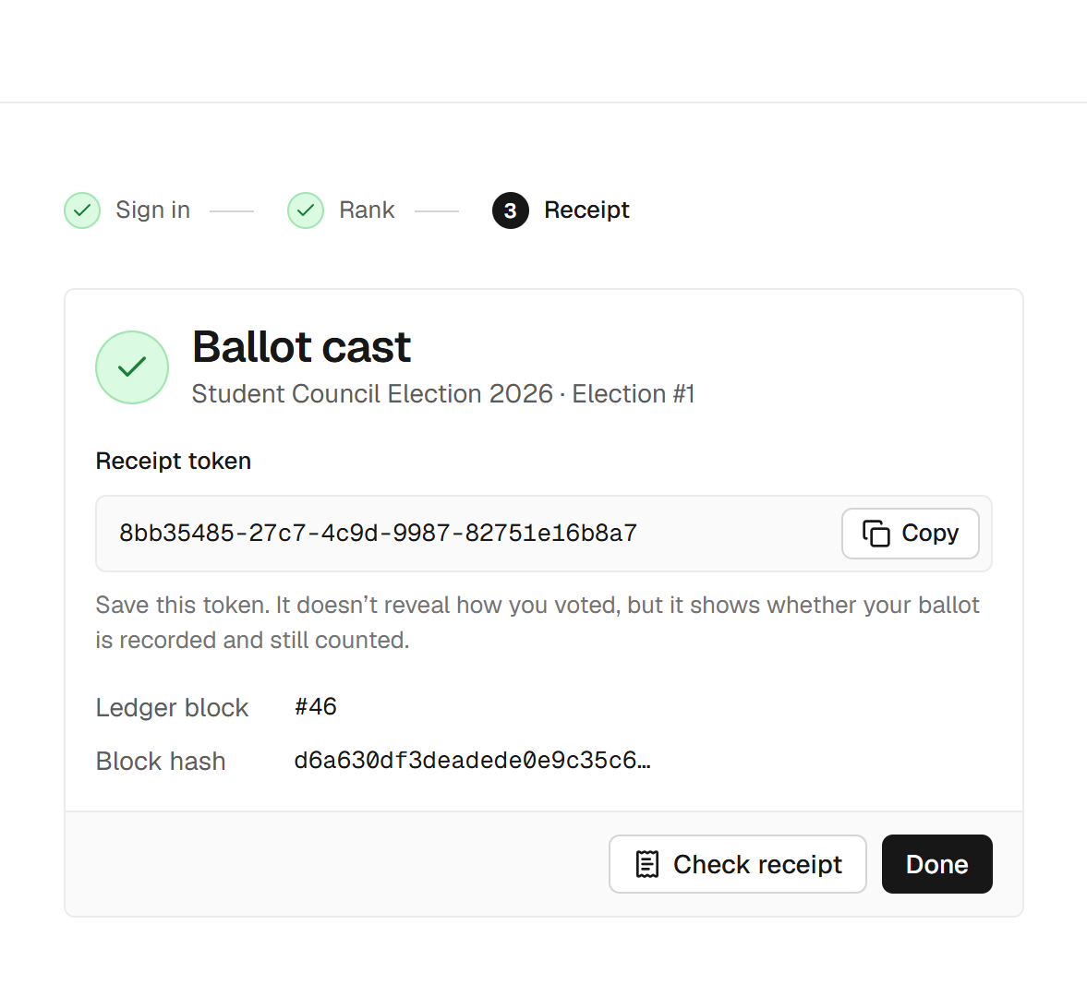
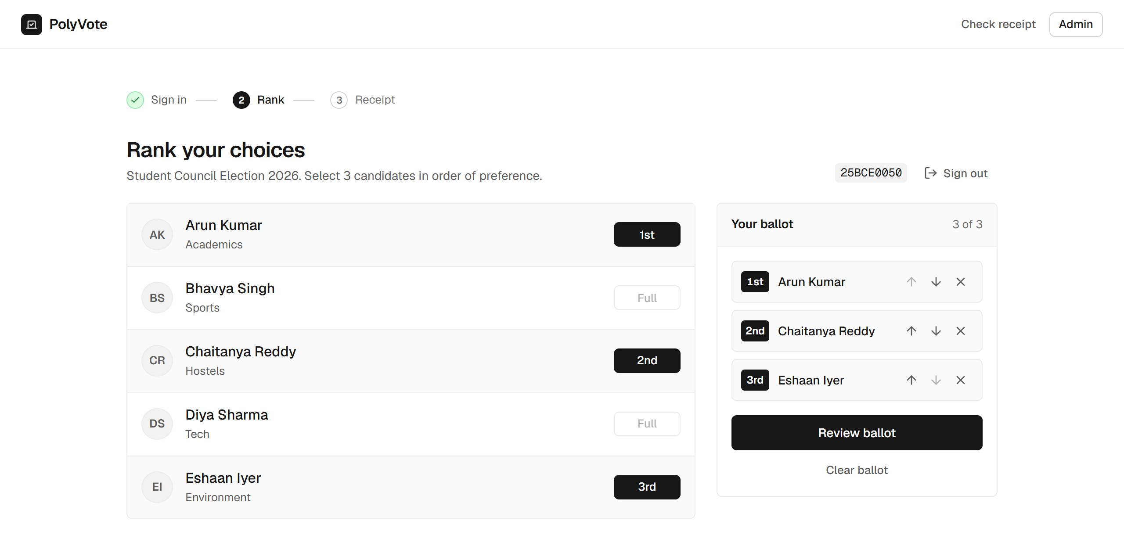
THE VOTER EXPERIENCE
Sign in, confirm by code, rank, and keep a receipt
1 Sign in (QR for phones)
2 Enter the emailed code
3 Rank three choices
4 Receipt token
BACSE202 – Database Systems | Review 3 | Fall Semester 2026 · Slide 17
Notes:
This is what a voter sees. One: sign in with registration number and password; the QR code lets a phone open the same ballot. Two: the new step, the code sent to the address on file. Three: rank three candidates in order; there is a review step before the irreversible cast. Four: the receipt token and the ledger block number. The token shows that a ballot is recorded and counted; it does not reveal how anyone voted.

Slide 18
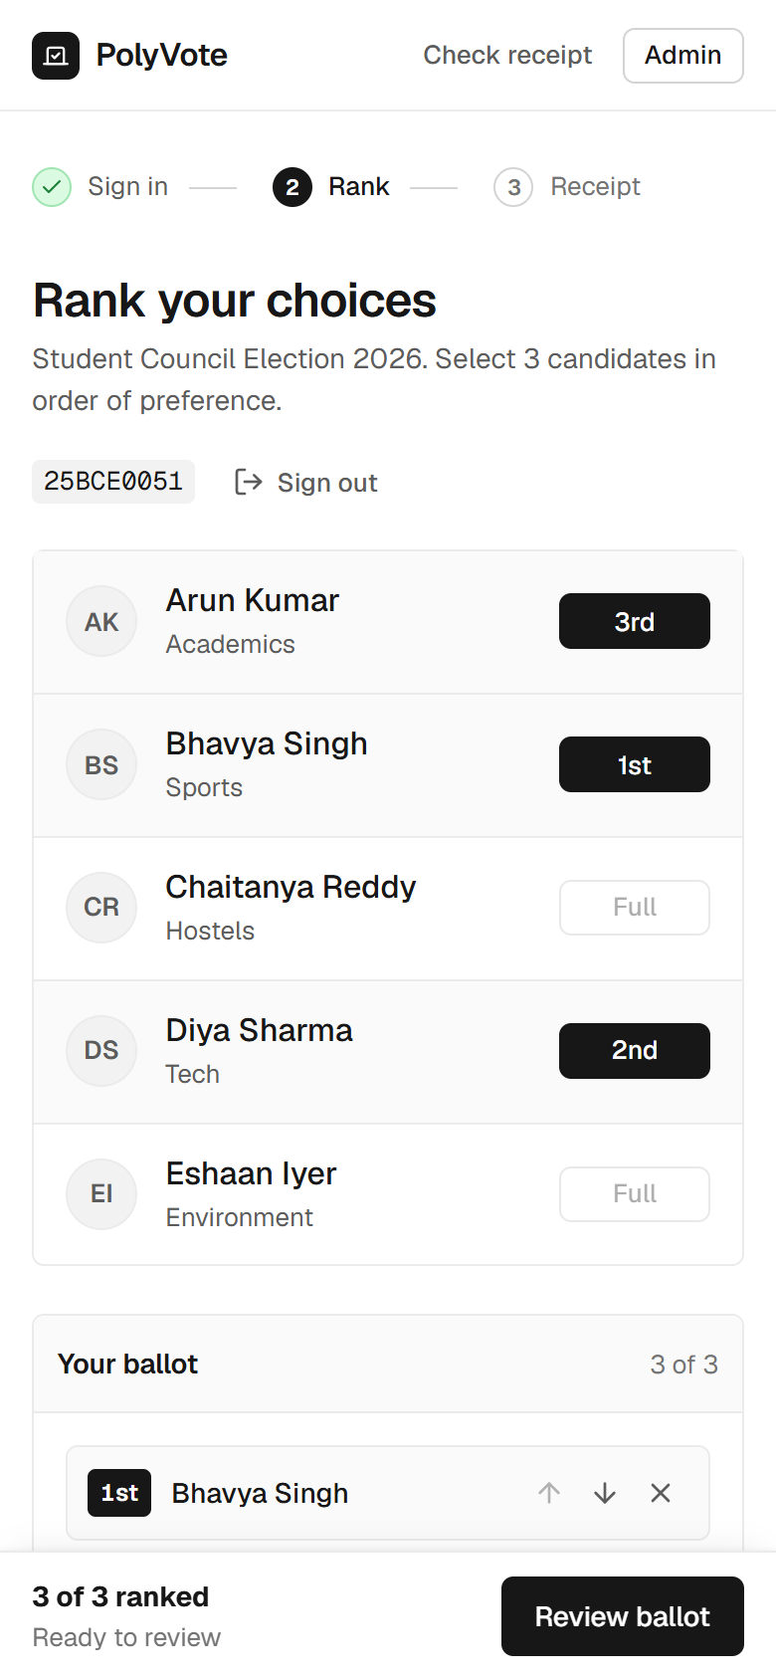
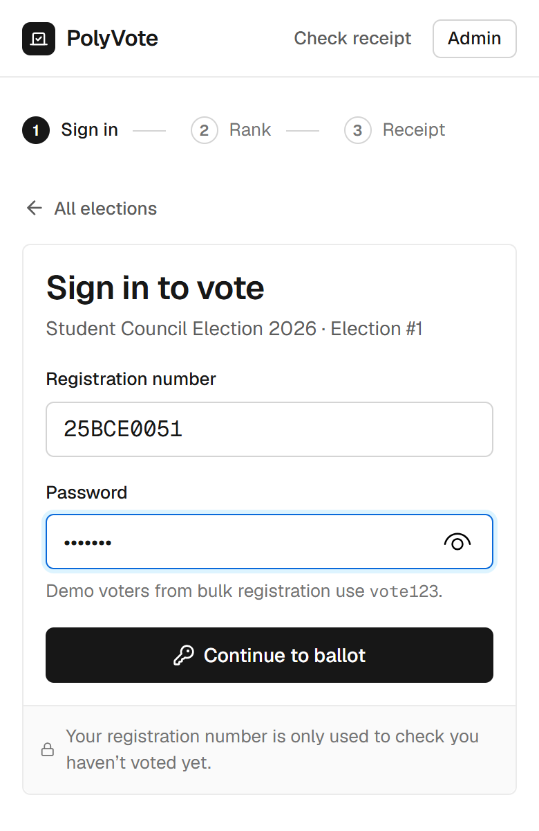
PHONE VOTING AND HOSTING
Phone voting, a public link, and an honest account
• How: a Cloudflare quick tunnel gives a temporary public HTTPS address; the vote page shows a QR code for it.
• Works from any network; tested casting a real ballot from a phone.
• What it is not: cloud deployment. The laptop must stay on, and the address changes when the tunnel restarts.
• Why we say so: a true cloud platform with Oracle is the next step.
• Safe by default: secrets stay in .env; the repository holds only .env.example.
BACSE202 – Database Systems | Review 3 | Fall Semester 2026 · Slide 18
Notes:
Hosting. We expose the service through a Cloudflare quick tunnel, which gives a temporary public HTTPS address without opening ports. The voter page shows a QR code for it, so a phone scans and votes; we cast a real ballot from a phone this way. To be precise, this is public hosting from a laptop, not cloud deployment: the laptop has to stay on and the address changes when the tunnel restarts. A real cloud platform is part of the Oracle migration planned next. The repository contains only a template for the environment file, never the secrets.

Slide 19
LIVE DEMO · SAMPLE POLYVOTE
The same system with email verification switched on
1
2
3
4
Admin
Sign in
Code
Vote
Voters have emails; Mail outbox open
Password right, still no ballot
Read it from the outbox or inbox
Rank, cast, get the receipt
5
6
7
Safety net
Every code also appears in the outbox, so a slow email cannot stall the demo.
Seal
Tamper
Ledger
Receipt check; new block in Atlas
DB Studio edit; sweep names it
Edit a block in Atlas; chain breaks
Separate copy: its own database, its own Atlas collection, port 8001; START_DEMO resets it in about 20 seconds.
BACSE202 – Database Systems | Review 3 | Fall Semester 2026 · Slide 19
Notes:
Now a short live demonstration, on a separate copy of the project we call Sample PolyVote. It is identical except that email verification is switched on, and it has its own database and its own Atlas collection so it cannot disturb the main system. The flow: show the admin view with voter emails and the outbox; sign in as a voter, and note that the right password is not enough; take the code from the outbox, or from the inbox if mail is configured; rank and cast; check the receipt and show the new block in Atlas. Then the tamper test: edit a ballot in DB Studio and run the sweep, and edit a block in Atlas to show the chain breaking. If email is slow, the code is always in the outbox.

Slide 20
HOW WE EVALUATED
47 executable scenarios, old design versus final
7
13
13
14
3
DB prevention
API abuse
Tampering
One-time code
Benchmark sizes
Statements the schema should reject
Wrong password, injection, replay, races
Edits by someone with storage access
Replay, expiry, limits, failure
100, 1,000, 10,000 ballots
• A throwaway copy of the app is driven through the real API; a "rogue administrator" edits the database and ledger files directly.
• Baseline: the Review 2 design, checked out and run unchanged. Attacker scripts never receive the ledger key.
• Outcome per attack: detected by the sweep or chain, visible only in counters, or not detected. Benchmarks are medians of three runs.
BACSE202 – Database Systems | Review 3 | Fall Semester 2026 · Slide 20
Notes:
To prove the design is better we built a suite instead of arguing. Forty-seven scenarios: seven database-level prevention tests, thirteen API abuse tests, thirteen tampering scenarios, and fourteen one-time-code tests, plus benchmarks at one hundred, one thousand and ten thousand ballots. The suite runs on a throwaway copy, drives the real API, and plays the rogue administrator by editing the database and ledger files directly. The baseline is the Review 2 design, run unchanged, and the attacker scripts never see the ledger key. We repeat each run three times; the outcomes were identical every time.

Slide 21
PREVENTION RESULTS
Prevention results: one gap taught us something
Attempt | Stopped by | Result
Second vote by the same voter | Trigger | Prevented
Rank 4 on a 1–3 ballot | CHECK | Prevented
Same candidate ranked twice | Composite key | Prevented
Duplicate roster entry | UNIQUE | Prevented
Wrong password, SQL injection, replayed session | API | Prevented
20 simultaneous casts by one voter | Lock + transaction | Exactly one accepted
Nonexistent candidate from a default console | FK (off by default in SQLite) | Not prevented
The gap: SQLite enforces foreign keys only on connections that enable it. The application does; a console with default settings does not. A server database removes this, which is part of the Oracle move.
BACSE202 – Database Systems | Review 3 | Fall Semester 2026 · Slide 21
Notes:
The prevention results. Six of seven database statements are rejected by the engine with its own error message, and all thirteen API abuse tests are refused, including twenty simultaneous casts by one voter of which exactly one is stored. The one gap is instructive: SQLite enforces foreign keys only on connections that turn the setting on. Our application does; a console opened with default settings does not. So a rogue administrator can insert a ballot for a candidate that does not exist. The sweep reports it as injected, but the lesson is that a constraint is only as strong as the engine's enforcement, which is one reason for the move to a server database.

Slide 22
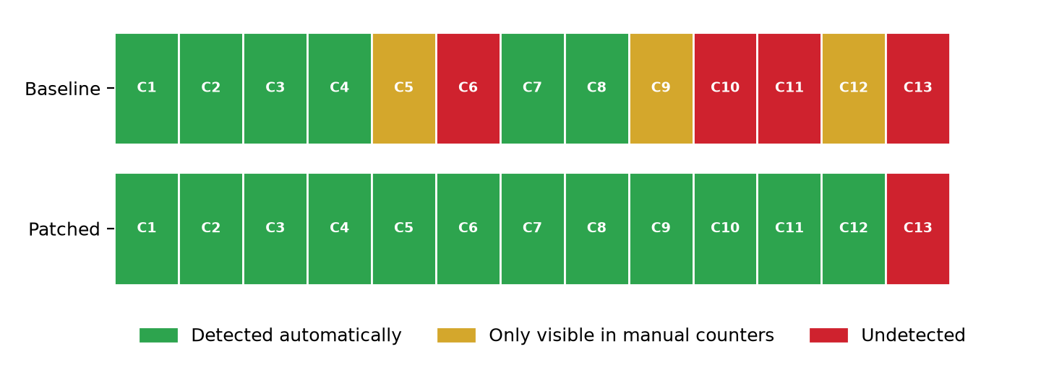
TAMPERING RESULTS
Automatic detection rises from 6 of 13 to 12 of 13
6/13
Review 2 design: detected automatically
12/13
Final design: detected automatically
1
Still undetected: roster injection (C13)
BACSE202 – Database Systems | Review 3 | Fall Semester 2026 · Slide 22
Notes:
The central result. Thirteen scenarios of tampering by someone with direct storage access. Under the Review 2 design, 6 are detected automatically, three are visible only if an officer compares the counters by eye, and four are not detected at all. Under the final design, 12 are detected automatically, none depend on the counters, and one is not detected: adding a ghost voter to the roster and voting as them. We report that one openly. The detection bar shows each scenario, colour-coded.

Slide 23
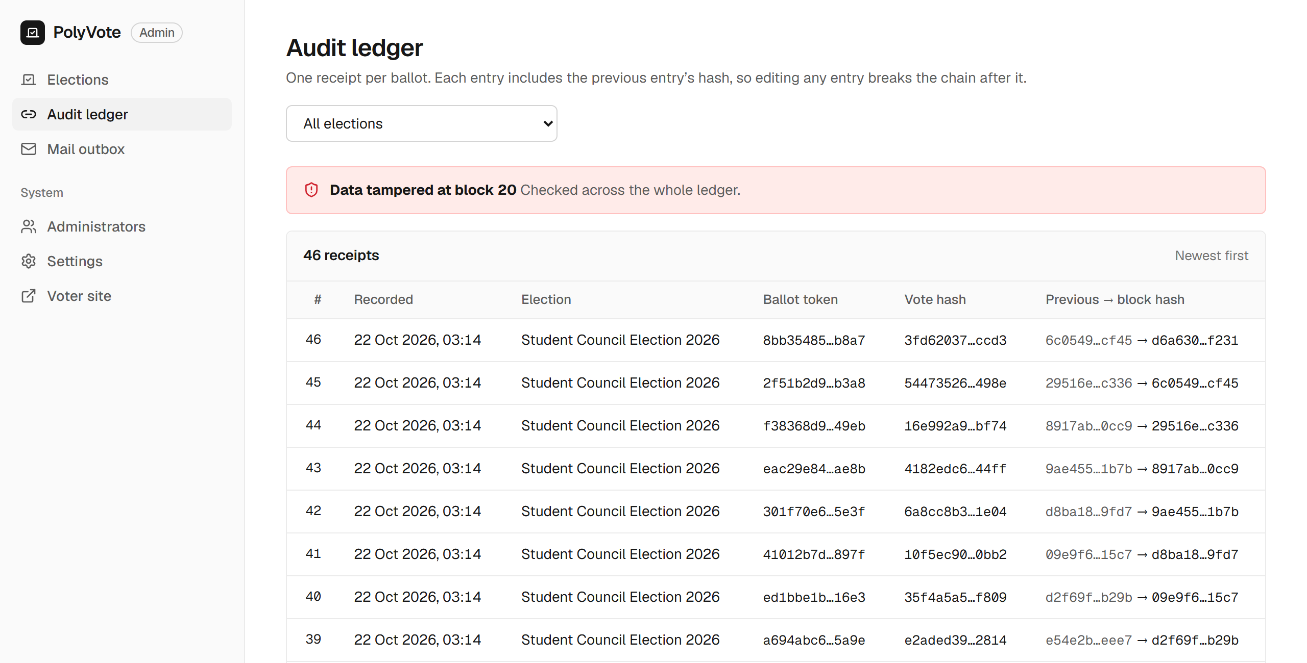
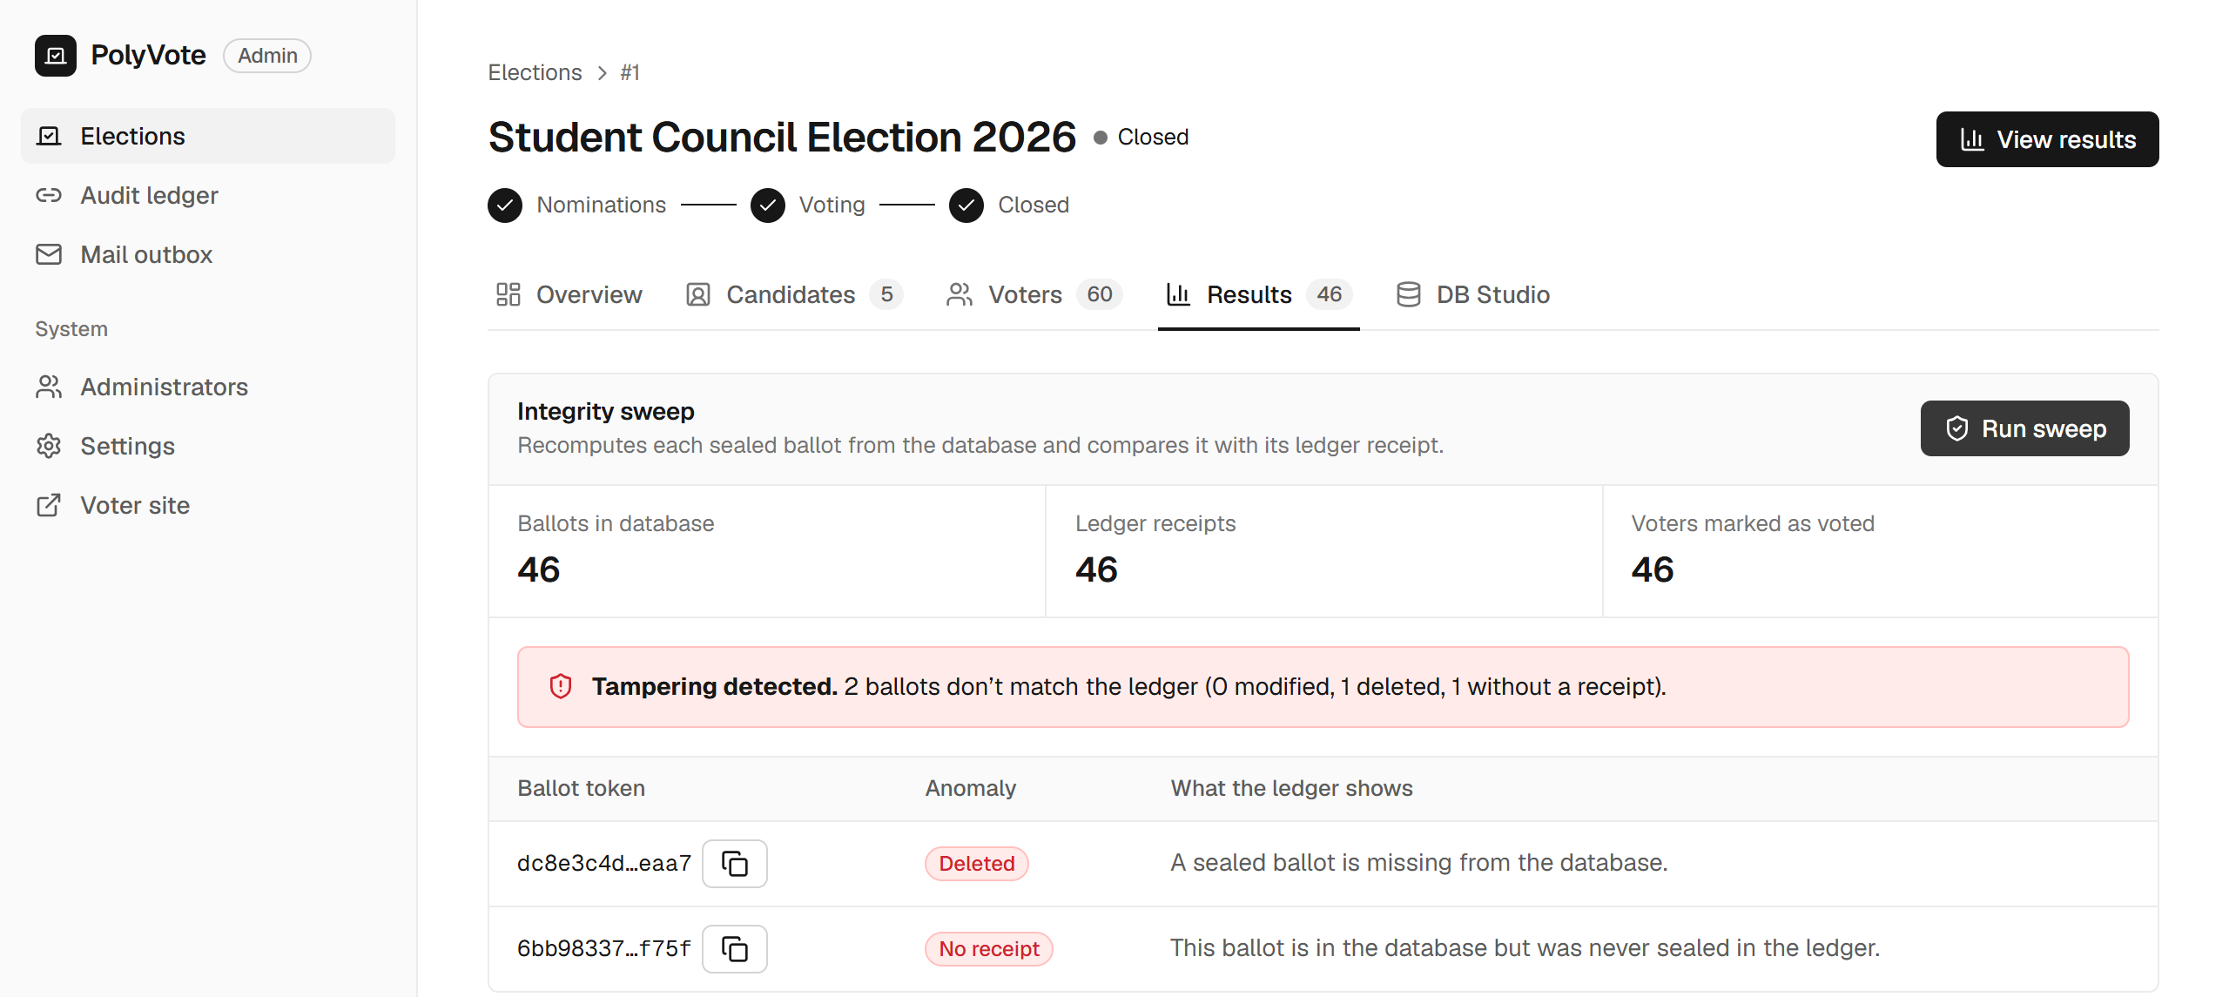
SWEEP IN ACTION
A deletion and an injection hide in the counts
• Left: counters read 46 / 46 / 46, yet the sweep reports 1 deleted and 1 without a receipt.
• Above: one edited block breaks the chain.
BACSE202 – Database Systems | Review 3 | Fall Semester 2026 · Slide 23
Notes:
Here is why counters alone are not enough. On the left, one ballot was deleted and another injected, so the counters still read forty-six, forty-six, forty-six and look perfectly healthy. The sweep nevertheless names both ballots, one deleted and one without a receipt. On the right, a single edited block makes the audit ledger page show a red banner: data tampered at block twenty.

Slide 24
WHY THE KEY MATTERS
Six scenarios the Review 2 design missed
ID | Scenario | Review 2 | Final | What closed it
C5 | Inject a ballot with no receipt | Counters only | Detected | Injected-ballot rule
C6 | Ballot stuffing: inject, forge receipt, set a flag | Not detected | Detected | Keyed chain
C9 | Truncate the last ledger block | Counters only | Detected | Reconciliation rule
C10 | Alter a ballot and rebuild the whole chain | Not detected | Detected | Keyed chain
C11 | Swap two candidates' names after voting | Not detected | Detected | Sealed roster hash
C12 | Reset a voted flag, vote again | Counters only | Detected | Reconciliation rule
Key point: C6 and C10 defeat any chain that is only hashed, because the attacker recomputes the hashes. With the HMAC key they fail at the first block the attacker cannot compute.
BACSE202 – Database Systems | Review 3 | Fall Semester 2026 · Slide 24
Notes:
Six scenarios the old design missed or only half caught. A ballot injected without a receipt, and a truncated ledger, were visible only in the counters; the new injected-ballot and reconciliation rules catch them. Renaming candidates after voting was invisible; the sealed roster hash catches it. The two serious ones are ballot stuffing with a forged receipt and a consistent rewrite of the whole chain. Both were completely undetected, because a plain hash chain lets an attacker recompute every hash. With the key, the forged or rebuilt blocks fail verification.

Slide 25
ONE-TIME CODE TESTS
14 of 14 pass, and the suite caught a real defect on the way
• Password alone gives no session; the challenge id is not a token.
• Right code opens the ballot; a used code cannot be replayed.
• Three wrong codes lock the challenge, even if the right code follows.
• Expired codes, rapid resends and a sixth code are refused.
• No email on file: clear refusal.
• Plaintext codes are absent from the database.
• A failed mail server does not block sign-in.
• No email column exists in the election database.
The defect
Test F4 first failed. The wrong-guess counter was saved inside a database context, and the request then raised an error. SQLite rolls back when an exception leaves the context, so every failed guess was recorded and then undone: unlimited guessing. The fix commits state before the error propagates. Review would not have found it; the test did.
BACSE202 – Database Systems | Review 3 | Fall Semester 2026 · Slide 25
Notes:
All fourteen one-time-code tests pass: no session from a password alone, replay refused, three wrong guesses lock the challenge, expiry, resend limits, privacy of stored codes, and resilience to a failed mail server. But it did not start that way. Test F4 failed. The attempt counter was updated inside a database context manager and the handler then raised an HTTP error; SQLite rolls back when an exception leaves the context, so every failed guess was recorded and then undone, which meant unlimited guessing. We fixed it by committing before the error propagates. It is a good argument for executable tests over review for security logic.

Slide 26
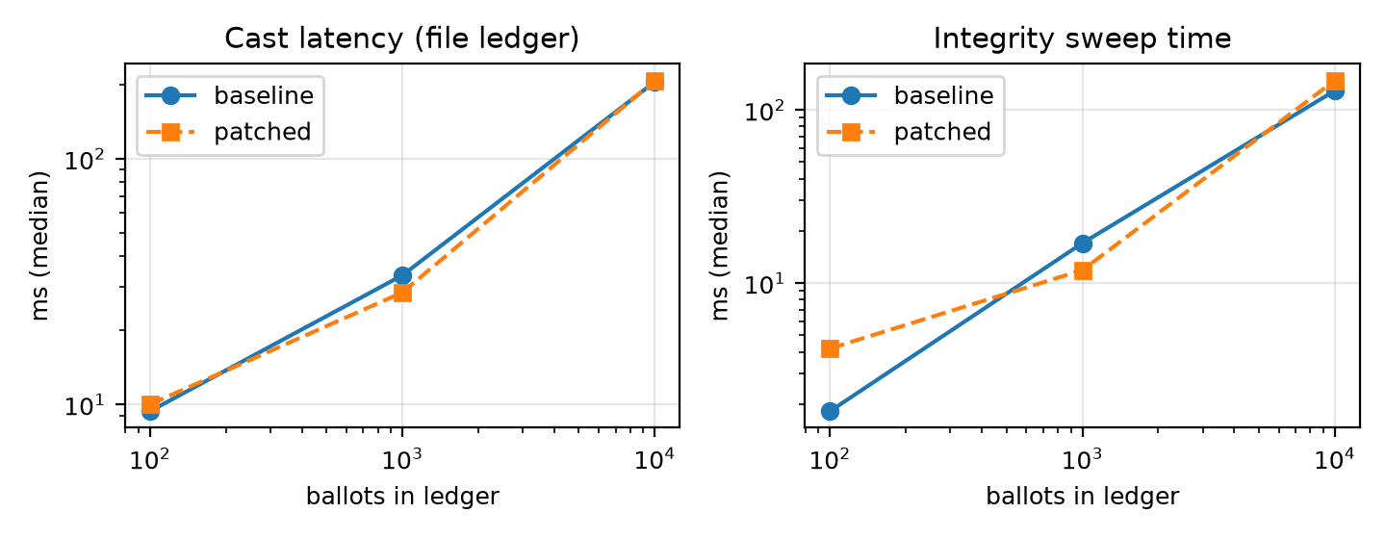
PERFORMANCE
Checks are cheap; the file ledger is the one that grows
• Sweep at 10,000 ballots: 147 ms, about 15% slower than before.
• File ledger: a cast grows from 9 to 205 ms because each append rewrites the file.
• Atlas: about 147 ms at any size (network round trip).
• The file is faster when small; Atlas wins on flat growth, concurrency control and living off-machine.
Ballots | Cast ms (file) | Sweep ms | Atlas append ms
100 | 9 | 4 | 136
1,000 | 33 | 12 | 147
10,000 | 205 | 147 | 139
BACSE202 – Database Systems | Review 3 | Fall Semester 2026 · Slide 26
Notes:
Performance. The keyed chain and the three extra rules cost little: the sweep at ten thousand ballots takes about 147 milliseconds, roughly 15 percent slower than before. The file ledger is the one that grows: a cast goes from about 9 milliseconds at a hundred ballots to 205 at ten thousand, because every append rewrites the whole file. Against Atlas an append costs about 147 milliseconds at any size, which is mostly network time on a mobile hotspot. So Atlas is not about raw speed at small sizes; it is about flat growth, concurrency control, and holding the ledger off the application machine.

Slide 27
COMPARATIVE STUDY · SCOPE
We compared PolyVote with 33 systems in five groups
8
Verifiable and research
10
Web services and form tools
2
Independent analyses
Helios, Belenios, Civitas, ElectionGuard, Zeus, Verificatum, Vocdoni, Aragon
CIVS, OpaVote, ElectionBuddy, Simply Voting, Election Runner, TapVoter, RankedVote, BetterVoting, Google and Microsoft Forms
Voatz (USENIX 2020) and Democracy Live (USENIX 2021)
2
Civic platforms
11
Open-source student projects
How
We read each project's own page, README or paper (23 web queries, 20 GitHub searches, 23 Oct 2026). A feature counts only if it is documented. "Not documented" is not proof of absence.
Decidim and Consul Democracy
FlexyVotes, VeriVote and nine other GitHub repositories
We did not run these systems. Every cell has a source URL in the evidence file; PolyVote's own cells rest on the tests in this deck.
BACSE202 – Database Systems | Review 3 | Fall Semester 2026 · Slide 27
Notes:
The comparative study. A tool like this has no single obvious competitor, so we broke it into nine features and compared each against the kinds of systems people actually use. We read thirty-three systems in five groups: eight verifiable or research systems such as Helios and Belenios; ten web services and form tools; two independent security analyses of commercial voting products; two civic platforms; and eleven open-source student or hobby projects from GitHub. We ran twenty-three web searches and twenty repository searches on the twenty-third of October. For each system we read its own page, README or paper, and a feature counts only if it is documented. Not documented is not proof of absence. We did not run these systems ourselves, and every cell has a source URL in our evidence file.

Slide 28
COMPARATIVE STUDY · THE NINE FEATURES
Nine features, each with a way to test it
 | Feature | How we prove PolyVote has it
F1 | Ranked-choice counting with a round-by-round transcript | 46-ballot election, 5 rounds shown, tie flagged
F2 | Many organisations on one install | Tests B8 and B13
F3 | Voting rules enforced inside the database | 6 of 7 direct SQL attempts refused; 13 of 13 API abuses refused; 1 of 20 simultaneous casts accepted
F4 | No link between ballot and voter; emails in a separate database | Automated check: no shared column, no email column in the election database
F5 | Keyed audit ledger in a separate store, with a reconciling sweep | 12 of 13 tampering attacks caught (plain chain: 6); identical in 3 runs
F6 | Emailed one-time code as a second factor | 14 of 14 tests, including replay, expiry and guess limits
F7 | Scan-to-vote QR code on a phone | A real ballot cast from a phone through the public link
F8 | Receipt to check a ballot is recorded and counted | Receipt check page; one ledger block per ballot
F9 | Easy to run and host | One command locally; free hosted demo configured for Render
BACSE202 – Database Systems | Review 3 | Fall Semester 2026 · Slide 28
Notes:
These are the nine features we compare, and next to each the evidence that PolyVote itself has it. F1 ranked counting, shown in the results screen. F2 many organisations, tests B8 and B13. F3 rules inside the database: six of seven direct SQL attempts refused, all thirteen API abuse tests refused, and exactly one of twenty simultaneous casts accepted. F4 no link between ballot and voter, with emails in a separate database, checked by an automated column test. F5 the keyed ledger and sweep: 12 of thirteen attacks caught against 6 for a plain chain. F6 the emailed code: fourteen of fourteen tests. F7 QR voting: a real ballot cast from a phone. F8 the receipt, F9 easy to run. The next slide shows which other systems document which feature, and the five slides after it go feature by feature with sources.

Slide 29
COMPARATIVE STUDY · COVERAGE MATRIX
Coverage matrix: who documents which feature
System
F1
F2
F3
F4
F5
F6
F7
F8
F9
Yes
documented
Part
partly
No
absent
–
not documented
Helios
No
–
–
Part
Part
–
–
Yes
Part
Belenios
Part
Part
–
Part
Part
Part
–
Yes
Part
OpaVote
Yes
Part
–
–
–
Part
–
–
Part
ElectionBuddy
Part
Part
–
Part
Part
Part
Part
–
Part
TapVoter
Part
Part
–
Part
Part
Part
Part
Yes
Part
BetterVoting
Part
Yes
–
Part
Part
Part
Part
Yes
Yes
Google Forms
–
–
–
Part
–
No
–
–
Part
FlexyVotes
Yes
Yes
Yes
Part
Part
Yes
No
Yes
Part
VeriVote
–
–
Part
Part
Part
Part
–
Yes
Part
SecureVote
–
No
–
–
Part
Yes
–
–
Part
PolyVote (our tests)
Yes
Yes
Yes
Yes
Yes
Yes
Yes
Yes
Yes
F1 ranked counting · F2 many organisations · F3 database rules · F4 unlinked ballots · F5 keyed ledger and sweep · F6 email OTP · F7 QR voting · F8 receipt · F9 easy to run. Other rows: documentation we read. F5 is judged strictly (keyed chain, separate store, reconciling sweep, published attack results), so most systems score Part.
BACSE202 – Database Systems | Review 3 | Fall Semester 2026 · Slide 29
Notes:
This matrix shows eleven of the thirty-three systems against the nine features. Green means documented, amber partly, red documented as absent, and a dash means we found nothing on the pages we read, which is not the same as absent. The bottom row is PolyVote, and it is all green only because those are the cells our own tests back. Read the other rows for what they show: FlexyVotes is nearly as complete and is the closest project we found; it is missing QR voting and has a weaker form of the ledger. BetterVoting covers many features but not database rules or a ledger of ballots. The cryptographic systems, Helios and Belenios, score amber on most of these because they solve the problem differently, with encryption. Feature five is judged strictly, which is why most rows are amber there. Nothing in the matrix says PolyVote is better overall; it says that one free small-election tool documenting every column is not something we found.

Slide 30
FEATURES 1-2 · COUNTING AND MANY ORGANISATIONS
Ranked counting and many organisations: not unique
System | What its own page, README or paper documents | Match
OpaVote (web service) | Instant-runoff, STV and Condorcet with a step-by-step explanation of each count; free up to 25 voters; sub-groups only partly. | F1 Yes · F2 Part
FlexyVotes (GitHub) | Instant-runoff for one seat, STV for several, with per-round data stored; many organisations with scoped roles. | F1 Yes · F2 Yes
BetterVoting (GitHub) | Ranked-choice listed among voting methods; organisations and teams; round-by-round output not verified. | F1 Part · F2 Yes
Belenios | Condorcet-Schulze and STV are documented; instant-runoff and round transcripts are not. | F1 Part · F2 Part
Microsoft Forms | A ranking question exists, but no instant-runoff tally is documented. | F1 Part
PolyVote: counts instant-runoff and shows every round (46 ballots, 5 candidates, 5 rounds, tie flagged). Several organisations and elections ran in one install in tests B8 and B13.
Verdict: a baseline feature, not our claim. OpaVote and FlexyVotes also count ranked ballots, and OpaVote explains every count.
BACSE202 – Database Systems | Review 3 | Fall Semester 2026 · Slide 30
Notes:
Features one and two. Ranked-choice counting is common: OpaVote offers instant-runoff, STV and Condorcet with an explanation of each count, and FlexyVotes stores per-round data. BetterVoting lists ranked-choice and has organisations and teams, though we could not verify its round output. Belenios documents Condorcet and STV but not instant-runoff, and Microsoft Forms has a ranking question but no ranked tally. PolyVote counts instant-runoff and shows every round, and several organisations ran in one install in our tests. The honest verdict is that this is a baseline feature. We list it because a voting tool without it would not be usable, not because it sets us apart.

Slide 31
FEATURES 3-4 · DATABASE RULES AND UNLINKED BALLOTS
Database rules and unlinked ballots
System | What its own page, README or paper documents | Match
FlexyVotes (GitHub) | Unique indexes and append-only triggers that block even raw SQL; ballot rows carry no voter key. Voters and encrypted emails share one PostgreSQL database. | F3 Yes · F4 Part
VeriVote (GitHub) | Ballots stored without voter identity; triggers, CHECK and foreign-key rules are not documented. | F3 Part · F4 Part
CIVS (Cornell) | Voter emails are erased once the election begins; ballots are stored under a hash of the receipt. | F3 – · F4 Part
Helios, Belenios | Secrecy comes from encryption, not from a schema with no linking column; ballots sit on a public ballot box. | F3 – · F4 Part
Democracy Live (USENIX 2021) | The authors report voter identity, selections and a browser fingerprint sent to the vendor. | F4 No
PolyVote: 6 of 7 direct SQL attempts refused by the engine, 13 of 13 API abuses refused, exactly 1 of 20 simultaneous casts accepted. An automated check finds no column shared by ballots and voters; emails live in a separate file.
Verdict: FlexyVotes is stronger on database rules (append-only triggers). Our known gap is the one attempt not refused: SQLite foreign keys apply per connection.
BACSE202 – Database Systems | Review 3 | Fall Semester 2026 · Slide 31
Notes:
Features three and four. FlexyVotes is the strongest comparison here: its unique indexes and append-only triggers refuse changes even from a raw SQL session, and its ballot rows have no voter key, although voters and encrypted emails live in the same PostgreSQL database. VeriVote stores ballots without identity but documents no database rules. CIVS erases voter emails once the election begins. Helios and Belenios get secrecy from encryption rather than from the schema. And the independent analysis of Democracy Live reported voter identity being sent to the vendor. For PolyVote, six of seven direct SQL attempts are refused, all thirteen API abuses are refused, and one of twenty simultaneous casts is accepted. An automated check finds no column shared by ballots and voters, and emails live in a separate file. We say plainly that FlexyVotes is stronger on database rules, and that our one miss is SQLite foreign keys, which apply per connection.

Slide 32
FEATURE 5 · TAMPER-EVIDENT LEDGER
Tamper-evident ledgers: where a keyed chain differs
System | What its own page, README or paper documents | Match
FlexyVotes (GitHub) | SHA-256 chain per organisation inside PostgreSQL, verified every 6 hours; Merkle bulletin board; 204 tests, no published attack table. | F5 Part
VeriVote (GitHub) | SHA-256 chain in MongoDB with an audit endpoint and a manual tamper demo; no HMAC key, no reconciliation. | F5 Part
SecureVote (GitHub) | Hash-linked ledger with hashed one-time codes; no ranking; a single instance by design. | F5 Part
BetterVoting (GitHub) | Audit log covers administrator actions (sharing a link, revealing a ballot link), not a chain of ballots. | F5 Part
Helios, Belenios | A public, cryptographically verifiable ballot box: a stronger guarantee by a different mechanism. | F5 Part
Voatz (USENIX 2020) | Claims a blockchain; the analysis found no public formal description and reported flaws. | F5 Part
PolyVote: an HMAC-keyed chain in a separate MongoDB store, a five-rule sweep and a published attack suite. 12 of 13 attacks caught against 6 of 13 for the plain-chain design, the same in 3 runs; C6 and C10 only fail with the key.
Verdict: better than a plain chain against someone who can write to the database. Not a match for cryptographic verification, and whoever holds the key can still forge.
BACSE202 – Database Systems | Review 3 | Fall Semester 2026 · Slide 32
Notes:
Feature five, the audit ledger. Hash-chained logs are common: FlexyVotes keeps one per organisation in PostgreSQL and verifies it every six hours, VeriVote keeps one in MongoDB, SecureVote has a hash-linked ledger, and BetterVoting has an audit log of administrator actions. Helios and Belenios use a public verifiable ballot box, which is a stronger guarantee by a different mechanism, and Voatz claimed a blockchain that analysts could not verify. What we did not find documented elsewhere is the combination of a keyed chain, a separate store, a sweep that reconciles ballots, receipts, flags and candidates, and published attack results. In our suite that combination catches 12 of thirteen attacks against 6 for a plain chain, identical across three runs. The limit: whoever holds the key can still forge, and cryptographic systems remain stronger on verification.

Slide 33
FEATURES 6-7 · SECOND FACTOR AND QR VOTING
Emailed codes exist elsewhere; so does QR sharing
System | What its own page, README or paper documents | Match
FlexyVotes (GitHub) | Keyed-hash one-time code with expiry, attempt limit and hourly rate limit; QR only for event ticket check-in. | F6 Yes · F7 No
SecureVote (GitHub) | Hashed one-time code with expiry and attempt limits. | F6 Yes
VeriVote (GitHub) | Email one-time code with rate limits. | F6 Part
BetterVoting | A unique emailed link per voter; docs mention no one-time code or 2FA; a QR code shares the election link. | F6 Part · F7 Part
TapVoter | Single-use key handed out by QR poster or email; no emailed second-factor code documented. | F6 Part · F7 Part
Belenios | Default voter login is an emailed short code at voting time; hashing, expiry and limits not documented. | F6 Part
PolyVote: password plus an emailed six-digit code (hashed, 5 minutes, single use, 3 guesses, resend limits). 14 of 14 tests pass, and one real defect (unlimited guesses) was found and fixed. A QR code on the vote page opens the ballot on any phone; a real ballot was cast from one.
Verdict: F6 alone is not unique: FlexyVotes and SecureVote have it too. What we did not find documented is a scan-to-vote QR flow together with an emailed code.
BACSE202 – Database Systems | Review 3 | Fall Semester 2026 · Slide 33
Notes:
Features six and seven. Emailed one-time codes are not new: FlexyVotes and SecureVote hash the code and limit attempts, VeriVote rate-limits it, and Belenios sends a short code by default. BetterVoting and TapVoter use single-use links or keys, and both share them by QR. PolyVote adds a six-digit code, hashed, valid five minutes, single use, three guesses, with resend limits, and fourteen of fourteen tests pass, including the one that found a real defect. A QR code on the vote page opens the ballot on any phone, and we cast a real ballot from one. So feature six alone is not unique. The combination of scan-to-vote with an emailed code is what we did not find documented elsewhere, and we say so in those words.

Slide 34
FEATURES 8-9 · RECEIPT AND EASE OF RUNNING
Receipts, cost and ease of running
System | What its own page, README or paper documents | Match
Helios, Belenios | Voters can check their ballot cryptographically, a stronger guarantee than a receipt. Helios needs PostgreSQL, RabbitMQ and about nine install steps. | F8 Yes · F9 Part
CIVS (Cornell) | Receipt per voter; free hosted service; MIT-licensed Perl code. | F8 Yes · F9 Yes
TapVoter | Receipt codes and a public transparency log; free tier up to 10,000 voters; closed source. | F8 Yes · F9 Part
BetterVoting | Receipt by email; AGPL licence; docker-compose in the repository; free hosted service. | F8 Yes · F9 Yes
FlexyVotes (GitHub) | Per-voter ballot tracker, Merkle proofs and an offline verifier; docker compose; no licence file found. | F8 Yes · F9 Part
OpaVote, ElectionBuddy | Free for 25 and 20 voters; closed source; no receipt documented. | F9 Part
PolyVote: a receipt proves a ballot is recorded and counted, not what it says, so it is weaker than Helios or Belenios. One command starts it (python -m uvicorn server:app); a free hosted demo is configured for Render; the source is public on GitHub, though without a licence file yet.
Verdict: easy to run, but BetterVoting and CIVS are also free and open. We do not claim an advantage here.
BACSE202 – Database Systems | Review 3 | Fall Semester 2026 · Slide 34
Notes:
Features eight and nine. Most systems have some kind of receipt. Helios and Belenios go further, letting a voter verify the ballot cryptographically; our receipt only proves that a ballot is recorded and counted, not what it says, so we are weaker on this one property. On running it, CIVS and BetterVoting are also free and open, and TapVoter has a generous free tier. PolyVote starts with one command, has a free hosted demo configured for Render, and the source is public on GitHub, though we have not yet added a licence file. We do not claim an advantage on these two features.

Slide 35
COMPARATIVE STUDY · CLOSEST PROJECTS
The three closest projects, and what each lacks
Closest project (source) | What it has | What we found it does not document
FlexyVotes, Django and PostgreSQL (github.com/deOpty/flexyvotes) | Many organisations; instant-runoff and STV; triggers that block raw SQL; ballots with no voter key; hash-chained audit log; hashed single-use email OTP | QR scan-to-vote; an HMAC-keyed chain; a separate document store and email database; a reconciling sweep; published attack results
VeriVote, Node, React and MongoDB (github.com/9022574361/Online_Voting_System) | SHA-256 chain in MongoDB with an audit endpoint; ballots without voter identity; email OTP with rate limits; receipt hash | Ranked counting; many organisations; database rules; HMAC key; reconciliation; automated attack suite
BetterVoting (github.com/Equal-Vote/bettervoting) | Ranked-choice voting; teams; QR sharing; receipts; free and open source (AGPL) | Database-enforced rules; a ledger of ballots (its audit log covers admin actions); one-time-code factor; reconciliation and attack tests
What we claim: every single feature exists somewhere, so PolyVote is not the first or the only one. We found no free small-election tool documenting all of them together. What we do not claim: to be more secure than Helios, Belenios or ElectionGuard. Limits: GitHub code search and non-English repositories were not covered.
BACSE202 – Database Systems | Review 3 | Fall Semester 2026 · Slide 35
Notes:
The three closest projects. FlexyVotes, a Django and PostgreSQL project created in August, is the nearest: it has many organisations, instant-runoff and STV, triggers that block raw SQL, ballots with no voter key, a hash-chained audit log and hashed email codes. We did not find in it QR scan-to-vote, an HMAC-keyed chain, a separate document store or email database, a sweep that reconciles ballots, receipts, flags and candidates, or published attack results. VeriVote has a SHA-256 chain in MongoDB with an audit endpoint and email codes, but no ranked counting, organisations or database rules. BetterVoting has ranked-choice, teams, QR sharing and receipts, but no database rules, ballot ledger or one-time code. So our claim is narrow and checkable: every feature exists somewhere, and we found no free small-election tool documenting all of them together. We do not claim to be more secure than the cryptographic systems. The search had limits, which we state.

Slide 36
COMPARATIVE STUDY · VERDICT
Best for small elections, not a Helios replacement
PolyVote IS A GOOD FIT WHEN
CHOOSE HELIOS / BELENIOS WHEN
• A club, council or class needs ranked-choice results.
• Someone must be able to run it in an afternoon, free.
• You need proof that edits and deletions are caught.
• Voters should confirm themselves by email and vote from a phone.
• The administrator itself cannot be trusted.
• Voters must verify their own ballot content.
• Coercion or vote selling is a real threat.
• A public cryptographic audit is required.
Our claim: for small elections, PolyVote adds database-level rules and tested tamper detection to an easy setup. It is not the strongest on verifiability.
BACSE202 – Database Systems | Review 3 | Fall Semester 2026 · Slide 36
Notes:
The verdict. For the problem we target, small and medium elections such as clubs, councils and classes, PolyVote is a good fit: ranked-choice results, an afternoon to set up, free to run, proof that edits and deletions are caught, and voters who confirm by email and can vote from a phone. The cryptographic systems are the better choice when the administrator cannot be trusted, when voters must verify their own ballot content, when coercion is a threat, or when a public cryptographic audit is required. We say this openly because it makes the claim credible. Our claim is modest: for small elections PolyVote adds database-level rules and tested tamper detection to an easy setup, and it is not the strongest on verifiability.

Slide 37
REVIEW 2 DESIGN VERSUS FINAL DESIGN
What improved, measured
Measure | Review 2 | Final
Tampering detected automatically | 6 of 13 | 12 of 13
Forged receipt or chain rewrite | Undetected | Detected (key)
Candidate renaming | Undetected | Detected (sealed roster)
Voter authentication | Password | Password + emailed code
Ledger storage | Local file | MongoDB Atlas
Ledger append at 10,000 ballots | 205 ms (file, whole cast) | ~147 ms (Atlas, flat)
Sweep at 10,000 ballots | 129 ms | 147 ms
Access | Local only | Public link + QR
BACSE202 – Database Systems | Review 3 | Fall Semester 2026 · Slide 37
Notes:
The summary of improvements over our own Review 2 design. Automatic detection of tampering rises from six to twelve of thirteen. Forged receipts, rebuilt chains and renamed candidates move from undetected to detected. Authentication goes from password only to password plus an emailed code. The ledger moves to Atlas, and the system becomes publicly reachable. The cost is small: the sweep at ten thousand ballots goes from about one hundred and twenty-nine to about one hundred and forty-seven milliseconds.

Slide 38
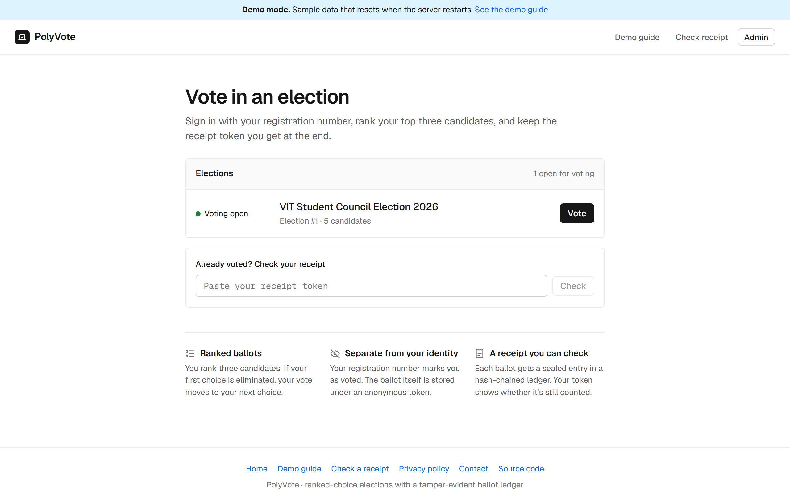
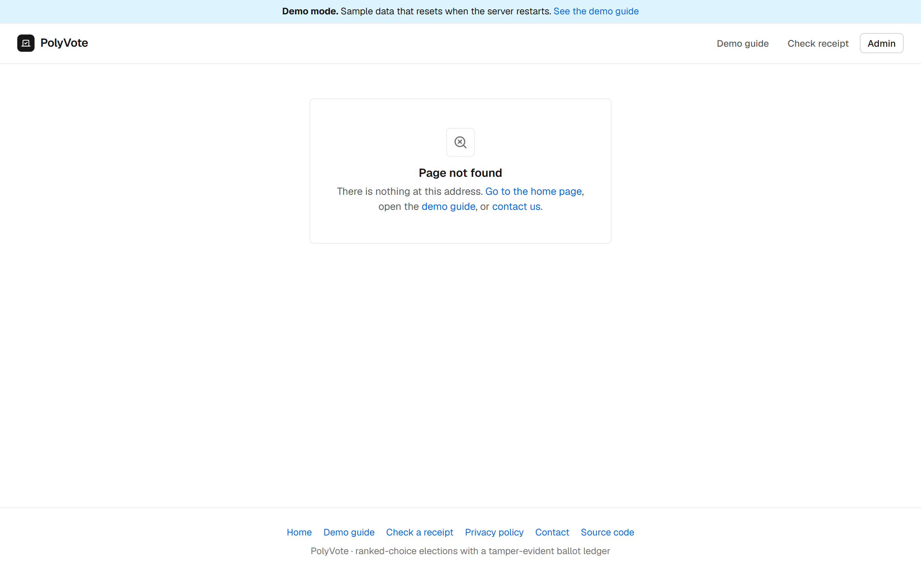
THE WEB PAGE · LAUNCH CHECKLIST
Website launch checklist: 17 pass, 4 N/A, 0 fail
PASS Server-side rendering (pre-rendered shell)
N/A HTTPS and mobile viewport
PASS robots.txt
PASS sitemap.xml
PASS Unique title tags
PASS Meta descriptions
PASS One H1 per page
PASS Canonical tags
PASS Open Graph images
PASS Custom 404 page
PASS 301 redirects
PASS Alt text on images
N/A WebP images
PASS Lazy loading
PASS Organization schema
PASS Breadcrumbs
PASS Internal links
N/A Google Analytics
N/A Search Console
PASS Privacy policy
PASS Working contact form
N/A: HTTPS (a local run; the host provides it), WebP (no raster images in the pages), Google Analytics and Search Console (need the owner's own IDs).
BACSE202 – Database Systems | Review 3 | Fall Semester 2026 · Slide 38
Notes:
A friend shared a launch checklist for websites, and we turned it into an automated check. The script experiments/web_checklist.py tests a running copy of the site against twenty-one items and prints pass, fail or not applicable with the evidence. Result on a local run of the current code: 17 pass, 4 not applicable, 0 fail. The pass items include a pre-rendered page shell with one heading and unique title and description for each page, robots.txt and a sitemap, canonical tags, a link-preview image, a custom 404 page, 301 redirects, lazy-loaded routes, structured data for the organisation and breadcrumbs, a privacy policy, and a contact form that stores messages and ignores bots. The four not-applicable items are HTTPS, because a local run is plain http and the hosting provider supplies it; WebP, because the pages have no raster images; and Google Analytics and Search Console, which need the owner's own identifiers and are built in but switched off. To be exact, the page shell is pre-rendered HTML that the React app then replaces; it is not full server-side rendering. We will rerun the same script against the public link after the next deploy.

Slide 39
PRIVACY AND ETHICS
Privacy and ethics: what is stored, and where
Data | Where it lives | Stored as
Registration number | Election database | Roster entry
Password | Election database | SHA-256 hash only
Email address | Verification database (separate file) | Never stored with ballots
One-time code | Verification database | Keyed hash only; 5 min, one use
Your ballot | Election database | Random token; no voter column
Receipt block | Audit ledger | Token and hash of the ranks
Contact message | Verification database | Admins only
ETHICS AND LIMITS
• Sample data: the demo uses sample voters and resets on restart.
• Officers see more: the roster, emails and an outbox that lists codes for ten minutes. We kept it so a demo never stalls; a real election should switch it off.
• Receipts: prove a ballot is counted, not its content.
• No tracking: no tracking cookies; analytics is off unless the operator enables it.
• Not for binding votes: no independent review yet; passwords use plain SHA-256.
The ballot table and the voter table share no column, so the database cannot say who cast which ballot. A person with direct file access could read ballots, but not link them to people.
BACSE202 – Database Systems | Review 3 | Fall Semester 2026 · Slide 39
Notes:
Privacy and ethics, taken from our own privacy page. The table shows where each piece of data lives. The registration number and a password hash are in the election database. The voter's email address is in a separate verification database and is never stored with ballots. The one-time code is stored only as a keyed hash and lasts five minutes. The ballot is stored under a random token with no voter column, and the receipt block holds the token and a hash of the ranks. Contact messages are readable by administrators only. The ethical points we want to be upfront about. The demo uses sample data and resets when the server restarts. Election officers can see the roster, the emails and an outbox that lists codes for ten minutes; we kept the outbox so a live demo never stalls on a slow email, and a real election should switch it off. A receipt shows a ballot is counted but not what it says, though anyone holding both the token and database access could see that one ballot. There are no tracking cookies. And this is a course project with no independent security review and plain SHA-256 password hashing, so it is not for binding elections yet.

Slide 40
LIMITATIONS AND FUTURE WORK
What we do not claim, and what comes next
Limitation | Direction
Insider with key and both stores can forge (A6) | Publish the chain head to an external witness; managed secret store
Roster injection is not detected (A7) | Committed or signed roster, checked at sweep time
Not end-to-end verifiable; receipt shows recorded, not content | Cast-as-intended mechanism, or a verifiable protocol if needed
Passwords stored as plain SHA-256; default admin login | Salted, slow hashing; forced first-login change
Email is a weak second factor | Authenticator app (TOTP) or printed one-time slip
IRV ties broken arbitrarily; no statistical audit | Published tie rule; risk-limiting audit
SQLite foreign keys are per connection; single node | Oracle or PostgreSQL with PL/SQL, roles; cloud platform
BACSE202 – Database Systems | Review 3 | Fall Semester 2026 · Slide 40
Notes:
What we do not claim. An insider holding the key and both stores can still forge a chain; the remedy is an external witness for the chain head. Roster injection is not detected; we need a committed roster. We are not end-to-end verifiable. Passwords are stored with plain SHA-256, which we know should be a salted slow hash. Email is a weak factor compared with an authenticator app. Ties in instant-runoff are broken arbitrarily. And SQLite is a single-node engine with per-connection foreign keys, so the planned move to Oracle with PL/SQL and roles also fixes that.

Slide 41
GLOSSARY
Glossary in plain words
Term | In plain words
Hash | A fixed-length fingerprint of data. Change one character and the fingerprint changes completely.
HMAC | A hash made with a secret key, so only someone holding the key can produce a valid one.
Hash chain | Each record stores the previous record's hash, so editing one breaks every later link.
Ledger, block | The append-only list of receipts; one block for each ballot.
Instant-runoff | Rank candidates; last place drops out each round and its ballots move on, until someone has a majority.
OTP | One-time password: a short code that works once and expires.
Term | In plain words
Roster hash | A fingerprint of the candidate list, sealed into every block.
Receipt token | A random code that shows a ballot is recorded. It does not show the vote.
Trigger, CHECK, UNIQUE | Rules the database enforces itself, even against direct SQL.
Integrity sweep | Recomputes the election from the database and compares it with the ledger.
Polyglot persistence | Different kinds of database for different jobs: SQLite and MongoDB here.
Multi-tenant | Many organisations share one install, each with its own elections.
BACSE202 – Database Systems | Review 3 | Fall Semester 2026 · Slide 41
Notes:
A glossary for anyone new to these words. A hash is a fingerprint of data. An HMAC is a hash made with a secret key, so only the key holder can produce a valid one. A hash chain links records so that editing one breaks all later links. The ledger is the append-only list of receipts, one block per ballot. Instant-runoff is the counting method: rank candidates, and each round the last-place candidate drops out and their ballots move to their next choice until someone has a majority. An OTP is a one-time password, a short code that works once and expires. The roster hash is a fingerprint of the candidate list sealed into every block. The receipt token shows a ballot is recorded but not how it voted. Triggers, CHECK and UNIQUE constraints are rules the database enforces itself. The integrity sweep recomputes the election from the database and compares it with the ledger. Polyglot persistence means using different databases for different jobs, and multi-tenant means many organisations share one install.

Slide 42
EVIDENCE
Evidence: where every claim can be checked
Claim in this deck | How it was produced | Where to look
Tampering caught: 6 of 13 (old), 12 of 13 (final) | Executable suite, 3 identical runs | experiments/results/summary.json, detection.png
Database refuses bad votes (6 of 7; 13 of 13; 1 of 20) | Direct SQL and API tests | experiments/run_experiments.py
14 of 14 one-time-code tests | Tests F1 to F14 on a throwaway copy | experiments/run_experiments.py
Sweep +15% at 10,000 ballots; Atlas append flat | Benchmarks, median of 3 runs | bench.png, mongo_bench.json
Website checklist 17 / 4 / 0 | Automated check of 21 items | experiments/web_checklist.py, web_checklist.json
What 33 other systems offer | Their own pages, READMEs, papers; a URL for every cell | docs/review3/uniqueness_evidence.md
Closest projects and their gaps | FlexyVotes code and docs read directly | docs/review3/uniqueness_evidence.md
Search method: 23 web queries, 20 GitHub repository searches, 33 systems, on 23 October 2026. Not covered: GitHub code search, non-English and private repositories, commercial internals.
BACSE202 – Database Systems | Review 3 | Fall Semester 2026 · Slide 42
Notes:
This is the back-up slide for any question that starts with how do you know. Each claim in the deck maps to something that can be rerun or opened. The tampering numbers come from the executable suite, run three times with identical outcomes. The prevention and one-time-code results come from the same experiments script. The benchmark numbers are medians of three runs, with the Atlas figures from a separate script. The website checklist is an automated script with its output saved. And everything we say about other systems comes from their own pages, READMEs and papers, with a URL for every cell in the evidence file. The search method and its limits are at the bottom: twenty-three web queries, twenty GitHub repository searches, thirty-three systems, on the twenty-third of October, without GitHub code search or non-English and private repositories.

Slide 43
OPEN FOR SUBMISSION TODAY · BY FEE
Venues still accepting papers, cheapest first
# | Venue | Submit by | Student fee | Where | IEEE/Springer indexing | Fit
1 | Confluence 2027 | 4 Dec 2026 | INR 8,000 + GST | Noida, India | Submitted for IEEE Xplore | Good
2 | INDIACom-2027 | 7 Dec 2026 | INR 8,000 + GST | New Delhi, India | IEEE approval pending | Good
3 | IEM-ICDC 2027 | 10 Dec 2026 | INR 8,000 | Kolkata, India | Springer awaited; 10+ pages | Stretch
4 | ICRCICN 2027 | 30 Nov 2026 | INR 8,500 | Kalyani, India (hybrid) | IEEE record 73691; conditional | Stretch
5 | ICESICSC-2027 | 30 Oct 2026 | INR 9,000 | Bhubaneswar, India | Says published by IEEE | Good
6 | i-PACT 2027 (VIT) | 31 May 2027 | INR 12,000 | Vellore, India | Recommended to IEEE | Stretch
7 | ISDFS 2027 | 31 Jan 2027 | USD 500 (~INR 47,000) | San Jose, USA (online ok) | Submitted for IEEE Xplore | Stretch
8 | ICISSP 2027 | 29 Oct 2026 | EUR 640 (~INR 68,000) | Valletta, Malta | Submitted for evaluation | Good
9 | DATA 2027 | 16 Feb / 25 Mar | EUR 640 (~INR 68,000) | Rome, Italy | Not confirmed | Good
10 | ICEIS 2027 | 17 Nov / 21 Dec | EUR 680 (~INR 72,000) | Rome, Italy | Submitted for evaluation | Good
Fees are per accepted paper and excluding travel, GST and bank charges; INR is approximate at 22 Oct 2026 rates. No venue has yet confirmed indexing; "submitted for" is a plan, not a result.
BACSE202 – Database Systems | Review 3 | Fall Semester 2026 · Slide 43
Notes:
These are the venues we found that are still accepting papers today, sorted by the student author fee. The cheapest are Indian conferences at about eight to nine thousand rupees: Confluence at Amity Noida, closing the fourth of December; INDIACom in New Delhi, closing the seventh of December, with a six page limit; IEM-ICDC in Kolkata; ICRCICN at Kalyani; and ICESICSC at KIIT Bhubaneswar, which closes on the thirtieth of October. i-PACT is at VIT Vellore in September 2027 for twelve thousand rupees. The international ones cost fifty to seventy-five thousand rupees before travel. The important caveat is the last column: none of these venues has confirmed indexing yet. Every one says submitted for, proposed, or approval awaited, so they are plans, not results, and indexing should be checked on the publisher's site before paying. Fees are normally paid after acceptance, and are approximate in rupees.

Slide 44
RECOMMENDED SUBMISSION ORDER
One venue at a time: dual submission is not allowed
Step | Venue | Submit by | Decision | Why this order
1 | ICISSP 2027 (Malta) | 29 Oct 2026 | 4 Dec 2026 | Best topical fit open now; EUR 640 plus travel
2a | INDIACom-2027 (Delhi) | 7 Dec 2026 | 8 Feb 2027 | Cheap India fallback if step 1 fails; IEEE not confirmed
2b | Confluence 2027 (Noida) | 4 Dec 2026 | 25 Dec 2026 | Alternative to 2a if you want a fast answer
3 | ICEIS, IFIP SEC or ICDF2C | 15-21 Dec 2026 | mid-Feb 2027 | Better-quality fallbacks; higher fees and travel
4 | ISDFS 2027 (online ok) | 31 Jan 2027 | 15 Feb 2027 | IEEE-submitted, USD 500, can present online
5 | ICEDEG or DATA/SECRYPT | Feb-Mar 2027 | Apr-May 2027 | Best audience; the highest cost
Before submitting: check the publisher's page, remove author names where double-blind, follow each venue's AI-disclosure rule, and recheck the deadline. Journals cost USD 2,000 to 3,000 in fees: only as a later extended version.
BACSE202 – Database Systems | Review 3 | Fall Semester 2026 · Slide 44
Notes:
The recommended order, remembering that we cannot submit to two venues at the same time. ICISSP closes on the twenty-ninth of October, so it is first if we can adapt the paper to their template in time; the decision arrives on the fourth of December. If that fails, INDIACom or Confluence are the cheap Indian options; pick one, not both. Confluence gives the fastest answer, by the twenty-fifth of December, but the deadline is the same day as the ICISSP decision. Then ICEIS, IFIP SEC or ICDF2C as better-quality fallbacks, ISDFS in January with online presentation, and ICEDEG or DATA in the spring. Before submitting: verify the publisher on its own page, remove author names for double-blind venues, follow each venue's AI-disclosure policy, and recheck the deadline, because dates move.

Slide 45
ROOMMATE LIST: REALITY CHECK
The venues are real; "easy" is not supported
HOLDS UP
COULD NOT BE SUPPORTED
• ICRTAC: real, VIT Chennai SCOPE, 9th edition 10-11 Dec 2026, but closed: the page shows no late route.
• ICSCAN: real; the 7th edition ran in June 2026.
• i-PACT: real, at VIT Vellore in Sep 2027, but it is a power-engineering conference.
• E-Vote-ID: real and the best topical fit.
• DASFAA / ICDE demo tracks: exist, but are competitive.
• "75% acceptance": no venue publishes it; ICRTAC 2024 took 36 of 315 papers, about 11%.
• "Springer" for ICRTAC: only the 2024 edition; 2026 says IEEE Xplore, subject to review.
• ICSCAN / ICCCNT "IEEE": not confirmed on the official sites.
• ViTECoN: no current call found.
• "Fast to accept": very short reviews are a warning sign, not a feature.
BACSE202 – Database Systems | Review 3 | Fall Semester 2026 · Slide 45
Notes:
We also checked the list your roommates found. The venues are real. ICRTAC is run by VIT Chennai SCOPE and its ninth edition is on the tenth and eleventh of December, but its paper deadline passed in August. ICSCAN held its seventh edition in June. i-PACT is real but is a power-engineering conference. E-Vote-ID is real and the best topical match. What we could not support is the claim that these are easy or have seventy-five percent acceptance: no venue publishes such a figure, and the numbers we found point the other way, for example ICRTAC 2024 accepted thirty-six of three hundred and fifteen papers, about eleven percent. Also, ICRTAC 2026 says IEEE Xplore, not Springer, and IEEE sponsorship for ICSCAN and ICCCNT is not confirmed on their official sites. A very fast acceptance is a warning sign, so we recommend choosing on fit and verified indexing.

Slide 46
PROJECT CONCLUSION · REVIEW 3
Thank You
Questions and discussion
Source code and documents
github.com/Tharakeshtj/polyvote-election-platform
Run it: python -m uvicorn server:app --port 8000
Demo copy: Sample PolyVote, with email verification on
Reports: Review 3 report (44 pages) and IEEE-style paper
BACSE202 – Database Systems | Review 3 | Fall Semester 2026 · Slide 46
Notes:
Thank you. To summarise: PolyVote now enforces election rules in the database, seals every ballot in a keyed ledger on MongoDB Atlas, confirms voters with an emailed one-time code, runs publicly, and is evaluated by an executable suite that shows automatic detection of tampering rising from six to twelve of thirteen scenarios, with the remaining gaps stated openly. The code, the long report and the short paper are available, and we are happy to take questions or run any part of the demonstration again.

