Slide 1

BACSE202 · Fall Semester 2026
PolyVote
A Multi-Tenant, Ranked-Choice Election Platform with a Tamper-Evident Audit Trail
Review 2 · Implementation & Outputs · Guide: Dr. Katari Balakrishna
S.No | Name | Register No
1 | Tharakesharasu Thennarasu | 25BCE2699
2 | Pawan Durga Karthik | 25BCE2712
3 | Shivam Malge | 25BCE0386
BACSE202 – Database Systems | Review 2 | Fall Semester 2026 · Slide 1
Notes:
Good morning, sir, and everyone. This is Review 2 of PolyVote, our ranked-choice election platform with a tamper-evident audit trail. Last week we presented the design. Today we show what we have actually built, with live outputs. In one line: about seventy-five percent of the scope we promised in Review 1 is implemented and running.

Slide 2
REVIEW 2 · WHERE WE STAND
What we submitted, what we built, what changed
SUBMITTED
BUILT
CHANGED
Review 1
Since Review 1
And why
Design, relational schema and ER diagram, security approach, literature review, and a planned architecture on Oracle, MongoDB and Streamlit.
A working system: React voter booth and admin console, FastAPI service, SQLite schema with trigger and views, instant-runoff tally, hash-chained receipts and a live tamper test.
SQLite stands in for Oracle and a JSON document ledger for MongoDB; React + FastAPI now sits beside Streamlit; an ADMIN_USERS table was added.
75%
Left for the final review: Oracle with PL/SQL procedures and DCL, MongoDB Atlas, cloud deployment, and the POSITION entity.
Next: the design recap, updated diagrams, then the running system and its outputs.
of the Review 1 scope
BACSE202 – Database Systems | Review 2 | Fall Semester 2026 · Slide 2
Notes:
Let me start with a short recap and what has changed. In Review 1 we submitted the design: the three weaknesses we target, six database techniques, a literature review, the relational schema and ER diagram, and an architecture planned on Oracle, MongoDB and Streamlit.
Since then we built a working system: a React voter booth and admin console, a FastAPI service, a SQLite schema with a trigger and views, an instant-runoff engine, hash-chained receipts, and a live tamper test.
Three things changed from the plan. SQLite stands in for Oracle, a JSON document ledger stands in for MongoDB, and React plus FastAPI now sits beside Streamlit, which we kept. We also added one table, ADMIN_USERS, for officer logins.
Overall about seventy-five percent of the Review 1 scope is done. What remains is the final-review work: Oracle with PL/SQL, MongoDB Atlas, cloud deployment and the POSITION entity. The next slides revisit the design quickly, show the updated diagrams, then walk through the running system.

Slide 3
SYSTEM RATIONALE
PolyVote tackles three weaknesses in digital elections
PROBLEM
SOLUTION
OUTCOME
Plurality & Insider Risk
Ranked Choice & Hash Chain
Reusable Web Service
Plurality records one choice and can split support across three or more candidates, producing a winner without majority backing. Single-election systems are hard to reuse across organizations, and an administrator with UPDATE access can silently alter results.
A reusable, multi-organization web service (cloud hosting is planned for the final review), designed for a continuing-ballot majority winner, detectable record changes, and a secret ballot.
Let voters rank candidates, then use Instant-Runoff Voting (IRV). Host organizations in one tenant-scoped schema; separate voter identity from ballot content; link audit records in a hash chain.
BACSE202 – Database Systems | Review 2 | Fall Semester 2026 · Slide 3
Notes:
Quick reminder of why we built this. Plurality voting can crown a winner without majority support, single-election systems are hard to reuse, and an administrator with UPDATE access can silently change results. Our answer is ranked-choice voting, one shared multi-tenant schema, voter identity separated from ballot content, and a hash chain over the audit records. The outcome is a reusable service. One update on this slide: it runs today as a web service, and hosting it in the cloud is planned for the final review.

Slide 4
CORE ARCHITECTURE
Six database techniques make the platform work
1
2
3
Multi-Tenant Schema
Instant-Runoff Tally
SHA-256 Hash Chaining
One shared relational schema isolates tenant institutions through foreign-key predicates and row-level policies.
Tallies first choices, eliminates lowest candidates iteratively, and redistributes votes until reaching a true majority.
Every vote event cryptographically references its prior block digest, rendering unauthorized retro-edits instantly invalid.
4
5
6
Polyglot Persistence
Integrity
Cloud Deployment
A relational store keeps structured entities; an append-only JSON event ledger (MongoDB document model) supports audit. Oracle and MongoDB hosting follow.
UNIQUE and CHECK constraints plus a trigger block duplicate participation independently of application logic; PL/SQL packages follow with Oracle.
Runs today as one web service (API and UI). Hosting it on a cloud platform is the remaining deployment step.
BACSE202 – Database Systems | Review 2 | Fall Semester 2026 · Slide 4
Notes:
These are the six techniques from Review 1, unchanged in principle. What differs is how far each has got. Techniques one, two and three, multi-tenancy, instant-runoff and hash chaining, are fully working. Four, polyglot persistence, runs today as a relational store plus an append-only JSON ledger in the MongoDB document model, with Oracle and MongoDB hosting still to come. Five, integrity, is enforced by constraints and a trigger now, with PL/SQL packages arriving with Oracle. Six, deployment, works as a single web service, and cloud hosting is the remaining step.

Slide 5
THEORETICAL FOUNDATION
Six studies frame PolyVote’s design choices
Ref | Author / Year | Theme | Technique | Tools / Data | Key Finding | Limitation
[1] | Aulbach et al. (2008) | Multi-tenant Data | Schema Mapping | Relational DBs | Shared schema minimizes SaaS operational costs | DB privileges cannot block insider table edits
[2] | Haber & Stornetta (1991) | Audit Trails | Hash Chaining | Timestamps, SHA | Chained block digests establish tamper evidence | Requires external verification monitor
[3] | Sadalage & Fowler (2012) | Polyglot Data | Hybrid SQL/NoSQL | Dual DB Engines | Specialized engines optimize discrete access patterns | Cross-database distributed consistency overhead
[4] | Chaum (2004) | Voter Privacy | Pseudonym Receipts | Crypto Receipts | Decouples eligibility registry from cast ballots | Relies on physical printer hardware verification
[5] | Crosby & Wallach (2009) | Authenticated Logs | Merkle History Trees | Tree-based Hashes | Enables lightweight, verifiable history membership | Tree generation adds computational latency
[6] | Blom et al. (2019) | IRV Auditing | Risk-Limiting Audit | Cast Vote Records | Mathematical audit proofs across elimination rounds | Assumes physical paper ballots for recount
BACSE202 – Database Systems | Review 2 | Fall Semester 2026 · Slide 5
Notes:
This is the literature table from Review 1, unchanged. Aulbach for multi-tenant schemas, Haber and Stornetta for hash chains, Sadalage and Fowler for polyglot persistence, Chaum for receipts that keep the ballot secret, Crosby and Wallach for tamper-evident logs, and Blom for auditing ranked-choice elections. We treat these as the foundation, and the next slide shows how our implementation closes the gaps they leave.

Slide 6
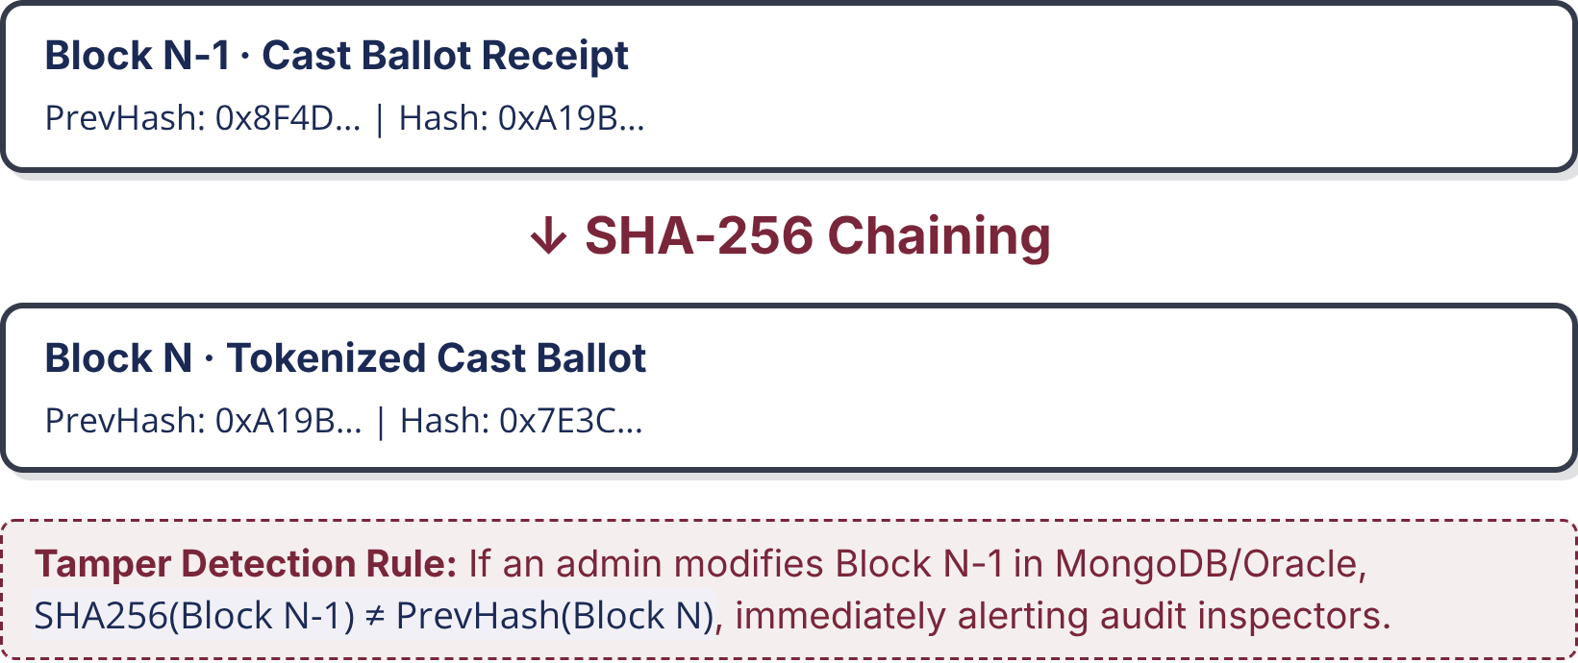
RESEARCH GAPS & TAMPER MODEL
Four gaps remain between auditability and usable digital voting
G1 · Multi-Tenant Isolation [1]
PolyVote Hash Chain & Tamper Verification
Shared schemas rely on DBMS privileges; rogue root DBAs can modify election rows undetected without cryptographic ledgers.
Each cast ballot generates an append-only JSON record linking its payload to the prior record hash.
G2 · Passive Audit Logs [2, 5]
Hash chains record history, but tamper evidence fails unless active automated verification routines routinely validate digests.
G3 · Paper-Dependent Privacy [4]
Cryptographic receipts traditionally demand specialized in-person printers, proving unusable for fully digital web voting.
G4 · Paper-Reliant IRV Auditing [6]
Risk-limiting audits assume physical ballot boxes for manual recount; purely digital IRV workflows lack native auditability.
PolyVote Design Challenge: unifies multi-tenant reuse, automated integrity checks, and tokenized voter privacy.
BACSE202 – Database Systems | Review 2 | Fall Semester 2026 · Slide 6
Notes:
These are the four gaps from the literature. The one we want you to hold on to is gap two, passive audit logs. A hash chain alone proves nothing unless something actively verifies it. That is why we built the integrity sweep, which recomputes every ballot from the database and compares it with its sealed receipt. You will see it catch tampering live in a few slides.

Slide 7
Four modules separate identity, tallying, and audit
Relational core (SQLite now, Oracle planned): Stores organizations, elections, candidates, voters and admin accounts; constraints, a trigger and views enforce integrity.
Python · tally engine: Counts rankings, eliminates the lowest candidate, redistributes ballots, and handles empty elections and exhausted ballots; last-place ties are flagged.
JSON audit ledger (MongoDB planned): Stores one hash-chained receipt per ballot, each linked to its predecessor and re-checked by the integrity sweep.
React + FastAPI · application: Voter booth, receipt check and admin console over a REST API; coordinates the anonymous dual write. Streamlit is retained.
Core entities: ORGANIZATION · ELECTION · CANDIDATE · VOTER_PARTICIPATION · BALLOT_RANKS · ADMIN_USERS (POSITION is deferred). Privacy boundary: VOTER_PARTICIPATION and BALLOT_RANKS remain separate; only an anonymous token connects voter participation to ballot content.
BACSE202 – Database Systems | Review 2 | Fall Semester 2026 · Slide 7
Notes:
The four modules are the same as planned, with the technology as it stands today. Module one is the relational core, SQLite today with Oracle planned. Module two is the Python tally engine. Module three is the ledger of hash-chained JSON receipts, with MongoDB planned. Module four is the application, now React plus FastAPI, with Streamlit retained. The core entities are now six tables, including ADMIN_USERS, and POSITION is deferred. The privacy boundary is unchanged: only an anonymous token connects a voter to a ballot.

Slide 8
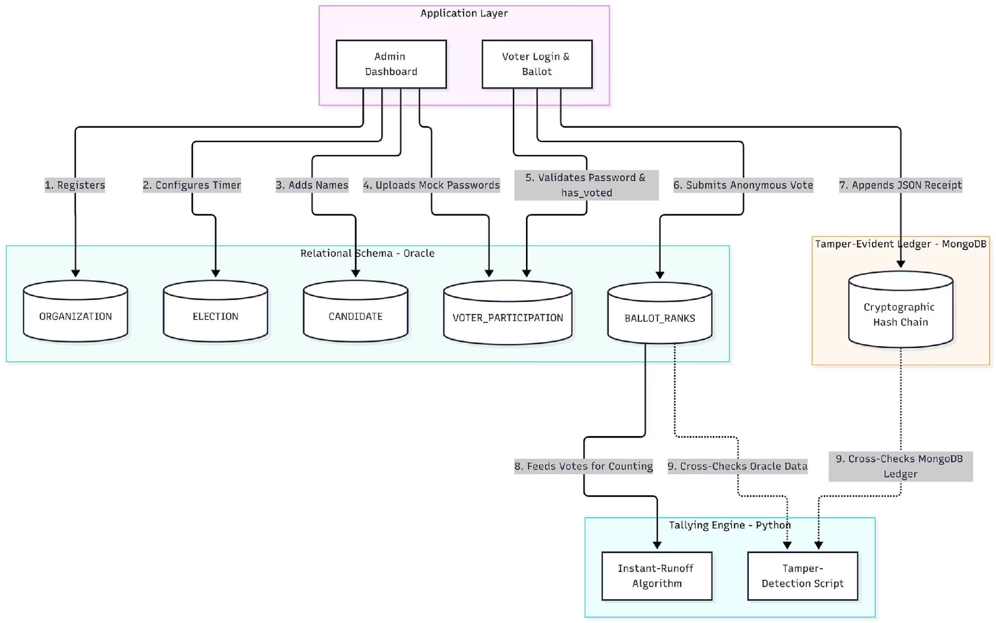

SYSTEM ARCHITECTURE
Data flows through three layers, with the ledger kept apart
Presentation layer · React + TypeScript single-page app
Voter booth
Receipt check
Admin console
DB Studio (simulated DBA)
JSON / HTTP
Application layer · FastAPI REST API auth & sessions · election lifecycle & roster · ballot cast (dual write under WRITE_LOCK) · sweep, tally, ledger & receipt endpoints
1–6 · read / write rows
12 · direct UPDATE / DELETE
7 · append SHA-256 receipt
Relational schema · SQLite · foreign keys ON · trigger · views
Tamper-evident ledger
ORGAN-
IZATION
ELECTION
CANDIDATE
VOTER_
PARTICIPATION
BALLOT_
RANKS
ADMIN_
USERS
Hash-chained JSON receipts
8 · ranks
9 · recompute hashes
10 · cross-check
verify links
Instant-runoff tally (pandas)
Integrity sweep
Chain verification
BACSE202 – Database Systems | Review 2 | Fall Semester 2026 · Slide 8
Notes:
This is the updated data flow diagram, redrawn to match what we built. At the top is the React app with the voter booth, receipt check and admin console, plus DB Studio, which simulates a rogue database administrator. Everything passes through one FastAPI layer.
Below that are two stores. Flows one to six create organizations, elections, candidates and voters, and store anonymous ranks in the relational schema. Flow seven appends the SHA-256 receipt to the separate ledger.
At the bottom is the Python engine. Eight feeds ranks to the instant-runoff tally. Nine recomputes ballot hashes, and ten cross-checks them against the ledger. The red dashed arrow, twelve, is the tampering path that DB Studio simulates and the sweep is built to expose.

Slide 9
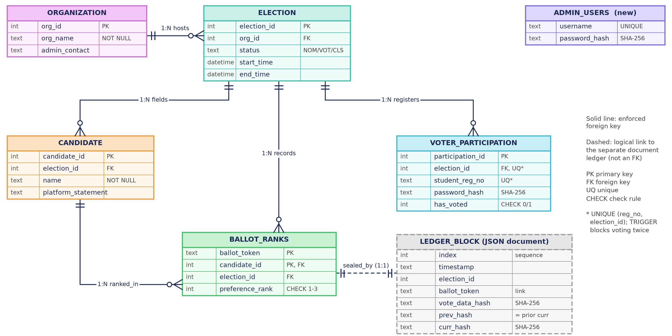
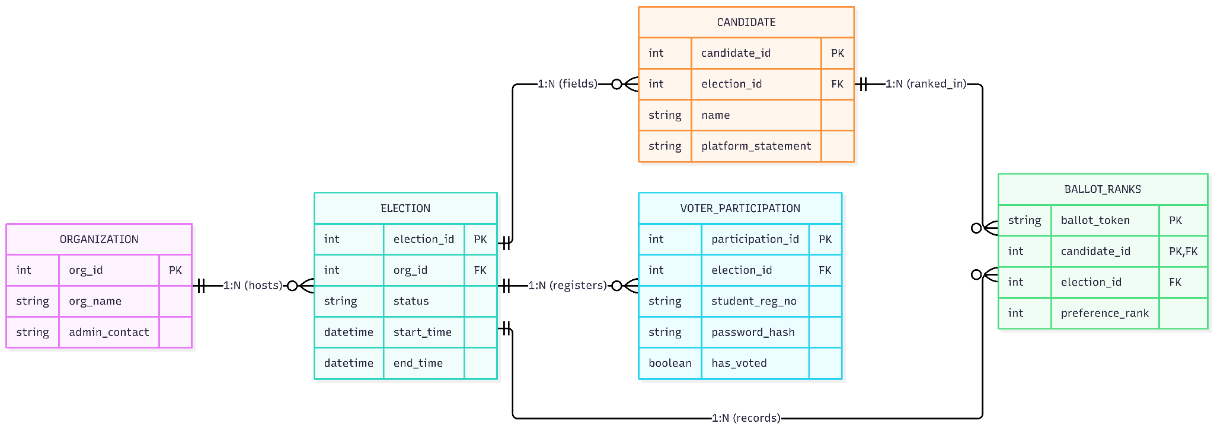
ER DIAGRAM & RELATIONAL SCHEMA
Tables and ledger are linked by token, not by identity
BACSE202 – Database Systems | Review 2 | Fall Semester 2026 · Slide 9
Notes:
This is the updated ER diagram. The five Review 1 tables are unchanged: ORGANIZATION hosts ELECTIONS, which have CANDIDATES and VOTER_PARTICIPATION, and BALLOT_RANKS ties candidates to anonymous ballot tokens. What is new is, first, ADMIN_USERS, a standalone table for officer logins with no link to ballots. Second, the constraints are now visible: the CHECK on has_voted, the one-to-three CHECK on preference_rank, and the UNIQUE rule on registration number per election. Third, the grey dashed box is the ledger block, a JSON document linked to a ballot by its token, not by a foreign key. Note there is no voter identifier anywhere in BALLOT_RANKS.

Slide 10
DATABASE INTEGRITY
The database itself refuses invalid votes
Rule | Enforced by | Response when we tried to break it
One vote per voter | TRIGGER trg_block_duplicate_vote | DBMS Trigger Violation: Voter has already submitted a ballot.
Top three ranks only | CHECK (preference_rank BETWEEN 1 AND 3) | CHECK constraint failed: preference_rank BETWEEN 1 AND 3
No candidate twice on one ballot | PRIMARY KEY (ballot_token, candidate_id) | UNIQUE constraint failed: BALLOT_RANKS.ballot_token, BALLOT_RANKS.candidate_id
Only real candidates | FOREIGN KEY → CANDIDATE | FOREIGN KEY constraint failed
Live views
VIEW_ELECTION_TURNOUT and VIEW_FIRST_PREFERENCES feed the dashboards: 45 of 60 voters, 75% turnout.
Each statement ran on the live database
and was rolled back; the messages shown are the database’s own, not the application’s.
BACSE202 – Database Systems | Review 2 | Fall Semester 2026 · Slide 10
Notes:
Now the implementation, starting at the database. The point of this slide is that the database refuses invalid votes by itself, regardless of the application.
We tried to break four rules directly in SQL. A second vote by the same voter hits our trigger and is aborted with a trigger violation. A rank of four fails the CHECK constraint. Ranking the same candidate twice fails the composite primary key. A candidate that does not exist fails the foreign key. These are the database's own messages, not ours, and each statement was rolled back afterwards.
Below, two views, turnout and first preferences, feed the dashboards. In the demo election, forty-five of sixty voters have voted, seventy-five percent turnout.

Slide 11
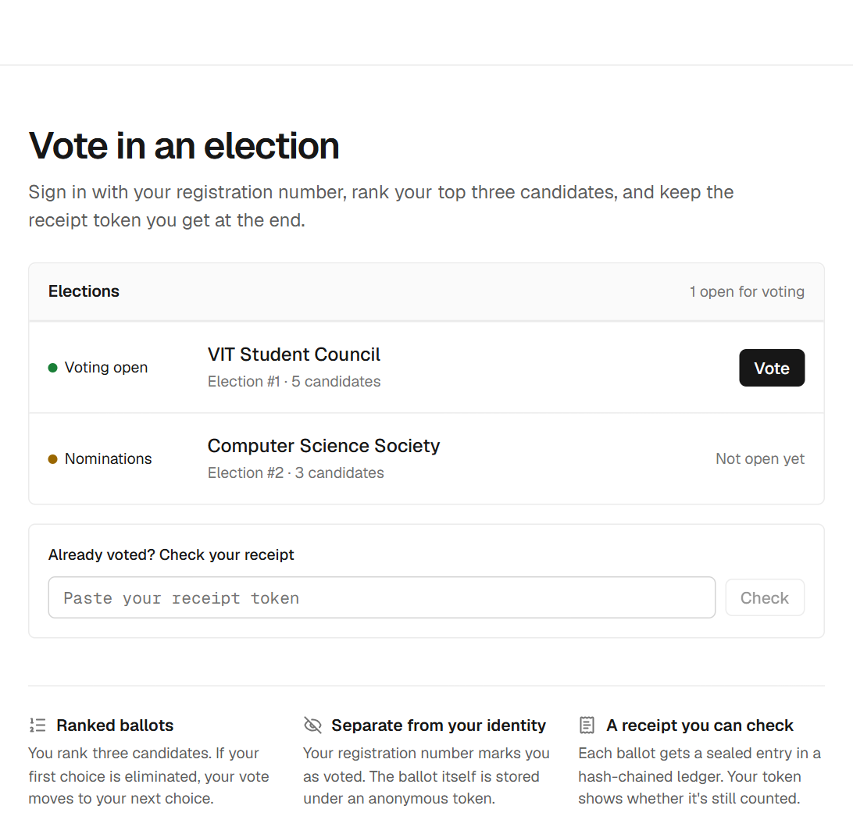
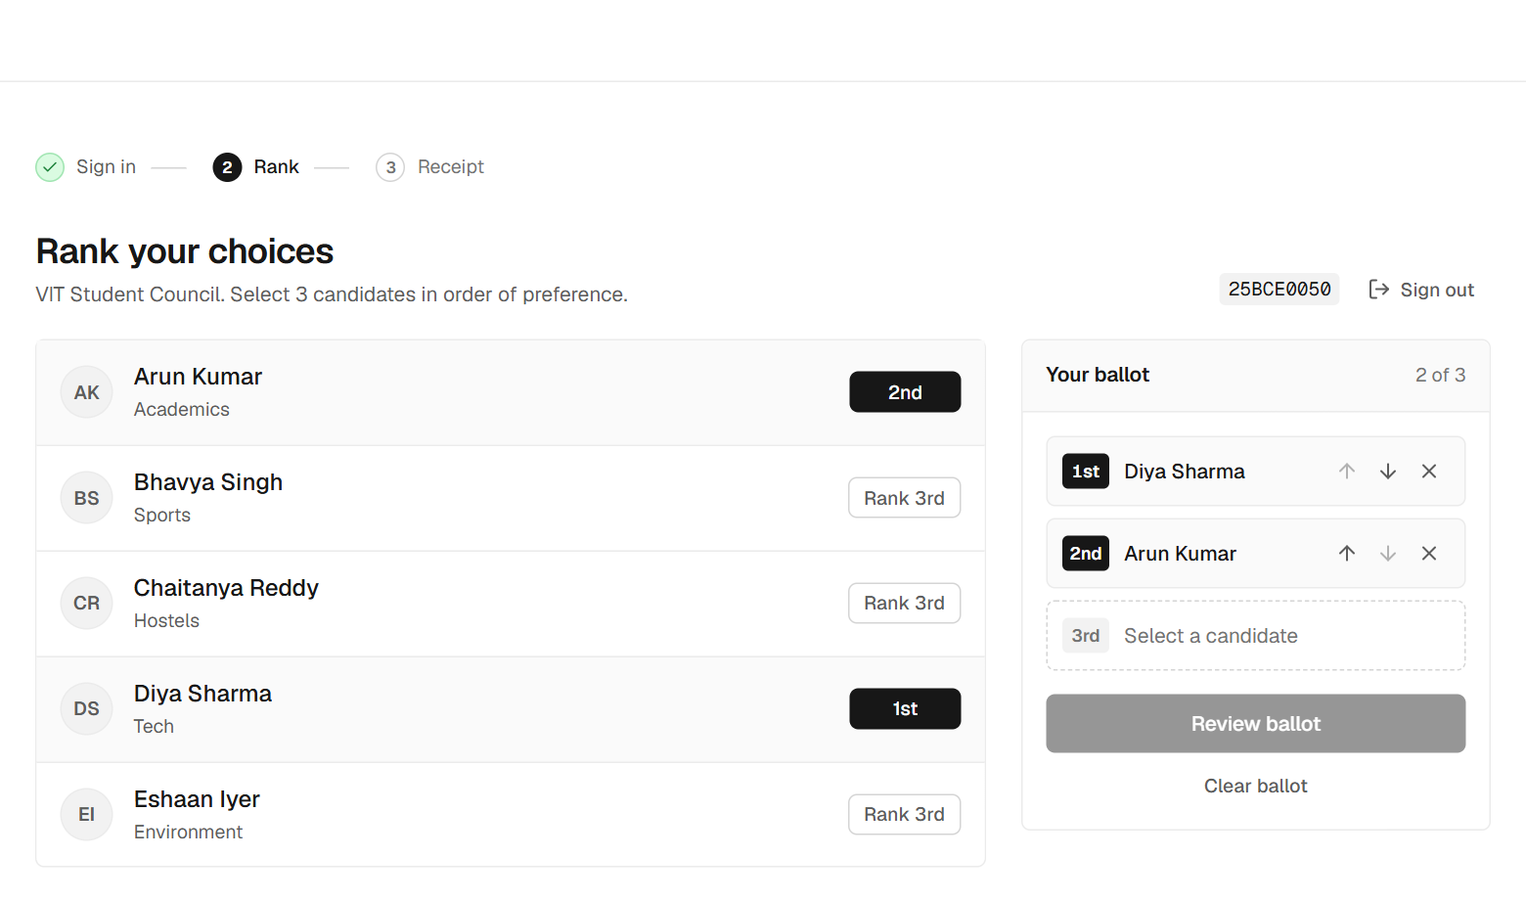
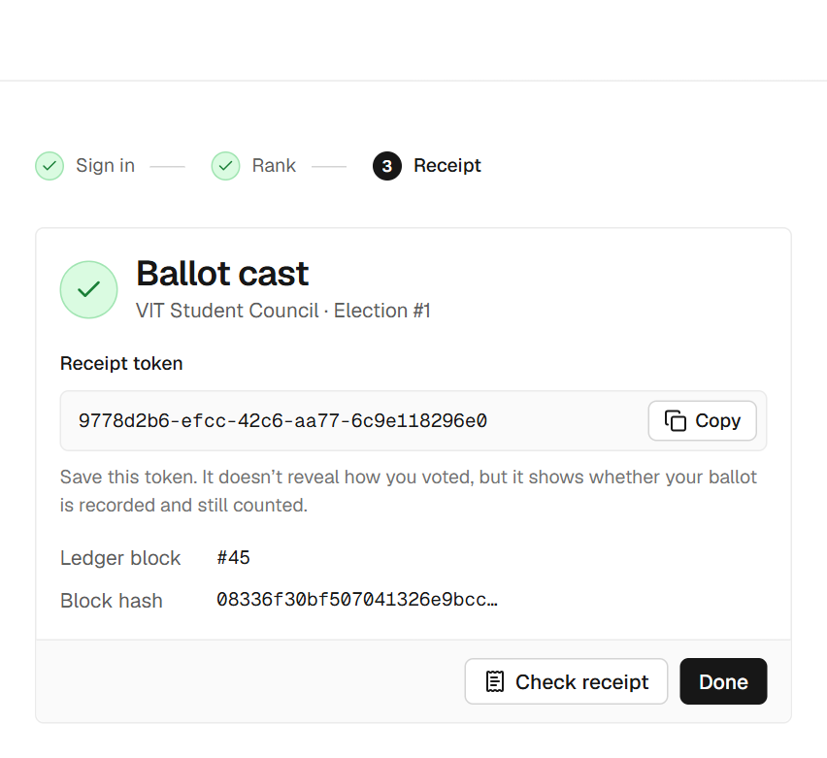
VOTER SIDE
Voting takes three steps and ends with a receipt
1 · Choose an open election
2 · Rank three candidates
3 · Keep the receipt token
Only elections in the Voting phase can be entered.
Tap in order of preference; review before casting.
It proves the ballot is sealed, not how you voted.
Guards in the flow: wrong password is rejected, a voter who already voted is refused, and the ballot cannot be changed once cast.
BACSE202 – Database Systems | Review 2 | Fall Semester 2026 · Slide 11
Notes:
This is the voter side, three steps. First, the voter picks an open election; only elections in the Voting phase can be entered. Second, the voter ranks three candidates in order of preference, with a review step before casting. Third, the voter gets a receipt token.
The guards matter. A wrong password is rejected, a voter who already voted is refused, and a ballot cannot be changed once cast. The receipt proves the ballot is sealed, not how you voted.

Slide 12
PRIVACY BY DESIGN
One vote becomes two records that cannot be joined
One database transaction
Voter signs in
registration no. + password
VOTER_PARTICIPATION
has_voted = 1 (identity side)
Receipt token
returned to the voter
privacy boundary: no voter ID is ever stored with a ballot
BALLOT_RANKS
random ballot_token + 3 ranked candidates
(ballot side)
Ledger append
SHA-256 of the ranks + prev_hash, sealed as curr_hash
Atomic
The voter flag and the ballot rows commit together, then the receipt is appended.
Serialized
A server-side write lock keeps simultaneous ballots from corrupting the ledger.
Verifiable
Voters can look their token up later without revealing their choices.
BACSE202 – Database Systems | Review 2 | Fall Semester 2026 · Slide 12
Notes:
This is the heart of the privacy design. When a voter casts a ballot, one database transaction does two things. On the identity side, it sets has_voted to one in VOTER_PARTICIPATION. On the ballot side, it stores a random ballot token with the three ranked candidates in BALLOT_RANKS. There is no voter identifier stored with the ballot, so the two records cannot be joined.
After the commit, the system appends a receipt to the ledger: a SHA-256 hash of the ranks chained to the previous block. The token goes back to the voter.
The three boxes underneath summarise why it is safe: the writes are atomic, a server-side lock serializes simultaneous ballots, and voters can verify later without revealing their choices.

Slide 13
TALLYING ENGINE
Instant-runoff counts until someone holds a majority
Chaitanya Reddy wins
23 of 45 continuing ballots (51.1%) in round 4, against 22 for Diya Sharma.
How it runs
Count each ballot’s top continuing choice.
No majority? Eliminate the last-place candidate and move those ballots to their next choice.
Edge cases: exhausted ballots, empty elections, and last-place ties are flagged in the interface.
BACSE202 – Database Systems | Review 2 | Fall Semester 2026 · Slide 13
Notes:
This is the tallying engine, instant-runoff voting, run on the demo election with forty-five ballots. Each bar is a round. In round one, nobody has a majority, and Bhavya Singh and Eshaan Iyer tie for last with eight each, so one is eliminated and those ballots move to their next choice. After round two Eshaan goes, after round three Arun goes, and in round four Chaitanya Reddy has twenty-three of forty-five continuing ballots, fifty-one percent, against twenty-two for Diya Sharma.
The engine also handles exhausted ballots and empty elections, and the interface flags a last-place tie, as in round one, because the tie-break rule is something we plan to formalise.

Slide 14
AUDIT LEDGER
Every ballot is sealed in a hash chain
Block 1
Block 2
Block 3
ballot_token
0f2da608…
ballot_token
050556d2…
ballot_token
de410a8a…
vote_data_hash
98f83226…
vote_data_hash
470ef925…
vote_data_hash
98f83226…
prev_hash
00000000…
prev_hash
5906eaba…
prev_hash
077a697b…
curr_hash
5906eaba…
curr_hash
077a697b…
curr_hash
e50bbfe1…
Block 2’s prev_hash equals block 1’s curr_hash, and so on: editing any block breaks every link after it.
Seal
vote_data_hash = SHA-256 of the ballot’s ranks; curr_hash covers the whole block.
Chain check
audit_ledger.py recomputes every hash and link: 45 of 45 blocks intact.
Ballot check
The integrity sweep recomputes each ballot from the database and compares it with its receipt.
BACSE202 – Database Systems | Review 2 | Fall Semester 2026 · Slide 14
Notes:
This is the audit ledger. Each ballot gets one block with its token, a vote hash, which is SHA-256 of the ranked choices, the previous block's hash, and the block's own hash. Look at the green values: block two's prev_hash is exactly block one's curr_hash, and block three links to block two. Change any block and every link after it breaks.
We verify at two levels. The chain check recomputes every hash and link, and all forty-five blocks are intact. The integrity sweep recomputes each ballot from the database and compares it with its receipt.

Slide 15
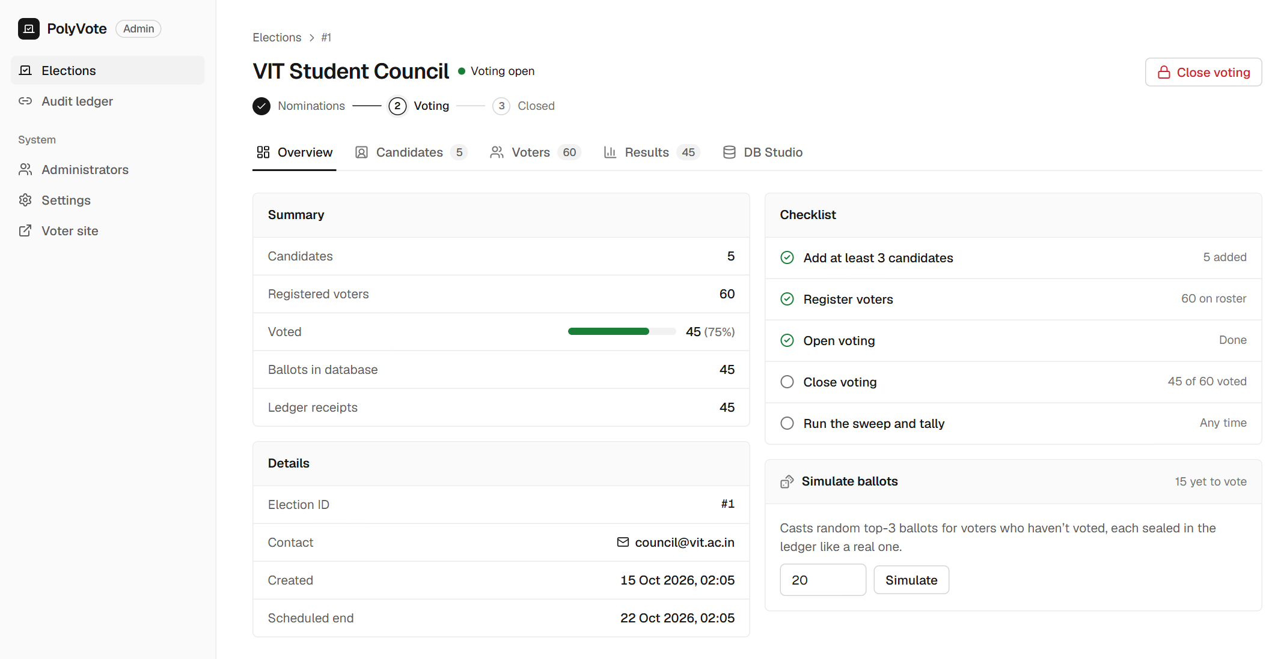
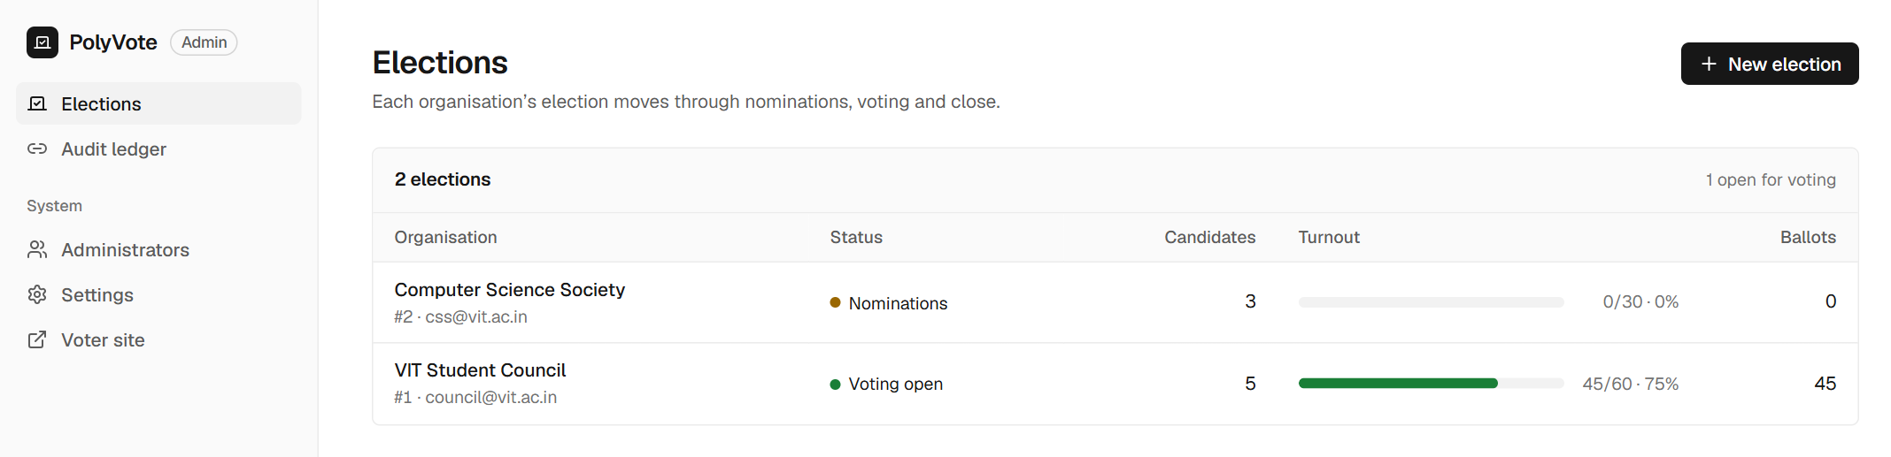
ADMINISTRATOR SIDE
Officers run each election through a guarded lifecycle
Election lifecycle
1
Nominations
Add candidates; build the roster by hand or in bulk.
2
Voting
Candidates are locked; voters cast ballots; simulation tools for testing.
3
Closed
No more votes; run the integrity sweep, then count.
Each change asks for confirmation, and a closed election cannot be reopened.
BACSE202 – Database Systems | Review 2 | Fall Semester 2026 · Slide 15
Notes:
This is the administrator side. The election list shows each organization's election, its phase and turnout. Inside an election the officer works through a guarded lifecycle. In Nominations, they add candidates and build the roster by hand or in bulk. In Voting, candidates are locked and voters cast ballots. In Closed, no more votes are accepted, and the officer runs the sweep and the count. Each transition asks for confirmation and a closed election cannot be reopened.

Slide 16
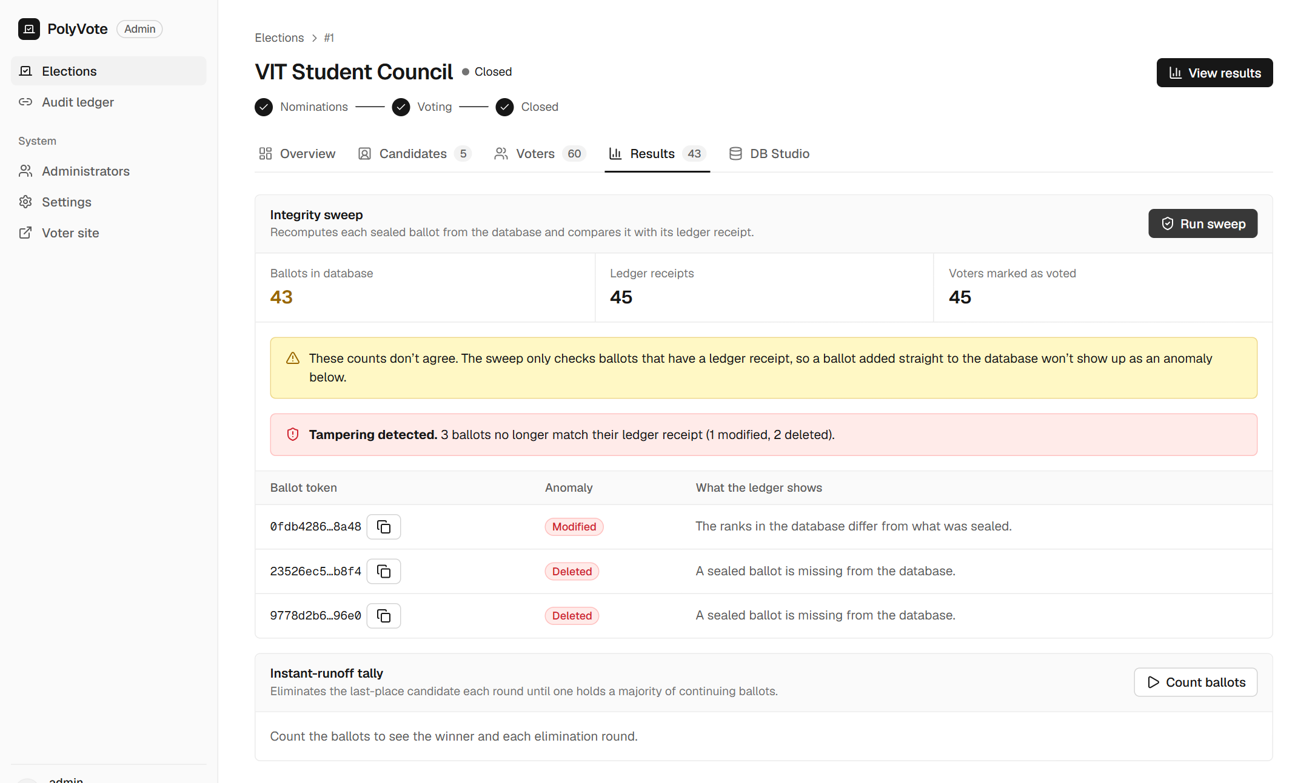
LIVE TAMPER TEST
A rogue DBA edits the database and the sweep catches it
1
Edit
In DB Studio we re-assigned one ballot’s first choice.
2
Delete
We deleted two ballot rows, including a voter’s own.
3
Sweep
Run integrity sweep: every sealed ballot is recomputed and compared.
Result: 3 of 3 flagged (1 modified, 2 deleted)
BACSE202 – Database Systems | Review 2 | Fall Semester 2026 · Slide 16
Notes:
Now the live tamper test, the main thing the ledger exists for. In DB Studio, which simulates a rogue DBA, we re-assigned one ballot's first choice and deleted two ballot rows, including a voter's own ballot. Then we ran the integrity sweep. It reported tampering detected: three ballots no longer match their receipts, one modified and two deleted, each identified by token. The counts also stop agreeing: forty-three ballots against forty-five receipts and forty-five voters marked as voted.

Slide 17
VERIFICATION
Seven checks, seven expected outcomes
Check | Expected | Observed
Same voter votes twice | Refused | You have already voted in this election.
Wrong password at sign-in | Rejected | Incorrect password.
Ledger hash chain | Intact | Chain intact across all 45 receipts
1 ballot re-ranked, 2 deleted in the database | All three flagged | 1 modified and 2 deleted detected
Voter checks a deleted ballot’s receipt | Warned | Recorded, but missing from the count
Counts after tampering | Mismatch visible | 43 ballots vs 45 receipts vs 45 voted
Ranked-choice majority | Winner holds a majority | Chaitanya Reddy: 23 of 45 (51.1%)
Outputs captured on a demo election: 60 registered voters, 45 ballots cast, five candidates.
BACSE202 – Database Systems | Review 2 | Fall Semester 2026 · Slide 17
Notes:
To summarise the evidence, here are seven checks with expected and observed results. A second vote is refused and a wrong password rejected. The hash chain is intact across all forty-five receipts. After tampering, all three altered ballots are flagged, the voter's receipt check warns that the ballot is recorded but missing from the count, and the count mismatch is visible. And the tally gives a winner with a real majority. Every observed result came from the running system.

Slide 18
IMPLEMENTATION STATUS
About 75% of the Review 1 scope is implemented
Done
Multi-tenant schema, trigger and views, instant-runoff tally, hash-chained ledger, tamper detection, voter and admin applications.
Remaining for the final review
Oracle with PL/SQL procedures and DCL
MongoDB Atlas for the ledger
Cloud deployment
POSITION entity
BACSE202 – Database Systems | Review 2 | Fall Semester 2026 · Slide 18
Notes:
Here is our honest progress against Review 1. We scored each of the fourteen promised items as done, partly done or not started. Core features come to sixty-four percent, because database commands beyond DML, stored procedures and cloud deployment are still open. The four modules come to ninety-one percent, the three deliverables to eighty percent, and overall seventy-five percent. On the right, what is done and what remains for the final review.

Slide 19
PLAN VS BUILD
Where the build differs from the Review 1 plan, and why
Area | Review 1 plan | Built for Review 2 | Why
Relational DBMS | Oracle Autonomous DB with PL/SQL | SQLite with trigger, views, constraints | Zero-setup development; schema kept portable
NoSQL ledger | MongoDB Atlas | Hash-chained JSON documents | Same document model without a hosted cluster
Frontend | Streamlit | React + FastAPI; Streamlit kept | Separate voter and admin experiences, mobile support
Schema | Five core tables | + ADMIN_USERS; POSITION deferred | Officer logins needed a table
Lifecycle | Timestamp-driven procedures | Guarded Nominations → Voting → Closed | SQLite has no stored procedures
Unchanged targets: Oracle with PL/SQL, MongoDB Atlas and cloud deployment remain the goals for the final review; the code is structured so they are a migration, not a rewrite.
BACSE202 – Database Systems | Review 2 | Fall Semester 2026 · Slide 19
Notes:
This table explains every place the build differs from the plan. Oracle became SQLite for zero-setup development, with the schema kept portable. MongoDB became hash-chained JSON documents using the same document model. Streamlit gained a React and FastAPI front end for separate voter and admin experiences. We added ADMIN_USERS and deferred POSITION. And lifecycle became guarded transitions because SQLite has no stored procedures. The targets themselves, Oracle with PL/SQL, MongoDB Atlas and cloud, are unchanged, and the code is structured so they are migrations, not rewrites.

Slide 20
ROADMAP & DELIVERABLES
Three reviews move from design to a finished system
REVIEW 1 · DONE
REVIEW 2 · NOW
FINAL REVIEW
Presented the design, schema, security approach, and planned system architecture.
Working implementation, about 75% of the planned scope, with live outputs and a tamper demonstration.
Oracle + PL/SQL, MongoDB Atlas, cloud deployment, POSITION entity, then comparison with existing e-voting systems.
Remaining · Application: host the platform live in the cloud
Database: PL/SQL procedures, DCL roles, Oracle and MongoDB scripts
Verification: detect ballots injected without a receipt
BACSE202 – Database Systems | Review 2 | Fall Semester 2026 · Slide 20
Notes:
Looking ahead. Review 1 presented the design. Review 2, today, is the working implementation at about seventy-five percent with live outputs and a tamper demonstration. For the final review we will move to Oracle with PL/SQL procedures and DCL roles, move the ledger to MongoDB Atlas, deploy to the cloud, add the POSITION entity, and compare PolyVote with existing e-voting systems. We also plan to add detection of ballots injected without a receipt.

Slide 21
PROJECT CONCLUSION · REVIEW 2
Thank You
Questions and discussion
Source code and documents
github.com/Tharakeshtj/polyvote-election-platform
Run it: python -m uvicorn server:app --port 8000
BACSE202 – Database Systems | Review 2 | Fall Semester 2026 · Slide 21
Notes:
Thank you. The code and documents are on GitHub, and the application runs with one command. We are happy to take questions on the schema, the privacy model, the ledger, or the tamper test, and we can run any of them live.

