Slide 1

BACSE202 · Fall Semester 2026
PolyVote
A Multi-Tenant, Ranked-Choice Election Platform with a Tamper-Evident Audit Trail
Reviews 2 and 3 · Final Project Review · Guide: Dr. Katari Balakrishna
S.No | Name | Register No
1 | Tharakesharasu Thennarasu | 25BCE2699
2 | Pawan Durga Karthik | 25BCE2712
3 | Shivam Malge | 25BCE0386
BACSE202 – Database Systems | Review 3 | Fall Semester 2026 · Slide 1
Notes:
Good morning, sir, and everyone. This deck has two parts: slides 2 to 20 are the Review 2 presentation, and from slide 21 we continue with Review 3. This is Review 3, the final review of PolyVote, our ranked-choice election platform with a tamper-evident audit trail. Review 1 presented the design and Review 2 showed the working system. Today we show the completed system: a MongoDB Atlas ledger, a keyed hash chain, a second authentication factor using emailed one-time codes, public hosting, and an evaluation that tests our claims instead of asserting them. We will also show a short live demonstration of the version with email verification switched on.

Slide 2
WHERE WE STAND · FINAL REVIEW
Reviews 1 and 2 are done; this is Review 3
DONE
DONE
NOW
Review 1
Review 2
Review 3 · final review
Design, relational schema and ER diagram, security approach, literature review, and a planned architecture on Oracle, MongoDB and Streamlit.
A working system: React voter booth and admin console, FastAPI service, SQLite schema with trigger and views, instant-runoff tally, hash-chained receipts and a live tamper test.
MongoDB Atlas ledger, emailed one-time code and QR voting, public hosting, a 47-scenario evaluation and a comparison with existing systems.
Done
We did not use Oracle: SQLite stood in for it throughout (see the conclusion slides).
Reviews 1 and 2
BACSE202 – Database Systems | Review 3 | Fall Semester 2026 · Slide 2
Notes:
A short recap of where we stand. Review 1 is done: we presented the design, the relational schema and ER diagram, the security approach, the literature review and a planned architecture on Oracle, MongoDB and Streamlit. Review 2 is done: a working system with a React voter booth and admin console, a FastAPI service, a SQLite schema with trigger and views, the instant-runoff tally, hash-chained receipts and a live tamper test. Review 3, this one, is the final review: the MongoDB Atlas ledger, the emailed one-time code with QR voting, public hosting, a 47-scenario evaluation and a comparison with existing systems. One thing to flag early: we did not use Oracle. SQLite stood in for it throughout, and the conclusion slides at the end explain why and how Oracle would fit.

Slide 3
SYSTEM RATIONALE
PolyVote tackles three weaknesses in digital elections
PROBLEM
SOLUTION
OUTCOME
Plurality & Insider Risk
Ranked Choice & Hash Chain
Reusable Web Service
Plurality records one choice and can split support across three or more candidates, producing a winner without majority backing. Single-election systems are hard to reuse across organizations, and an administrator with UPDATE access can silently alter results.
A reusable, multi-organization web service (with a public HTTPS link and QR phone voting), designed for a continuing-ballot majority winner, detectable record changes, and a secret ballot.
Let voters rank candidates, then use Instant-Runoff Voting (IRV). Host organizations in one tenant-scoped schema; separate voter identity from ballot content; link audit records in a hash chain.
BACSE202 – Database Systems | Review 3 | Fall Semester 2026 · Slide 3
Notes:
Quick reminder of why we built this. Plurality voting can crown a winner without majority support, single-election systems are hard to reuse, and an administrator with UPDATE access can silently change results. Our answer is ranked-choice voting, one shared multi-tenant schema, voter identity separated from ballot content, and a hash chain over the audit records. The outcome is a reusable web service with a public link and QR phone voting.

Slide 4
CORE ARCHITECTURE
Six database techniques make the platform work
1
2
3
Multi-Tenant Schema
Instant-Runoff Tally
Keyed Hash Chaining
One shared relational schema isolates tenant institutions through foreign-key predicates and row-level policies.
Tallies first choices, eliminates lowest candidates iteratively, and redistributes votes until reaching a true majority.
Every vote event references its prior block digest and is sealed with an HMAC key, so retro-edits fail verification.
4
5
6
Polyglot Persistence
Integrity
Public Hosting
A relational store (SQLite) keeps structured entities; the audit ledger lives in MongoDB Atlas, with a local-file fallback.
UNIQUE and CHECK constraints plus a trigger block duplicate participation independently of application logic, backed by a six-rule integrity sweep.
Runs as one web service (API and UI) behind a public HTTPS link, with QR phone voting and a free-tier hosted demo configured.
BACSE202 – Database Systems | Review 3 | Fall Semester 2026 · Slide 4
Notes:
These are the six techniques from Review 1. Techniques one, two and three, multi-tenancy, instant-runoff and hash chaining, work as designed, and the chain is now sealed with an HMAC key. Four, polyglot persistence, uses a relational SQLite store plus the audit ledger in MongoDB Atlas, with a local-file fallback. Five, integrity, is enforced by constraints and a trigger and backed by a six-rule integrity sweep. Six, the service runs as one web service behind a public HTTPS link with QR phone voting.

Slide 5
THEORETICAL FOUNDATION
Six studies frame PolyVote’s design choices
Ref | Author / Year | Theme | Technique | Tools / Data | Key Finding | Limitation
[1] | Aulbach et al. (2008) | Multi-tenant Data | Schema Mapping | Relational DBs | Shared schema minimizes SaaS operational costs | DB privileges cannot block insider table edits
[2] | Haber & Stornetta (1991) | Audit Trails | Hash Chaining | Timestamps, SHA | Chained block digests establish tamper evidence | Requires external verification monitor
[3] | Sadalage & Fowler (2012) | Polyglot Data | Hybrid SQL/NoSQL | Dual DB Engines | Specialized engines optimize discrete access patterns | Cross-database distributed consistency overhead
[4] | Chaum (2004) | Voter Privacy | Pseudonym Receipts | Crypto Receipts | Decouples eligibility registry from cast ballots | Relies on physical printer hardware verification
[5] | Crosby & Wallach (2009) | Authenticated Logs | Merkle History Trees | Tree-based Hashes | Enables lightweight, verifiable history membership | Tree generation adds computational latency
[6] | Blom et al. (2019) | IRV Auditing | Risk-Limiting Audit | Cast Vote Records | Mathematical audit proofs across elimination rounds | Assumes physical paper ballots for recount
BACSE202 – Database Systems | Review 3 | Fall Semester 2026 · Slide 5
Notes:
This is the literature table from Review 1, unchanged. Aulbach for multi-tenant schemas, Haber and Stornetta for hash chains, Sadalage and Fowler for polyglot persistence, Chaum for receipts that keep the ballot secret, Crosby and Wallach for tamper-evident logs, and Blom for auditing ranked-choice elections. We treat these as the foundation, and the next slide shows how our implementation closes the gaps they leave.

Slide 6
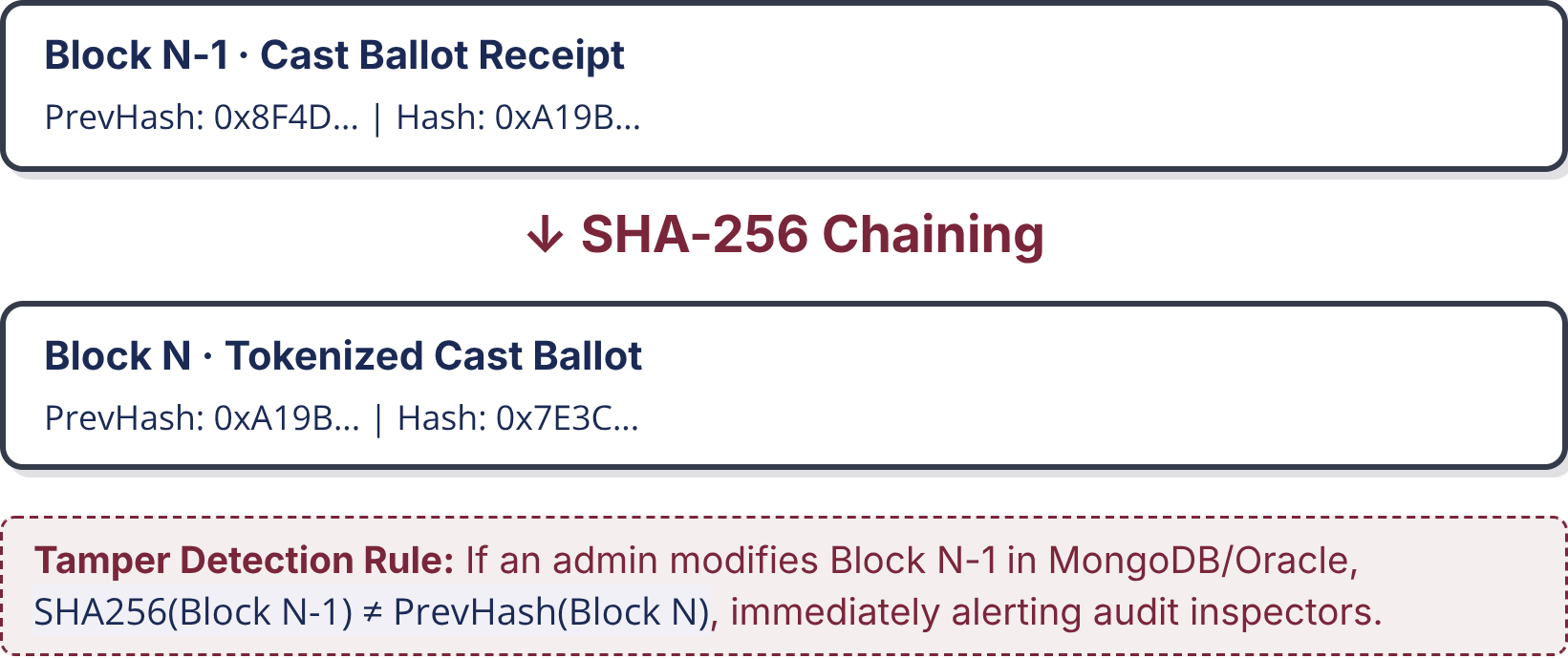
RESEARCH GAPS & TAMPER MODEL
Four gaps remain between auditability and usable digital voting
G1 · Multi-Tenant Isolation [1]
PolyVote Hash Chain & Tamper Verification
Shared schemas rely on DBMS privileges; rogue root DBAs can modify election rows undetected without cryptographic ledgers.
Each cast ballot generates an append-only JSON record linking its payload to the prior record hash.
G2 · Passive Audit Logs [2, 5]
Hash chains record history, but tamper evidence fails unless active automated verification routines routinely validate digests.
G3 · Paper-Dependent Privacy [4]
Cryptographic receipts traditionally demand specialized in-person printers, proving unusable for fully digital web voting.
G4 · Paper-Reliant IRV Auditing [6]
Risk-limiting audits assume physical ballot boxes for manual recount; purely digital IRV workflows lack native auditability.
PolyVote Design Challenge: unifies multi-tenant reuse, automated integrity checks, and tokenized voter privacy.
BACSE202 – Database Systems | Review 3 | Fall Semester 2026 · Slide 6
Notes:
These are the four gaps from the literature. The one we want you to hold on to is gap two, passive audit logs. A hash chain alone proves nothing unless something actively verifies it. That is why we built the integrity sweep, which recomputes every ballot from the database and compares it with its sealed receipt. You will see it catch tampering live in a few slides.

Slide 7
Four modules separate identity, tallying, and audit
Relational core (SQLite): Stores organizations, elections, candidates, voters and admin accounts; constraints, a trigger and views enforce integrity.
Python · tally engine: Counts rankings, eliminates the lowest candidate, redistributes ballots, and handles empty elections and exhausted ballots; last-place ties are flagged.
Audit ledger (MongoDB Atlas): Stores one HMAC-sealed receipt per ballot in MongoDB Atlas (local file as fallback), each linked to its predecessor and re-checked by the integrity sweep.
React + FastAPI · application: Voter booth, receipt check and admin console over a REST API; coordinates the anonymous dual write. Emailed one-time codes confirm the voter; Streamlit is retained.
Core entities: ORGANIZATION · ELECTION · CANDIDATE · VOTER_PARTICIPATION · BALLOT_RANKS · ADMIN_USERS (POSITION not built). Privacy boundary: VOTER_PARTICIPATION and BALLOT_RANKS remain separate; only an anonymous token connects voter participation to ballot content.
BACSE202 – Database Systems | Review 3 | Fall Semester 2026 · Slide 7
Notes:
The four modules are the same as planned, with the technology as it stands. Module one is the relational core, SQLite. Module two is the Python tally engine. Module three is the ledger of HMAC-sealed receipts in MongoDB Atlas. Module four is the application, React plus FastAPI, with an emailed one-time code that confirms the voter and Streamlit retained. The core entities are six tables, including ADMIN_USERS, and POSITION is not implemented. The privacy boundary holds: only an anonymous token connects a voter to a ballot.

Slide 8
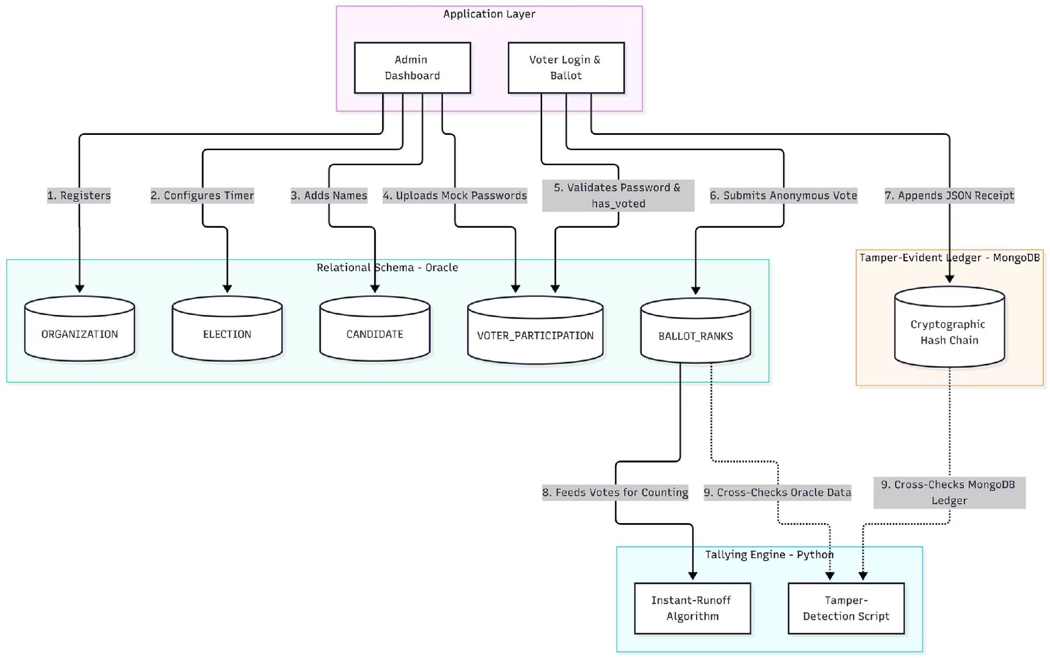

SYSTEM ARCHITECTURE
Data flows through three layers, with the ledger kept apart
Presentation layer · React + TypeScript single-page app
Voter booth
Receipt check
Admin console
DB Studio (simulated DBA)
JSON / HTTP
Application layer · FastAPI REST API auth & sessions · election lifecycle & roster · ballot cast (dual write under WRITE_LOCK) · sweep, tally, ledger & receipt endpoints
1–6 · read / write rows
12 · direct UPDATE / DELETE
7 · append SHA-256 receipt
Relational schema · SQLite · foreign keys ON · trigger · views
Tamper-evident ledger
ORGAN-
IZATION
ELECTION
CANDIDATE
VOTER_
PARTICIPATION
BALLOT_
RANKS
ADMIN_
USERS
Keyed receipts · MongoDB Atlas
8 · ranks
9 · recompute hashes
10 · cross-check
verify links
Instant-runoff tally (pandas)
Integrity sweep
Chain verification
BACSE202 – Database Systems | Review 3 | Fall Semester 2026 · Slide 8
Notes:
This is the updated data flow diagram, redrawn to match what we built. At the top is the React app with the voter booth, receipt check and admin console, plus DB Studio, which simulates a rogue database administrator. Everything passes through one FastAPI layer.
Below that are two stores. Flows one to six create organizations, elections, candidates and voters, and store anonymous ranks in the relational schema. Flow seven appends the HMAC-sealed receipt to the separate ledger in MongoDB Atlas.
At the bottom is the Python engine. Eight feeds ranks to the instant-runoff tally. Nine recomputes ballot hashes, and ten cross-checks them against the ledger. The red dashed arrow, twelve, is the tampering path that DB Studio simulates and the sweep is built to expose.

Slide 9
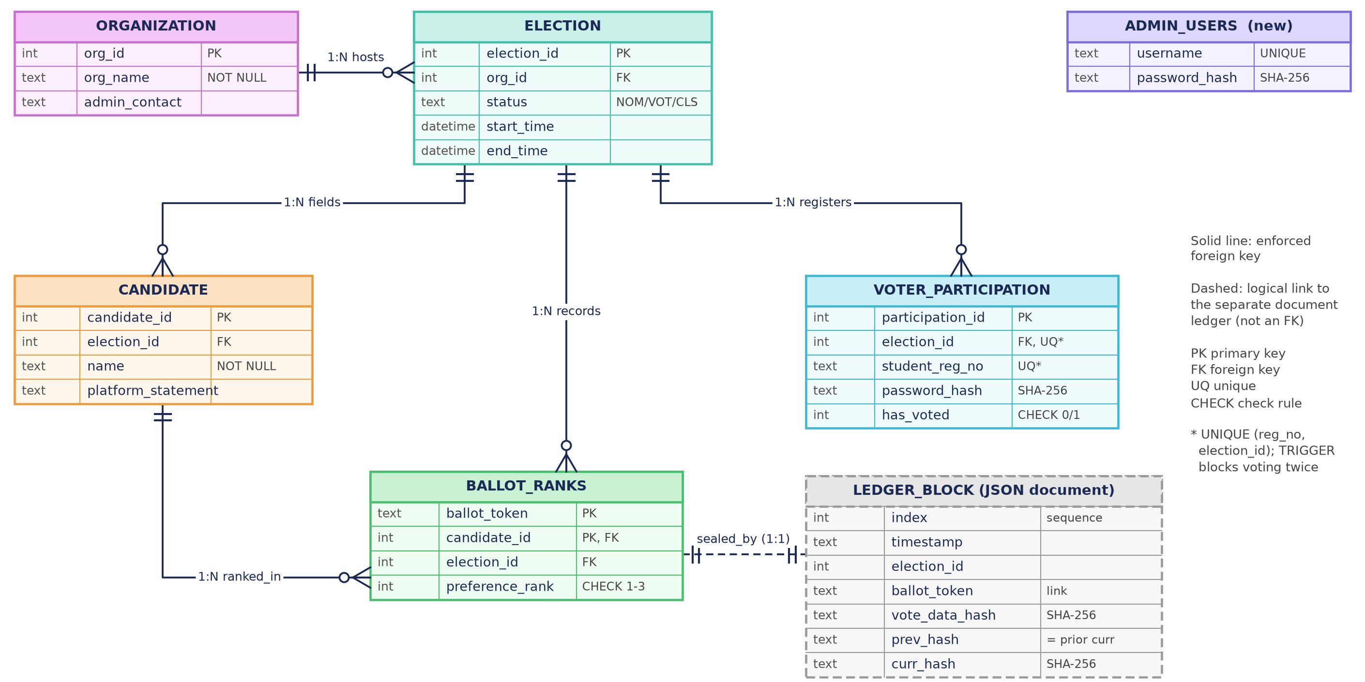
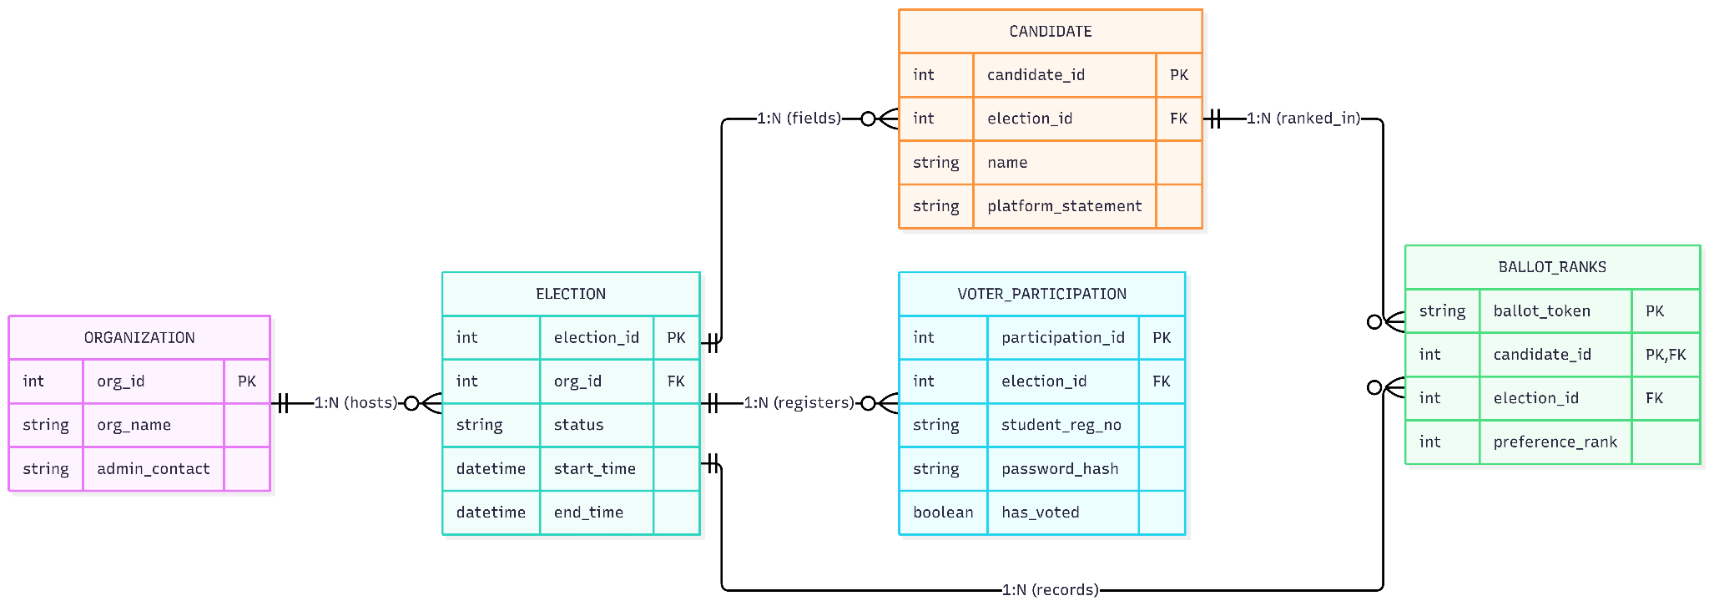
ER DIAGRAM & RELATIONAL SCHEMA
Tables and ledger are linked by token, not by identity
BACSE202 – Database Systems | Review 3 | Fall Semester 2026 · Slide 9
Notes:
This is the updated ER diagram. The five Review 1 tables are unchanged: ORGANIZATION hosts ELECTIONS, which have CANDIDATES and VOTER_PARTICIPATION, and BALLOT_RANKS ties candidates to anonymous ballot tokens. What is new is, first, ADMIN_USERS, a standalone table for officer logins with no link to ballots. Second, the constraints are now visible: the CHECK on has_voted, the one-to-three CHECK on preference_rank, and the UNIQUE rule on registration number per election. Third, the grey dashed box is the ledger block, a JSON document linked to a ballot by its token, not by a foreign key. Note there is no voter identifier anywhere in BALLOT_RANKS.

Slide 10
DATABASE INTEGRITY
The database itself refuses invalid votes
Rule | Enforced by | Response when we tried to break it
One vote per voter | TRIGGER trg_block_duplicate_vote | DBMS Trigger Violation: Voter has already submitted a ballot.
Top three ranks only | CHECK (preference_rank BETWEEN 1 AND 3) | CHECK constraint failed: preference_rank BETWEEN 1 AND 3
No candidate twice on one ballot | PRIMARY KEY (ballot_token, candidate_id) | UNIQUE constraint failed: BALLOT_RANKS.ballot_token, BALLOT_RANKS.candidate_id
Only real candidates | FOREIGN KEY → CANDIDATE | FOREIGN KEY constraint failed
Live views
VIEW_ELECTION_TURNOUT and VIEW_FIRST_PREFERENCES feed the dashboards: 45 of 60 voters, 75% turnout.
Each statement ran on the live database
and was rolled back; the messages shown are the database’s own, not the application’s.
BACSE202 – Database Systems | Review 3 | Fall Semester 2026 · Slide 10
Notes:
Now the implementation, starting at the database. The point of this slide is that the database refuses invalid votes by itself, regardless of the application.
We tried to break four rules directly in SQL. A second vote by the same voter hits our trigger and is aborted with a trigger violation. A rank of four fails the CHECK constraint. Ranking the same candidate twice fails the composite primary key. A candidate that does not exist fails the foreign key. These are the database's own messages, not ours, and each statement was rolled back afterwards.
Below, two views, turnout and first preferences, feed the dashboards. In the demo election, forty-five of sixty voters have voted, seventy-five percent turnout.

Slide 11
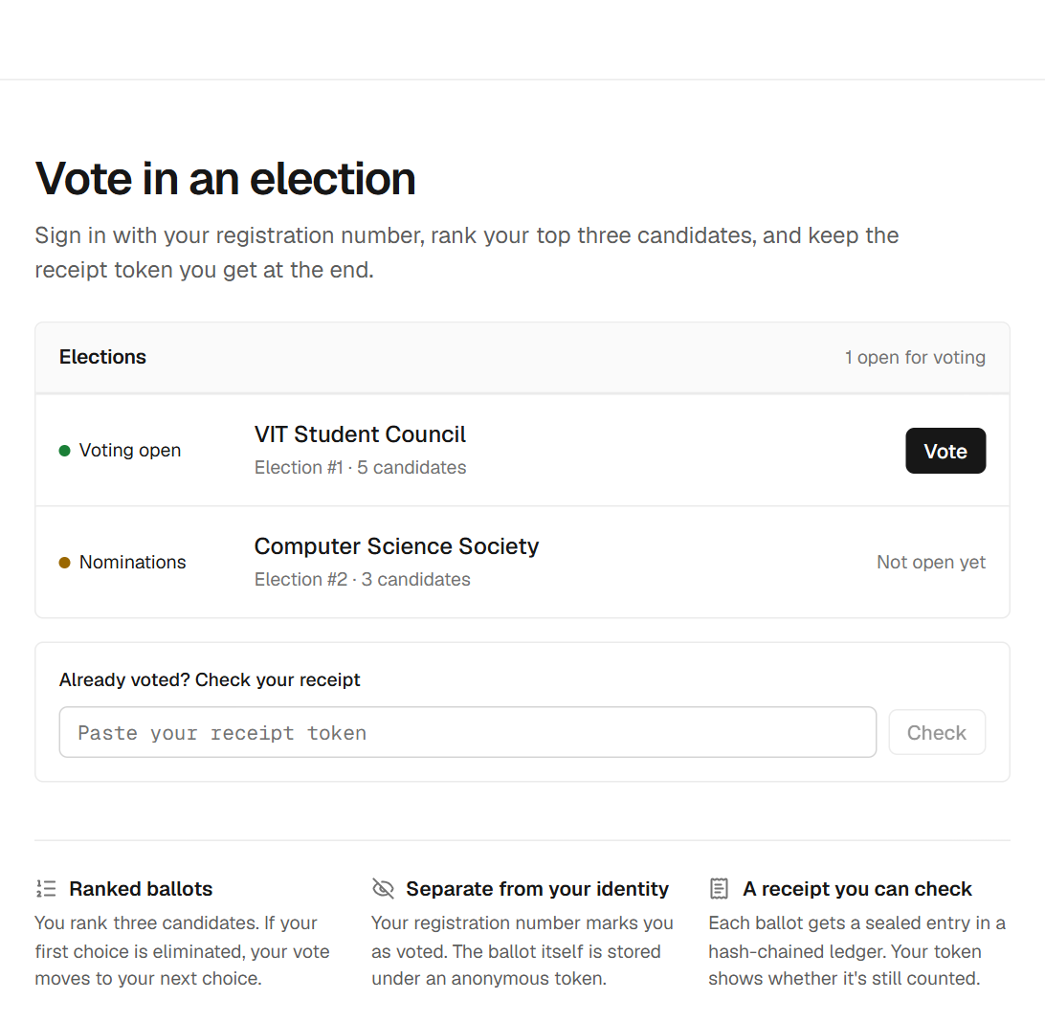
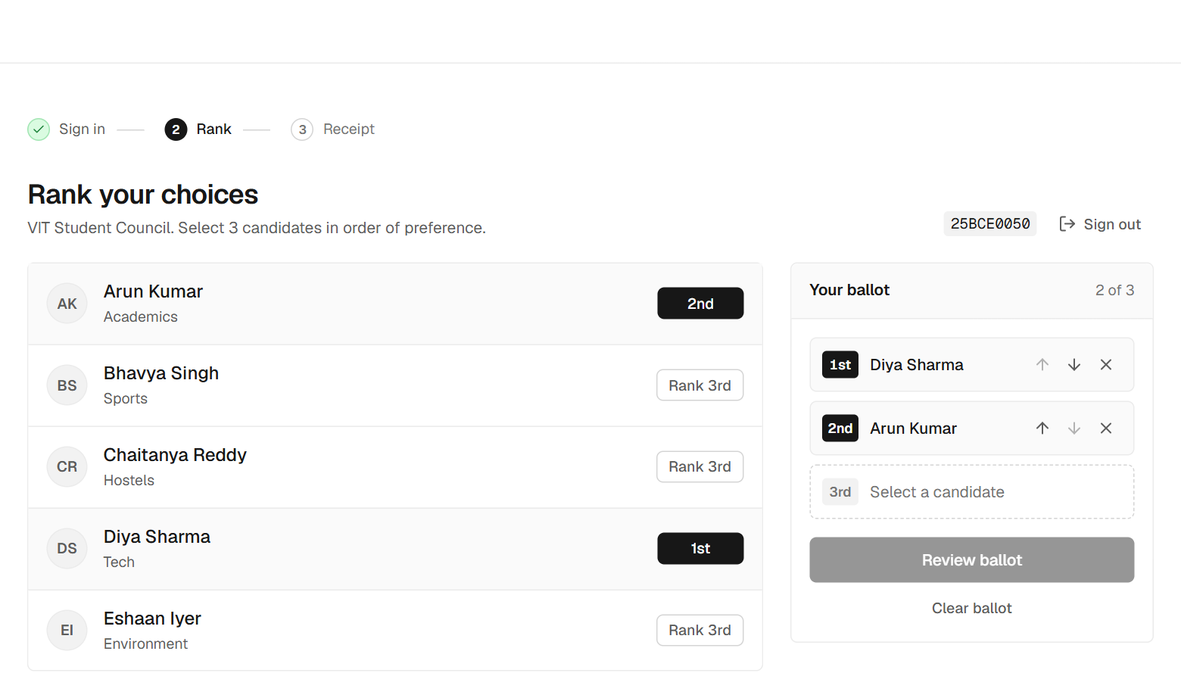
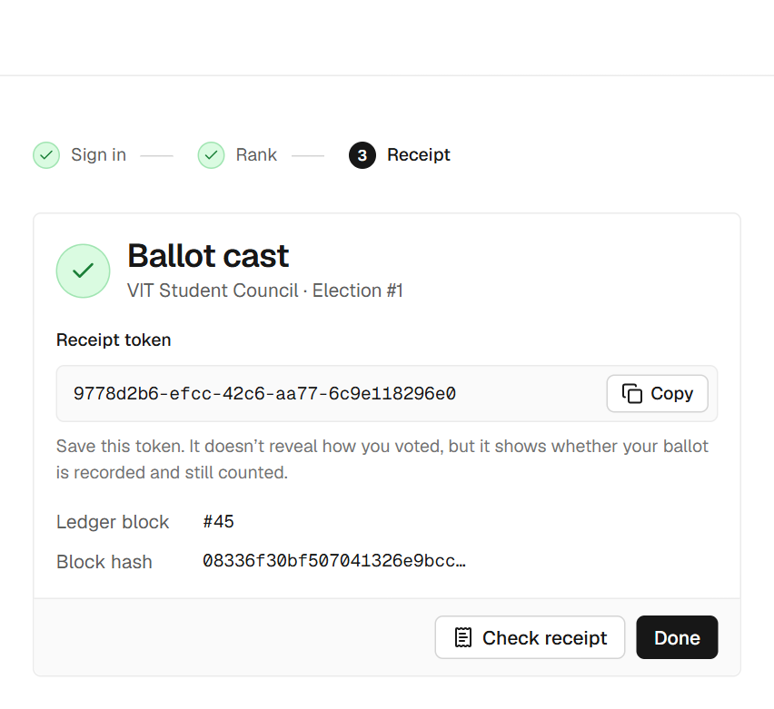
VOTER SIDE
Voting takes three steps and ends with a receipt
1 · Choose an open election
2 · Rank three candidates
3 · Keep the receipt token
Only open elections; sign in with a password and an emailed code.
Tap in order of preference; review before casting.
It proves the ballot is sealed, not how you voted.
Guards in the flow: a wrong password is rejected, the emailed code is required, a voter who already voted is refused, and a cast ballot cannot be changed.
BACSE202 – Database Systems | Review 3 | Fall Semester 2026 · Slide 11
Notes:
This is the voter side, three steps. First, the voter picks an open election; only elections in the Voting phase can be entered. The voter signs in with a password and then types the code emailed to them. Second, the voter ranks three candidates in order of preference, with a review step before casting. Third, the voter gets a receipt token.
The guards matter. A wrong password is rejected, the emailed code is required, a voter who already voted is refused, and a ballot cannot be changed once cast. The receipt proves the ballot is sealed, not how you voted.

Slide 12
PRIVACY BY DESIGN
One vote becomes two records that cannot be joined
One database transaction
Voter signs in
registration no. + password
VOTER_PARTICIPATION
has_voted = 1 (identity side)
Receipt token
returned to the voter
privacy boundary: no voter ID is ever stored with a ballot
BALLOT_RANKS
random ballot_token + 3 ranked candidates
(ballot side)
Ledger append
SHA-256 of the ranks + prev_hash, sealed as curr_hash with an HMAC key
Atomic
The voter flag and the ballot rows commit together, then the receipt is appended.
Serialized
A server-side write lock keeps simultaneous ballots from corrupting the ledger.
Verifiable
Voters can look their token up later without revealing their choices.
BACSE202 – Database Systems | Review 3 | Fall Semester 2026 · Slide 12
Notes:
This is the heart of the privacy design. When a voter casts a ballot, one database transaction does two things. On the identity side, it sets has_voted to one in VOTER_PARTICIPATION. On the ballot side, it stores a random ballot token with the three ranked candidates in BALLOT_RANKS. There is no voter identifier stored with the ballot, so the two records cannot be joined.
After the commit, the system appends a receipt to the ledger: a SHA-256 hash of the ranks chained to the previous block and sealed with an HMAC key. The token goes back to the voter.
The three boxes underneath summarise why it is safe: the writes are atomic, a server-side lock serializes simultaneous ballots, and voters can verify later without revealing their choices.

Slide 13
TALLYING ENGINE
Instant-runoff counts until someone holds a majority
Chaitanya Reddy wins
23 of 45 continuing ballots (51.1%) in round 4, against 22 for Diya Sharma.
How it runs
Count each ballot’s top continuing choice.
No majority? Eliminate the last-place candidate and move those ballots to their next choice.
Edge cases: exhausted ballots, empty elections, and last-place ties are flagged in the interface.
BACSE202 – Database Systems | Review 3 | Fall Semester 2026 · Slide 13
Notes:
This is the tallying engine, instant-runoff voting, run on the demo election with forty-five ballots. Each bar is a round. In round one, nobody has a majority, and Bhavya Singh and Eshaan Iyer tie for last with eight each, so one is eliminated and those ballots move to their next choice. After round two Eshaan goes, after round three Arun goes, and in round four Chaitanya Reddy has twenty-three of forty-five continuing ballots, fifty-one percent, against twenty-two for Diya Sharma.
The engine also handles exhausted ballots and empty elections, and the interface flags a last-place tie, as in round one, because a published tie-break rule is future work.

Slide 14
AUDIT LEDGER
Every ballot is sealed in a hash chain
Block 1
Block 2
Block 3
ballot_token
0f2da608…
ballot_token
050556d2…
ballot_token
de410a8a…
vote_data_hash
98f83226…
vote_data_hash
470ef925…
vote_data_hash
98f83226…
prev_hash
00000000…
prev_hash
5906eaba…
prev_hash
077a697b…
curr_hash
5906eaba…
curr_hash
077a697b…
curr_hash
e50bbfe1…
Block 2’s prev_hash equals block 1’s curr_hash, and so on: editing any block breaks every link after it.
Seal
vote_data_hash = SHA-256 of the ballot’s ranks; curr_hash covers the whole block and is sealed with an HMAC key.
Chain check
audit_ledger.py recomputes every hash and link: 45 of 45 blocks intact.
Ballot check
The integrity sweep recomputes each ballot from the database and compares it with its receipt.
BACSE202 – Database Systems | Review 3 | Fall Semester 2026 · Slide 14
Notes:
This is the audit ledger. Each ballot gets one block with its token, a vote hash, which is SHA-256 of the ranked choices, the previous block's hash, and the block's own hash. Look at the green values: block two's prev_hash is exactly block one's curr_hash, and block three links to block two. Change any block and every link after it breaks.
We verify at two levels. The chain check recomputes every hash and link, and all forty-five blocks are intact. The integrity sweep recomputes each ballot from the database and compares it with its receipt. The blocks are sealed with an HMAC key, so rebuilding the chain needs the key.

Slide 15
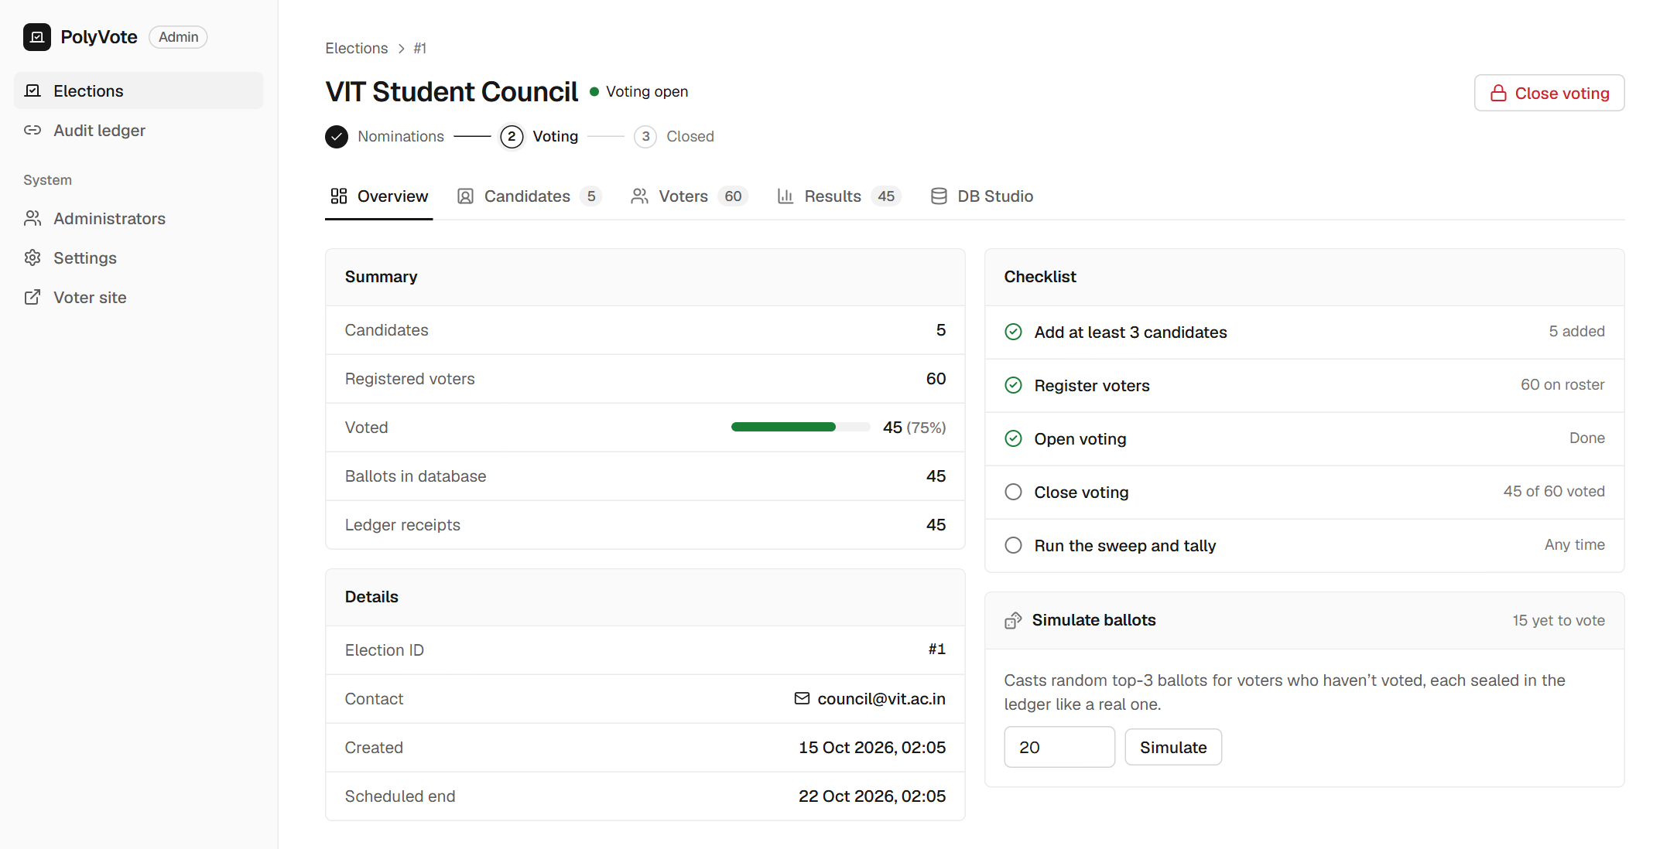
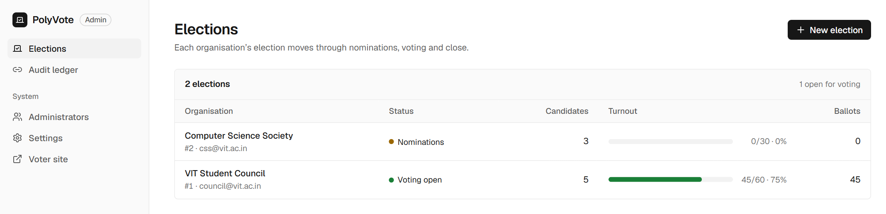
ADMINISTRATOR SIDE
Officers run each election through a guarded lifecycle
Election lifecycle
1
Nominations
Add candidates; build the roster by hand or in bulk.
2
Voting
Candidates are locked; voters cast ballots; simulation tools for testing.
3
Closed
No more votes; run the integrity sweep, then count.
Each change asks for confirmation, and a closed election cannot be reopened.
BACSE202 – Database Systems | Review 3 | Fall Semester 2026 · Slide 15
Notes:
This is the administrator side. The election list shows each organization's election, its phase and turnout. Inside an election the officer works through a guarded lifecycle. In Nominations, they add candidates and build the roster by hand or in bulk. In Voting, candidates are locked and voters cast ballots. In Closed, no more votes are accepted, and the officer runs the sweep and the count. Each transition asks for confirmation and a closed election cannot be reopened.

Slide 16
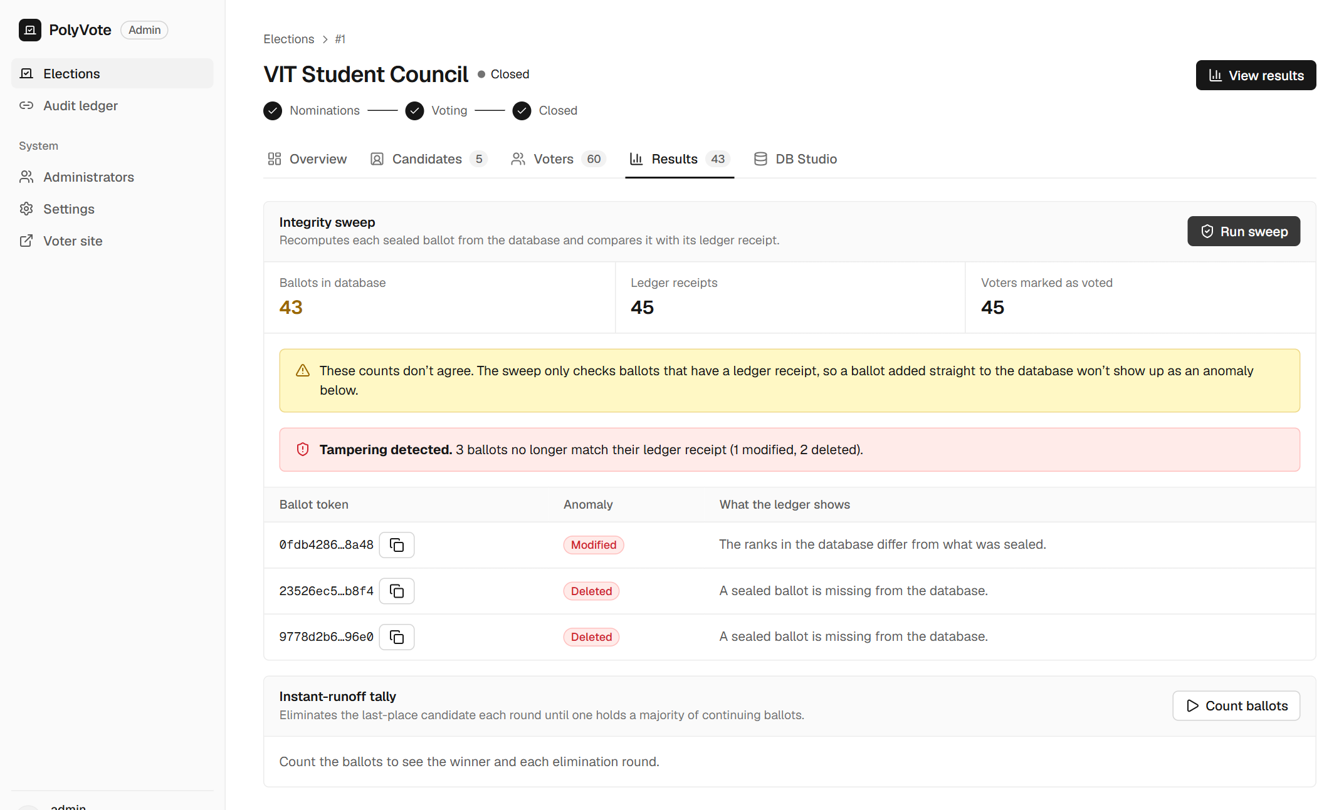
LIVE TAMPER TEST
A rogue DBA edits the database and the sweep catches it
1
Edit
In DB Studio we re-assigned one ballot’s first choice.
2
Delete
We deleted two ballot rows, including a voter’s own.
3
Sweep
Run integrity sweep: every sealed ballot is recomputed and compared.
Result: 3 of 3 flagged (1 modified, 2 deleted)
BACSE202 – Database Systems | Review 3 | Fall Semester 2026 · Slide 16
Notes:
Now the live tamper test, the main thing the ledger exists for. In DB Studio, which simulates a rogue DBA, we re-assigned one ballot's first choice and deleted two ballot rows, including a voter's own ballot. Then we ran the integrity sweep. It reported tampering detected: three ballots no longer match their receipts, one modified and two deleted, each identified by token. The counts also stop agreeing: forty-three ballots against forty-five receipts and forty-five voters marked as voted.

Slide 17
VERIFICATION
Seven checks, seven expected outcomes
Check | Expected | Observed
Same voter votes twice | Refused | You have already voted in this election.
Wrong password at sign-in | Rejected | Incorrect password.
Ledger hash chain | Intact | Chain intact across all 45 receipts
1 ballot re-ranked, 2 deleted in the database | All three flagged | 1 modified and 2 deleted detected
Voter checks a deleted ballot’s receipt | Warned | Recorded, but missing from the count
Counts after tampering | Mismatch visible | 43 ballots vs 45 receipts vs 45 voted
Ranked-choice majority | Winner holds a majority | Chaitanya Reddy: 23 of 45 (51.1%)
Outputs captured on a demo election: 60 registered voters, 45 ballots cast, five candidates.
BACSE202 – Database Systems | Review 3 | Fall Semester 2026 · Slide 17
Notes:
To summarise the evidence, here are seven checks with expected and observed results. A second vote is refused and a wrong password rejected. The hash chain is intact across all forty-five receipts. After tampering, all three altered ballots are flagged, the voter's receipt check warns that the ballot is recorded but missing from the count, and the count mismatch is visible. And the tally gives a winner with a real majority. Every observed result came from the running system.

Slide 18
IMPLEMENTATION STATUS
Implementation status: all but Oracle and POSITION
Done
Multi-tenant schema, trigger and views, instant-runoff tally, keyed hash-chained ledger on MongoDB Atlas, tamper detection, emailed one-time code, voter and admin applications, public hosting.
Not implemented
Oracle with PL/SQL procedures and DCL
POSITION entity
A managed cloud database platform
Why Oracle was not used: SQLite needs no set-up and keeps the tests repeatable; the schema is portable, so Oracle would be a migration (see the conclusion slides).
BACSE202 – Database Systems | Review 3 | Fall Semester 2026 · Slide 18
Notes:
Here is our progress against the Review 1 scope. On the left, what is done: the multi-tenant schema, trigger and views, the instant-runoff tally, the keyed hash-chained ledger on MongoDB Atlas, tamper detection, the emailed one-time code, and the voter and admin applications with public hosting. On the right, what is not implemented: Oracle with PL/SQL procedures and DCL, the POSITION entity, and a managed cloud database platform.

Slide 19
PLAN VS BUILD
Where the build differs from the Review 1 plan, and why
Area | Review 1 plan | Built | Why
Relational DBMS | Oracle Autonomous DB with PL/SQL | SQLite with trigger, views, constraints | Zero-setup development; schema kept portable
NoSQL ledger | MongoDB Atlas | MongoDB Atlas, HMAC-keyed chain; file fallback | Document store; a unique index gives concurrency control
Frontend | Streamlit | React + FastAPI; Streamlit kept | Separate voter and admin experiences, mobile support
Schema | Five core tables | + ADMIN_USERS; POSITION not implemented | Officer logins needed a table
Lifecycle | Timestamp-driven procedures | Guarded Nominations → Voting → Closed | SQLite has no stored procedures
Result: MongoDB Atlas is in use. Oracle with PL/SQL was not used; the code is structured so it would be a migration, not a rewrite (see the conclusion slides).
BACSE202 – Database Systems | Review 3 | Fall Semester 2026 · Slide 19
Notes:
This table explains every place the build differs from the plan. Oracle became SQLite for zero-setup development and repeatable tests, with the schema kept portable. MongoDB Atlas is in use, with an HMAC-keyed chain and a file fallback. Streamlit gained a React and FastAPI front end for separate voter and admin experiences. We added ADMIN_USERS and did not implement POSITION. The lifecycle is guarded transitions because SQLite has no stored procedures. Oracle with PL/SQL was not used; the code is structured so it would be a migration, not a rewrite.

Slide 20
ROADMAP & DELIVERABLES
Three reviews move from design to a finished system
REVIEW 1 · DONE
REVIEW 2 · DONE
REVIEW 3 · NOW
Presented the design, schema, security approach, and planned system architecture.
Working implementation with live outputs and a tamper demonstration.
This is the final review: MongoDB Atlas, emailed code, public hosting, evaluation and comparison with existing systems.
Delivered · MongoDB Atlas ledger, emailed one-time code, public link and QR voting
Evidence · 47 tests, 31 attacks and a comparison with 33 systems
Left out · Oracle with PL/SQL and DCL roles, and the POSITION entity (SQLite kept)
BACSE202 – Database Systems | Review 3 | Fall Semester 2026 · Slide 20
Notes:
Looking at the three reviews together. Review 1 presented the design and Review 2 presented the working implementation with live outputs and a tamper demonstration; both are done. This is Review 3, the final review. We delivered the MongoDB Atlas ledger, the emailed one-time code, public hosting with phone voting, a 47-scenario evaluation and a comparison with 33 existing systems. Oracle with PL/SQL procedures and DCL roles, and the POSITION entity, were left out, and SQLite was kept; the conclusion slides at the end explain why and how Oracle would be possible.

Slide 21
PICKING UP FROM REVIEW 2
Review 2 left a short list; two new features lead it
REVIEW 2 ENDED WITH
NEW: EMAIL OTP
NEW: QR VOTING
• A working system built and demonstrated.
• Open: MongoDB Atlas, hosting, injected-ballot detection.
• Faculty feedback: confirm the voter with a second factor.
• Deferred on purpose: Oracle with PL/SQL, POSITION entity.
A correct password is no longer enough.
A 6-digit code is emailed to the voter, valid 5 minutes, one use, 3 guesses.
Answers the Review 2 comment.
Scan, sign in, vote.
The vote page shows a QR code for the public link, so any phone opens the ballot in seconds.
Works with the emailed code on the same phone.
BACSE202 – Database Systems | Review 3 | Fall Semester 2026 · Slide 21
Notes:
We pick up exactly where Review 2 ended. At Review 2 we had a working system, with MongoDB Atlas, hosting and injected-ballot detection still open, and the faculty comment that we should confirm the person voting is the person whose credentials are used. Two new features lead this review. First, the emailed one-time code: a correct password is no longer enough, because a six-digit code goes to the voter's email, valid for five minutes, usable once, with three guesses. Second, QR voting: the vote page shows a QR code for the public link, so any phone can open the ballot in seconds, and the same phone can receive the emailed code. The rest of the deck shows how they work, the evidence, and how this compares with similar systems.

Slide 22
RESPONSE TO FEEDBACK
Each Review 2 comment has a concrete answer
Comment at Review 2 | What we did | Evidence
Confirm the voter: OTP or face ID | Emailed one-time code after the password; separate verification database; admin outbox | 14 of 14 OTP tests pass
Finish MongoDB | Ledger now in MongoDB Atlas, unique-index concurrency control, file fallback, migration script | 25 blocks migrated; live health endpoint
Host it online | Public HTTPS link through a tunnel; QR code on the voter page for phones | Cast a ballot from a phone
Prove it is better | 47-scenario executable suite run on the Review 2 design and the final design | 6 of 13 to 13 of 13 attacks caught
Weak spots we knew about | Injected ballots, forged receipts, rewritten chains, renamed candidates | Each has a test and a fix
Where we say "future work", it is because the design needs something we cannot add honestly in one semester, and we say what.
BACSE202 – Database Systems | Review 3 | Fall Semester 2026 · Slide 22
Notes:
This slide is the direct response to the Review 2 comments. The second factor became an emailed one-time code with its own database and fourteen passing tests. MongoDB is done and live on Atlas. Hosting is a public HTTPS link with a QR code, so a phone can vote. And to prove the design is better, we built a forty-seven scenario suite and ran it against both the Review 2 design and the final one. The weaknesses we knew about, such as injected ballots, forged receipts and renamed candidates, each have a test and a fix. Where we still say future work, we explain why.

Slide 23
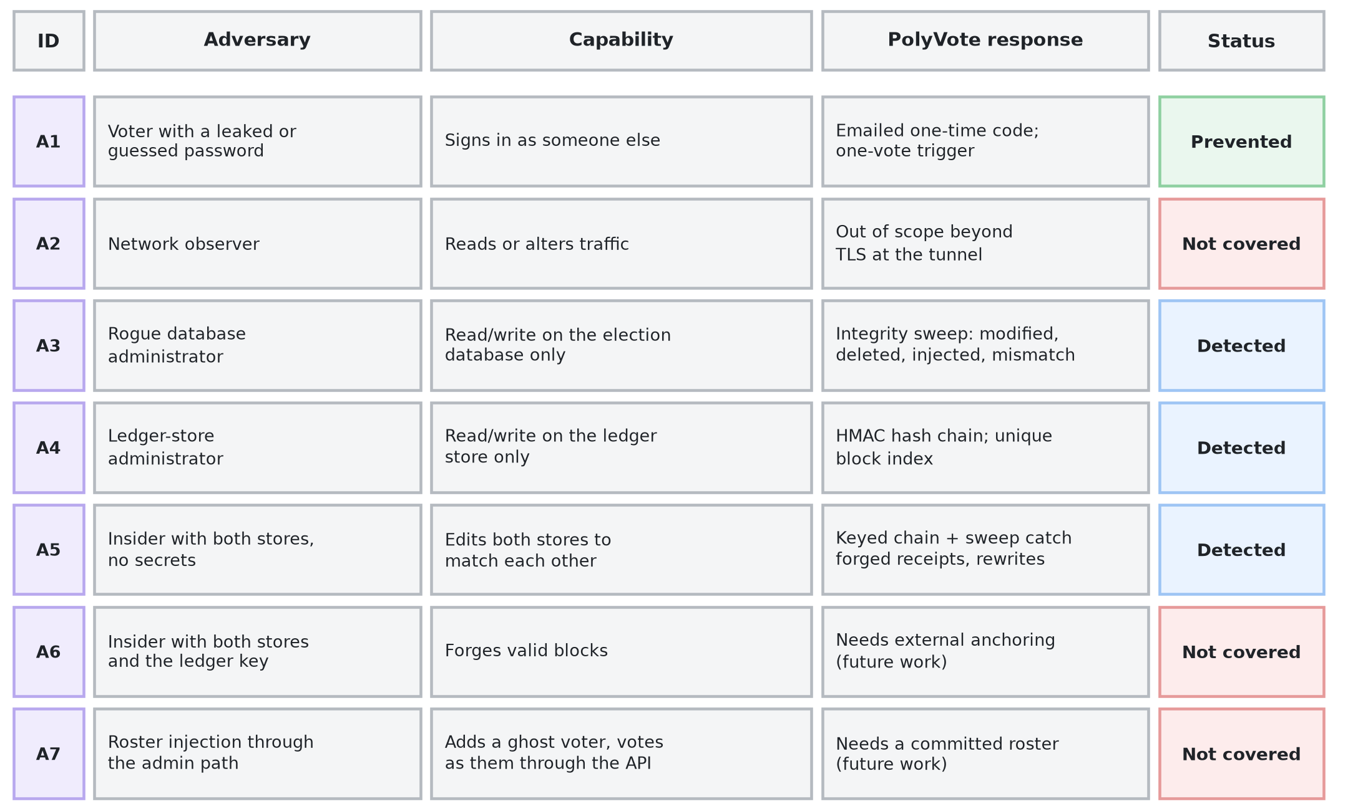
THREAT MODEL
Who the attacker is, and who we do not stop
Detected means found by an auditor running the checks, not blocked in real time.
BACSE202 – Database Systems | Review 3 | Fall Semester 2026 · Slide 23
Notes:
A security claim means nothing without a threat model, so we start there. Seven adversaries, ordered by capability. A voter with a leaked password is stopped by the emailed code. A rogue database administrator and a ledger-store administrator are detected by the sweep and the keyed chain. An insider with both stores but no secrets is detected, because they cannot recompute the keyed chain. Two are not covered: a network observer, beyond the tunnel's encryption, and an insider who also holds the key. Roster injection through the admin path is now detected by the keyed voter-roster seal. We say so now rather than have it found later.

Slide 24
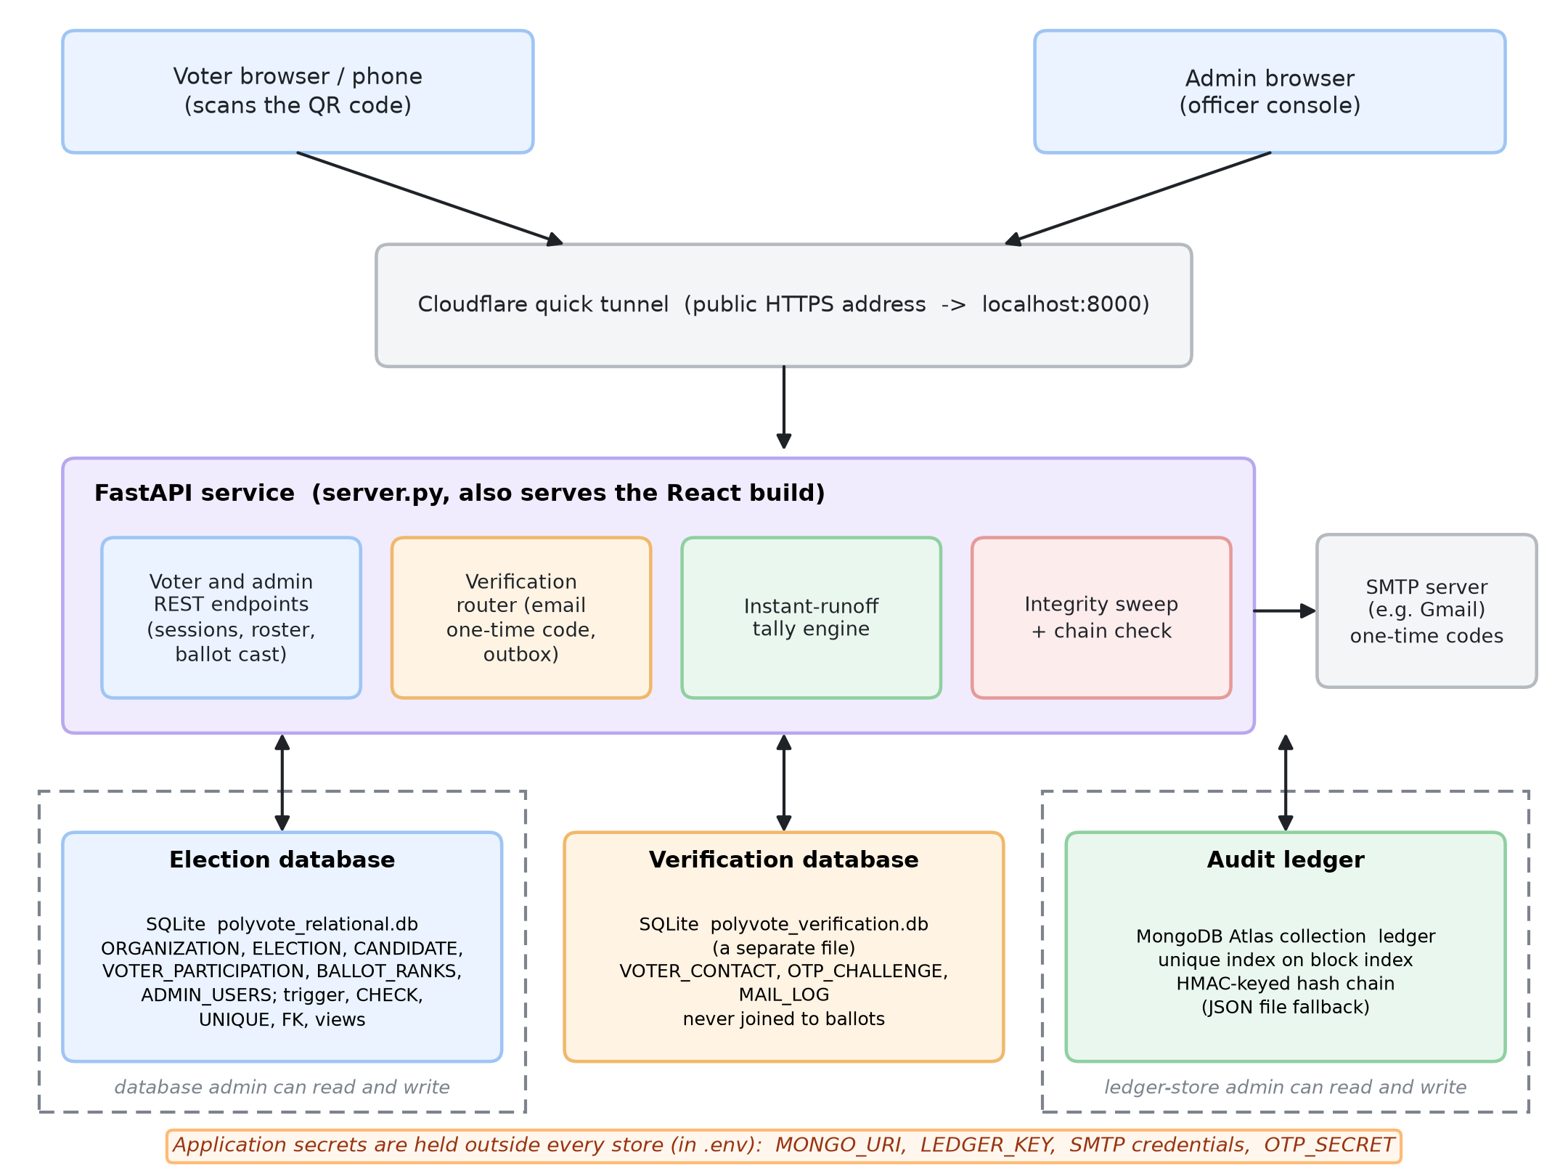
FINAL ARCHITECTURE
Three stores, separated by what each is trusted with
• Election DB: roster, candidates, anonymous ballots.
• Verification DB: emails and one-time codes, a separate file, never joined to ballots.
• Ledger: MongoDB Atlas, HMAC chain.
• Secrets: in .env, outside every store.
• An administrator of one store cannot touch the others.
BACSE202 – Database Systems | Review 3 | Fall Semester 2026 · Slide 24
Notes:
The architecture. One FastAPI service that also serves the React app, exposed through a tunnel. Behind it three stores. The election database holds the roster, candidates and anonymous ballots. The verification database is a separate file that holds voter emails and one-time-code challenges, and it is never joined to ballots. The ledger is a MongoDB Atlas collection. Secrets live in an environment file outside all three. The point of the separation is that an administrator of one store cannot touch the others; only the application host sees all three, which is why host compromise is outside our model.

Slide 25
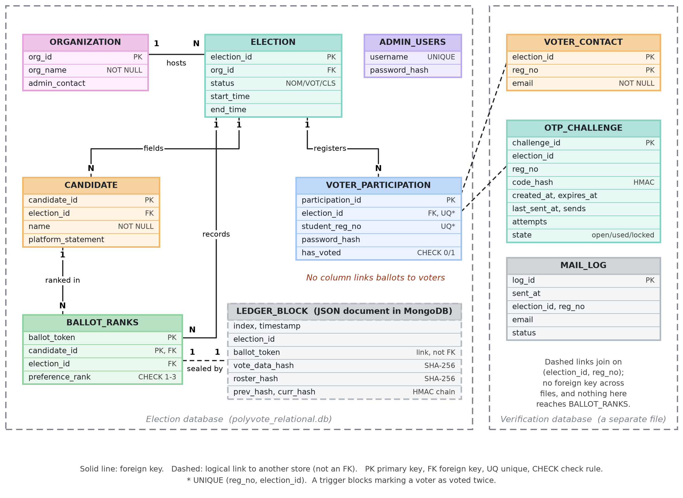
DATA MODEL
Data model: election, ledger and verification stores
• Shared multi-tenant schema, scoped by election.
• No column links a ballot to a voter.
• Candidate roster hash sealed in the ledger.
• Emails live in a different file; no key reaches ballots.
• Trigger, CHECK, UNIQUE, FK enforce the rules.
BACSE202 – Database Systems | Review 3 | Fall Semester 2026 · Slide 25
Notes:
The updated ER diagram. The left frame is the election database, unchanged in structure from Review 2 apart from what it protects. The dashed box is a ledger block, a JSON document linked to a ballot by its token, not by a foreign key. The right frame is new: the verification database with voter contacts, challenges and a mail log. Notice there is deliberately no line from it to the ballot table. A voter's email can never be joined to a ballot.

Slide 26
KEYED AUDIT LEDGER
Keyed chain: rebuilding it needs the secret key
Block 1
Block 2
Block 3
prev_hash links each block to the one before it.
ballot_token, vote_data_hash,
roster_hash, prev_hash
ballot_token, vote_data_hash,
roster_hash, prev_hash
ballot_token, vote_data_hash,
roster_hash, prev_hash
curr_hash = HMAC(key, block)
curr_hash = HMAC(key, block)
curr_hash = HMAC(key, block)
• Review 2: curr_hash was plain SHA-256. An attacker who can write the store can edit a ballot and recompute every later hash.
• Final: curr_hash is HMAC-SHA-256 under LEDGER_KEY, held outside the database and the ledger store. Without the key the rebuilt chain fails verification.
• Roster hash: every block also seals the candidate list, so renaming candidates after voting is detected.
• Backward compatible: blocks written before the key existed still verify (LEDGER_LEGACY_UNTIL).
• Limit: whoever holds the key can still forge blocks; that needs an external witness (future work).
BACSE202 – Database Systems | Review 3 | Fall Semester 2026 · Slide 26
Notes:
This is the key idea of the integrity story. Each block holds the ranks hash, the roster hash, the previous block's hash and its own hash. In Review 2 the block hash was plain SHA-256, so someone who could write the store could change a ballot and recompute every later hash. The chain was consistent but not authenticated. Now the block hash is an HMAC under a secret key held outside both stores. An attacker without the key can rebuild a chain, but it fails verification at the first block. Older blocks still verify. The limit is stated on the slide: whoever holds the key can still forge, which needs an external witness.

Slide 27
INTEGRITY SWEEP
Six rules compare the database with the ledger
Rule | Detects | How | New?
1 Modified | A ballot whose ranks changed | Recompute ranks hash; compare with the receipt | Review 2
2 Deleted | A sealed ballot missing from the database | Receipt exists with no ballot rows | Review 2
3 Injected | A ballot with no receipt | Ballot rows exist with no block | New
4 Roster changed | Candidate names altered after voting | Current roster hash differs from the sealed hash | New
5 Count mismatch | Flags, ballots, receipts disagree | Compare the three counts for the election | New
6 Voter roster changed | Voter added, deleted or edited outside the app; seal removed or forged | Recompute a keyed tag per voter and a signature over the set | Updated
Plus the chain check: recompute every block's link and hash across the whole ledger. The chain check finds edits inside the ledger; the sweep finds edits to the database.
BACSE202 – Database Systems | Review 3 | Fall Semester 2026 · Slide 27
Notes:
The sweep recomputes the state of an election from the database and compares it with the ledger. Rules one and two were in Review 2. Rule three finds a ballot in the database that has no receipt. Rule four compares the current candidate names with the sealed hash. Rule five compares voter flags, ballots and receipts. Rule six, added after the first submission, recomputes a keyed seal over the voter roster so a ghost voter is caught. The chain check, which verifies every block, is separate and complementary: it finds edits inside the ledger, while the sweep finds edits to the database.

Slide 28
MONGODB ATLAS LEDGER
A real document store with its own concurrency control
• Collection: each block is one document in polyvote.ledger.
• Unique index on block index: two writers cannot both claim the next slot, so the chain cannot fork.
• Append cost: reads only the last block and inserts one document, so it does not grow with the chain.
• Fallback: no connection string, or Atlas unreachable, and it uses the local file; /api/health shows which.
• Migration: a script copies the old blocks and verifies the chain; it refuses to overwrite a non-empty collection.
• Secrets: the connection string lives in .env, never in the code or the repository.
Live health check
{"backend":"mongodb",
"detail":"mongodb
(polyvote.ledger)",
"sealing":"hmac-sha256"}
Editing any block in Atlas (for example a vote_data_hash) makes the Audit ledger page show "Data tampered at block N".
BACSE202 – Database Systems | Review 3 | Fall Semester 2026 · Slide 28
Notes:
MongoDB. Each block is a document in a collection with a unique index on the block position. That index is our compare-and-swap: two simultaneous writers cannot both take the same slot, so the chain cannot fork. Appending reads only the last block and inserts one document, so the cost does not grow with the chain. If no connection string is set, or Atlas is unreachable, the system falls back to the local file, and the health endpoint says which backend is active. A migration script moved our existing blocks and verified the chain. The connection string lives only in the environment file.

Slide 29
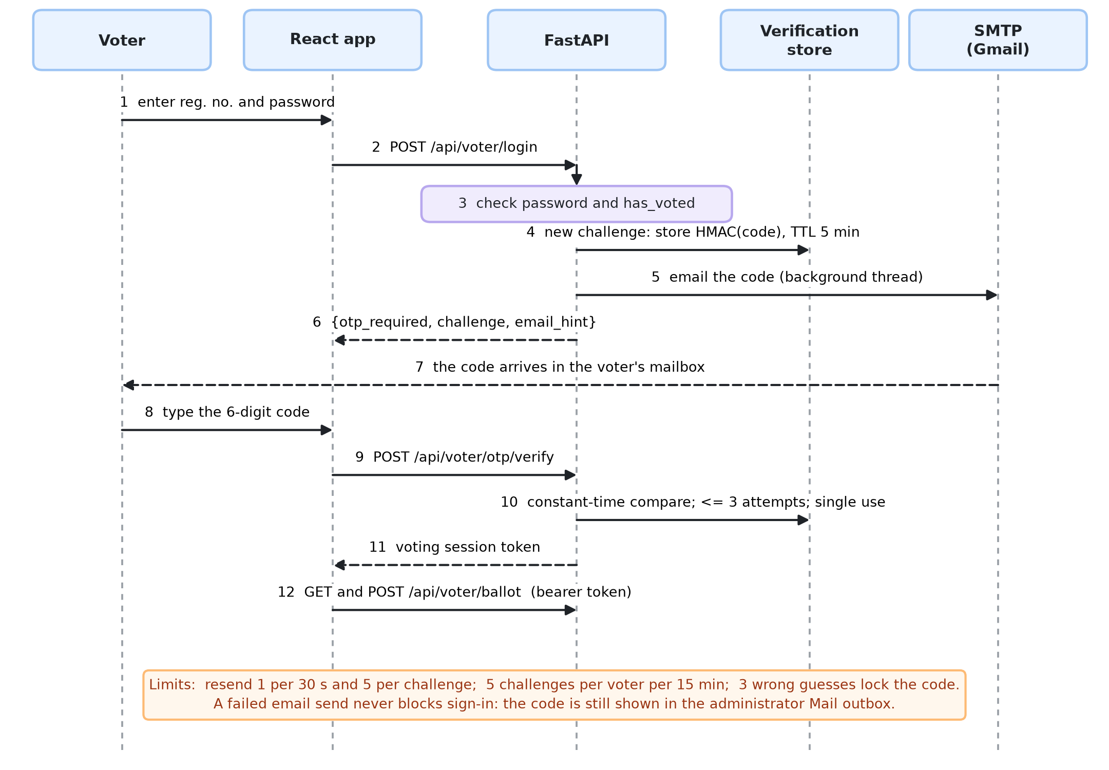
EMAIL ONE-TIME CODE
A correct password no longer opens a ballot on its own
Demo only: the public demo also shows the code on the screen so it never waits on email. A real deployment emails it only; shown on screen, it would not prove the voter owns the mailbox.
BACSE202 – Database Systems | Review 3 | Fall Semester 2026 · Slide 29
Notes:
The second factor. The voter enters the registration number and password. If they are right, the server does not issue a session; it issues a challenge, generates a six-digit code, stores only a keyed hash of it, and emails the code from a background thread so the page never waits on the mail server. The voter types the code, the server compares it in constant time, checks the attempt count and the single-use flag, and only then issues the voting session. A failed email never blocks sign-in because the code is also visible in the administrator outbox. The code shown on the screen exists only because this is a demo: visitors to a public demo cannot open the demo mailboxes, so the page also shows the code. A real deployment emails the code only and leaves that setting off, because a code shown on the screen would no longer prove the voter controls the mailbox.

Slide 30
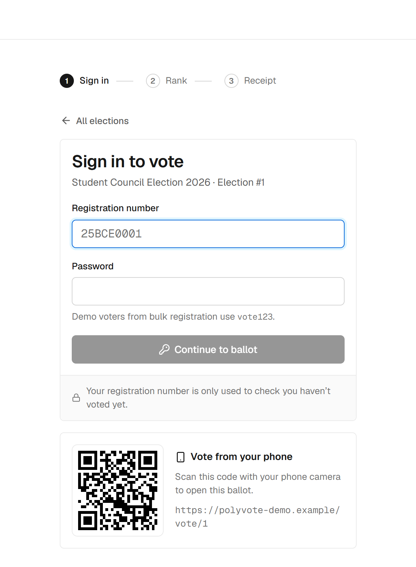
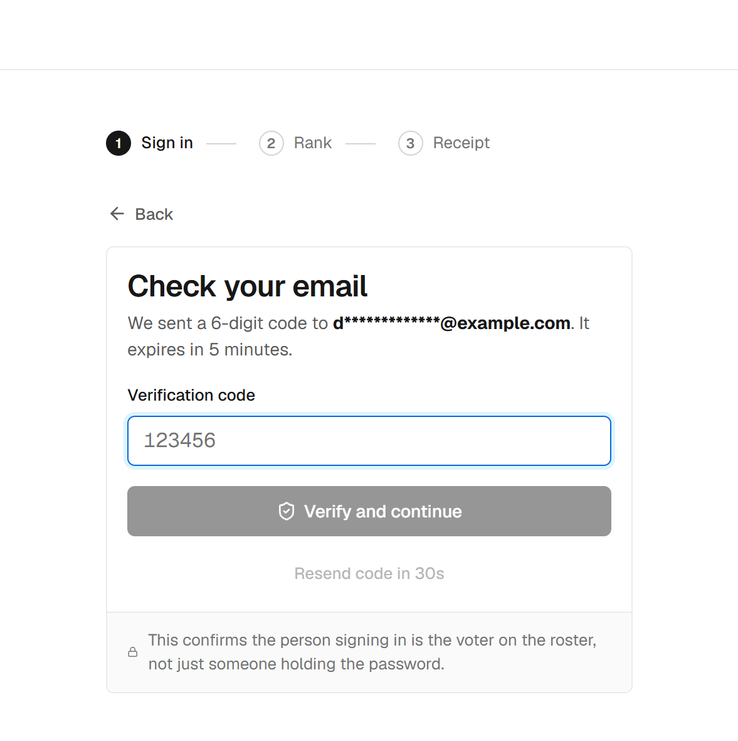
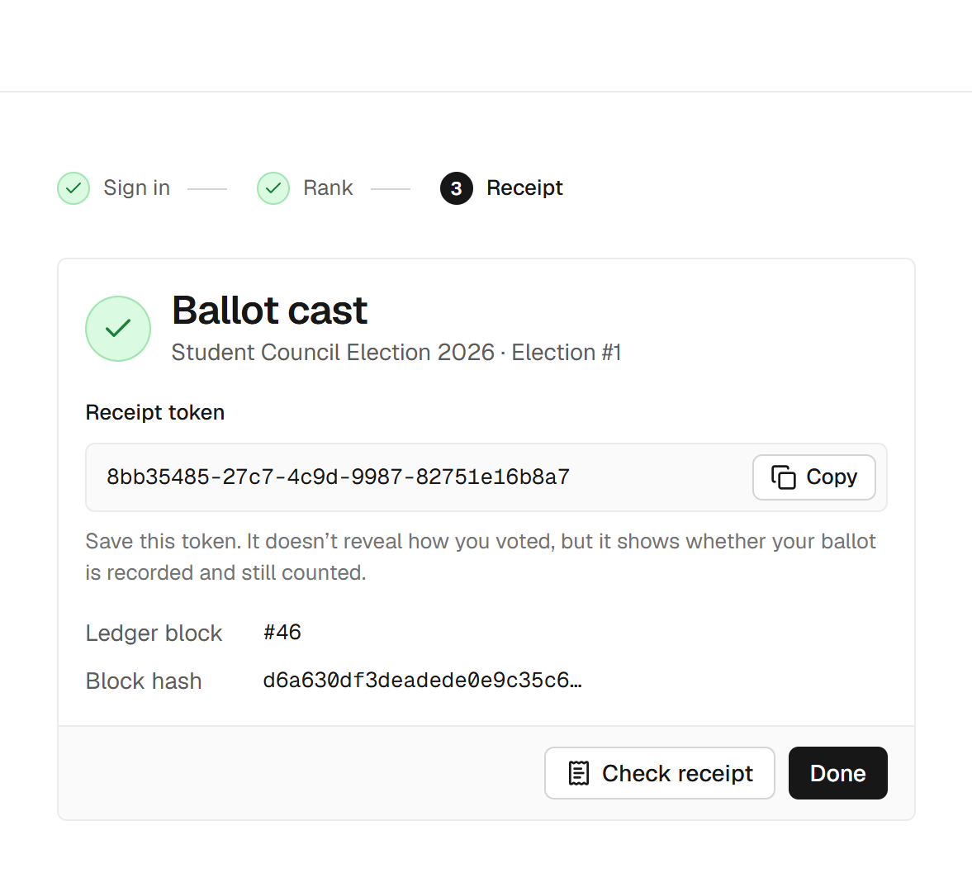
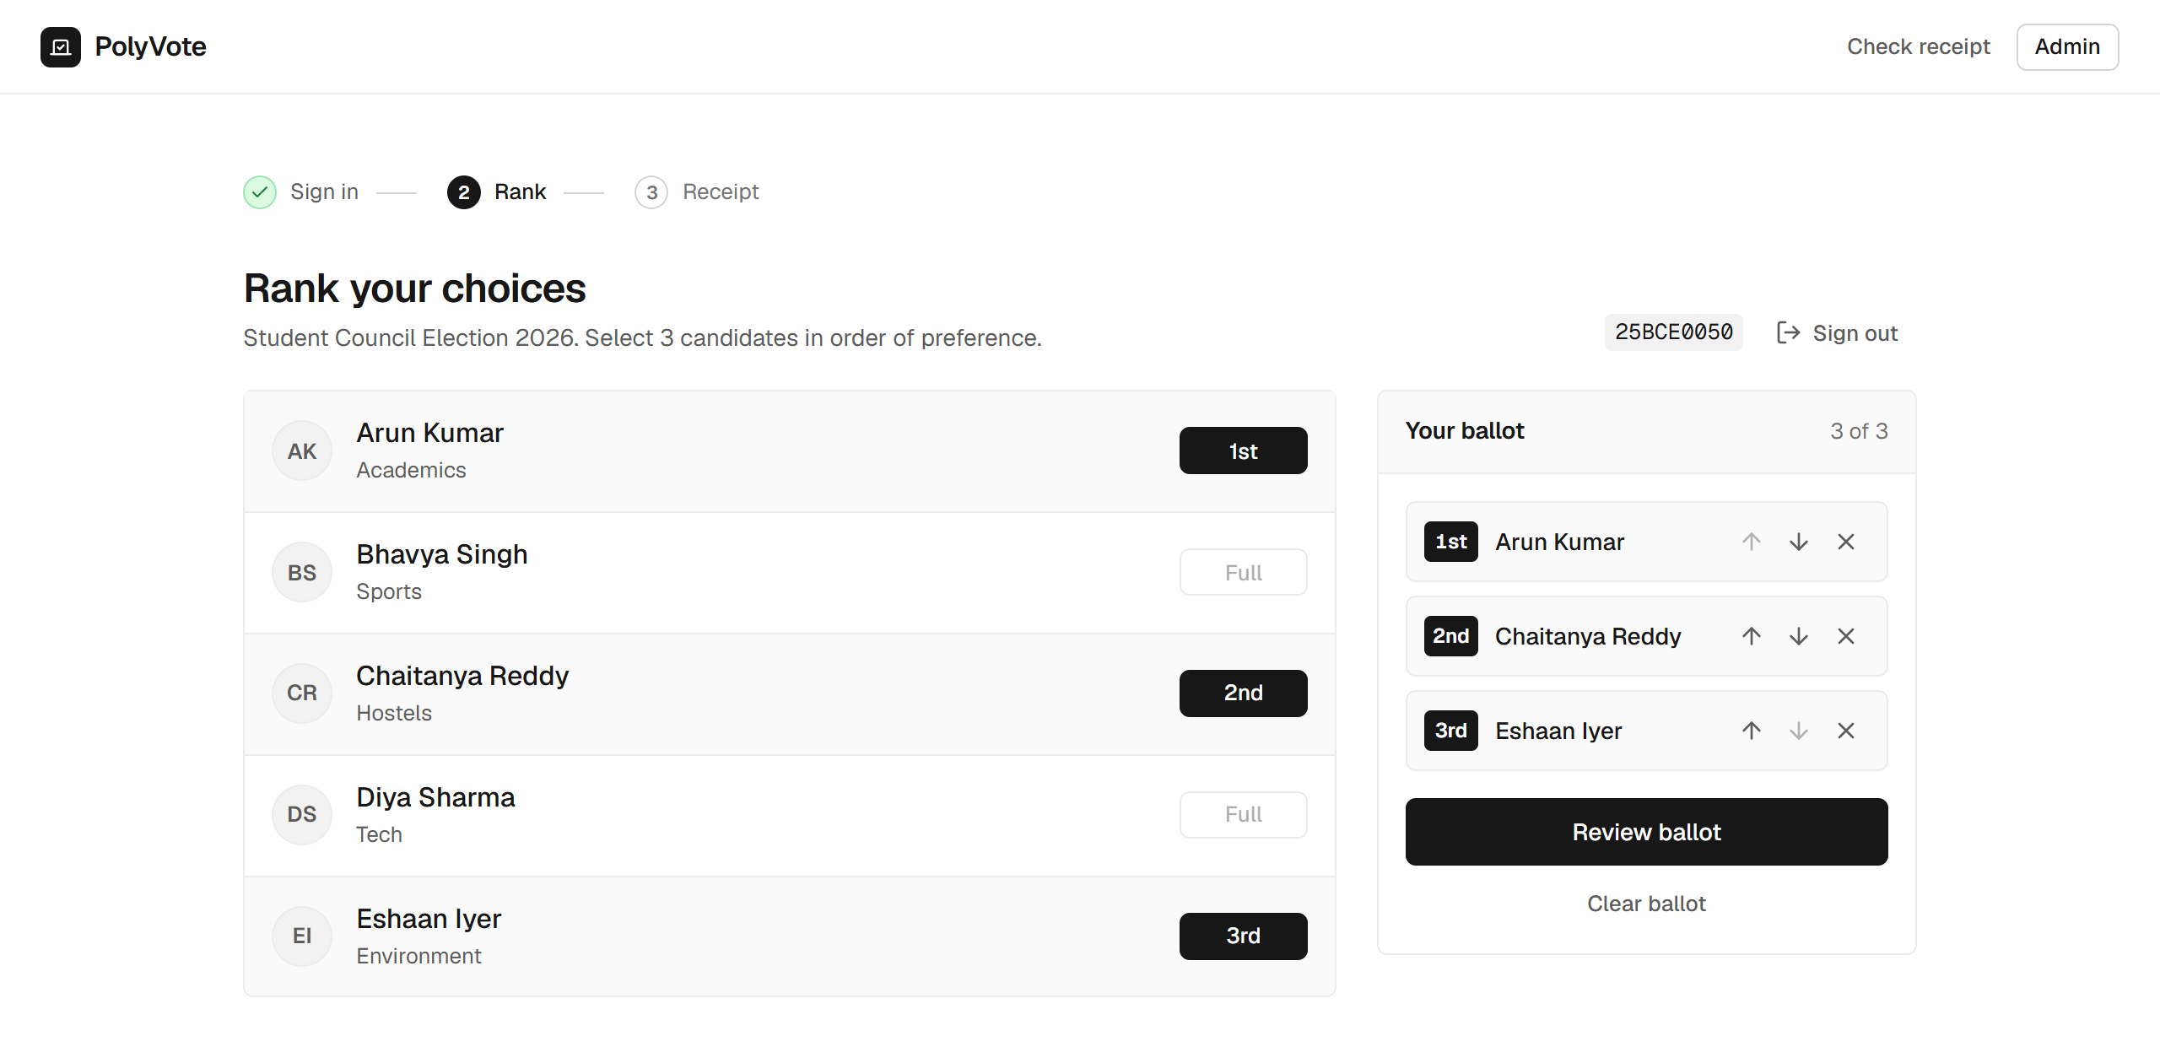
THE VOTER EXPERIENCE
Sign in, confirm by code, rank, and keep a receipt
1 Sign in (QR for phones)
2 Enter the emailed code
3 Rank three choices
4 Receipt token
BACSE202 – Database Systems | Review 3 | Fall Semester 2026 · Slide 30
Notes:
This is what a voter sees. One: sign in with registration number and password; the QR code lets a phone open the same ballot. Two: the new step, the code sent to the address on file. Three: rank three candidates in order; there is a review step before the irreversible cast. Four: the receipt token and the ledger block number. The token shows that a ballot is recorded and counted; it does not reveal how anyone voted.

Slide 31
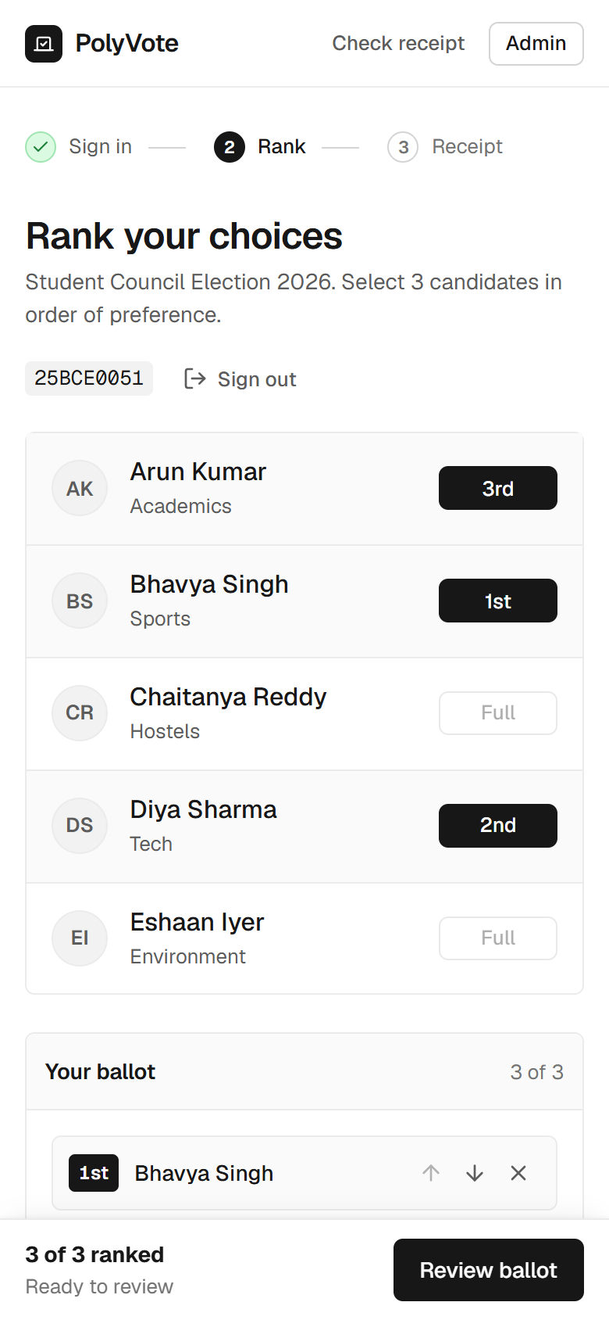
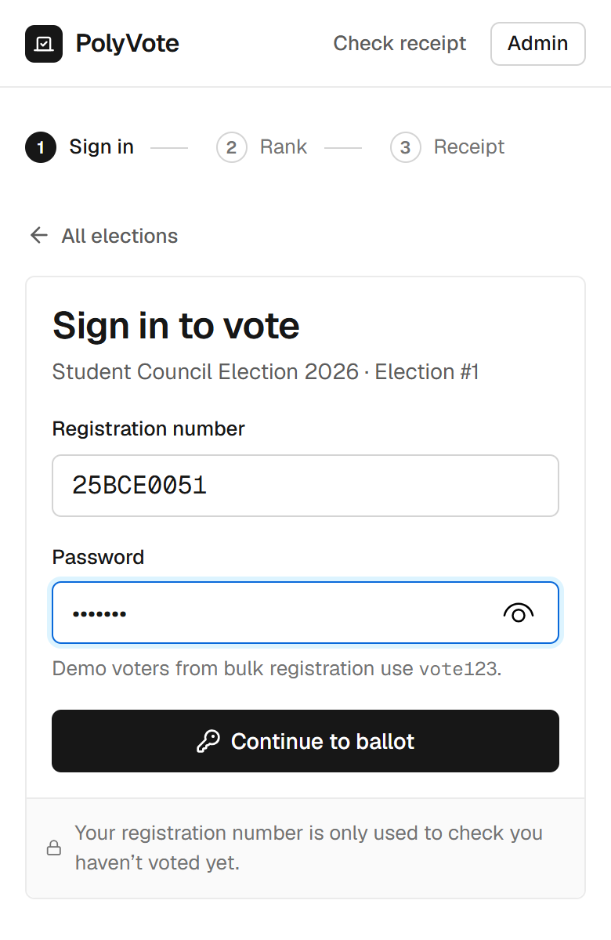
PHONE VOTING AND HOSTING
Phone voting, a public link, and an honest account
• How: a Cloudflare quick tunnel gives a temporary public HTTPS address; the vote page shows a QR code for it.
• Works from any network; tested casting a real ballot from a phone.
• What it is not: cloud deployment. The laptop must stay on, and the address changes when the tunnel restarts.
• Why we say so: a true cloud platform with Oracle is the next step.
• Safe by default: secrets stay in .env; the repository holds only .env.example.
BACSE202 – Database Systems | Review 3 | Fall Semester 2026 · Slide 31
Notes:
Hosting. We expose the service through a Cloudflare quick tunnel, which gives a temporary public HTTPS address without opening ports. The voter page shows a QR code for it, so a phone scans and votes; we cast a real ballot from a phone this way. To be precise, this is public hosting from a laptop, not cloud deployment: the laptop has to stay on and the address changes when the tunnel restarts. A real cloud platform is part of the Oracle migration planned next. The repository contains only a template for the environment file, never the secrets. The code shown on the screen exists only because this is a demo: visitors to a public demo cannot open the demo mailboxes, so the page also shows the code. A real deployment emails the code only and leaves that setting off, because a code shown on the screen would no longer prove the voter controls the mailbox.

Slide 32
LIVE DEMO · SAMPLE POLYVOTE
The same system with email verification switched on
1
2
3
4
Admin
Sign in
Code
Vote
Voters have emails; Mail outbox open
Password right, still no ballot
Read it from the outbox or inbox
Rank, cast, get the receipt
5
6
7
Safety net
Every code also appears in the outbox, so a slow email cannot stall the demo.
Seal
Tamper
Ledger
Receipt check; new block in Atlas
DB Studio edit; sweep names it
Edit a block in Atlas; chain breaks
Separate copy: its own database, its own Atlas collection, port 8001; START_DEMO resets it in about 20 seconds.
BACSE202 – Database Systems | Review 3 | Fall Semester 2026 · Slide 32
Notes:
Now a short live demonstration, on a separate copy of the project we call Sample PolyVote. It is identical except that email verification is switched on, and it has its own database and its own Atlas collection so it cannot disturb the main system. The flow: show the admin view with voter emails and the outbox; sign in as a voter, and note that the right password is not enough; take the code from the outbox, or from the inbox if mail is configured; rank and cast; check the receipt and show the new block in Atlas. Then the tamper test: edit a ballot in DB Studio and run the sweep, and edit a block in Atlas to show the chain breaking. If email is slow, the code is always in the outbox. The code shown on the screen exists only because this is a demo: visitors to a public demo cannot open the demo mailboxes, so the page also shows the code. A real deployment emails the code only and leaves that setting off, because a code shown on the screen would no longer prove the voter controls the mailbox.

Slide 33
HOW WE EVALUATED
47 executable scenarios, old design versus final
7
13
13
14
3
DB prevention
API abuse
Tampering
One-time code
Benchmark sizes
Statements the schema should reject
Wrong password, injection, replay, races
Edits by someone with storage access
Replay, expiry, limits, failure
100, 1,000, 10,000 ballots
• A throwaway copy of the app is driven through the real API; a "rogue administrator" edits the database and ledger files directly.
• Baseline: the Review 2 design, checked out and run unchanged. Attacker scripts never receive the ledger key.
• Outcome per attack: detected by the sweep or chain, visible only in counters, or not detected. Benchmarks are medians of three runs.
BACSE202 – Database Systems | Review 3 | Fall Semester 2026 · Slide 33
Notes:
To prove the design is better we built a suite instead of arguing. Forty-seven scenarios: seven database-level prevention tests, thirteen API abuse tests, thirteen tampering scenarios, and fourteen one-time-code tests, plus benchmarks at one hundred, one thousand and ten thousand ballots. The suite runs on a throwaway copy, drives the real API, and plays the rogue administrator by editing the database and ledger files directly. The baseline is the Review 2 design, run unchanged, and the attacker scripts never see the ledger key. We repeat each run three times; the outcomes were identical every time.

Slide 34
PREVENTION RESULTS
Prevention results: one gap taught us something
Attempt | Stopped by | Result
Second vote by the same voter | Trigger | Prevented
Rank 4 on a 1–3 ballot | CHECK | Prevented
Same candidate ranked twice | Composite key | Prevented
Duplicate roster entry | UNIQUE | Prevented
Wrong password, SQL injection, replayed session | API | Prevented
20 simultaneous casts by one voter | Lock + transaction | Exactly one accepted
Nonexistent candidate from a default console | FK (off by default in SQLite) | Not prevented
The gap: SQLite enforces foreign keys only on connections that enable it. The application does; a console with default settings does not. A server database removes this, which is part of the Oracle move.
BACSE202 – Database Systems | Review 3 | Fall Semester 2026 · Slide 34
Notes:
The prevention results. Six of seven database statements are rejected by the engine with its own error message, and all thirteen API abuse tests are refused, including twenty simultaneous casts by one voter of which exactly one is stored. The one gap is instructive: SQLite enforces foreign keys only on connections that turn the setting on. Our application does; a console opened with default settings does not. So a rogue administrator can insert a ballot for a candidate that does not exist. The sweep reports it as injected, but the lesson is that a constraint is only as strong as the engine's enforcement, which is one reason for the move to a server database.

Slide 35
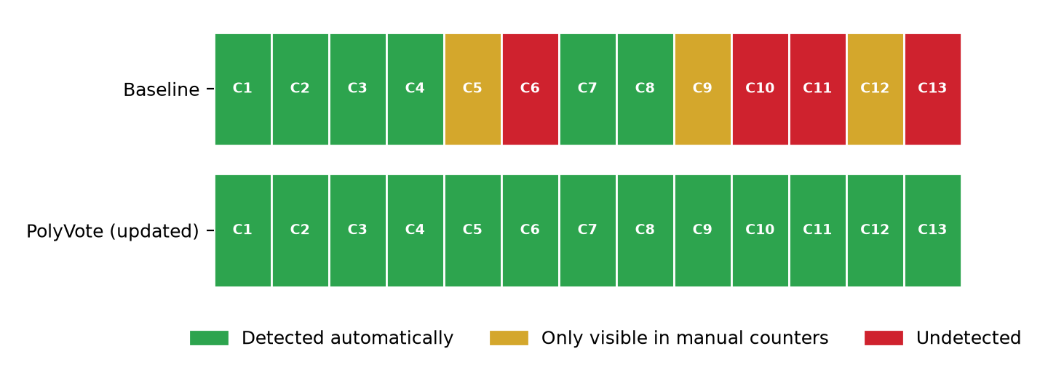
TAMPERING RESULTS
Automatic detection rises from 6 of 13 to 13 of 13
6/13
Review 2 design: detected automatically
13/13
Final design: detected automatically
0
Undetected: C13 is now caught by the voter-roster seal
BACSE202 – Database Systems | Review 3 | Fall Semester 2026 · Slide 35
Notes:
The central result. Thirteen scenarios of tampering by someone with direct storage access. Under the Review 2 design, 6 are detected automatically, three are visible only if an officer compares the counters by eye, and four are not detected at all. Under the final design, 13 are detected automatically, none depend on the counters, and none is missed. The first edition of this deck reported one miss, C13, adding a ghost voter to the roster and voting as them; the keyed voter-roster seal closes it, and the next slides show the wider evaluation. The detection bar shows each scenario, colour-coded.

Slide 36
EXTENDED EVALUATION
Thirty-one attacks, and every in-scope one is detected
28/28
0/399
500/500
361,996x
in-scope attacks detected by the final design
false alarms on clean elections
tallies match an independent count
slower password guessing than before
• Changed in the system: a keyed voter-roster seal (sweep rule 6) closes the ghost-voter gap C13, and passwords are now salted PBKDF2.
• Changed in the evaluation: 31 attacks, each run with and without the key; the detector that fires is recorded, so ablations and design comparisons come from one record.
• Honest limit: we wrote the attacks; two need the ledger key and one edits unsealed text, so three fall outside the stated attacker model and are reported anyway.
BACSE202 – Database Systems | Review 3 | Fall Semester 2026 · Slide 36
Notes:
After the first submission we widened the evaluation. The thirteen scenarios became thirty-one, covering ledger replay and reordering, roster attacks, rollbacks and key-holder insiders. Each attack runs once with the keyed chain and once with a plain chain, and we record which detector fires, so every ablation and every comparison with another design is read from the same record rather than re-implemented. The final design detects all 28 scenarios inside the attacker model. Across 399 sweeps of randomised clean elections there were no false alarms, and the tally matched an independent exhaustive count in 500 of 500 random elections. Two system changes came out of this: a keyed seal over the voter roster, which closes the one gap we reported before, and salted password hashing. We wrote the attacks ourselves, and three are outside the stated model: two need the key and one edits unsealed text.

Slide 37
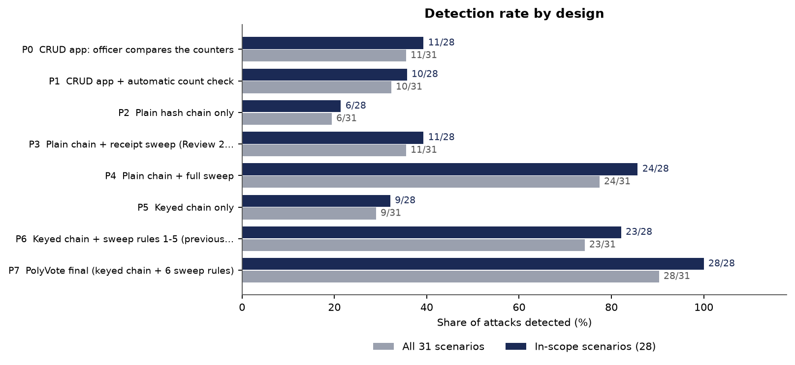
DETECTION BY DESIGN
No single control is enough; the combination catches all
• A typical CRUD app with an officer comparing counters: 11 of 28.
• Plain chain with a receipt sweep (our Review 2 design): 11 of 28.
• Plain chain with all six rules: 24 of 28. The key adds the rest.
• Previous final design without the voter seal: 23 of 28.
• Final design: 28 of 28.
BACSE202 – Database Systems | Review 3 | Fall Semester 2026 · Slide 37
Notes:
Each bar is a design built from the same record. A typical student voting app, where an officer compares the counters, detects 11 of the 28 in-scope attacks. A plain hash chain with the receipt sweep, which is our Review 2 design, detects 11. Adding all six sweep rules to a plain chain gets to 24; the remaining four are the attacks that forge or rebuild a chain, which only the key stops. Our design before the voter seal detected 23, and the final design detects all 28. The designs other than the last are emulated from the record and validated against the real Review 2 code on the first thirteen scenarios, where they agreed on thirteen of thirteen. Other people's products were not run.

Slide 38
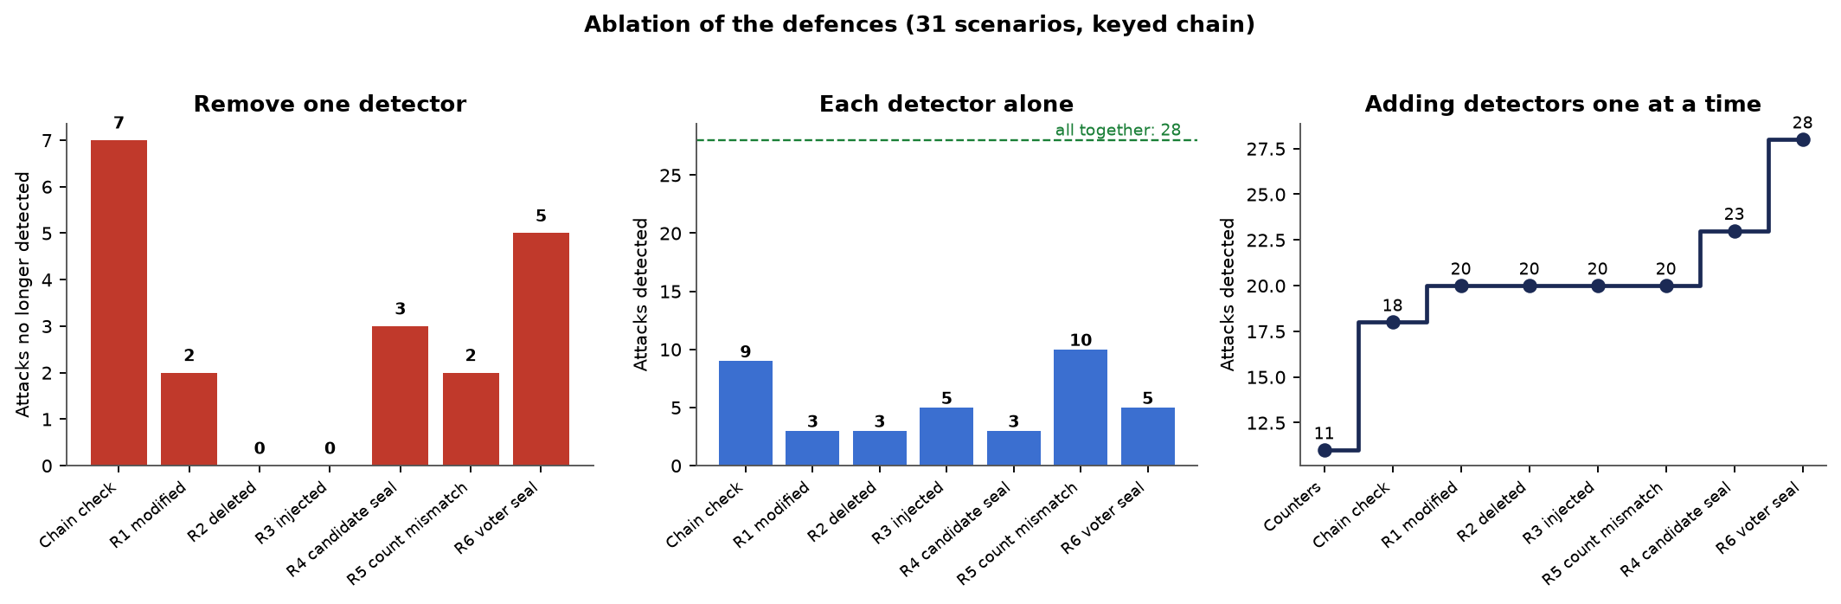
ABLATION
Take any one defence away and something is missed
• Biggest losses: chain check (7 attacks), voter seal (5), candidate seal (3).
• Rules 2 and 3: lose nothing alone because the chain and counters also see those attacks, but they name the tampered ballots.
• Strongest single detector: finds 10 of 31 on its own.
BACSE202 – Database Systems | Review 3 | Fall Semester 2026 · Slide 38
Notes:
Left panel: remove one detector from the final design and count the attacks that are no longer caught. The chain check matters most, with seven, then the voter seal with five and the candidate seal with three. Middle panel: each detector alone; the best finds ten of thirty-one. Right panel: add detectors one at a time. Removing rule two or rule three loses nothing, because the chain check and the counters also see those attacks, but we keep them because they say which ballots were tampered with. Most attacks are caught by more than one detector, which is the point.

Slide 39
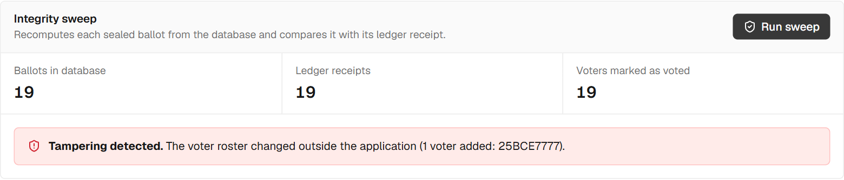

VOTER-ROSTER SEAL
Closing the ghost-voter gap (C13)
C13: a ghost voter added and used.
C17: the seal forged without the key.
• Gap before: a voter added to the roster by someone with database access could vote; the ballot was valid and nothing recorded the roster.
• Fix: the application seals the roster with one keyed tag per voter and a signature over the set, kept in the ledger store; sweep rule 6 recomputes them.
• Also caught: deleted or renamed voters, a deleted seal and a forged seal. Blocks record whether an election was sealed, so removing the seal is itself detected.
• Limit: an insider with the key can re-seal; older elections show "not sealed" instead of a false alarm.
BACSE202 – Database Systems | Review 3 | Fall Semester 2026 · Slide 39
Notes:
This is the gap we reported as the one undetected scenario. Someone with database access adds a ghost voter and votes as them. The ballot is valid and sealed; what is false is the voter's eligibility, and the system had no independent record of the roster. Now the application writes a keyed seal whenever it registers voters: one tag per voter and a signature over the set, kept in the ledger store with the key outside both stores. Sweep rule six recomputes them. The left screenshot is the ghost voter, the right is a seal forged without the key. Blocks also record whether the election was sealed, so deleting the seal is itself detected. An insider who holds the key can still re-seal, which is outside the model, and elections that predate the seal show not sealed rather than raising an alarm.

Slide 40
ACCURACY, PASSWORDS AND SCALE
No false alarms, a correct tally, and costs that stay small
Measure | Result
False alarms on clean elections | 0 in 399 sweeps over 120 randomised elections
Tampered ballots named when 1, 5 or 20 per category are altered | Precision 1.0 and recall 1.0 in all nine cases
Instant-runoff tally against an independent exhaustive count | 500 of 500 random elections agree (66 had a tie path)
Offline guessing against a stolen password table | about 361,996 times slower; sign-in hashing about 478 ms
Integrity sweep at 10,000 and 100,000 ballots | 269 ms and 6.0 s (keyed file ledger)
One to sixteen simultaneous voters | no errors; chain and sweep intact after every run; up to 16 casts per second
Measured on one laptop with synthetic elections; trends matter more than the absolute times.
BACSE202 – Database Systems | Review 3 | Fall Semester 2026 · Slide 40
Notes:
Four checks on whether the sweep can be trusted. First, false alarms: 399 sweeps on randomised clean elections, none raised an alarm. Second, when we tamper with one, five or twenty ballots of each kind, the sweep names exactly those ballots. Third, the tally matches an independent implementation that explores every tie-break in 500 of 500 elections. Fourth, passwords: salted PBKDF2 with six hundred thousand rounds makes each guess about 361,996 times slower. Scale: the sweep takes 269 milliseconds at ten thousand ballots and about 6 seconds at one hundred thousand. Sixteen simultaneous voters produced no errors. All of this is on one laptop with synthetic data.

Slide 41
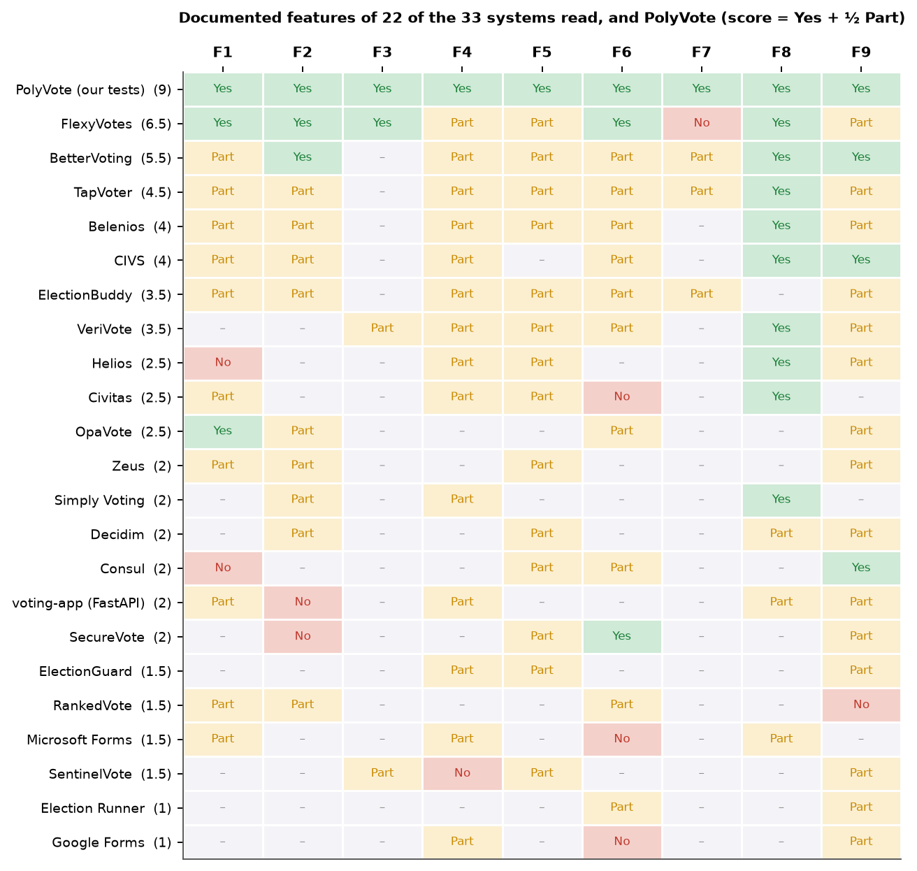
COMPARISON WITH ALTERNATIVES
Against 33 systems, the combination is what differs
• What we did: read each system's own pages for nine features; "not documented" means we did not find it, not that it is absent. Other products were not run.
• What stands out: in the strict form we use, none documents a keyed ledger with a reconciling sweep and published attack results, and none documents all of ranked counting, in-database rules, such a ledger and an emailed second factor.
• Where others are stronger: Helios, Belenios and ElectionGuard let a voter verify the ballot and anyone verify the tally; a hostile administrator with our ledger key beats us and does not beat them. They also have years of public analysis.
BACSE202 – Database Systems | Review 3 | Fall Semester 2026 · Slide 41
Notes:
We compared PolyVote with thirty-three related systems using only what each project documents about itself, across nine features. The picture shows twenty-two of them by name. We are careful with the wording: not documented does not mean absent, and we did not run other products. What stands out is the combination: ranked-choice counting, rules enforced in the database, a keyed ledger with a reconciling sweep and published attack results, and an emailed second factor. We do not claim to be more secure than Helios, Belenios or ElectionGuard. They let a voter verify the ballot and anyone verify the tally. A hostile administrator who holds our ledger key defeats us, and does not defeat them. Our claim is cost and fit for small elections, with a result anyone can re-run.

Slide 42
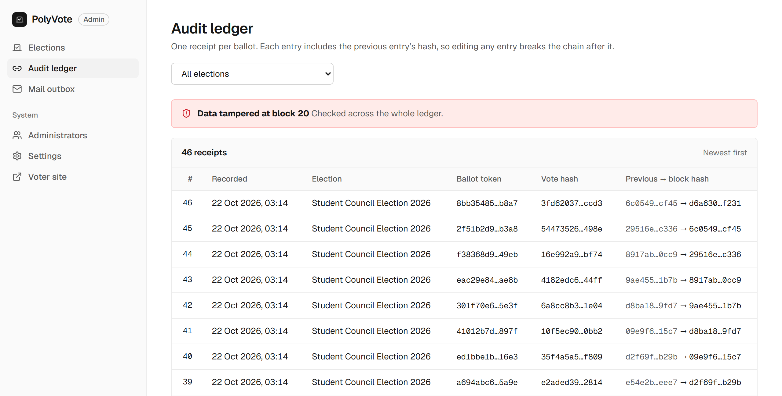
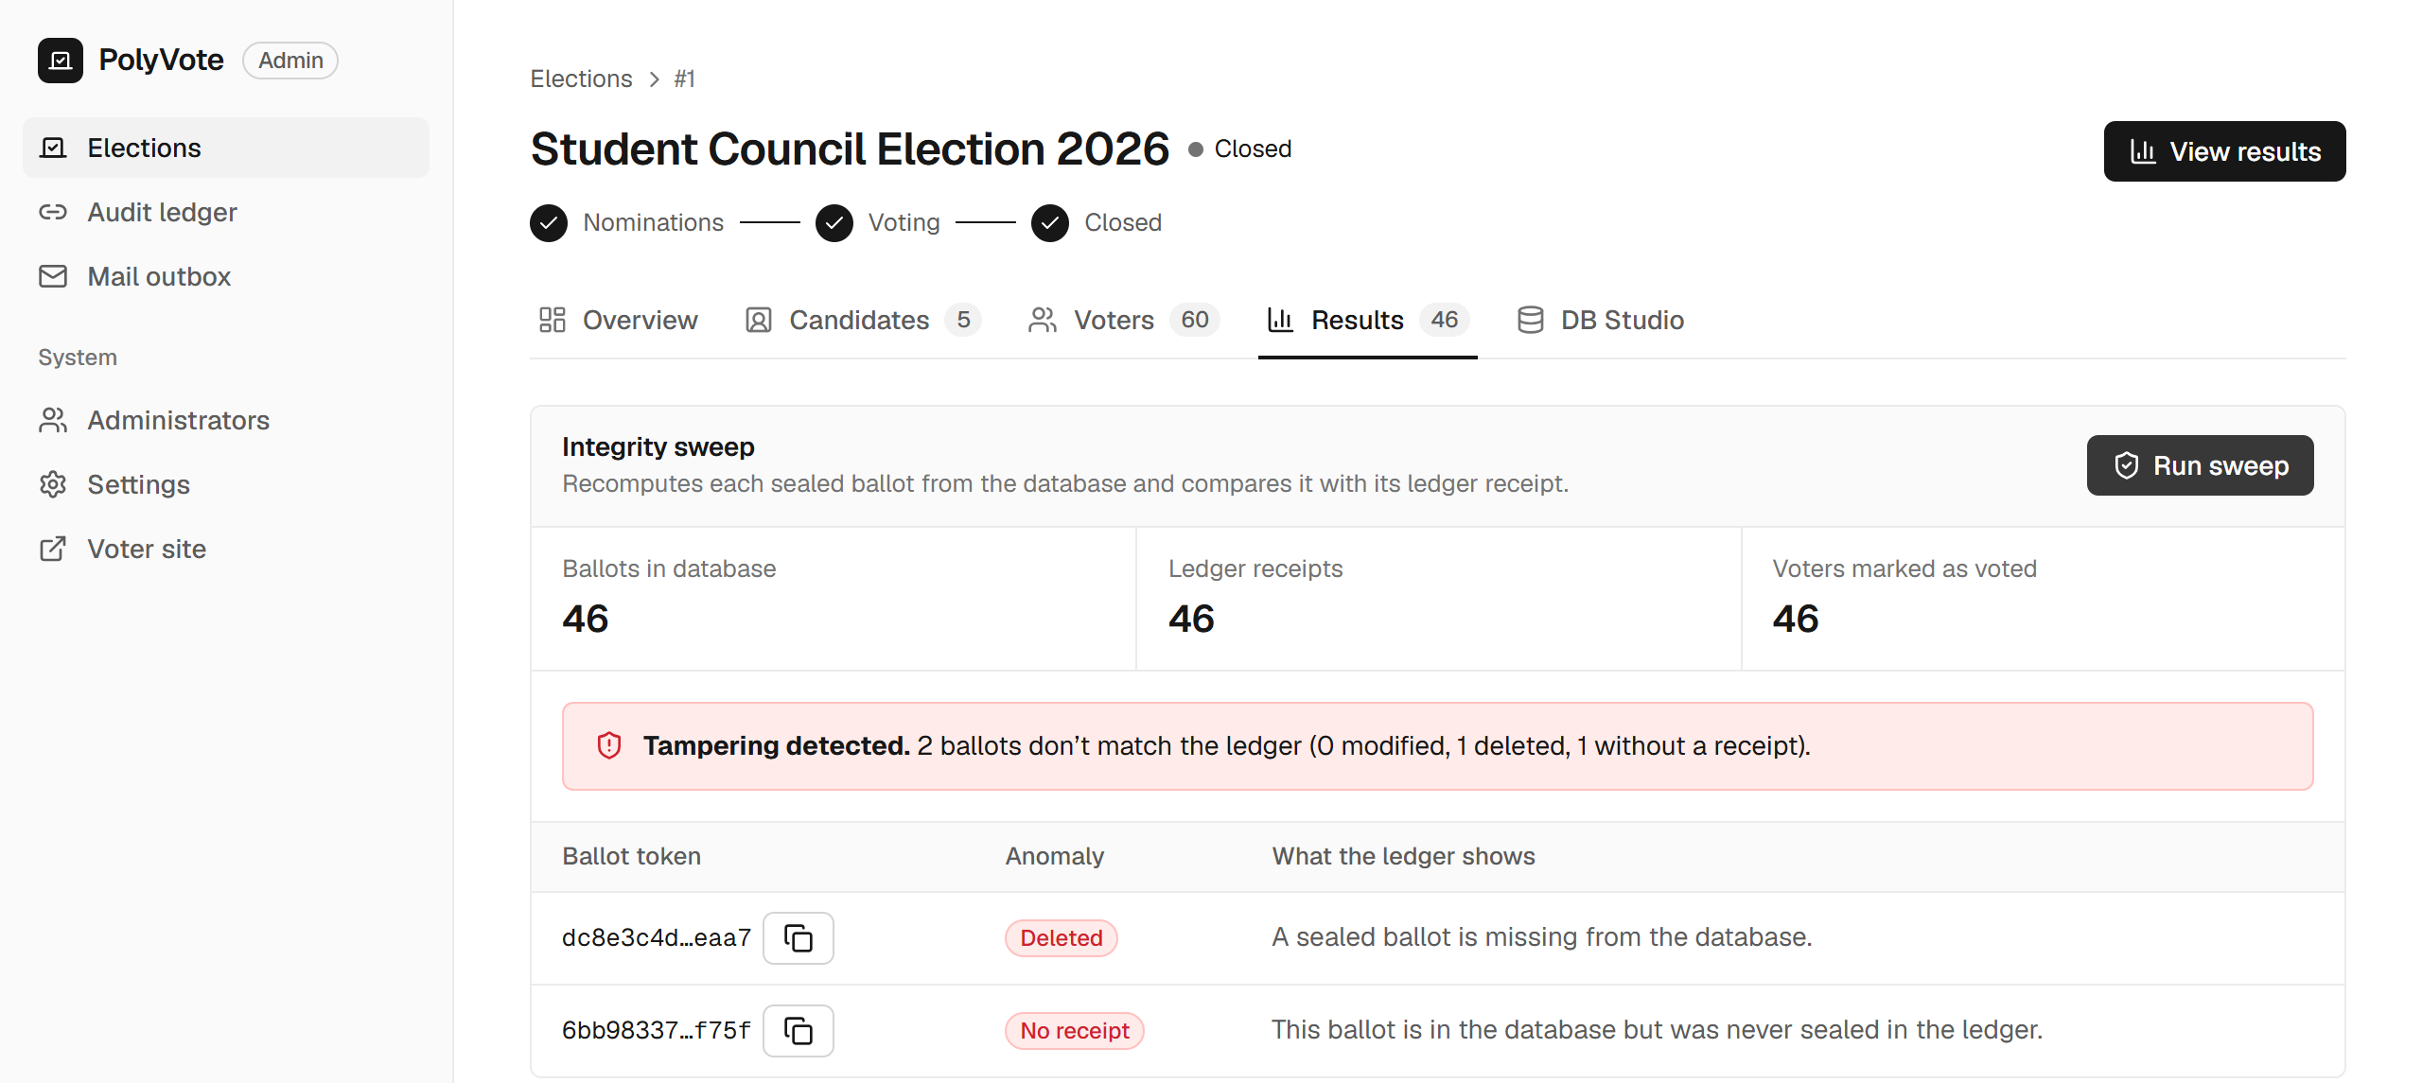
SWEEP IN ACTION
A deletion and an injection hide in the counts
• Left: counters read 46 / 46 / 46, yet the sweep reports 1 deleted and 1 without a receipt.
• Above: one edited block breaks the chain.
BACSE202 – Database Systems | Review 3 | Fall Semester 2026 · Slide 42
Notes:
Here is why counters alone are not enough. On the left, one ballot was deleted and another injected, so the counters still read forty-six, forty-six, forty-six and look perfectly healthy. The sweep nevertheless names both ballots, one deleted and one without a receipt. On the right, a single edited block makes the audit ledger page show a red banner: data tampered at block twenty.

Slide 43
WHY THE KEY MATTERS
Six scenarios the Review 2 design missed
ID | Scenario | Review 2 | Final | What closed it
C5 | Inject a ballot with no receipt | Counters only | Detected | Injected-ballot rule
C6 | Ballot stuffing: inject, forge receipt, set a flag | Not detected | Detected | Keyed chain
C9 | Truncate the last ledger block | Counters only | Detected | Reconciliation rule
C10 | Alter a ballot and rebuild the whole chain | Not detected | Detected | Keyed chain
C11 | Swap two candidates' names after voting | Not detected | Detected | Sealed roster hash
C12 | Reset a voted flag, vote again | Counters only | Detected | Reconciliation rule
Key point: C6 and C10 defeat any chain that is only hashed, because the attacker recomputes the hashes. With the HMAC key they fail at the first block the attacker cannot compute.
BACSE202 – Database Systems | Review 3 | Fall Semester 2026 · Slide 43
Notes:
Six scenarios the old design missed or only half caught. A ballot injected without a receipt, and a truncated ledger, were visible only in the counters; the new injected-ballot and reconciliation rules catch them. Renaming candidates after voting was invisible; the sealed roster hash catches it. The two serious ones are ballot stuffing with a forged receipt and a consistent rewrite of the whole chain. Both were completely undetected, because a plain hash chain lets an attacker recompute every hash. With the key, the forged or rebuilt blocks fail verification.

Slide 44
ONE-TIME CODE TESTS
14 of 14 pass, and the suite caught a real defect on the way
• Password alone gives no session; the challenge id is not a token.
• Right code opens the ballot; a used code cannot be replayed.
• Three wrong codes lock the challenge, even if the right code follows.
• Expired codes, rapid resends and a sixth code are refused.
• No email on file: clear refusal.
• Plaintext codes are absent from the database.
• A failed mail server does not block sign-in.
• No email column exists in the election database.
The defect
Test F4 first failed. The wrong-guess counter was saved inside a database context, and the request then raised an error. SQLite rolls back when an exception leaves the context, so every failed guess was recorded and then undone: unlimited guessing. The fix commits state before the error propagates. Review would not have found it; the test did.
BACSE202 – Database Systems | Review 3 | Fall Semester 2026 · Slide 44
Notes:
All fourteen one-time-code tests pass: no session from a password alone, replay refused, three wrong guesses lock the challenge, expiry, resend limits, privacy of stored codes, and resilience to a failed mail server. But it did not start that way. Test F4 failed. The attempt counter was updated inside a database context manager and the handler then raised an HTTP error; SQLite rolls back when an exception leaves the context, so every failed guess was recorded and then undone, which meant unlimited guessing. We fixed it by committing before the error propagates. It is a good argument for executable tests over review for security logic.

Slide 45
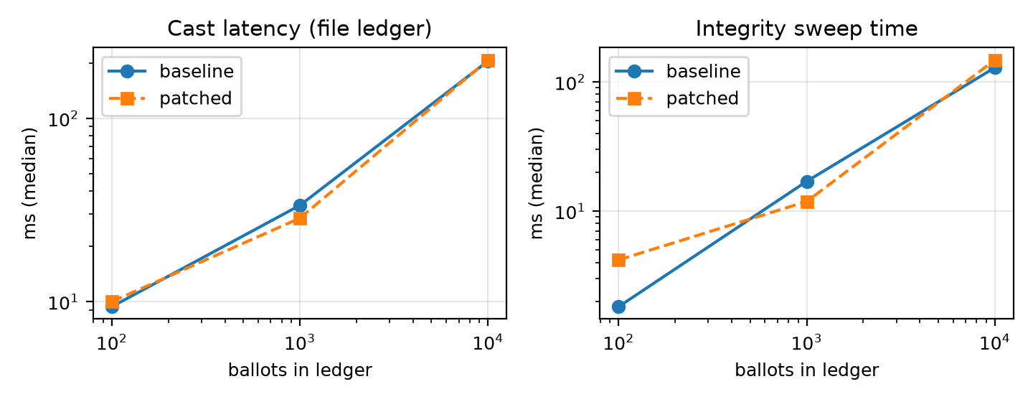
PERFORMANCE
Checks are cheap; the file ledger is the one that grows
• Sweep at 10,000 ballots: 147 ms, about 15% slower than before.
• File ledger: a cast grows from 9 to 205 ms because each append rewrites the file.
• Atlas: about 147 ms at any size (network round trip).
• The file is faster when small; Atlas wins on flat growth, concurrency control and living off-machine.
Ballots | Cast ms (file) | Sweep ms | Atlas append ms
100 | 9 | 4 | 136
1,000 | 33 | 12 | 147
10,000 | 205 | 147 | 139
BACSE202 – Database Systems | Review 3 | Fall Semester 2026 · Slide 45
Notes:
Performance. The keyed chain and the three extra rules cost little: the sweep at ten thousand ballots takes about 147 milliseconds, roughly 15 percent slower than before. The file ledger is the one that grows: a cast goes from about 9 milliseconds at a hundred ballots to 205 at ten thousand, because every append rewrites the whole file. Against Atlas an append costs about 147 milliseconds at any size, which is mostly network time on a mobile hotspot. So Atlas is not about raw speed at small sizes; it is about flat growth, concurrency control, and holding the ledger off the application machine.

Slide 46
COMPARATIVE STUDY · COVERAGE MATRIX
Coverage matrix: who documents which feature
System
F1
F2
F3
F4
F5
F6
F7
F8
F9
Yes
documented
Part
partly
No
absent
–
not documented
Helios
No
–
–
Part
Part
–
–
Yes
Part
Belenios
Part
Part
–
Part
Part
Part
–
Yes
Part
OpaVote
Yes
Part
–
–
–
Part
–
–
Part
ElectionBuddy
Part
Part
–
Part
Part
Part
Part
–
Part
TapVoter
Part
Part
–
Part
Part
Part
Part
Yes
Part
BetterVoting
Part
Yes
–
Part
Part
Part
Part
Yes
Yes
Google Forms
–
–
–
Part
–
No
–
–
Part
FlexyVotes
Yes
Yes
Yes
Part
Part
Yes
No
Yes
Part
VeriVote
–
–
Part
Part
Part
Part
–
Yes
Part
SecureVote
–
No
–
–
Part
Yes
–
–
Part
PolyVote (our tests)
Yes
Yes
Yes
Yes
Yes
Yes
Yes
Yes
Yes
33 systems read, 11 shown. F1 ranked counting · F2 many organisations · F3 database rules · F4 unlinked ballots · F5 keyed ledger and sweep · F6 email OTP · F7 QR voting · F8 receipt · F9 easy to run. Other rows: documentation we read. F5 is judged strictly (keyed chain, separate store, reconciling sweep, published attack results), so most systems score Part.
BACSE202 – Database Systems | Review 3 | Fall Semester 2026 · Slide 46
Notes:
This matrix shows eleven of the thirty-three systems against the nine features. Green means documented, amber partly, red documented as absent, and a dash means we found nothing on the pages we read, which is not the same as absent. The bottom row is PolyVote, and it is all green only because those are the cells our own tests back. Read the other rows for what they show: FlexyVotes is nearly as complete and is the closest project we found; it is missing QR voting and has a weaker form of the ledger. BetterVoting covers many features but not database rules or a ledger of ballots. The cryptographic systems, Helios and Belenios, score amber on most of these because they solve the problem differently, with encryption. Feature five is judged strictly, which is why most rows are amber there. Nothing in the matrix says PolyVote is better overall; it says that one free small-election tool documenting every column is not something we found.

Slide 47
FEATURES 3-4 · DATABASE RULES AND UNLINKED BALLOTS
Database rules and unlinked ballots
System | What its own page, README or paper documents | Match
FlexyVotes (GitHub) | Unique indexes and append-only triggers that block even raw SQL; ballot rows carry no voter key. Voters and encrypted emails share one PostgreSQL database. | F3 Yes · F4 Part
VeriVote (GitHub) | Ballots stored without voter identity; triggers, CHECK and foreign-key rules are not documented. | F3 Part · F4 Part
CIVS (Cornell) | Voter emails are erased once the election begins; ballots are stored under a hash of the receipt. | F3 – · F4 Part
Helios, Belenios | Secrecy comes from encryption, not from a schema with no linking column; ballots sit on a public ballot box. | F3 – · F4 Part
Democracy Live (USENIX 2021) | The authors report voter identity, selections and a browser fingerprint sent to the vendor. | F4 No
PolyVote: 6 of 7 direct SQL attempts refused by the engine, 13 of 13 API abuses refused, exactly 1 of 20 simultaneous casts accepted. An automated check finds no column shared by ballots and voters; emails live in a separate file.
Verdict: FlexyVotes is stronger on database rules (append-only triggers). Our known gap is the one attempt not refused: SQLite foreign keys apply per connection.
BACSE202 – Database Systems | Review 3 | Fall Semester 2026 · Slide 47
Notes:
Features three and four. FlexyVotes is the strongest comparison here: its unique indexes and append-only triggers refuse changes even from a raw SQL session, and its ballot rows have no voter key, although voters and encrypted emails live in the same PostgreSQL database. VeriVote stores ballots without identity but documents no database rules. CIVS erases voter emails once the election begins. Helios and Belenios get secrecy from encryption rather than from the schema. And the independent analysis of Democracy Live reported voter identity being sent to the vendor. For PolyVote, six of seven direct SQL attempts are refused, all thirteen API abuses are refused, and one of twenty simultaneous casts is accepted. An automated check finds no column shared by ballots and voters, and emails live in a separate file. We say plainly that FlexyVotes is stronger on database rules, and that our one miss is SQLite foreign keys, which apply per connection.

Slide 48
FEATURE 5 · TAMPER-EVIDENT LEDGER
Tamper-evident ledgers: where a keyed chain differs
System | What its own page, README or paper documents | Match
FlexyVotes (GitHub) | SHA-256 chain per organisation inside PostgreSQL, verified every 6 hours; Merkle bulletin board; 204 tests, no published attack table. | F5 Part
VeriVote (GitHub) | SHA-256 chain in MongoDB with an audit endpoint and a manual tamper demo; no HMAC key, no reconciliation. | F5 Part
SecureVote (GitHub) | Hash-linked ledger with hashed one-time codes; no ranking; a single instance by design. | F5 Part
BetterVoting (GitHub) | Audit log covers administrator actions (sharing a link, revealing a ballot link), not a chain of ballots. | F5 Part
Helios, Belenios | A public, cryptographically verifiable ballot box: a stronger guarantee by a different mechanism. | F5 Part
Voatz (USENIX 2020) | Claims a blockchain; the analysis found no public formal description and reported flaws. | F5 Part
PolyVote: an HMAC-keyed chain in a separate MongoDB store, a six-rule sweep and a published attack suite. 13 of 13 attacks caught against 6 of 13 for the plain-chain design (baseline identical in 3 runs); C6 and C10 only fail with the key.
Verdict: better than a plain chain against someone who can write to the database. Not a match for cryptographic verification, and whoever holds the key can still forge.
BACSE202 – Database Systems | Review 3 | Fall Semester 2026 · Slide 48
Notes:
Feature five, the audit ledger. Hash-chained logs are common: FlexyVotes keeps one per organisation in PostgreSQL and verifies it every six hours, VeriVote keeps one in MongoDB, SecureVote has a hash-linked ledger, and BetterVoting has an audit log of administrator actions. Helios and Belenios use a public verifiable ballot box, which is a stronger guarantee by a different mechanism, and Voatz claimed a blockchain that analysts could not verify. What we did not find documented elsewhere is the combination of a keyed chain, a separate store, a sweep that reconciles ballots, receipts, flags and candidates, and published attack results. In our suite that combination catches 13 of thirteen attacks against 6 for a plain chain, identical across three runs. The limit: whoever holds the key can still forge, and cryptographic systems remain stronger on verification.

Slide 49
FEATURES 6-7 · SECOND FACTOR AND QR VOTING
Emailed codes exist elsewhere; so does QR sharing
System | What its own page, README or paper documents | Match
FlexyVotes (GitHub) | Keyed-hash one-time code with expiry, attempt limit and hourly rate limit; QR only for event ticket check-in. | F6 Yes · F7 No
SecureVote (GitHub) | Hashed one-time code with expiry and attempt limits. | F6 Yes
VeriVote (GitHub) | Email one-time code with rate limits. | F6 Part
BetterVoting | A unique emailed link per voter; docs mention no one-time code or 2FA; a QR code shares the election link. | F6 Part · F7 Part
TapVoter | Single-use key handed out by QR poster or email; no emailed second-factor code documented. | F6 Part · F7 Part
Belenios | Default voter login is an emailed short code at voting time; hashing, expiry and limits not documented. | F6 Part
PolyVote: password plus an emailed six-digit code (hashed, 5 minutes, single use, 3 guesses, resend limits). 14 of 14 tests pass, and one real defect (unlimited guesses) was found and fixed. A QR code on the vote page opens the ballot on any phone; a real ballot was cast from one.
Verdict: F6 alone is not unique: FlexyVotes and SecureVote have it too. What we did not find documented is a scan-to-vote QR flow together with an emailed code.
BACSE202 – Database Systems | Review 3 | Fall Semester 2026 · Slide 49
Notes:
Features six and seven. Emailed one-time codes are not new: FlexyVotes and SecureVote hash the code and limit attempts, VeriVote rate-limits it, and Belenios sends a short code by default. BetterVoting and TapVoter use single-use links or keys, and both share them by QR. PolyVote adds a six-digit code, hashed, valid five minutes, single use, three guesses, with resend limits, and fourteen of fourteen tests pass, including the one that found a real defect. A QR code on the vote page opens the ballot on any phone, and we cast a real ballot from one. So feature six alone is not unique. The combination of scan-to-vote with an emailed code is what we did not find documented elsewhere, and we say so in those words.

Slide 50
COMPARATIVE STUDY · CLOSEST PROJECTS
The three closest projects, and what each lacks
Closest project (source) | What it has | What we found it does not document
FlexyVotes, Django and PostgreSQL (github.com/deOpty/flexyvotes) | Many organisations; instant-runoff and STV; triggers that block raw SQL; ballots with no voter key; hash-chained audit log; hashed single-use email OTP | QR scan-to-vote; an HMAC-keyed chain; a separate document store and email database; a reconciling sweep; published attack results
VeriVote, Node, React and MongoDB (github.com/9022574361/Online_Voting_System) | SHA-256 chain in MongoDB with an audit endpoint; ballots without voter identity; email OTP with rate limits; receipt hash | Ranked counting; many organisations; database rules; HMAC key; reconciliation; automated attack suite
BetterVoting (github.com/Equal-Vote/bettervoting) | Ranked-choice voting; teams; QR sharing; receipts; free and open source (AGPL) | Database-enforced rules; a ledger of ballots (its audit log covers admin actions); one-time-code factor; reconciliation and attack tests
What we claim: every single feature exists somewhere, so PolyVote is not the first or the only one. We found no free small-election tool documenting all of them together. What we do not claim: to be more secure than Helios, Belenios or ElectionGuard. Limits: GitHub code search and non-English repositories were not covered.
BACSE202 – Database Systems | Review 3 | Fall Semester 2026 · Slide 50
Notes:
The three closest projects. FlexyVotes, a Django and PostgreSQL project created in August, is the nearest: it has many organisations, instant-runoff and STV, triggers that block raw SQL, ballots with no voter key, a hash-chained audit log and hashed email codes. We did not find in it QR scan-to-vote, an HMAC-keyed chain, a separate document store or email database, a sweep that reconciles ballots, receipts, flags and candidates, or published attack results. VeriVote has a SHA-256 chain in MongoDB with an audit endpoint and email codes, but no ranked counting, organisations or database rules. BetterVoting has ranked-choice, teams, QR sharing and receipts, but no database rules, ballot ledger or one-time code. So our claim is narrow and checkable: every feature exists somewhere, and we found no free small-election tool documenting all of them together. We do not claim to be more secure than the cryptographic systems. The search had limits, which we state.

Slide 51
COMPARATIVE STUDY · VERDICT
Best for small elections, not a Helios replacement
PolyVote IS A GOOD FIT WHEN
CHOOSE HELIOS / BELENIOS WHEN
• A club, council or class needs ranked-choice results.
• Someone must be able to run it in an afternoon, free.
• You need proof that edits and deletions are caught.
• Voters should confirm themselves by email and vote from a phone.
• The administrator itself cannot be trusted.
• Voters must verify their own ballot content.
• Coercion or vote selling is a real threat.
• A public cryptographic audit is required.
Our claim: for small elections, PolyVote adds database-level rules and tested tamper detection to an easy setup. It is not the strongest on verifiability.
BACSE202 – Database Systems | Review 3 | Fall Semester 2026 · Slide 51
Notes:
The verdict. For the problem we target, small and medium elections such as clubs, councils and classes, PolyVote is a good fit: ranked-choice results, an afternoon to set up, free to run, proof that edits and deletions are caught, and voters who confirm by email and can vote from a phone. The cryptographic systems are the better choice when the administrator cannot be trusted, when voters must verify their own ballot content, when coercion is a threat, or when a public cryptographic audit is required. We say this openly because it makes the claim credible. Our claim is modest: for small elections PolyVote adds database-level rules and tested tamper detection to an easy setup, and it is not the strongest on verifiability.

Slide 52
REVIEW 2 DESIGN VERSUS FINAL DESIGN
What improved, measured
Measure | Review 2 | Final
Tampering detected automatically | 6 of 13 | 13 of 13
Forged receipt or chain rewrite | Undetected | Detected (key)
Candidate renaming | Undetected | Detected (sealed roster)
Ghost voter added to the roster | Undetected | Detected (voter seal)
Voter authentication | Password | Password + emailed code
Ledger storage | Local file | MongoDB Atlas
Ledger append at 10,000 ballots | 205 ms (file, whole cast) | ~147 ms (Atlas, flat)
Sweep at 10,000 ballots | 129 ms | 147 ms
Access | Local only | Public link + QR
BACSE202 – Database Systems | Review 3 | Fall Semester 2026 · Slide 52
Notes:
The summary of improvements over our own Review 2 design. Automatic detection of tampering rises from six to thirteen of thirteen. Forged receipts, rebuilt chains and renamed candidates move from undetected to detected. Authentication goes from password only to password plus an emailed code. The ledger moves to Atlas, and the system becomes publicly reachable. The cost is small: the sweep at ten thousand ballots goes from about one hundred and twenty-nine to about one hundred and forty-seven milliseconds in the original measurement; the extended evaluation re-measures it with the voter seal.

Slide 53
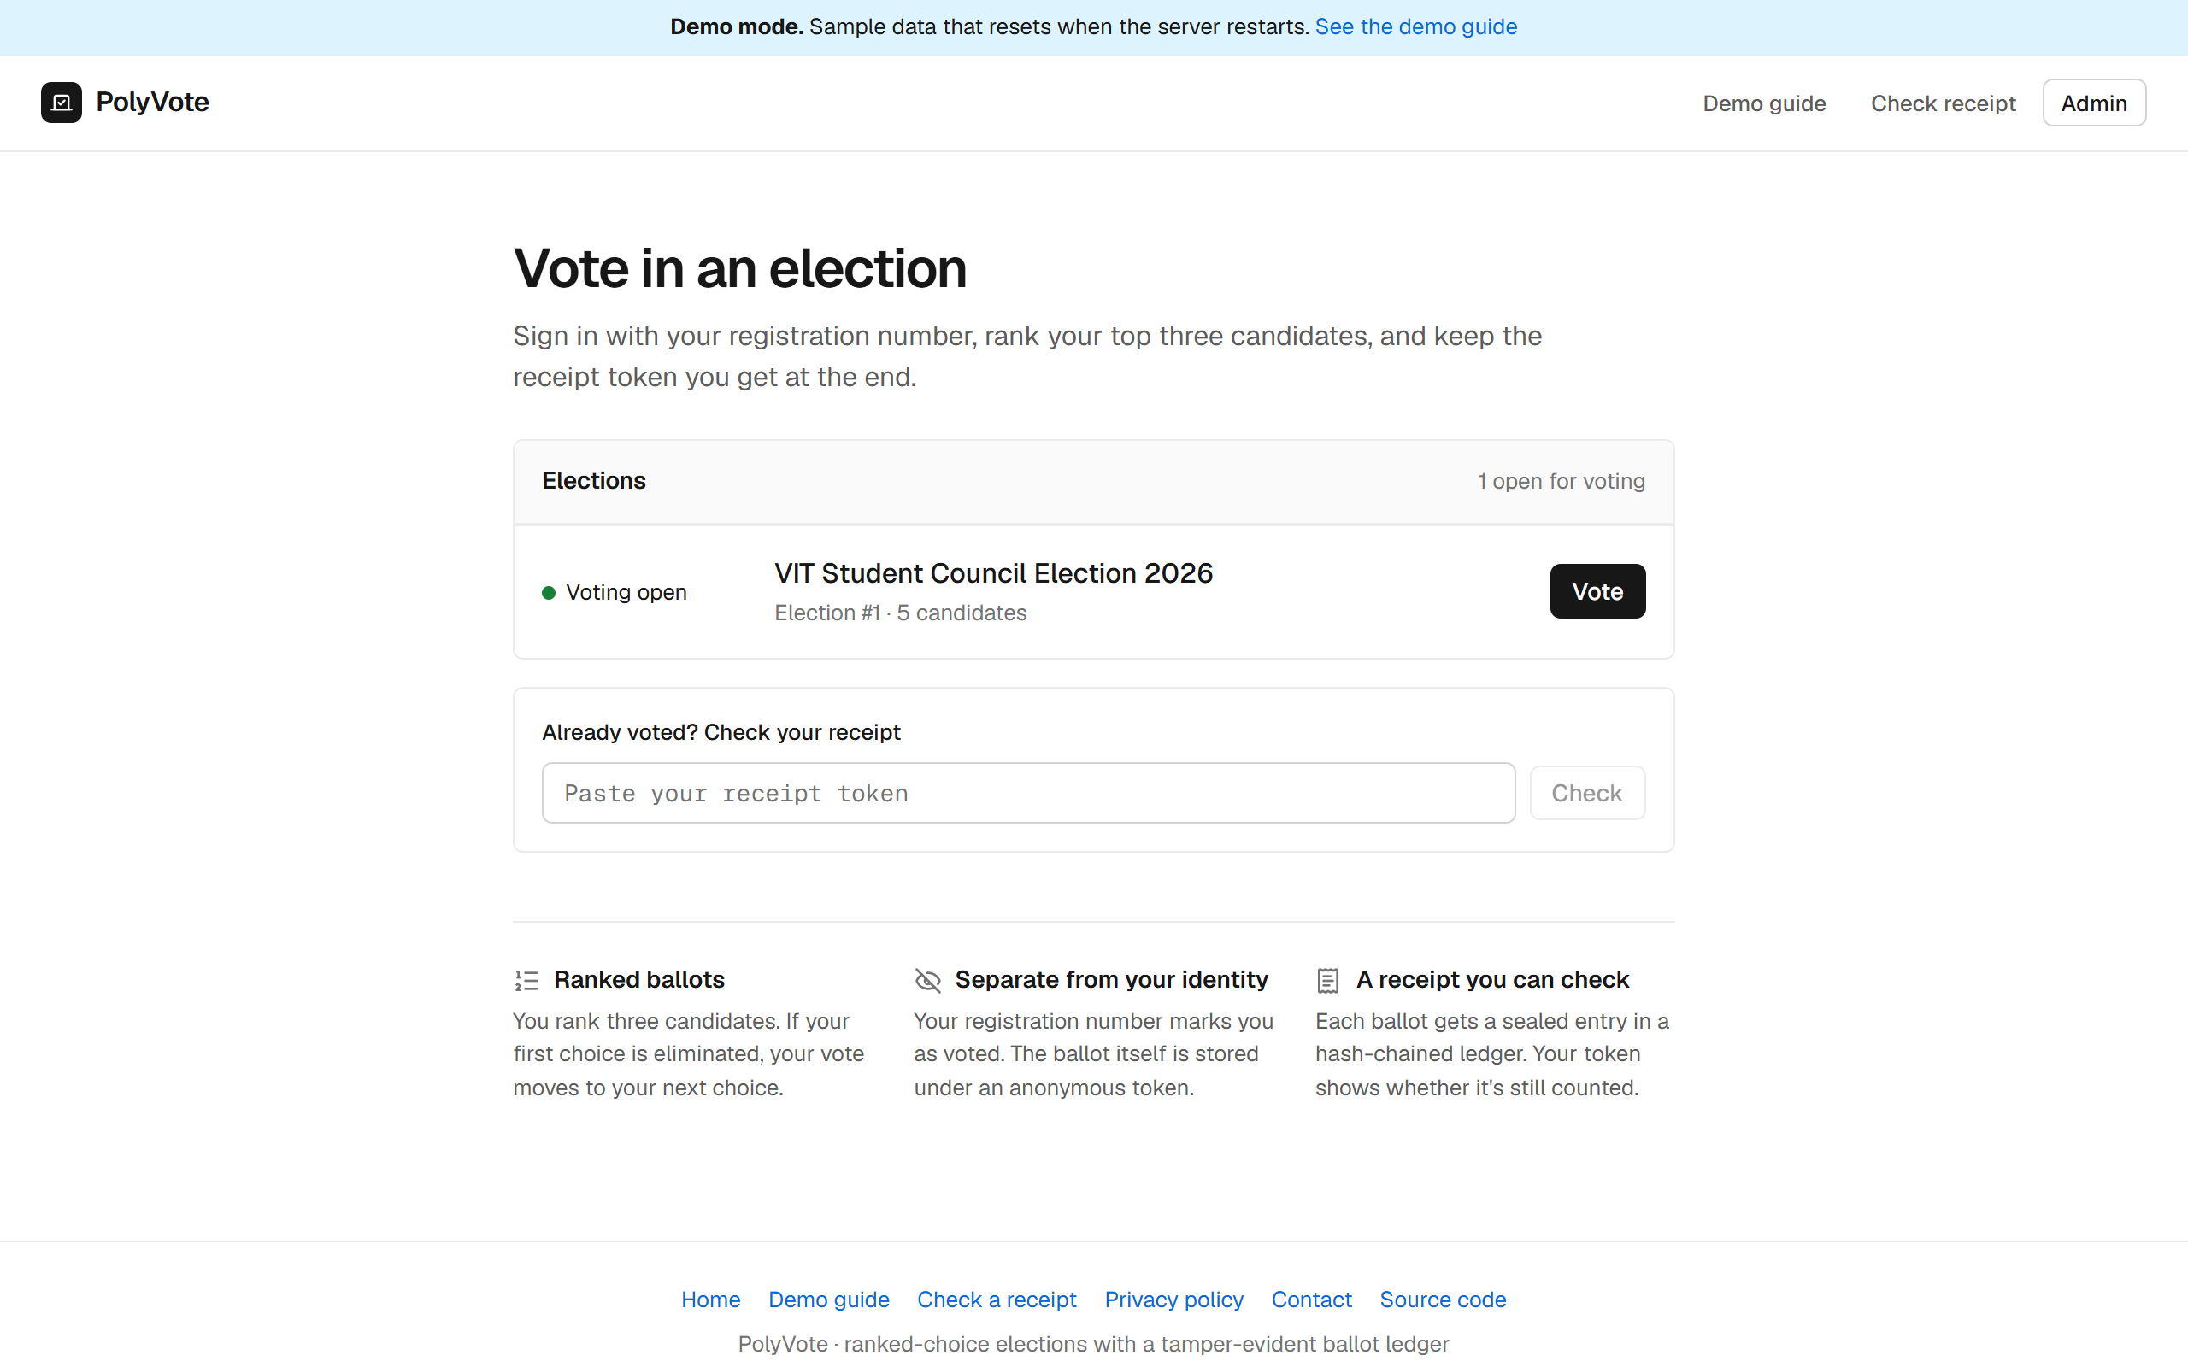
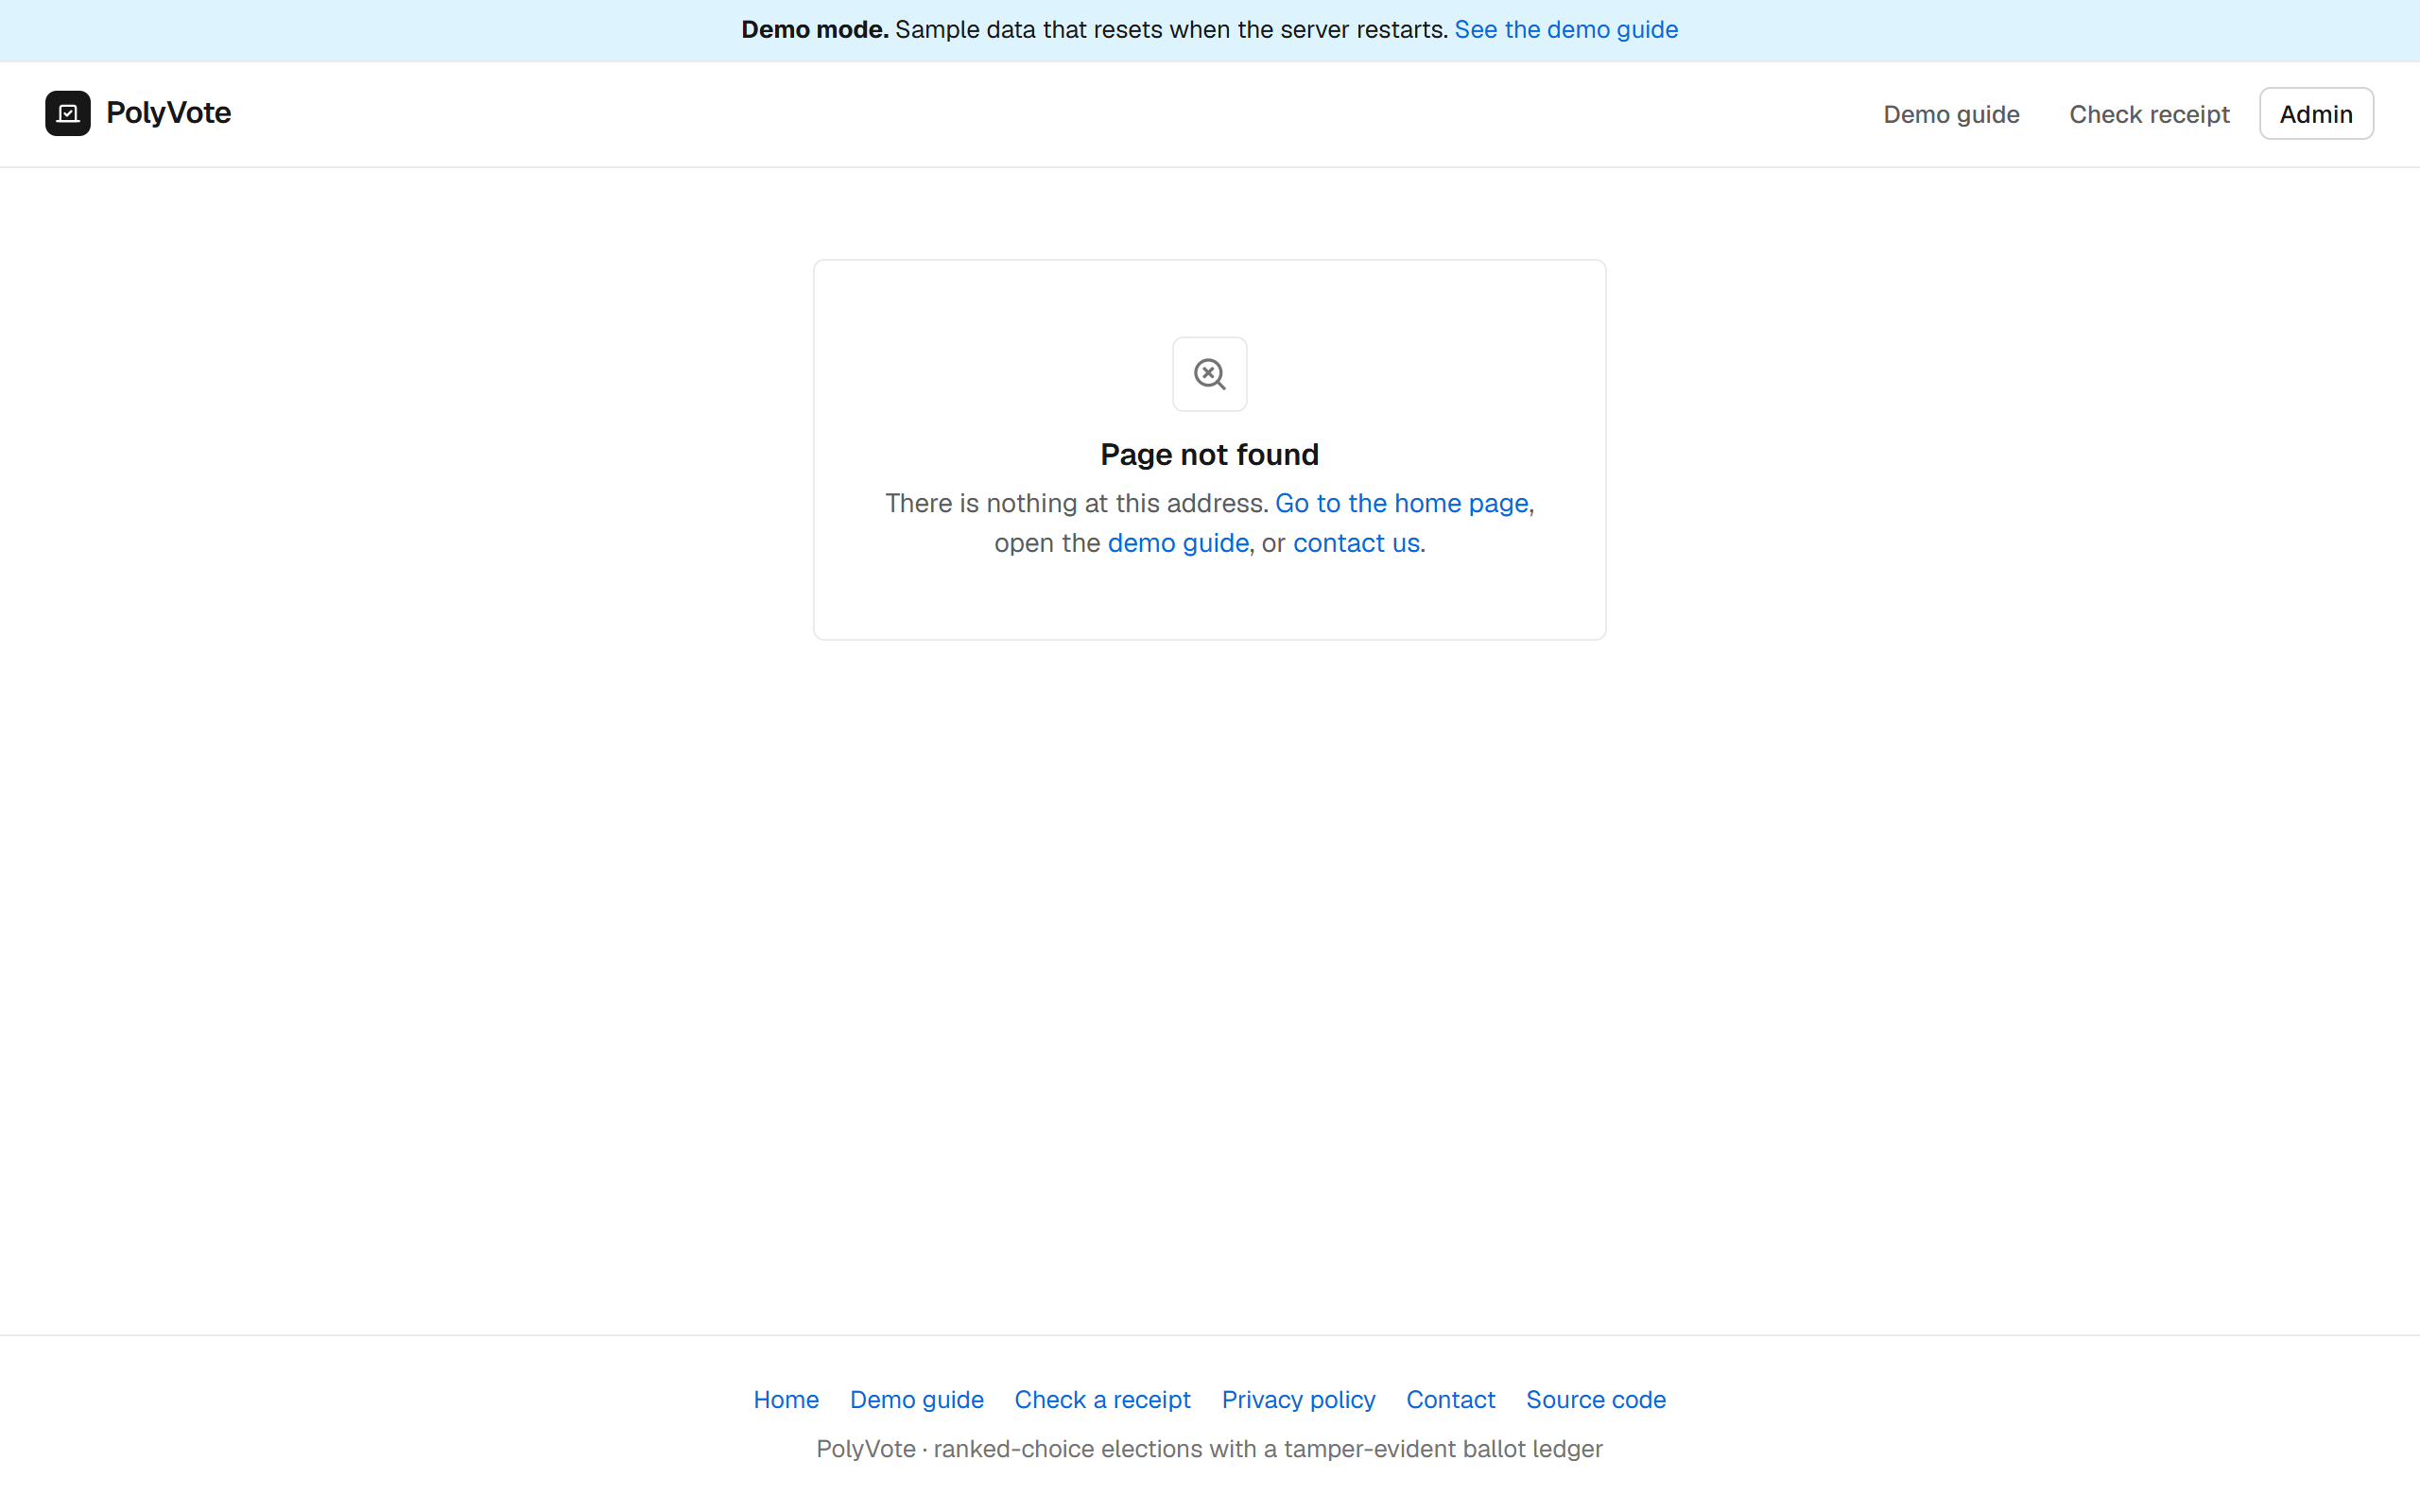
THE WEB PAGE · LAUNCH CHECKLIST
Website launch checklist: 17 pass, 4 N/A, 0 fail
PASS Server-side rendering (pre-rendered shell)
N/A HTTPS and mobile viewport
PASS robots.txt
PASS sitemap.xml
PASS Unique title tags
PASS Meta descriptions
PASS One H1 per page
PASS Canonical tags
PASS Open Graph images
PASS Custom 404 page
PASS 301 redirects
PASS Alt text on images
N/A WebP images
PASS Lazy loading
PASS Organization schema
PASS Breadcrumbs
PASS Internal links
N/A Google Analytics
N/A Search Console
PASS Privacy policy
PASS Working contact form
N/A: HTTPS (a local run; the host provides it), WebP (no raster images in the pages), Google Analytics and Search Console (need the owner's own IDs).
BACSE202 – Database Systems | Review 3 | Fall Semester 2026 · Slide 53
Notes:
A friend shared a launch checklist for websites, and we turned it into an automated check. The script experiments/web_checklist.py tests a running copy of the site against twenty-one items and prints pass, fail or not applicable with the evidence. Result on a local run of the current code: 17 pass, 4 not applicable, 0 fail. The pass items include a pre-rendered page shell with one heading and unique title and description for each page, robots.txt and a sitemap, canonical tags, a link-preview image, a custom 404 page, 301 redirects, lazy-loaded routes, structured data for the organisation and breadcrumbs, a privacy policy, and a contact form that stores messages and ignores bots. The four not-applicable items are HTTPS, because a local run is plain http and the hosting provider supplies it; WebP, because the pages have no raster images; and Google Analytics and Search Console, which need the owner's own identifiers and are built in but switched off. To be exact, the page shell is pre-rendered HTML that the React app then replaces; it is not full server-side rendering. We will rerun the same script against the public link after the next deploy.

Slide 54
PRIVACY AND ETHICS
Privacy and ethics: what is stored, and where
Data | Where it lives | Stored as
Registration number | Election database | Roster entry
Password | Election database | Salted PBKDF2 hash only
Email address | Verification database (separate file) | Never stored with ballots
One-time code | Verification database | Keyed hash only; 5 min, one use
Your ballot | Election database | Random token; no voter column
Receipt block | Audit ledger | Token and hash of the ranks
Contact message | Verification database | Admins only
ETHICS AND LIMITS
• Sample data: the demo uses sample voters and resets on restart.
• Officers see more: the roster, emails and an outbox that lists codes for ten minutes. We kept it so a demo never stalls; a real election should switch it off.
• Receipts: prove a ballot is counted, not its content.
• No tracking: no tracking cookies; analytics is off unless the operator enables it.
• Not for binding votes: no independent review yet; passwords are salted PBKDF2.
The ballot table and the voter table share no column, so the database cannot say who cast which ballot. A person with direct file access could read ballots, but not link them to people.
BACSE202 – Database Systems | Review 3 | Fall Semester 2026 · Slide 54
Notes:
Privacy and ethics, taken from our own privacy page. The table shows where each piece of data lives. The registration number and a password hash are in the election database. The voter's email address is in a separate verification database and is never stored with ballots. The one-time code is stored only as a keyed hash and lasts five minutes. The ballot is stored under a random token with no voter column, and the receipt block holds the token and a hash of the ranks. Contact messages are readable by administrators only. The ethical points we want to be upfront about. The demo uses sample data and resets when the server restarts. Election officers can see the roster, the emails and an outbox that lists codes for ten minutes; we kept the outbox so a live demo never stalls on a slow email, and a real election should switch it off. A receipt shows a ballot is counted but not what it says, though anyone holding both the token and database access could see that one ballot. There are no tracking cookies. And this is a course project with no independent security review, so it is not for binding elections yet. Passwords are now salted PBKDF2, upgraded from plain SHA-256 after the first submission.

Slide 55
LIMITATIONS AND FUTURE WORK
What we do not claim, and what comes next
Limitation | Direction
Insider with key and both stores can forge (A6) | Publish the chain head to an external witness; managed secret store
Roster provenance: the seal catches later changes, not a wrong roster at sealing; a key holder can re-seal (A7) | Dual control or an external record when registration closes
Not end-to-end verifiable; receipt shows recorded, not content | Cast-as-intended mechanism, or a verifiable protocol if needed
Default admin login; no lock-out, session expiry or API security headers | Forced first-login change; lock-out with back-off; session expiry; response headers
No user study yet | Task-based usability test; protocol and analysis script are prepared
Email is a weak second factor | Authenticator app (TOTP) or printed one-time slip
IRV ties broken arbitrarily; no statistical audit | Published tie rule; risk-limiting audit
SQLite foreign keys are per connection; single node | Oracle or PostgreSQL with PL/SQL, roles; cloud platform
BACSE202 – Database Systems | Review 3 | Fall Semester 2026 · Slide 55
Notes:
What we do not claim. An insider holding the key and both stores can still forge a chain; the remedy is an external witness for the chain head. The roster seal catches later changes to the voter roster but not a wrong roster at sealing, and a key holder can re-seal. We are not end-to-end verifiable. Passwords are now salted PBKDF2; the public demo still uses known passwords on purpose, and there is no lock-out or session expiry. We have not run a user study. Email is a weak factor compared with an authenticator app. Ties in instant-runoff are broken arbitrarily. And SQLite is a single-node engine with per-connection foreign keys, so the planned move to Oracle with PL/SQL and roles also fixes that.

Slide 56
GLOSSARY
Glossary in plain words
Term | In plain words
Hash | A fixed-length fingerprint of data. Change one character and the fingerprint changes completely.
HMAC | A hash made with a secret key, so only someone holding the key can produce a valid one.
Hash chain | Each record stores the previous record's hash, so editing one breaks every later link.
Ledger, block | The append-only list of receipts; one block for each ballot.
Instant-runoff | Rank candidates; last place drops out each round and its ballots move on, until someone has a majority.
OTP | One-time password: a short code that works once and expires.
Term | In plain words
Roster hash | A fingerprint of the candidate list, sealed into every block.
Receipt token | A random code that shows a ballot is recorded. It does not show the vote.
Trigger, CHECK, UNIQUE | Rules the database enforces itself, even against direct SQL.
Integrity sweep | Recomputes the election from the database and compares it with the ledger.
Polyglot persistence | Different kinds of database for different jobs: SQLite and MongoDB here.
Multi-tenant | Many organisations share one install, each with its own elections.
BACSE202 – Database Systems | Review 3 | Fall Semester 2026 · Slide 56
Notes:
A glossary for anyone new to these words. A hash is a fingerprint of data. An HMAC is a hash made with a secret key, so only the key holder can produce a valid one. A hash chain links records so that editing one breaks all later links. The ledger is the append-only list of receipts, one block per ballot. Instant-runoff is the counting method: rank candidates, and each round the last-place candidate drops out and their ballots move to their next choice until someone has a majority. An OTP is a one-time password, a short code that works once and expires. The roster hash is a fingerprint of the candidate list sealed into every block. The receipt token shows a ballot is recorded but not how it voted. Triggers, CHECK and UNIQUE constraints are rules the database enforces itself. The integrity sweep recomputes the election from the database and compares it with the ledger. Polyglot persistence means using different databases for different jobs, and multi-tenant means many organisations share one install.

Slide 57
EVIDENCE
Evidence: where every claim can be checked
Claim in this deck | How it was produced | Where to look
Tampering caught: 6 of 13 (old), 13 of 13 (final) | Executable suite; baseline identical in 3 runs, final design re-run | experiments/results/summary.json, detection.png
Database refuses bad votes (6 of 7; 13 of 13; 1 of 20) | Direct SQL and API tests | experiments/run_experiments.py
14 of 14 one-time-code tests | Tests F1 to F14 on a throwaway copy | experiments/run_experiments.py
Sweep +15% at 10,000 ballots; Atlas append flat | Benchmarks, median of 3 runs | bench.png, mongo_bench.json
Website checklist 17 / 4 / 0 | Automated check of 21 items | experiments/web_checklist.py, web_checklist.json
What 33 other systems offer | Their own pages, READMEs, papers; a URL for every cell | docs/review3/uniqueness_evidence.md
Closest projects and their gaps | FlexyVotes code and docs read directly | docs/review3/uniqueness_evidence.md
Search method: 23 web queries, 20 GitHub repository searches, 33 systems, on 23 October 2026. Not covered: GitHub code search, non-English and private repositories, commercial internals.
BACSE202 – Database Systems | Review 3 | Fall Semester 2026 · Slide 57
Notes:
This is the back-up slide for any question that starts with how do you know. Each claim in the deck maps to something that can be rerun or opened. The tampering numbers come from the executable suite, run three times with identical outcomes. The prevention and one-time-code results come from the same experiments script. The benchmark numbers are medians of three runs, with the Atlas figures from a separate script. The website checklist is an automated script with its output saved. And everything we say about other systems comes from their own pages, READMEs and papers, with a URL for every cell in the evidence file. The search method and its limits are at the bottom: twenty-three web queries, twenty GitHub repository searches, thirty-three systems, on the twenty-third of October, without GitHub code search or non-English and private repositories.

Slide 58
INDIA ONLY · NIRF TOP-100 HOSTS · IEEE-LINKED
IEEE-linked venues at NIRF top-100 hosts
# | Venue | Host university (NIRF 2025 rank) | Submit by | Student fee, INR | Held | IEEE status
1 | IEEE SANKALP 2027 | ABV-IIITM, Gwalior (Engineering 96) | 30 Nov 2026 | 7,000 | 9-11 Apr 2027 | Record #73342 shown
2 | ICDSBS 2027 | SRM IST (Overall 22) | 5 Jan 2027 | 8,000 | 22-23 Apr 2027 | Record #69077 printed; may be an old edition
3 | ICESICSC-2027 | KIIT, Bhubaneswar (Overall 27) | 30 Oct 2026 | 9,000 | 20-21 Feb 2027 | IEEE claimed, no record
4 | Confluence 2027 | Amity University, Noida (Overall 37) | 4 Dec 2026 | 9,440 incl. GST | 21-22 Jan 2027 | Record #71526 shown
5 | ICRITO 2027 | Amity University, Noida (Overall 37) | 15 Dec 2026 (abstract 15 Nov) | not read | 11-12 Feb 2027 | Record #72560 on its page; last year in Xplore and Scopus
6 | CoaCoNS 2027 | SRM IST (Overall 22) | 20 Nov 2026 | not published | 3-4 May 2027 | Record #72806, "awaiting IEEE"
7 | GTSS 2027 | MMMUT, Gorakhpur (Overall 99) | 31 Oct 2026 | not read | 12-13 Mar 2027* | Record #72645 only in an IEEE vTools notice
"Record shown" means a record number is on the official page; I read ICRITO's page myself, and the others come from research notes. Nothing is confirmed for IEEE Xplore until proceedings are published, and record numbers should be checked on the IEEE site. *GTSS dates differ between its site and the IEEE notice. ICESICSC and GTSS close within days. Ranked by fee, unknown fees last.
BACSE202 – Database Systems | Review 3 | Fall Semester 2026 · Slide 58
Notes:
Your professor suggested IEEE conferences run by NIRF top-100 institutions, so this slide lists the open ones with IEEE signals, sorted by fee with unknown fees last. We used the 2025 India Rankings, the latest published. SANKALP at the IIIT in Gwalior costs seven thousand rupees and shows an IEEE record number. ICDSBS and CoaCoNS are at SRM; ICDSBS prints a record number that may belong to an older edition, and CoaCoNS says it is awaiting IEEE. ICESICSC at KIIT closes on the thirtieth of October. Confluence and ICRITO are both at Amity University Noida: Confluence shows record seventy-one five twenty-six, and ICRITO shows record seventy-two five sixty on its own page, with last year's proceedings in IEEE Xplore and Scopus, a six-page IEEE format, and a full-paper deadline of the fifteenth of December. GTSS at MMMUT Gorakhpur has a record number only in an IEEE notice and conflicting dates. In every case, an IEEE record number on a conference page is not a guarantee of IEEE Xplore, so we check it on the IEEE site before paying.

Slide 59
INDIA ONLY · NIRF TOP-100 HOSTS · OTHER OPEN VENUES
Other open venues at NIRF top-100 hosts, cheapest first
# | Venue | Host university (NIRF 2025 rank) | Submit by | Student fee, INR | Held | Indexing / format
1 | SCES-2027 | MNNIT Allahabad, Prayagraj (Engineering 62) | 15 Nov 2026* | 5,900 incl. GST | 12-14 Mar 2027 | Claimed
2 | IEEE COEP CON 2027 | COEP Technological Univ., Pune (Engineering 90) | 31 Mar 2027 | 6,000† | 4-6 Jun 2027 | IEEE in the name; indexing claimed
3 | ICFCIT 2027 | SRM IST (Overall 22) | 20 Apr 2027 | 7,000 | 21-23 Sep 2027 | No IEEE or Springer claim
4 | ICSSD 2027 | NIT Tiruchirappalli (Engineering 9) | 10 Nov 2026 | 7,500 early, 10,000 | 4-6 Feb 2027 | Springer, 10-12 pages; secure software
5 | WcCST-2027 | Chandigarh University (Overall 32) | 10 Dec 2026 | 8,500 | 11-12 Mar 2027 | IEEE co-sponsorship "subject to approval"
6 | NGCAPS-2027 | Lovely Professional University (Overall 49) | 15 Nov 2026 | 9,000 | 16-17 Apr 2027 | IEEE Xplore only "proposed"
7 | INDIACom-2027 | BVICAM, Bharati Vidyapeeth (parent only, University 59) | 7 Dec 2026 | 9,440 incl. GST | 7-9 Apr 2027 | Claimed
8 | i-PACT 2027 | VIT, Vellore (Overall 21) | 31 May 2027 | 12,000 | 2-3 Sep 2027 | Claimed; a power-engineering topic
*Page marks the date tentative. †Fee read from a flattened table. Topic fit is best for NGCAPS-2027 (security, blockchain, database tracks) and ICSSD 2027 (secure software, privacy, databases). Not usable: venues hosted outside the top 100, closed calls, and off-topic energy, RF, power or biomedical conferences. The search tools could not read the IEEE conference calendar, so more venues may exist.
BACSE202 – Database Systems | Review 3 | Fall Semester 2026 · Slide 59
Notes:
These open venues are also at NIRF top-100 hosts, but their IEEE status is weaker or absent. SCES at Motilal Nehru National Institute is the cheapest at about five thousand nine hundred rupees. COEP CON in Pune has IEEE in its name but its indexing is only claimed. ICSSD at NIT Tiruchirappalli is the best topic match, a secure software conference with privacy and database tracks, but it publishes with Springer in a ten to twelve page format, so it is not an IEEE venue and our paper would need expanding. NGCAPS at Lovely Professional University has security, blockchain and database tracks, but IEEE Xplore is only proposed. INDIACom is borderline because only the parent university is ranked. i-PACT is on our own campus but is a power-engineering conference. We could not read the IEEE conference calendar with our tools, so there may be more venues that we did not find.

Slide 60
RECOMMENDED SUBMISSION ORDER
One venue at a time: dual submission is not allowed
Step | Venue | Host university | Submit by | Why this order
1 | ICRITO 2027 | Amity University, Noida | 15 Dec 2026 | IEEE record number on its own page; 6-page IEEE format; last year's papers are in Xplore and Scopus
2 | IEEE SANKALP 2027 | ABV-IIITM, Gwalior | 30 Nov 2026 | Record shown; security and distributed-database tracks; INR 7,000; choose it if you want to submit sooner
3 | Confluence 2027 | Amity University, Noida | 4 Dec 2026 | Record shown; INR 9,440; quick decision
4 | NGCAPS-2027 | Lovely Professional University | 15 Nov 2026 | Topics fit, but IEEE Xplore is only proposed
5 | ICSSD 2027 | NIT Tiruchirappalli | 10 Nov 2026 | On topic, but Springer, 10-12 pages and not IEEE
Before submitting: pick one venue now, because decisions arrive after most of these deadlines. Check the IEEE record number on the IEEE site, recheck the deadline and the NIRF edition (a 2026 list may appear), remove author names where double-blind, and follow the venue's AI-disclosure rule. No venue publishes a student fee waiver, and VIT has no public undergraduate reimbursement policy, so budget the fee as our own cost.
BACSE202 – Database Systems | Review 3 | Fall Semester 2026 · Slide 60
Notes:
The recommended order within the India and NIRF filter. Because we cannot submit to two venues at once and decisions arrive after most of these deadlines, the practical advice is to pick one venue now. ICRITO at Amity Noida is first: its own page shows an IEEE record number, a six-page IEEE format, a full-paper deadline of the fifteenth of December, and last year's proceedings in IEEE Xplore and Scopus. SANKALP at Gwalior is the alternative if we want to submit earlier, with security and distributed-database tracks and a fee of seven thousand rupees. Confluence is a quick-decision fallback. NGCAPS fits the topics but IEEE is only proposed, and ICSSD fits the topic but is Springer. Before submitting, verify the record number on the IEEE site, recheck deadlines, remove author names for double-blind venues, and follow AI-disclosure rules. No venue publishes a student fee waiver, and VIT has no public undergraduate reimbursement policy, so we budget the fee as our own cost.

Slide 61
PROJECT CONCLUSION
Planned versus delivered
Item planned at Reviews 1 and 2 | Status | Note
Multi-tenant normalised schema, views, trigger | Delivered | On SQLite
Instant-runoff tally and admin console | Delivered | Round-by-round results
Hash-chained receipts and integrity sweep | Delivered, extended | Keyed chain, six sweep rules
MongoDB ledger | Delivered | Atlas, with a file fallback
Second factor for the voter | Delivered | Emailed one-time code
Public hosting and phone voting | Delivered | Public link, QR code, free hosted demo configured
Comparative study and evaluation | Delivered | 47 tests, then 31 attacks and a comparison with 33 systems
True cloud platform | Partly | Free-tier hosting only; no managed cloud database
Oracle with PL/SQL procedures and DCL roles | Left out | SQLite kept; the path is on the next slide
POSITION entity | Left out | Deferred
BACSE202 – Database Systems | Review 3 | Fall Semester 2026 · Slide 61
Notes:
The conclusion. Against what we planned at Reviews one and two: the multi-tenant schema with views and the trigger, the instant-runoff tally and admin console, the hash-chained receipts and integrity sweep, now keyed and with six rules, the MongoDB Atlas ledger, a second factor for the voter, public hosting with phone voting, and the comparative study with forty-seven test scenarios are all delivered. A true cloud platform is only partly done: we have free-tier hosting configured but no managed cloud database. Two items were left out: Oracle with PL/SQL procedures and DCL roles, because we kept SQLite, and the POSITION entity, which was deferred. The next slide explains why we chose SQLite and how Oracle would be possible.

Slide 62
WHY SQLITE · AND THE PATH TO ORACLE
Why SQLite, and how Oracle is possible
WHY WE CHOSE SQLITE
HOW ORACLE WOULD FIT
• Nothing to install: one file, no server; anyone runs it on a laptop or free hosting with one command.
• Repeatable tests: the evaluation copies the database file into a throwaway sandbox, so all 47 scenarios rerun the same way.
• Cost and time: Oracle needs a licence or cloud account and set-up that a semester project and a hotspot demo cannot rely on.
• Trade-off we accept: foreign keys only where switched on, one node, no roles.
• Schema: the 5 tables, 1 trigger and 2 views sit in one file; turn AUTOINCREMENT into identity columns and the trigger into PL/SQL.
• Driver: database calls are in a handful of modules; swap sqlite3 for python-oracledb and change the placeholders.
• Add what SQLite lacks: GRANT-based roles and PL/SQL procedures; foreign keys always on, which closes the one gap our tests found.
• Unchanged: the MongoDB ledger, the one-time-code module and the React app.
This is the planned path, not a result: we have not run it on Oracle.
BACSE202 – Database Systems | Review 3 | Fall Semester 2026 · Slide 62
Notes:
Why SQLite, and how Oracle is possible. We chose SQLite because there is nothing to install, it is one file, anyone can run the project with one command on a laptop or free hosting, and our evaluation copies that file into a throwaway sandbox so the forty-seven scenarios rerun identically. Oracle would need a licence or a cloud account and a set-up that a semester project and a demo over a mobile hotspot cannot rely on. The trade-offs we accept are that foreign keys apply only on connections that switch them on, that it is a single node, and that there are no roles. Moving to Oracle is a migration rather than a redesign. The schema is five tables, one trigger and two views in a single file, so AUTOINCREMENT becomes identity columns and the trigger becomes a PL/SQL trigger. The database calls are in a handful of modules, so we would swap the sqlite3 driver for python-oracledb and change the placeholders. Then we would add what SQLite lacks, GRANT-based roles and PL/SQL procedures, with foreign keys always on, which closes the one gap our tests found. The MongoDB ledger, the one-time-code module and the React app would not change. To be clear, this is the planned path and we have not run it on Oracle.

Slide 63
PROJECT CONCLUSION · REVIEW 3
Thank You
Questions and discussion
Source code and documents
https://github.com/Tharakeshtj/polyvote-election-platform
Live project
https://polyvote-bacse202.onrender.com
BACSE202 – Database Systems | Review 3 | Fall Semester 2026 · Slide 63
Notes:
Thank you. To summarise: PolyVote now enforces election rules in the database, seals every ballot in a keyed ledger on MongoDB Atlas, confirms voters with an emailed one-time code, runs publicly, and is evaluated by an executable suite that shows automatic detection of tampering rising from six to thirteen of thirteen scenarios, and all twenty-eight in-scope attacks in the wider thirty-one scenario evaluation, with the remaining limits stated openly. The code and documents are on GitHub and the project is live online, and we are happy to take questions or run any part of the demonstration again.

