Slide 1



Time calculation for anytime zone
NAME : THARANIDHARAN M
ROLL NO : 23ADR174
CLASS : AIDS-C
SUBJECT : JAVA

Slide 2
OUTLINE
The program calculates the time difference between Indian Standard Time (IST) and the selected target time zone, adjusting the date and time accordingly.
It can also include additional features like giving dd-mm-yyyy as an input
The main objective of the program is to convert a given date and time from Indian Standard Time (IST) to any selected time zone accurately.

Slide 3
FEATURES ADDED
First, we Allows users to input the following date and time.
And the user selects the time zone that want to be converted as.
The interface displays the converted time that belongs to that timezone
Now, the user can view top time zones across the world
Finally, after completing the whole process the user can exit the program.

Slide 4
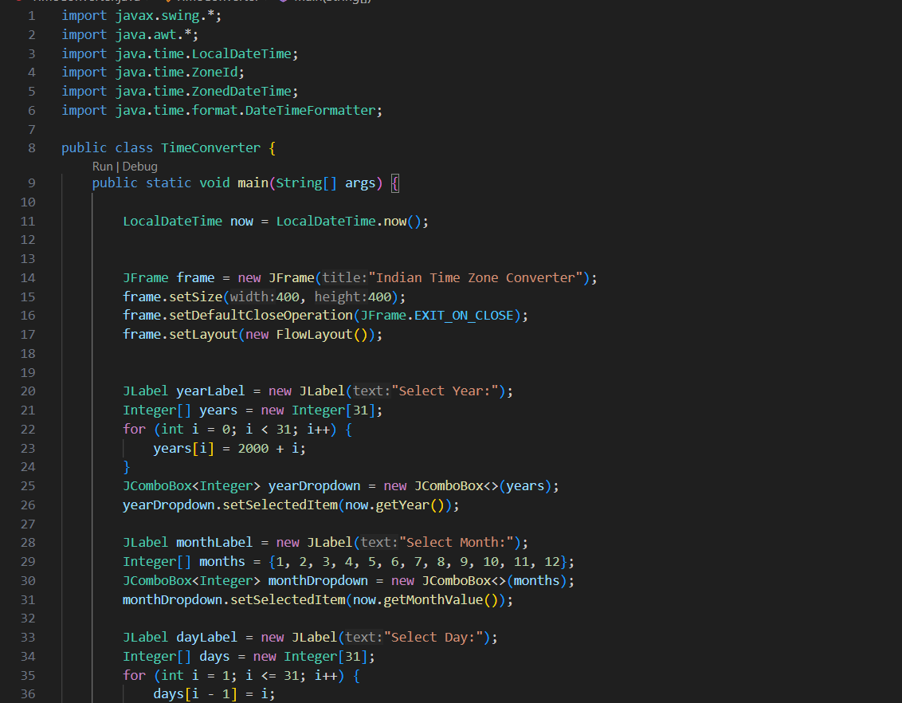
CODING

Slide 5
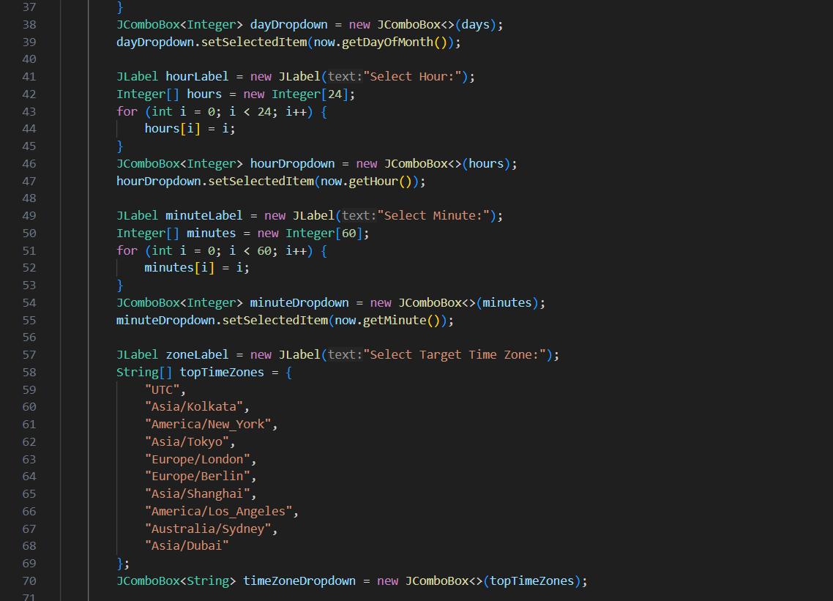

Slide 6
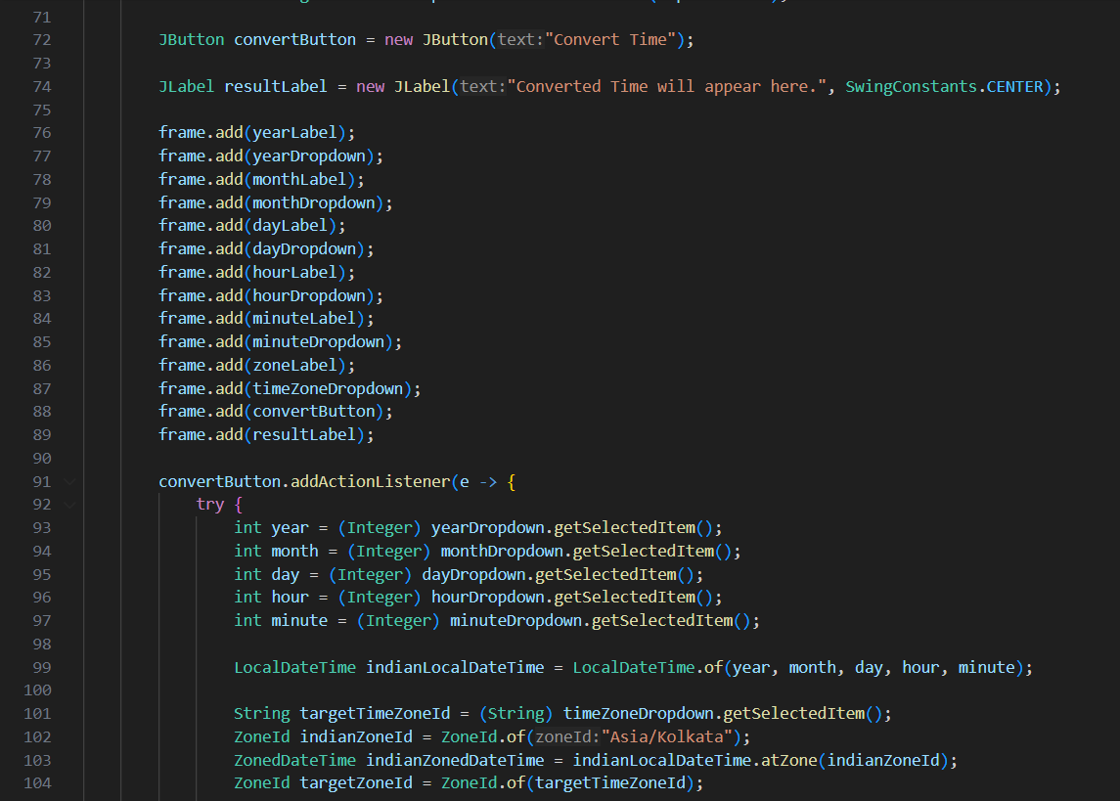

Slide 7
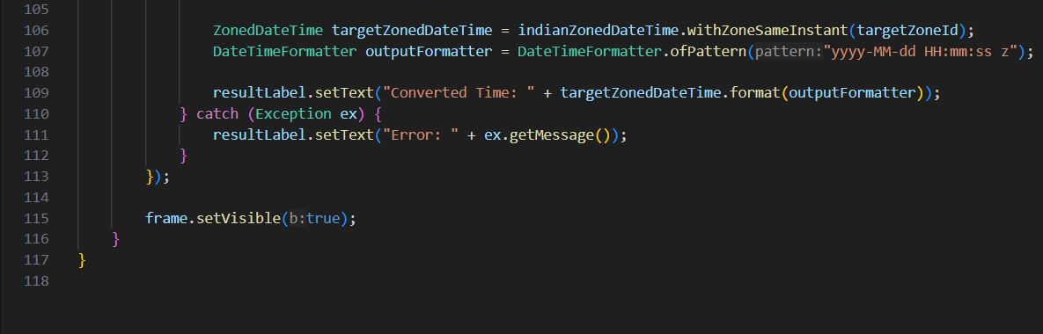

Slide 8
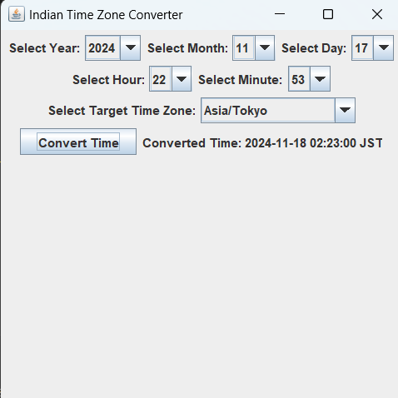
OUTPUT

Slide 9
THANK YOU GITHUB LINK : https://github.com/Tharanidharan-M/java

