Slide 1
CSCI 4588/5588 Machine Learning II Chapter 2: Regression, Regularization and Model Selection
Md Tamjidul Hoque

Slide 2
Applications of learning from given data
Here we are to learn from given data.
Given: demographic, diet, clinical measurements
To Do: Predict whether a patient, hospitalized due to a heart attack, will have a second heart attack
Given: Company performance, economic data
To Do: Predict the price of stock 6 months from now.
Given: Model hand-written digits
To Do: Identify hand-written ZIP codes in post office's mail sorting application.
Given: Infrared absorption spectrum of blood sample
To Do: Amount of glucose in the blood of a diabetic.
Given: Clinical, demographic, … (www.medscape.com/viewarticle/497924)
e.g. The worldwide incidence of prostate cancer is higher among American black men than any other male group.
To Do: Risk factors for prostate cancer.

Slide 3
Terms
Outcome measurements:
Either Quantitative (e.g. predicted stock price)
Or, Categorical (e.g. likely to have cancer: yes or, no)
The outcome is predicted based on a set of input/features/input features and their corresponding observed outcome. The set of known input and output data are used as training data.
The inputs are basically independent variables. And the output are dependent variables.
The prediction model is called a learner or predictor or classifier.
In supervised learning the set of input(s) is paired with desired/observed output(s).
In unsupervised learning the association of the input with the output is not given rather we try to predict the association.
We also have reinforcement learning and evolutionary learning.
Notes:
Reinforcement Learning: Reinforcement learning is about taking suitable action to maximize reward in a situation to find the best possible behavior or path that should be taken.
Evolutionary Learning: The Evolutionary Algorithm (EA) learning is a population-based metaheuristic optimization algorithm. An EA uses mechanisms inspired by biological evolution, such as reproduction, mutation, recombination, and selection and it is guided by some fitness functions to find a better solution.

Slide 4
Terminologies
Input:
X_{i} indicates the i^{th} element in vector X (or, X).
A set of N input (i.e., observations) p-vectors x_{i} = 1,…,N is a (N * p) matrix X.
Vectors are assumed to be column vectors:
x^{T}_{i} => the i^{th} row of X (i.e. the transpose of x_{i})
Output:
Quantitative Y [we use regression to predict]
Qualitative G (for group) [we use classification to predict]
Goal:
Given the value of an input vector X, make a good prediction of the output Y, denoted as Ŷ (“y-hat”).
The prediction should be of the same kind as the searched output (categorical vs. quantitative)
Binary outputs can be approximated by values in [0,1], which can be interpreted as probabilities. This also generalizes to k-level outputs.

Slide 5
Example: Regression for given housing dataset.
Bed | Bath | Area (sqft) | Price
5 | 7.5 | 5823 | 695000
4 | 4 | 4314 | 749000
4 | 4 | 3800 | 320000
5 | 4 | 3500 | 38900
3 | 3 | 3193 | 500000
4 | 4 | 2962 | 300000
4 | 3 | 2860 | 439000
3 | 2 | 2576 | 225000
4 | 3 | 2480 | 225000
5 | 1 | 2440 | 204999
3 | 2 | 2400 | 75000
5 | 3 | 2367 | 139000
… | … | … | …
Figure: Snapshot: housing data-set (sorted by: area in descending order).

Slide 6
Figure 1: Plot of the area of house versus the price of the house.

Slide 8
Linear Models and Least Squares: Linear Regression
Here, Given a vector of inputs X^{T} = (X₁,X₂, . . . ,X_{p}), we predict the output Y (i.e., ) via the model:
(1)
Equation (1) can be summarized as,
(2)
We can also write (1) as:
(3)
Finally:
(4)

Slide 9
Fitting the linear model to a set of training data
To apply least squares approach, we pick the coefficients β to minimize the residual sum of squares (RSS), also known as cost function in other context.
Our target for equation # 5 is to obtain a suitable value of β so that the RSS(β) is minimized, i.e.:
(5)

Slide 10
Minimization Approaches
We will discuss 4 different minimization approaches:
(1) Newton / Newton-Raphson method (iterative approach)
(2) Gradient Descent approach (iterative approach)
(3) Genetic Algorithms (iterative approach)
(4) Exact method/ Normal Equation (analytic approach).

Slide 11
1. Newton’s Method
Assume, we have an equation f(x)=0.
Figure (a): How does Newton’s method work in finding the solution?
For the solution (i.e., to find for what value of x, f(x) = 0), assume our initial point is x₁ and, X = x₁ intersects x-axis at C and f(x) at A (see Figure (a)). Also, assume that the tangent at A intersects x-axis at B, where the value of x is x₂. From ΔABC and the definition of the slope of an equation, we can write:

Slide 12
… Newton’s Method
(i)
(ii)
In general, we can write:
(iii)
Equation (iii) can be iteratively used to get the solution of the equation
Question: Are we after the solution of an equation or the minimization?
Answer: Minimization.

Slide 13
… Newton’s Method
Minimization using newton’s method:
Therefore, we can similarly write,
(iv)

Slide 14
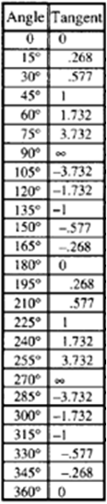
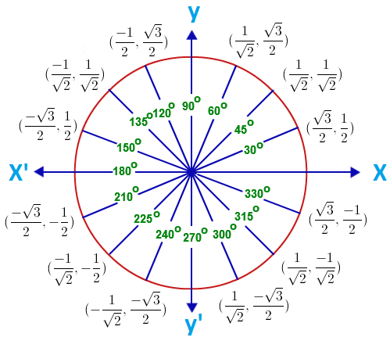
Tan

Slide 15
2. Gradient Descent
Gradient descent is a simple equation to get the nearest local minima.
(v)
These methods return the local minimum unless there is only one global minimum.

Slide 16
… Gradient Descent
Overshooting Problem!
If we set the value of α (alpha, the learning rate), to a higher value then overshooting might occur. How?
(A) <----------- (B)
Assume, starting from x_{t}, with a higher value of α we compute, x_{t+1} as:

Slide 17
… Overshooting problem / Gradient Descent
From the figure, we see distance of x_{t+1} from the minimum point is higher than the distance of x_{t} from minimum point. So, it is obvious that:
(A) <----------- (B)
Based on this information and the figure, we can say that the next point x_{t+2} would be behind x_{t} as we will apply:
Therefore, we see, instead of converging, it is diverging in each iterations which is called the overshooting problem (due to setting higher value of the step-size or α).

Slide 18
Apply Newton & GD
(6)
For gradient descent the corresponding equation should be:
(7)
Notes:
Instead of RSS(Beta), 0.5 MSE (Beta) is often used.
MSE => mean-squared-error.

Slide 19
… Apply Newton & GD
Using the computed two terms from previous slides we can simplify (not shown here, but in Adv. ML I) Equation (6) derived from Newton’s method as:
Similarly from Equation (7) we can write for gradient descent:
(8)
(9)

Slide 20

3. Genetic Algorithms
Genetic Algorithm (GA) is a population based optimization algorithm. The formation was inspired by the natural evolution. A pseudo code for GA is given as:
GA can get global minima, however it is not always assured.
Figure: Pseudo code for Genetic Algorithm

Slide 21
Does the minimum exist?
It is important to ask, does the minimum exist for equation (5):
The answer is ‘yes’, but again How?

Slide 22
GA
We will formulate the exact approach next.

Slide 23
Exact Equation / Non-Iterative Algorithm
=
(1)
(2)
Answer: we have,

Slide 24
… Exact Equation / Non-Iterative Algorithm

Slide 25
… Exact Equation / Non-Iterative Algorithm
(3)
Note: Equation (3) is the final form of our “Exact Equation”.

Slide 26
Exercise: Application of Exact Equation
I have placed the data into X.txt and Y.txt. Note: X.txt contains a starting column with all ‘1’s.
MATLAB/Octave code:
load X.txt
load Y.txt
B=inv(X'*X)*X'*Y
Answers:
B =
3.3868e+004
-3.6762e+004
1.0501e+004
1.3291e+002
For a Query, Q=[1 5 3 2500] for example, we can predict the house price by:
Q*B; [which should return 2.1384e+005 or, 213,840]

Slide 27
Regularization
We can have more than one model to fit the data. Say, we have models from linear to polynomial of power or order 9. In this context we will discuss the followings:
underfitting and overfitting issues
how to take care of the overfitting problem to take the benefit of the higher order polynomials, as well as
how to select the best model.
Next, we investigate some simple cases.

Slide 28
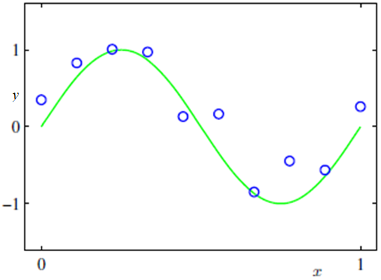
A Simple Curve Fitting Target

Slide 29
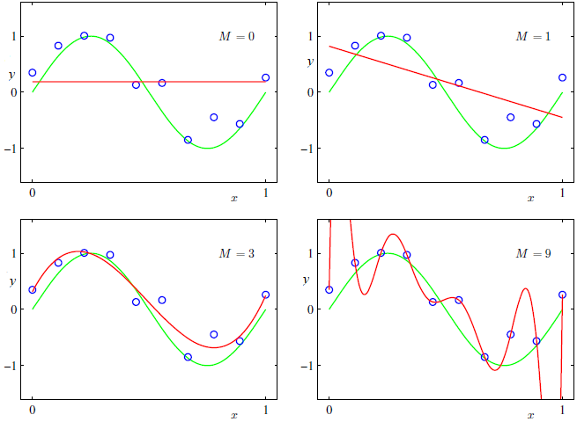
Fitting Polynomials of Various Order
Under
fitting
Under
fitting
Over
fitting
Figure 2: Plots of polynomials having various orders M, shown as red curves, fitting to the data set shown here

Slide 30
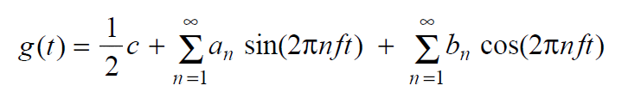
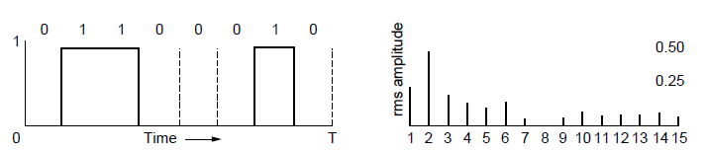
Fourier Analysis
A time-varying signal can be equivalently represented as a series of frequency components (harmonics):
=
Signal over time
a, b weights of harmonics
Notes:
Fourier analysis is basically an approximation of a function by the sums of simpler trigonometric functions.
If a frequency of a signal is f, its harmonics will be (integer multiple of the fundamental frequency, f) 2f, 3f, 4f, 5f, etc.

Slide 31
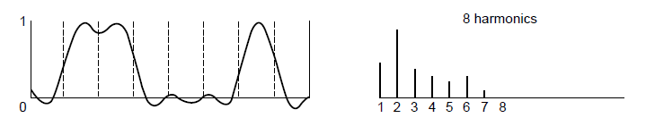
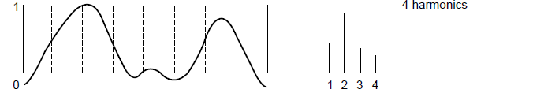
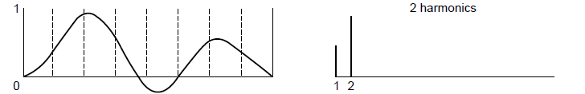
Bandwidth-Limited Signals
Having less bandwidth (harmonics) degrades the signal
8 harmonics
Lost!
Bandwidth
4 harmonics
Lost!
2 harmonics
Lost!
Notes:
Bandwidth (in Electrical) => width of frequency band, measured in Hz
Bandwidth (in Computation) => information carrying capacity, in bits/sec

Slide 32
Polynomial Fitting
There remains the problem of choosing the order M of the polynomial, and as we shall see this will turn out to be an example of an important concept called model selection.
In Figure 2, we show four examples of the results of fitting polynomials having orders M = 0, 1, 3 and 9 to the data set show in Figure 1.
We give the general Equation as:
(1)

Slide 33
We notice that the constant (M = 0) and first order (M = 1) polynomials give rather poor fits to the data and consequently rather poor presentations of the function sin(2 π x).
The third order (M = 3) polynomial seems to give the best fit to the function sin(2 π x).

Slide 34
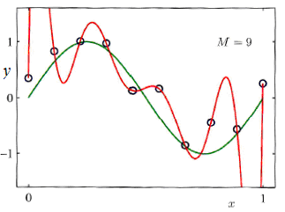
When we got to a much higher order polynomial (M = 9), we obtain an excellent fit to the training data. In fact, the polynomial passes exactly through each data points and the residual sum of squares (RSS) must be 0.
However, the fitted curve oscillates wildly and gives a very poor representation of the function sin(2 π x). This latter behavior is known as overfitting.

Slide 35
Error Rate w.r.t Test Set
Here, we define the root-mean-square (RMS) error by:
(2)
Figure 3: Graphs of the root-mean-square error, defined by (Eq^{n} 2), evaluated on the training set and on an independent test set for various values of M.

Slide 36

For M = 9, the training set error goes to zero, as we might expect because this polynomial contains 10 degrees of freedom.
However, the test set error has become very large.
← function ( with M = 9) exhibits wild oscillations as we saw before.

Slide 37
Paradox!
This may seem paradoxical because a polynomial of given order contains all lower order polynomials as special cases.
The M = 9 polynomial is therefore capable of generating results at least as good as the M = 3 polynomial.
We know that a power series expansion of the function sin(2 π x) contains terms of all orders, so we might expect that results should improve monotonically as we increase M.
Let us investigate the status of the coefficients before solving the paradox.

Slide 38
We see that, as M increases, the magnitudes of the coefficients typically get larger.
In particular for M = 9 polynomial, the coefficients have become finely tuned to the data by developing large positive and negative values so that the corresponding polynomial function matches each of the data points exactly, but between data points (particularly near the ends of the range) the function exhibits the large oscillations (observed).
Intuitively, what is happening is that the more flexible polynomials with larger values of M are becoming increasingly tuned to the random noise on the target values.

Slide 39
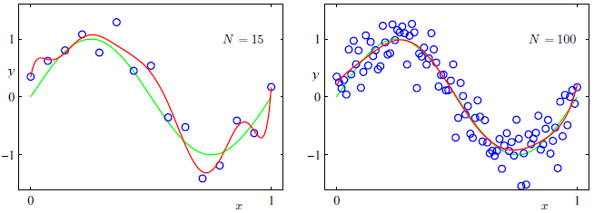
More Data for M=9
It is also interesting to examine the behavior of a given model as the size of the data set is varied
We see that, for a given model complexity, the overfltting problem become less severe as the size of the data set increases

Slide 40
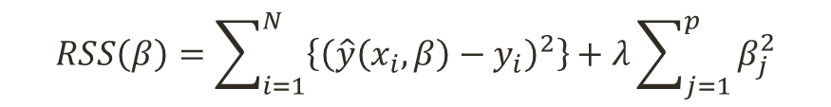
Managing Overfitting for limited sized Dataset
In many experiments, data is not found enough.
Therefore, we need to control the coefficients /parameters to get the fitting advantage of higher order polynomial as well as to fit the equation more correctly.
One technique that is often used to control the overfitting phenomenon in such cases is that of regularization, which involves adding a penalty term to the error function:
$$RSS\left(β\right)=\sum_{i=1}^{N}{\left\{{\left(\hat{y}\left(x_{i},β\right)−y_{i}\right)}^{2}\right\}}+λ\sum_{j=1}^{p}{β_{j}^{2}}$$
(3)
Note that often the coefficient β₀ is omitted from the regularizer because its inclusion causes the results to depend on the choice of origin for the target variable, or it may be included but with its own regularization coefficient.

Slide 41
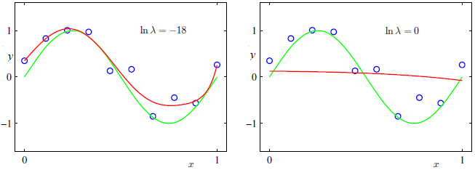
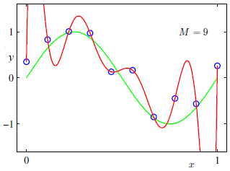
Adjusting the Regularizer (M=9)
Note: ln λ = -18 => λ = e ^ (-18) =1.52 × 10^-8
ln λ = 0 => λ = e^0 = 1
Notes:
If ln (lamda) =- bignum, then lamda = e^(-big_num) => 0
If ln (lamda) = -18, then lamda = e^(-18) = 1.5230164146599837779531922145647e-8
If ln (lamda) = 0, then lamda = e^0 = 1

Slide 42
Coefficients Table, For M=9
Note: ln λ = -Inf => λ = e ^ (-Inf) = 0.0000000000 … => 0
ln λ = -18 => λ = e ^ (-18) =1.52 × 10^-8
ln λ = 0 => λ = e^0 = 1
We see that, for a value of ln λ = -18, the overfltting has been suppressed and we now obtain a much closer representation of the underlying function sin(2πx). If, however, we use too large a value for λ then we again obtain a poor fit, as shown in Figure 5 for ln λ =0.
Notes:
If ln (lamda) =- bignum, then lamda = e^(-big_num) => 0
If ln (lamda) = -18, then lamda = e^(-18) = 1.5230164146599837779531922145647e-8
If ln (lamda) = 0, then lamda = e^0 = 1

Slide 43

The Effects of the values of λ
The issue of model complexity is an important one and here we simply note that, if we were trying to solve a practical application using this approach of minimizing an error function, we would have to find a way to determine a suitable value for the model complexity.
To solve, we can take the available data and partitioning it into a training set, used to determine the coefficients, and a separate validation set, also called a hold-out set, used to optimize the model complexity (either M or λ).

Slide 44

Minimization Target and Eq^{n}
Objective:
$$\begin{matrix}{RSS}_{λ}\left(β\right) \\ min\end{matrix}=\sum_{i=1}^{N}{\left\{{\left(\hat{y}\left(x_{i},β\right)−y_{i}\right)}^{2}\right\}}+λ\sum_{j=1}^{p}{β_{j}^{2}}$$
To have minimum error, the term has to adjust such a way that if we set the value λ too large then the values of β will be too low and other way around.
The Minimization Eqn the we drove before can be like (next):

Slide 45
Minimization Equations
Newton’s Method:
From
To
Gradient Descent:
From
To
Or,

Slide 46
Here is how: (…Minimization Equations)

Slide 47

… Here is how (Minimization Equations)
Finally,
Note: The minus signs inside and outside of the square bracket are changed just to look better.

Slide 48
… Here is how (Minimization Equations)
Similarly, for gradient descent method: , we can have:

Slide 49
Normal Equation
Recall: here is our normal equation derived before
To involve regularization we rewrite the equation:
The is done to keep β₀ away from the influence of the regularization.
Octave code:
M_lamda=eye(3,3);
M_lamda(1,1)=0;

Slide 50
How do we use Normal Eq. for higher order polynomial?
Recall our housing example and data. Let us assume that we want to involve features: (1) Number of Beds (x₁) and (2) Living Areas (x₂) and we want to fit a second order polynomial. Our equation should look like:
Here, we use the developed linear model to fit nonlinear data by simply adding powers of feature as new features, and then train a linear model on this extended set of features. This technique is called Polynomial Regression.
Notes:
We can use Scikit-Learn’s PolynomialFeatures class to transform our training data, adding the square of each feature in the training set as a new feature.

Slide 51
... How do we use Normal Eq. for higher order polynomial?
For the above example assume you have loaded x1 and x2 variables as column vectors, then:
We can use Scikit-Learn’s PolynomialFeatures class to transform our training data, adding the square of each feature in the training set as a new feature.
Notes:
You can save this newly formed X in a file myNewX (for example): Save myNewX Z -ASCII

Slide 52
Model Selection
Question: Given a finite set of models, M = {M₁, M₂, …, M_{n}}, for a problem, how can we select the best model? Here, assume, M_{i} is the i^{th} order polynomial regression model.
Answer: We assess model quality by cross-validation.
Cross-validation: Here, we split the dataset into training and test datasets.
We train the model using training dataset and test the model performance using test-dataset.
We discuss cross-validation algorithms next.

Slide 53
… Model Selection
Algorithm: hold-out cross validation
1. Randomly split data (D): D_{train} and D_{holdout} (Say, 25-30% of the data).
4. Pick the predictor where the error is the lowest.
The disadvantage of the hold-out method is the wastage of the data, as we typically hold out 30% data to get the error reliably.
Also, in many experiment the data is not abundant.
Further, we have seen that for higher order polynomial, it is better to feed more data to get a reliable predictor.
To avoid these issues, we follow k-fold cross validation where we hold out less data.

Slide 54
… Model Selection
Algorithm: k-fold cross validation
A typical choice of the value of k in such k-fold cross validation is 10.
This method is also called leave-one-out cross validation.

Slide 55
How to obtain the best value of regularization parameter, λ?

Slide 56
Recall, our target involving regularization was:
In vector form we can rewrite the term:

Slide 57
[Proved]

