Slide 1
CSCI 4588/5588 Machine Learning II Chapter 3: Support Vector Machine
Md Tamjidul Hoque

Slide 2
SVMs
Objectives behind SVM’s design
Identify the best decision boundary (or, class separating hyperplane), i.e. the decision boundary with maximum class margin.
There may be no margin for overlapped class boundary; still we adjust the theme of decision boundary with maximum margin.
For non-linearly separable classes, we would like to learn to transform the space into a linearly separable space.

Slide 3
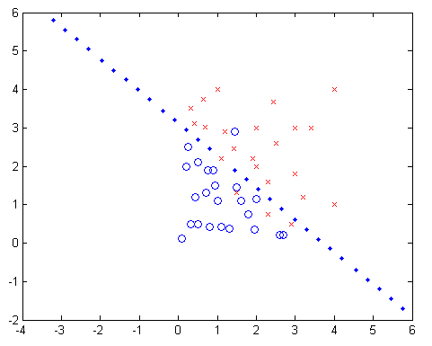
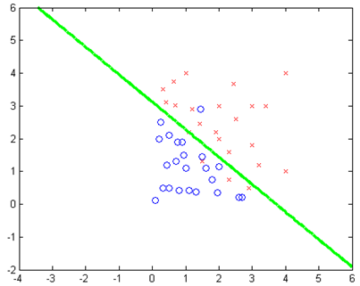
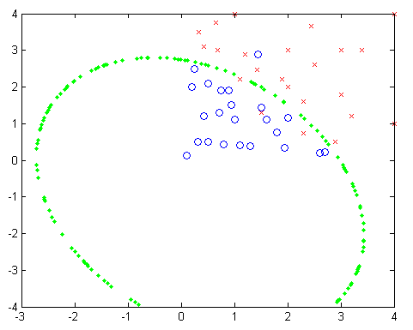
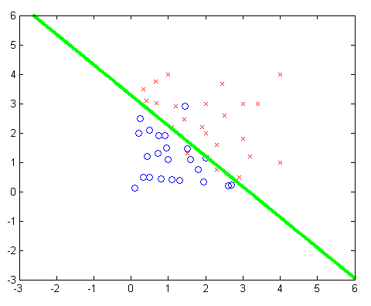
Various Boundaries (for Cancer Data)
Recall
Linear Reg. with Indicator Fn.
LDA
QDA
Logistic Reg.

Slide 4
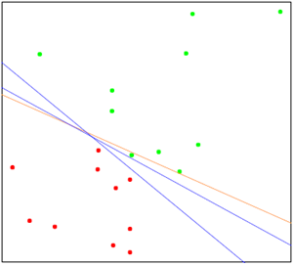
Separating Hyperplanes
The orange line is the least squares solution, which misclassifies one of the training points.
Two blue separating hyperplanes found by the perceptron learning algorithm with different random starts.

Slide 5
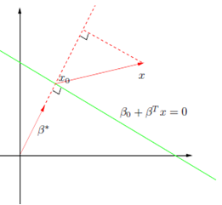
Vector Algebra
Hence, f(x) is proportional to the signed distance from x to the hyperplane defined by f(x) = 0.

Slide 6
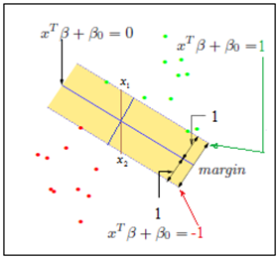
Optimal Separating Hyperplanes
We can have many possible set of (β, β₀) to have the separating hyperplane.
However, we are interested in the one having the maximum margin.
We can define the margins as in the Figure below:
The decision boundary is the solid line, while broken lines bound the shaded maximal margin of width, 1+1 = 2

Slide 7
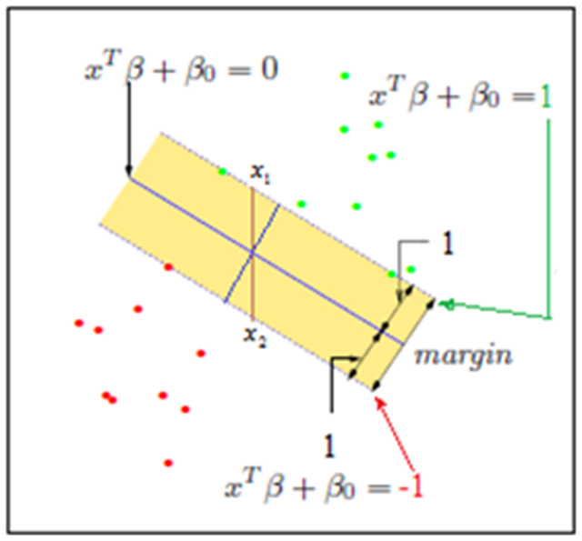
Optimal Separating Hyperplanes
Goal: We want to maximize the projection in between the margins

Slide 8
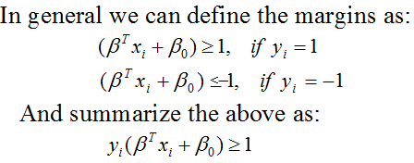
Optimal Separating Hyperplanes
We have goal: min || β||
Finally we can write our constrained optimization goal as:
This is a convex optimization problem, quadratic criterion with linear inequality constraints.
Notes:
Note: the properties of inequality when mul or div by negative numbers.
20 > -4 [valid]
or, (20/-4) <(-4/-4) [note sign has changed]
or, -5 < 1 [valid]
Sequential minimal optimization (SMO) is applied for the optimization.

Slide 9
Optimal Separating Hyperplanes
The Lagrange (primal, L_{p}) function, to be minimized w.r.t. β and β₀, is
Next: we want to put the obtained new two equations into the first equation, Lagrange (primal, L_{p}) and obtain the corresponding (Wolfe) dual.

Slide 10
Optimal Separating Hyperplanes
=
=
=

Slide 11
Optimal Separating Hyperplanes
Clearly, we can now express the equation as a function of α_{i}
Any simple optimization software can now solve the above eq^{n}.
The solution must satisfy KKT conditions which includes:

Slide 12
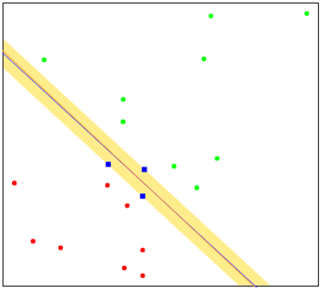
Optimal Separating Hyperplanes
Now from and
From , we see that the solution vector β is defined in terms of a linear combination of the support points x_{i} - those points defined to be on the boundary of the slab via α_{i} > 0.
Figure shows the optimal separating hyperplane for the toy example; there are three support points.

Slide 13
Optimal Separating Hyperplanes
The intuition here is that a large margin on the training data will lead to good separation on the test data. The description of the solution in terms of support points seems to suggest that the optimal hyperplane focuses more on the points that count, and is more robust to model misspecification.
The LDA solution, on the other hand, depends on all of the data, even points far away from the decision boundary.
Note, however, that the identification of these support points required the use of all the data.
Of course, if the classes are really Gaussian, then LDA is optimal, and separating hyperplanes will pay a price for focusing on the (noisier) data at the boundaries of the classes.

Slide 14
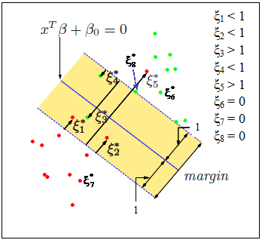
Overlapped Classes
One way to deal with the overlap is to still maximize the margin, but allow for some points to be on the wrong side of the margin.
We can now set our goal to maximize the margin while softly penalizing points that lie on the wrong side of the margin boundary. We therefore minimize:
Goal:
And C > 0
Notes:
Zeta => Capital Z,
small case, Zeta => ξ

Slide 15
Overlapped Classes
The cost parameter C > 0, controls the trade-off between the slack variable penalty and the margin.
The parameter C is similar to regularization parameter.
For separable case, C = ∞.
Anyway the Lagrange (primal) function can be given by:

Slide 16
Overlapped Classes
We minimize L_{p} w.r.t β, β₀ and ξ_{i}. Setting the respective derivatives to zero, we get:
By substituting above equations into L_{p}, we obtain the Lagrangian (Wolfe) dual objective function:

Slide 17
Overlapped Classes
We have
And for KKT we include the followings further:
For the solution of β we can use:

Slide 18
Overlapped Classes
The tuning parameter of this procedure is the cost parameter C.

Slide 19
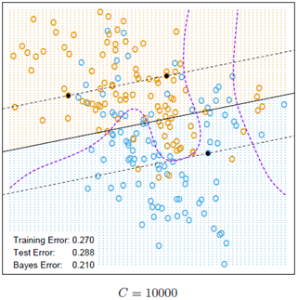
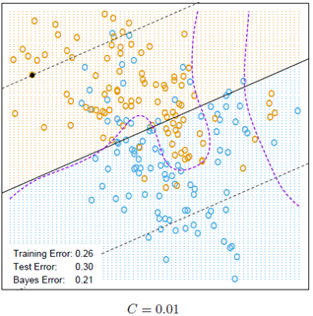
Overlapped Classes
Effect of C for the mixture example:
Figure: The broken lines indicate the margins, where f(x) = ± 1

Slide 20
Support Vector Machines and Kernels
The support vector classifier described so far finds linear boundaries in the input feature space.
we can make the procedure more flexible by enlarging the feature space using basis expansions such as polynomials or splines
Generally linear boundaries in the enlarged space achieve better training-class separation, and translate to nonlinear boundaries in the original space.
It is an extension of this idea, where the dimension of the enlarged space is allowed to get very large, infinite in some cases.

Slide 21
Computing the SVM for Classification
We can represent the optimization problem and its solution in a special way that only involves the input features via inner products. We do this directly for the transformed feature vectors h(x_{i}). We then see that for particular choices of h, these inner products can be computed very cheaply.
Thus, the Lagrange dual function has the form:
And the solution function f(x) can be written as:
Given α_{i}, β₀ can be determined by solving y_{i} f(x_{i}) = 1 for any (or all) x_{i} for which 0 < α_{i} < C.

Slide 22
Kernel function
Practically, we need not specify the transformation h(x) at all, but require only knowledge of the kernel function, expressed as:
that computes inner products in the transformed space.
K should be a symmetric positive (semi-) definite function
Some popular choices for K in the SVM literature are:

Slide 23
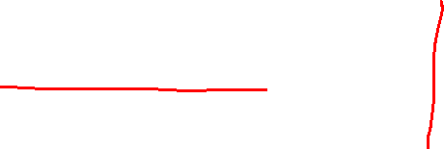
Kernel function
Consider for example a feature space with two inputs X₁ and X₂, and a polynomial kernel of degree 2:

Slide 24
Kernel function
Therefore, in terms of h we can write:
So, we write:

Slide 25
Kernel function

Slide 26
Kernel function
Question: what are the parameters to be tuned or, value of the parameter to be predicted while using SVM with RBF for classification problem?
Ans: C (from SVM) and γ (from RBF).

Slide 27
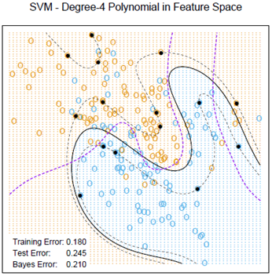

Impact of Kernel functions
(a) (b)
(a) 4th degree polynomial kernel is used
(b) a radial basis kernel (with γ = 1) is used, having lower test error.
In each case C was tuned to approximately achieve the best test error performance, and C = 1 worked well in both cases.
Notes:
See: A 3-D demonstration here:
http://www.csie.ntu.edu.tw/~cjlin/libsvmtools/svmtoy3d/
http://www.csie.ntu.edu.tw/~cjlin/libsvmtools/svmtoy3d/examples/

Slide 28
Constructing Kernels
Self-read the details from the lecture notes (page ~17 to 20):
One powerful technique for constructing new kernels is to build them out of simpler kernels as building blocks.

Slide 29
Multi-Class SVM
The support vector machine is fundamentally a two-class classifier.
For multiclass, one-versus-all or one-versus-the-rest approach is commonly used. We construct K separate SVMs, where k^{th} model y_{k}(x) is trained using the data from class C_{k} as the positive example and the data from the remaining (K-1) classes as the negative examples.
Unfortunately, this heuristic approach may suffer from the problem that the different classifiers were trained on different tasks, and there is no guarantee that the real valued quantities y_{k}(x) for different classifiers will have appropriate scales.
Also, if training sets are imbalanced: For instance, if we have ten classes each with equal numbers of training data points, then the individual classifiers are trained on data sets comprising 90% negative examples and only 10% positive examples.
Solution:

Slide 30
MultiClass SVM
Also, this approach may suffer like one-versus-the-rest approach sometimes.
Also, for large K this approach requires significantly more training time than the one-versus-the-rest approach.
Some improvement has been done for one-versus-one. See Dietterich and Bakiri (1995), Allwein et al. (2000).
The application of SVMs to multiclass classification problems remains an open issue.
In practice the one-versus-the-rest approach is the most widely used in spite the mentioned limitations.

Slide 31
Optional reading: Support Vector Machines for Regression
Next we will study the usage of LIBSVM

Slide 32
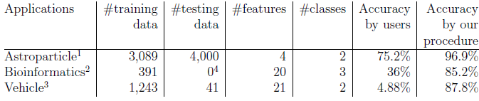
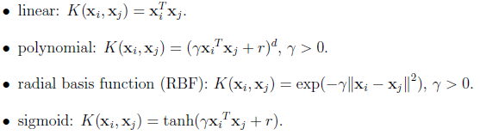
Usage of LIBSVM
We will mostly be discussing the following problem characteristics and performance comparisons.
In general the following 4 kernel are suggested;
Here, Ɣ, r, and d are kernel parameters

Slide 33
Real-World Examples
Dataset: http://www.csie.ntu.edu.tw/~cjlin/papers/guide/data/
Steps to follow:
Transform data to the format of an SVM package
Conduct simple scaling on the data
Consider the RBF kernel K(x; y) =
Use cross-validation to find the best parameter C and γ
Use the best parameter C and γ to train the whole training set
Test

Slide 34
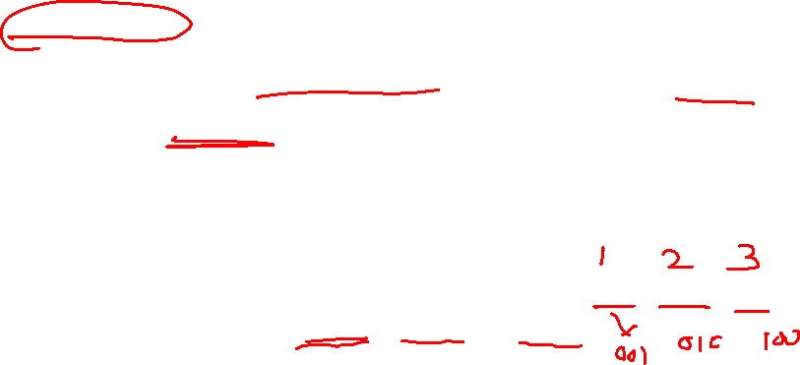
Data Processing
SVM requires that each data instance is represented as a vector of real numbers.
Hence, if there are categorical attributes, we first have to convert them into numeric data.
It is recommended to use m numbers to represent an m-category attribute. Only one of the m numbers is one, and others are zero.
For example, a three-category attribute such as {red, green, blue} can be represented as (0,0,1), (0,1,0), and (1,0,0).
Experience says that if the number of values in an attribute is not too large, this coding might be more stable than using a single number.

Slide 35
Scaling
Scaling before applying SVM is very important.
The main advantage of scaling is to avoid attributes in greater numeric ranges dominating those in smaller numeric ranges.
Another advantage is to avoid numerical difficulties during the calculation. Because kernel values usually depend on the inner products of feature vectors, e.g. the linear kernel and the polynomial kernel, large attribute values might cause numerical problems.
Linearly scaling each attribute to the range [-1, +1] or [0, 1] is recommended.
Use the same scale for both the training and the testing data. Assume, we scaled the first attribute of training data from [-10, +10] to [-1, +1]. If the first attribute of testing data lies in the range [-11, +8], we must scale the testing data to [-1.1, +0.8].

Slide 36
Model Selection
In general, the RBF kernel is a reasonable first choice.
This kernel nonlinearly maps samples into a higher dimensional space. So it, unlike the linear kernel, can handle the case when the relation between class labels and attributes is nonlinear.
Furthermore, the linear kernel is a special case of RBF.
In addition, the sigmoid kernel behaves like RBF for certain parameters (Lin and Lin, 2003).
The second reason is the number of parameters which influences the complexity of model selection. The polynomial kernel has more parameters than the RBF kernel.
Finally, the RBF kernel has fewer numerical difficulties.

Slide 37
Cross-validation and Grid-Search
For RBF we need to find the best set of (C, Ɣ).
A “grid-search" on C and γ using cross-validation. Various pairs of (C, γ) values are tried and the one with the best cross-validation accuracy is picked or, recommended.
It is found that trying exponentially growing sequences of C and γ is a practical method to identify good parameters (for example, C = 2⁻⁵, 2⁻³, …, 2¹⁵, γ= 2⁻¹⁵, 2⁻¹³,…, 2³).
Grid search is applied for parameter search, reasons:
(1) piece of mind
(2) Computation is not much (when implemented *strategically)
(3) Can easily be parallelized.
* Strategically, grid search is better applied using coarse grid first and then for finer grid for the potential region.

Slide 38
Grid Search: Coarse to Fine

Slide 39
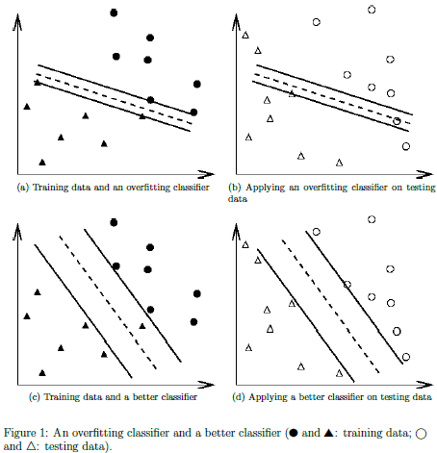
Cross-validation avoid overfitting

Slide 40
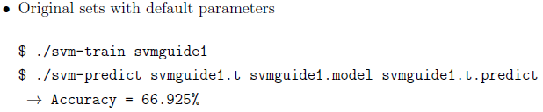
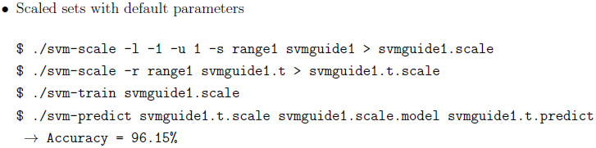
Example run of the proposed procedure
Astroparticle Physics;

Slide 41
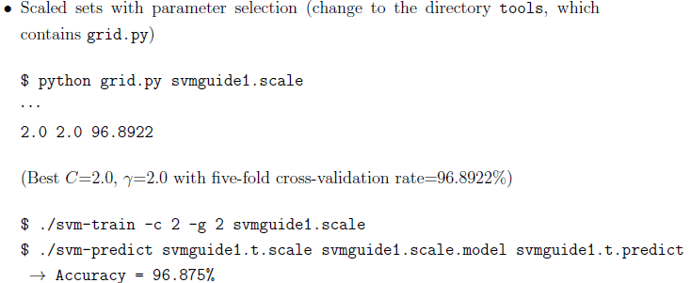
Example runs
Also there is a script (easy.py) to do the same automatically to achieve this same best result.

Slide 42

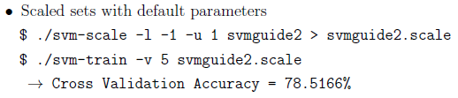
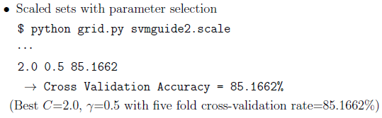
Example runs
Bioinformatics Example (Note: no test data & 3 classes)

Slide 43
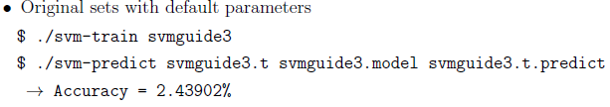
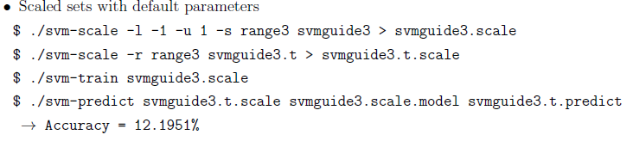
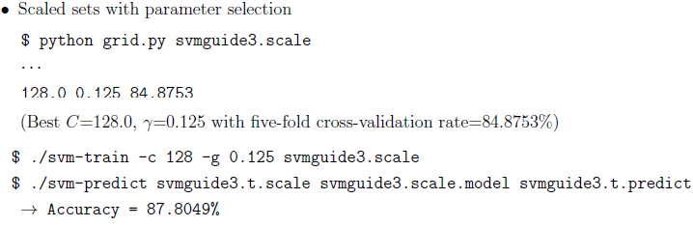
Example run
Vehicle example

Slide 44
When to Use Linear but not RBF Kernel
Please (continue and) check the attached document of Lin et al

Slide 45
…Formulas for Measuring Classification Performance
Accuracy metrics:
Assume a new test method is applied to screen people for cancer. The test results can be positive (have cancer) or negative (do not have cancer).
The prediction or test results for each subject may or may not match the subject's actual status. In this context, the terminologies –
True Positive (TP) refers to the situation, where subjects having cancers are predicted to have cancer;
True Negative (TN) refers to the situation, where subjects do not have cancer are predicted to have no cancer;
False Positive (FP) refers to the situation, where subjects do not have cancer but are predicted to have cancer;
False Negative (FN) refers to the situation, where subjects have cancer but are predicted to have no cancer.

Slide 46
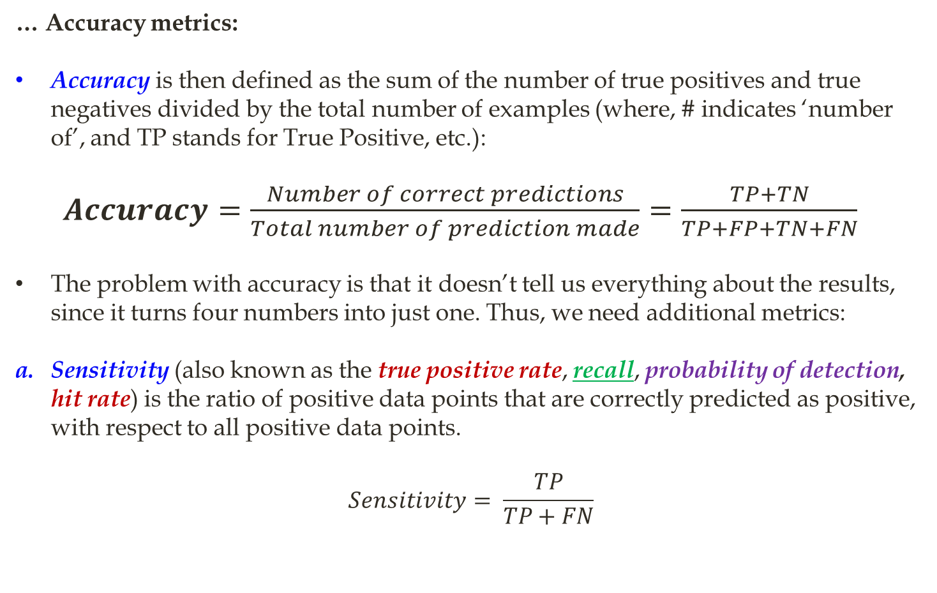
…Formulas for Measuring Classification Performance
… Accuracy metrics:
Accuracy is then defined as the sum of the number of true positives and true negatives divided by the total number of examples (where, # indicates ‘number of’, and TP stands for True Positive, etc.):
$Accuracy=\frac{Number of correct predictions}{Total number of prediction made}=\frac{TP+TN}{TP+FP+TN+FN}$
The problem with accuracy is that it doesn’t tell us everything about the results, since it turns four numbers into just one. Thus, we need additional metrics:
Sensitivity (also known as the true positive rate, recall, probability of detection, hit rate) is the ratio of positive data points that are correctly predicted as positive, with respect to all positive data points.
$$Sensitivity= \frac{TP}{TP+FN}$$

Slide 47
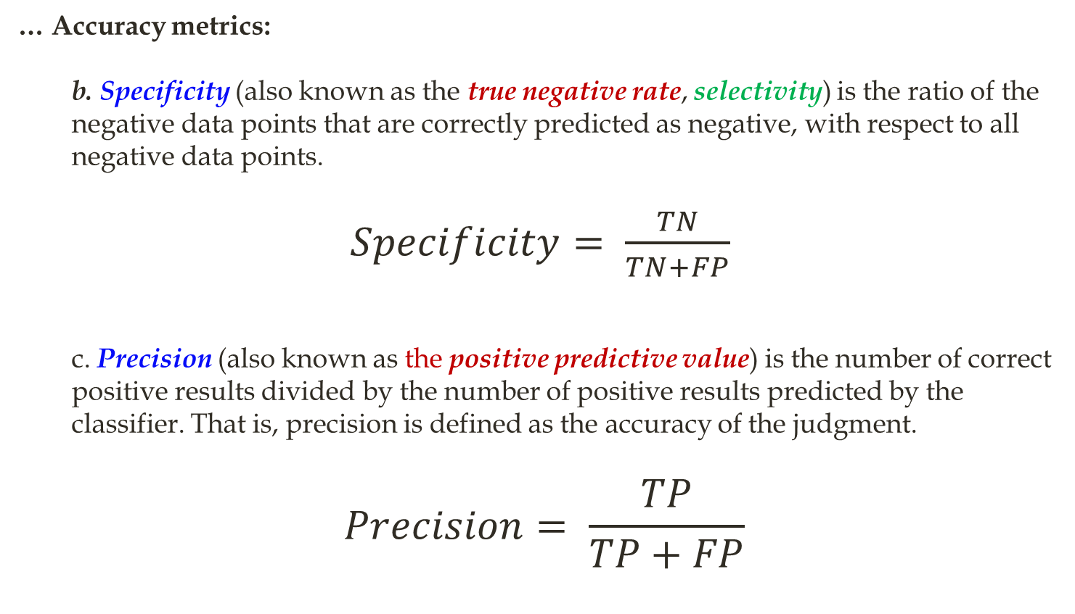
…Formulas for Measuring Classification Performance
… Accuracy metrics:
b. Specificity (also known as the true negative rate, selectivity) is the ratio of the negative data points that are correctly predicted as negative, with respect to all negative data points.
$Specificity= \frac{TN}{TN+FP}$
c. Precision (also known as the positive predictive value) is the number of correct positive results divided by the number of positive results predicted by the classifier. That is, precision is defined as the accuracy of the judgment.
$$Precision= \frac{TP}{TP+FP}$$

Slide 48
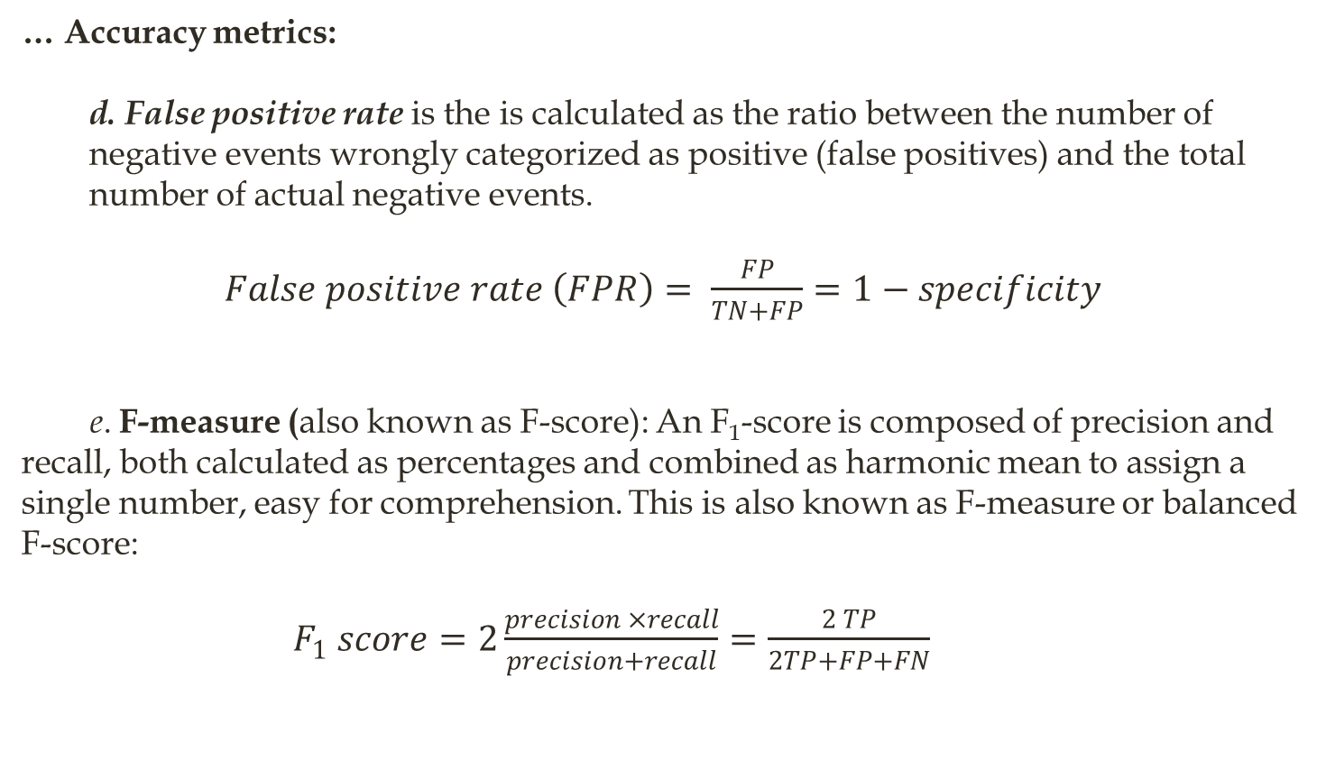
…Formulas for Measuring Classification Performance
… Accuracy metrics:
d. False positive rate is the is calculated as the ratio between the number of negative events wrongly categorized as positive (false positives) and the total number of actual negative events.
$False positive rate \left(FPR\right)= \frac{FP}{TN+FP}=1−specificity$
e. F-measure (also known as F-score): An F₁-score is composed of precision and recall, both calculated as percentages and combined as harmonic mean to assign a single number, easy for comprehension. This is also known as F-measure or balanced F-score:
$F_{1} score=2\frac{precision ×recall}{precision+recall}=\frac{2 TP}{2TP+FP+FN}$

Slide 49
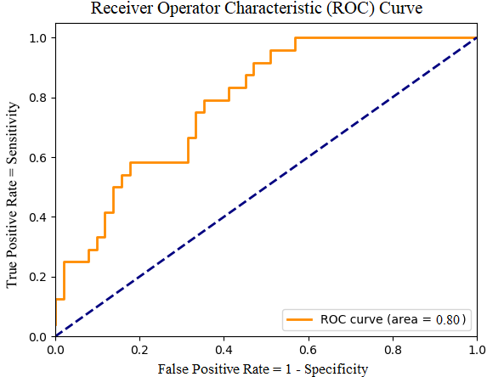
…Formulas for Measuring Classification Performance
The Receiver Operator Characteristic (ROC) curve: To draw ROC curve, TPR and FPR both are computed at threshold values such as (0.00, 0.02, 0.04, …., 1.00) and a graph is drawn (see Figure 1). The AUC is the area under the curve of the plot. AUC close to or equal to 1.0 indicates the best performance.
Figure 1: An example of an ROC curve. The diagonal line represents exactly a chance, so anything above the line is better than chance, and the further from the line, the better.

Slide 50
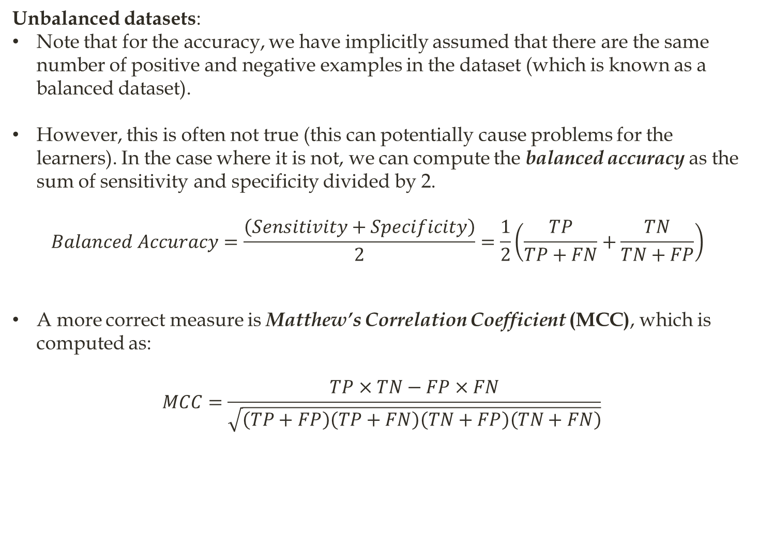
…Formulas for Measuring Classification Performance
Unbalanced datasets:
Note that for the accuracy, we have implicitly assumed that there are the same number of positive and negative examples in the dataset (which is known as a balanced dataset).
However, this is often not true (this can potentially cause problems for the learners). In the case where it is not, we can compute the balanced accuracy as the sum of sensitivity and specificity divided by 2.
$$Balanced Accuracy=\frac{\left(Sensitivity+Specificity\right)}{2}=\frac{1}{2}\left(\frac{TP}{TP+FN}+\frac{TN}{TN+FP}\right)$$
A more correct measure is Matthew’s Correlation Coefficient (MCC), which is computed as:
$$MCC=\frac{TP×TN−FP×FN}{\sqrt{\left(TP+FP\right)\left(TP+FN\right)\left(TN+FP\right)\left(TN+FN\right)}}$$
End

