Slide 1
The Imperative for Grid Cyber Resilience
Bill Sanders
April 23, 2018

Slide 2
The Challenge: Provide Trustworthy Grid Operation in Possibly Hostile Environments
Be Trustworthy
A system which does what is supposed to do, and nothing else
Safety, availability, integrity, timeliness, confidentiality, …
Tolerate a Hostile Environment
Accidental failures, design flaws, and malicious attacks
Consider the Cyber, Physical, and Social System Aspects
Provide Assurance through Assessment
Provide justification that the system will operated as expected
Choose among design alternatives to achieve greater trustworthiness

Slide 3
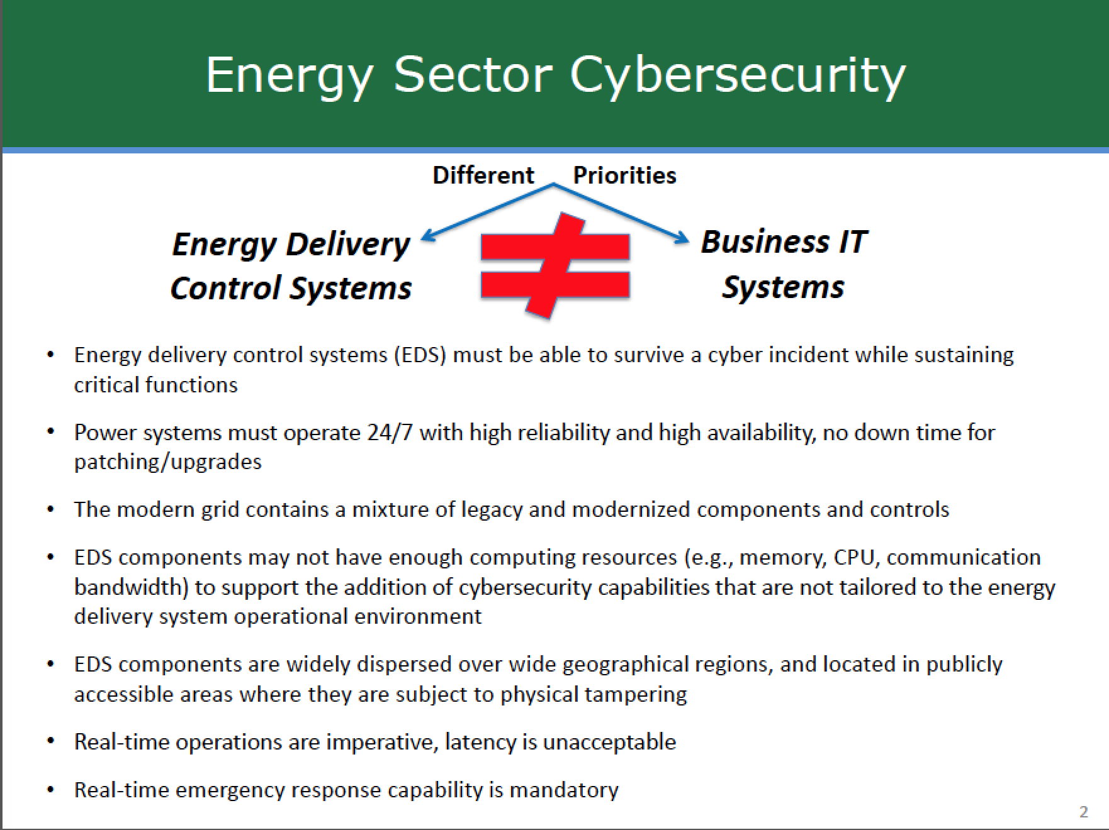
Source: carol Hawk, DOE ceds overview presentation

Slide 4
Cyber Security Facts (according to Sanders)
Grid cyber infrastructures are complex, and their complexity will only continue to increase.

Slide 5
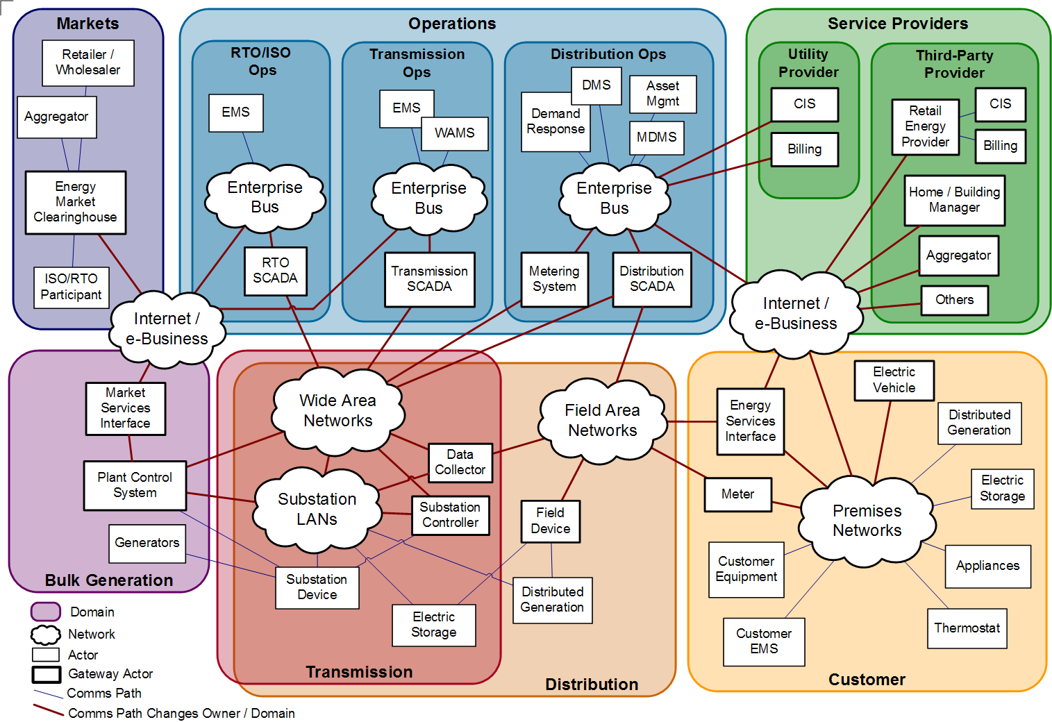
In the smart grid, the cyber Infrastructure must provide control at many levels and multiple dimensions
Multi-layer Control Loops
Multi-domain Control Loops
Demand Response
Wide-area Real-time control
Distributed Electric Storage
Distributed Generation
Intra-domain Control Loops
Home controls for smart heating, cooling, appliances
Home controls for distributed generation
Utility distribution Automation
Resilient and Secure Control
Secure and real-time communication substrate
Integrity, authentication, confidentiality
Trust and key management
End-to-end Quality of Service
Automated attack response systems
Risk and security assessment
Model-based, quantitative validation tools
Resilient and Secure Control Loops
Generation and Transmission
Transmission and Distribution
Distribution and Generation
Note: the underlying Smart Grid Architecture has been developed by EPRI/NIST.

Slide 6
Cyber Security Facts (according to Sanders)
Grid cyber infrastructures are complex, and their complexity will only continue to increase.
Cyber infrastructures intended to be secure must operate through attacks.

Slide 7
Cyber Security Facts (according to Sanders)
Grid cyber infrastructures are complex, and their complexity will only continue to increase.
Cyber infrastructures intended to be secure must operate through attacks.
Absolute cyber security is unattainable.

Slide 8
A Decade of Energy Cyber Infrastructure Attack Malware
2010: Stuxnet: Targeted Siemans industrial control systems in Iran. Was first discovered malware that spies on and subverts industrial systems and the first to include a programmable logic controller (PLC) rootkit.
2014: Dragonfly/Havex: Focus was to collect ICS network and access control information. Evidence suggests this was provided to a well organized and funded group outside countries from which the data was collected.
2015: Black Energy 3: Used in attack on the Ukraine power grid. Considered to be the first known power grid cyberattack. Hackers were able to successfully compromise information systems of three energy distribution companies and temporarily disrupt electricity supply to the end consumers.
2016: CRASHOVERRIDE: Second known attack in Ukraine. Impacted a single transmission level substation. Significant increase in sophistication of attack code relative to past attacks.
2017: TRISIS/TRITON: Incident at a critical infrastructure organization which targeted Schneider Electric’s Triconex safety instrumented system (SIS) and where an attacker deployed malware which targeted systems provided emergency shutdown capability for industrial processes. Deployed against at least one victim in the Middle East.

Slide 9
Potential Power-System-Specific Cyber Attack Strategies
Tripping breakers
Changing values breaker settings
Lower settings can destabilize a system by inducing a large number of false trips
Lowering trip settings can cause extraneous other breakers, causing overloading of other transmission lines and/or loss of system stability
Corrupting Control Information: Smart Meters, SCADA Data, PMU Data, Dispatch Information, etc.
Sophisticated lateral movement attacks
Life cycle attacks
Insider threats
Physical damage by cyber means
Combined physical and cyber attacks

Slide 10
Lateral Movement in Cyber Kill Chain Demands Resiliency
Port scanning
Media analysis
Reconnaissance
Delivery
Command and Control
Lateral Movement
Goal Accomplishment
During lateral movement:
Attacker moves laterally between hosts
Attacker uses remote desktop connections, SSH, Windows management inventory, administrator tools
Spear phishing
Zero-day exploits
Control channels
Remote desktop
Privilege escalation
Data exfiltration
Physical damage
Source: http://about-threats.trendmicro.com/cloud-content/us/ent-primers/pdf/tlp_lateral_movement.pdf

Slide 11




Lateral Movement Attack Examples
Many companies and government agencies have experienced
lateral movement based attacks, leading to large-scale damages.
Ukrainian
Power Grid
2009
2011
2013
2015
40 million credit card records stolen
Expected cost ~$248 million
Power outage for about 6 hrs.
Affected ~225,000 consumers
80 million personal records stolen
Expected cost ~$115 million

Slide 12
Cyber Security Facts (according to Sanders)
Grid cyber infrastructures are complex, and their complexity will only continue to increase.
Cyber infrastructures intended to be secure must operate through attacks.
Absolute cyber security is unattainable.
Resiliency is key: Protect the best you can, but realize that perfect protection is impossible, so resiliency can only be achieved through tolerating attacks through online detection and response.

Slide 13
Notional Architecture for Resiliency
Diverse System
Monitoring
Monitor Placement
Secure Monitoring and Response Infrastructure
Monitor Fusion
”World View”
System Model
Response Selection and Actuation
OFFLINE/ONLINE
COMPUTATION
RESILIENCY
INFRASTRUCTURE
ONLINE COMPUTATION

Slide 14
Notional Architecture for Resiliency
Diverse System
Monitoring
The system model represents the services, possible responses, attacker characteristics, and architecture of a system.
Monitor Placement
Secure Monitoring and Response Infrastructure
Monitor Fusion
”World View”
System Model
The monitor placement algorithm deploys sensors according to specified monitoring goals
Response Selection and Actuation
OFFLINE/ONLINE
COMPUTATION
ONLINE COMPUTATION
RESILIENCY
INFRASTRUCTURE

Slide 15
Notional Architecture for Resiliency
Diverse System
Monitoring
Monitor Placement
Secure Monitoring and Response Infrastructure
Monitor Fusion
”World View”
System Model
The sensor inputs, alerts, and logs feed into a different set of fusion and correlation algorithms to generate a higher-level alert
Response Selection and Actuation
OFFLINE/ONLINE
COMPUTATION
ONLINE COMPUTATION
RESILIENCY
INFRASTRUCTURE

Slide 16
Notional Architecture for Resiliency
The decision algorithm decides on learning responses to intensify and focus the monitoring resources, and/or effect a response strategy, e.g.
Block an attacker
Move a target
Reallocate services
Recover services
Diverse System
Monitoring
Monitor Placement
Secure Monitoring and Response Infrastructure
Monitor Fusion
”World View”
System Model
Response Selection and Actuation
OFFLINE/ONLINE
COMPUTATION
ONLINE COMPUTATION
RESILIENCY
INFRASTRUCTURE

Slide 17
Notional Architecture for Resiliency
Diverse System
Monitoring
Monitor Placement
Secure
Monitoring and Response Infrastructure
Monitor Fusion
”World View”
System Model
The monitoring and response architecture provides a trustworthy infrastructure on which to implement resiliency services and maintain a trustworthy world view.
Response Selection and Actuation
OFFLINE/ONLINE
COMPUTATION
ONLINE COMPUTATION
RESILIENCY
INFRASTRUCTURE

Slide 18
Resiliency in Practice: Detecting Lateral Movement
Network-wide hierarchical fusion
Host-level activities
(e.g., sockets, files, and processes)
Lateral movement chains
Unsupervised anomaly detection
Internal and external NetFlow
Compromised hosts

Slide 19
Hierarchical Fusion
F
Lateral Movement detection by fusing host-level process communication with network flow information
Process communication used to infer network flow correlation
Hierarchical fusion of events results in a chain of correlated connections that describes lateral movement in the system
Local inference of correlation events allows for fusion without the need for a global clock
S2
T=6
P5
P3
T=3
T=5
P2
P4
T=4
T=1
P1
T=0
S1
Host-view
Socket
A
C
Host
Process
Ahmed Fawaz, Atul Bohara, Carmen Cheh, and William H. Sanders. 2016, Lateral Movement Detection Using Distributed Data Fusion. In Proc. IEEE 35th Symposium on Reliable Distributed Systems pp. 21-30.
Notes:
Current methods: Correlate NetFlow to detect lateral movement
Proposed method: Correlate between host-level system calls and network information across the system to generate system-wide lateral movement chain
Hierarchical Fusion: Process communication graph → Host communication graph → Group communication graph
Agent on each host: infers connection correlation using the Process Communication Graph
Collect timestamped events of:
Processes running
Process communication (pipes, messages,…)
Network connections (with a unique ID across system)
File access
The agent creates a timed directed graph of communication between processes
Correlation is inferred via a path between incoming and outgoing connections

Slide 20
Malicious Lateral Movement via Machine Learning
Indicators | Anomalous external communication | Large number of divers LM chains
Insights | Communication with potential C&C servers will result in large number of distinct outward connections | Communication graph generated by normal hosts is sparse and significantly follows client-server model Benign chains are long as compared to attacker chains
Features | C_score E.g., number of connections to unique external domains | Number of LM chains Statistics on LM chain lengths: {mean, MAD, IQR, Range}
Atul Bohara, Mohammad A. Noureddine, Ahmed Fawaz, and William H. Sanders. 2017, An Unsupervised Multi-Detector Approach for Identifying Malicious Lateral Movement. In Proc. IEEE 36th Symposium on Reliable Distributed Systems pp. 224-233.

Slide 21
Challenges in Providing Cyber Resiliency
Adaptation inherently increases the attack surface of a system
Monitoring is essential and increasingly possible, but creates a data deluge that makes difficult to identify relevant attack indicators
Monitors are corruptible, which makes knowledge about the cyber state of the system only partially trustworthy
A world model is needed to reason about indicators, but this reasoning is fallible if an attacker can work outside the model
Catastrophic failures are (hopefully) rare, but can have a huge impact. Predictions based on historical data are notoriously bad at coping with rare events.

Slide 22
Cyber Security Facts (according to Sanders)
Grid cyber infrastructures are complex, and their complexity will only continue to increase.
Cyber infrastructures intended to be secure must operate through attacks.
Absolute cyber security is unattainable.
Resiliency is imperative: Protect the best you can, but realize that perfect protection is impossible, so resiliency can only be achieved through tolerating attacks through online detection and response.
Assessment of the “amount” of security that a particular resiliency approach provides is essential.

Slide 23

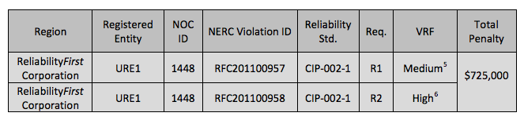
Failure to Comply with NERC/CIP Requirements: Real Financial Penalties
http://www.nerc.com/filez/enforcement/Public_FinalFiled_NOP_NOC-1448.pdf

Slide 24
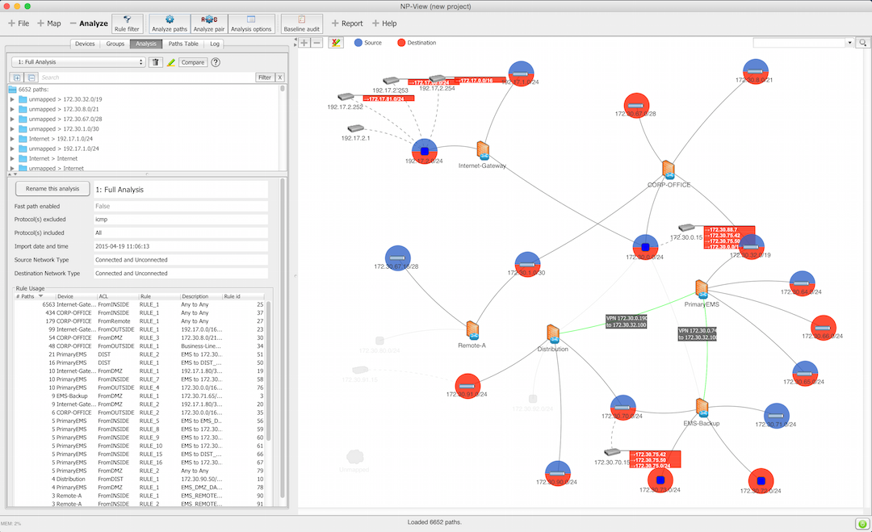
Industrial Control System Network Vulnerability Analysis with NP-View

Slide 25

Industrial Control System Network Vulnerability Analysis with NP-View

Slide 26
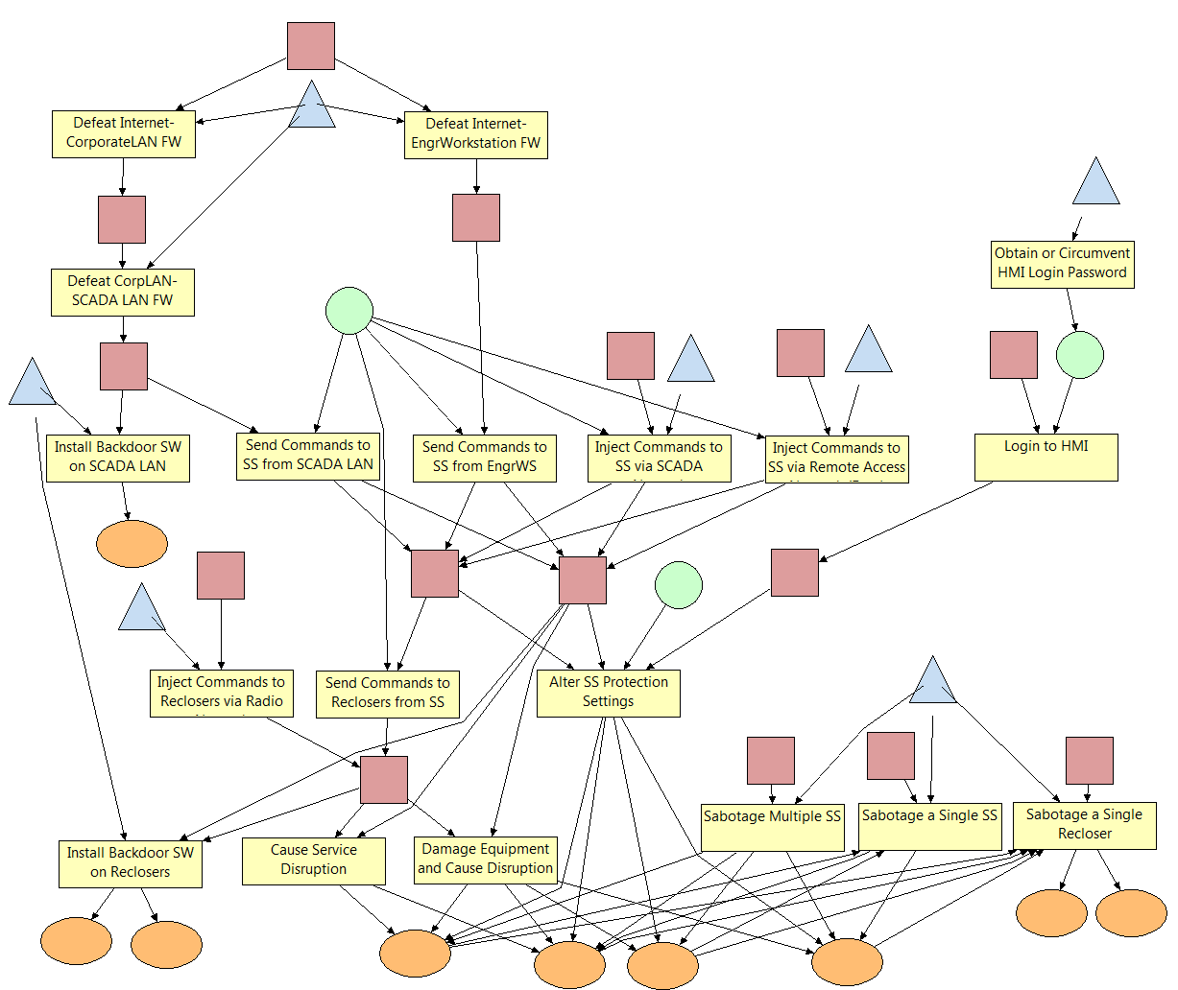
Hacker, Foreign Gov.
Preview of ADVISE Analysis Results
Insider Engineer
Hostile Org.
Insider Engineer
Insider Technician, Insider Operator

Slide 27
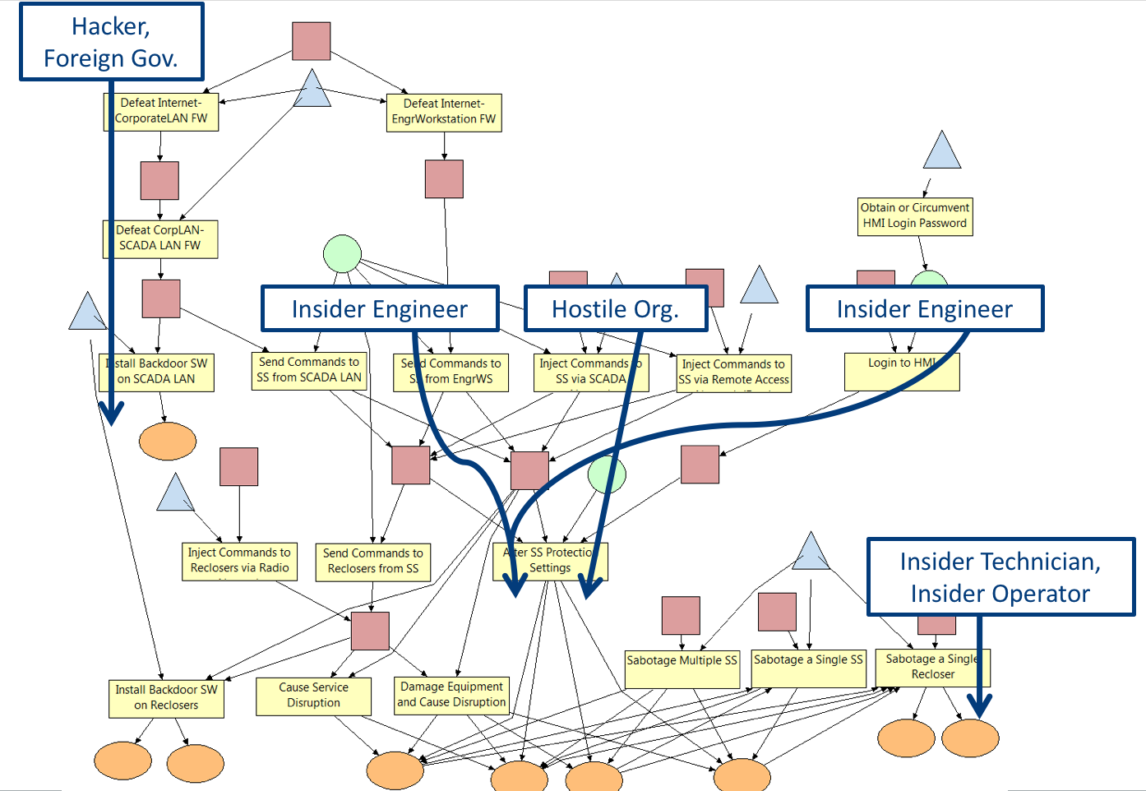
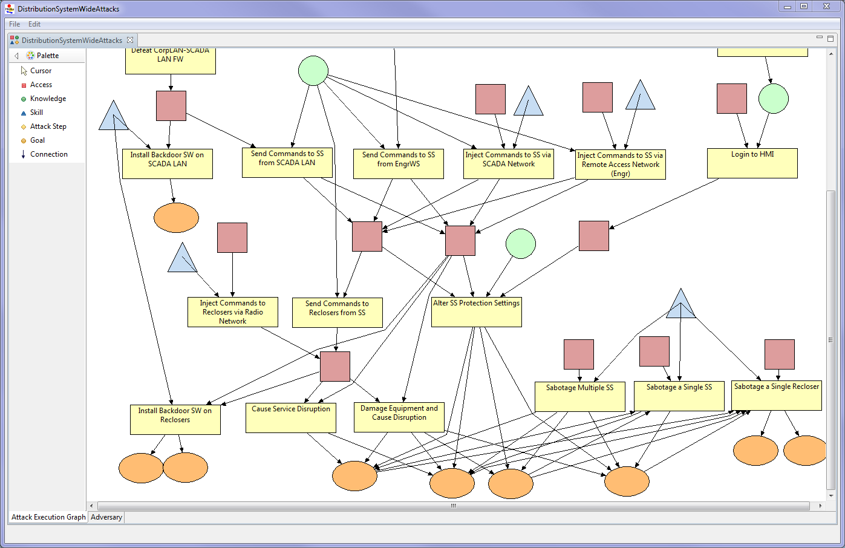
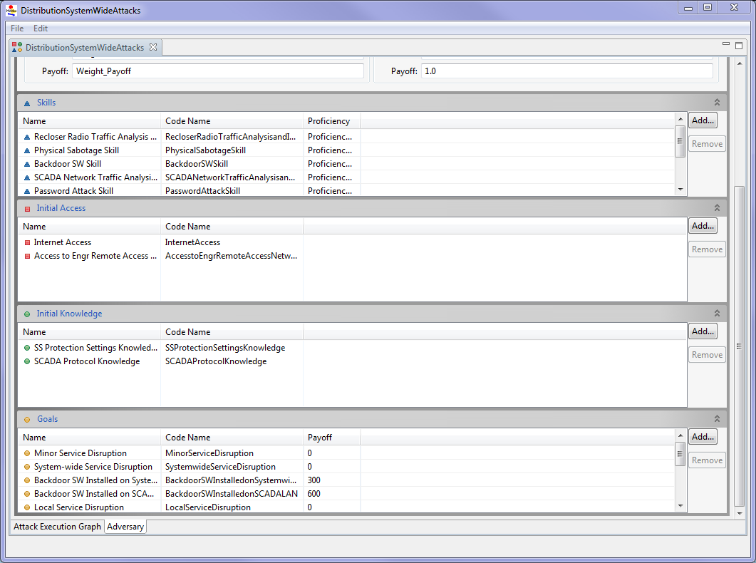
Engineering in Cyber Resilience: Making Sound Design Choices

Slide 28
Cyber Security Facts (according to Sanders)
Grid cyber infrastructures are complex, and their complexity will only continue to increase.
Cyber infrastructures intended to be secure must operate through attacks.
Absolute cyber security is unattainable.
Resiliency is imperative: Protect the best you can, but realize that perfect protection is impossible, so resiliency can only be achieved through tolerating attacks through online detection and response.
Assessment of the “amount” of security that a particular resiliency approach provides is essential.

Slide 29

Cyber Resilient Energy Delivery Consortium (CREDC)
Will improve the resilience and security of the cyber networks that serve as the backbone of energy infrastructure
11 universities and national laboratories: Argonne, Arizona State, Dartmouth, MIT, Oregon State, PNNL, Rutgers, Tennessee State, Univ. Houston, and Wash. State
Funded by DOE: $28.1 million initiative
Led by David Nicol, with Sanders and Sauer as co-PIs
Broadens TCIPG research scope to include the oil & gas industry and provides focus on resiliency

Slide 30
Final Thoughts
Problem of immense societal importance: “Keeping the lights on”
Absolute cyber security is unattainable
System resiliency is the path forward
Incredible opportunity for academics, rich with opportunity for algorithms and analysis
Can make progress by solving parts of the problem
Must deeply engage academia, industry, and government

