Slide 1

DEVELOPING BIOSYNTHESISED ALLELOCHEMICALS FOR EFFECTIVE WEED MANAGEMENT IN DIRECT SOWN RICE

Slide 2
APPLICANT PROFILE
TEAM MEMBERS DETAIL’S
S.no | STUDENT NAME | COURSE | SEMESTER & YEAR
1. | THARANYA S | B. Sc. (Hons.) Agriculture | IV SEMESTER- II YEAR, KIA
2. | SWATHI V
3. | THARSHINI TV
4. | VINOTHA B

Slide 3
PROBLEM STATEMENT
NEED
Rice is staple food crop for more than 60% of people in Asian countries.
Direct rice sown method - reduce duration, minimize water use.
Poor weed management - 100% yield loss (Shekhawat et al., 2020).
Rice alone consumes 2.3 million tonnes of herbicide per annum (Statista, 2023)
Application of herbicide damages ecosystems and pollutes the environment (Mehdizadeh et al., 2021).
Therefore, allelochemicals is the best alternative for producing rice in ecofriendly manner.
Dosage, spectrum of target weed, effect on crop, soil implication needs more attention before commercialization
HYPOTHESIS
Crude extract of
Parthenium hysterophorus (Dukpa et al., 2020),
Eucalyptus globulus (Dukpa, 2020),
Helianthus annuus L. (Janusauskaite, 2023) exhibited the strongest allelopathic potential on weeds.
The major allelochemical present in these crops are phenolic acid and volatile terpenes which suppresses weed growth.
Hence, extraction of ecofriendly allelopathic molecule present in those plants can be used for weed management in direct sown rice.
Notes:
Shekhawat, Kapila, Sanjay Singh Rathore, and Bhagirath S. Chauhan. "Weed management in dry direct-seeded rice: a review on challenges and opportunities for sustainable rice production." Agronomy 10, no. 9 (2020): 1264.
Harvard Jabran, K., & Jabran, K. (2017). Sunflower allelopathy for weed control. Manipulation of allelopathic crops for weed control, 77-85.
Chicago Kanatas, P. (2020). Potential role of Eucalyptus spp. and Acacia spp. allelochemicals in weed management. Chilean journal of agricultural research, 80(3), 452-458.
Dukpa, R., Tiwari, A., & Kapoor, D. (2020). Biological management of allelopathic plant Parthenium sp. Open Agriculture, 5(1), 252-261.
Mehdizadeh, Mohammad, Waseem Mushtaq, Shahida Anusha Siddiqui, Sawsen Ayadi, Pervinder Kaur, Stephen Yeboah, Sargol Mazraedoost, Duraid KA AL-Taey, and Koko Tampubolon. "Herbicide residues in agroecosystems: Fate, detection, and effect on non-target plants." Reviews in Agricultural Science 9 (2021): 157-167.
Janusauskaite, D. (2023). The Allelopathic Activity of Aqueous Extracts of Helianthus annuus L., Grown in Boreal Conditions, on Germination, Development, and Physiological Indices of Pisum sativum L. Plants, 12(9), 1920.

Slide 4
PROPOSED SOLUTION
Outcome of the proposed solution
Identification of potential ecofriendly allelopathic components with new mode of action can be used as an alternate to synthetic herbicides for weed management in direct sown rice
Understanding ecological implication through analyzing degradation pattern of applied allelochemicals in direct sown rice field soil
Development of new natural ecofriendly allelopathic herbicide product

Slide 5
How is the proposed solution better than existing solutions ?
Synthetic herbicides are harmful and pollutes the environment.
Bioherbicide molecules derived from plant (lack of unnatural rings) degrade easily.
Organic farming - adopt hand weeding and avoid chemical herbicides- increases cost.
Allelochemical reducing the weeds, labour cost and cultivation cost.
As this bioherbicides derived from plant, it will helps the soil to retain its functional stability and restore its productivity.
Identification of new site of action herbicide- manage herbicide resistant weeds

Slide 6
WORK PLAN
S.no | Milestones | Deliverables | Estimated time
1 | Identification and extraction of major allelochemicals present in the potential allelopathy producing plants, Compound identified – GCMS and Compound separated – Flash chromotograpy | Identification of major allelochemicals and extraction of the major allelochemicals from plants | 3 month
2 | Testing the efficiency of single or combination of purified allelochemicals on the major weeds of direct sown rice under controlled condition. | Identification of effective single or combination of allelochemicals for weed management in direct sown rice | 2 month
3 | Assessment of its suitability to crops, persistence of herbicide and soil microbial study under natural environmental condition. | Identification of ecofriendly herbicide molecule for effective weed management in direct sown rice | 5 month
4 | Development of ecofriendly alleolocemicals based bio-herbicide for weed management in direct sown rice. Final report submission | Stabilizing the effective allelopathic chemical molecules suitable for commercialization | 2 month

Slide 7
BUDGET ALLOCATION
S.NO | Budget Head | Budget allocation (RS)
Recurring
1 | Chemicals for extraction and analysis | 150,000
2 | Analyzing and extraction of components (out sourcing) | 1,00,000
3. | Travelling | 50,000
4. | Field experimentation | 70,000
5. | Other miscellaneous | 70,000
Non recurring
1. | Vacuum flask evaporator | 50,000
 | Total | 4,90,000

Slide 8
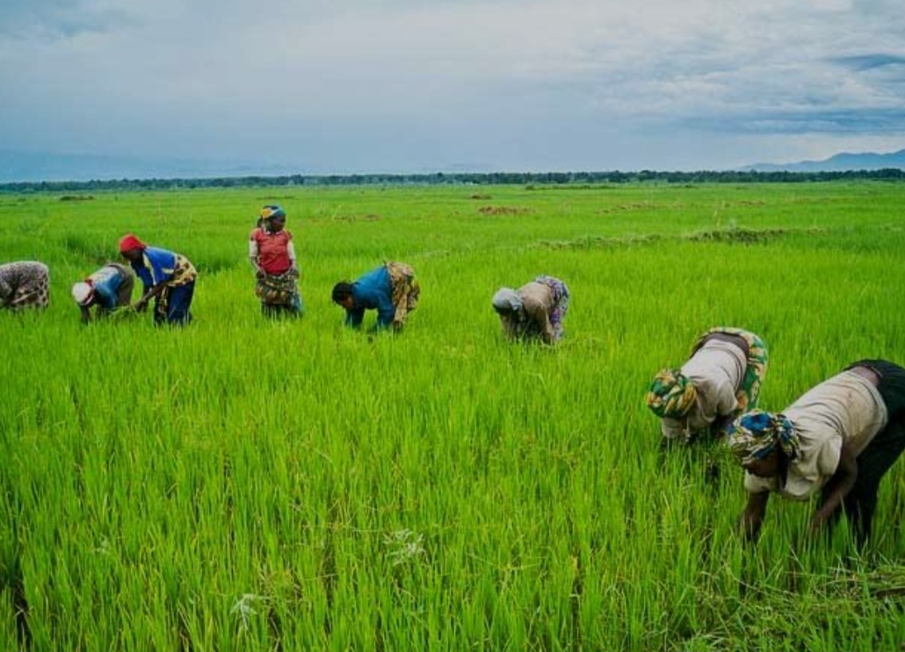
SOCIAL AND ECONOMIC IMPACT
In response to mounting concerns over the adverse environmental and health effects associated with synthetic herbicides, there's an increasing demand for sustainable alternatives in weed management of rice crop.
Allelochemicals stand out as a natural and eco-friendly solution, appealing to farmers, consumers, and regulatory bodies alike.
The organic farming sector presents a lucrative market opportunity for allelochemical-based weed management products.
Organic farmers are actively seeking alternatives to synthetic chemicals, prioritizing natural and sustainable solutions that align with organic certification standards.

Slide 9


