Slide 1
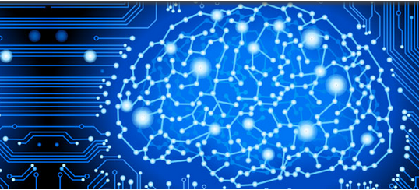

NeuroMiner®
pattern recognition for
neurodiagnostic applications
V1.1
beorn
{devel}
© Nikolaos Koutsouleris, Clara Weyer, Ariane Wiegand
The development of this software has been supported by the European Commission under the 7th Framework Programme / Grant Agreement No. 602152

