Slide 1
CAPSTONE PROJECT
Sri Lankan Vehicle Price prediction Machine Learning Model
Tharindu Dissanayake

Slide 2
Outline
Introduction
Methodology
Results
Feature Importance
Conclusion

Slide 3
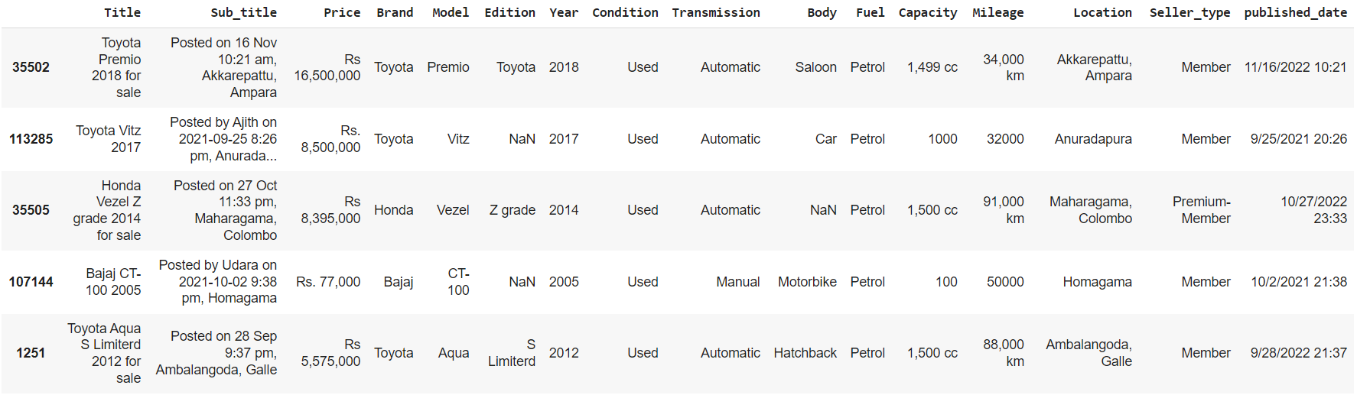
Introduction
The machine learning model was created to predict Sri Lankan vehicle prices
Regression-type supervised learning model
Brand, model, manufactured year, condition, transmission, body, fuel type, capacity, and mileage are used as features
R2 score was used to evaluate the machine learning model
The Sri Lanka vehicle prices dataset on the Kaggle website was used as the dataset
The dataset contains data from ikman.lk website
Sample of the Sri Lanka vehicle prices dataset

Slide 4
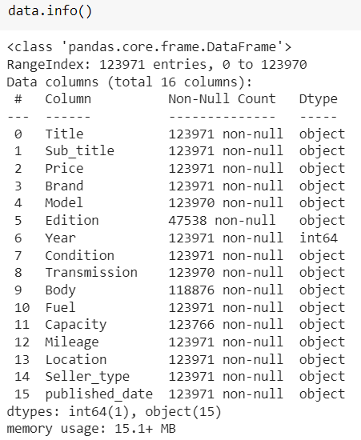
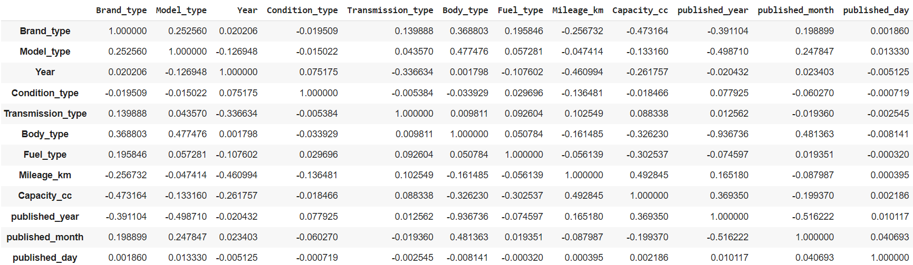
Methodology
The dataset was pre-process
The missing values were removed
The incorrect categories were removed
The outliers were removed
The data was changed to numerical values
Linear regression, decision tree regression, lasso regression, and random forest algorithms were used
70% of the dataset (61863 data rows) was used to train the models
30% of the dataset (26514 data rows) was used to test the models
Data information of the dataset
Correlation Matrix

Slide 5
Results
The decision tree regression model with a 0.999819 R2 score value is the best model

Slide 6
Feature Importance
capacity followed by manufactured year is the two most important parameters

Slide 7
Conclusion
The decision tree regression model is the best model
The best R2 score of 0. 999819 was shown by the decision tree regression model
Vehicle capacity and vehicle manufactured year are the most important features

Slide 8
Thank You

