Slide 1
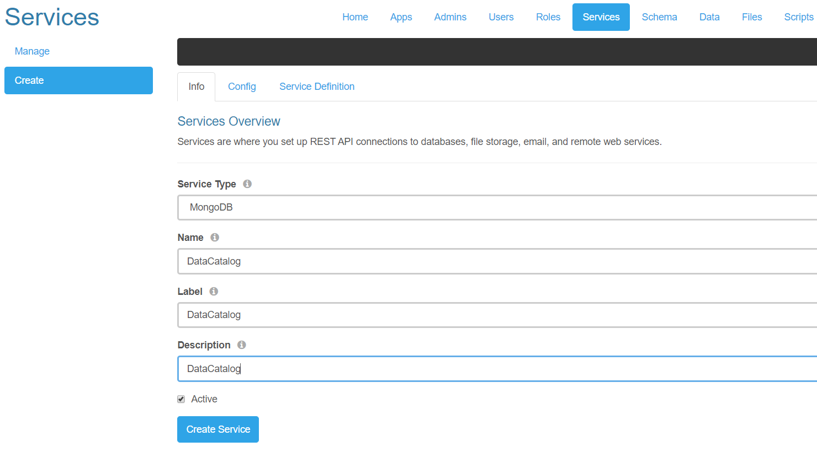
!1. Create Service

Slide 2
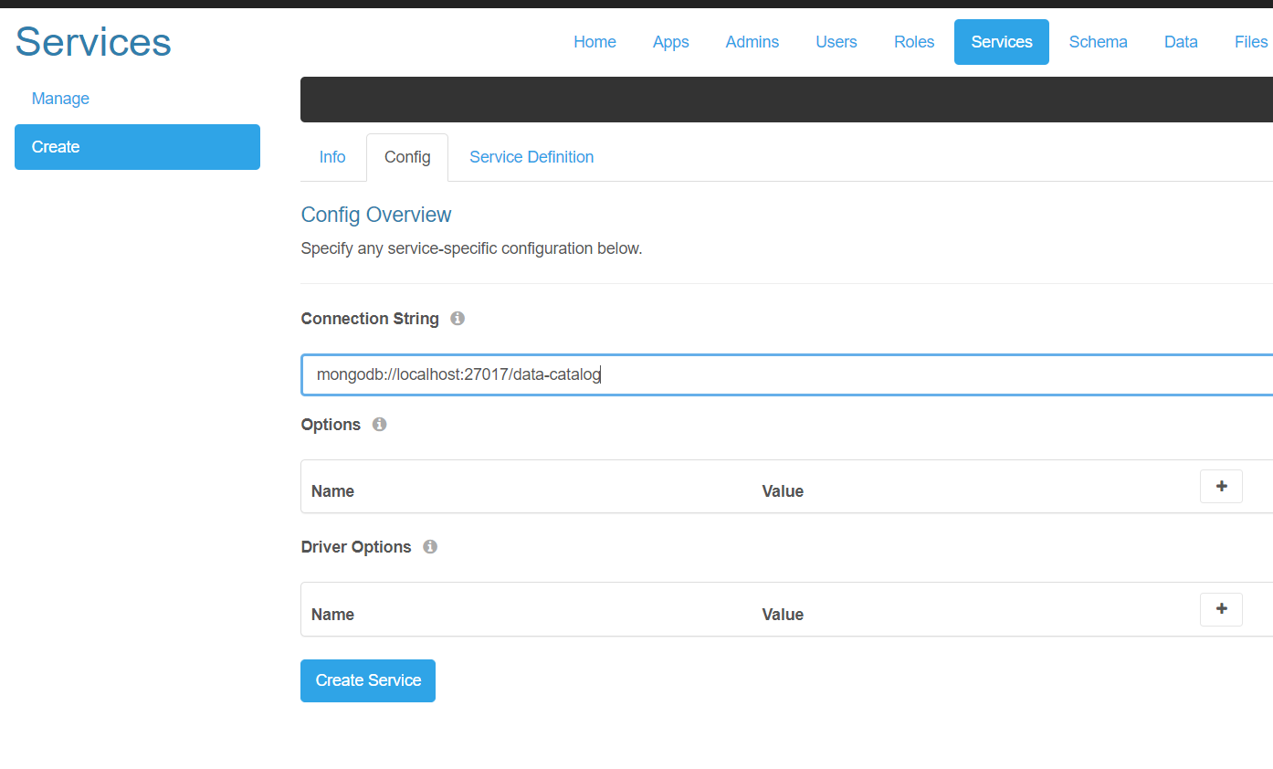
!1. Create Service

Slide 3
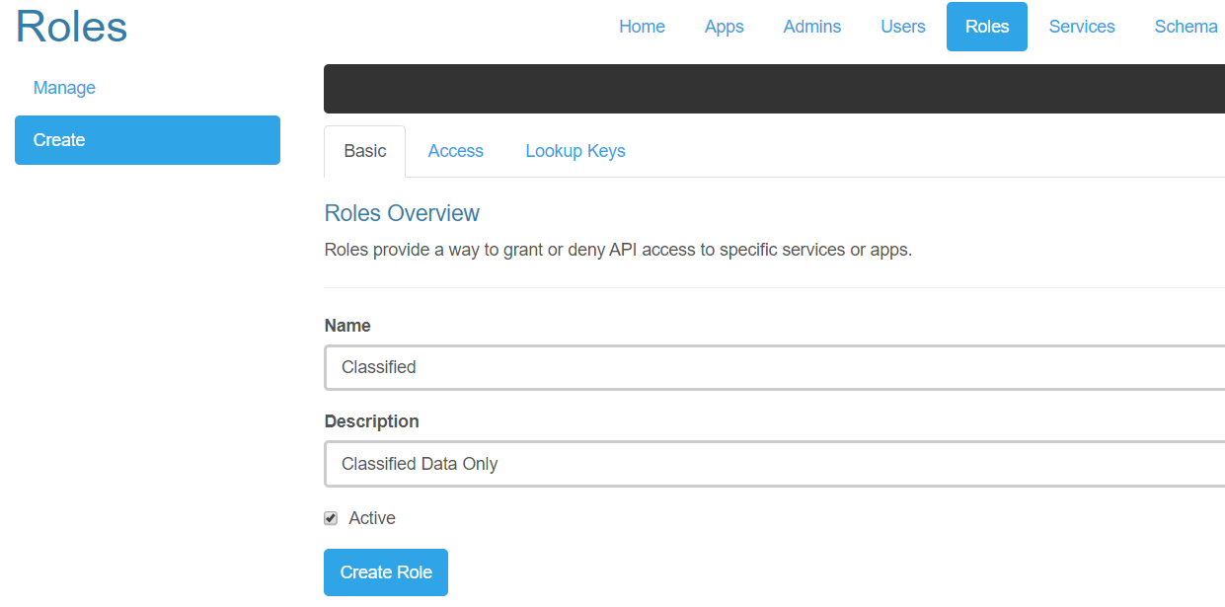
2. Create Roles

Slide 4
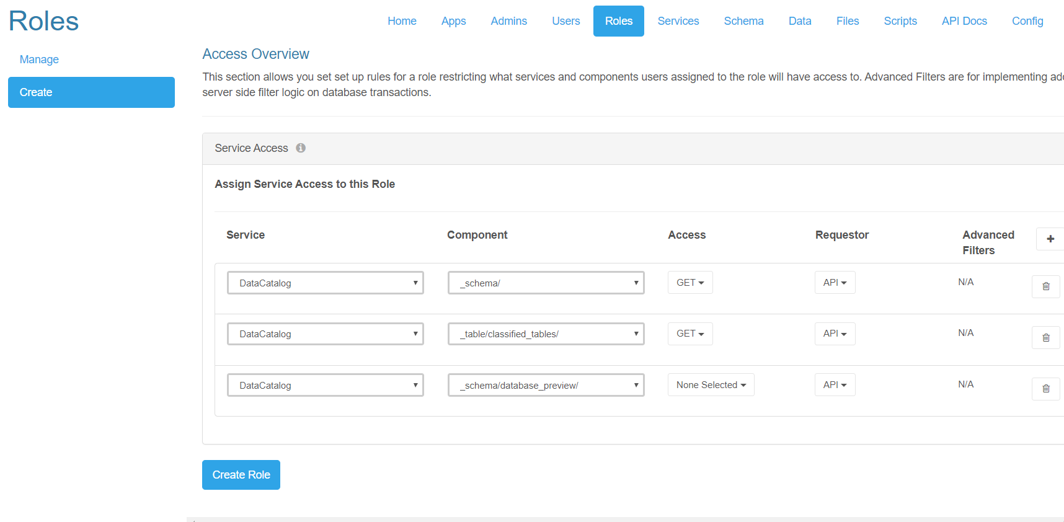
2. Create Role Access rights

Slide 5
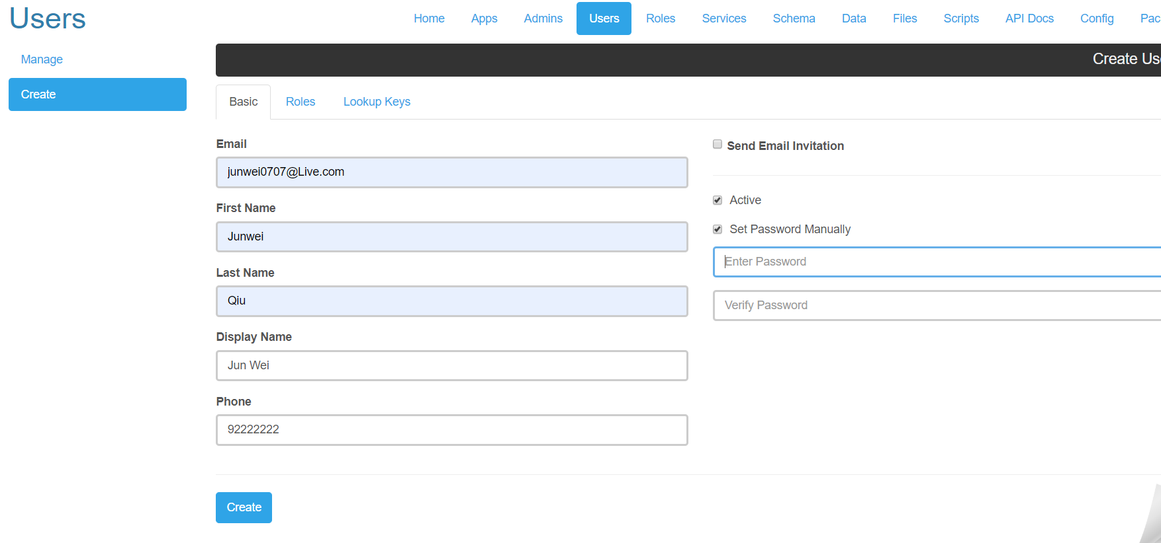
3. Create User
May have to create a universal password for every user, old version will only pass back the session token if there is username/email and password

Slide 6
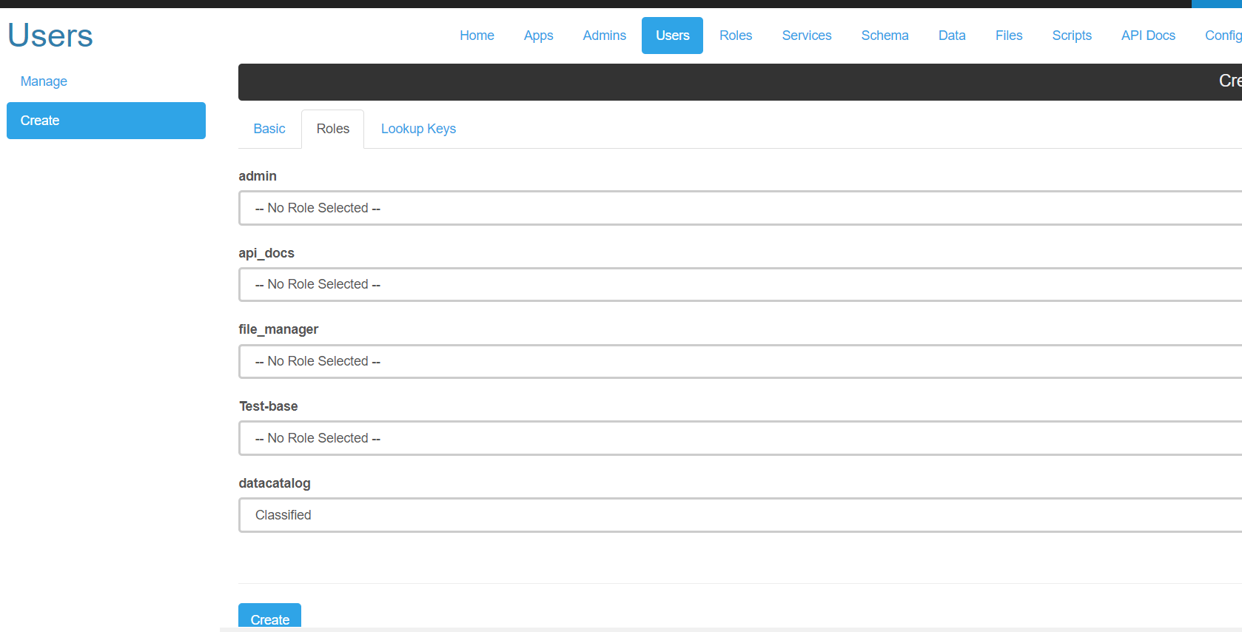
3. Assign User
Role

Slide 7
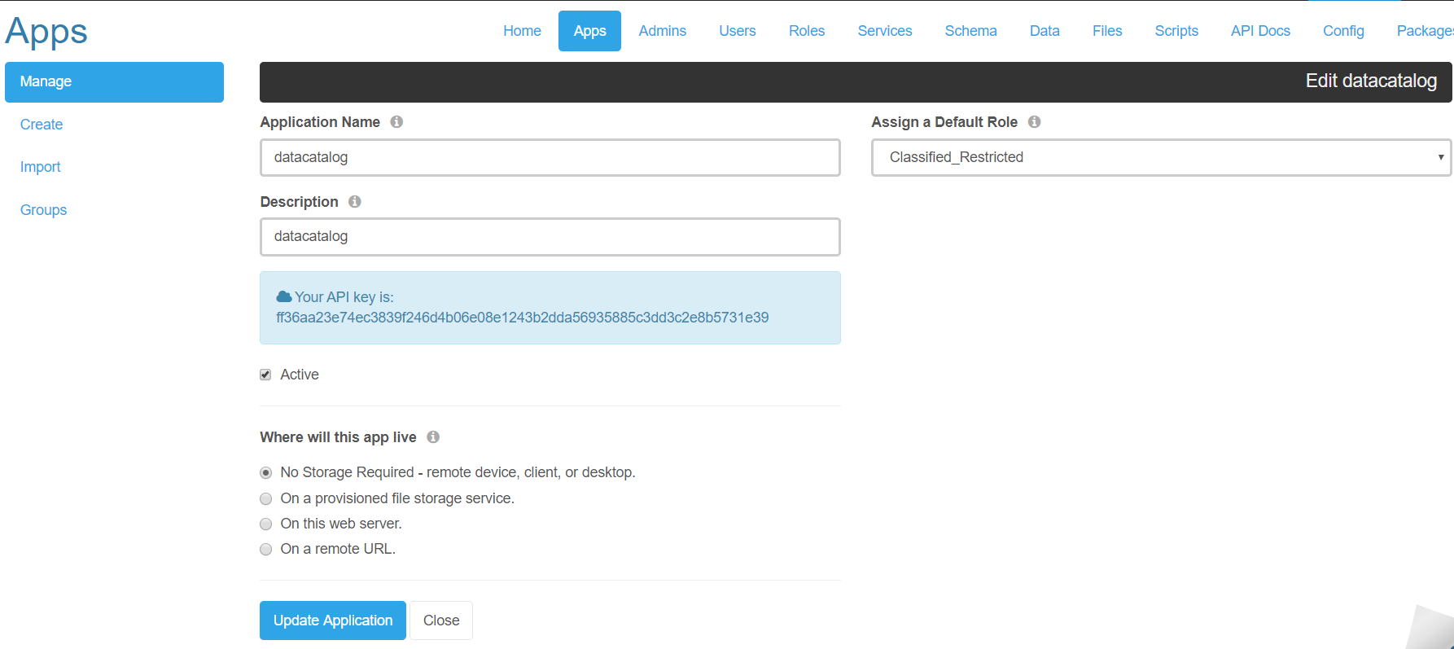
4. Create app for API key
API calls require session token and
API key

