Slide 1
CLEAN ARCHITECTURE

Slide 2

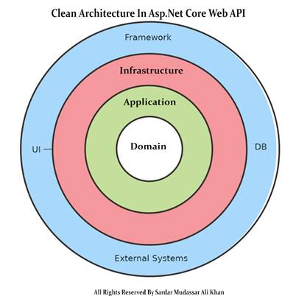
What is Clean Architecture?
Clean Architecture is a design pattern.
It has 4 Layers:
1.Domain layer,
2.Application Layer,
3.Infrastructure Layer,
4.Presentation(Framework) Layer.
The domain and application layer are core of the system (Heart of the Application).
It has to be written without any direct dependency.
This means that if I want to change my framework OR User Interface (UI) of the system, the core of the system should not be changed.

Slide 3

Domain Layer:
The domain layer in the clean architecture contains the enterprise logic, like the entities.
The model classes using the code first approach in the application using Asp.net core these entities are used to create the tables in the database.

Slide 4
Application Layer:
The application layer contains the business logic. All the business logic will be written in this layer.
It is in this layer that services interfaces are kept, separate from their implementation, for loose coupling and separation of concerns.

Slide 5

Infrastructure Layer:
In the infrastructure layer, we have model objects we will maintain all the database migrations and database context Objects in this layer. In this layer, we have the repositories of all the domain model objects.

Slide 6
Presentation(Framework) Layer:
In the case of the API Presentation layer that presents us the object data from the database using the HTTP request in the form of JSON Object. But in the case of front-end applications, we present the data using the UI by consuming the APIS.

Slide 7

Advantages of Clean Architecture:
You can implement this architecture with any programming language.
This architecture allows you to change the external system without affecting the core of the system.
You can create a highly scalable and quality product.

