Slide 1
Separation and Purification of Ilmenite from Red Earth Deposits in Aruwakkalu area
V.Sinthujan UWU/MRT/19/048
Department of Applied Earth Sciences Uva Wellassa University

Slide 2
Content
Introduction
Research problem
Objectives
Materials and Methods
Expected outcome
References

Slide 3
Introduction
Ilmenite is a titanium baring mineral with the chemical formula of FeTiO₃
It is mainly used for the production of TiO₂ or titanium
TiO₂ is a bright white powder widely used as a base pigment in paint / paper / plastics, orthopedic related applications and welding electrodes ^{[1]}
South Africa is the world s’ leading ilmenite supplier with an annual production of 1120 thousand MT.
Australia is the second-largest ilmenite producer and is followed by Canada, China, India, Vietnam, Mozambique, Norway, Ukraine, the United States, Madagascar, Brazil, and Sri Lanka ^{[2]}

Slide 4
Ilmenite in Sri Lanka
Introduction cont.
In Sri Lanka, Pulmoddai is the only depositional area has been profitably mined since 1958 ^{[3]}
The deposit is exceptionally high grade, consisting of 70-72% ilmenite, with zircon, rutile, sillimanite and monazite with a heavy mineral content of 80% ^{[4]}
In Pulmoddai processing plant annually 70 metric tons of ilmenite is getting exported.

Slide 5
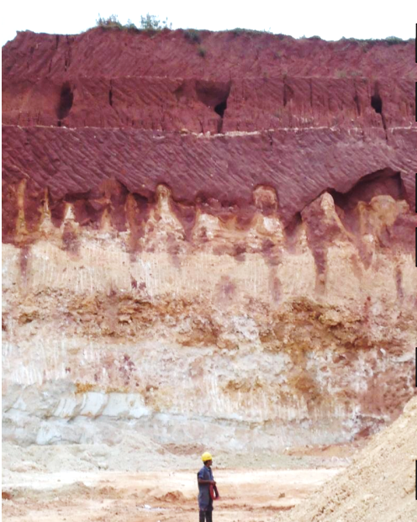
Aruwakkalu Red Earth
Introduction cont.
The Red earth deposits exist along the northwest part of Sri Lanka
Aruwakkalu Red Earth deposits is found in Puttalam district
Presently, Red earth are being removed as an overburden due to the mining of limestone by “INSEE/ Siam City Cement (Lanka) Limited at Aruwakkaru
Generally, fine-grained sand coated with iron-aluminum oxides provides the characteristic reddish color

Slide 6
Mineralogy of Aruwakkalu Red Earth
Introduction cont.
Major | Minor
Quartz, Ilmenite, Magnetite, Kaolinite | Rutile ,Zircon ,Leucoxene, Monazite, Sillimanite, Garnet
All the major component red earth is Fe coated and hence show the distinctive reddish -brown color
In 2014 the US Geological Survey has reported that the average amount of heavy minerals in red earth was 8.2% in Aruwakkaru area and Ilmenite accounts for 67%
Due to the Fe-Al oxide coating Aruwakkaru Ilmenite are the low grade than ilmenite from Pulmoddai

Slide 7
Research Problem
In 2021 the worldwide Ilmenite market valued as USD 1920.67 million and is expected to become double by 2027
High Demand
Mineralogy, geological occurrence, and distribution of Aruwakkaru red earth have been investigated by previous studies but few have been focused on obtaining ilmenite from Aruwakkaru RE.
Lack of Studies
According to the statistics of US geological survey, there is chance to get 4-6% of recoverable ilmenite from Aruwakkaru red earth . However, the interference of FeO contamination has limited the economical recovery
Disturbance from Fe coating

Slide 8
Objectives
Main Objective
Separate ilmenite from Aruwakkalu red earth by employing both physical and chemical techniques
Secondary Objectives
To investigate a suitable flow chart for the physical separation of ilmenite from Aruwakkalu red earth
To evaluate the effectiveness of the chemical purification technique to remove the Fe/Al coating from ilmenite from Aruwakkalu red earth

Slide 9
Materials and Methods
Characterization
OM - Optical Microscopy
XRD - X-ray Diffraction Analysis
XRF - X-ray Fluorescence Analysis
XRD
XRF
Middling & Concentrate
XRD
OM
Sampling
OM
XRD
10 samples from different places in the Aruwakkaru limestone quarry site from 1m depth
Humphrey Spiral Concentrator
Shaking Table
Heavy Minerals
XRD
XRF
OM
Clay minerals & Organic Impurities
Light Minerals

Slide 10
Materials and Methods
Characterization
OM - Optical Microscopy
XRD - X-ray Diffraction Analysis
XRF - X-ray Fluorescence Analysis
Chemical Treatment
XRF
Magnetic Separation
Magnetic Fraction
XRF
XRD
OM
OM
Heavy Minerals
Magnetic Separation
XRF
Magnetic Fraction
Chemical Treatment
XRF
XRD
XRD
OM
OM

Slide 11
Expected Outcome
Check objective and write

Slide 12
References
[1] N. H. Koralegedara, W. L. A. C. I. Weedagama, B. Athurupana, N. W. B. Balasooriya, R. Chandrajith, and A. Senaratne, “Chemical, Mineralogical and Textural Characterization of Red Earth Formation in the Northwest Coast of Sri Lanka,” J. Geol. Soc. Sri Lanka, vol. 22, no. 1, p. 1, Jun. 2021, doi: 10.4038/jgssl.v22i1.53.
[2] W. L. A. Chamidu, I. Weedagama, N. Koralegedara, N. W. B. Balasooriya, and B. Athurupana, “Lateral variation of texture and mineralogy of Red earth in northwest, Sri Lanka.” [Online]. Available: https://www.researchgate.net/publication/342978119
[3] J. F. Lv, Y. X. Zheng, X. Tong, Y. M. Zheng, and H. P. Zhang, “Mineralogy, physical characterization and magnetic separation performance of a raw ilmenite concentrate for its purification,” Russ. J. Non-Ferrous Met., vol. 58, no. 2, pp. 101–108, Mar. 2017, doi: 10.3103/S1067821217020067.
[4] A. Senaratne, “CHARACTERIZATION AND PROSPECTS FOR HARVESTING OF HEAVY MINERAL BEACH SANDS IN THE COASTAL BELT OF SRI LANKA,” 2014, doi: 10.13140/2.1.4559.1841.
[5] K. N. J. Katupotha, “Degradation of Mangrove Swamps in Sri Lanka,” Proc. Int. For. Environ. Symp., vol. 0, no. 0, p. 2000, 2013, doi: 10.31357/fesympo.v0i0.1603.
[6] A. H. J. Sampath, N. D. Wickramasinghe, K. M. N. de Silva, and R. M. de Silva, “Methods of Extracting TiO2 and Other Related Compounds from Ilmenite,” Minerals, vol. 13, no. 5, 2023, doi: 10.3390/min13050662.
[7] C. Thambiliyagodage, R. Wijesekera, and M. G. Bakker, “Leaching of ilmenite to produce titanium based materials: a review,” Discov. Mater., vol. 1, no. 1, Dec. 2021, doi: 10.1007/s43939-021-00020-0.

Slide 13
THANK YOU

