Slide 1

Extraction of TiO₂ from Ilmenite, Found in Aruwakkalu Red Earth
Ratheeskaran. L UWU/MRT/20/002
Department of Applied Earth Science Uva Wellassa University

Slide 2
Content
Introduction
Research Problem
Objectives
Materials and Methods
Expected Outcome
References
1
1

Slide 3
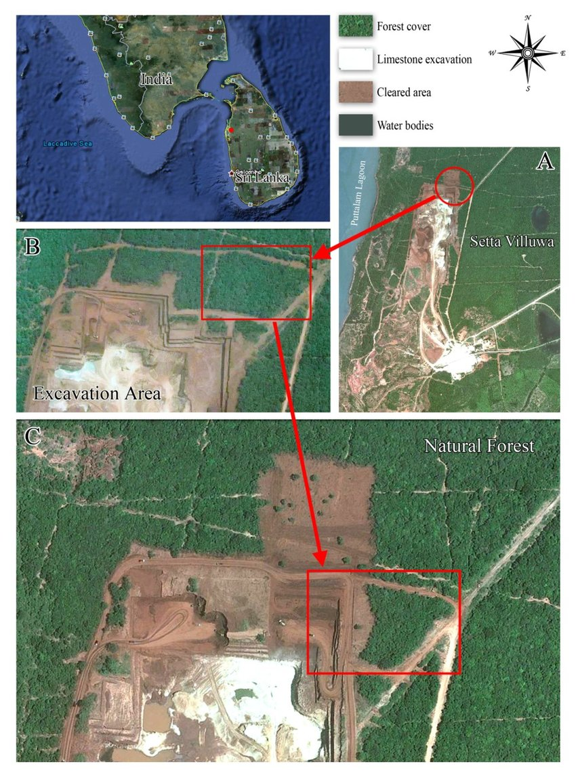
Introduction
Red earth (RE) deposit exists along the northwest coastal belt of Sri Lanka. ^{[1]}
The largest open pit limstone mine in Sri Lanka operated by Siam City Cement Lanka Limited. ^{[2]}
The red soil overburden is directly excavated and low grade and high grade limestone layers are drilled and blasted for extracting limestone. ^{[2]}
Iron-aluminum oxides brings the characteristic reddish color.
Figure 1: Map of the Holcim limestone excavation site.
L. Gunatilake et al., "Map of the Holcim limestone excavation site, Eluwankulama, Aruwakkalu Forest, Puttalam," *ResearchGate*, 2010. [Online]. Available: https://www.researchgate.net/figure/Map-of-the-Holcim-limestone-excavation-site-Eluwankulama-Aruwakkalu-Forest-Puttalam_fig20_256454738.
[1]L. Gunatilake et al., "Map of the Holcim limestone excavation site, Eluwankulama, Aruwakkalu Forest, Puttalam," *ResearchGate*, 2010. [Online]. Available: https://www.researchgate.net/figure/Map-of-the-Holcim-limestone-excavation-site-Eluwankulama-Aruwakkalu-Forest-Puttalam_fig20_256454738.
[2] P. M. D. C. Perera, "Study on the properties of steel reinforcement bars produced in Sri Lanka," University of Moratuwa Institutional Repository, 2020. [Online]. Available: http://dl.lib.uom.lk/handle/123/17423.
.
2

Slide 4
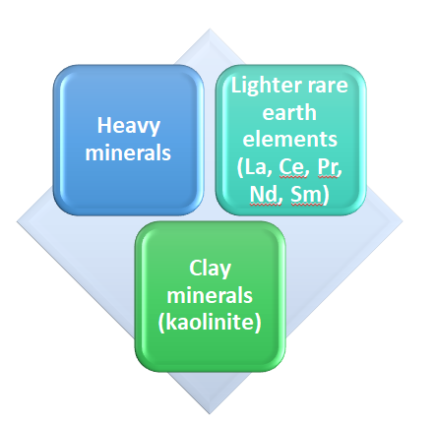
Introduction
Significantly 3 types of minerals and elements are found in RE.
RE have important heavy minerals such as magnetite, ilmenite, and rutile enhance its economic importance.^{[3]}
The ilmenite content is around 8-10 % in RE.^{[3]}
[3]Spotlight on Puttalam: Aussie company buys Lankan ilmenite deposit for a pittance," *Daily Mirror*, Feb. 17, 2023. [Online]. Available: https://www.dailymirror.lk/print/expose/Spotlight-on-Puttalam-Aussie-company-buys-Lankan-ilmenite-deposit-for-a-pittance/333-250736.
3

Slide 5
Introduction
Ilmenite is a heavy, iron-black mineral composed of iron and titanium oxide (FeTiO₃).
Key source of titanium/titanium dioxide.
Characteristics properties of titanium dioxide (TiO₂) making it important in industrial and consume application. ^{[4]}
High refractive index
UV-blocking properties
Phocatalytic activity
Titanium dioxide is used in paints, paper, toothpaste, sunscreen and even food colouring. ^{[5]}
[4] A. Shah, D. Ban, and A. Kumar, "Photocatalytic TiO2-Based Nanostructures as a Promising Material for Diverse Environmental Applications: A Review," Bioengineering, vol. 5, no. 1, p. 7, 2023. [Online]. Available: https://www.mdpi.com/2624-781X/5/1/7.
[5] "Mineral Sands Products & Sales," *Mineral Commodities Ltd.*, 2023. [Online]. Available: https://www.mineralcommodities.com/products-sales/mineral-sands/.
4

Slide 6
Research problem
Demand for TiO₂
Worldwide ilmenite mining is utilized for the extraction of TiO₂
Contamination in Red Earth
Ilmenite can be separated from red earth by gravity and magnetic separation techniques
Challenge
Difficulties in extraction of TiO₂ from ilmenite found in red earth due to the complex mineral structure of ilmenite and the presence of impurities.
However, Fe-Al coating is adversely affected for the magnetic separation.
The RE contains 8-10% of economically recoverable ilmenite
5

Slide 7
Objectives
Major Objective
The main goal is to extract titanium dioxide (TiO₂) from ilmenite found in the red earth deposits of the Aruwakkalu region in Sri Lanka.
Specific Objectives
To employ and optimize the physical separation technique to obtain ilmenite while minimizing other contaminants.
To evaluate and optimize a chemical extraction method for titanium dioxide (TiO₂) by minimizing the Fe and Al contamination.
6

Slide 8

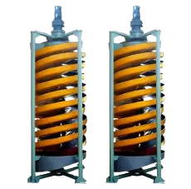

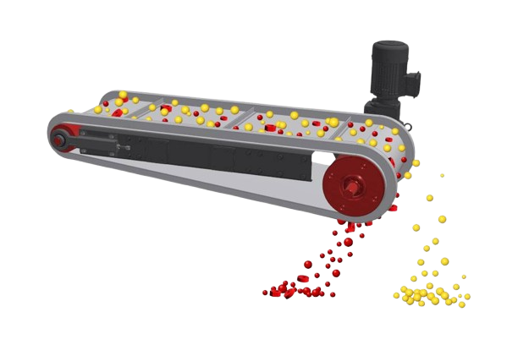
Materials and Methods
Characterization
OM - Optical Microscopy
XRD - X-ray Diffraction Analysis
XRF - X-ray Fluorescence Analysis
XRD
OM
XRF
XRD
OM
Middle & concentrate
Magnetic minerals
XRD
OM
XRF
Heavy minerals
Sampling
XRD
Humphrey spiral Concentrator
Shaking table
Magnetic separator
Water washing
Clay mineral and organic material
Non-magnetic minerals
XRD
OM
XRF
Light minerals
7

Slide 9
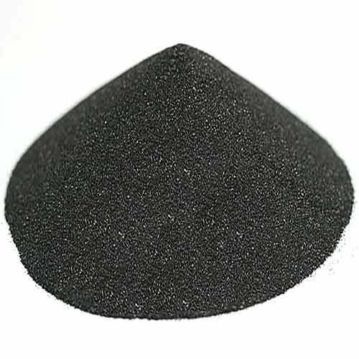
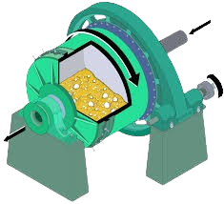
Materials and Methods
< 53 μm
powdered sample
XRD
OM
XRF
XRD
OM
XRF
XRD
OM
XRF
Alkaline leaching
EDTA selective iron removal
Sulfate process
Al₂​O₃​+2NaOH→2NaAlO₂​+H₂​O
Ilmenite
Ball milling
9

Slide 10
Expected Outcome
Both gravity and magnetic separation techniques will be utilized to separate the Ilmenite from red earth.
Develop an efficient method for TiO₂ extraction, while overcoming the disturbance from Fe-Al oxide surface coating of ilmenite.
Evaluate the quality of extracted TiO₂ with respect to the Fe and Al contamination.
Add value to the red earth available in northwest coastal belt of Sri Lanka
10

Slide 11

Gant Chart
Research Activity | November |  |  |  | December |  |  |  | January |  |  |  | February |  |  |  | March |  |  |  | April |  |  |  | May |  |  |  | June
Topic selection and literature review.
Sample collection and preparation.
Extraction and impurity removal.
Characterization of TiO₂ and Materials.
Data analysis and process refinement.
Dissemination of results and publication.
11

Slide 12
References
[1] L. Gunatilake et al., "Map of the Holcim limestone excavation site, Eluwankulama, Aruwakkalu Forest, Puttalam," *ResearchGate*, 2010. [Online]. Available: https://www.researchgate.net/figure/Map-of-the-Holcim-limestone-excavation-site-Eluwankulama-Aruwakkalu-Forest-Puttalam_fig20_256454738.
[2] P. M. D. C. Perera, "Study on the properties of steel reinforcement bars produced in Sri Lanka," University of Moratuwa Institutional Repository, 2020. [Online]. Available: http://dl.lib.uom.lk/handle/123/17423.
[3] Spotlight on Puttalam: Aussie company buys Lankan ilmenite deposit for a pittance," *Daily Mirror*, Feb. 17, 2023. [Online]. Available: https://www.dailymirror.lk/print/expose/Spotlight-on-Puttalam-Aussie-company-buys-Lankan-ilmenite-deposit-for-a-pittance/333-250736.
[4] A. Shah, D. Ban, and A. Kumar, "Photocatalytic TiO2-Based Nanostructures as a Promising Material for Diverse Environmental Applications: A Review," Bioengineering, vol. 5, no. 1, p. 7, 2023. [Online]. Available: https://www.mdpi.com/2624-781X/5/1/7.
[5] "Mineral Sands Products & Sales," *Mineral Commodities Ltd.*, 2023. [Online]. Available: https://www.mineralcommodities.com/products-sales/mineral-sands/.
[6] "Mineral resources from Sri Lanka," *Sri Lanka Export Development Board*, 2020. [Online]. Available: https://www.srilankabusiness.com/blog/mineral-resources-from-sri-lanka.html.
12

Slide 13
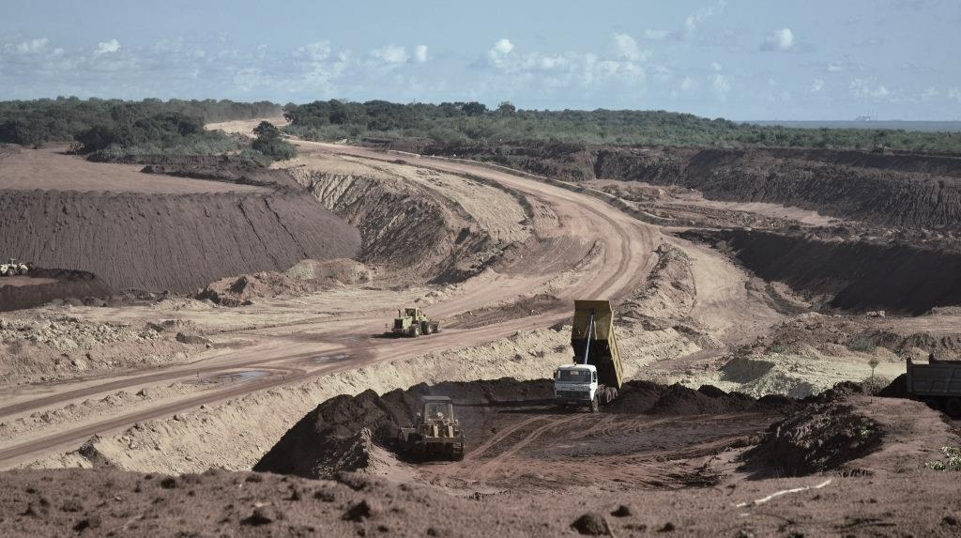
Thank You
13

