Slide 1
Mystery Vault
Investigate → Collect → Interrogate → Connect → Deduce → Solve

Slide 2

Problem Statement
In today's digital world, people are often exposed to misinformation, misleading statements, and incomplete information. There is a need for an engaging way to develop critical thinking and evidence-based reasoning.
Mystery Vault addresses this through an interactive investigation game where players analyse evidence, question information, identify contradictions, and make decisions based on facts.

Slide 3
Objective
Develop an interactive mystery investigation game using Java.
Allow players to investigate cases through clues, evidence and interrogations.
Analyze relationships and contradictions using a Case Connection Engine.
Evaluate the player's final deduction and generate a case report.
Demonstrate Java concepts through a single integrated application.

Slide 4
Topics Used
OOP: Classes, Objects, Encapsulation, Inheritance, Polymorphism, Abstract Classes, Interfaces
Core Java: Strings, Date/Time API, Packages, static, final, this
Advanced Java: Exceptions, Custom Exceptions, Assertions, Multithreading, Synchronization
Collections: List, Set, Map, Generics, Lambda Expressions, Streams
File Handling: File Streams, Random Access, Serialization, Regex
Database: JDBC, SQL, Prepared Statement, Result Set
GUI & Web: Swing/AWT, Event Handling, Servlets, Spring Boot

Slide 5
Database Tables
Table | Purpose
PLAYER | Player profile, rank & score
CASE | Case details & status
SUSPECT | Suspect information & alibis
EVIDENCE | Evidence collected during investigation
CLUE | Discovered clues
STATEMENT | Suspect/interrogation statements
TIMELINE_EVENT | Events with date & time
CASE_CONNECTION | Relationships between clues, suspects & evidence
INVESTIGATION | Player's investigation progress
SCORE | Final score & deduction result

Slide 6
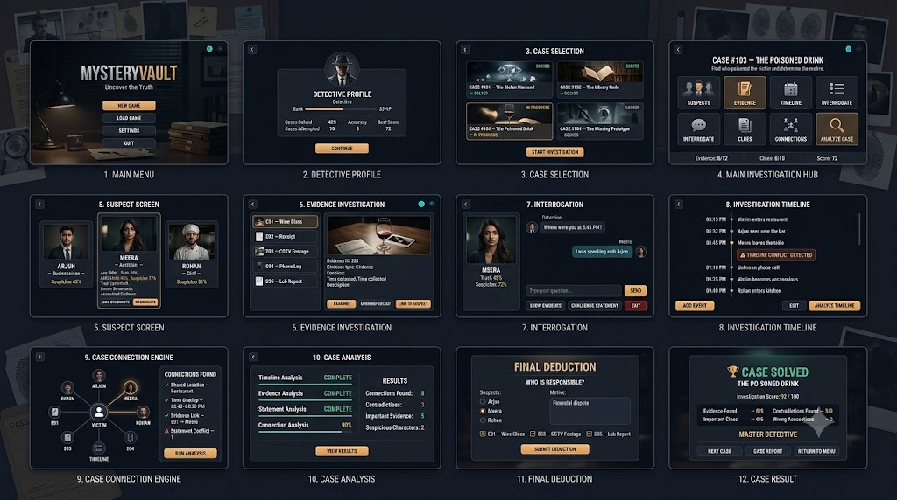
APP WIREFRAME

Slide 7
Thank You
By Mystery Finders
Gopika M : 2025503050
Priyanka M : 2025503044
Srivarsha D M : 2025503558
Tharnikaa Balakrishnan : 2025503598

