Slide 1
HINTS, Theme D “Adaptive and Distributed AI for Intelligent Realities”
Client Behavior Monitoring in Federated Learning via Eccentricity Analysis
Oct 27, 2023

Slide 2
Introduction
In federated learning, devices collaborate to train a global model while protecting their data privacy. FL’s success depends on edge devices actively participating and their contributions towards the better performance of the federated model.
Measuring how much each client contributes to the federation is challenging in FL.
Evaluating clients’ contributions for optimal client selection and better performance is crucial.
To address these issues and understand client behavior in FL, this research introduces a new method via eccentricity analysis, as a promising solution.

Slide 3
Federated Learning
FL was introduced by Google researchers in a 2017 paper, "Communication-Efficient Learning of Deep Networks from Decentralized Data”.
FL is a decentralized machine learning approach that enables model training across multiple edge devices or servers while keeping data localized and private.
FL is gaining popularity because of its Privacy Preservation, Reduced Data Transfer, Edge Computing, Scalability, and Collaborative Training.
Three different FL categories can be recognized: horizontal FL, where clients hold distinct samples of the same features, vertical FL where clients possess unique attributes for shared instances, and transfer FL, a specialized form focused on adapting knowledge from one domain to enhance models in related domains.

Slide 4
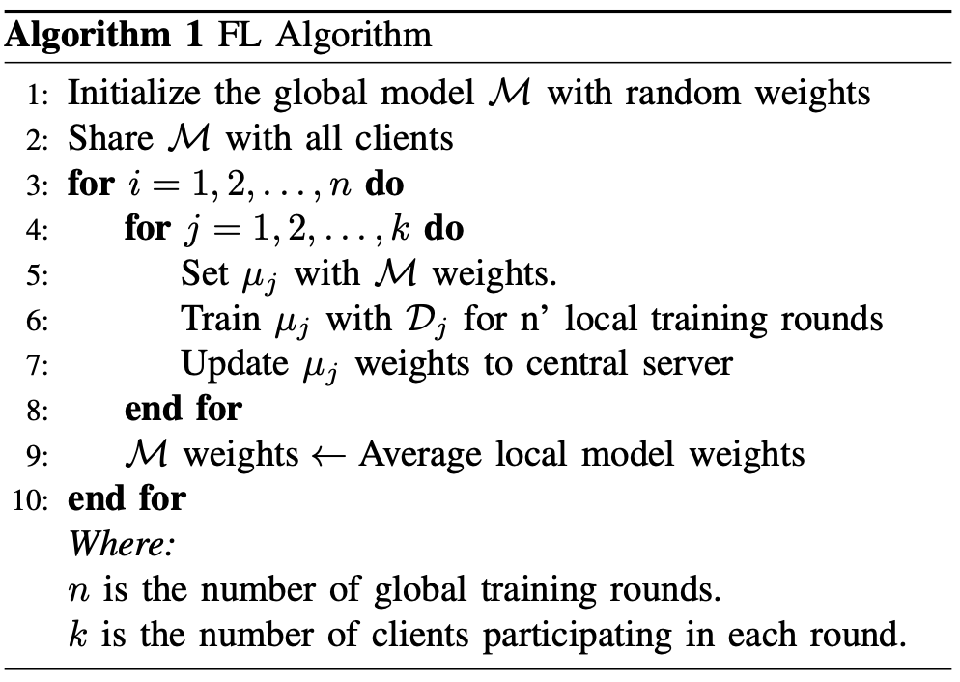
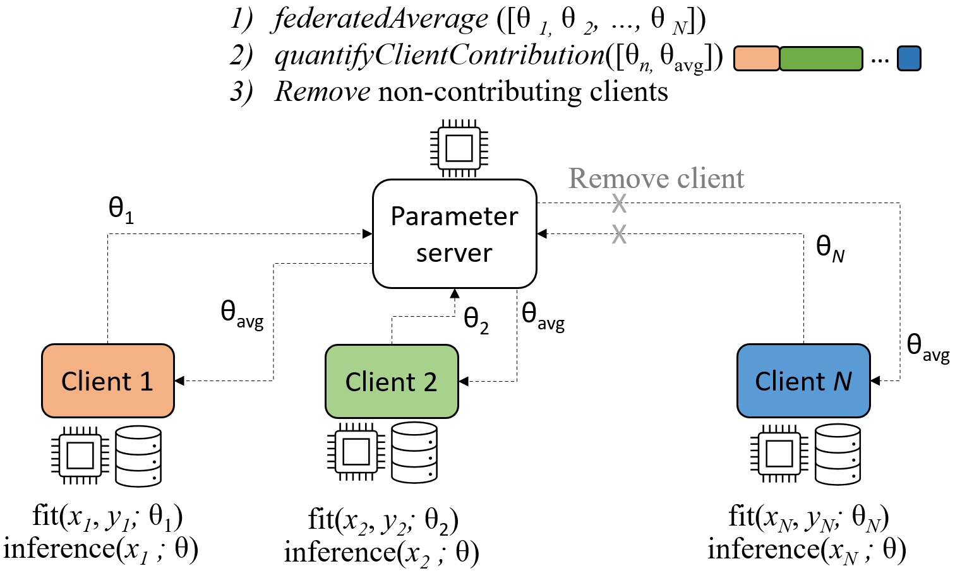
Cont…

Slide 5
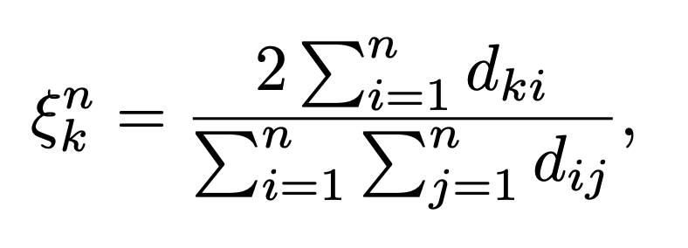
Eccentricity Analysis
TEDA (Typicality and Eccentricity-Based Data Analytics) is an alternative statistical framework. It is a systematic methodology that doesn't rely on prior assumptions and is based entirely on data and its mutual distribution in the data space.
Unlike some traditional statistical methods, TEDA doesn't require the assumption of independence among individual data samples and does not need an infinite number of data samples.
The eccentricity of a particular data sample X_{k} when n ( > 2 ) non-identical data samples are available is defined as the sum of the distances of X_{k} to all other existing data samples, divided by the sums of the distances from all data samples to all other data samples.

Slide 6
Neural Network Parameters and Hessian Matrix
A Neural Network (NN) typically contains an input layer, a few hidden layers, and an output layer. These layers are interconnected with weights and biases.
The weights and biases of the NN are initially set to random values and updated iteratively during the training process to minimize the prediction error over time.
The prediction error is assessed using a loss function, which is used to compute gradients for weight and bias updates.

Slide 7
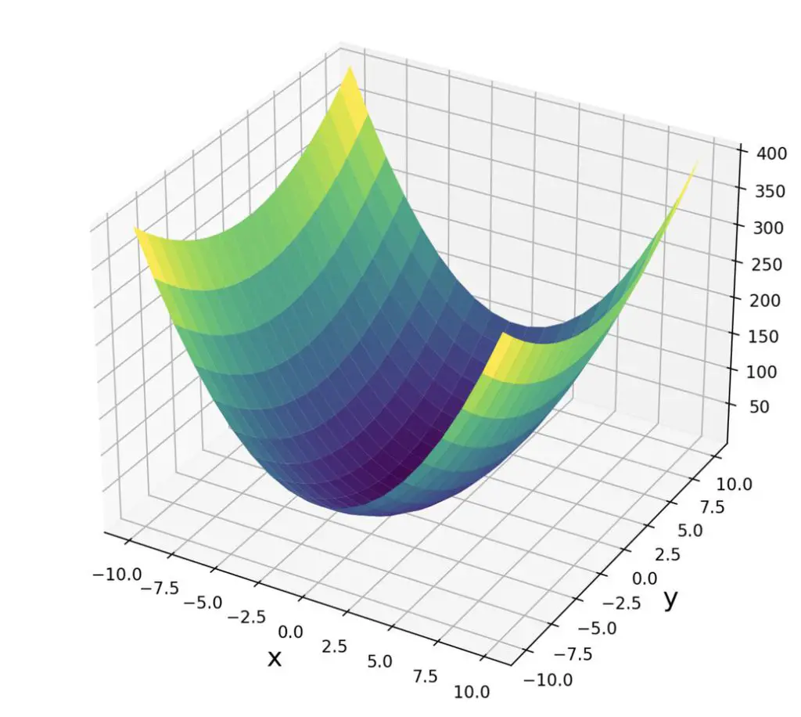
Cont…
The Hessian is a mathematical function that describes the curvature of a scalar function at a specific point.
The Hessian matrix can capture curvature information of the loss function concerning NN parameter changes.
It provides insights into how small changes in individual parameters collectively affect the change in the overall loss function.

Slide 8
Experimental Setup
Data
The data set was obtained through experiments at a key-value store database in a cluster and is publicly available.
Contained 24 distinct clients, 197 features, and 24,225 data points per client
In this study, the target variable to predict was “average read latency, " a continuous value.
Federated Model Training Setup
A shallow neural network for regression with an input layer, two hidden layers, and the output layer.
SGD as optimization algorithm, learning rate set at 0.005, where MAE was the loss function.
During training, mini-batch SGD was utilized, with a batch size of 64.
The following Experimentation was carried out with a holdout validation set compromising 33% of the entire data.

Slide 9

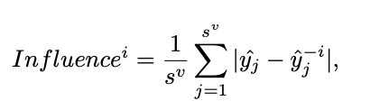
Baseline Approaches
Clients Benefit from the federation.
We trained clients’ local models (only using clients’ data) and calculated the performance difference between the local and federated models.
For the client i, benefit score is given in the following equation.
Contribution Evaluation via Deletion
The influence (contribution) of each party involved in horizontal FL can be calculated using the client deletion approach.
In this strategy, the dataset provided by a certain client (e.g., client i) is skipped, and the global model (M′) is built considering other clients’ local models.

Slide 10
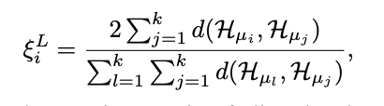
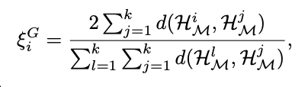
Proposed Approach
Approach 1 – Hessian Based Eccentricity
For client i, we can calculate two hessian matrixes. One is based on the client's local model and its data, H^{i}_{μ}. One is on the global model H^{i}_{M} and client data.
The local model-based eccentricity score for client i.
The global model-based eccentricity score for client i.
Approach 2 – Parameter Based Eccentricity
Calculate the eccentricity scores for clients without transforming the NN local models into Hessian matrices.
For each layer’s weights and biases, the respective eccentricity scores are computed separately and then averaged to get the overall eccentricity score (called ξ^{i}_{p} for client i).

Slide 11
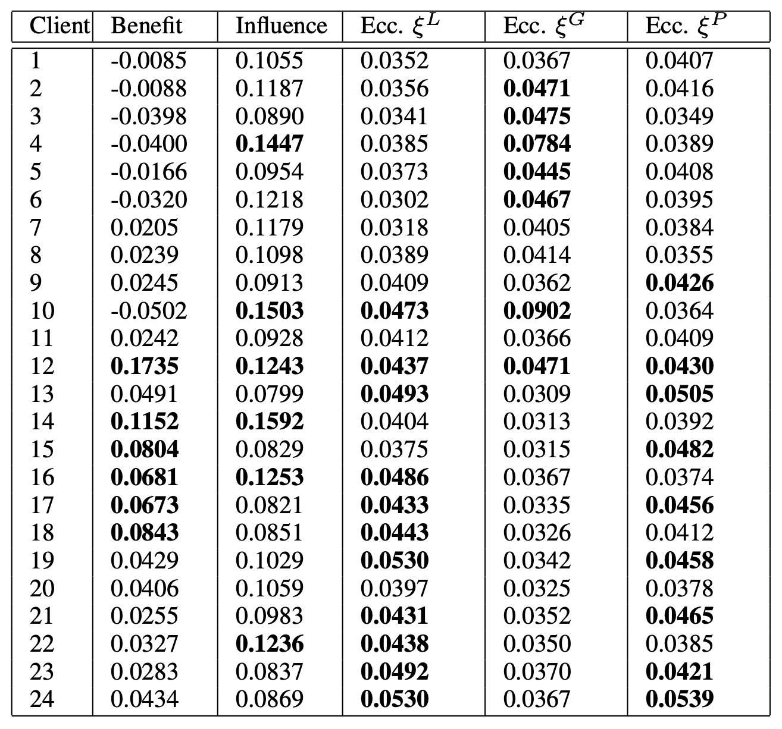
Results
Experiment 1
500 global model updates are conducted for each client with one local training round before calculating these measures.
7 clients (1,2,3,4,5,6,10) are not benefitting from the federation.
The 6 topmost influencing (contributing) clients are marked in bold.
The eccentric values above 0.0416 (1/24) are marked in bold.
Observe the 12th client is benefiting influencing and eccentric with two approaches.

Slide 12
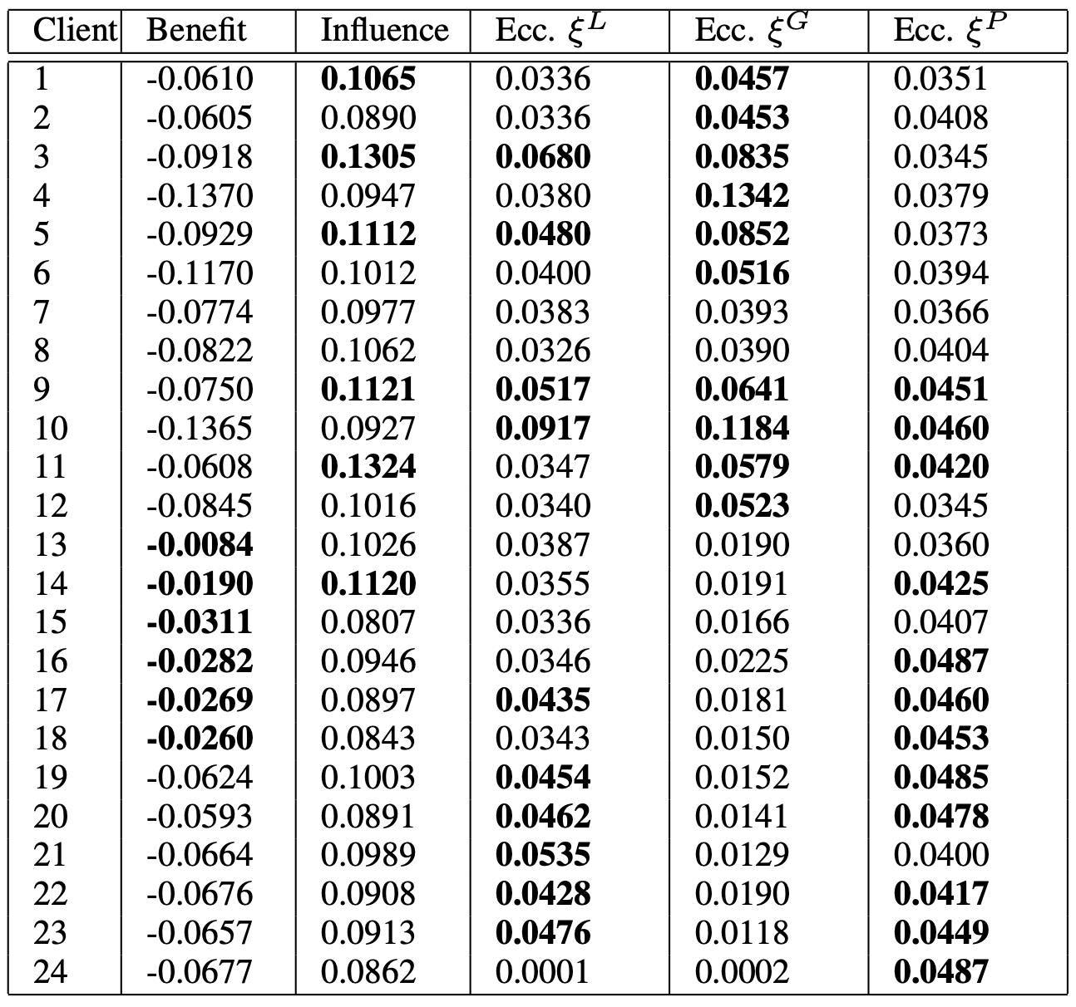
Results
Experiment 2
Evaluations after 25 local and 1 global updates at the first training round.
At this stage, none of the clients are benefitting from the federation.
This eccentricity metric cannot provide meaningful information about the clients’ Influences on the federated model at such an early stage of model training.

Slide 13
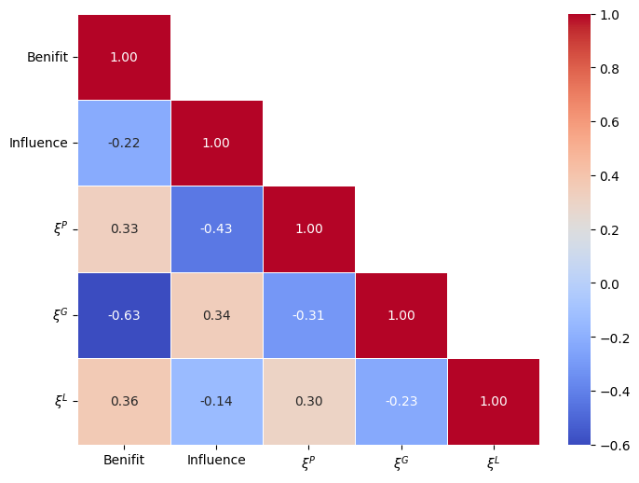
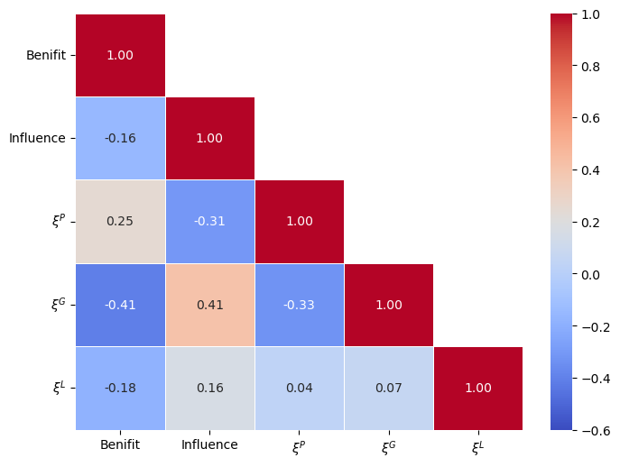
Kendal Ranking Comparison
Experiment 1
Correlations evaluated by Kendal ranking between the clients’ local model eccentricity and clients’ benefit and influence are 0.36 and -0.14, respectively.
Kendall correlations based on global model-based eccentricity scores and clients’ benefit and influence rankings are -0.63 and 0.34, respectively.
Experiment 2
The correlation evaluated by Kendal ranking between the clients’ local model eccentricity and clients’ benefit and influence is close to zero and opposite from experiment 1.
Kendall correlations based on global model-based eccentricity scores and clients’ benefit and influence rankings are -0.41 and 0.41, respectively.

Slide 14
Eccentric Signatures
We have also built the clients’ eccentricity vectors by calculating ξ^{P} and ξ^{G} scores for each client for each global (communication) round.
These vectors (clients’ eccentricity signatures) can be used to analyze and better understand the client’s behavioral patterns throughout the training process.
To obtain the eccentric signature, we trained the global model for 20 global rounds, with each client training with 25 local rounds at each global iteration.

Slide 15
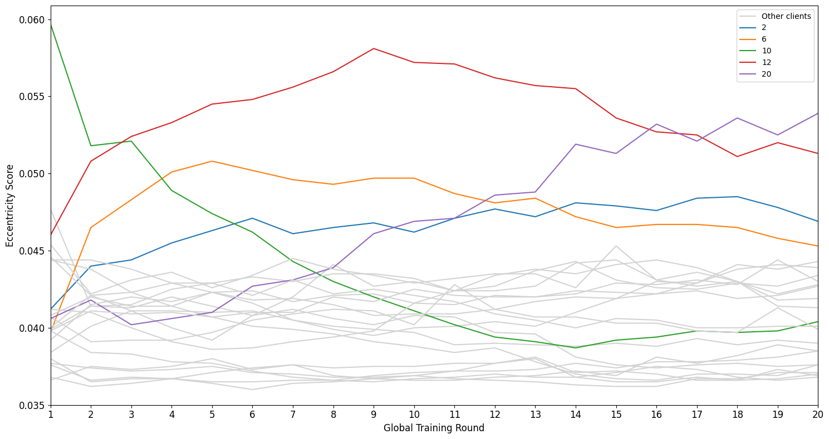
Eccentric Signature with Parameters
Five clients (2, 6, 10, 12, and 20) demonstrate deviating behavioral patterns.
We have also calculated the clients’ average eccentricity scores over all 20 rounds.
We observed these five clients are eccentric according to their average eccentricity scores.
To evaluate the influence of these five clients on the global model, we removed the clients from the federation and retrained the model.
The global model trained only using selected clients, shows MAE of 0.45, and the model trained with data from all 24 clients, had an MAE of 0.47.

Slide 16
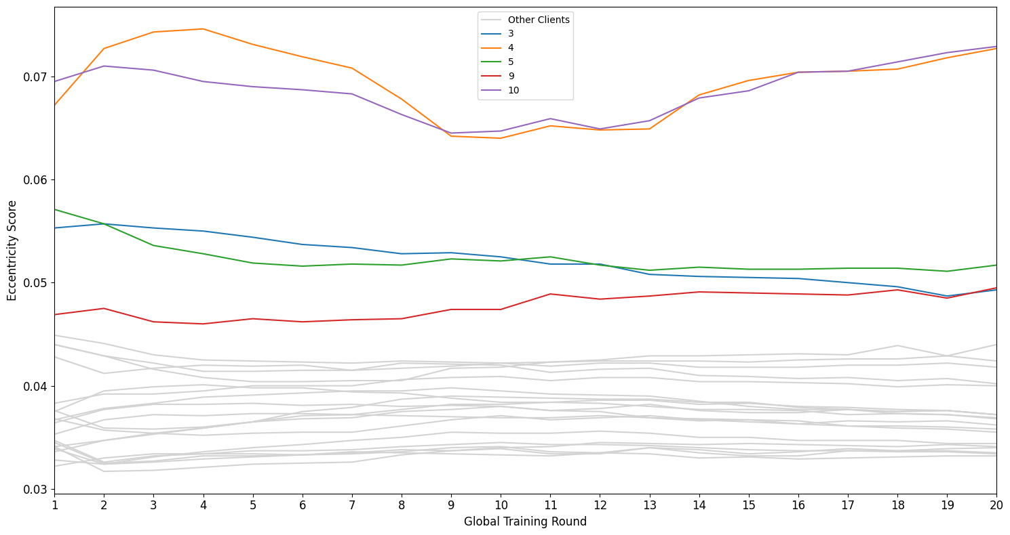
Eccentric Signature with Hessian Matrixes
Five clients (3, 4, 5,9, and 10) demonstrate deviating behavioral patterns.
These two eccentricity measures (parameter-based and global model-based) evaluate different things (local model behavior w.r.t. the other clients’ local models and global model behavior w.r.t. the client data, respectively). Hence, it is logical that they identify different clients with outlying behavior.

Slide 17
Conclusion
We have studied how eccentricity analysis can be used to evaluate the clients’ local models’ behavior and the global model’s customization to the client’s data.
The defined eccentricity metrics have been benchmarked to the clients’ benefits and influence to investigate whether there are correlations between these concepts. The Kendall ranking method has been used for this purpose.
Our initial experiments with publicly available data have demonstrated that our defined measures can effectively monitor and identify clients with deviating behavioral patterns, individually or in combination, providing valuable insights.

