Slide 1
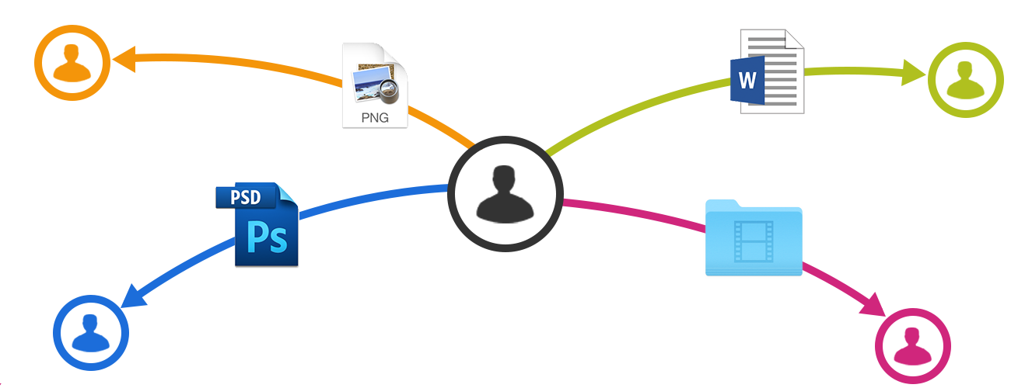
FILE SHARING SYSTEM
Q - Share
Group No. 03

Slide 2
Team Members
I N K Gamage SE/2013/014
D D T Pramuditha SE/2013/030
L S S Premasiri SE/2013/031
D W R Sandamal SE/2013/037
S H T V Sarathchandra SE/2013/038
D M M Menaka SE/2014/062

Slide 3
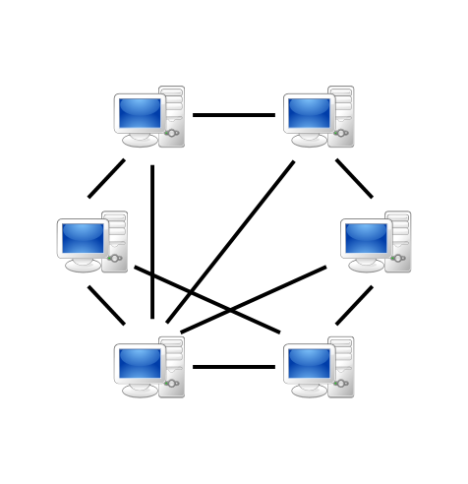
Peer to Peer System
Peer-to-peer (P2P) computing or networking is a distributed application architecture that partitions tasks or workloads between peers

Slide 4
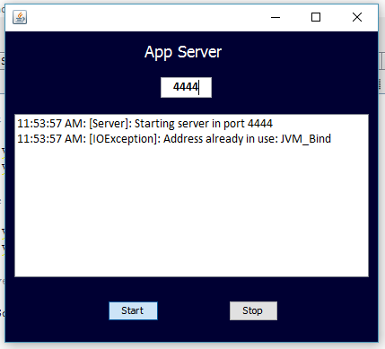
Interfaces
This is the interface of the
Application Server

Slide 5
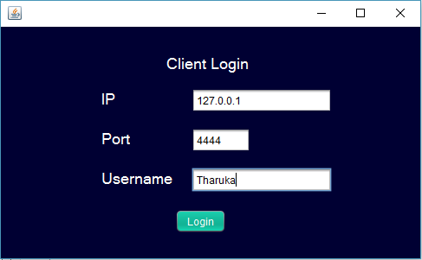
Interfaces
This is the interface
of Client login

Slide 6
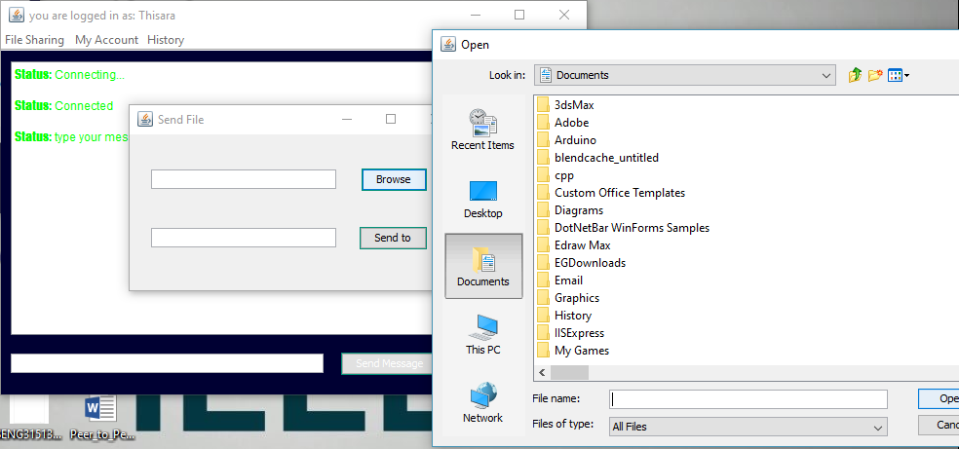
Interfaces
This is interface of the
File Shearing

Slide 7
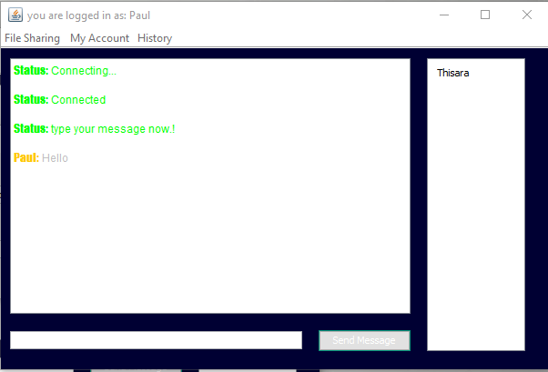
Interfaces
This is the interface of
the Connected Users
and Chat with all

Slide 8
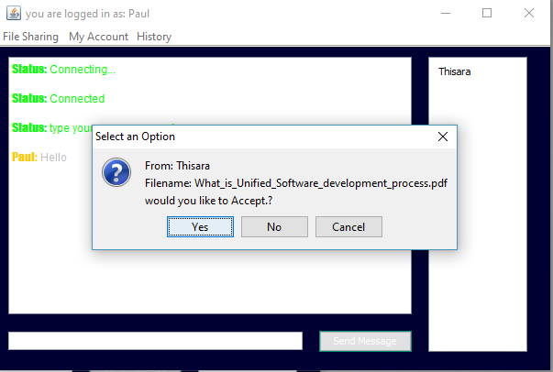
Interfaces
This is the interface of
the Send File

Slide 9
Interfaces
This is the user login interface of the system

Slide 10
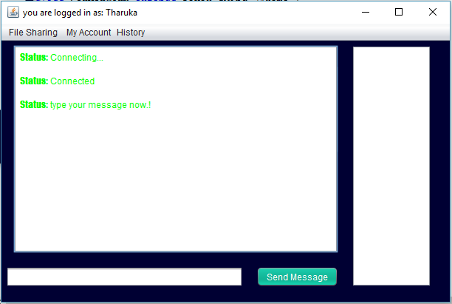
Interfaces
This is the interface of theconnecting of the users

Slide 11
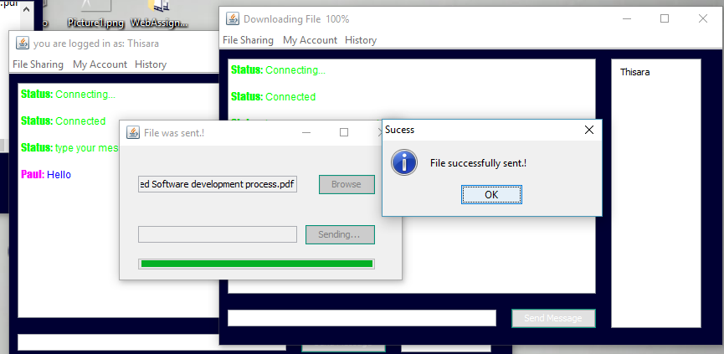
Interfaces
This is the interface of the Successful
Sent of an file

Slide 12
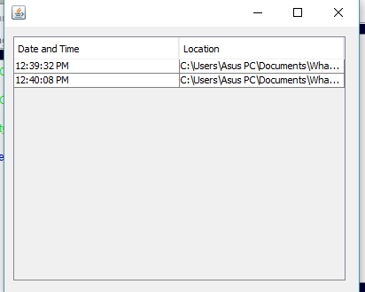
Interfaces
This is the interface of the
File sharing history

Slide 13
Question
Answer

Slide 14
Thank You

