Slide 1
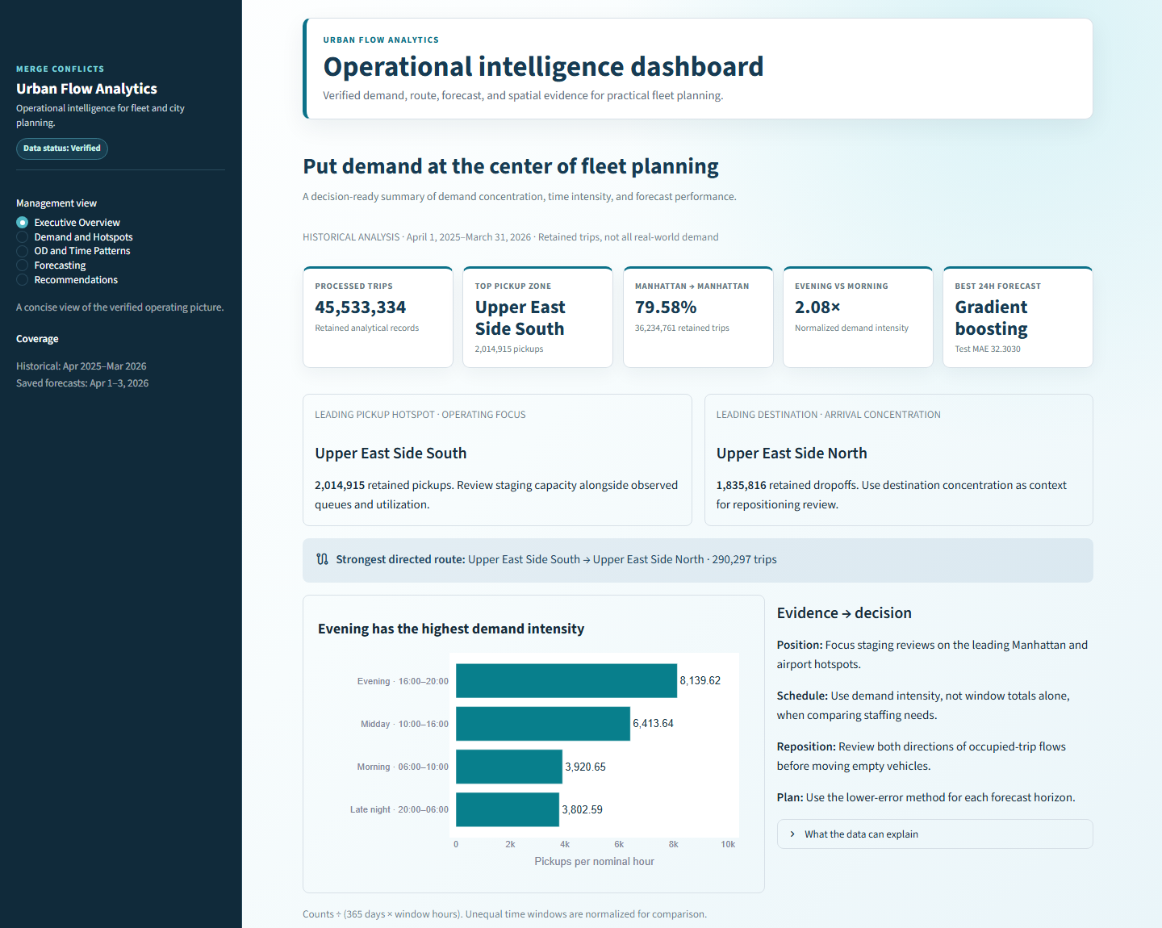
URBAN FLOW
ANALYTICS
Data-Driven Taxi Operations Intelligence
Team Merge Conflicts • Codefest Datathon 2026
45.5M
2
24/48/72h
Processed Trips
Predictive Models
Forecast Horizons
Fare Prediction • Duration Prediction • Demand Forecasting • Spatial Intelligence • Dashboard • AI Assistant
0:00–0:25
Notes:
We are Team Merge Conflicts, and this is our Urban Flow Analytics solution. We transformed more than 45.5 million processed taxi trips into operational intelligence for fare estimation, trip-duration prediction, demand forecasting, spatial analytics, a business dashboard, and an AI mobility assistant.

Slide 2
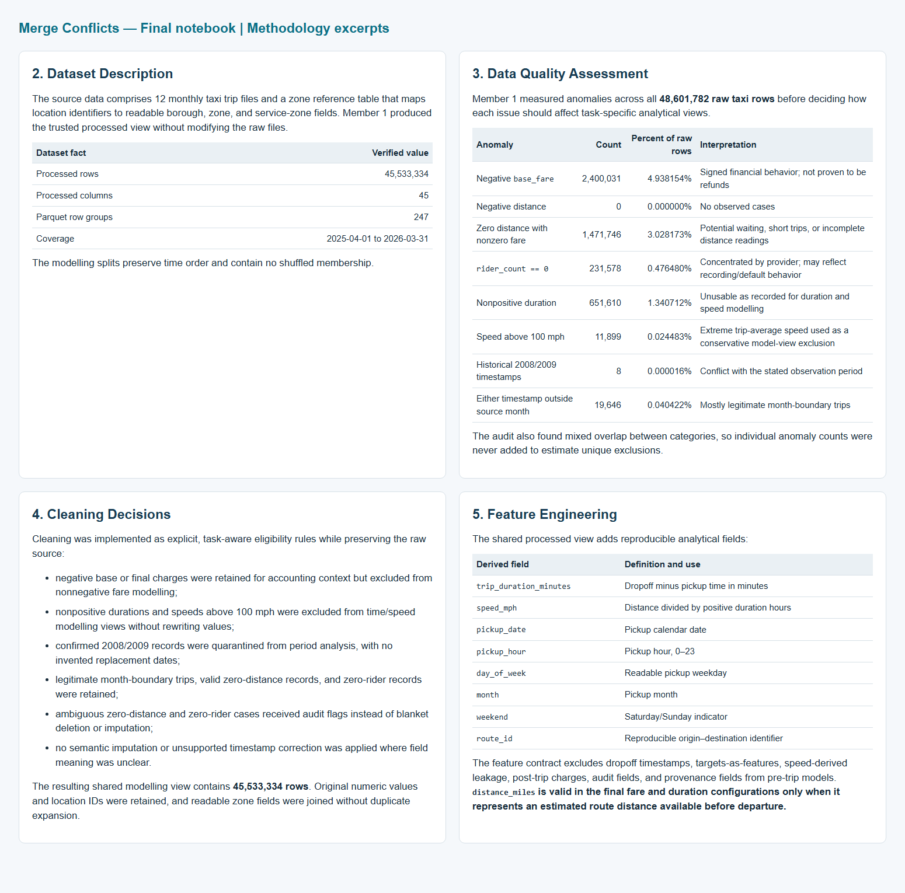
Data Preparation & Methodology
A trusted modelling view built from large-scale taxi and zone data
PROCESSED TRIPS
COLUMNS
SPLITS
45,533,334
45
Train → Val → Test
April 2025–March 2026
engineered + retained
chronological, no shuffling
Quality checks completed
Negative base fares
Zero-distance trips with fare
Nonpositive durations
Unrealistic speeds
Historical timestamp anomalies
Leakage-safe design: only pre-trip information can be used as model input.
0:25–0:50
Notes:
We first built a reliable analytical dataset using chronological train, validation, and test splits. We checked major data-quality issues such as negative fares, zero-distance trips, invalid durations, and unrealistic speeds. We also followed a leakage-safe feature contract so information from after the trip does not enter pre-trip predictions.

Slide 3
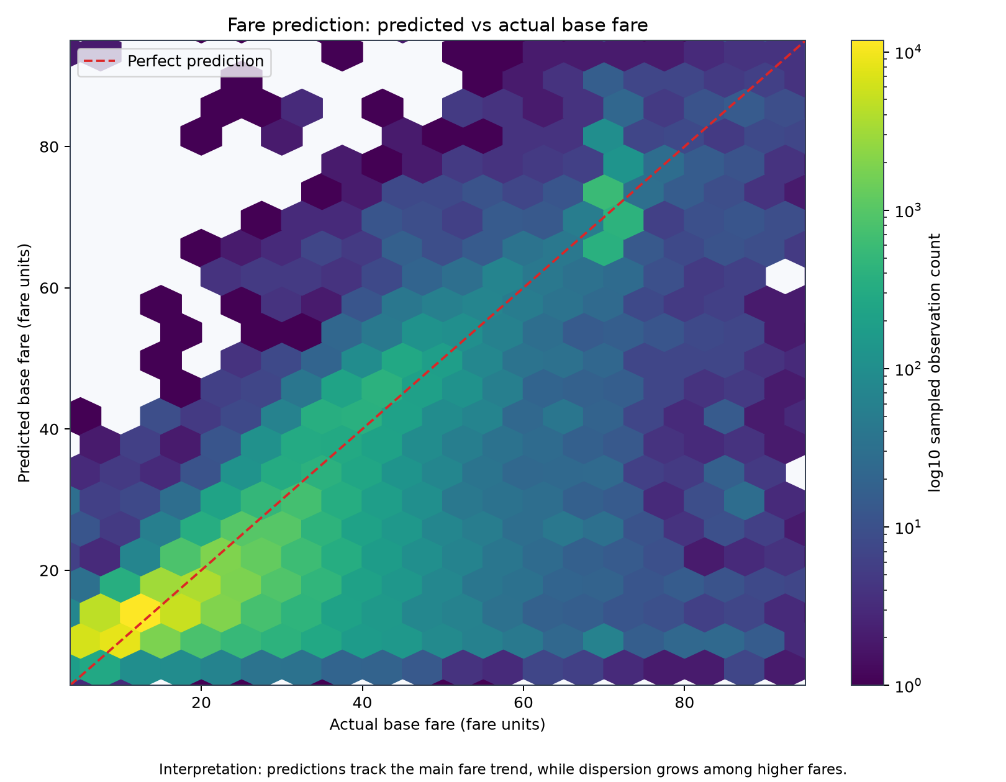
Fare Prediction
Predicting base fare before trip departure
SELECTED MODEL
Linear Regression
Pipeline
Final chronological test performance
MAE
RMSE
5.571799
10.324520
fare units
large errors weighted
R²
0.676153
variance explained
Distance used only as a pre-trip route estimate.
0:50–1:20
Notes:
For fare prediction, Linear Regression was the strongest tested model. On the final chronological test set, it achieved an MAE of 5.57, RMSE of 10.32, and an R-squared of 0.676. Estimated route distance significantly improved prediction quality, but we only use that feature under the assumption that a route estimate is available before the trip begins.

Slide 4
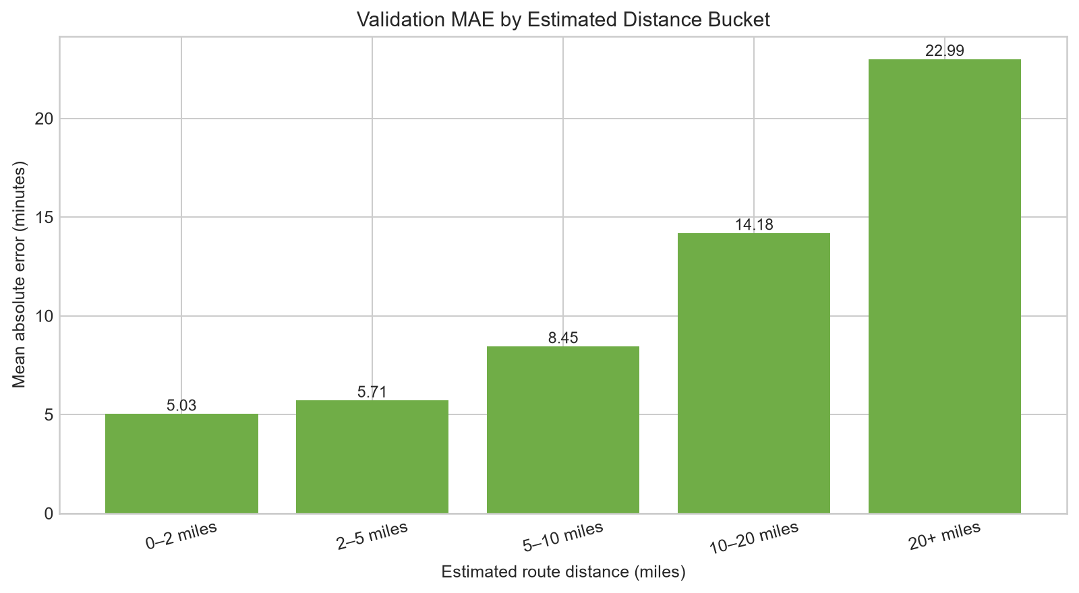
Trip Duration Prediction
Estimating travel time before departure
SELECTED MODEL
Linear Regression
Pipeline
Final chronological test performance
MAE
RMSE
5.802654
22.259013
minutes
tail-sensitive
R²
0.206474
modest fit
Main limitations
Long trips • No live traffic • No weather/incidents
1:20–1:50
Notes:
For trip duration, Linear Regression again performed best among the tested models. It achieved a final test MAE of about 5.8 minutes. Duration prediction is harder because extreme long trips increase RMSE, and our dataset does not contain live traffic, incidents, road conditions, or weather information.

Slide 5
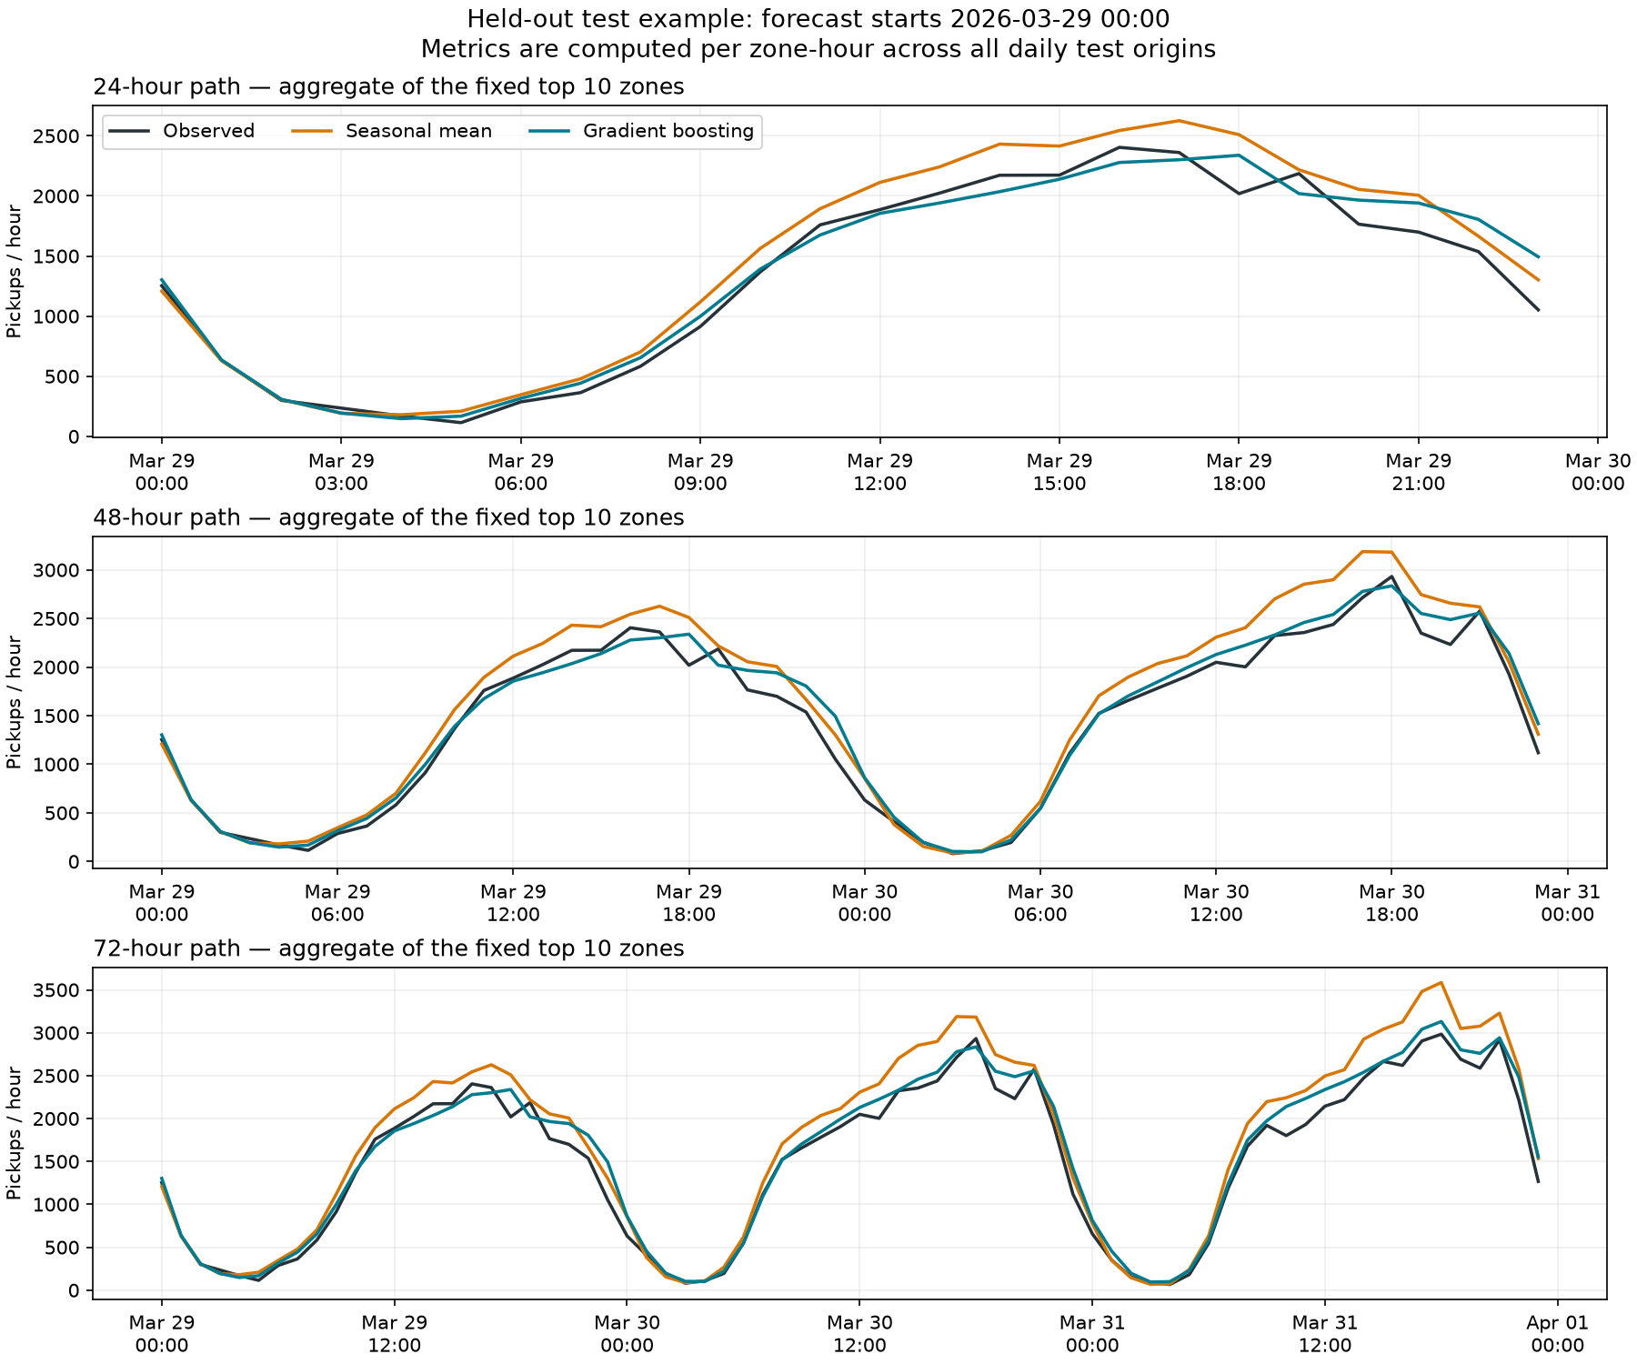
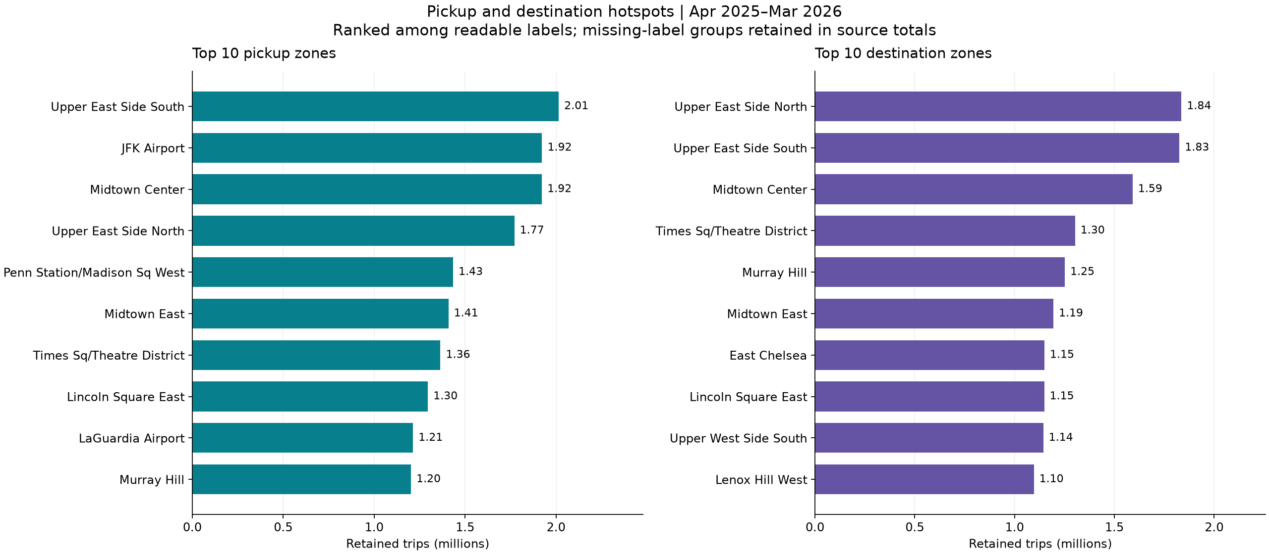
Demand Forecasting & Spatial Intelligence
Choosing horizon-specific forecasts and locating concentrated demand
MAE 32.303
79.58%
2.08×
Upper East Side South
24h winner: Gradient Boosting
Manhattan → Manhattan trips
Evening vs morning intensity
Top pickup zone
1:50–2:25
Notes:
Forecast performance depends on the planning horizon. Gradient Boosting performs best at 24 hours, while the seasonal baseline performs better at 48 and 72 hours. Spatial analysis also shows strong concentration in Upper East Side South, JFK Airport, and Midtown Center. Manhattan-to-Manhattan trips represent 79.58 percent of retained movements, while evening pickup intensity is about 2.08 times the morning level.

Slide 6
Live Demo: Business Analytics Dashboard
Show the management-facing layer built from verified analytics outputs
Demo path
1. Executive Overview
2. Demand & Hotspots
3. Forecasting
4. Recommendations
Show how managers move from evidence to action.
Launch before recording:
python -m streamlit run dashboard/app.py --server.port 8501
2:25–3:00
Notes:
We then transformed the verified analytical outputs into a professional management dashboard. The Executive Overview summarizes the operational picture. Managers can explore demand and hotspot patterns, compare forecast horizons, and review recommendations directly linked to the analytical evidence.

Slide 7
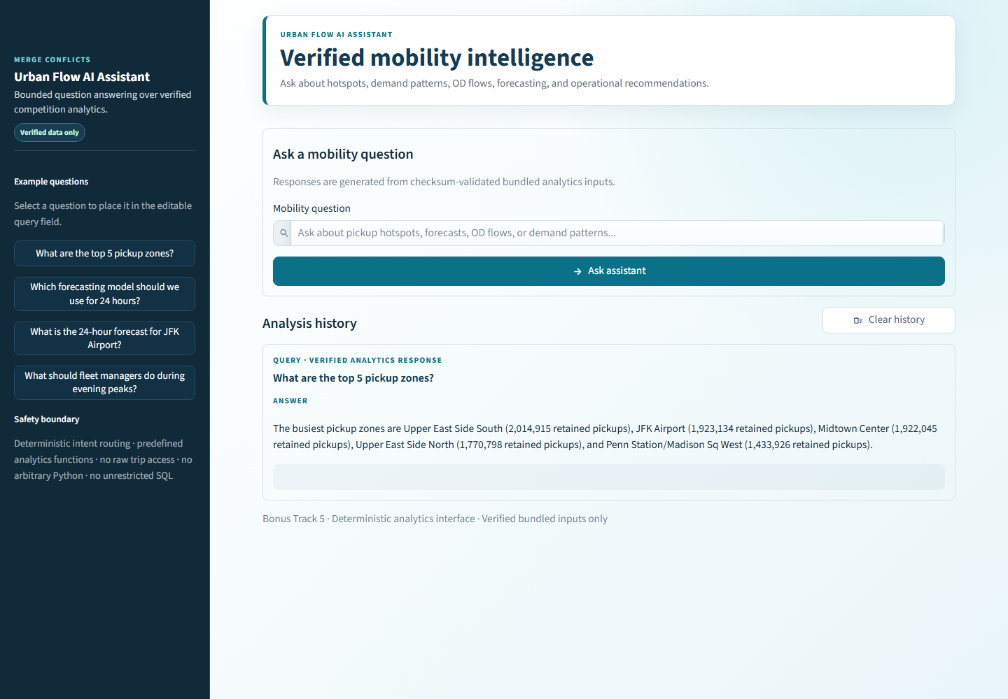
Live Demo: AI Mobility Assistant
A safe natural-language layer over verified analytics data
Live questions to ask
What are the top 5 pickup zones?
Which forecasting model should we use for 24 hours?
What is the 24-hour forecast for JFK Airport?
What should fleet managers do during evening peaks?
Deterministic routing • Verified data only • No arbitrary Python or SQL
3:00–3:40
Notes:
The AI Mobility Assistant provides a natural-language interface to the same verified analytics. Users can select example questions directly from the sidebar, edit them if needed, and view previous analyses in the query history. The system uses deterministic intent routing, entity extraction, and predefined analytics functions rather than arbitrary code execution, so its responses remain grounded in the verified project outputs.

Slide 8
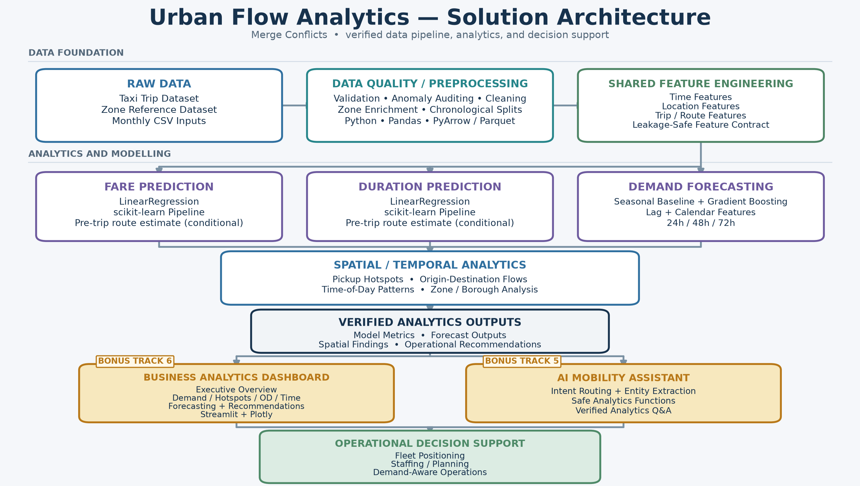
End-to-End Solution Architecture
Governed data, analytics, delivery layers, and operational decisions
Staging • Dispatch • Staffing • Repositioning • Monitoring
3:40–4:05
Notes:
This is our complete architecture. Raw taxi and zone data first pass through validation, cleaning, and shared feature engineering. Those trusted features feed fare prediction, duration prediction, demand forecasting, and spatial analysis. Verified outputs then power the business dashboard and AI assistant, which provide the final operational decision-support layer.

Slide 9
Urban Flow Analytics — Final Solution
From trip records to operational decision support
45.5M trips transformed into actionable operational intelligence
✓ Fare Prediction
✓ Trip Duration Prediction
✓ 24–72h Demand Forecasting
✓ Hotspot & OD Analytics
✓ Business Dashboard
✓ AI Mobility Assistant
Team Merge Conflicts
Thank You
4:05–4:20
Notes:
Merge Conflicts created an end-to-end solution combining predictive modelling, demand forecasting, spatial intelligence, a business dashboard, and a verified analytics assistant. Together, these components transform large-scale taxi data into practical operational decision support. Thank you.

