Slide 1

BOSTON INSTITUTE OF ANALYTICS | TRIVANDRUM
GENAI HACKATHON 2026 | OFFICIAL CHALLENGE
AI FOR INCLUSIVE KERALA
Empowering Senior Citizens and Persons with Disabilities Through Generative AI
Innovation with Empathy. Technology for Everyone.
BOSTON INSTITUTE OF ANALYTICS • GENAI HACKATHON 2026 • AI FOR INCLUSIVE KERALA

Slide 2
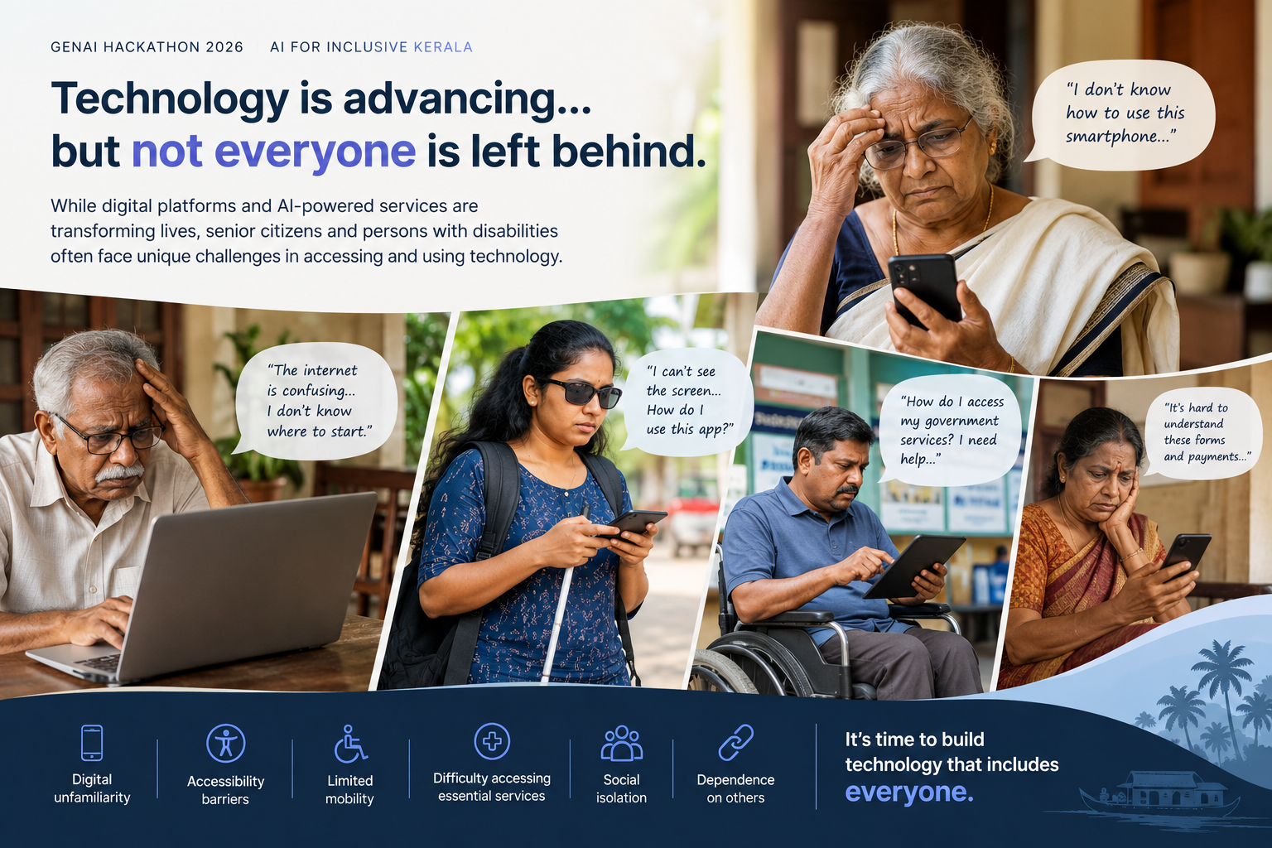
BOSTON INSTITUTE OF ANALYTICS | TRIVANDRUM
BOSTON INSTITUTE OF ANALYTICS • GENAI HACKATHON 2026 • AI FOR INCLUSIVE KERALA

Slide 3
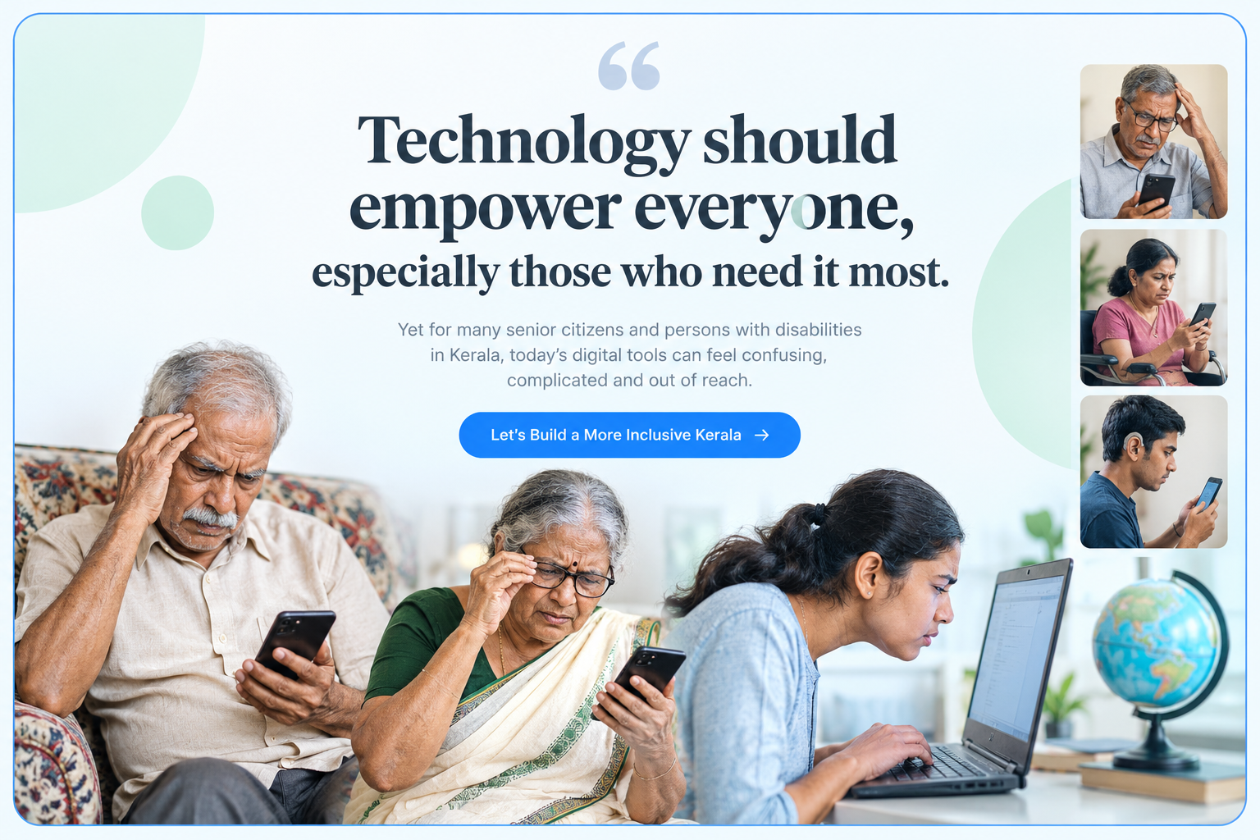
BOSTON INSTITUTE OF ANALYTICS | TRIVANDRUM
BOSTON INSTITUTE OF ANALYTICS • GENAI HACKATHON 2026 • AI FOR INCLUSIVE KERALA

Slide 4
BOSTON INSTITUTE OF ANALYTICS | TRIVANDRUM
GENAI HACKATHON 2026 / THE CHALLENGE
AI FOR INCLUSIVE KERALA
Design a Generative AI-powered assistant that empowers senior citizens and/or persons with disabilities in Kerala to live more independently, safely, confidently and with dignity.
Choose one meaningful everyday challenge. Build an accessible, creative solution that reduces barriers, simplifies daily activities, or strengthens social inclusion.
4 HOURS • INDIVIDUAL OR TEAMS OF 2–3 • ANY AI TOOLS • WORKING PROTOTYPE
BOSTON INSTITUTE OF ANALYTICS • GENAI HACKATHON 2026 • AI FOR INCLUSIVE KERALA

Slide 5
BOSTON INSTITUTE OF ANALYTICS | TRIVANDRUM
GENAI HACKATHON 2026 | DEVELOPER GUIDELINES
Build for Impact — In Just 4 Hours
HOW TO PROCEED
EXPECTED DELIVERABLES
1. Pick one everyday accessibility challenge.
2. Define your user and their needs.
3. Sketch a simple, inclusive user journey.
4. Integrate GenAI meaningfully.
5. Build, test and rehearse your demo.
• Working prototype or interactive demo
• One complete end-to-end use case
• Accessible, intuitive UI/UX
• Clear explanation of AI functionality
• 3-minute demo: problem → solution → impact
TIP: Prioritize originality, usability and a reliable demo over feature count. AI tools are welcome.
BOSTON INSTITUTE OF ANALYTICS • GENAI HACKATHON 2026 • AI FOR INCLUSIVE KERALA

