Slide 1



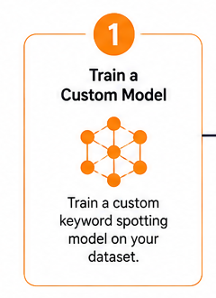
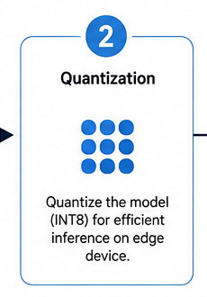
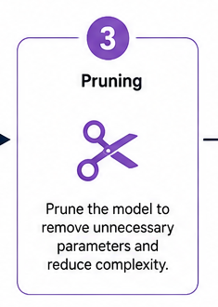
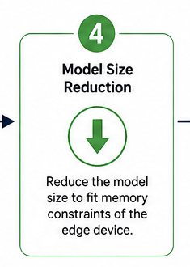
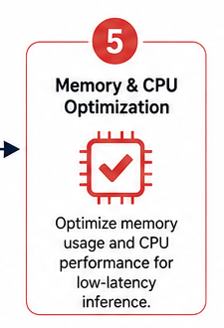
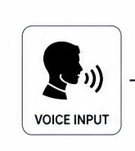
TECHNICAL APPROACH — SPLIT COMPONENTS 1
01 Team Badge
02 Title
03 SIH Logo
04 Train Custom Model
05 Quantization
06 Pruning
07 Model Size Reduction
08 Memory CPU Optimization
09 Voice Input

Slide 2
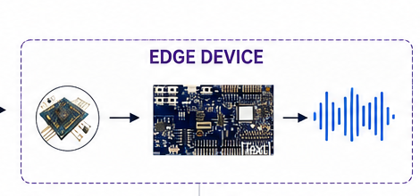
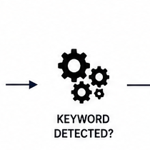
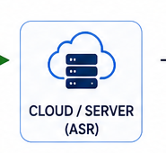
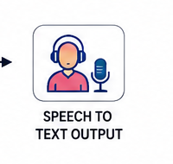
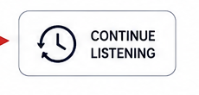


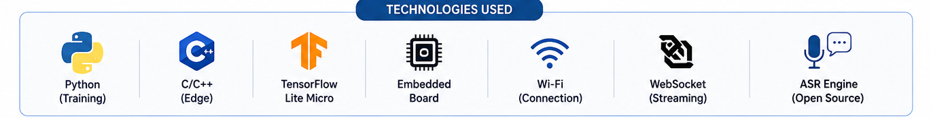
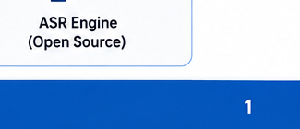
TECHNICAL APPROACH — SPLIT COMPONENTS 2
10 Edge Device
11 Keyword Decision
12 Cloud ASR
13 Speech To Text
14 Continue Listening
15 Local Processing
16 Low Power
17 Technologies Used
18 Legend

Slide 3
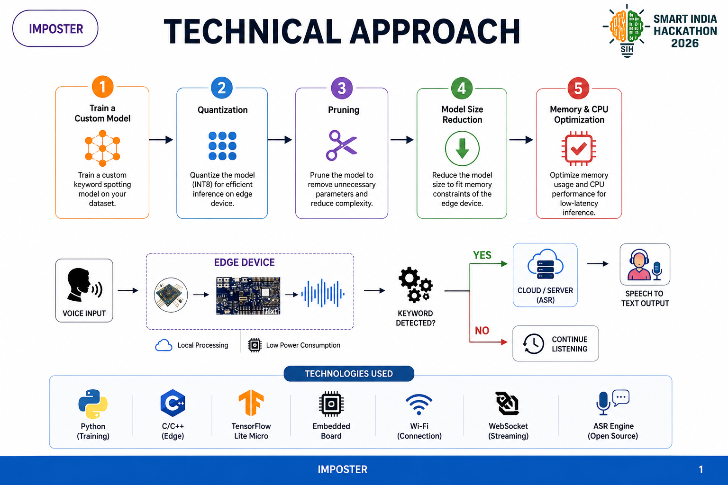
REFERENCE + LEGEND

