Slide 1


KONGU ENGINEERING COLLEGE
PERUNDURAI ERODE-638060
COMPUTER SCIENCE AND ENGINEERING
“PERISENSE: INTELLIGENT MONITORING OF PERISHABLE GOODS USING INTERNET OF THINGS AND ARTIFICIAL INTELLIGENCE”
Team Mentor:
Dr.S. Malliga, Professor, CSE
Team Members:
THARUNKUMAR M 23CSR228
SANTHEESH S 23CSR193
SANJAY KUMAR P 23CSR190

Slide 2


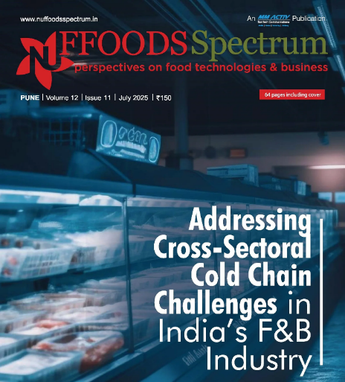
PROBLEM STATEMENT
How might we develop a system where the temperature and humidity of perishable goods be monitored during transportation and storage to ensure product quality and minimize spoilage in the food processing industry?
India produces over 400 million metric tonne (MT) of perishable food annually, yet 30–40 per cent of fruits and vegetables and up to 16 per cent of marine products spoil……
Farmers in India incur nearly USD 12,520 million in post-harvest losses annually due to inadequate cold storage facilities. BASE and Empa’s ‘Your Virtual Cold Chain Assistant’ project is making sustainable cooling accessible, affordable, and an indispensable part of post-harvest management for the Indian farmer

Slide 3
Idea & Approach
OBJECTIVE
To develop an intelligent, IoT-based solution that ensures the quality and safety of perishable goods during transportation and storage by enabling real-time monitoring, prediction, and decision-making.
CORE IDEA
Real-time monitoring of environmental conditions affecting perishables
Dashboard for live status tracking by all stakeholders
Predictive alerts and optimized delivery routing
Demand-supply matching through intelligent analytics

Slide 4
Approach
Smart IoT-Based Monitoring:
Design and implement a smart system that continuously monitors temperature, humidity, and gas emissions using sensors (DHT11, MQ6) to detect early signs of spoilage.
Cloud-Integrated Dashboard:
Develop a centralized, cloud-connected dashboard that provides real-time data visualization, alerts, and status updates to vendors, drivers, and customers for transparent supply chain tracking.
Machine Learning for Spoilage Prediction:
Utilize machine learning algorithms to identify anomalies in sensor data, enabling early spoilage detection and predictive maintenance of cooling systems.
Dynamic Logistics and Decision-Making:
Incorporate external data sources (e.g., weather APIs, maps) to enable intelligent rerouting, demand forecasting, and on-the-go utilization, thereby reducing wastage and ensuring timely delivery.

Slide 5
Methodology
🧪 Spoilage detection using ME3CH3
🌡️ Temperature and Humidity Monitoring using DHT11
🤖 Microcontroller and IoT Communication
🛠️ Backend Integration
☁️ Dashboard & Cloud Connectivity
💻 Frontend Web Application
🗺️ Map Integration ( Dynamic Routing)

Slide 6
Technology
Hardware Stack
Sensors: MQ6, DHT11
Microcontroller: ESP8266
Communication: Wi-Fi
Software and Cloud Stack
Software: Embedded C
Cloud Integration: Blynk
External Data: OpenStreetMap API
Dashboards: React Native UI , Leaflet
CI/CD: For seamless updates

Slide 7
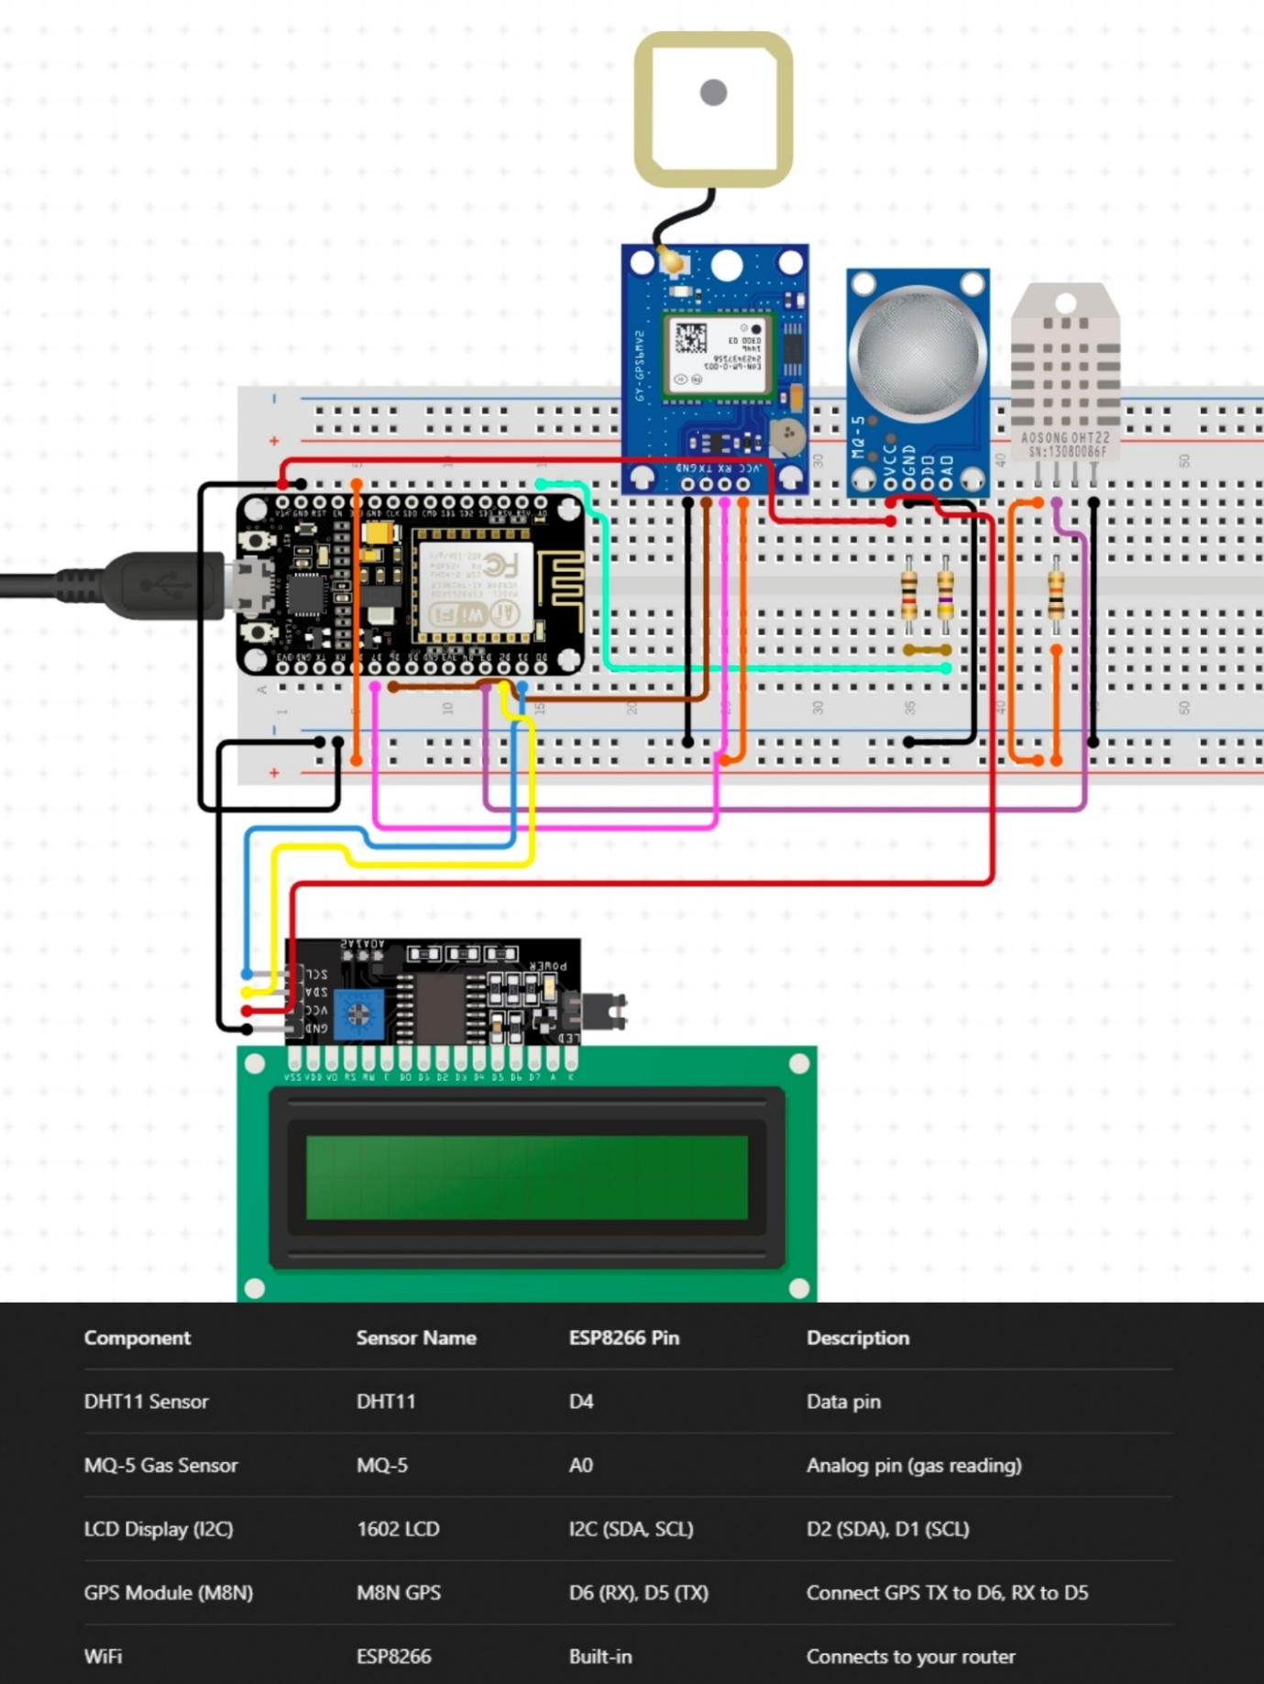
Circuit Diagram

Slide 8
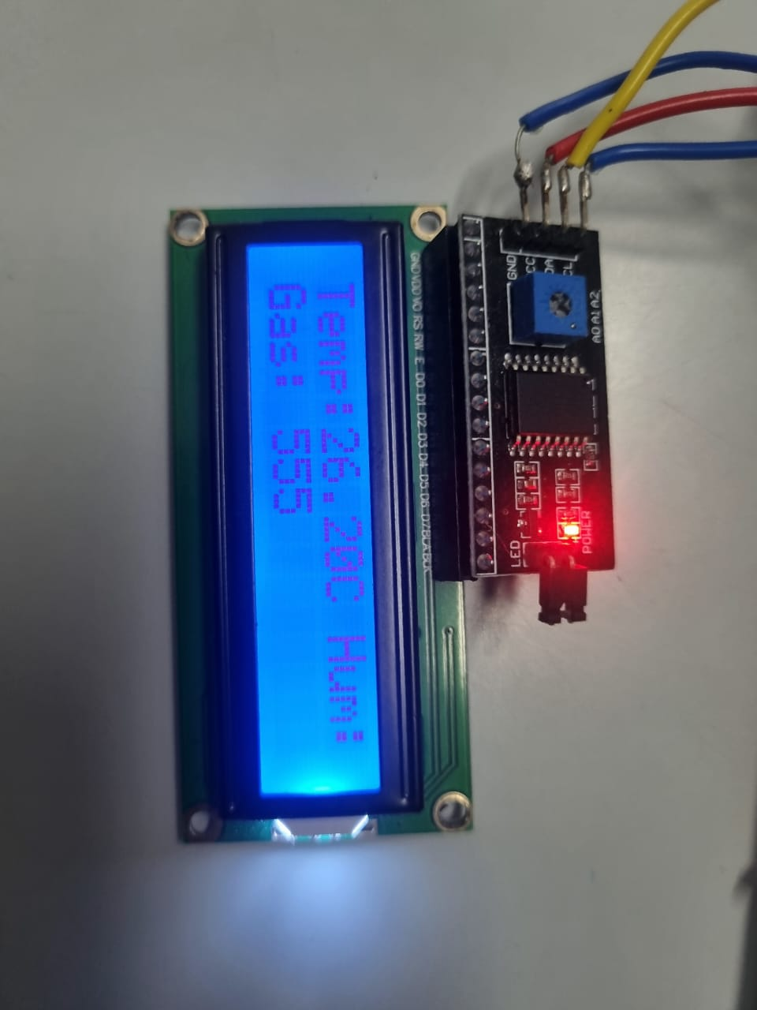
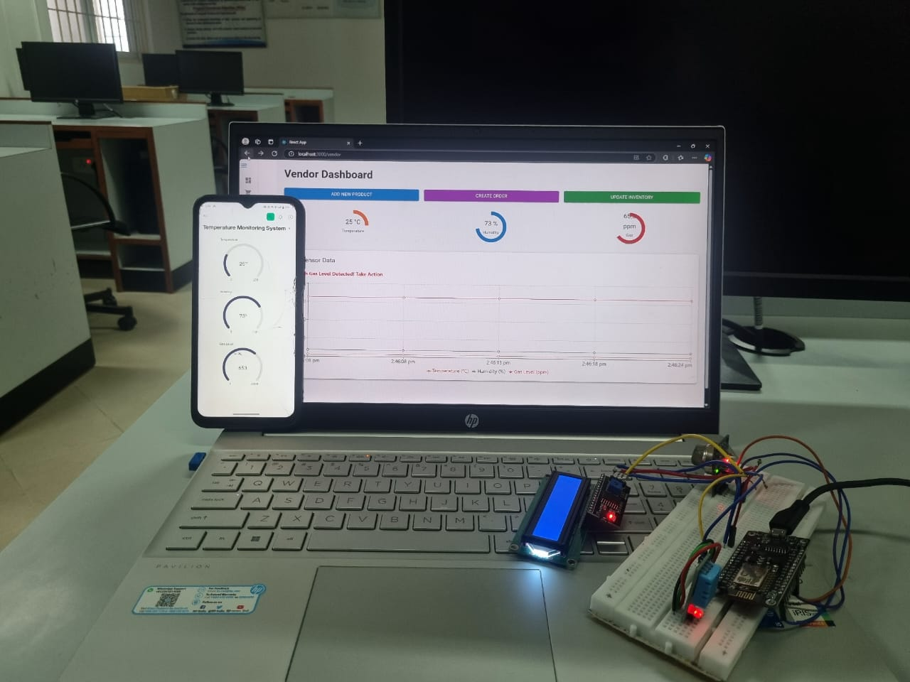
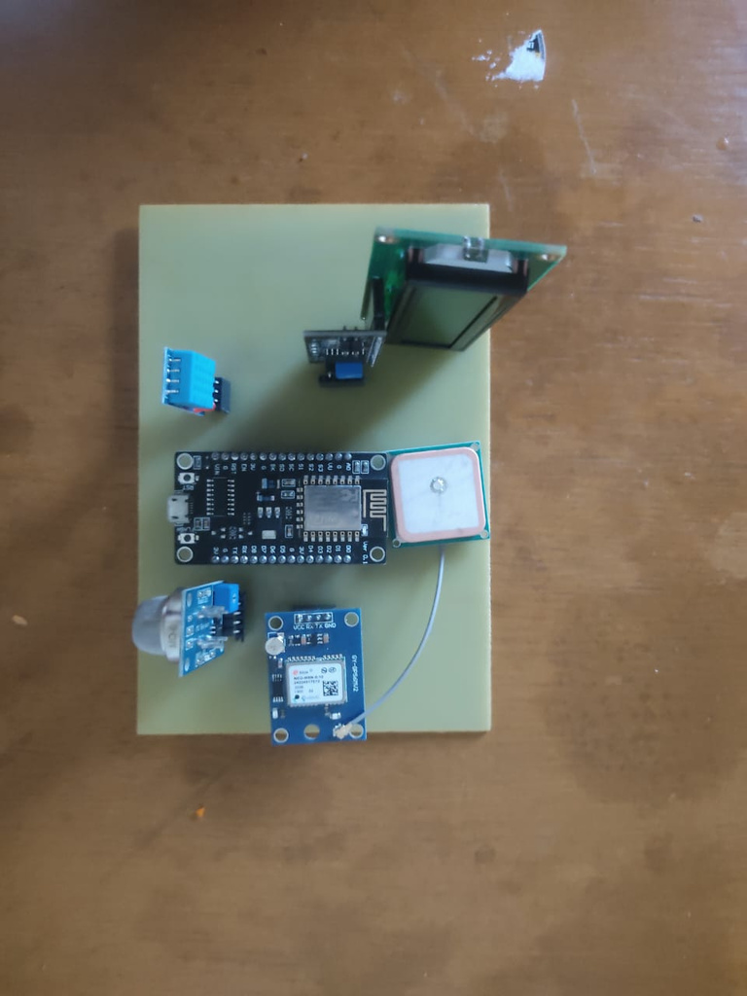
Design Model

Slide 9
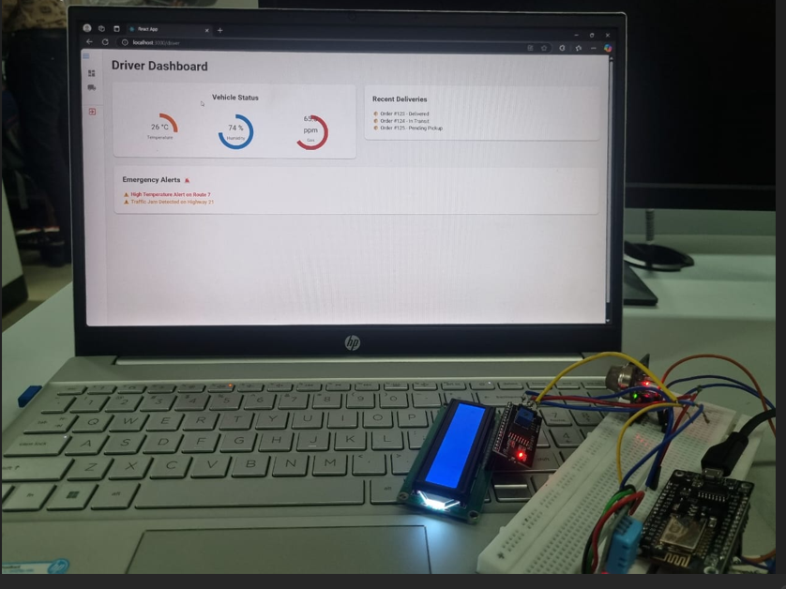
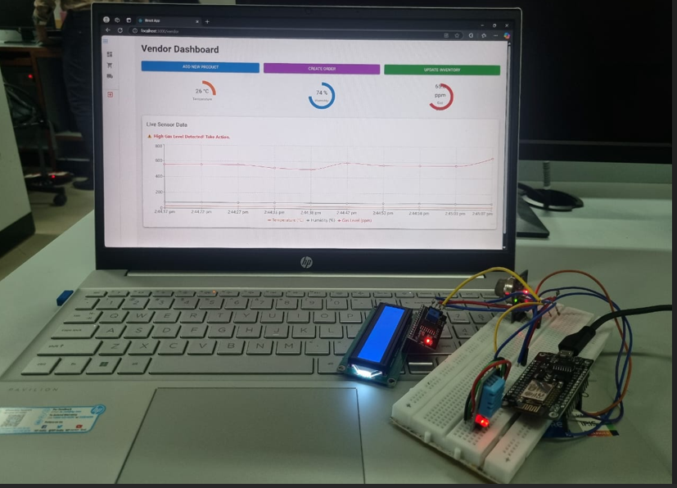
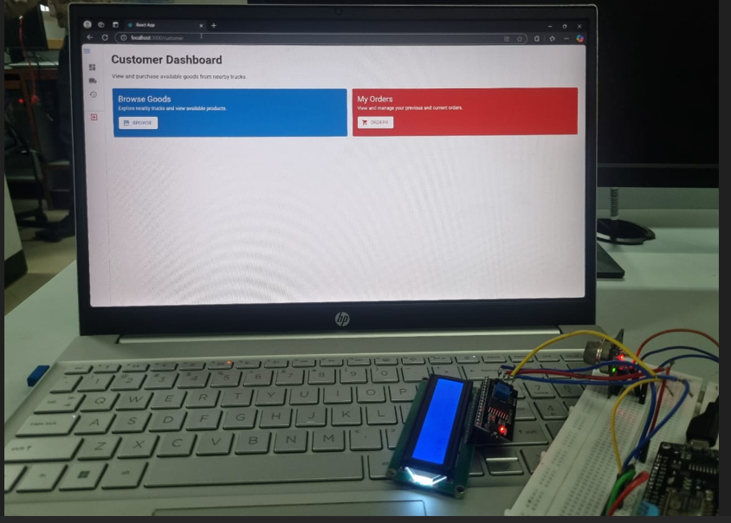
Dashboard

Slide 10
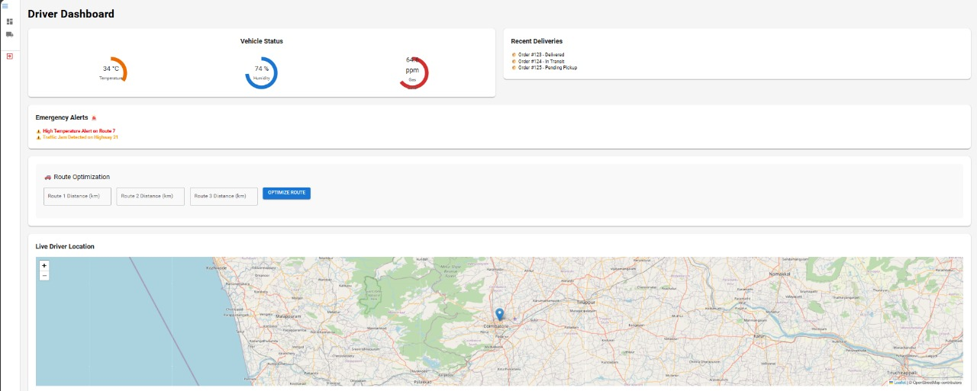
Dashboard ( with driver location)

Slide 11
Business Canvas Model
Key Partners
Value Proposition
IoT hardware suppliers (e.g., sensor and microcontroller vendors)
Local farmers, vendors
Weather data providers (e.g., OpenWeatherMap API)
Mapping services (Leaflet, Google Maps API)
Cloud service providers (AWS, Blynk – initially)
Reduced food spoilage through real-time monitoring
Alerts for spoilage or condition deviations
Real-time vehicle tracking and estimated delivery times
Easy-to-use web and mobile dashboards
Improved trust and transparency for buyers
Demand-supply matching via vendor and buyer platform
Customer Relationship
Automated alerts and notifications
Dedicated support for fleet managers and vendors
Self-service dashboard for live monitoring
Feedback system for delivery performance
API access for enterprise users (future phase)

Slide 12
💡 Key Innovations
🔥 Unique Selling Points (USPs)
🔍 Predictive analytics for spoilage & cooling system failures
🚚 Smart prioritization for fast delivery of near-spoiled goods
⚙️ Real-time adaptive control using actuators
🌤️ Weather-aware insights using OpenWeatherMap API
🌡️ Real-time spoilage detection & control
🚛 Scalability to many vehicles
🚚 Smart Route Optimization to prevent spoilage
🌐 Vendor-Customer Transparency through live
Dashboards
Benefits
✅ Reduces food spoilage and wastage
💰 Minimizes operational costs
🔒 Ensures food safety compliance
📈 Scalable & cloud-integrated
😊 Increases customer satisfaction & trust

Slide 13
THANK YOU

