Slide 1
Deep Recurrent Q-Network for
Memory-Based Navigation
A Comparative Study of DQN vs DRQN
in Two-Goal POMDP Environments
Done by:
Faculty Adviser:
L THARUN
23BCE8698
Dr. D. John Pradeep

Slide 2
Outline
1
Introduction
2
Problem Statement
Background and motivation
Challenges in POMDP navigation
3
Methodology
4
Formulas
DRQN architecture and training
Mathematical foundations
5
Results
6
Literature Review
Performance comparison
Related work and context

Slide 3
Introduction
Reinforcement Learning in Partially Observable Environments
Research Motivation
Many real-world tasks require agents to make decisions under uncertainty, where the full state of the environment is not directly observable. These Partially Observable Markov Decision Processes (POMDPs) pose unique challenges for traditional reinforcement learning methods.
Traditional DQN
Limited to immediate observations
DRQN (This Work)
Maintains belief state through LSTM memory
Key Challenges:
• Hidden state information requires memory
• Observation aliasing creates ambiguity
• Memoryless policies are provably suboptimal
• Credit assignment across time steps

Slide 4
Problem Statement & Proposed Solution
Problem
Solution: DRQN
Two-Goal Memory Task:
• Agent receives a one-time hint at step 0 (±1) indicating which of two goals is correct
• After step 0, hint becomes 0 — all observations identical
• DQN cannot distinguish between goal types after hint disappears
• Theoretical ceiling: ~50% success rate (random goal selection)
Recurrent Architecture:
• LSTM maintains hidden state h_t across time
• Encodes hint at step 0 into memory
• Carries goal identity forward through episode
• Auxiliary hint-prediction head strengthens gradient
• Achieves 92.5% success rate
Environment Configuration
Grid Size:
11 × 11
Obstacles:
15 random
Goals:
goal_A=(1,9), goal_B=(9,1)
Observation:
3×3 FOV + hint + dual compass (14D)
Reward:
+10 correct, -10 wrong, -0.05/step
Episode Length:
150 steps max

Slide 5
Methodology: DRQN Architecture
Network Architecture
Key Idea
Input Layer
Auxiliary Hint Head
• Creates direct gradient path from step-0 hint to encoder
• Without it: 10-step TBPTT gradient is too weak
• With it: 1-step gradient teaches encoder to make hint salient
• Standard in R2D2, Dreamer
14D observation (FOV + hint + compass)
Encoder
Linear(14 → 256) + ReLU
LSTM Memory
LSTM(256 → 256) - maintains h_t, c_t
Q-Value Head
Linear(256 → 4 actions)
Hint Head (Auxiliary)
Linear(256 → 1) + Sigmoid
Training Configuration
Episodes: 3000 | Batch: 32 | Sequence Length: 20 | Burn-in: 10 | Hidden: 256 | LR: 10⁻³ | γ: 0.99 | ε: 1.0→0.05

Slide 6
Mathematical Foundations
Bellman Equation (Q-Learning)
Q(s, a) ← Q(s, a) + α [r + γ max_a' Q(s', a') - Q(s, a)]
DQN Loss (Temporal Difference)
L = E[(r + γ max_a' Q_target(s', a') - Q(s, a))²]
DRQN Forward Pass (with hidden state)
x_t = ReLU(W_encoder · o_t)
h_t, c_t = LSTM(x_t, h_t-1, c_t-1)
Q(o_t, a | h_t) = W_head · h_t
Auxiliary Hint Prediction Loss (step 0 only)
L_hint = BCE(σ(W_hint · h_0), hint_label) where hint ∈ {0,1} encodes goal_A vs goal_B

Slide 7
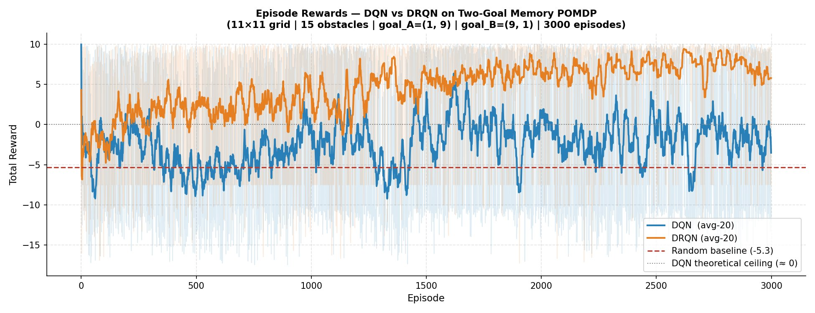
Results: Training Performance
Key Finding: DRQN converges to ~+6 reward | DQN stuck near 0 (theoretical ceiling) | Gap proves memory is essential

Slide 8
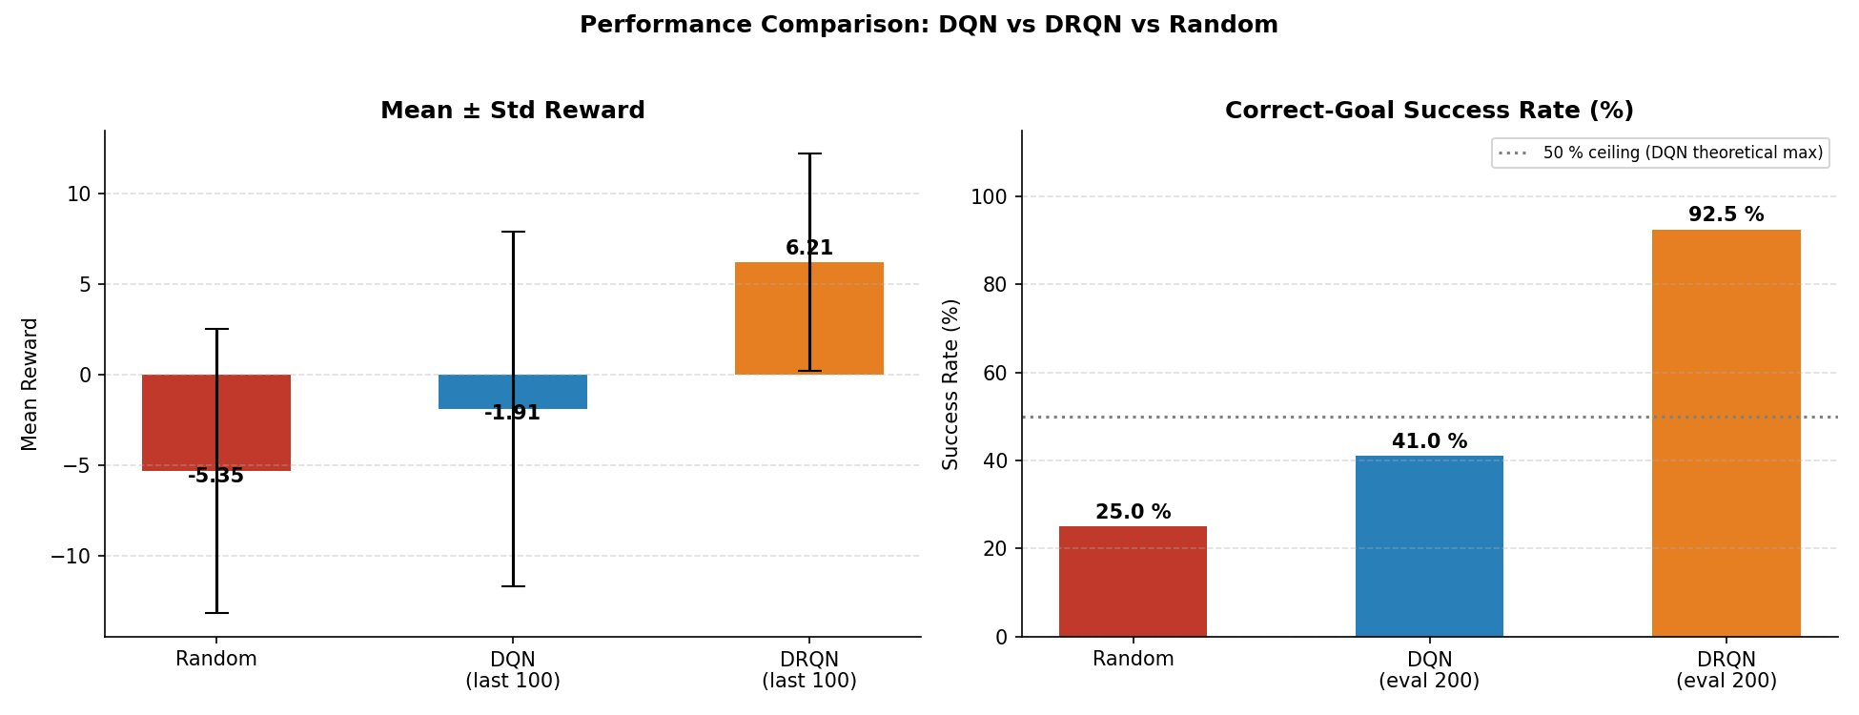
Results: Performance Metrics
DRQN achieves 92.5% success vs DQN's 41% (ceiling: 50%) — 2.25× improvement validates LSTM memory for goal-disambiguation

Slide 9
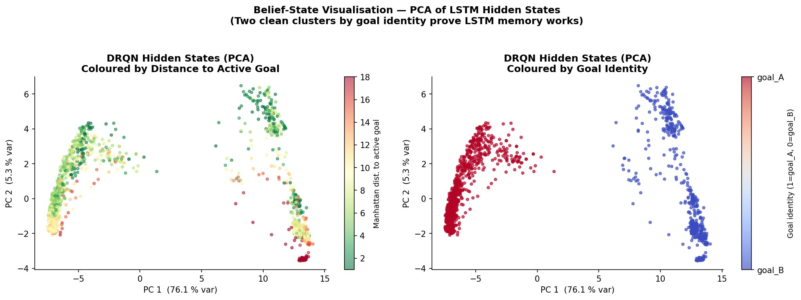
Results: Belief State Analysis (PCA)
Interpretation:
Clean separation of goal_A vs goal_B clusters proves LSTM encodes and maintains goal identity throughout episodes

Slide 10
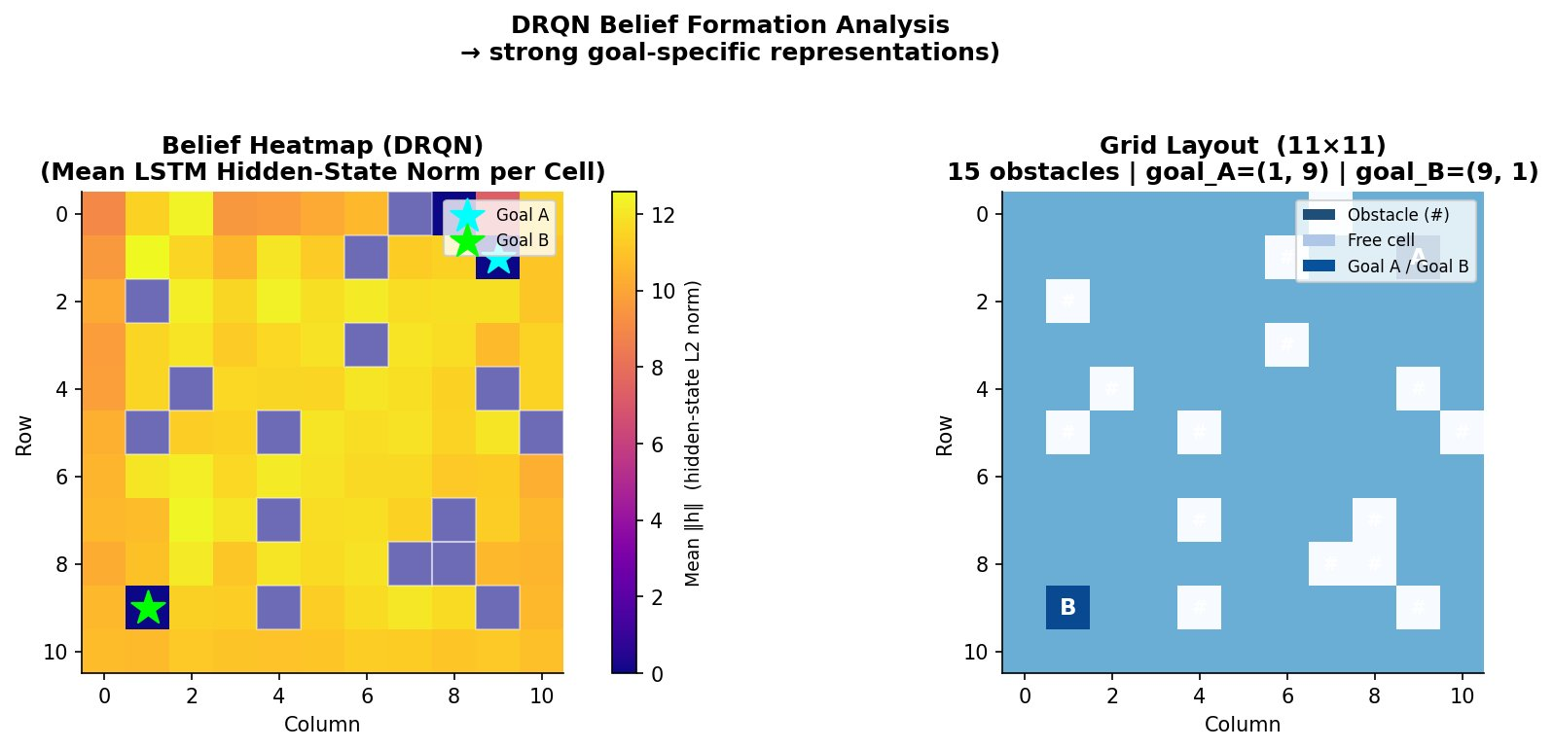
Results: Spatial Belief Representation
Analysis:
Hidden state activations show goal-specific spatial representations — obstacles encoded with goal-awareness in LSTM memory

Slide 11
Literature Review
Foundational Work
Deep Q-Network (DQN)
Mnih et al., 2015
Human-level control through deep RL on Atari games — established value-based deep RL
Deep Recurrent Q-Network
Hausknecht & Stone, 2015
Added LSTM to DQN for handling partial observability in Atari with flickering
Modern Advances
R2D2 (Recurrent Experience Replay)
Kapturowski et al., 2019
Stored/replayed sequences + burn-in for stable recurrent training in DQN
Dreamer (World Models)
Hafner et al., 2020
Latent dynamics model with auxiliary prediction tasks for belief maintenance

Slide 12
Conclusions
1
DRQN with auxiliary hint loss achieves 92.5% success vs DQN's 41% on two-goal memory task
2
LSTM successfully encodes and maintains goal identity from one-time step-0 hint
3
PCA visualization confirms clean goal-type separation in hidden state space
4
Auxiliary prediction tasks provide critical gradient signal for memory formation
Future Directions
Transformer architectures • Multi-task learning • Real-world robotics applications

