Slide 1
PROJECT TITLE
CAPSTONE PROJECT
Presented By: Kammalapalli Tharun Kumar
Student Name : Kammalapalli Tharun Kumar
College Name & Department :KMM Institute of Technology and Science & CSE

Slide 2
OUTLINE
Problem Statement
Technology used
Wow factor
End users
Result
Conclusion
Git-hub Link
Future scope

Slide 3
Problem Statement
In today's digital age, the secure transmission of sensitive data is paramount. Traditional encryption, while vital, can draw unwanted attention and become a target for interception. Steganography offers a discreet alternative, concealing data within seemingly ordinary images, thus ensuring confidentiality. By hiding the very presence of the message, steganography effectively thwarts casual observers and even sophisticated surveillance. The core challenge, however, lies in developing robust steganographic techniques that strike a balance between security, capacity, and the ability to remain undetected.

Slide 4
Technology used
Programming Language: Java
Tools & Libraries:
Java ImageIO – For image processing (reading and writing image files).
HashMap (Java Collections Framework) – To map characters to integer values for encoding/decoding.
BufferedImage (Java AWT) – To manipulate image pixel values.
Swing & Scanner – For user interaction (input of messages and passwords).
Apache Commons Codec – For additional encoding/decoding support.

Slide 5
Wow factors
Uses advanced steganographic techniques to embed data in images without noticeable distortion.
Ensures secure and covert communication while maintaining image quality.
Customizable encoding techniques for different security levels.
User-friendly interface for embedding and extracting hidden data.

Slide 6
End users
Journalists & Whistleblowers: Securely transmit sensitive information.
Government & Defense: Hide classified data in images.
Cybersecurity Professionals: Secure confidential data transfers.
Individuals & Businesses: Protect personal and organizational secrets.

Slide 7
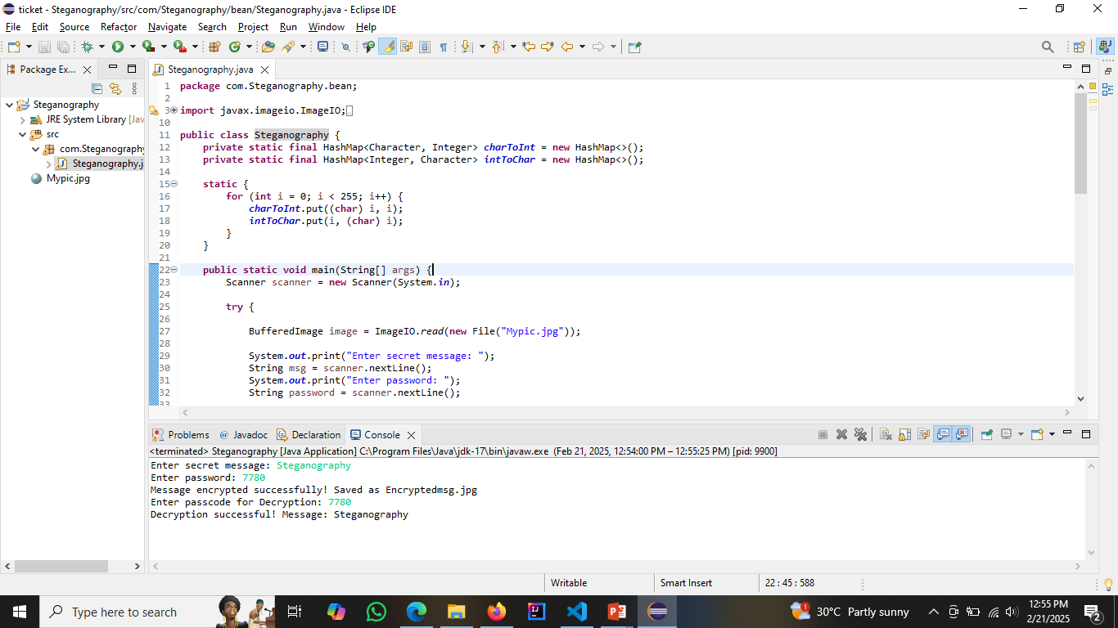
Results

Slide 8
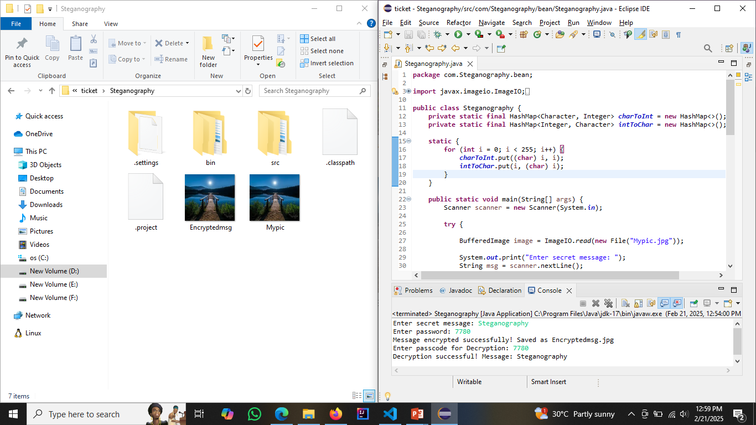
Results

Slide 9

Results

Slide 10
Conclusion
This project successfully demonstrates how steganography can be leveraged to securely hide and extract data from images while maintaining the original image’s appearance. By integrating steganographic techniques in Java, we achieve confidentiality, security, and efficiency in data hiding, reducing the risk of unauthorized interception.

Slide 11
GitHub Link
Here is my GitHub repository containing the code for steganography
https://github.com/Tharun-Tech09/Steganography.git

Slide 12
Future scope(optional)
Future advancements in steganography can focus on developing AI-driven adaptive embedding techniques that dynamically adjust to evade modern steganalysis methods. Additionally, quantum steganography and blockchain-based secure transmission can further enhance confidentiality and integrity. Improved resistance to deep learning-based attacks and real-time steganographic applications in cybersecurity can make covert communication more robust and undetectable.

Slide 13
THANK YOU

