Slide 1
INTRUSION DETECTION SYSTEM USING MACHINE LEARNING ALGORITHMS IN CLOUD ENVIRONMENT
PROJECT GUIDE : Dr. S BOSE
Team Members :
Araventh M - 2019103508
Gangaraju Tharun - 2019103520
Sourabh Sonny - 2019103064
Raj Kumar J - 2019103564

Slide 2
INTRODUCTION :
An intrusion detection system (IDS) is a monitoring tool that keeps track of suspicious activity and sends out warnings when it finds something suspicious.
To address this issue, machine learning algorithms are increasingly being used in IDSs to improve their accuracy and reduce false positives.
The proposed hybrid IDS uses a combination of supervised and unsupervised learning algorithms such as SVM, LSTM for intrusion detection.
The IDS is evaluated using the CICIDS2017 dataset and the results indicate that the proposed IDS is able to detect intrusions with a high degree of accuracy

Slide 3
OVERALL OBJECTIVE :
The proposed system should be able to detect, prevent, and respond to cyberattacks by utilizing ML techniques.
The system will be able to identify malicious network traffic and alert the user in case of any suspicious activities.
The system will be able to analyze the network traffic, identify any malicious behavior, and take appropriate action such as blocking the malicious traffic or alerting the user.
The system should also be able to detect and respond to zero-day attacks.

Slide 4
LITERATURE SURVEY :
S.No. | Author, Publication, Year, Title | Proposed Work | Advantages | Disadvantages
1. | W. Wang, X. Du, D. Shan, R. Qin and N. Wang, "Cloud Intrusion Detection Method Based on Stacked Contractive Auto-Encoder and Support Vector Machine," in IEEE Transactions on Cloud Computing, vol. 10, no. 3, pp. 1634-1646, 1 July-Sept. 2022. | Support Vector Machine | SCAE(feature extraction) | Cannot efficiently detect unknown attacks
2. | F. I. Shiri, B. Shanmugam and N. B. Idris, "A parallel technique for improving the performance of signature-based network intrusion detection system," 2011 IEEE 3rd International Conference on Communication Software and Networks, 2011, pp. 692-696. | Parallel Processing | Reduce Process Time | Cannot detect unknown attacks

Slide 5
S.No. | Author, Publication, Year, Title | Proposed Work | Advantages | Disadvantages
3. | A. M. Vartouni, S. S. Kashi and M. Teshnehlab, "An anomaly detection method to detect web attacks using Stacked Auto-Encoder," 2018 6th Iranian Joint Congress on Fuzzy and Intelligent Systems (CFIS), 2018, pp. 131-134. | Isolation Forest | Detection of unknown attacks | High false alarm rate
4. | A. Kannan, G. Q. Maguire Jr., A. Sharma and P. Schoo, "Genetic Algorithm Based Feature Selection Algorithm for Effective Intrusion Detection in Cloud Networks," 2012 IEEE 12th International Conference on Data Mining Workshops, 2012, pp. 416-423. | Genetic Feature Selection | Low false alarm rate | Features are removed without any extractions.

Slide 6
S.No. | Author, Publication, Year, Title | Proposed Work | Advantages | Disadvantages
5. | H. A. Kholidy and F. Baiardi, "CIDS: A Framework for Intrusion Detection in Cloud Systems," 2012 Ninth International Conference on Information Technology - New Generations, Las Vegas, NV, USA, 2012, pp. 379-385 | P2P Network Architecture | Flexibility and Scalability | Not sufficiet for detecting large scale attacks
6 . | A. Javadpour, S. Kazemi Abharian and G. Wang, "Feature Selection and Intrusion Detection in Cloud Environment Based on Machine Learning Algorithms," 2017 IEEE International Symposium on Parallel and Distributed Processing with Applications and 2017 IEEE International Conference on Ubiquitous Computing and Communications (ISPA/IUCC), Guangzhou, China, 2017, pp. 1417-1421F | Neural Network, Fuzzy Logic | Suitable for Qualitative features | Low Flexibility

Slide 7
S.No. | Author, Publication, Year, Title | Proposed Work | Advantages | Disadvantages
7. | G. Kene and D. P. Theng, "A review on intrusion detection techniques for cloud computing and security challenges," 2015 2nd International Conference on Electronics and Communication Systems (ICECS), Coimbatore, India, 2015, pp. 227-232 | Hybrid based detection | Accurate detection of known attacks | Can’t detect unknown attacks
8. | C. -C. Lo, C. -C. Huang and J. Ku, "A Cooperative Intrusion Detection System Framework for Cloud Computing Networks," 2010 39th International Conference on Parallel Processing Workshops, San Diego, CA, USA, 2010, pp. 280-284 | Majority Vote Method | Better accuracy | Less number of attacks detected

Slide 8
S.No. | Author, Publication, Year, Title | Proposed Work | Advantages | Disadvantages
9. | M. Ficco, L. Tasquier and R. Aversa, "Intrusion Detection in Cloud Computing," 2013 Eighth International Conference on P2P, Parallel, Grid, Cloud and Internet Computing, Compiegne, France, 2013, pp. 276-283 | Artificial Neural Network | Central correlation system to send alerts | Less Accuracy
10. | U. Oktay and O. K. Sahingoz, "Proxy Network Intrusion Detection System for cloud computing," 2013 The International Conference on Technological Advances in Electrical, Electronics and Computer Engineering (TAEECE), Konya, Turkey, 2013, pp. 98-104 | Deep learning algorithms | Better at hardware usage | Time taking

Slide 9
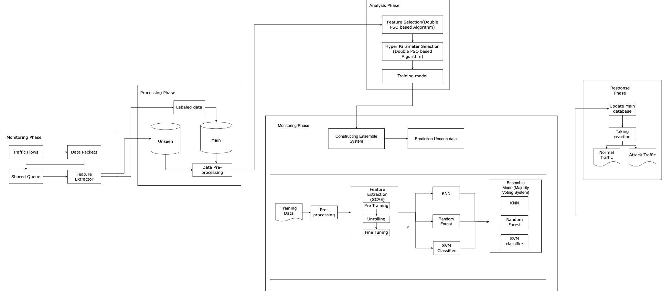
BLOCK DIAGRAM :

Slide 10
DETAILS OF MODULES :
MONITORING PHASE :
It carries out two distinct tasks: feature extraction and traffic flow capture.
The collected traffic flows is stored immediately in the shared queue.
Further, feature extractor handles every data packets in the shared queue
Then it stores all of the extracted data packet characteristics in a data record or tuple and passes it to the next module.

Slide 11
PROCESSING PHASE :
It tries to assign the already seen data into the proper class label
It will be determined by using the Signature based detection(Decision Tree)
Stores the labeled data into the main database
There will be unseen database where the unseen data will store, which contains unlabeled datasets

Slide 12
ANALYSIS PHASE :
Labeled and seen data will come as an input to this phase
Performs pre-training and training phases of the deep learning models
Executes the double PSO based algorithm for both feature and hyperparameter selection
After applying the upper level of the double PSO based algorithm we will get optimal feature subset as the output
After applying the lower level we will get optimal hyper parameter vector
After training the model we will get the predicted output for the labeled and seen data

Slide 13
MONITORING PHASE :
The prediction module, which performs two sequential tasks
The first step is to build the bagging ensemble system utilising the previously trained KNN, Random Forest, and SVM models.
The processing module then obtains a duplicate of the unseen database and does data preprocessing on it as well.
The prediction module's second purpose is to successively choose a data record from the preprocessed unseen database.
Following that, the selected data record is tested using the bagging ensemble system, and the majority voting engine's final judgement is sent to the response module.

Slide 14
RESPONSE PHASE :
After combining the base model and the input dataset the result will be either Normal or Attack traffic
The result will be updated into the main database.

Slide 15
DATASET :
Canadian Institute for Cybersecurity Intrusion Detection Systems 2017 (CICIDS2017) is a fully labelled dataset with 80 network traffic characteristics derived from raw pcap data using the CICFlowMeter. Furthermore, the traits are retrieved and estimated for both benign and malicious flows depending on various applications and network protocols.
They carried out 20 distinct attack types in order to cover a wide range of frequent attack scenarios, which may be classified into seven broad attack families or categories, namely, Brute Force, Heartbleed, Botnet, Denial of Service (DoS), DDoS, Web assault, and Infiltration.

Slide 16
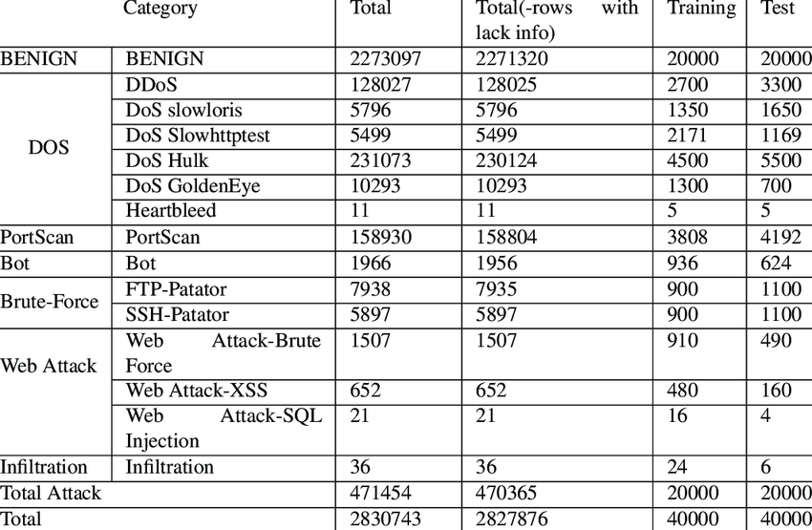
Here, in this project we are going to use 40 optimal features for this IDS. Some of those are Source Ip, Destination Ip, Source port, Destination port, Transport protocol, No of Submitted bytes, transmitted packets, Flow duration, Active mean etc..

Slide 17
PERFORMANCE MEASURES :
THRESHOLD METRICS :
Classification Rate (CR)
F Measure (FM)
Cost Per Example (CPE)
RANKING METRICS :
False Positive Rate (FPR)
Detection Rate (DR)
Intrusion Detection Capability (CID)
Precision (PR)
Area Under ROC Curve (AUC)
PROBABILITY METRICS :
Root Mean Square Error (RMSE)

Slide 18
REFERENCES :
W. Wang, X. Du, D. Shan, R. Qin and N. Wang, "Cloud Intrusion Detection Method Based on Stacked Contractive Auto-Encoder and Support Vector Machine," in IEEE Transactions on Cloud Computing, vol. 10, no. 3, pp. 1634-1646, 1 July-Sept. 2022.
F. I. Shiri, B. Shanmugam and N. B. Idris, "A parallel technique for improving the performance of signature-based network intrusion detection system," 2011 IEEE 3rd International Conference on Communication Software and Networks, 2011, pp. 692-696.
A. M. Vartouni, S. S. Kashi and M. Teshnehlab, "An anomaly detection method to detect web attacks using Stacked Auto-Encoder," 2018 6th Iranian Joint Congress on Fuzzy and Intelligent Systems (CFIS), 2018, pp. 131-134.
A. Kannan, G. Q. Maguire Jr., A. Sharma and P. Schoo, "Genetic Algorithm Based Feature Selection Algorithm for Effective Intrusion Detection in Cloud Networks," 2012 IEEE 12th International Conference on Data Mining Workshops, 2012, pp. 416-423.

Slide 19
H. A. Kholidy and F. Baiardi, "CIDS: A Framework for Intrusion Detection in Cloud Systems," 2012 Ninth International Conference on Information Technology - New Generations, Las Vegas, NV, USA, 2012, pp. 379-385
A. Javadpour, S. Kazemi Abharian and G. Wang, "Feature Selection and Intrusion Detection in Cloud Environment Based on Machine Learning Algorithms," 2017 IEEE International Symposium on Parallel and Distributed Processing with Applications and 2017 IEEE International Conference on Ubiquitous Computing and Communications (ISPA/IUCC), Guangzhou, China, 2017, pp. 1417-1421F
G. Kene and D. P. Theng, "A review on intrusion detection techniques for cloud computing and security challenges," 2015 2nd International Conference on Electronics and Communication Systems (ICECS), Coimbatore, India, 2015, pp. 227-232
C. -C. Lo, C. -C. Huang and J. Ku, "A Cooperative Intrusion Detection System Framework for Cloud Computing Networks," 2010 39th International Conference on Parallel Processing Workshops, San Diego, CA, USA, 2010, pp. 280-284

Slide 20
M. Ficco, L. Tasquier and R. Aversa, "Intrusion Detection in Cloud Computing," 2013 Eighth International Conference on P2P, Parallel, Grid, Cloud and Internet Computing, Compiegne, France, 2013, pp. 276-283
U. Oktay and O. K. Sahingoz, "Proxy Network Intrusion Detection System for cloud computing," 2013 The International Conference on Technological Advances in Electrical, Electronics and Computer Engineering (TAEECE), Konya, Turkey, 2013, pp. 98-104

