Slide 1


Tharun Kumar V
September 30, 2025
RAG SYSTEM ARCHITECTURE
Technical Documentation Query System

Slide 2


Contents
03 | High-Level System Architecture
04 | Document Ingestion Pipeline
05 | Query Processing & Retrieval

Slide 3
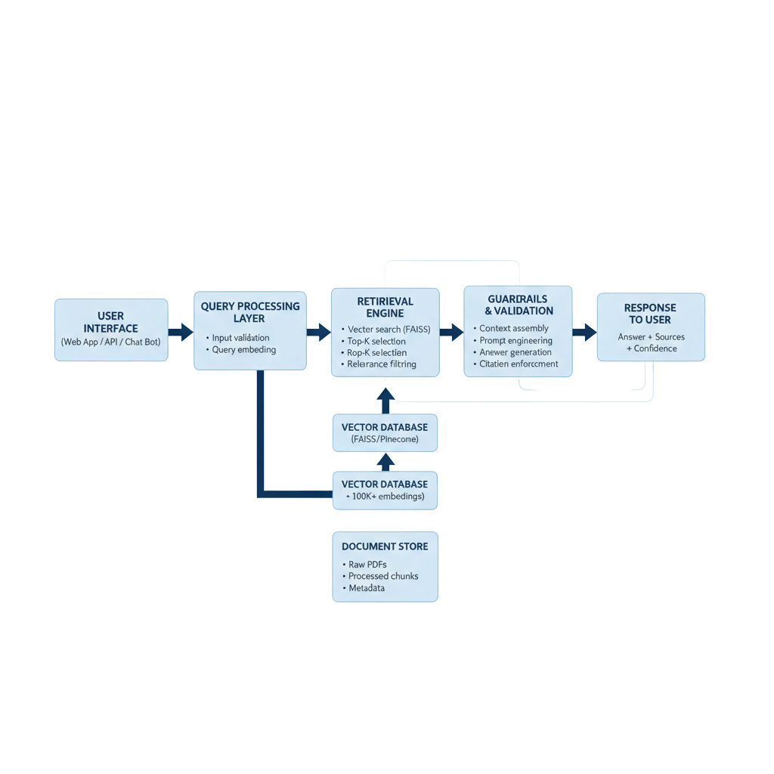
High-Level System Architecture
03/05

Slide 4
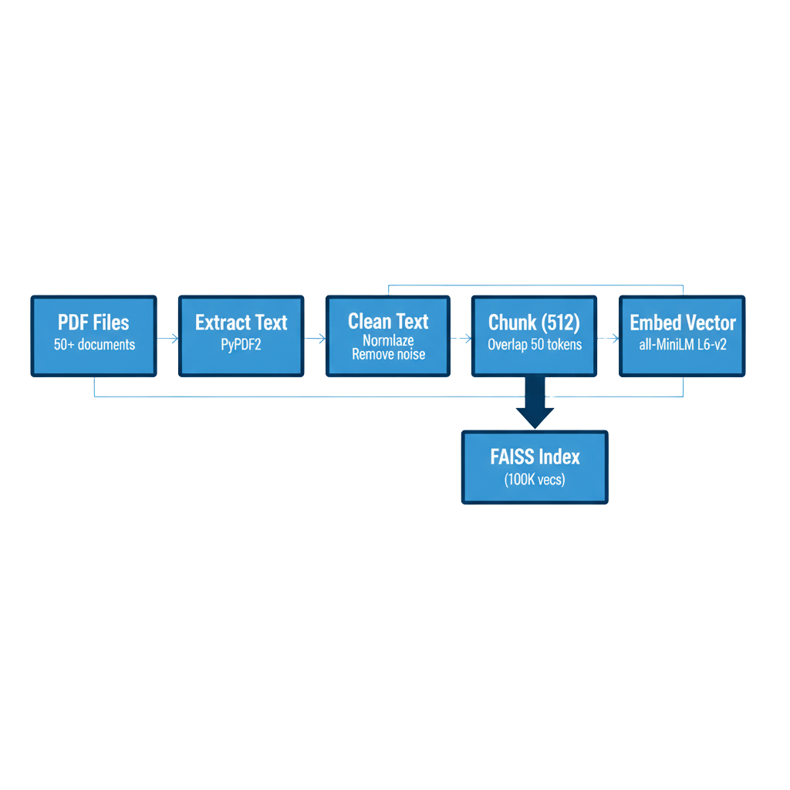
Document Ingestion Pipeline
04/05

Slide 5

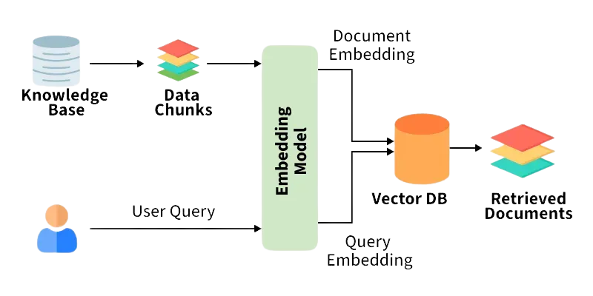
Query Processing & Retrieval
05/05

Slide 6
Thank you

