Slide 1


Tharun Kumar V
September 30, 2025
RAG SYSTEM ARCHITECTURE
Technical Documentation Query System

Slide 2


03 | High-Level System Architecture
04 | Document Ingestion Pipeline
05 | Query Processing & Retrieval
06 | LLM Generation with Guardrails
07 | Scalability Architecture
08 | Monitoring & Feedback Loop
09 | Overview
Contents

Slide 3
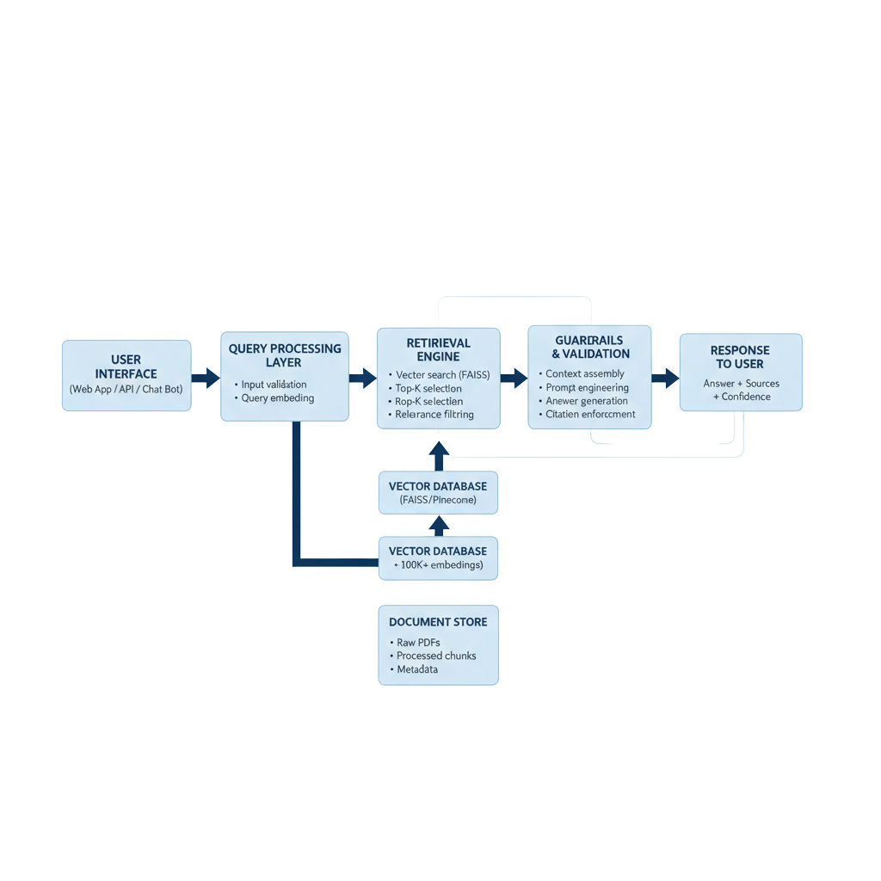
High-Level System Architecture
03/10

Slide 4
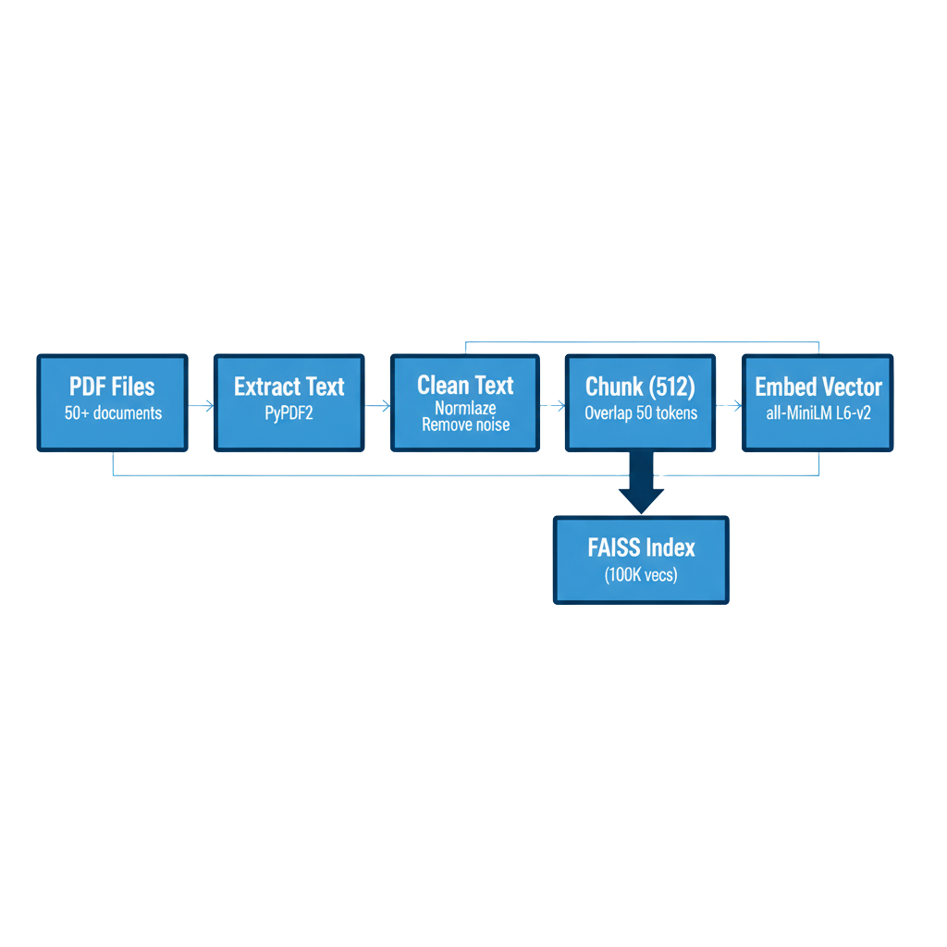
Document Ingestion Pipeline
04/10

Slide 5

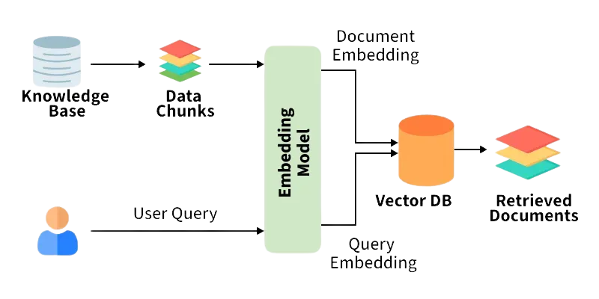
Query Processing & Retrieval
05/10

Slide 6
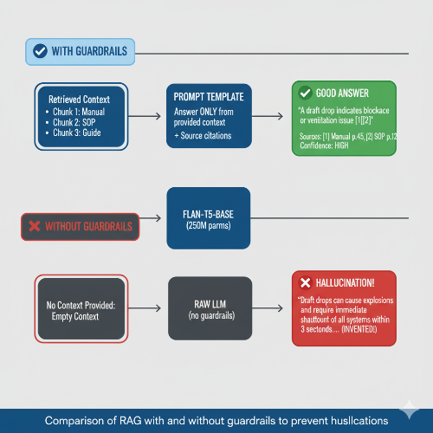

LLM Generation with Guardrails
06/10

Slide 7
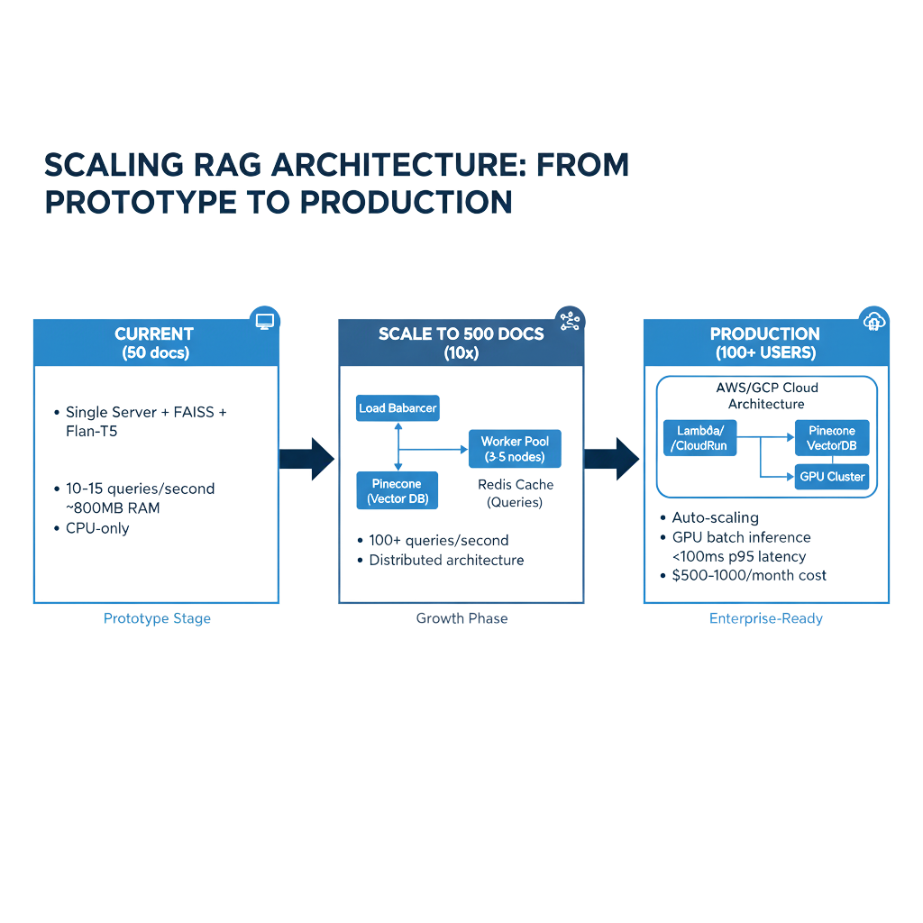

Scalability Architecture
07/10

Slide 8
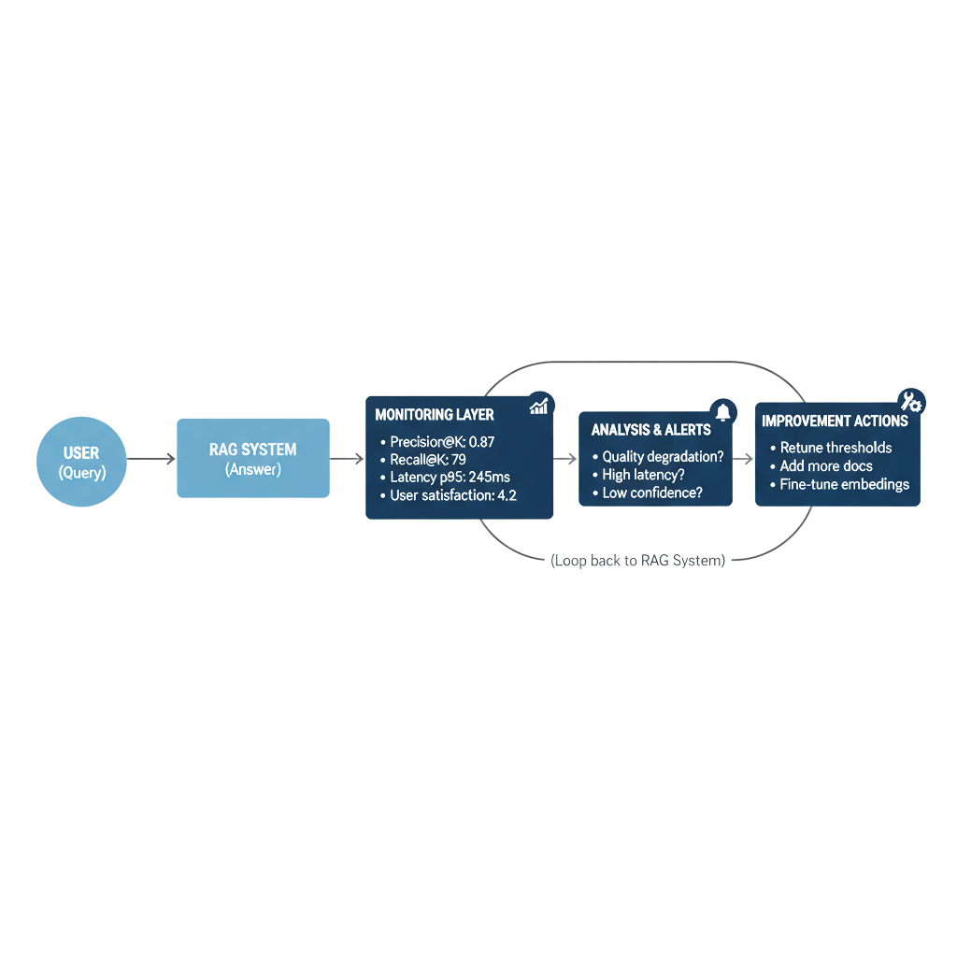
Monitoring & Feedback Loop
08/10

Slide 9

Overview
09/10
[INGEST] [PROCESS] [RETRIEVE] [GENERATE]
PDF docs → Embed + → Vector → LLM +
50+ files Index Search Citations
FAISS Top-K=3 Flan-T5
GUARDRAILS: Hallucination check ✓
Confidence scoring ✓
Source verification ✓
SCALABILITY: Current: 15 QPS → Phase 2: 100+ QPS → Production: 500+ QPS
MONITORING: Precision@3: 87% | Latency: 245ms | User Rating: 4.2/5

Slide 10
10/10
Thank you

