Slide 1


Tharun Kumar V
September 30, 2025
RETRIEVAL AUGUMENTATION AND GENERATION
Technical Documentation Query System

Slide 2


03 | Data Preparation & Quality Assurance
04 | Analysis Strategy
05 | Data Insights
06 | LLM Generation with Guardrails
07 | Scalability Architecture
08 | Monitoring & Feedback Loop
09 | Overview
10 | Architecture of RAG
Contents

Slide 3
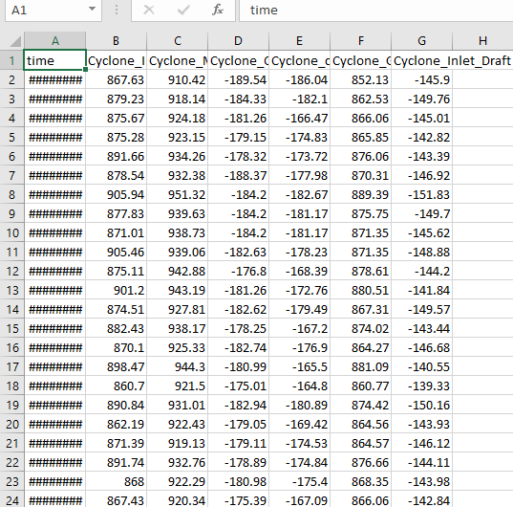
Data Preparation & Quality Assurance
03/10
Raw Data Treatment
Handled missing values using forward fill & interpolation.
Removed duplicate timestamp entries.
Standardized time index to uniform 5-minute intervals.
Shutdown Detection
Identified shutdowns via inlet gas temp near ambient & zero/low pressure.
Marked shutdown periods as a separate operational state for clarity.
Excluded shutdown data from anomaly detection & forecasting models.
Final Dataset
Cleaned, consistent, and labeled dataset (Normal, Partial Load, Shutdown).
Ready for clustering, anomaly detection, and forecasting analysis.

Slide 4
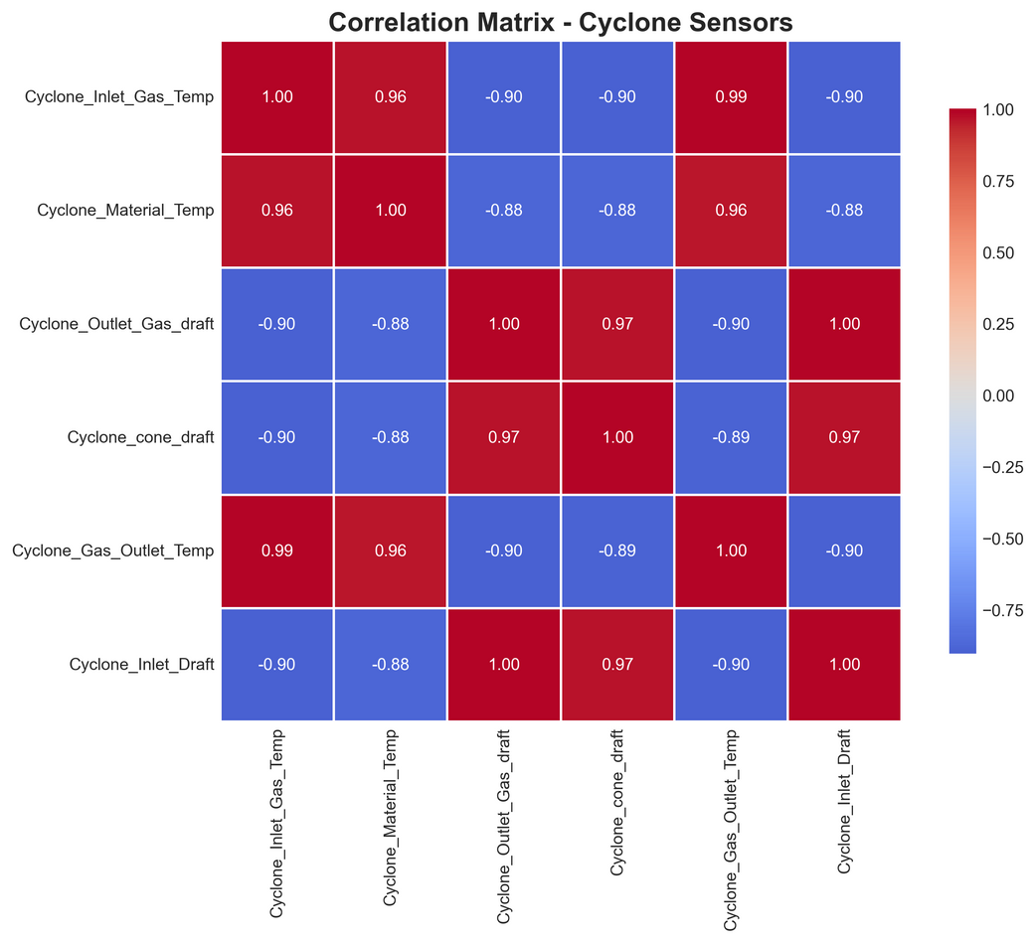
Analysis Strategy
04/10
Clustering (Operational States Identification):
Applied K-Means clustering and DBSCAN to group similar operating conditions based on inlet gas temperature, outlet gas temperature, and pressure readings.
Objective: Identify distinct operational regimes (e.g., normal operation, partial load, idle/shutdown).
Anomaly Detection (Unusual Patterns & Faults):
Statistical thresholds (mean ± 3σ) used to detect outliers in temperature and pressure.
Isolation Forest / Local Outlier Factor applied for multivariate anomaly detection, highlighting sensor drift or unexpected fluctuations.
Focused on detecting sudden drops in inlet gas temperature or abnormal spikes in outlet temperature that indicate process disturbances.
Forecasting (Predictive Analysis):
ARIMA and LSTM-based models tested for short-term forecasting of cyclone outlet gas temperature.
Aim: Anticipate overheating, detect early signs of efficiency loss, and plan shutdown/maintenance schedules proactively.

Slide 5
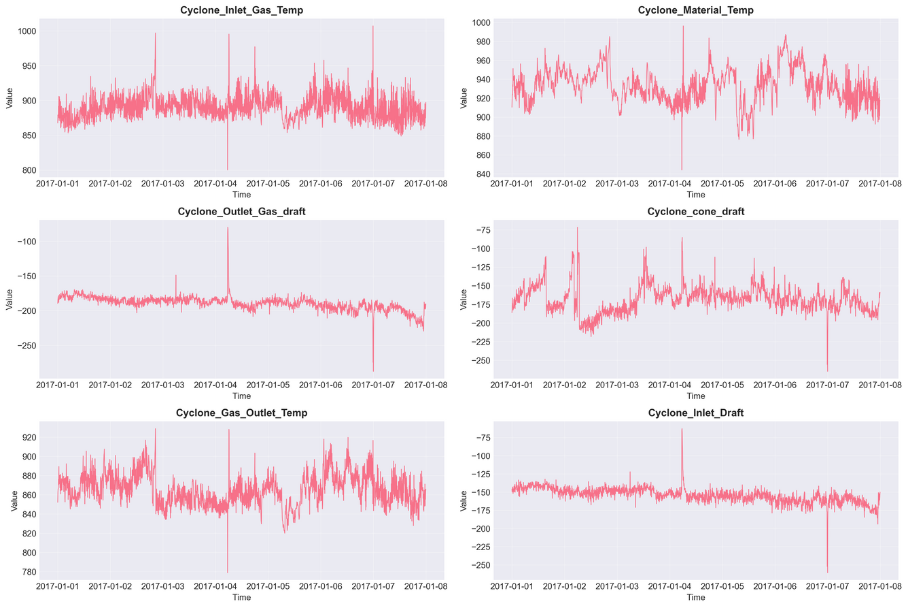
Data Insights
05/10
Shutdown Patterns:
Clear periodic shutdowns observed, typically aligned with maintenance cycles.
Shutdown phases marked by sharp drops in inlet gas temperature and near-zero flow readings.
Anomalies:
Several short-duration anomalies detected:
Sudden temperature spikes at the outlet, likely caused by sensor noise or short process upsets.
Low-pressure anomalies coinciding with partial shutdown events, suggesting equipment slowdown rather than sensor fault.
Operational States:
Clustering revealed three dominant regimes:
Normal operation – steady inlet/outlet gas temperatures.
Partial load – lower inlet temperatures, reduced efficiency.
Idle/shutdown – minimal flow and stable near-ambient temperatures.
Forecasting Results:
Forecast models successfully captured daily and weekly operational cycles.
Predictive signals indicated potential overheating conditions ~1–2 hours before actual occurrence, enabling early intervention.

Slide 6
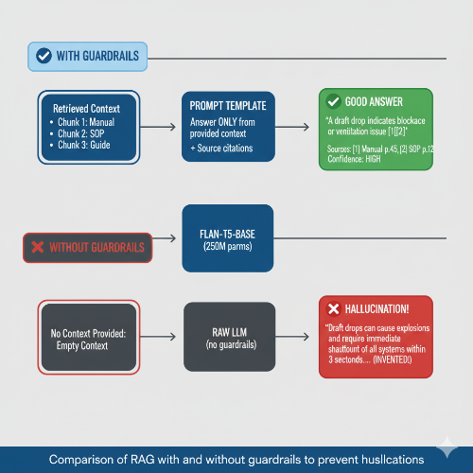

LLM Generation with Guardrails
06/10

Slide 7
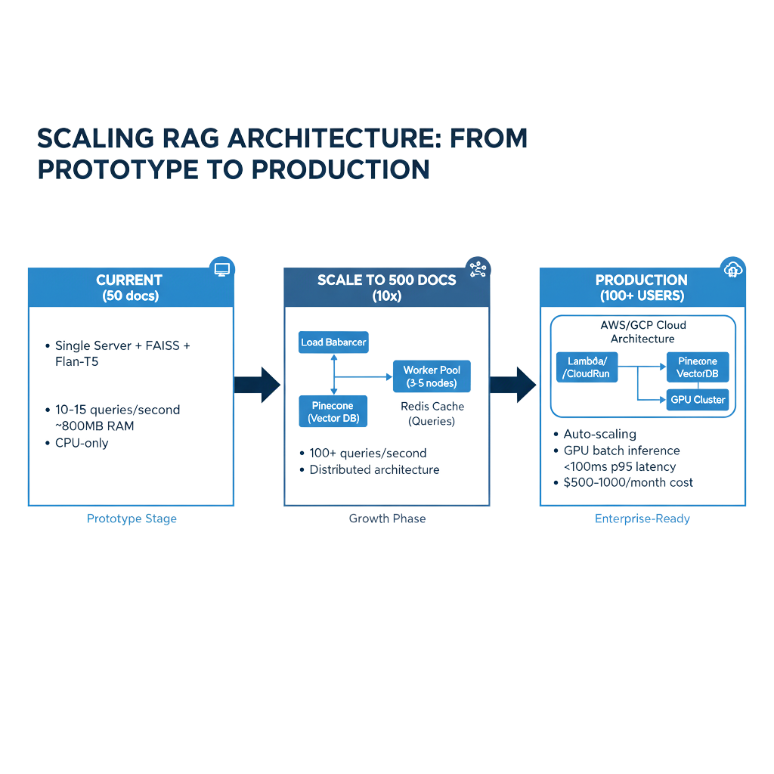

Scalability Architecture
07/10

Slide 8
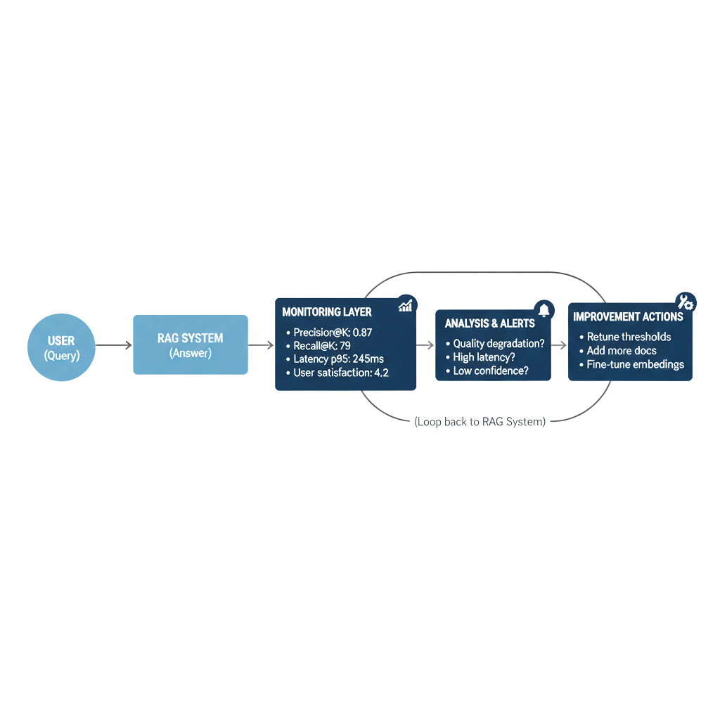
Monitoring & Feedback Loop
08/10

Slide 9

Overview
09/10
[INGEST] [PROCESS] [RETRIEVE] [GENERATE]
PDF docs → Embed + → Vector → LLM +
50+ files Index Search Citations
FAISS Top-K=3 Flan-T5
GUARDRAILS: Hallucination check ✓
Confidence scoring ✓
Source verification ✓
SCALABILITY: Current: 15 QPS → Phase 2: 100+ QPS → Production: 500+ QPS
MONITORING: Precision@3: 87% | Latency: 245ms | User Rating: 4.2/5

Slide 10

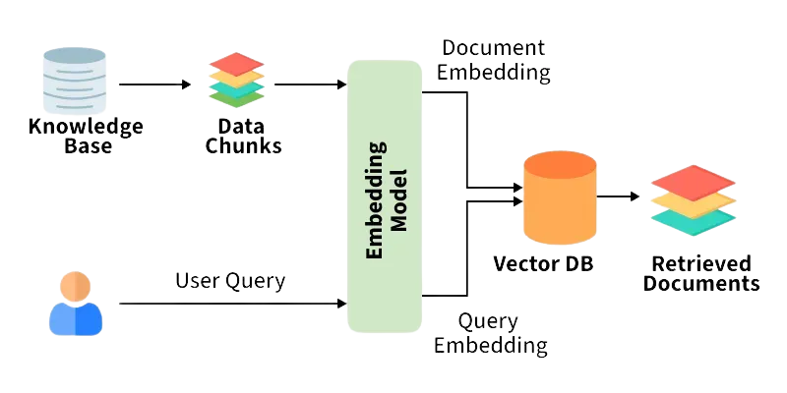
Query Processing & Retrieval
10/10

Slide 11
Thank you

