Slide 1

Documentation Agent Orchestrator
Stop AI from inventing documentation

Slide 2


The Real Problem with AI in Documentation
AI is fluent. Documentation must be correct.
When AI rewrites documentation, the biggest risk is not grammar or tone.
The real risk is silent meaning change—alterations that look professional but fundamentally alter accuracy.
Invented features or behaviors
Implied steps that were never written
AI describes functionality that doesn't exist, creating false expectations.
Missing procedures are fabricated to create narrative completeness.
Assumed workflows or defaults
Changed or “upgraded" terminology
AI infers standard behavior patterns that may not match
actual implementation.
Technical terms are modernized or simplified, breaking consistency
with product interfaces.
These changes often look professional and reasonable, which makes them nearly impossible to detect during casual review.

Slide 3
Why this hurts Technical Writers
When documentation is wrong, the AI is not blamed
What reviewers see
What reviewers do NOT see
The result
The documentation
The AI prompt
Documentation is treated as authoritative. Responsibility falls on the writer.
The published content
The AI's assumptions
The final wording
Where gaps were filled by guessing
The imbalance
AI increases speed
Accountability remains human
That’s what makes AI powerful — and risky — in documentation workflows.

Slide 4
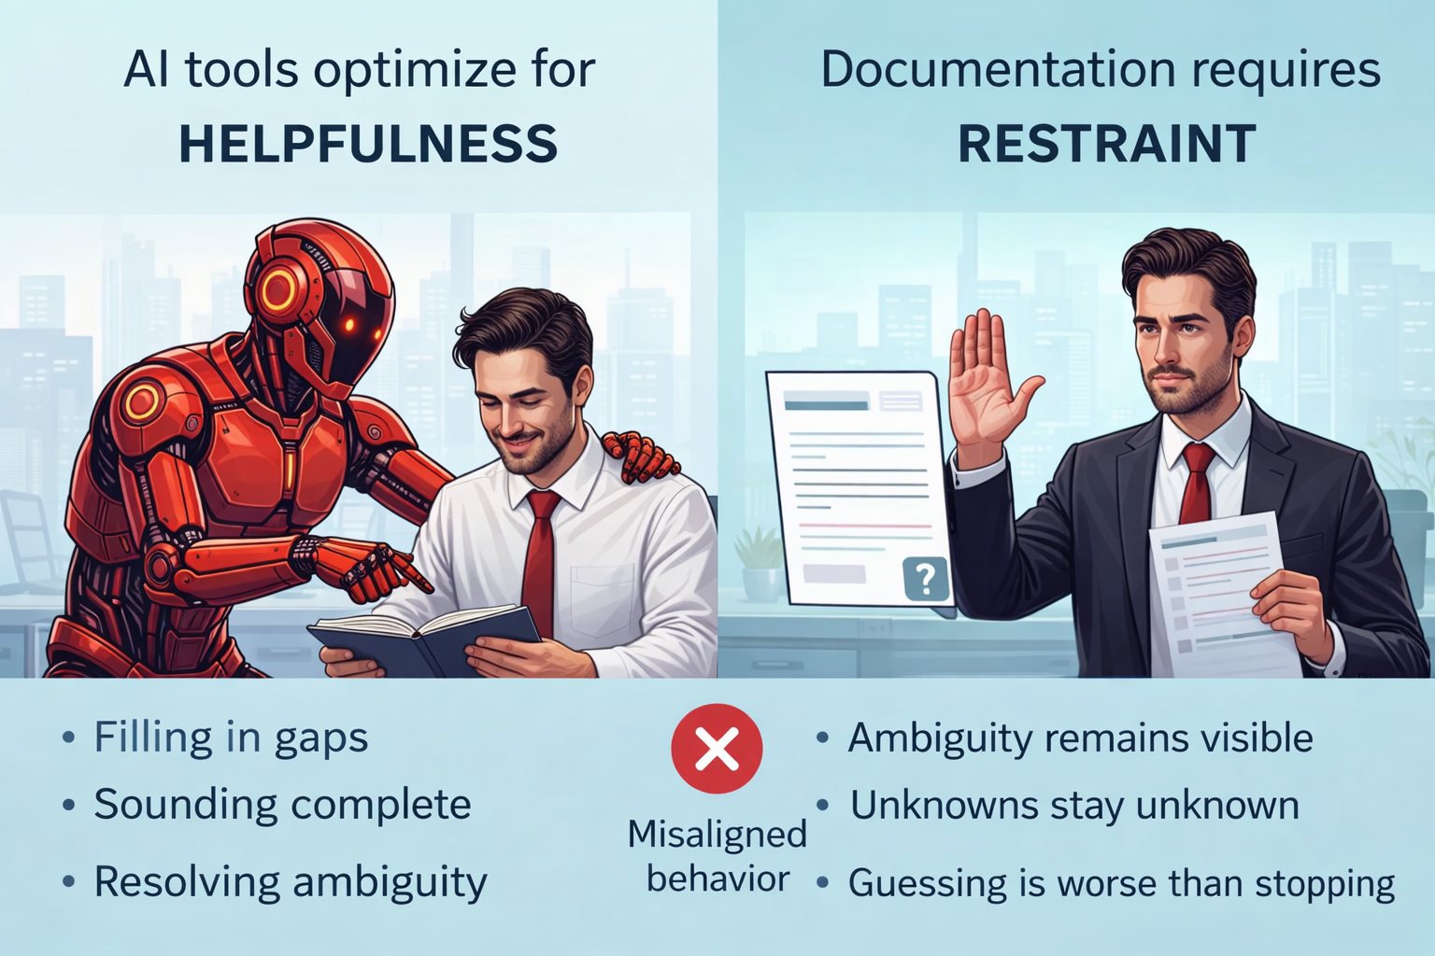
Why existing AI tools don’t solve this
AI today 🟢 Always proceeds 🟢 Always fills gaps
Documentation needs 🟢 Proceed only when safe 🔴 Stop when guessing is required
Helpful AI treats ambiguity as a problem. Documentation treats ambiguity as a signal

Slide 5

Documentation Agent Orchestrator introduces governance into AI-assisted documentation.
Creative AI that fills gaps to sound helpful
Controlled documentation agent that enforces rules
This approach shifts AI away from creative interpretation and toward professional accountability, ensuring documentation remains correct, traceable, and defensible.

Slide 6

The core idea: Governance instead of guessing
AI is allowed only two behaviors
Documentation Agent Orchestrator enforces a strict operational rule that eliminates the middle ground where AI "helps" by making assumptions:
1. Document exactly what is provided
Reproduce source content with precision, preserving ambiguity, gaps, and incomplete information exactly as written.
2. Stop and ask clarifying questions
When documentation would require invention, inference, or assumption, halt processing and explicitly request the missing information.
There is no middle ground. There is no "helpful guessing." This replaces AI creativity with AI restraint—the foundation of trustworthy automated documentation.

Slide 7

Concrete Example: Without vs With Governance
Original Input
Without Governance
With Governance
Output mirrors the source exactly
Credential validation method invented
User clicks login.
Credentials checked.
Valid → dashboard.
Invalid → error.
Admins get extra options.
Ambiguity is explicitly listed
Dashboard behavior assumed
No behavior is invented or inferred
Error handling expanded
Unknowns remain documented as unknowns
"Extra options" turned into specific features
The difference is not style, tone, or formatting. The difference is correctness—the fundamental requirement for technical documentation in regulated industries.

Slide 8
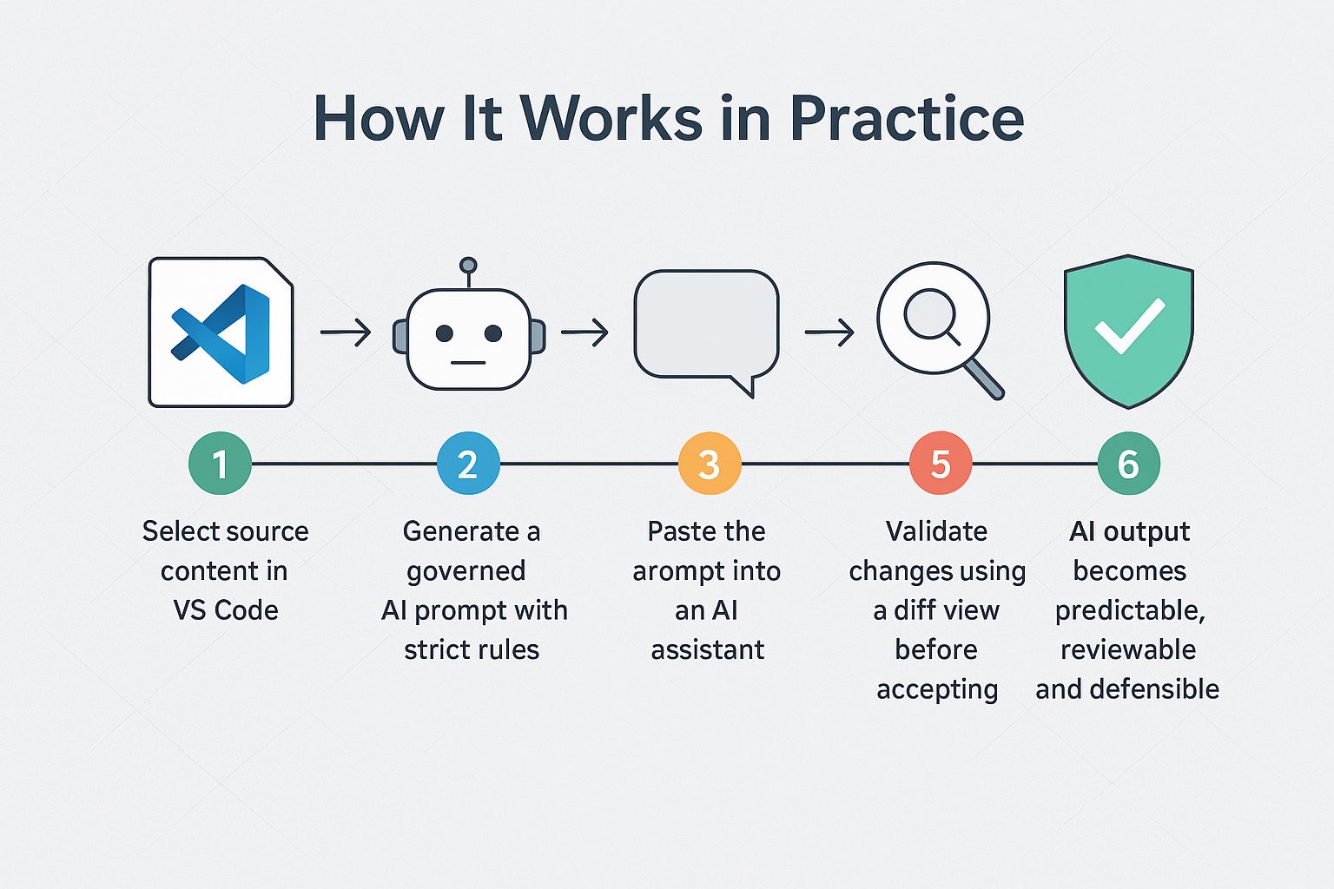

Slide 9
Why this is a real step forward
A governance layer, not a writing tool
What this is NOT
What this is
✖ Not a writing assistant
✖ Not a polishing tool
✖ Not a creativity booster
✔ A governance layer for AI-assisted documentation
✔ Predictable behavior
✔ Reviewable output
✔ Accountable changes
It doesn’t make AI smarter. It makes AI stop lying.

Slide 10
