Slide 1

AMAZON SALES ANALYTICS
Power BI Dashboard — Design & Layout Deck
4 Report Pages
48 Visuals
Screenshot placeholders included
Source: Amazon_SalesData_2026.pbix • Pages: Home, Executive Sales Overview, Product & Category Analysis, Customer & Regional Analysis

Slide 2
OBJECTIVE
What This Dashboard Answers
1
Executive Snapshot
Headline KPIs — sales, orders, quantity, customers, AOV — plus month-over-month growth and a sales trend over time.
REPORT SNAPSHOT
4
Report pages
2
Product & Category Performance
Which categories, sub-categories, brands and products drive revenue, and how discounting and price affect it.
48
Total visuals
8
KPI card measures on Executive page
3
Customer & Regional Reach
Top customers, spend by state and city, and how payment method and shipping cost vary by region.
9
Slicers across the report (date, state, city, brand, ship date)
4
Navigation Hub
3
Navigation buttons routing from Home
A Home page that routes viewers into the three analysis pages, each linked with back-and-forward buttons.
Amazon Sales Analytics — Dashboard Design
2

Slide 3
REPORT STRUCTURE
From Data to Four Dashboard Pages
How the .pbix report is organized, and how many visuals sit on each page
4
15
18
11
VISUALS
VISUALS
VISUALS
VISUALS
Home
→
Executive Sales Overview
→
Product & Category Analysis
→
Customer & Regional Analysis
Navigation hub — 4 action buttons routing into the report
KPI cards, trend combo chart, top brands & sub-categories, payment mix
Funnel, decomposition tree, category/brand breakdowns, 6 slicers
Top customers, state/city sales, payment mix, shipping cost
Amazon Sales Analytics — Dashboard Design
3

Slide 4
A
Calculated Columns
Built in Power Query / the Sales table before any measure runs
Column | Formula | Purpose
Gross Amount | quantity * unit_price | Revenue before discount is applied
Discount Amount | quantity * unit_price * discount | Value of discount given per line
Calculated Sales | quantity * unit_price * (1 - discount) | Cross-check vs. source total_sales column
Shipping Days ⚠ | DATEDIFF(order_date, ship_date, DAY) | Held back — 4,915 rows ship before order
Delivery Days ⚠ | DATEDIFF(order_date, delivery_date, DAY) | Held back for the same data-quality reason
Amazon Sales Analytics | Dashboard Design
5

Slide 5
DATA MODEL
DAX Measures — Volume & Value
The core aggregations every KPI card and chart is built on
Measure
Formula (typical pattern)
Purpose
Total_Sales
SUM('Sales'[sales_amount])
Base revenue figure behind every sales chart and card
Total_Order
DISTINCTCOUNT('Sales'[order_id])
Order count for the Executive KPI strip
Total_Quantity
SUM('Sales'[quantity])
Units sold, used on KPI cards and product charts
Total_Products
DISTINCTCOUNT('Sales'[product_name])
Distinct products sold, paired with Total_Sales in the trend combo chart
Total_Customers
DISTINCTCOUNT('Sales'[customer_name])
Unique buyer count for the Executive KPI strip
Average_Order_Value
DIVIDE([Total_Sales], [Total_Order])
Revenue per order (AOV)
Averagre_Selling_Price
DIVIDE([Total_Sales], [Total_Quantity])
Average price realised per unit sold
Note: Power BI's compiled data model is stored in a compressed binary format inside the .pbix file and can't be decompiled directly. Names below are the exact fields used in the report; formulas are the standard pattern for that name — verify the exact syntax in Power BI Desktop.
Amazon Sales Analytics — Dashboard Design
5

Slide 6
DATA MODEL
DAX Measures — Trend & Discount
Month-over-month growth, top performer, discount and shipping-cost measures
Measure
Formula (typical pattern)
Purpose
Previous_month_Sales
CALCULATE([Total_Sales], DATEADD('Date'[Date], -1, MONTH))
Prior month's sales, for the growth comparison
Current_month_Sales
CALCULATE([Total_Sales], MONTH('Date'[Date]) = MONTH(TODAY()))
This month's sales-to-date
Sales_Grwoth
DIVIDE([Current_month_Sales] - [Previous_month_Sales], [Previous_month_Sales])
Month-over-month % growth shown on the Executive KPI strip
Top_Product
CALCULATE(VALUES('Sales'[product_name]), TOPN(1, ALL('Sales'[product_name]), [Total_Sales]))
Best-selling product name, shown as a KPI card
Average_Discount_%
AVERAGE('Sales'[discount_pct])
Average discount applied across orders
Total_Shipping_Cost
SUM('Sales'[shipping_cost])
Total logistics spend, shown on the Regional page
Note: Power BI's compiled data model is stored in a compressed binary format inside the .pbix file and can't be decompiled directly. Names below are the exact fields used in the report; formulas are the standard pattern for that name — verify the exact syntax in Power BI Desktop.
Amazon Sales Analytics — Dashboard Design
6

Slide 7
VISUAL DESIGN
Chart Usage Mapping
Which visual type carries which kind of insight across the report
Chart
Where it's used
Why this chart
Card visual
Headline KPIs (Total Sales, Orders, AOV, Growth)
Single numbers read fastest at a glance
Donut chart
Payment method, category & sub-category share
Clean part-to-whole split with few slices
Treemap
Sub-category share of total sales
Shows hierarchy and relative size together
Bar / clustered column
Product, brand, category, state comparisons
Best for comparing magnitudes across groups
Line + column combo
Sales & product volume trend over time
Bars show volume, line highlights direction
Funnel
Product sales progression
Shows drop-off across a ranked sequence
Decomposition tree
Sales by category → sub-category → brand
Lets a viewer drill top-down into what drives sales
Table
Top 3 sub-categories, top brands, top customers
Precise ranked values a chart would blur
Slicer
Date, state, city, brand, ship date filters
Lets viewers cross-filter every visual on the page
Amazon Sales Analytics — Dashboard Design
7

Slide 8

PAGE 1
Home
Navigation hub — routes the viewer into the three analysis pages
CHARTS ON THIS PAGE
Action buttons (×4) Navigate to Executive Sales Overview, Product & Category Analysis, and Customer & Regional Analysis
Background / logo Amazon branding and title banner
SLICERS
None — this is a landing page only.
SCREENSHOT PLACEHOLDER
Paste your Power BI screenshot of
"Home" here (16:9, e.g. 1280×720)
1280 × 720
Flow: Home → Executive Sales Overview → Product & Category Analysis → Customer & Regional Analysis (each page also has back/forward arrows)
Amazon Sales Analytics — Dashboard Design
8

Slide 9
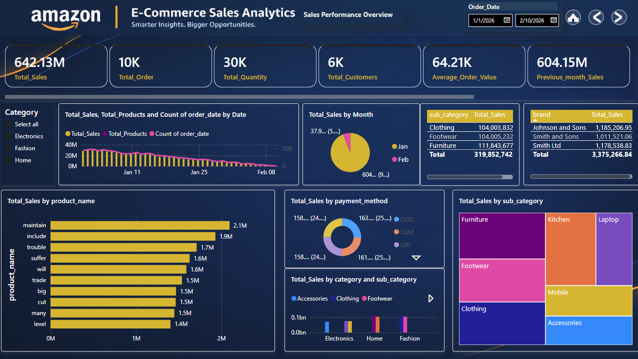
PAGE 2
Executive Sales Overview
Headline KPIs, sales trend, and top-line composition of the business
KPI CARDS
Total Sales
Total Orders
Total Quantity
Total Customers
Average Order Value
Previous Month Sales
Current Month Sales
Sales Growth %
SCREENSHOT PLACEHOLDER
Paste your Power BI screenshot of
"Executive Sales Overview" here (16:9, e.g. 1280×720)
CHARTS ON THIS PAGE
Line + column combo Total Sales & Total Products by order date
Clustered column Total Sales by category & sub-category
Bar chart Total Sales by product name
Treemap Total Sales share by sub-category
Donut chart Total Sales by payment method
Pie chart Total Sales by month
Table (×2) Top 3 sub-categories · Top 3 brands by sales
1280 × 720
SLICERS
Date (Order Date, between range)
Amazon Sales Analytics — Dashboard Design
9

Slide 10
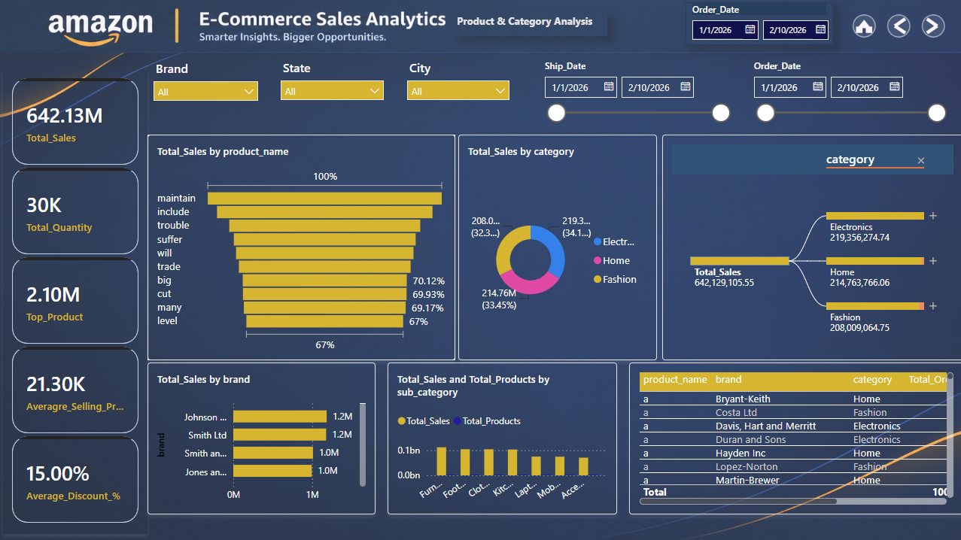
PAGE 3
Product & Category Analysis
Category, brand and product-level performance with pricing & discount detail
KPI CARDS
Total Sales
Total Quantity
Top Product
Avg. Selling Price
SCREENSHOT PLACEHOLDER
Paste your Power BI screenshot of
"Product & Category Analysis" here (16:9, e.g. 1280×720)
Avg. Discount %
CHARTS ON THIS PAGE
Decomposition tree Total Sales split by category → sub-category → brand
Funnel Total Sales by product name
Clustered column Total Sales & Total Products by sub-category
Bar chart Total Sales by brand
Donut chart Total Sales by category
Table Product · Brand · Category · Orders · Qty · Sales
1280 × 720
SLICERS
State · City · Brand · Order Date · Ship Date (6 slicers total)
Amazon Sales Analytics — Dashboard Design
10

Slide 11
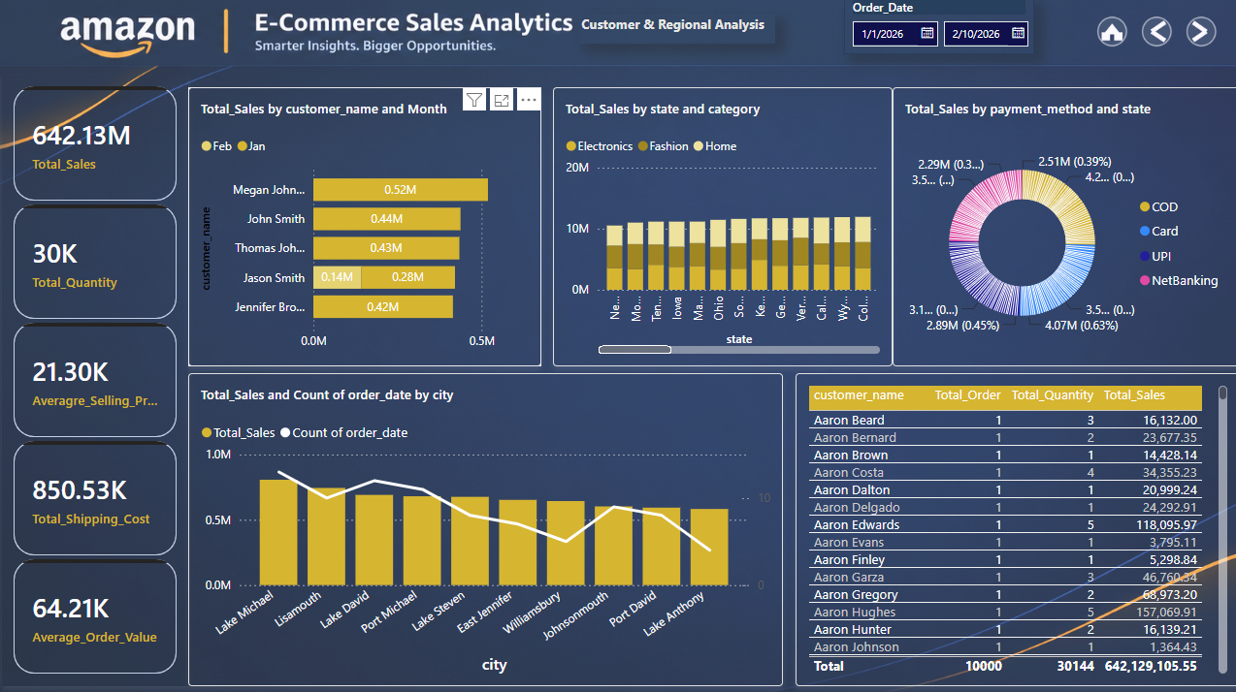
PAGE 4
Customer & Regional Analysis
Top customers plus sales, payment mix and shipping cost by state & city
KPI CARDS
Total Sales
Total Quantity
Avg. Selling Price
Total Shipping Cost
SCREENSHOT PLACEHOLDER
Paste your Power BI screenshot of
"Customer & Regional Analysis" here (16:9, e.g. 1280×720)
Average Order Value
CHARTS ON THIS PAGE
Line + stacked column combo Total Sales by city & order date, split by category
Column chart Total Sales by state, split by category
Bar chart Total Sales by customer name & month
Donut chart Total Sales by payment method / state / category
Table Customer · Orders · Quantity · Sales
1280 × 720
SLICERS
Date (Order Date, between range)
Amazon Sales Analytics — Dashboard Design
11

Slide 12
RECOMMENDED VIEWING FLOW
How a Viewer Moves Through the Report
1
2
3
4
Home
Executive Sales Overview
Product & Category Analysis
Customer & Regional Analysis
→
→
→
Landing page — pick a destination from the navigation menu.
Start with top-line KPIs and the overall sales trend.
Drill into which categories, brands and products drive it.
Close on who is buying, and from where.
ADDING YOUR SCREENSHOTS
Open each report page in Power BI, use Export → Image (or Alt+PrtScn) at 1280 × 720, then drag the image into the dashed placeholder on slides 8–11, resizing to fill the box.
Amazon Sales Analytics — Dashboard Design
12

