Slide 1
Assignment 3 - GoldRekt threat group using the MITRE ATT&CK framework
Name
Student ID

Slide 2
Introduction:
GoldRekt is a nation-state threat group focused on cybercrime for financial gain.
The group has been active for several years and is associated with notorious threat groups such as ATP28, Sandworm Team, FIN4, and ATP29.
GoldRekt's strategic objective is cyber espionage, particularly the interception of strategic decision-making data for financial advantage.
Notes:
GoldRekt, a nation-state threat group, is primarily motivated by financial gain through cybercrime activities. They have established a reputation in the cyber landscape and are linked to notorious threat groups like ATP28, Sandworm Team, FIN4, and ATP29. The group has been operating for a considerable period, indicating their expertise and experience in carrying out sophisticated cyber attacks. GoldRekt's strategic focus lies in cyber espionage, specifically targeting strategic decision-making data to gain a financial advantage. Their activities pose a significant threat to organizations' security and the protection of sensitive information.

Slide 3
Tactics and Techniques:
GoldRekt employs various tactics and techniques outlined in the MITRE ATT&CK framework to achieve its objectives.
The initial access tactic includes methods like phishing, remote access, and targeting public-facing applications.
Execution tactics involve the use of malicious point of sale (POS) malware for financial gain.
Collection tactics include traffic analysis, decryption, and forensics to gather valuable information.
Notes:
GoldRekt, the threat actor in this scenario, employs a range of tactics and techniques based on the MITRE ATT&CK framework to achieve its objectives. Let's dive into some of the key tactics they utilize:
The initial access tactic involves methods like phishing, remote access, and targeting public-facing applications. These techniques allow them to gain an initial foothold into the target network. Execution tactics revolve around the use of malicious point of sale (POS) malware. By compromising payment systems, they aim to reap financial gains from their activities.
Collection tactics encompass activities such as traffic analysis, decryption, and forensics. These techniques enable GoldRekt to gather valuable information from the compromised network. Understanding the specific tactics employed by the threat actor helps us develop effective countermeasures and strengthen our defense against their attacks.

Slide 4
Additional Tactics and Techniques
GoldRekt utilizes defense evasion tactics such as file deletion and virtualization/sandbox evasion to avoid detection.
Persistence tactics include the use of scheduled tasks and rootkits to maintain long-term access to compromised systems.
Command and control tactics involve the use of domain generation algorithms and remote file copy for controlling compromised systems.
Discovery tactics include system information discovery and network share discovery to gather intelligence within the target network.
Notes:
GoldRekt, the threat actor in the scenario, employs various defense evasion tactics to evade detection. They engage in file deletion and virtualization/sandbox evasion techniques to avoid triggering security measures. In terms of persistence tactics, GoldRekt relies on scheduled tasks and rootkits to ensure long-term access to compromised systems, enabling them to maintain control even after initial infiltration. Command and control tactics employed by GoldRekt involve the use of domain generation algorithms and remote file copy methods to establish and maintain control over compromised systems, enabling them to issue commands and exfiltrate data.

Slide 5
Lateral Movement
GoldRekt focuses on lateral movement within the target network to achieve its objectives.
Remote Desktop Protocol (RDP) hijacking is a commonly employed tactic for gaining unauthorized access to systems.
Pass the Ticket technique is used to exploit trust relationships and escalate privileges within the network.
These tactics allow GoldRekt to move laterally and access important information within the target organization.
Notes:
GoldRekt, the threat actor in this scenario, employs various tactics to achieve its objectives, with a focus on lateral movement within the target network. One commonly used tactic is Remote Desktop Protocol (RDP) hijacking, which allows unauthorized access to systems. Another technique employed is the Pass the Ticket method, which exploits trust relationships and escalates privileges within the network. By utilizing these tactics, GoldRekt can move laterally and gain access to crucial information within the target organization. These actions highlight the importance of understanding and mitigating such tactics to strengthen network security.

Slide 6
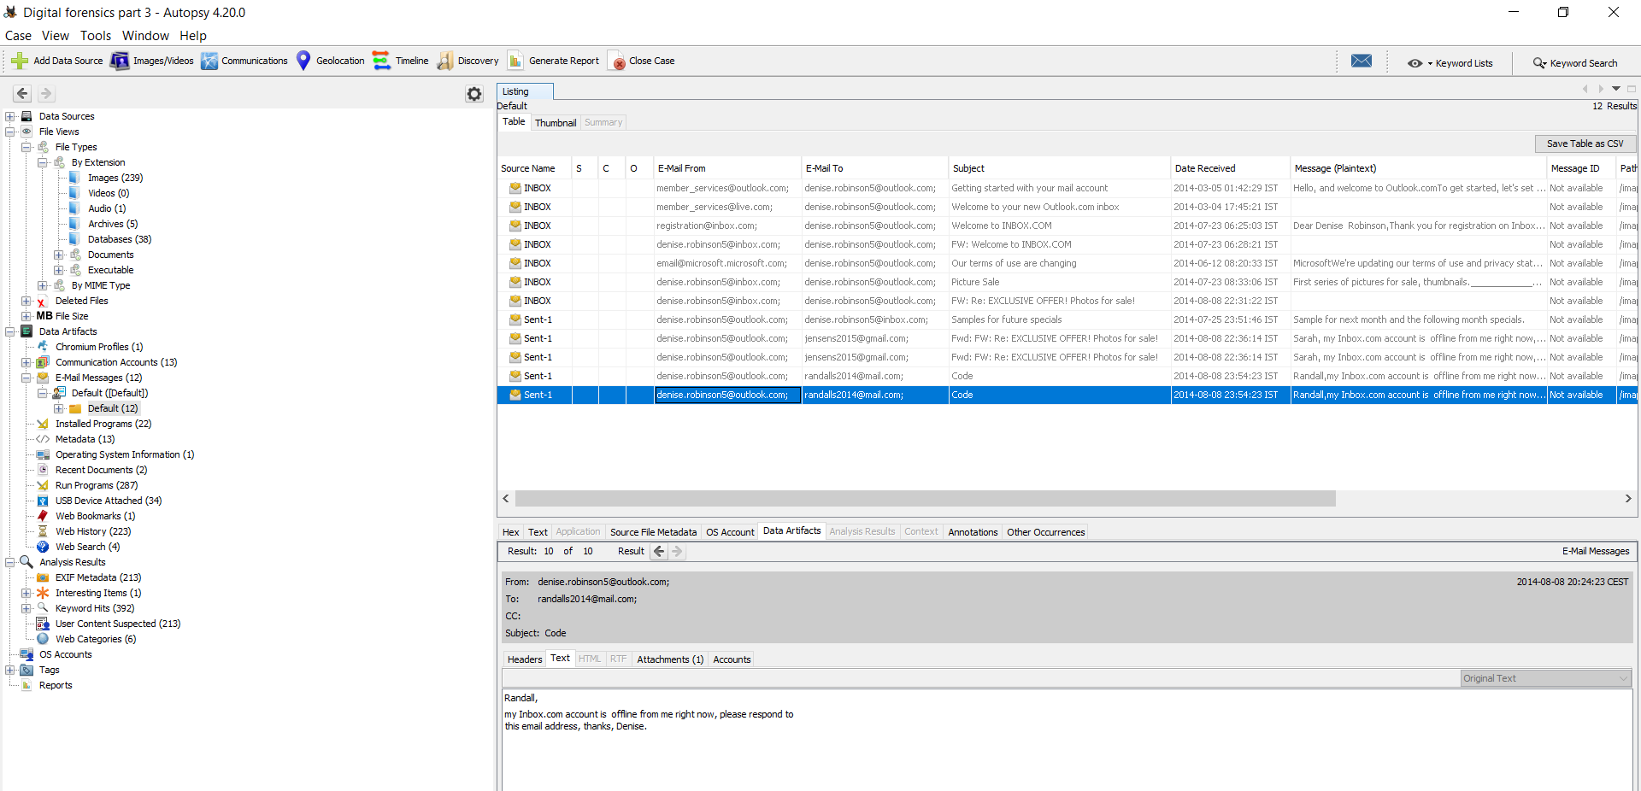
Notes:
Denise Robinson logged in to the computer. The email address is – denise.robinson5@outlook.com

Slide 7
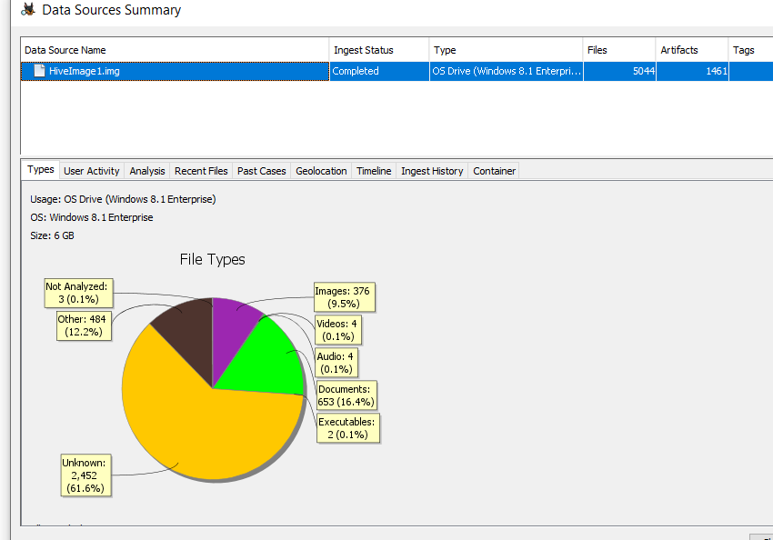
OS information:

Slide 8
Tactics:
Spear Phishing (T1566.001): Targeted phishing emails tailored to specific individuals or groups within the organization to trick them into revealing credentials or executing malicious attachments.
Remote Desktop Protocol (RDP) Exploitation (T1076): Exploiting vulnerabilities in the Remote Desktop Protocol to gain unauthorized access to systems.
Brute Force Authentication (T1110.001): Attempting to gain unauthorized access by systematically guessing passwords or trying common or weak credentials.
Web Application Exploitation (T1190): Exploiting vulnerabilities in public-facing web applications to gain access to internal systems or sensitive data.
Data Exfiltration (T1020): Unauthorized copying, transfer, or retrieval of data from a network or system to an external location controlled by the attacker.
Notes:
Spear Phishing (T1566.001): Spear phishing is a targeted form of phishing where attackers tailor their email messages to specific individuals or groups within the organization. By crafting convincing and personalized emails, attackers aim to trick recipients into revealing credentials or executing malicious attachments, leading to unauthorized access or data breaches. Remote Desktop Protocol (RDP) Exploitation (T1076): This tactic involves exploiting vulnerabilities in the Remote Desktop Protocol, a widely used protocol for remote access to systems. Attackers exploit security weaknesses in RDP implementations to gain unauthorized access to systems, enabling them to control the compromised machines and potentially move laterally within the network. Brute Force Authentication (T1110.001): Brute force authentication is an attack technique where attackers systematically guess passwords or try common or weak credentials to gain unauthorized access. By automating the process, attackers aim to bypass authentication mechanisms and gain control over targeted systems or accounts.

Slide 9
Impact and Destructive Actions
GoldRekt engages in destructive actions that have a significant impact on target organizations.
Data encryption for impact is a tactic used to disrupt operations by encrypting critical data.
Account manipulation is employed to gain unauthorized access and manipulate privileged accounts.
These actions aim to cause chaos, disrupt operations, and cover their tracks after compromising a target.
Notes:
GoldRekt engages in destructive actions that have a significant impact on target organizations. Data encryption for impact is a tactic used to disrupt operations by encrypting critical data. Account manipulation is employed to gain unauthorized access and manipulate privileged accounts. These actions aim to cause chaos, disrupt operations, and cover their tracks after compromising a target.

Slide 10
Demonstrated Use and Justification of Metrics and TTPs
Metric: Time to Detection (TTD)
TTD helped measure the efficiency of detecting the incident, allowing for prompt response and mitigation actions.
Metric: Threat Severity Rating
Assessing the severity of the threat aided in prioritizing response efforts, ensuring that critical vulnerabilities were addressed first.
TTP: Social Engineering (T1566)
Identifying social engineering as a potential TTP provided insights into the attacker's tactics, allowing for tailored awareness training and targeted mitigation measures.
TTP: Spear Phishing (T1566.001)
Recognizing spear phishing as a TTP highlighted the need for email security measures, employee education, and advanced threat detection solutions.

Slide 11
GoldRekt's Objectives and Consequences
GoldRekt's primary objective is cyber espionage for financial advantage.
A well-defined DFIRP (Digital Forensics Incident Response Plan) is crucial to effectively respond to data theft incidents and minimize their impact.
Key considerations include developing incident response procedures, establishing an incident response team, and implementing proactive security measures.
Notes:
GoldRekt's primary objective is cyber espionage for financial advantage. Their activities can have severe consequences for organizations, including reputational damage, financial losses, and regulatory penalties. A well-defined DFIRP (Digital Forensics Incident Response Plan) is crucial to effectively respond to data theft incidents and minimize their impact. Key considerations include developing incident response procedures, establishing an incident response team, and implementing proactive security measures.

Slide 12
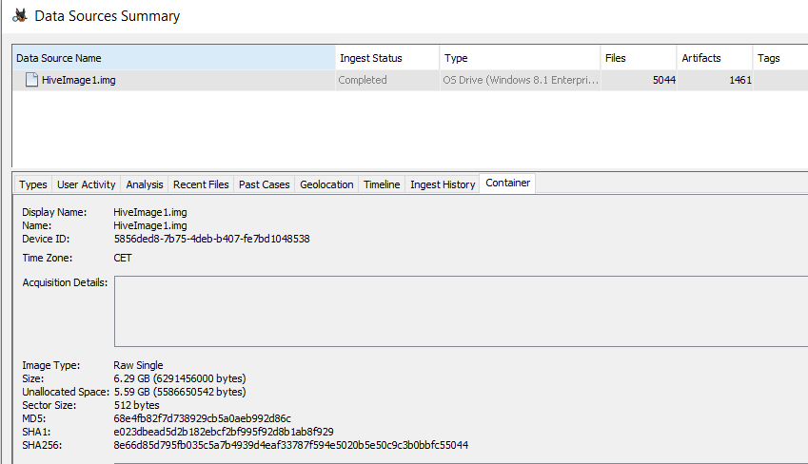
Notes:
Uninitiated people find it amazing that we can identify which USB devices have ever been connected to a system even when those devices are no longer there. Unfortunately, this proof frequently only holds up to inspection when the alleged USB devices are not present. That is a strange statement. The problem is brought about by erroneous, inconsistent, and inadequately supported nomenclature.

Slide 13
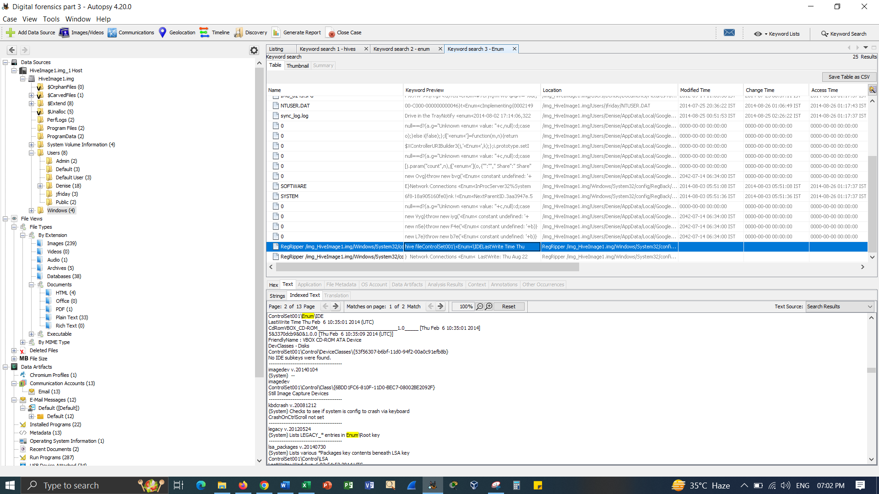
Notes:
Basically, the data theft incidents can have significant consequences for the organizations such as reputational damage, financial losses and regulatory penalties. Having a well-defined DFIRP is vital to effectively answer to the data theft incidents, preserve evidence for future investigation and minimize the impact.

Slide 14
Detection and Initial Response
The incident response team should be quickly activated and notified once a data theft incident is detected.
Mechanisms should be in place to identify indicators of a data theft incident, such as unusual traffic patterns, unauthorized access, or abnormal system behaviors.
It is essential to secure the affected systems by isolating them from the network to mitigate further data damage or exfiltration.
Notes:
The incident response team should be quickly activated and notified once a data theft incident is detected. Mechanisms should be in place to identify indicators of a data theft incident, such as unusual traffic patterns, unauthorized access, or abnormal system behaviors.
It is essential to secure the affected systems by isolating them from the network to mitigate further data damage or exfiltration.

Slide 15
External Partners and Relationships
Establish relationships with external partners, such as legal counsel, law enforcement agencies, and forensic experts, who can assist in the event of a data theft incident.
These external partners can provide valuable expertise and resources during the incident response and investigation process.
Situate contracts with these partners to ensure a smooth and coordinated response and leverage their specialized knowledge in handling data theft incidents.
Notes:
Establish relationships with external partners, such as legal counsel, law enforcement agencies, and forensic experts, who can assist in the event of a data theft incident.
These external partners can provide valuable expertise and resources during the incident response and investigation process. Situate contracts with these partners to ensure a smooth and coordinated response and leverage their specialized knowledge in handling data theft incidents.

Slide 16
Conclusion:
Destructive actions, such as data manipulation or storage, may be carried out by threat actors to disrupt operations and create chaos.
Having a well-defined Data Forensics Incident Response Plan (DFIRP) is important.
Notes:
Data theft incidents can have significant consequences for organizations, including reputational damage, financial losses, and regulatory penalties. Destructive actions, such as data manipulation or storage, may be carried out by threat actors to disrupt operations and create chaos. Having a well-defined Data Forensics Incident Response Plan (DFIRP) is vital to effectively respond to data theft incidents, preserve evidence, and minimize the impact.

Slide 17
References:
Casey, E. (2018). Digital Evidence and Computer Crime: Forensic Science, Computers and the Internet (3rd ed.). Academic Press.
Karie, N.M., Kebande, V.R., Venter, H.S. and Choo, K.K.R., 2019. On the importance of standardising the process of generating digital forensic reports. Forensic Science International: Reports, 1, p.100008.
Marcella, A. J., & Greenfield, D. (Eds.). (2017). Cyber Forensics: A Field Manual for Collecting, Examining, and Preserving Evidence of Computer Crimes (3rd ed.). Auerbach Publications.
Nance, K., Haynes, J. E., & Ortiz, S. (2016). Guide to Cyber Forensics: From Data to Digital Evidence. Springer.
Pollitt, M. (2017). Investigating Internet Crimes: An Introduction to Solving Crimes in Cyberspace (2nd ed.). Elsevier.
Quick, D., Choo, K.-K. R., & Martini, B. (Eds.). (2016). Handbook of Digital Forensics of Multimedia Data and Devices. Wiley.
Sammons, J. (2016). The Basics of Digital Forensics: The Primer for Getting Started in Digital Forensics. Syngress.
Xiao, J., Li, S. and Xu, Q., 2019. Video-based evidence analysis and extraction in digital forensic investigation. IEEE Access, 7, pp.55432-55442.

