Slide 1
SQL Tutorial for Beginners
by Thoufiq Mohammed (techTFQ)
on Lighthall.co

Slide 2
Contents
Understanding Data, Database and RDBMS
Introduction to SQL
Understanding how data is stored in Relational Database
SQL Commands
Creating and modifying database object using DDL
Loading and modifying data in the database using DML
DCL and TCL commands
SQL Query Writing
Understanding SELECT, FROM, WHERE clause.
Using different operators in SQL query.
CASE, DISTINCT, ORDER BY, LIMIT and Inbuild functions.
Group by and Having clause
Aggregate functions
Solving Assignment SQL Queries

Slide 3
Data
Anything & Everything can be considered as data.
Any information or fact can be considered as data.
For an insurance company, details related to its employees, customers, their products or even their address can be data.
Data can be in any form such as a text message or an image or a video or a document or single character itself.

Slide 4
Database
Container which is filled with data or information which is electronically stored in a computer system.
Can in any form can be stored in the database.
All companies use some sort of database to store their data.
Purpose of storing data in the database is:
Easily Accessed
Modified
Protected
Analyzed

Slide 5
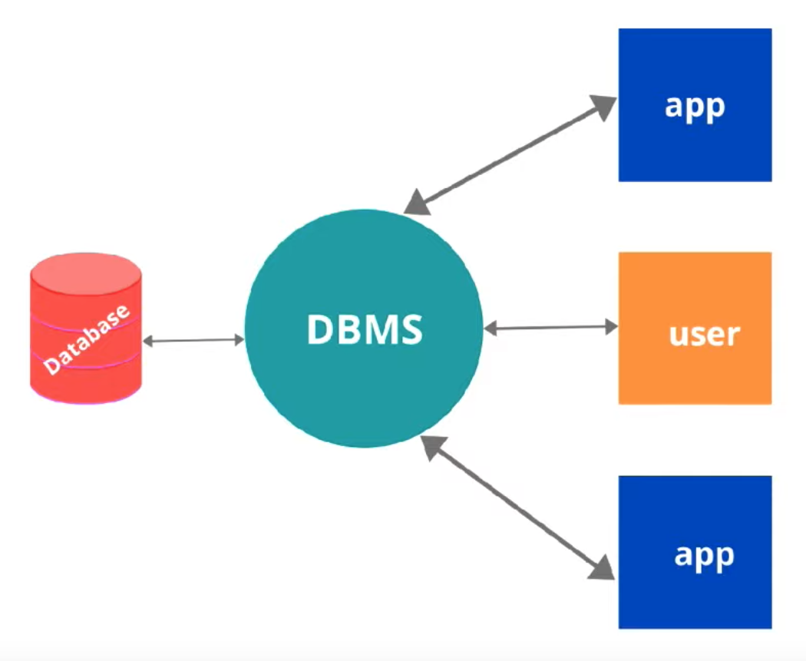
RDBMS vs Database

Slide 6
SQL
Structured Query Language (SQL). Also referred to as “SEQUEL”
SQL is a programming language used to interact with Relational Database Management System.
SQL is primarily used in RDBMS.
All major RDBMS like Oracle, MySQL, MSSQL, PostgreSQL etc use SQL.
Using SQL, you can:
Read data from a RDBMS
Write data into a RDBMS
Create, modify or delete database
Analyze data
Build reports

Slide 7
How data is stored in RDBMS
In RDBMS, data is stored in multiple tables.
Each table can have a set of rows and columns.
Different tables will be related to each other through certain columns forming relationship between these tables.

Slide 8
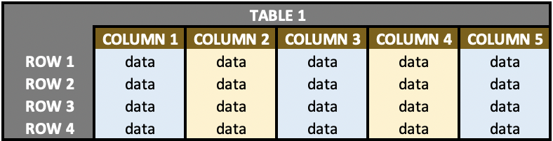
Sample RDBMS table data

Slide 9
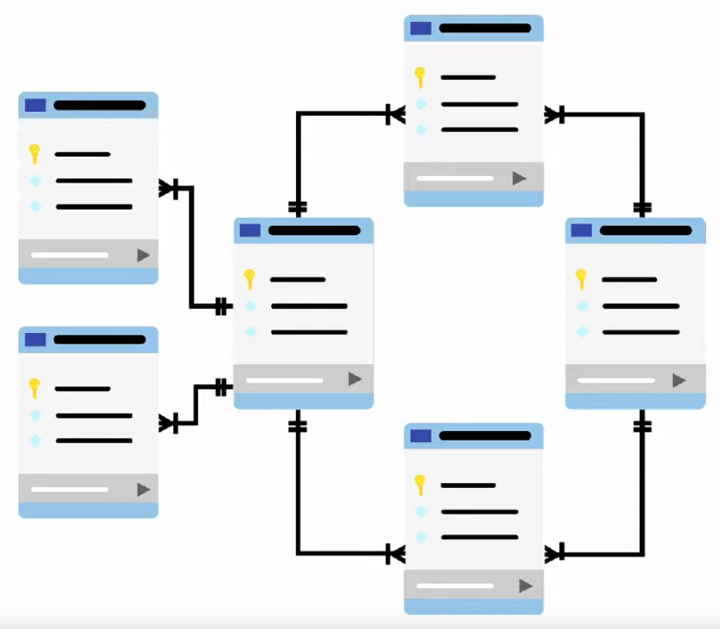
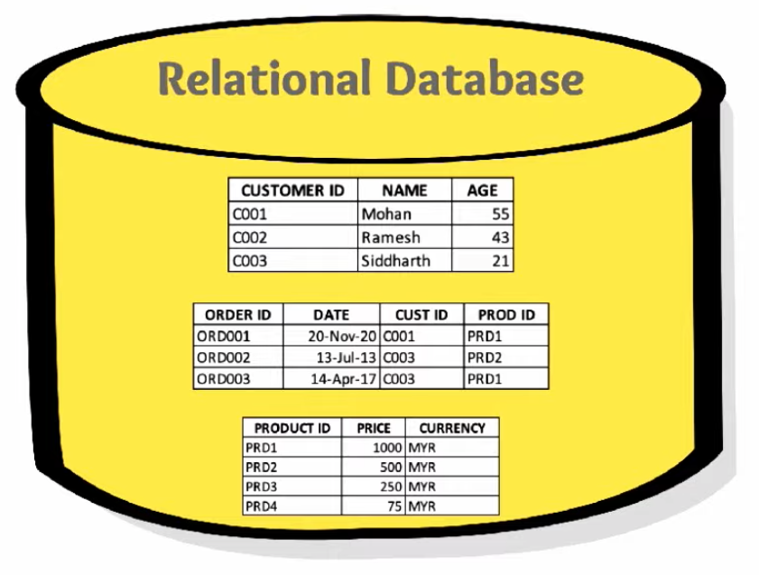

Slide 10
MySQL Oracle PostgreSQL MSSQL
Is SQL different across these different RDBMS ?

Slide 11
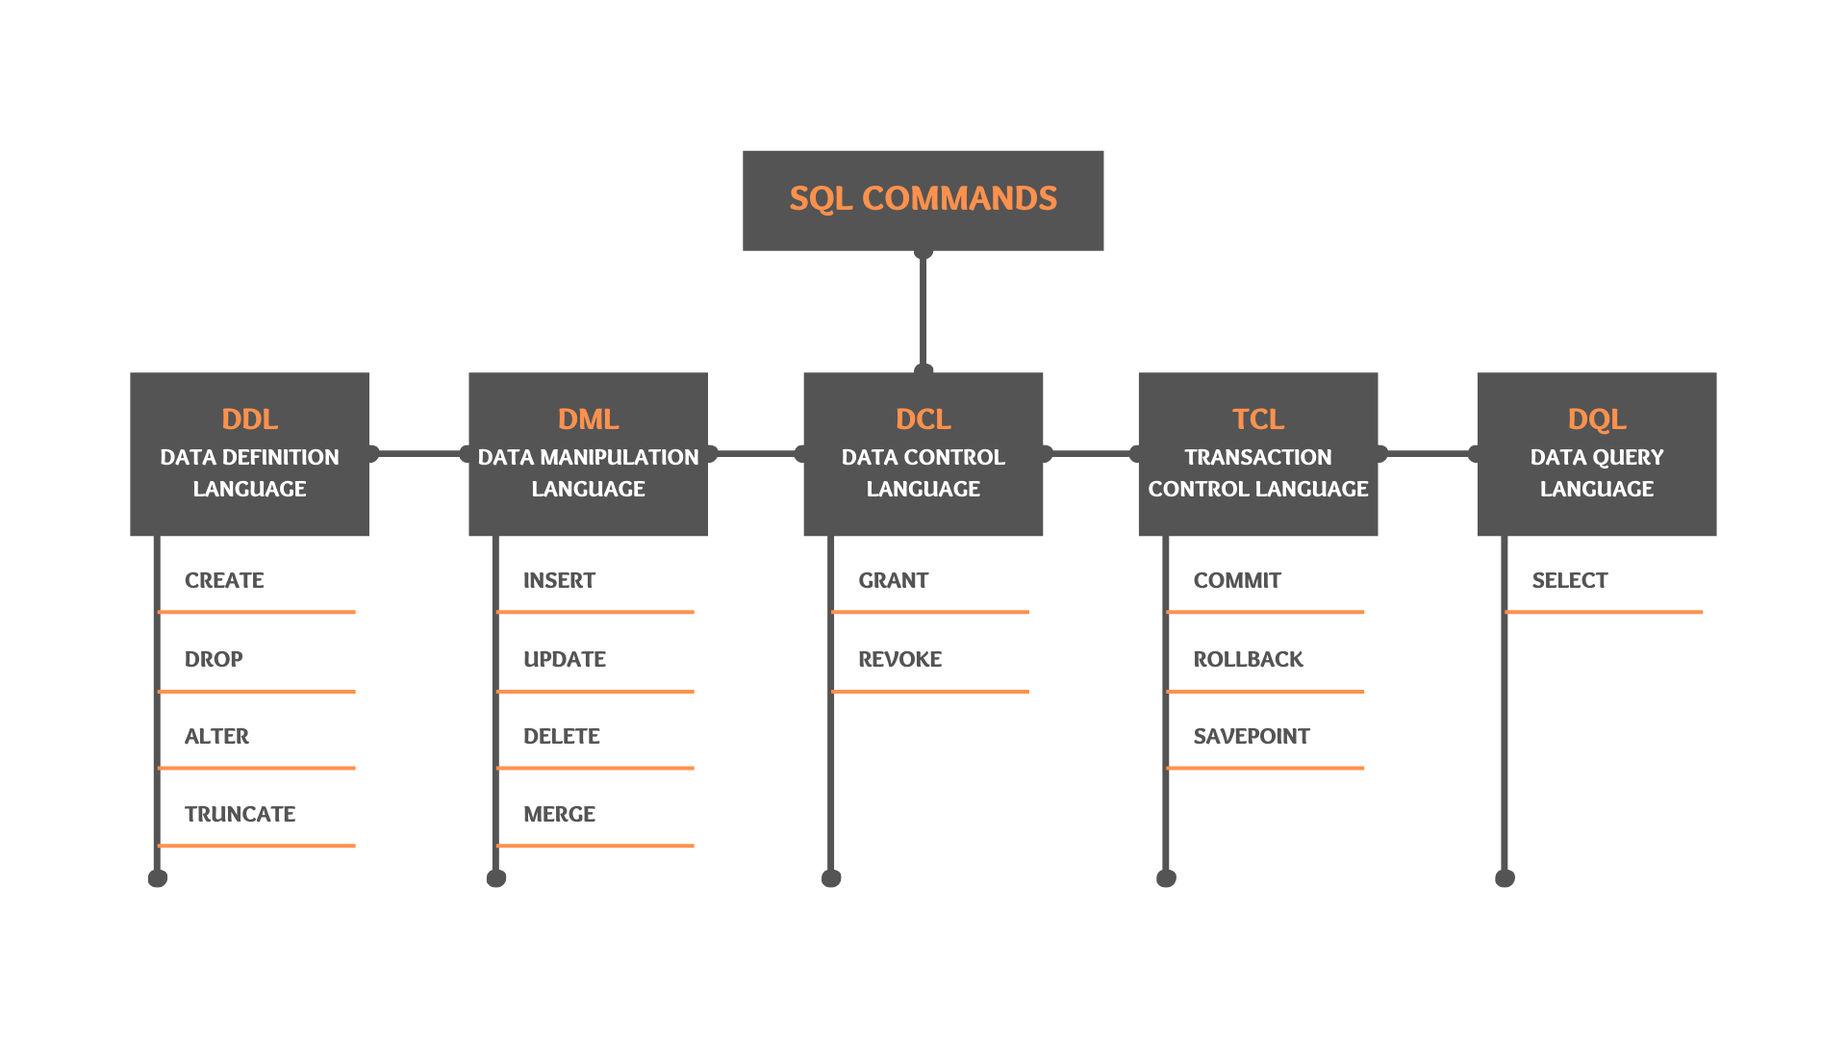

Slide 12
DDL Commands
Data Definition Language
Used to define the structure of a database object such as Table, Views, Procedure, Function etc.
Commands include:
CREATE
ALTER
DROP
TRUNCATE

Slide 13
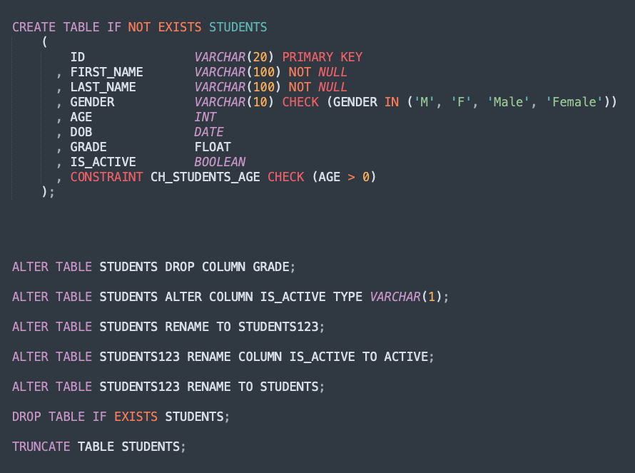

Slide 14
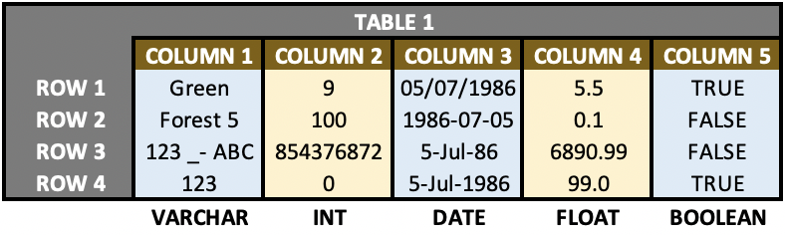
Data Types:
INT
VARCHAR
DATE
FLOAT
BOOLEAN

Slide 15
Constraints
CHECK constraint allows you to control the values that can be inserted into a column.
By applying NOT NULL constraint on a column, you make sure that this column will never have NULL values.
UNIQUE constraint makes sure that the values in your column are always unique. It can have NULL values.
A table can only have one PRIMARY KEY constraint. Primary key constraint can either be applied to a single column or to a combination of different columns. If a column (or if a combination of multiple columns) is defined as a primary key, then this column/columns will always have unique values across all the rows of that table. Also, primary key column cannot have null values hence primary key can be treated as a combination of UNIQUE and NOT NULL constraints.
FOREIGN KEY constraint can be used to form relation between tables. It basically helps to create a master child relation between 2 tables.

Slide 16
DML Commands
Data Manipulation Language
DML commands are used to load, modify and remove data from the database.
Commands include:
INSERT
UPDATE
DELETE
MERGE

Slide 17
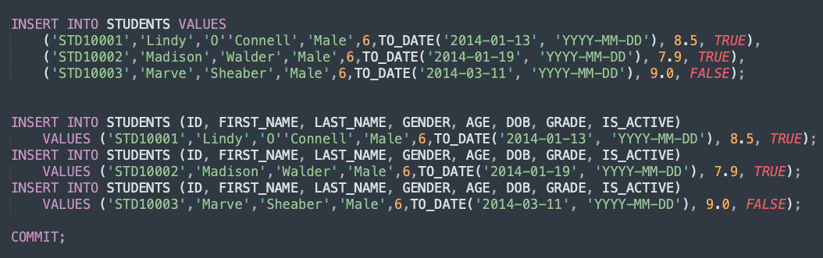
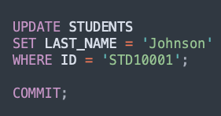
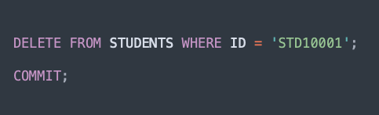

Slide 18
DQL command
Data Query Language
Includes only the SELECT statement
Can be used to read data from one or multiple tables.
Contains following clauses:
SELECT – list of columns
FROM – list of tables
WHERE – filter conditions and join conditions
Can also include following clauses:
GROUP BY – Grouping of data based on specified column(s)
HAVING – Filter condition for the grouped data

Slide 19
SQL Queries
JOINS
INNER JOIN
LEFT OUTER JOIN
RIGHT OUTER JOIN
FULL OUTER JOIN
SELF JOIN
NATURAL JOIN
CROSS JOIN
Subqueries
Group by and HAVING clause
Aggregate functions
MIN, MAX, AVG, SUM, COUNT
Operators
Logical operators (AND, OR, IN, NOT IN, LIKE, NOT LIKE, BETWEEN, EXISTS)
Arithmetic operators (+, -, /, *, % etc)
Comparison Operators (=, <>, !=, <, >, <=, >=)
DISTINCT clause
CASE Statements
Concatenation

Slide 20
Assignment SQL Queries
Write a SQL query to find the policies which have never done any claims.
Write a SQL query to find the policies whose transactions have never failed and have never done any claims.
Find the benefit whose policy was issued prior to risk commencement.
Which are the products currently not taken by inforce policies.
Find the policy and its status with the least sum assured
Fetch the policy id, benefit id, policy status and product name of all policies who are not inforce.
Find the policies who do not have any benefits.
Find the oldest policy with at least one benefit.
Find all the claims transaction that belong to Health Insurance product.
Write a SQL query to find the details of the product which has sold the most.
Using below tables:
REFERENCE_LOOKUP
TRANSACTION_MASTER
BENEFIT_MASTER
POLICY_MASTER
PRODUCT_MASTER
*SQL Scripts provided separately

Slide 21
References:
W3Schools
PostgreSQL Tutorial
My YouTube SQL Tutorial video
Recommended SQL Course on LearnSQL.com

Slide 22

Thank you
Questions?

