Slide 1
OBE Implementation
Module-11:Course Utilization Setting
Submitted By
AP22110010225 – Chelikani Aakash
AP22110010230 – Mopuru Tharun
AP22110010256 – Potugari Venkata Ravi Teja
AP22110010265 – Tentu Navadeep Ram
AP22110010266 - Kocherlakota Sundaram
CSE | 6th Semester | Regulation

Slide 2
Introduction to Project
Our University (herewith considered as SRM-AP) is going to implement OBE(Outcome Based Education) in our university and we are assigned in the project to develop a CURD(Create,Update,Retrieve and Delete) windows and mobile application using JAVA programming and Android studio for the same.

Slide 3
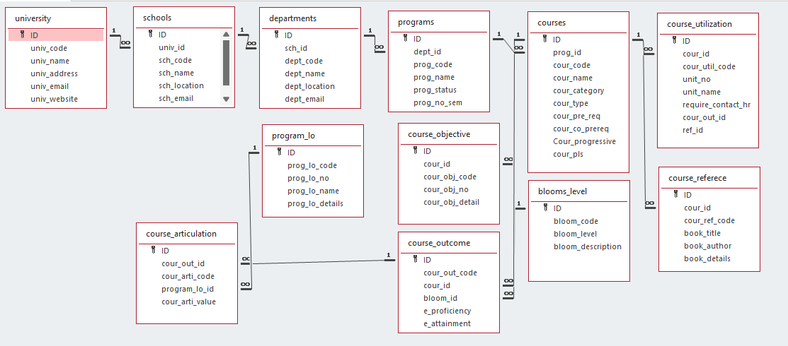
Architecture Diagram

Slide 4
Module Description : Course Utilization Setting
The Course Utilization Setting module is designed to Create, Update, Retrieve, and Delete (CURD) details related to course utilization.
This module allows users to manage information such as course IDs, utilization codes, unit numbers, unit names, required contact hours, course outcome IDs, and reference IDs.
All the entered and managed data is stored in the SQLite3 table, ensuring structured and efficient database management within the application

Slide 5
Course Utilization Setting: Field/table details
Field Name | Data Type
Id | Integer
Cour_id | String
Cour_util_code | String
Unit_no | String
Unit_name | String
Require_contact_hr | String
Cour_out_id | String
Ref_id | String

Slide 6
Course Utilization Setting:Programming Details
File name: narst_ CourseUtilizationSetting
Function/method name
Create:narst_ CourseUtilizationSetting _create
Update:narst_ CourseUtilizationSetting_update
Retrieve:narst_ CourseUtilizationSetting _retrieve
Delete:narst_ CourseUtilizationSetting _delete

Slide 7
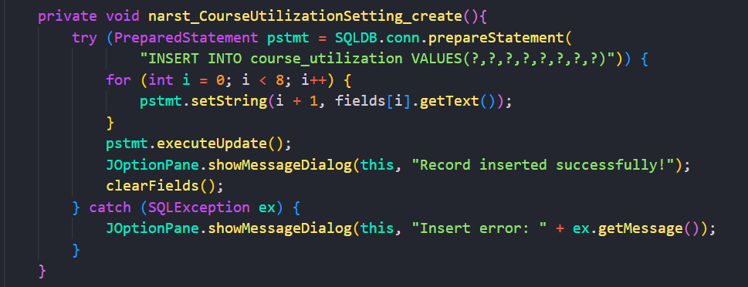
Sample Source Code [Insertion]

Slide 8
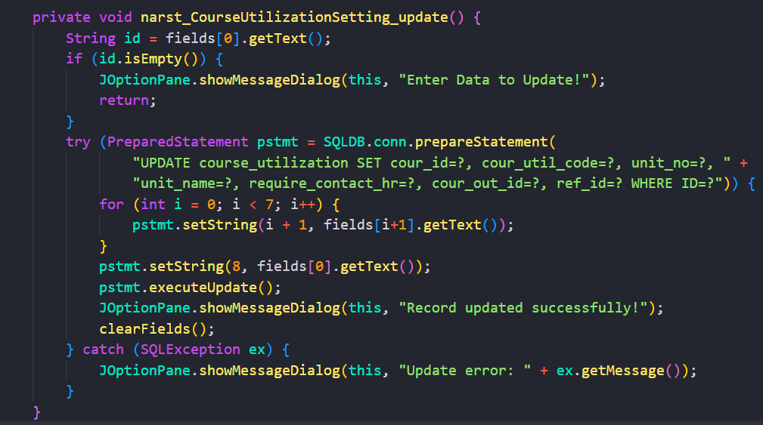
Sample Source Code [Update]

Slide 9
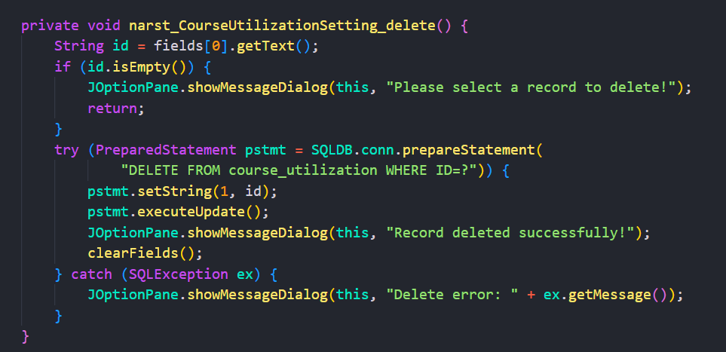
Sample Source Code [Deletion]

Slide 10
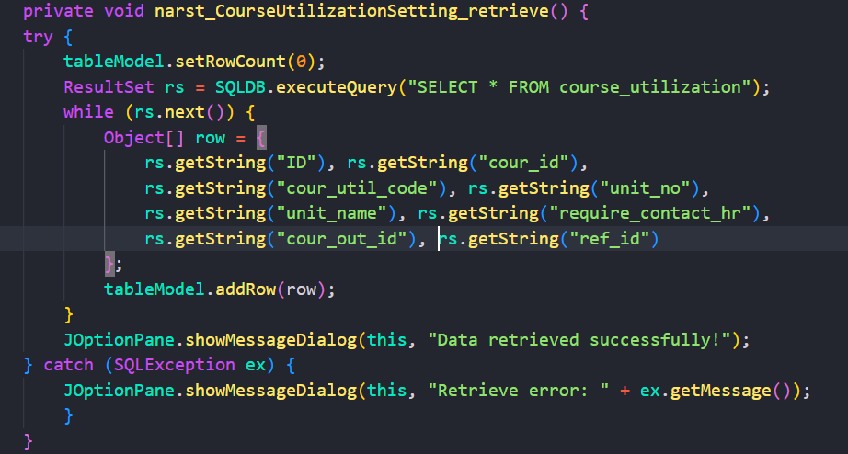
Sample Source Code [Retrieval]

Slide 11
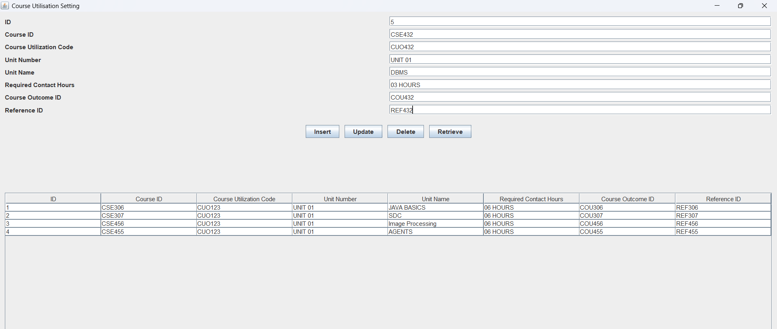
Sample Screen Shots[Insertion]

Slide 12
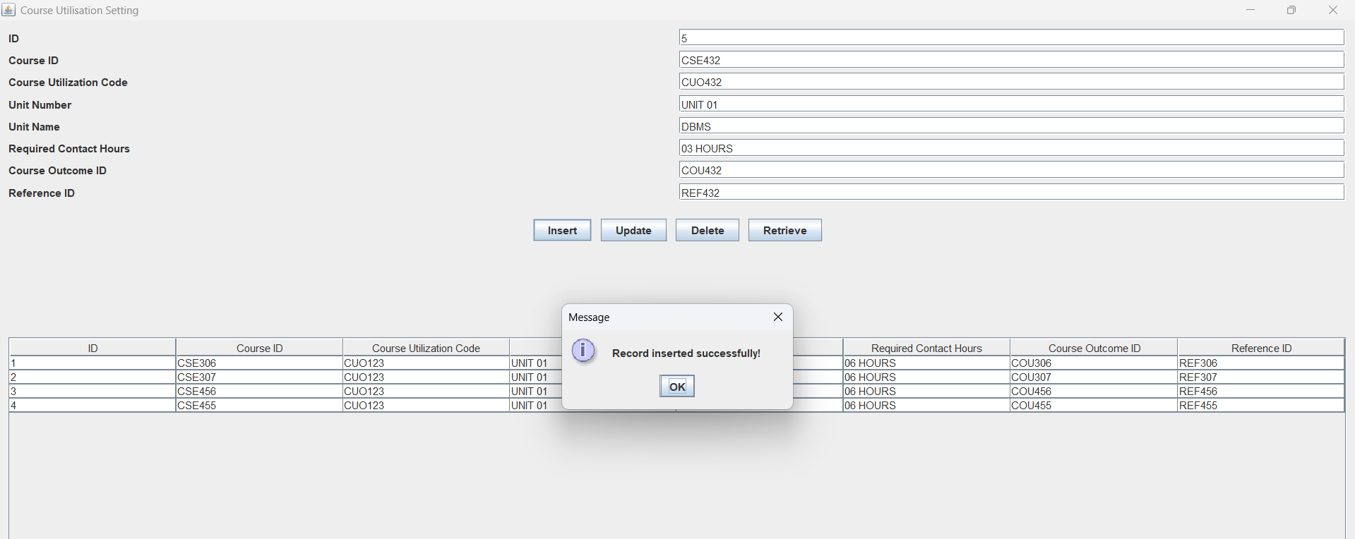
Sample Screen Shots[Insertion]

Slide 13
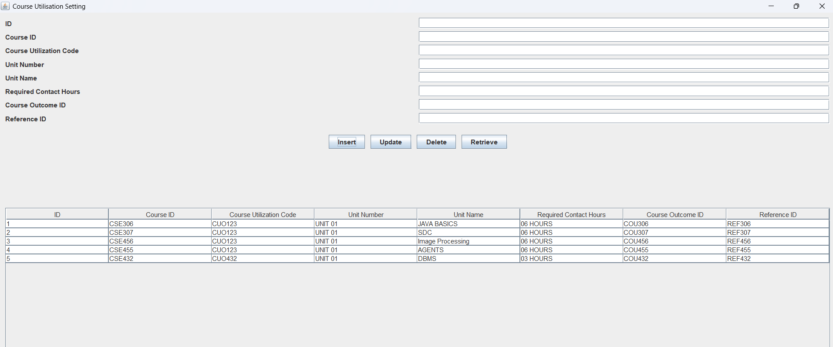
Sample Screen Shots[Insertion]

Slide 14
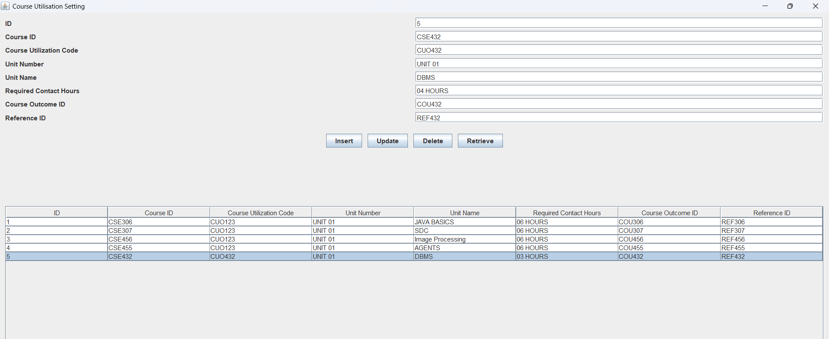
Sample Screen Shots[Updation]

Slide 15
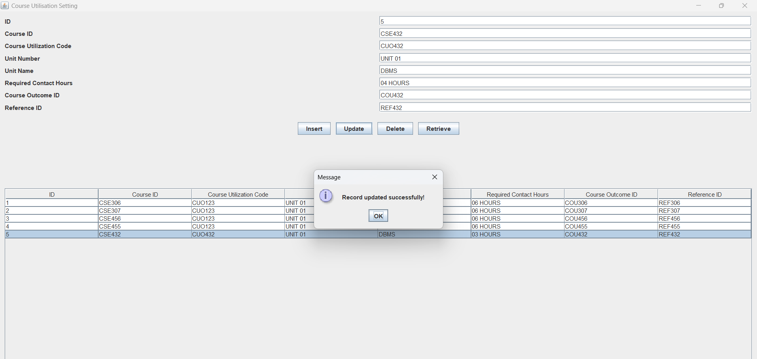
Sample Screen Shots[Updation]

Slide 16
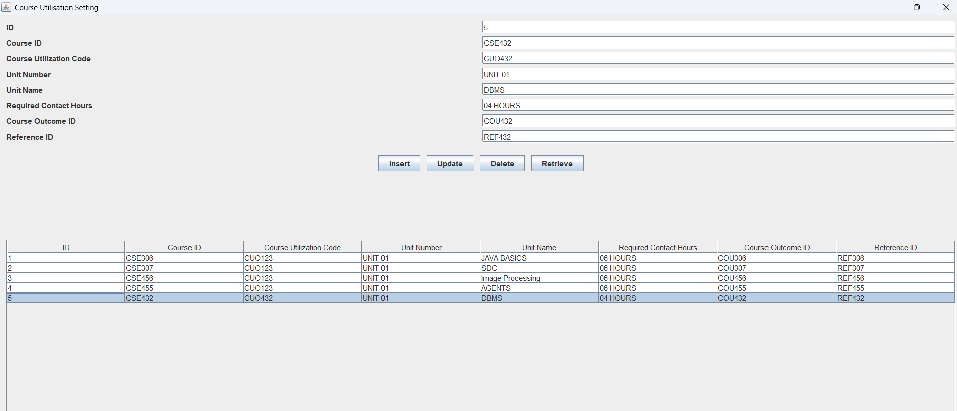
Sample Screen Shots[Deletion]

Slide 17
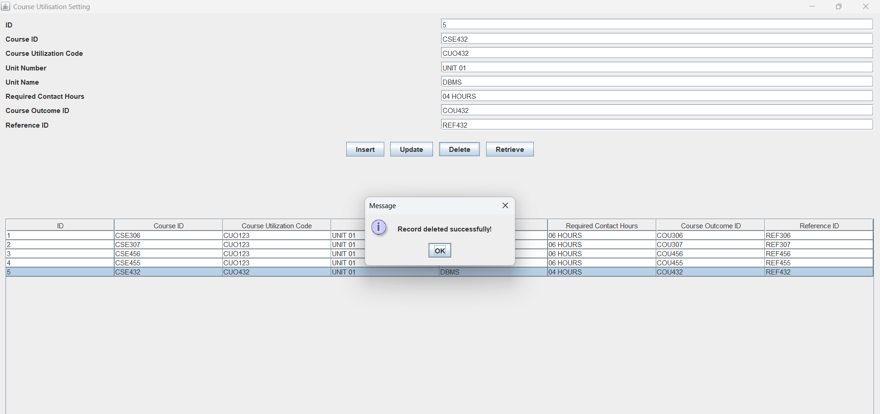
Sample Screen Shots[Deletion]

Slide 18
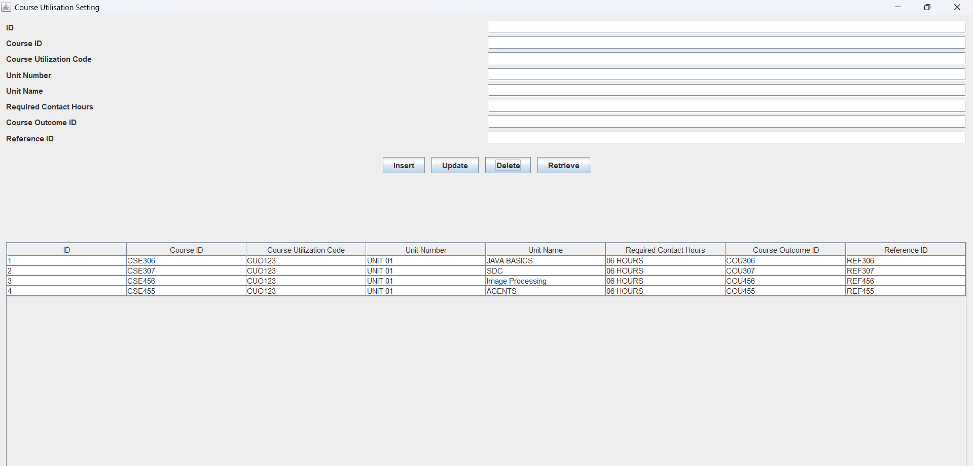
Sample Screen Shots[Deletion]

Slide 19
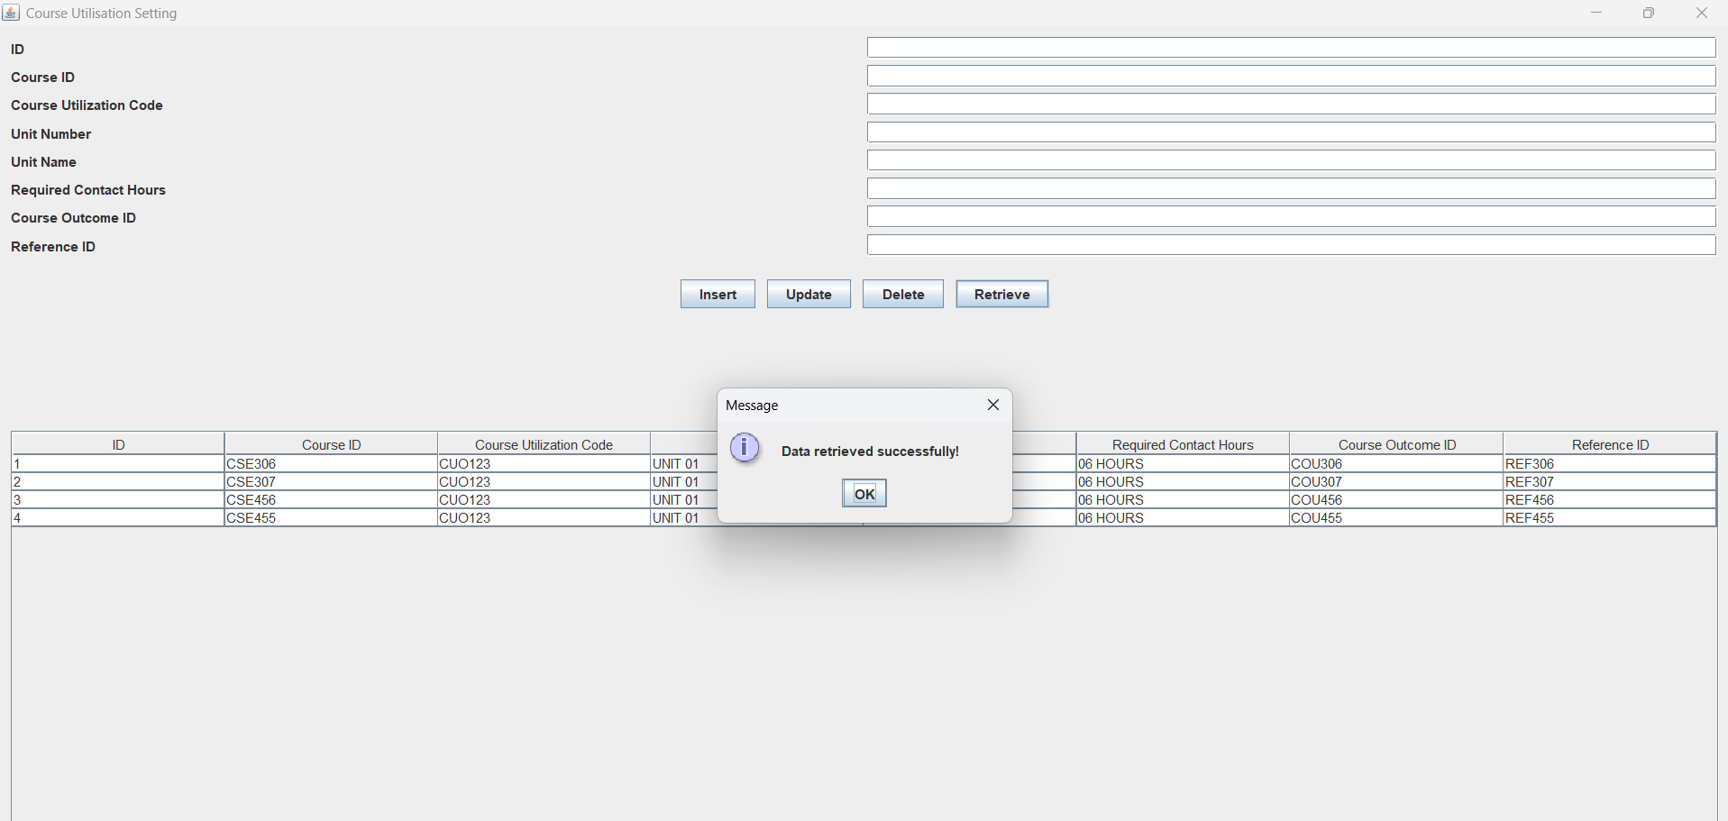
Sample Screen Shots[Retieval]

Slide 20
Conclusion
In conclusion, the Course Utilization Setting module successfully demonstrates the effective implementation of an OBE (Outcome Based Education) framework within the SRM-AP university setting.
The module is a robust solution for managing key aspects of course data through its comprehensive CURD operations Create, Update, Retrieve, and Delete.
By integrating a structured SQLite3 database with Java-based application programming, the system ensures efficient data management, thereby promoting reliability and user accessibility.

Slide 21
Thank You

