Slide 1
Employee-Attrition Visualization
By krithika V

Slide 2
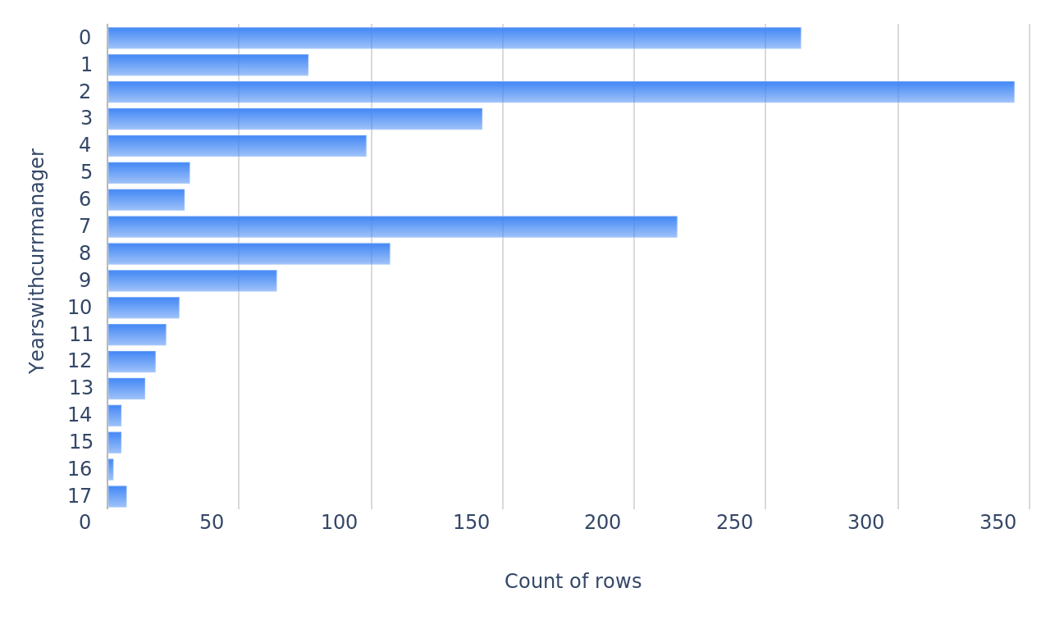
1. Displaying the distribution of years with the current manager.
YearsWithCurrManager
2

Slide 3
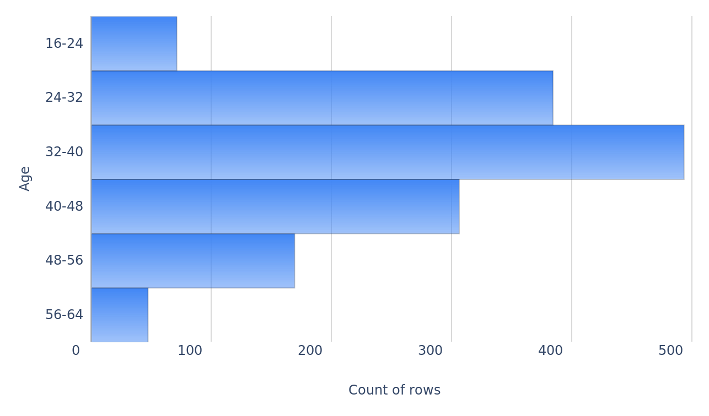
2. Displaying the distribution of employee ages.
Ages
3

Slide 4
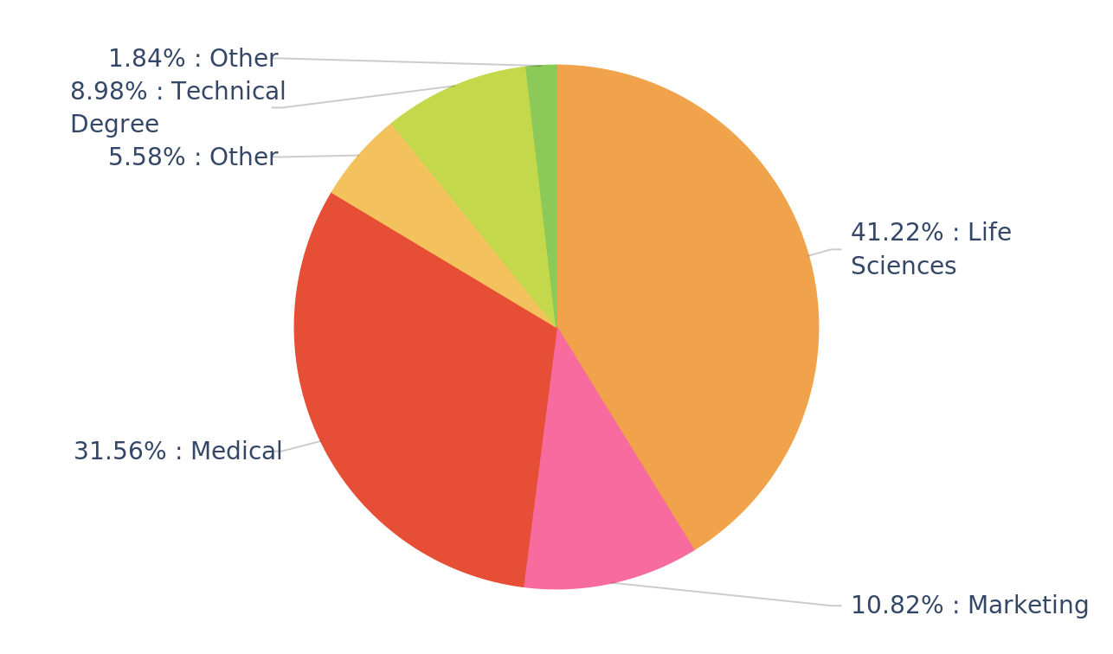
3. Showing the distribution of education fields.
EducationField
4

Slide 5
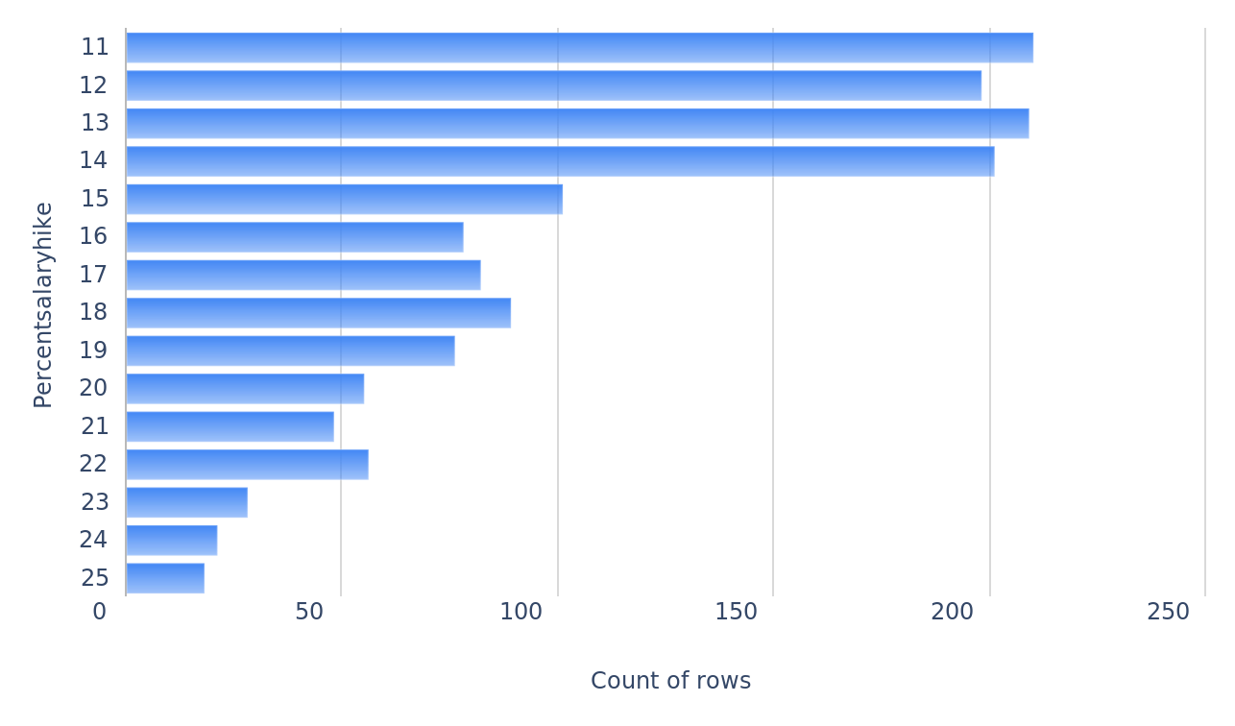
4. Displaying the distribution of percent salary hikes.
PercentSalaryHike
5

Slide 6
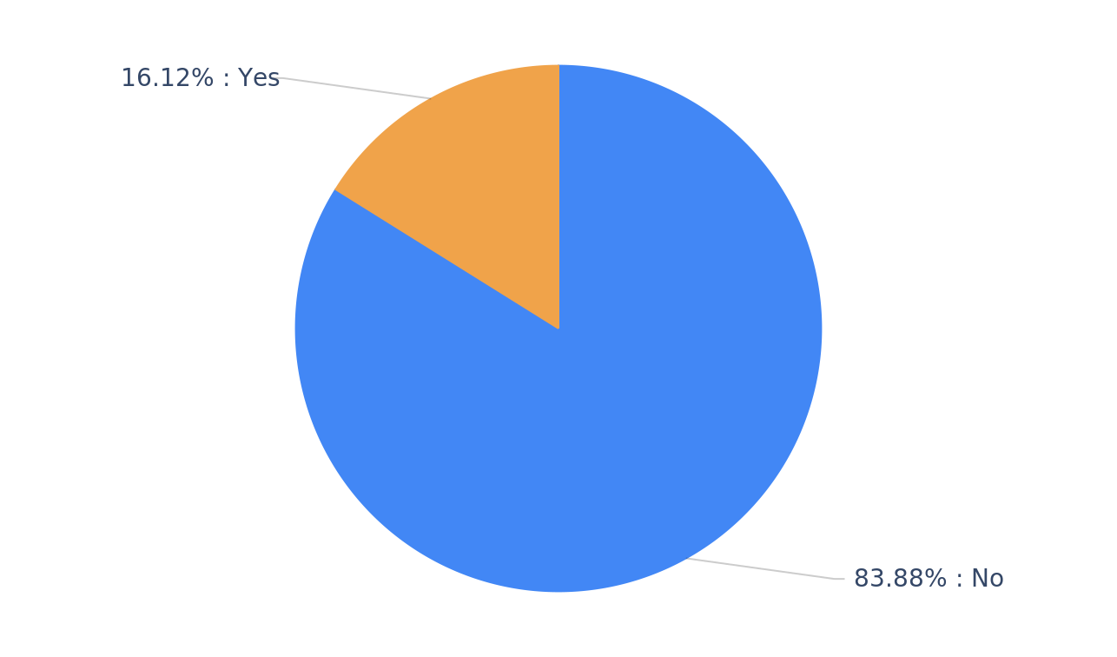
5. Showing the distribution of attrition indicators.
Attritions
6

Slide 7
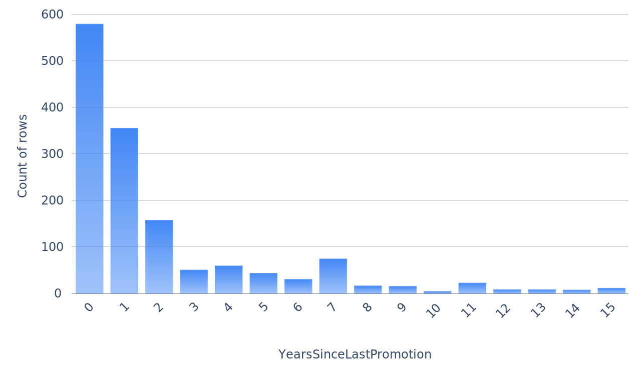
6. Displaying the distribution of years since the last promotion.
YearsSinceLastPromotion
7

Slide 8
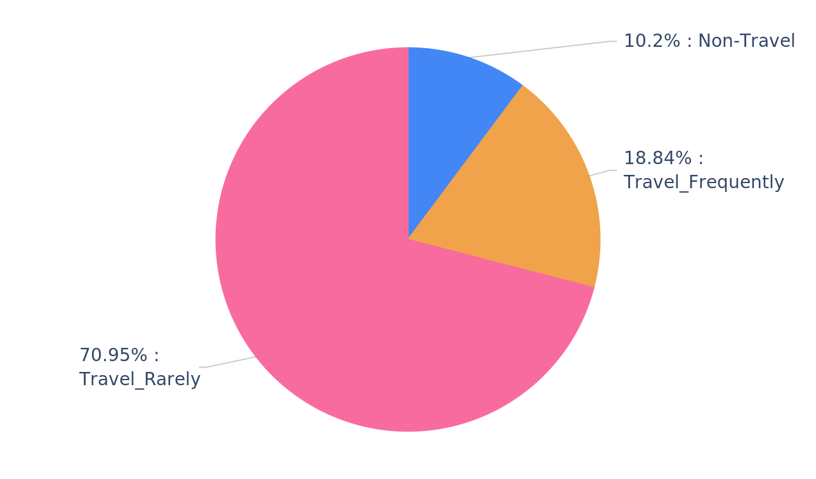
7. Showing the distribution of business travels.
BusinessTravel
8

Slide 9
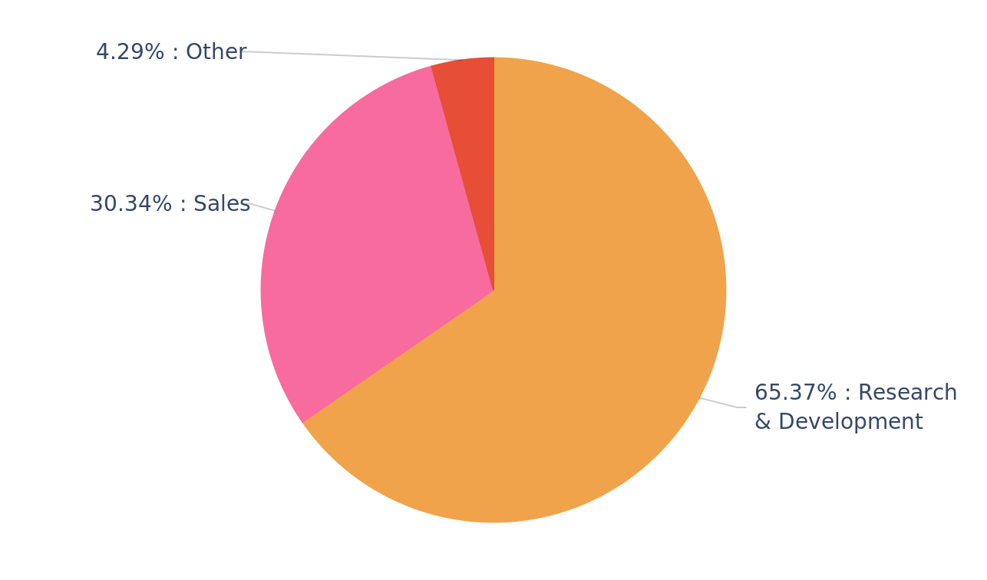
8. Showing the distribution of departments.
Departments
9

Slide 10
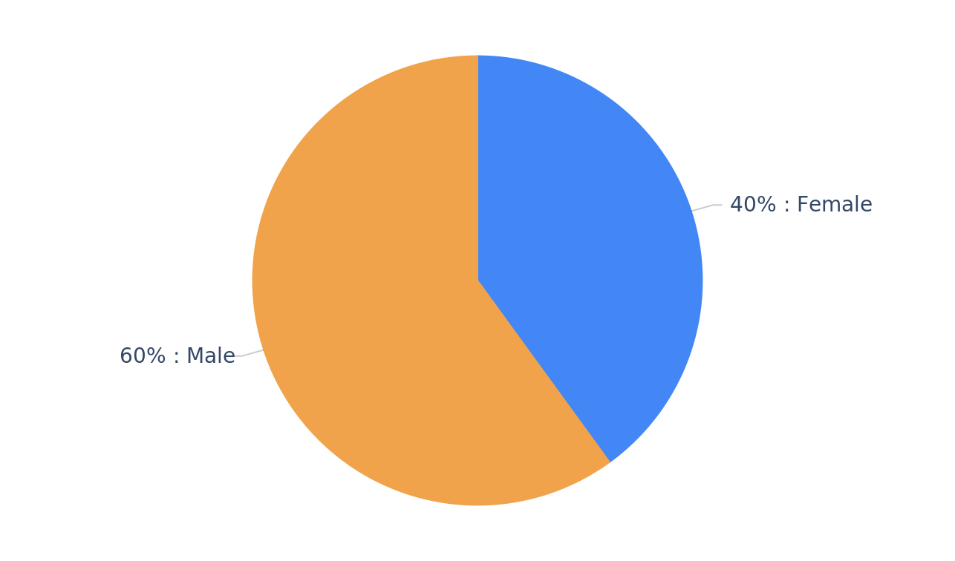
9. Showing the distribution of genders.
Genders
10

Slide 11
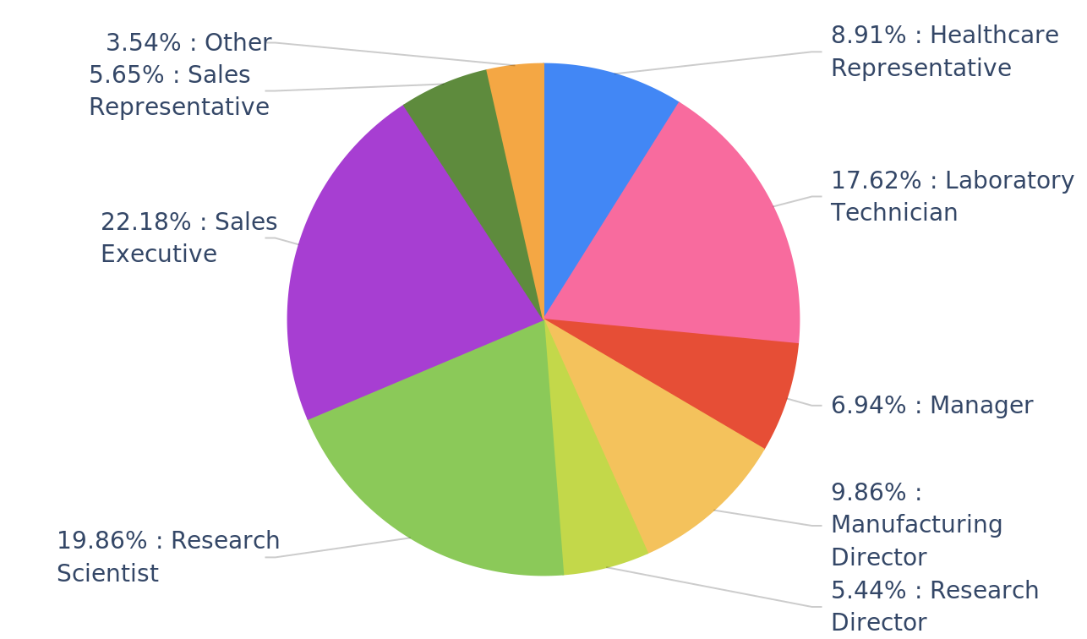
10. Showing the distribution of job roles.
JobRole
11

Slide 12
THANK YOU

