Slide 1


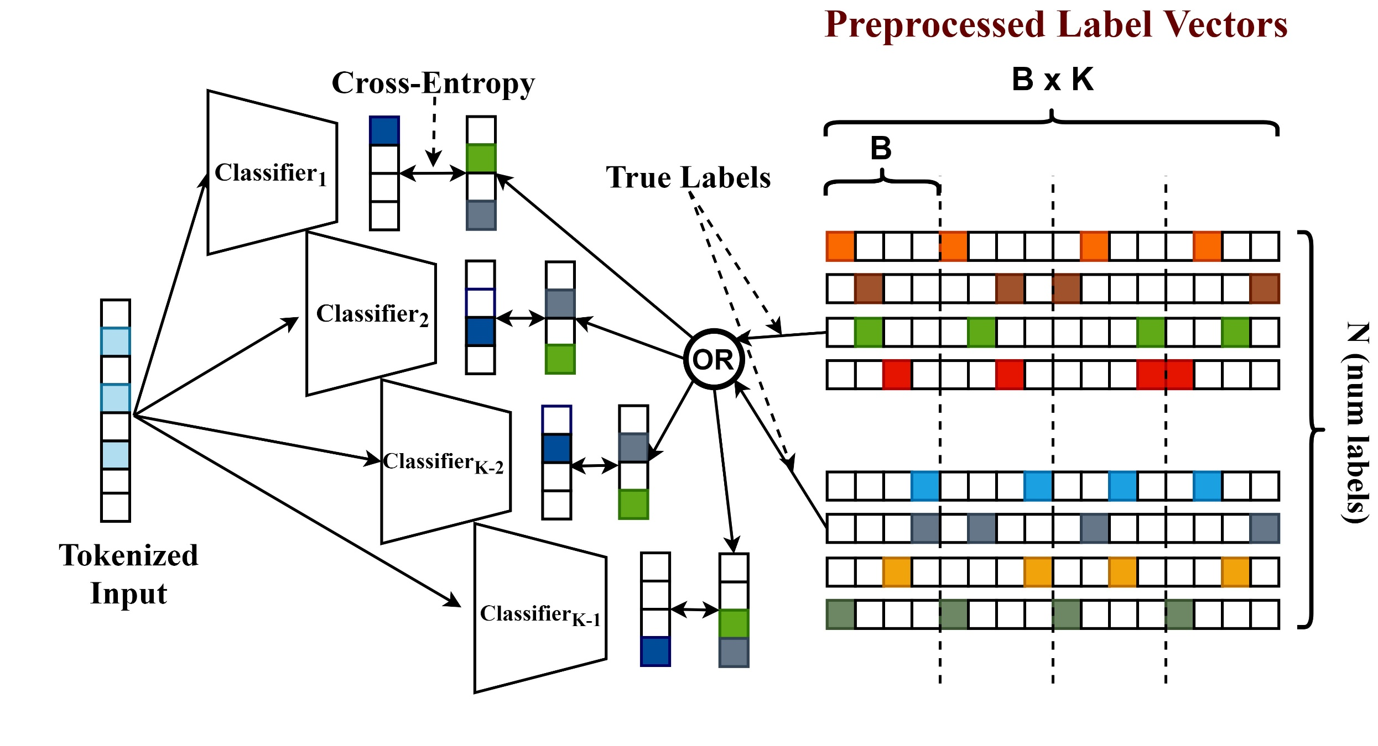
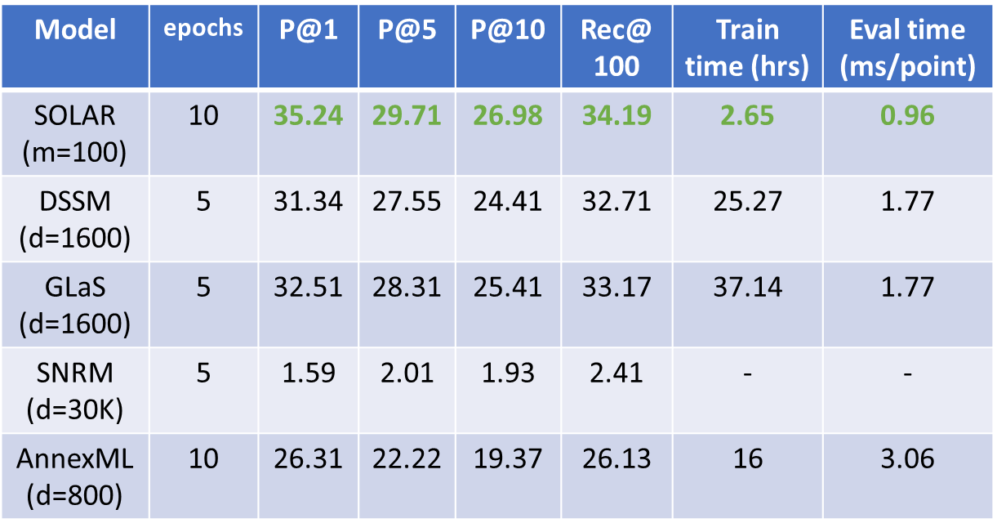
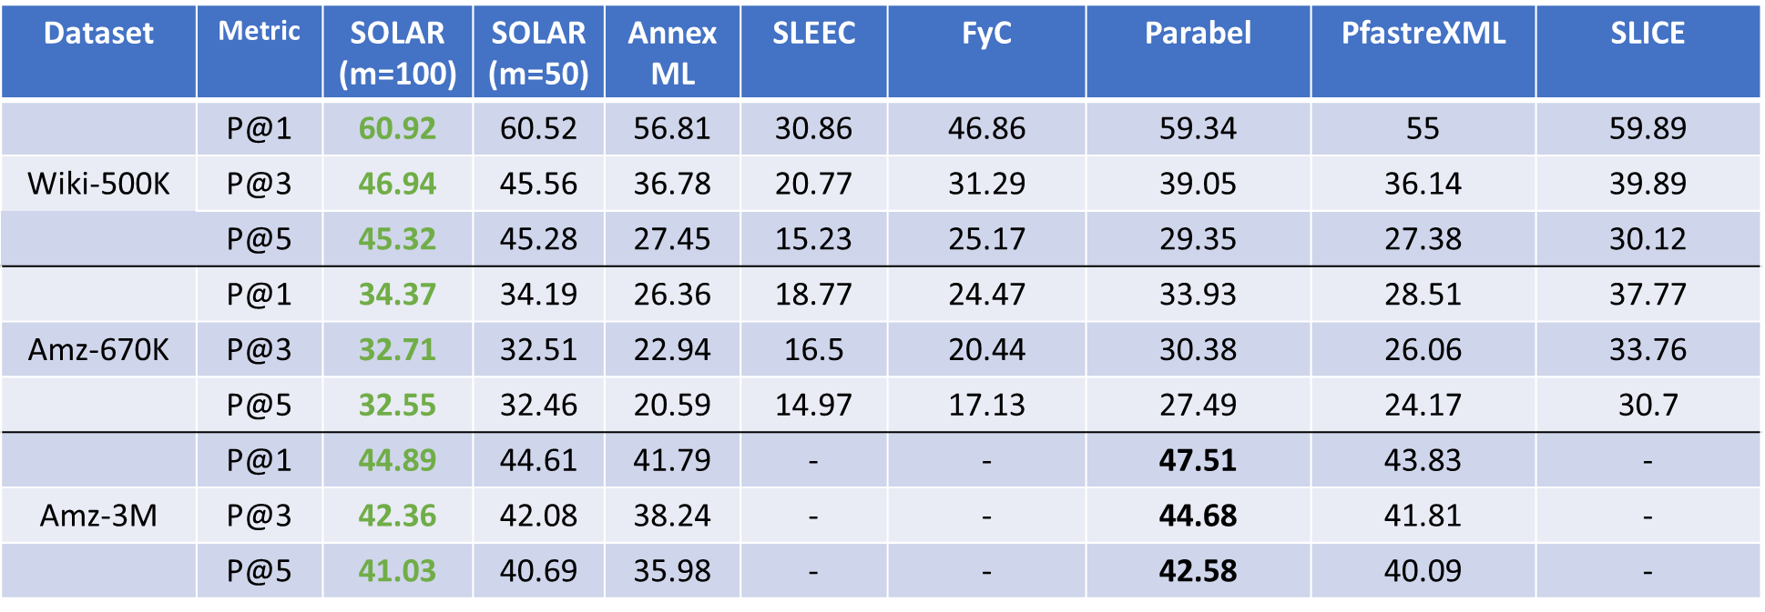
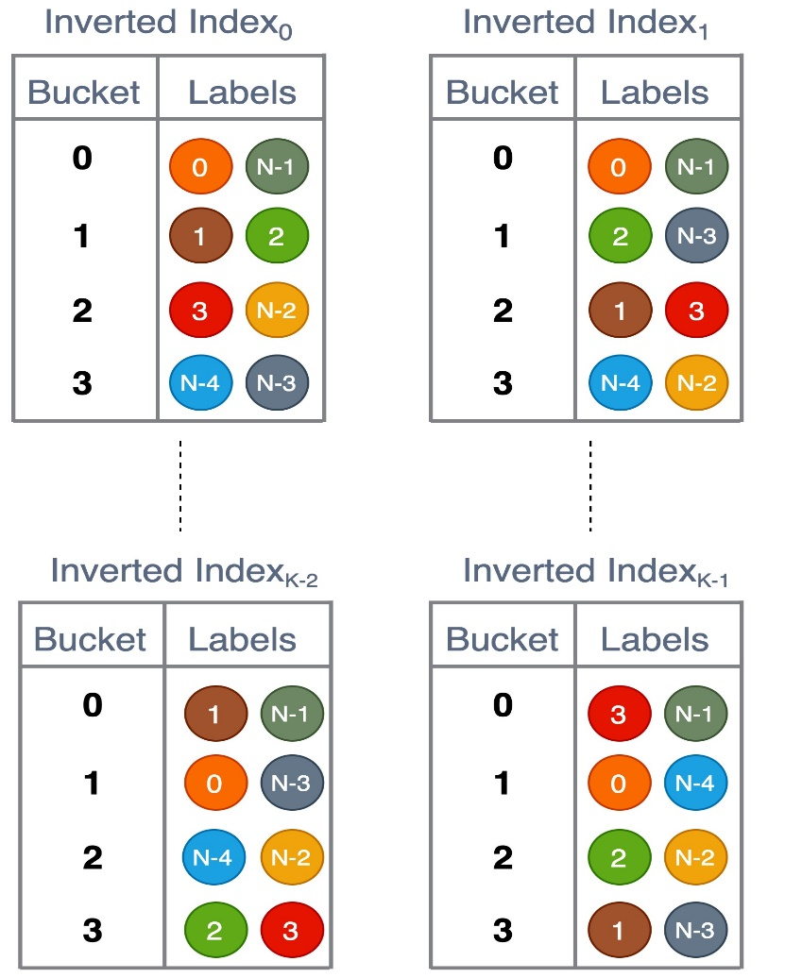
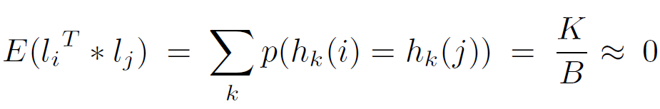
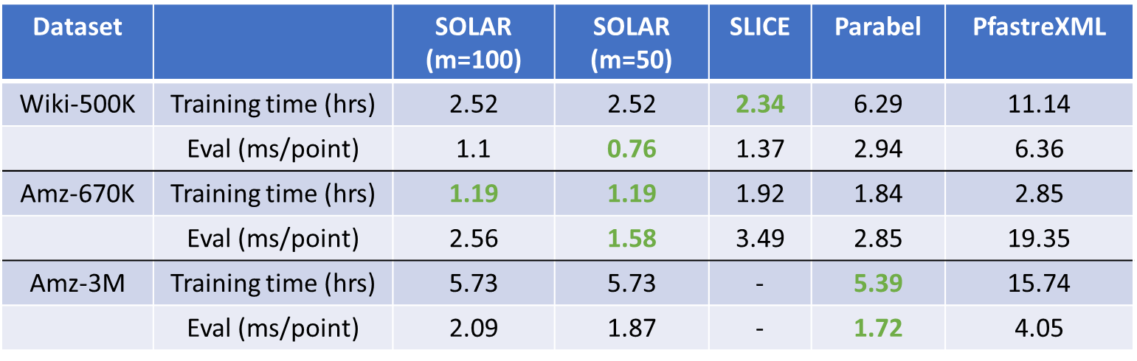
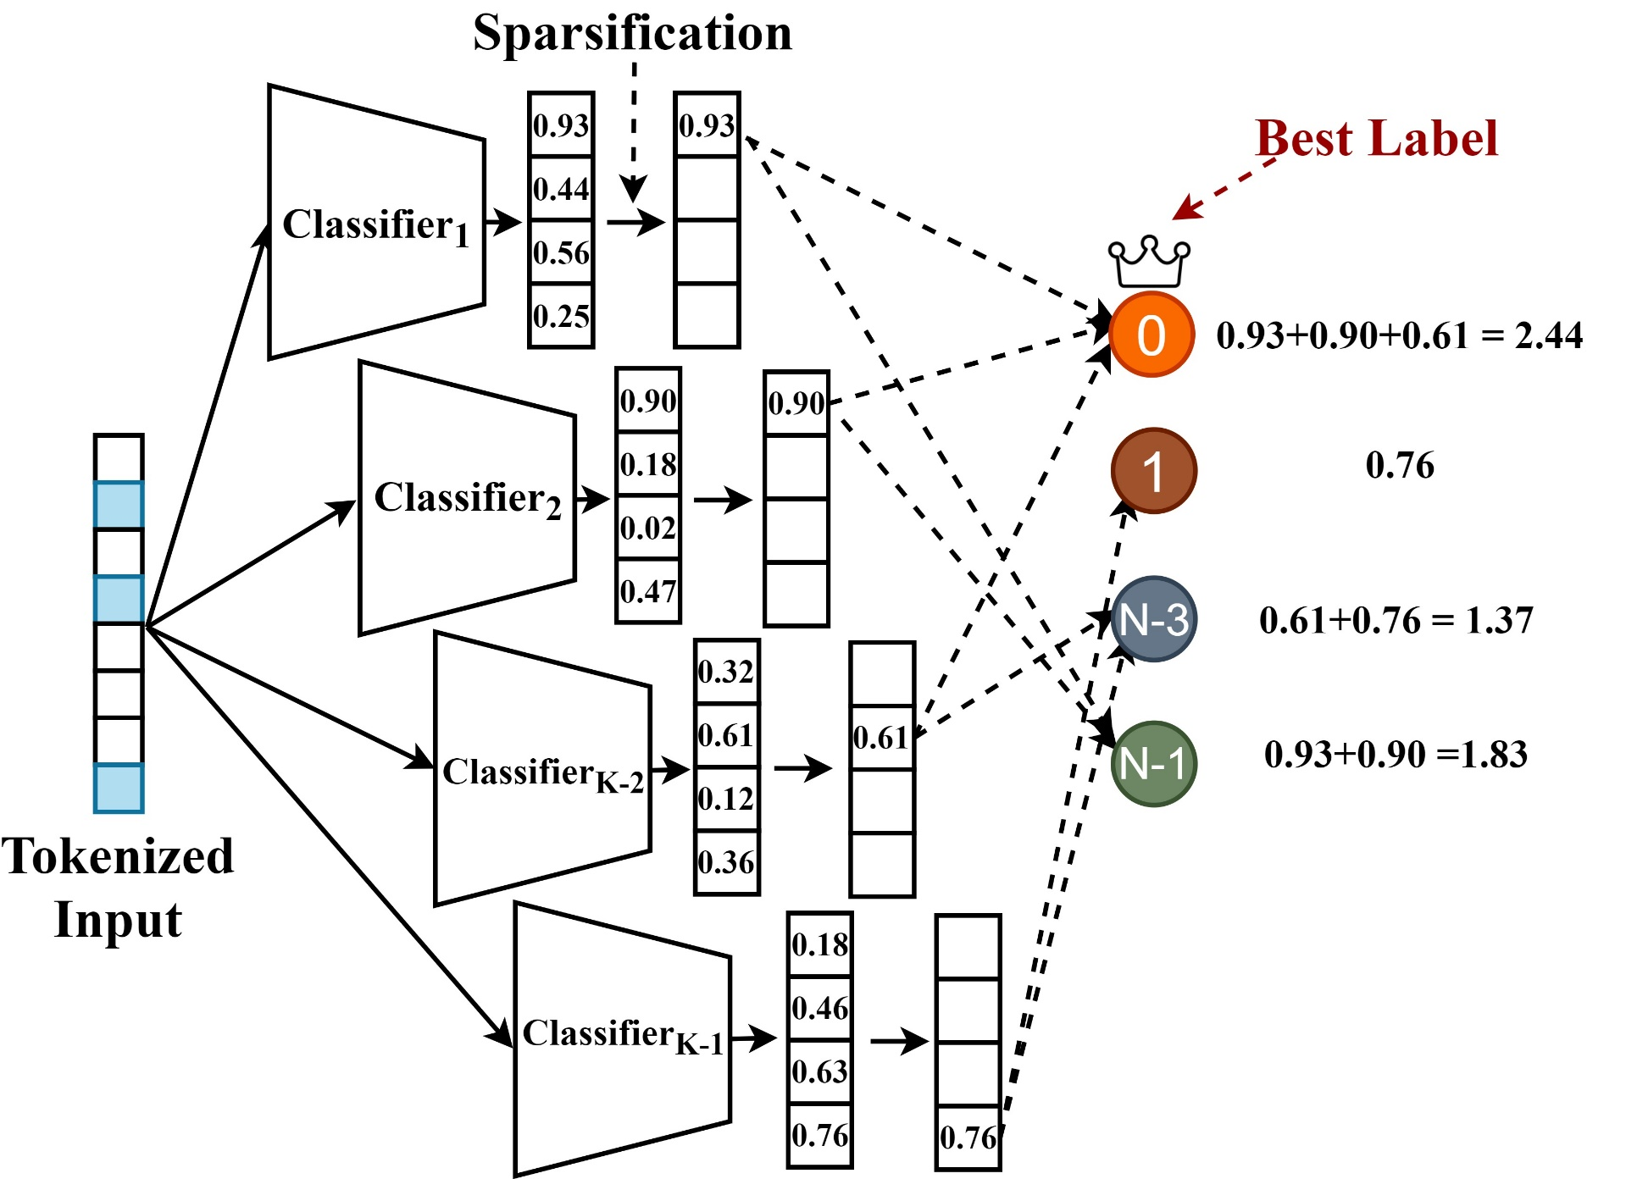
SOLAR: SPARSE ORTHOGONAL LEARNED AND RANDOM EMBEDDINGS
Tharun Medini¹, Beidi Chen², Anshumali Shrivastava¹
¹Rice University, ²Stanford University
Problem Statement
Training
Product-to-Product Recommendation
This work proposes SOLAR, a high-dimensional and ultra-sparse embedding learning method, which is a significantly superior alternative to dense low-dimensional embedding for both query efficiency and accuracy in Search Engines. The advantage is 4-fold
Matrix Multiplication is replaced by cheap Inverted-Index Lookups
Load-balanced Inverted Indexes
Lower Embedding Memory
Zero-communication distributed training of embeddings
Unique Design Choices:
Training a high dimensional embeddings needs huge memory. To facilitate trivial distribution across GPUs, we design label embeddings to be super-sparse and orthogonal.
We spread out the non-zeros of label vectors uniformly across the high dimensional space and fix the label vectors and only learn the query vectors.
Multilabel Datasets
Comparison of SOLAR against DSSM, DSSM+GLaS, and SNRM baselines. SOLAR’s metrics are better than the industry-standard DSSM model while training 10x faster and evaluating 2x faster (SOLAR-CPU vs DSSM-GPU evaluation). GLaS regularizer improves the metrics but still lags behind SOLAR.
Schematic diagram for label vector construction (on the right) and the training process (on the left). Each label vector is B*K dimensional divided into K components of length B. Each vector is K-sparse with exactly one non-zero index in each component (colored on the right). The components are separated by dotted vertical lines. For a given input, we perform an 'OR' operation over the true label vectors and feed the resultant pieces to independent small classifiers.
Extreme Classification Datasets
Our Proposal: SOLAR (Sparse Orthogonal Learned and Random Embedding)
Inverted Index
Notations: N denotes the total number of labels. D is the sparse vector dimension. K is the number of non-zeros in label vectors. B=D/K is the number of buckets in each component of the vector.
Preprocessing:
Partition D vector into K chunks
Each chunk has B buckets with exactly one non-zero index
The single non-zero index is picked randomly in the range of B for each of the K components
The expected dot-product between any two label vectors l_{i} and l_{j} is
Training:
Lookup all true label vectors for an input
Perform an ‘OR’ operation over the respective sparse vectors
Partition the combined label vector into K chunks
Train K feed-forward networks to predict one each of the K chunks
Inference:
Pass an input through all K models
Sort the B scores in each model to get top-m buckets
Query the m*K buckets in the inverted index and get the union of all candidate labels
Noisy candidates: Due to random initialization of label vectors, irrelevant labels are pooled together. We will omit all labels below a certain frequency threshold t across K models.
For each candidate, sum the predicted probability scores for the corresponding bucket and sort for the top results
Inverted-Index construction for the label vectors shown in the top figure. We construct one index for each of the K chunks. Each bucket will have the same number of labels by design (Load-Balanced)
SOLAR vs popular Extreme Classification benchmarks. Embedding models AnnexML and SLEEC clearly underperform compared to SOLAR. SOLAR even outperforms the state-of-the-art non-embedding baselines like Parabel and Slice. The gains in P@5 are particularly huge (45.32% vs31.57%). SLEEC and SLICE do not scale up to 3M labels (corroborated on XML-Repo)
Inference
Training and Evaluation speeds against the fastest baselines
References
[1] Medini, Tharun, et al. “SOLAR: Sparse Orthogonal Learned And Random”, ICLR 2021 .
[2] Medini, Tharun, et al. “MACH: Extreme Classification in Log-Memory”, NeurIPS 2019 .
Contact
Schematic diagram for Inference. We first get K probability vectors of B dimensions each. Then we only retain the top-m buckets after sparsification (m=1 in above figure. For our experiments, m varies among 50 and 100). We accumulate the candidate labels based on inverted-index for these top-buckets and aggregate their scores and identify the best labels
Tharun Medini: tharun.medini@rice.edu
Anshumali Shrivastava: anshumali@rice.edu
RUSH-LAB: rush.rice.edu

