Slide 1

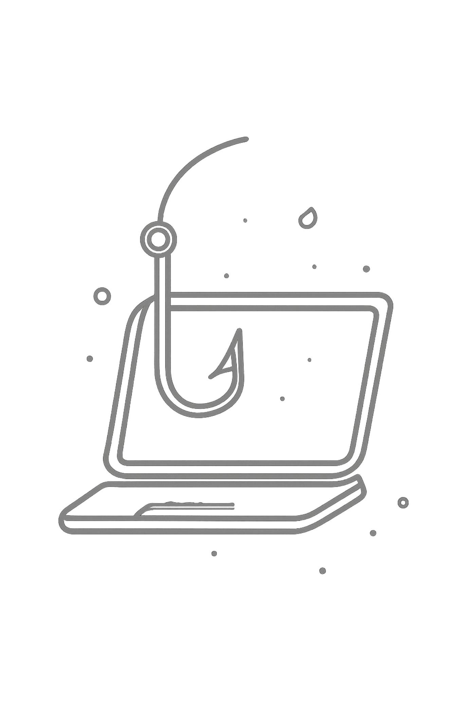
CODEALPHA CYBER SECURITY INTERNSHIP
Phishing Awareness Training
Task 2 · Prepared by Tharun R · Cyber Security Department
Understand phishing attacks, recognize suspicious emails and websites, and adopt safe practices to protect yourself and your organization from becoming a victim.

Slide 2
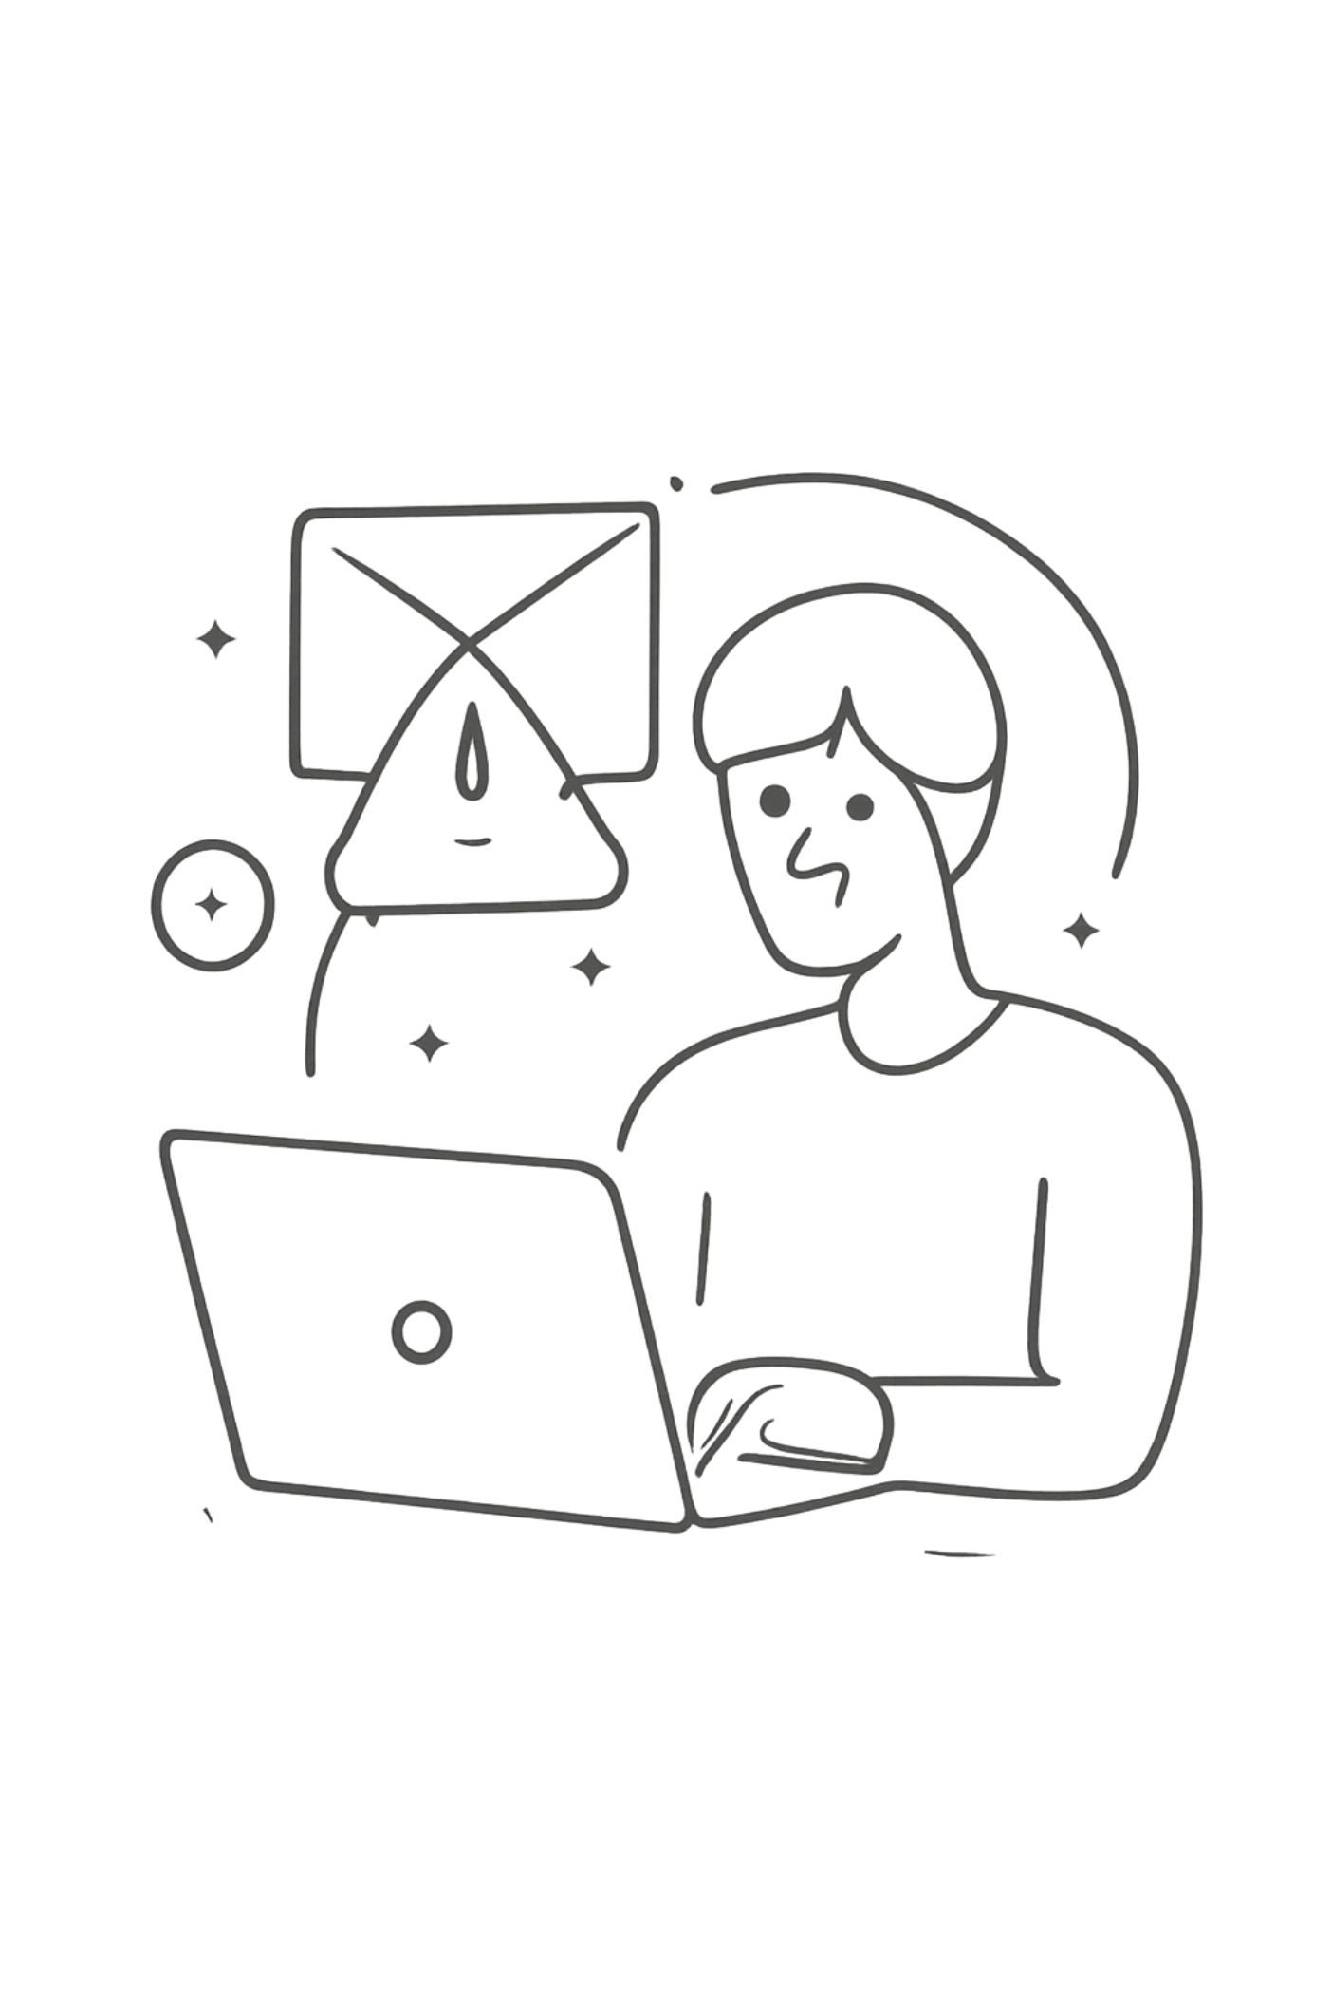
What Is Phishing?
Phishing is a cyber attack where an attacker impersonates a trusted person, company, or service to trick you into revealing sensitive information. It relies on deception and social engineering — not technical exploits.
Delivery Channels
Emails & SMS messages
Social media platforms
Fake websites
What They Target
Usernames & passwords
Banking & payment info
Personal & account details

Slide 3





How a Phishing Attack Works
Most phishing attacks follow a predictable five-step sequence. Recognizing each stage helps you break the chain before damage is done.
Create a Fake Message
Attacker crafts a message impersonating a trusted organization.
Contact the Victim
Message is sent via email, SMS, social media, or another platform.
Create Urgency
"Your account will be blocked" — pressure you to act immediately.
Victim Interacts
Victim clicks a link, opens an attachment, or submits information.
Information Collected
Attacker uses stolen data for unauthorized access or other harmful activity.

Slide 4
How to Identify a Phishing Email
1
Check the Sender
Look for unusual spelling or a domain that doesn't match the organization.
2
Watch for Urgent Language
Messages pressuring immediate action should raise red flags.
3
Check Spelling & Grammar
Unexpected errors in professional messages are a warning sign.
4
Hover Over Links
Check where a link actually leads before clicking.
5
Be Careful with Attachments
Never open unexpected attachments without verifying the sender.
6
Never Share Sensitive Info
Legitimate organizations won't ask for passwords via email.

Slide 5
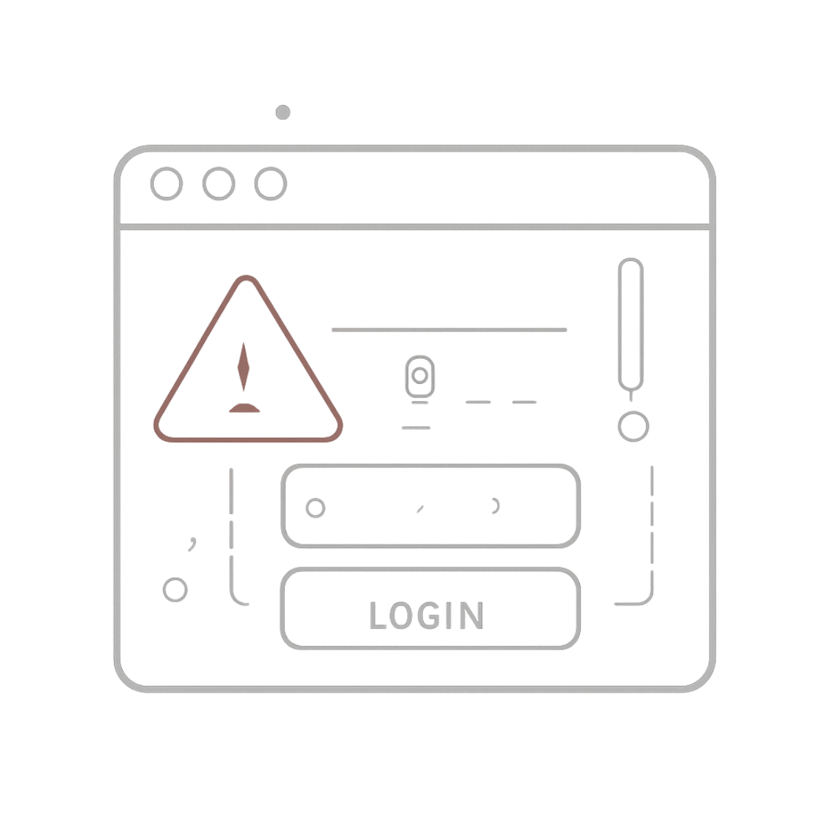

How to Identify a Fake Website
Phishing websites are designed to look identical to legitimate ones. A professional appearance does not guarantee authenticity.
Check the Domain Name
Unexpected Login Pages
Look for subtle misspellings or unusual extensions (e.g., paypa1.com).
Be cautious if an unexpected message redirects you to a login page.
Suspicious Requests
Use Official Sources
A site suddenly asking for sensitive info should be verified immediately.
Always navigate to services directly — never through an unexpected link.

Slide 6






Social Engineering Tactics
Social engineering uses psychological manipulation to influence behavior. Phishing attacks exploit these human tendencies:
Urgency
"You must act now" — prevents careful thinking.
Fear
"Your account will be blocked" — triggers panic responses.
Curiosity
An intriguing link or attachment encourages impulsive clicks.
Trust
Impersonating banks, companies, or known contacts to lower defenses.
Attackers target human behavior, not just technology — awareness is your strongest defense.

Slide 7







Best Practices to Stay Safe
Think Before You Click
Verify Unexpected Requests
Don't click links just because a message looks urgent.
Confirm using an official contact method — not the one provided in the message.
Use Strong Passwords
Enable MFA
Use unique, complex passwords for every account.
Multi-factor authentication adds a critical extra layer of protection.
Keep Software Updated
Report Suspicious Messages
Regular updates patch known vulnerabilities attackers exploit.
Report phishing attempts instead of forwarding them to others.
Remember: STOP → CHECK → VERIFY before taking any action on an unexpected message.

Slide 8


Real-World Phishing Scenario
The Message You Receive
⚠️ Warning Signs
"Your online account will be suspended today. Verify your account immediately using the link provided."
Unexpected Message
You weren't expecting an account verification request.
At first glance, it looks like a normal account notification. But look closer.
Urgent Language
Designed to make you act without thinking.
Suspicious Link
You're asked to use a provided link instead of navigating directly.
What to do: Don't click the link. Open the service's official website separately and check your account status directly.

Slide 9



INTERACTIVE QUIZ
Test Your Knowledge
1
Question 1
You receive an unexpected email asking you to click a link immediately. What should you do?
A) Click the link immediately
B) Verify the message first ✅
C) Share it with friends
D) Enter your password
2
Question 2
What should you check before entering information on a website?
A) Number of images
B) Website address ✅
C) Page background
D) Font size
3
Question 3
What is the main goal of a phishing attack?
A) Improve computer speed
B) Collect sensitive information ✅
C) Design websites
D) Send advertisements
4
Question 4
What does MFA stand for?
A) Multi-Factor Authentication ✅
B) Multiple File Access
C) Main Function Application
D) Manual Feature Activation

Slide 10

Key Takeaways
Phishing Uses Deception
Attackers rely on social engineering, not technical exploits.
Check Before You Click
Verify senders, links, and website addresses before interacting.
Urgency Is a Warning Sign
Messages pressuring immediate action are often phishing attempts.
Use Strong Security Habits
Strong passwords, MFA, and updated software reduce your risk.
Remember: STOP → CHECK → VERIFY. Taking a moment to think before acting can prevent most phishing attacks.

