Slide 1
School Management System
Complete SQL Project
Schema, Data Tables, ERD, and Queries
Prepared by Tharun Gundlapally
BATCH NO : JFS-ONR -005
NAME : THARUN GUNDLAPALLY

Slide 2
Project Overview & Objectives
Primary Objective:
  To design and implement a relational database system that standardizes the management of school records, ensuring data integrity and enabling quick analytical querying.
Key System Features:
  • Student Tracking: Maintain accurate personal records.
  • Curriculum Management: Standardize subject offerings.
  • Examination Cycles: Log specific evaluation events.
  • Performance Analytics: Link students and exams via numerical scores to compute averages, pass/fail rates, and top performers.

Slide 3
Database Initialization (DDL)
Creating the Foundation
  CREATE DATABASE school_management_system;
  USE school_management_system;
Table Structures:
  CREATE TABLE Students (student_id INT PRIMARY KEY, first_name VARCHAR(50), last_name VARCHAR(50));
  CREATE TABLE Marks (
  mark_id INT PRIMARY KEY,
  student_id INT, subject_id INT, exam_id INT, score INT,
  FOREIGN KEY (student_id) REFERENCES Students(student_id),
  ...
  );

Slide 4
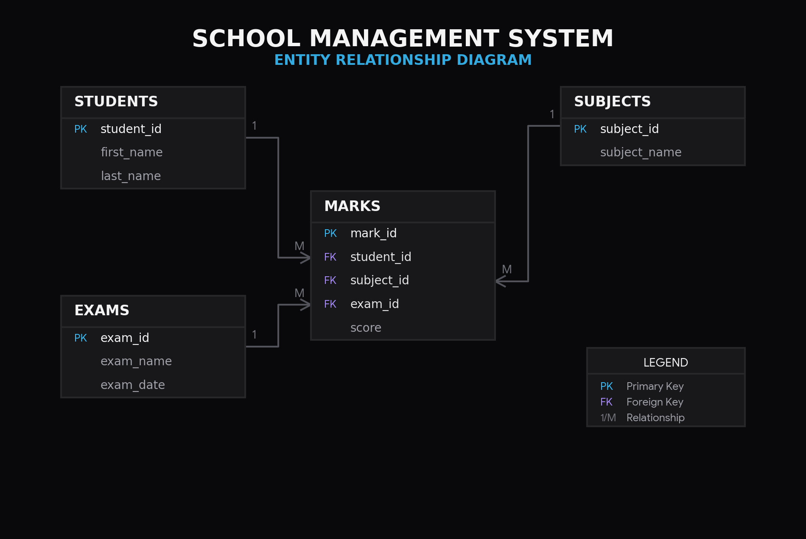
Database Schema (ER Diagram)

Slide 5
Sample Data: Dimension Tables
STUDENTS TABLE
SUBJECTS TABLE
student_id | first_name | last_name
1 | Yadagiri | Goud
2 | Narsimha | Roa
3 | Mallaiah | Yadav
4 | Padma | Patil
5 | Laxman | Konda
6 | Vikram | Singh
7 | Ramesh | Kumar
8 | Sunitha | Reddy
9 | Kiran | Chary
10 | Chandraiah | Varma
subject_id | subject_name
1 | Mathematics
2 | Science
3 | English
4 | Hindi
5 | Social Studies

Slide 6
Sample Data: Events & Transactions
EXAMS TABLE
MARKS TABLE (Top 10 of 31 Records)
exam_id | exam_name | exam_date
1 | Half-Yearly | 2024-09-15
2 | Annual | 2024-03-20
mark_id | student_id | subject_id | exam_id | score
1 | 1 | 1 | 1 | 95
2 | 1 | 2 | 1 | 62
3 | 1 | 3 | 1 | 56
4 | 1 | 4 | 1 | 72
5 | 1 | 5 | 1 | 70
6 | 2 | 1 | 1 | 69
7 | 2 | 2 | 1 | 63
8 | 2 | 3 | 1 | 61
9 | 2 | 4 | 1 | 98
10 | 2 | 5 | 1 | 89

Slide 7
SQL Queries (1-2)
1. Retrieve all students
SELECT first_name, last_name
FROM Students;
2. Filter scores greater than 80
SELECT *
FROM Marks
WHERE score > 80;

Slide 8
SQL Queries (3-4)
3. Sort exams by date
SELECT *
FROM Exams
ORDER BY exam_date DESC;
4. Student marks details
SELECT st.first_name, st.last_name, su.subject_name, m.score
FROM Marks AS m
JOIN Students AS st ON m.student_id = st.student_id
JOIN Subjects AS su ON m.subject_id = su.subject_id;

Slide 9
SQL Queries (5-6)
5. Subject averages
SELECT su.subject_name, ROUND(AVG(m.score), 2) AS average_score
FROM Marks AS m
JOIN Subjects AS su ON m.subject_id = su.subject_id
GROUP BY su.subject_id, su.subject_name;
6. Count marks for a student
SELECT COUNT(m.mark_id) AS total_marks_records
FROM Marks AS m
JOIN Students AS st ON m.student_id = st.student_id
WHERE st.first_name = 'Yadagiri' AND st.last_name = 'Goud';

Slide 10
SQL Queries (7-8)
7. Top performer
SELECT st.first_name, st.last_name, m.score
FROM Marks AS m
JOIN Students AS st ON m.student_id = st.student_id
ORDER BY m.score DESC
LIMIT 1;
8. Pass / Fail Label
SELECT st.first_name, st.last_name, su.subject_name, m.score,
CASE
WHEN m.score >= 70 THEN 'Pass'
ELSE 'Fail'
END AS status
FROM Marks AS m
JOIN Students AS st ON m.student_id = st.student_id
JOIN Subjects AS su ON m.subject_id = su.subject_id;

Slide 11
SQL Queries (9-10)
9. Total score per student
SELECT st.student_id, st.first_name, st.last_name, SUM(m.score) AS total_score
FROM Marks AS m
JOIN Students AS st ON m.student_id = st.student_id
GROUP BY st.student_id, st.first_name, st.last_name;
10. Subjects with avg score < 75
SELECT su.subject_name, AVG(m.score) AS avg_score
FROM Marks AS m
JOIN Subjects AS su ON m.subject_id = su.subject_id
GROUP BY su.subject_id, su.subject_name
HAVING AVG(m.score) < 75;

Slide 12
Queries (11-12)
EXTRA 1: Count total students
SELECT COUNT(*) AS total_students
FROM Students;
EXTRA 2: Count total subjects
SELECT COUNT(*) AS total_subjects
FROM Subjects;

Slide 13
Queries (13-14)
EXTRA 3: Find scores of 90 or above
SELECT st.first_name, st.last_name, su.subject_name, m.score
FROM Marks AS m
JOIN Students AS st ON m.student_id = st.student_id
JOIN Subjects AS su ON m.subject_id = su.subject_id
WHERE m.score >= 90
ORDER BY m.score DESC;
EXTRA 4: Find scores below 35
SELECT st.first_name, st.last_name, su.subject_name, m.score
FROM Marks AS m
JOIN Students AS st ON m.student_id = st.student_id
JOIN Subjects AS su ON m.subject_id = su.subject_id
WHERE m.score < 35;

Slide 14
Conclusion
Summary:
  The School Management System successfully models a scalable relational architecture for tracking student academics.
Key Takeaways:
  • Effectively normalized tables (Students, Subjects, Exams) reduce data redundancy.
  • The Marks transaction table acts as the core hub for generating academic metrics.
  • Advanced SQL operations empower precise performance insights and decision-making.

