Slide 1
Crop_AI – Crop Recommendation System
Tharun Kumar Reddy Chalamala
Platform: IBM Watsonx.ai Studio

Slide 2
Problem Statement
- Farmers face challenges choosing the right crop for their soil and climate.
- Wrong decisions lead to poor yield and financial losses.
- Need for a data-driven solution to enhance agricultural decision-making.

Slide 3
Solution Overview
- Crop_AI is a smart crop recommendation system.
- Utilizes machine learning (Random Forest Classifier).
- Predicts optimal crop based on soil and climate inputs.

Slide 4
Data & Parameters
- Parameters: Nitrogen (N), Phosphorus (P), Potassium (K), Temperature, Humidity, pH, Rainfall.
- Preprocessing and normalization applied.
- Model trained using Random Forest Classifier with multiclass outputs.

Slide 5
IBM Watsonx.ai Workflow
- Model developed in Watsonx.ai Studio.
- Deployed using IBM Cloud Machine Learning.
- Accessed via REST API and test interface.

Slide 6
Results & Demo
- Sample Input:
N=94, P=50, K=37, Temp=25.66°C, Humidity=80.66%, pH=6.94, Rainfall=209.58mm
- Predicted Crop: Rice
- Confidence: 83%
Screenshots included in next slides.

Slide 7
Conclusion & Future Scope
- Helps farmers make informed crop decisions.
- Enhances yield, reduces crop failure.
- Future: Add weather forecasts, geolocation, real-time sensors.
- Ready for integration with mobile or web platforms.

Slide 8
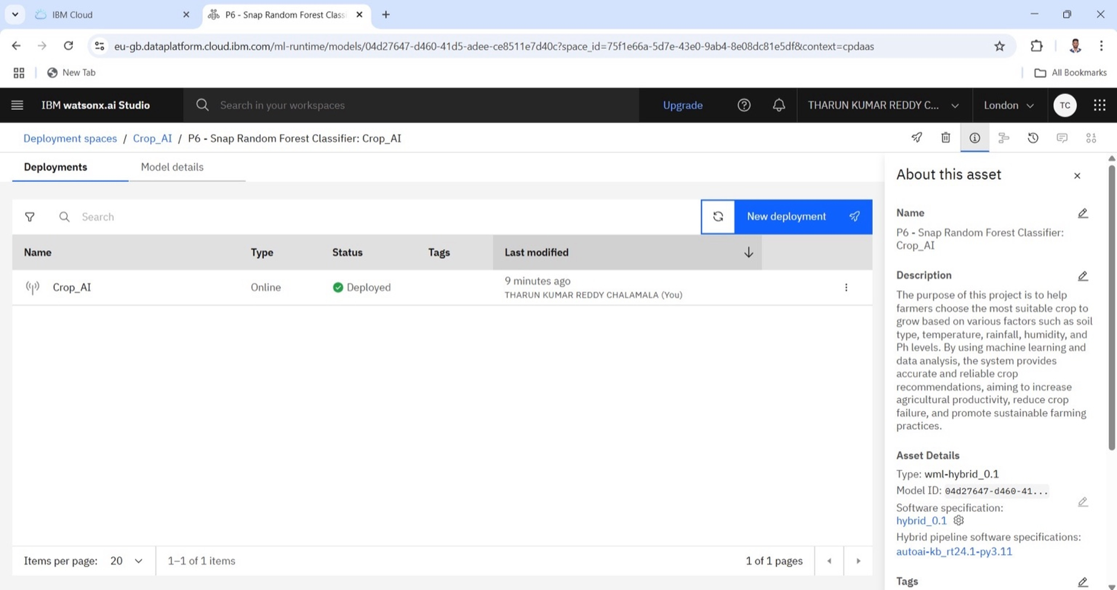
Deployment Overview

Slide 9
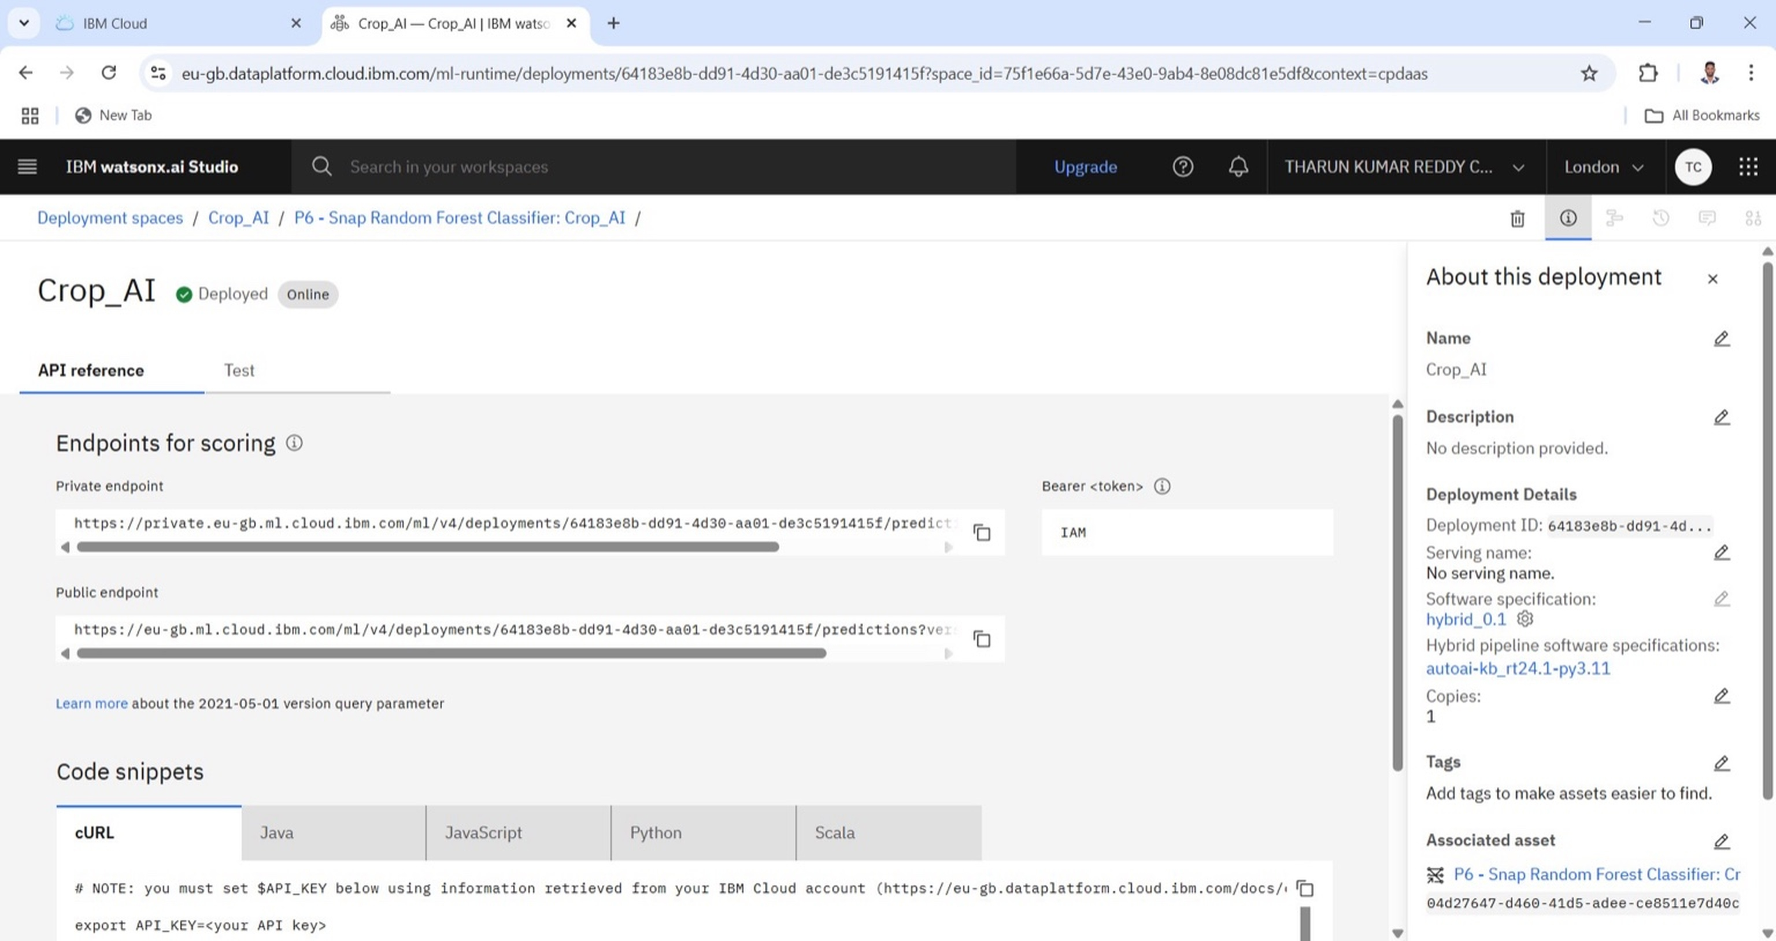
API Endpoints

Slide 10
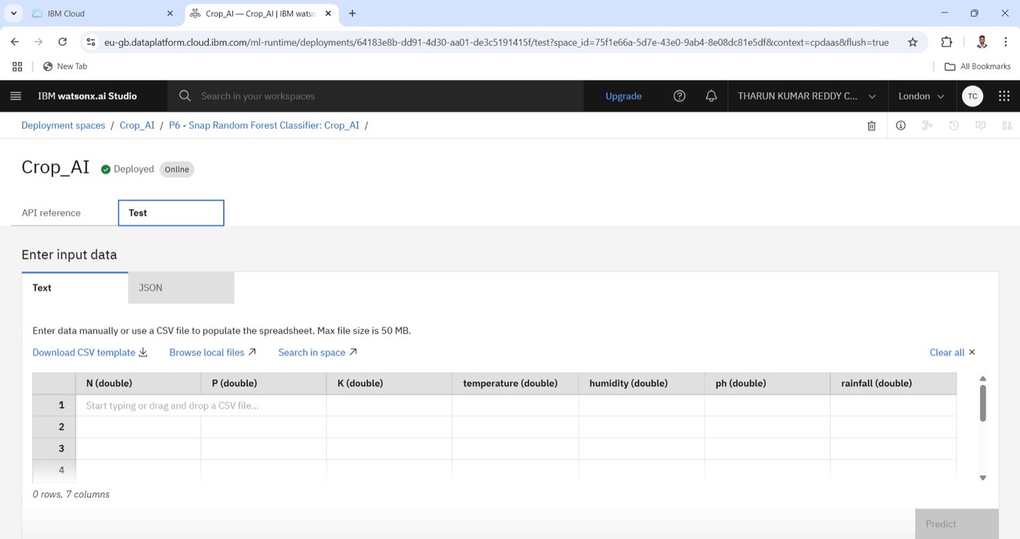
Input Data Format

Slide 11
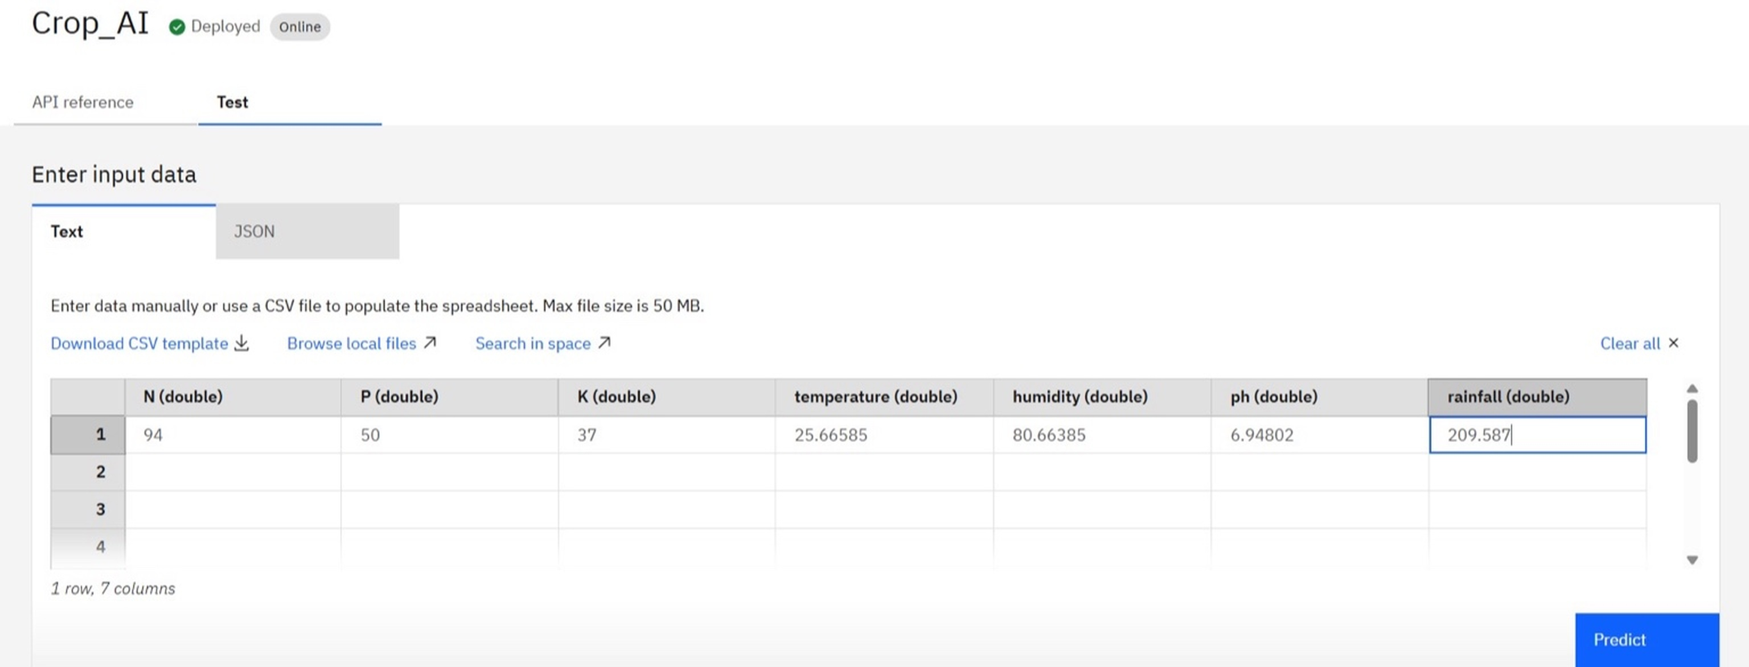
Sample Input Entry

Slide 12
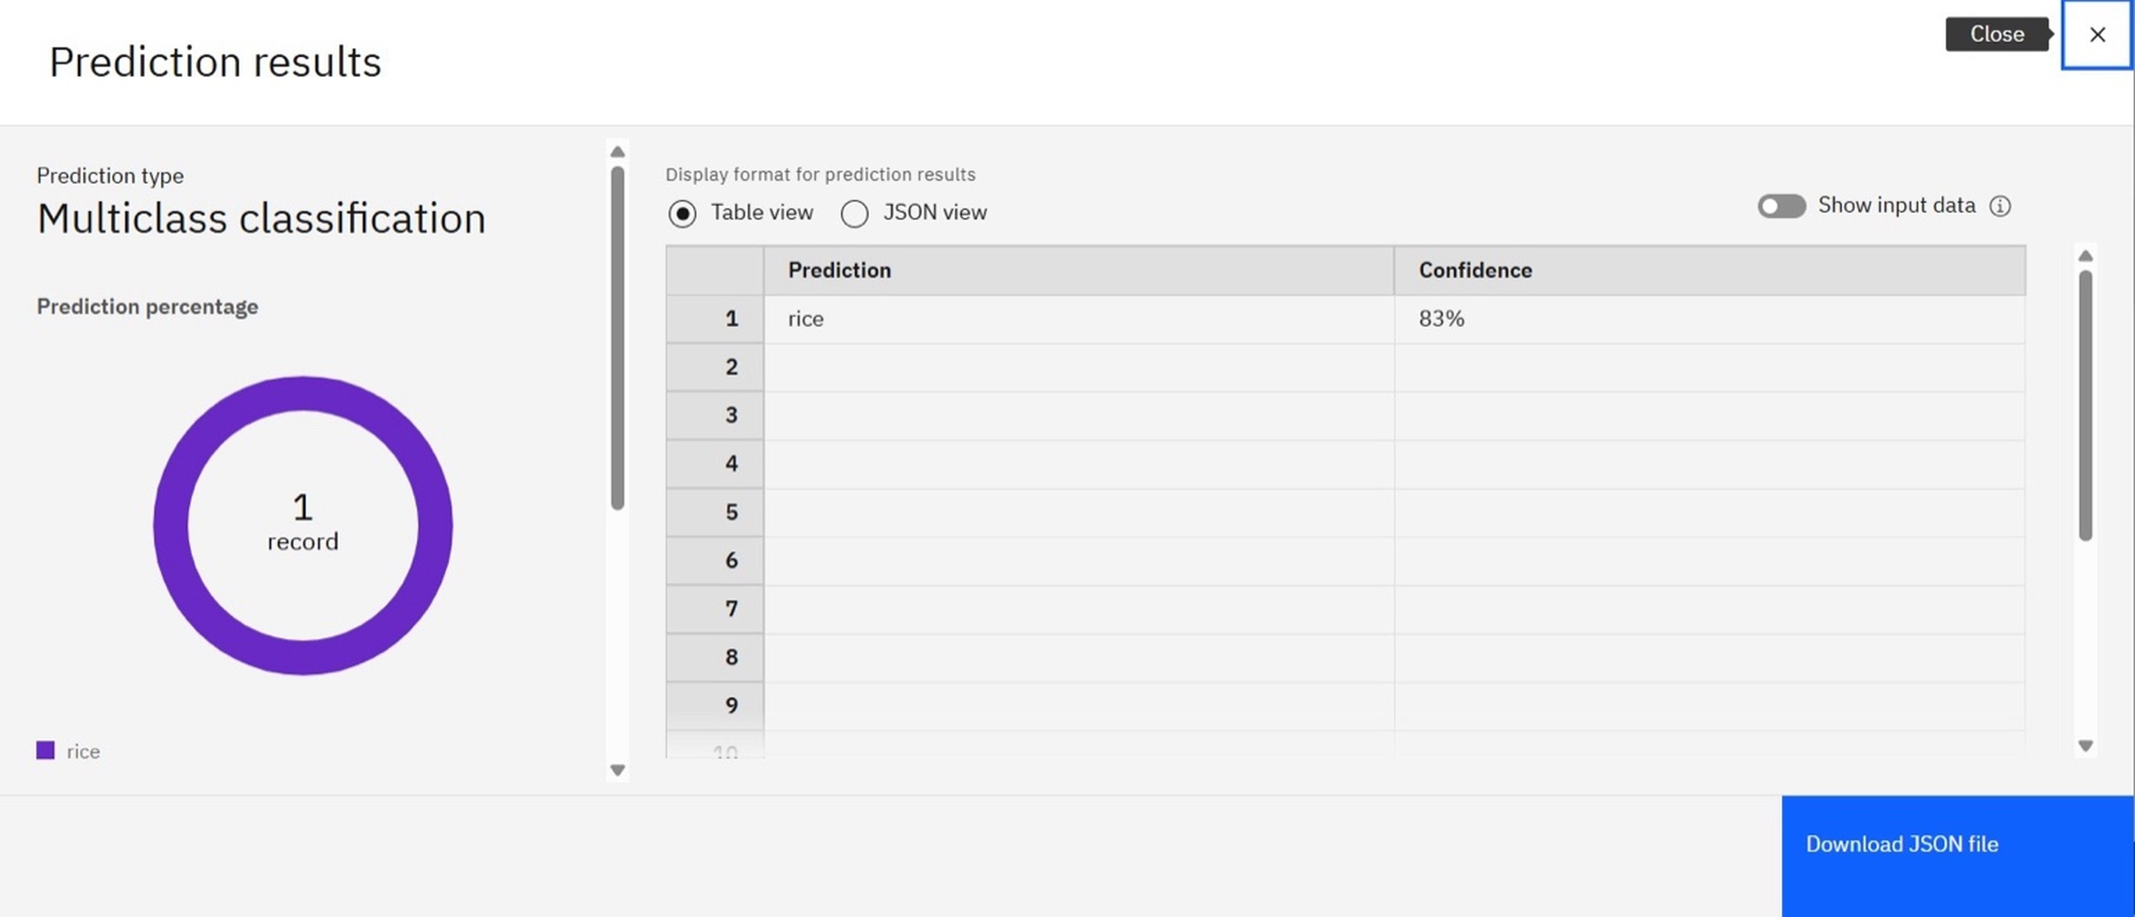
Prediction Output

Slide 13
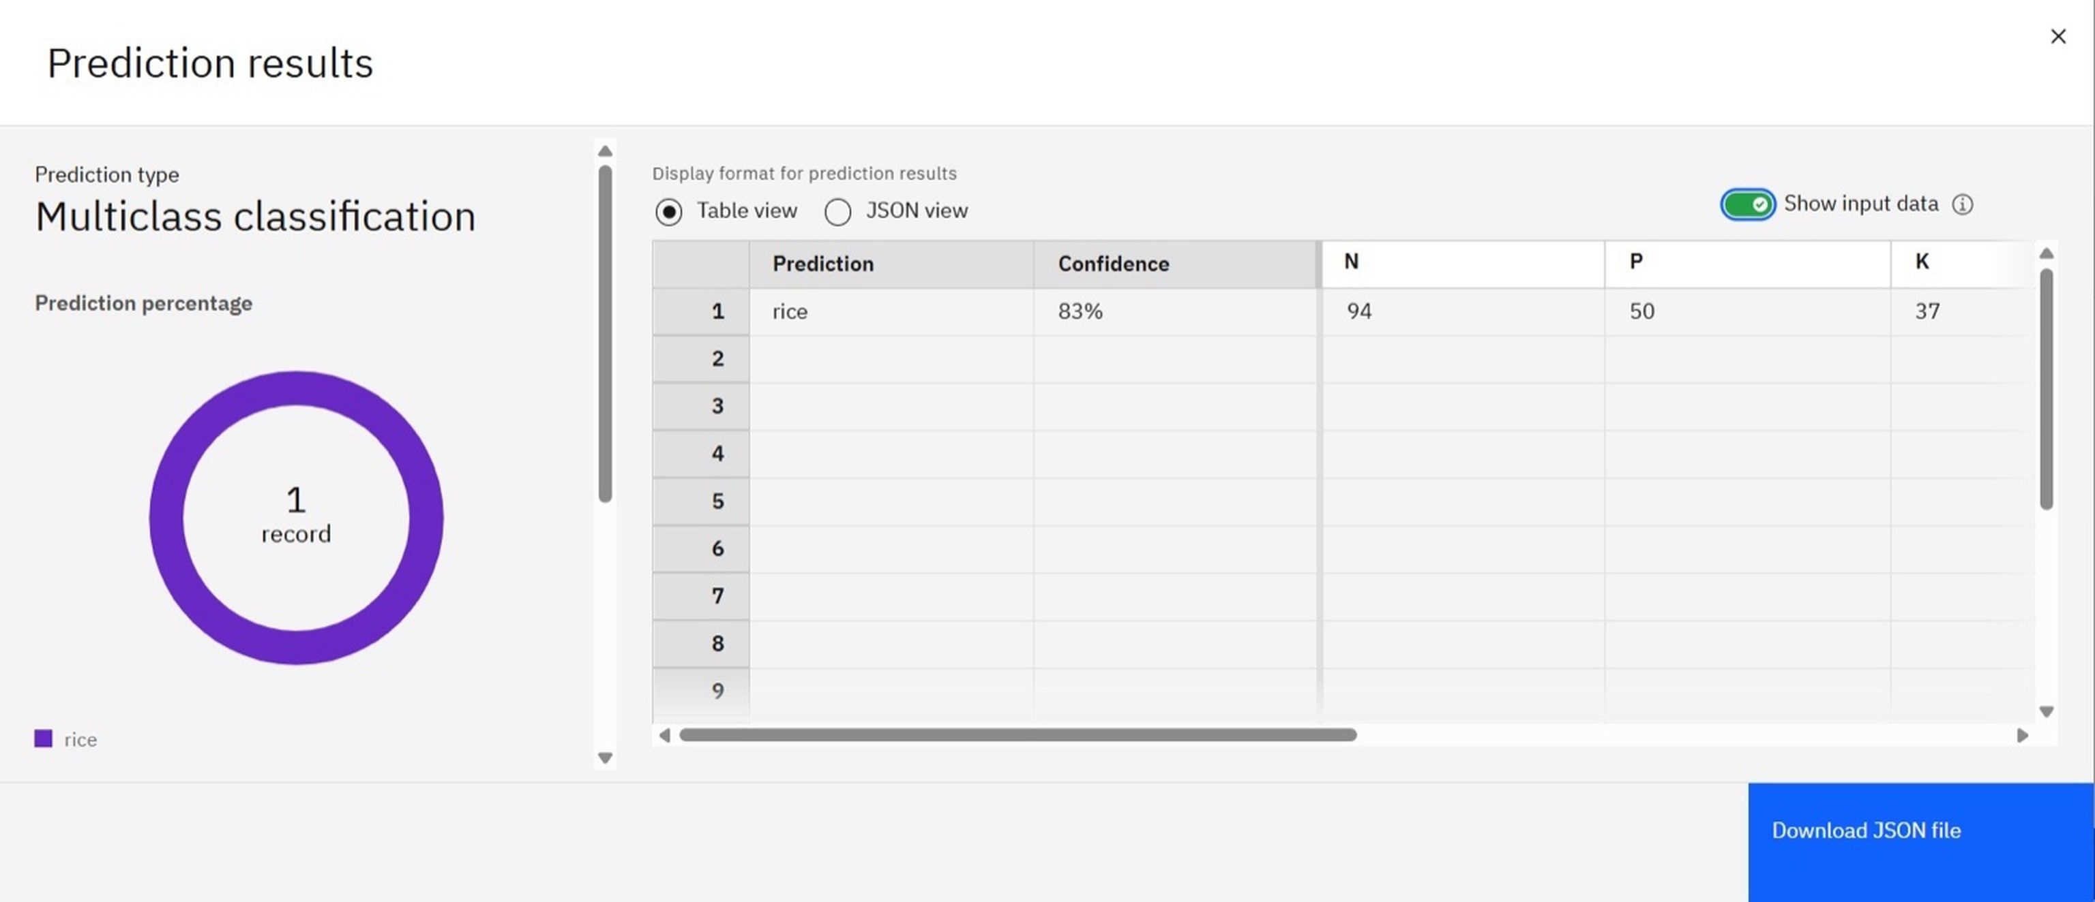
Prediction with Input Shown

