Slide 1
AVINYA_25 HACKATHON
Project Title – Diabetic Retinopathy Detection using Deep Learning
Theme - Medicine
Team name – Tech Titans

Slide 2
EXISTING SOLUTION
Tech Titans
Over the past decade, many DR detection platforms were created like EyeArt,Idx-DR,RetinaLyse etc…
They use AI and image analysis algorithms to assess the retinal images for sign of DR, offering rapid screening capabilities.
Drawbacks :
High cost
Ignoring patient context and only analyses images
Hard to interpret results and lack next steps
No built in explanations and recommendations.

Slide 3
PROPOSED SOLUTION
Tech Titans
Our project is an AI-based web application that automates the detection of diabetic retinopathy from retina images. It uses EfficientNetB0 to classify DR stages, enabling early screening and reducing the burden on ophthalmologists.
How our project addresses the drawbacks from existing solutions :
It is free application.
It has an integrated questionnaire.
Plain language results and personalized recommendations.
Easy to understand the result.
Can be open sourced.

Slide 4
Technical Approach
Tech Titans
Programming Languages:
Python (model development, preprocessing, backend)
JavaScript / HTML / CSS (frontend with ReactJS)
Frameworks & Libraries:
Deep Learning: PyTorch (EfficientNetB0 for DR classification)
Computer Vision: OpenCV (image preprocessing, augmentation)
Web & Backend: FastAPI / Flask (API), Streamlit (prototype frontend)
Visualization & Explainability: Matplotlib, Seaborn, Grad-CAM
Data Handling: NumPy, Pandas

Slide 5
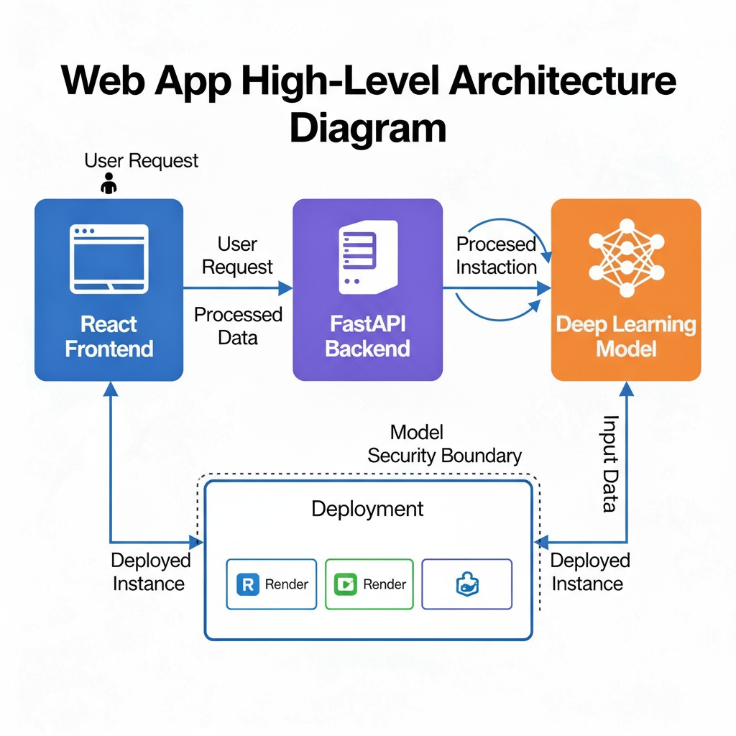
Process of Implementation
Tech Titans

Slide 6
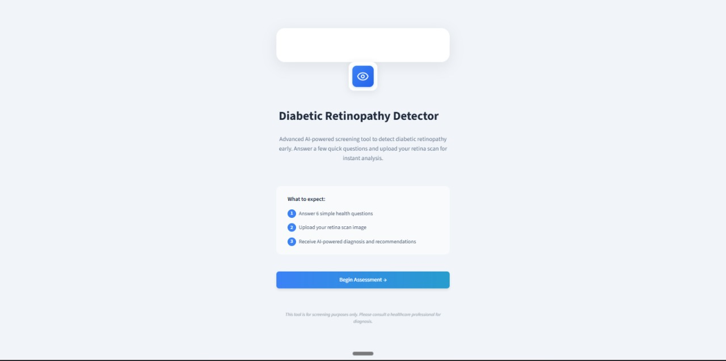
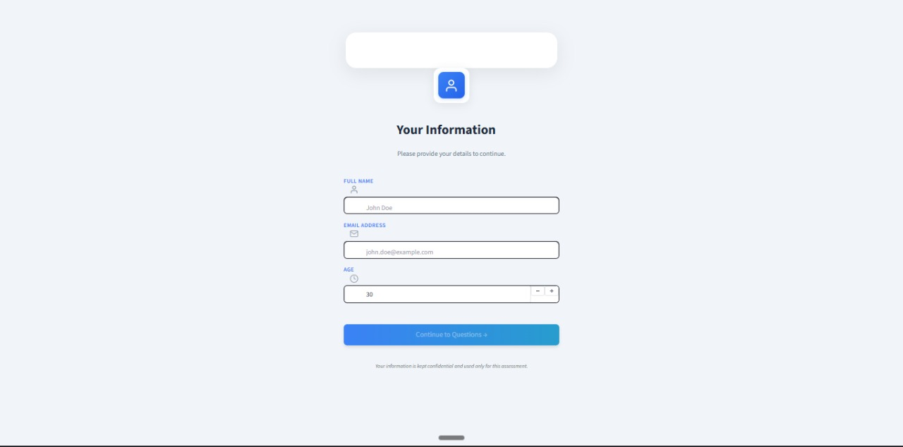
Demo
Tech Titans

Slide 7
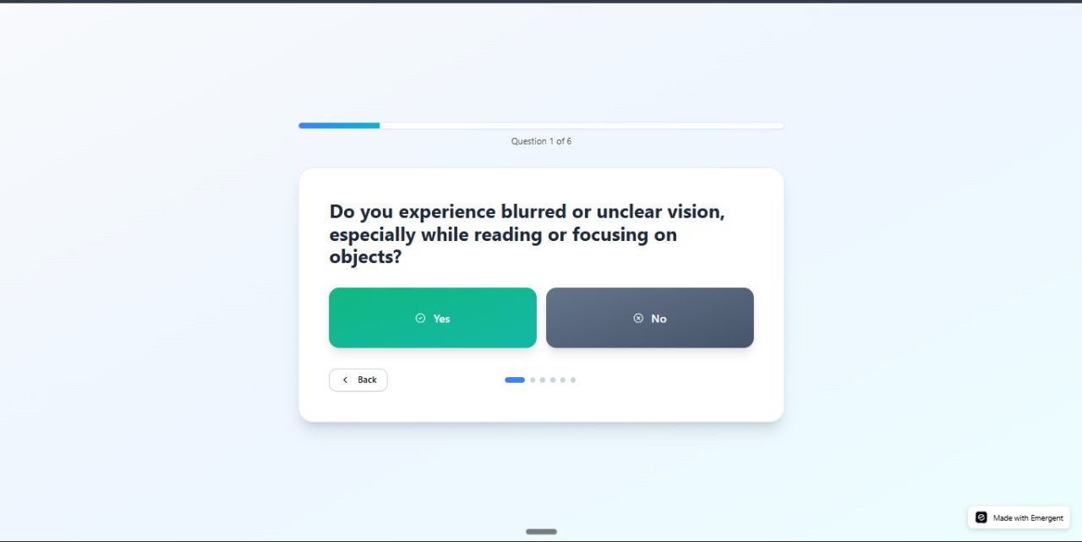
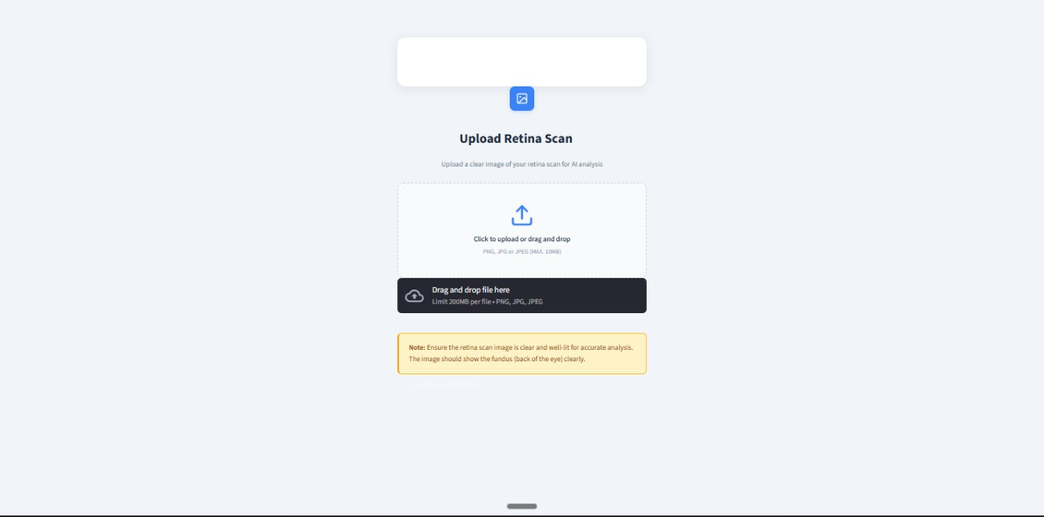
Demo
Tech Titans

Slide 8
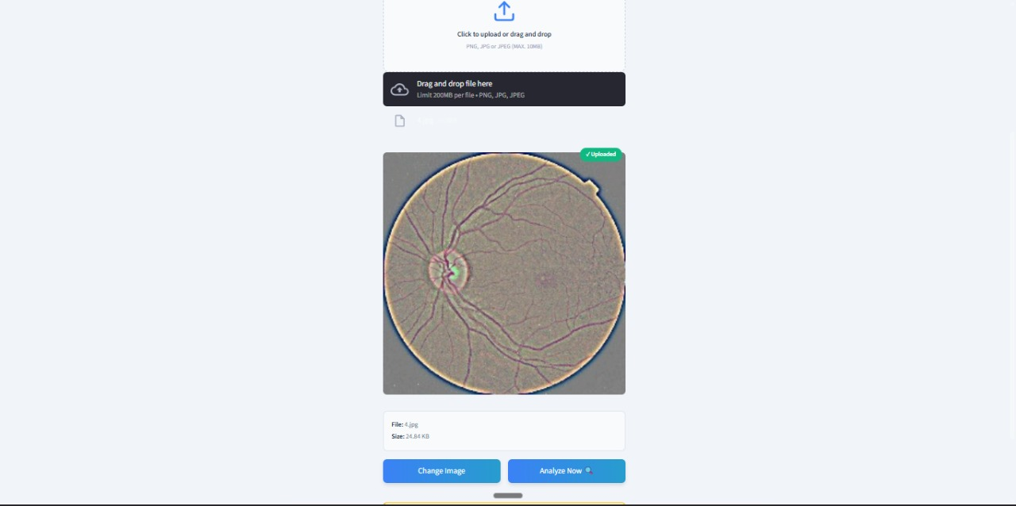
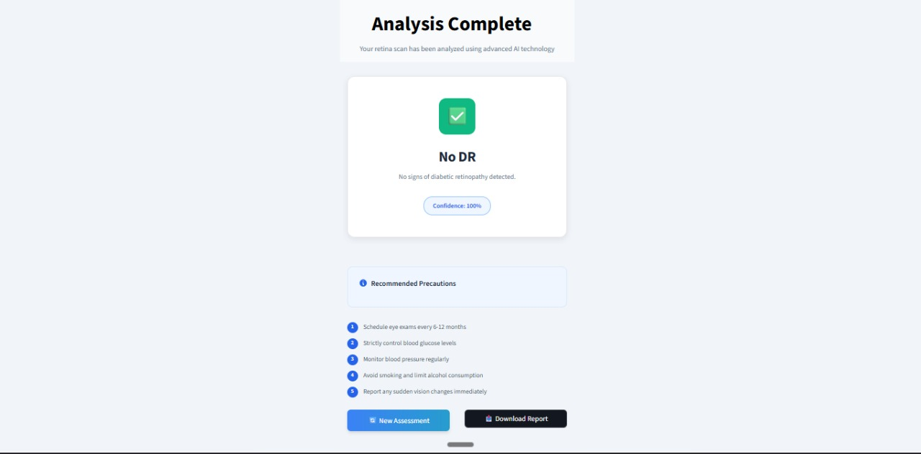
Demo
Tech Titans

Slide 9
FEASIBILITY AND VIABILITY
Tech Titans
Feasibility:
EfficientNetB0 (PyTorch) classifies retina images (80–85% accuracy)
Web app via Streamlit/ReactJS + FastAPI.
Challenges:
Data imbalance,
Variable image quality
GPU dependency.
Solutions:
Data augmentation,transfer learning, weighted loss
Cloud GPU deployment, Docker, secure access
Grad-CAM for explainable results.

Slide 10
IMPACT AND BENEFITS
Tech Titans
Early Disease Detection: Enables early identification of diabetic retinopathy, reducing the risk of vision loss through timely medical intervention.
Improved Accessibility: Brings affordable and automated eye screening to rural and under-resourced areas lacking ophthalmologists.
Reduced Healthcare Burden: Saves time and cost by minimizing manual diagnosis and hospital visits for initial screening.
Scalable & Sustainable: Uses cloud/web integration, allowing large-scale deployment with minimal environmental footprint.
Societal Well-being: Enhances quality of life by preventing blindness, supporting healthier communities, and improving productivity.

Slide 11
FUTURE SCOPE
Tech Titans
Real-Time Clinical Integration
Connect the model with hospital systems or fundus cameras for instant DR screening and reporting.
Mobile Application Deployment
Develop a lightweight Android/iOS app to allow remote rural screening using smartphone fundus adapters.
Model Enhancement
Upgrade to EfficientNetV2 / Vision Transformers for improved accuracy and faster inference on larger datasets.
Explainable AI (XAI)
Integrate better visualization (Grad-CAM++, LIME) to help doctors trust and understand predictions.
Multimodal Analysis
Combine retina images with patient data (glucose level, BP, duration of diabetes) for holistic diagnosis.

Slide 12
RESEARCH AND REFERENCES
Tech Titans
https://pmc.ncbi.nlm.nih.gov/articles/PMC8468161
https://www.kaggle.com/datasets/sovitrath/diabetic-retinopathy-224x224-gaussian-filtered/code
https://ieeexplore.ieee.org/document/10539012
https://retinalscreenings.com/blog/diabetic-retinopathy-stages/
https://www.ncbi.nlm.nih.gov/books/NBK560805/
https://pubmed.ncbi.nlm.nih.gov/29679616/
https://www.youtube.com/watch?v=5V3GPFUzCCk
https://www.youtube.com/watch?v=fCtMf6qHtdk

