Slide 1


CAR RENTAL SYSTEM
SUPERVISOR MR.A.MALARMANNAN,M.E.,, AP/CSE.
PRESENTED BY
2303811710421170 – THARUN S M

Slide 2

PRESENTATION OVERVIEW
Objective
Project Introduction
Problem Statement
Methodologies (Programming concepts relevant to problem statement)
Architecture of the proposed system
List of Modules
Merits
Results and Discussion
Queries

Slide 3
OBJECTIVE
To develop a user-friendly and efficient car rental system using Java AWT, streamlining the process of renting cars by automating operations like car selection, booking, and payment through an intuitive graphical interface. The system ensures ease of use for customers and effective management tools for administrators.

Slide 4
PROJECT INTRODUCTION
The "Car Rental System Using Java AWT" is a desktop application designed to modernize car rental services by eliminating manual processes. This system facilitates seamless interaction between customers and the service provider through a graphical user interface built using Java AWT. Key features include car catalog management, booking functionality, and secure transaction handling, aimed at improving service efficiency and customer satisfaction.

Slide 5
PROBLEM STATEMENT
Manual Processes: Traditional car rental systems rely heavily on manual processes, which are time-consuming and prone to errors.
Inefficient Record Keeping: Managing car inventory, booking details, and customer data manually leads to inconsistencies and inefficiencies.
Lack of Real-Time Updates: Customers often face delays in checking car availability and booking status.
Poor User Experience: Absence of a graphical interface makes the process less intuitive and user-friendly.
Operational Bottlenecks: Manual workflows result in delayed transactions and poor service delivery.

Slide 6
METHODOLOGIES (PROGRAMMING CONCEPTS RELEVANT TO PROBLEM STATEMENT)
Object-Oriented Programming (OOP): For modular and reusable code, encapsulating functionalities like car management, booking, and user authentication.
Event Handling: To manage user inputs and actions such as button clicks, form submissions, and menu selections.
Data Storage: Use of text files or simple databases to store information about available cars, bookings, and user credentials.
Exception Handling: To ensure system robustness by managing runtime errors gracefully.

Slide 7
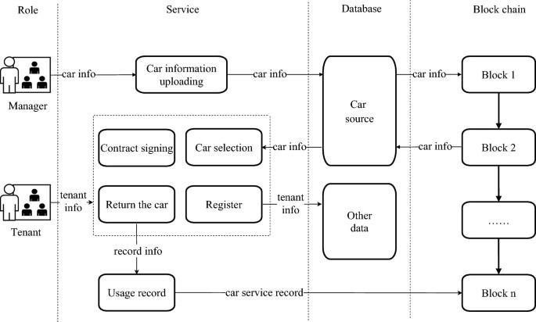
FLOW DIAGRAM

Slide 8
MODULE DESCRIPTION
1. Quiz Application Module :
Manages the quiz flow, including:
loadQuestions(): Reads and filters questions by category.
startQuiz(): Initiates the quiz with randomly selected questions.
loadQuestion(): Displays the current question and options.
displayScore(): Shows the final score after the quiz.
2. GUI Module :
Built using AWT and Swing components for interaction.

Slide 9
MODULE DESCRIPTION
User Authentication Module
Car Management Module
Car Search and Booking Module
Payment Module

Slide 10
MERITS
Automation: Reduces manual errors and operational delays.
User-Friendly Interface: Simplifies interactions for both customers and administrators.
Efficiency: Streamlines the process of car selection, booking, and payment.
Scalability: Modular design allows for future enhancements.
Cross-Platform Compatibility: Java-based implementation ensures it can run on multiple platforms.

Slide 11
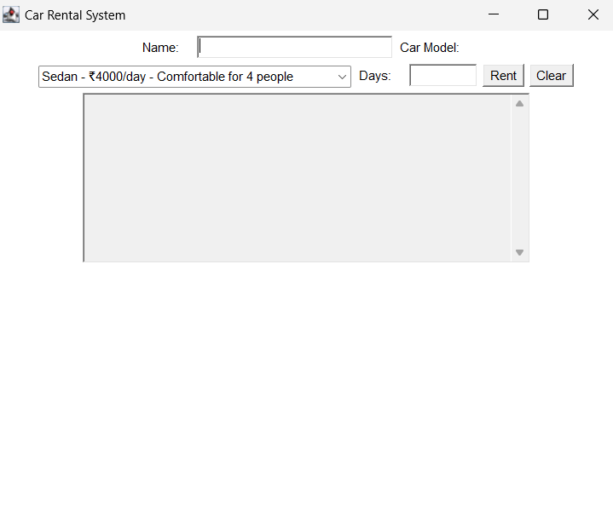
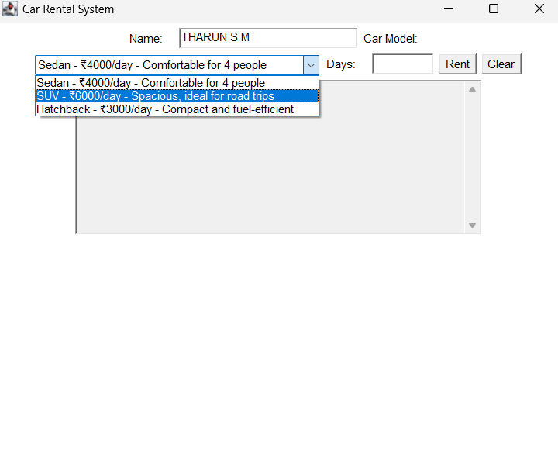
RESULT AND DISCUSSION

Slide 12
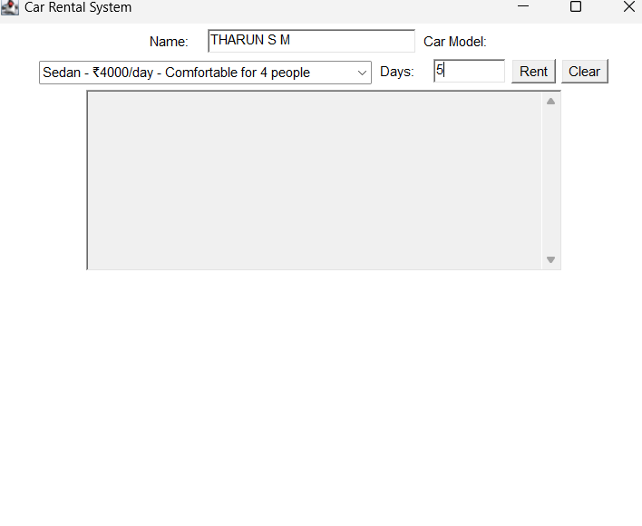
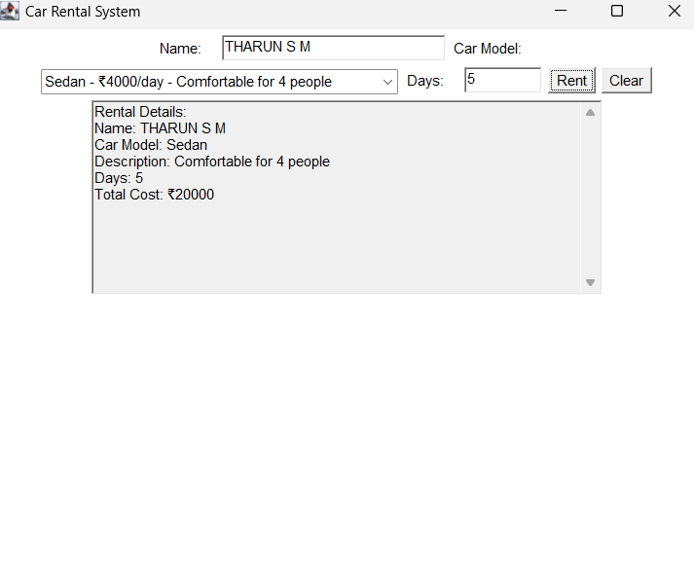
RESULT AND DISCUSSION

Slide 13
THANK YOU

