Slide 1

PMG SQL Challenge
Challenge
Tharun kumar kouda
5086155928, Tharun_linkedin

Slide 2
Approach to the SQL challenge
DB creation
I used SSMS (Microsoft SQL server) for creation of Data Base (PMG_SQL_TASK)
Using the Table creation statements from the given assessment, I created campaign_info, marketing_data, and website_revenue tables
Data ingestion
I used Tableau prep builder, ETL tool to ingest the data from CSV files(source system ) to the tables created in SSMS data base server (Target).
Imported CSV as a source to the tableau prep builder then created a cleaning step for data validation then a connection is established between tableau prep and SQL server, then I loaded data to the Data base tables.
Analytical operation
Using joins, CTEs (common term expressions) and nested queries I solve the questions asked in the “SQL Challenge”
Report Building
Tableau is used for the Visual reporting of the SQL queries asked in the challenge.

Slide 3
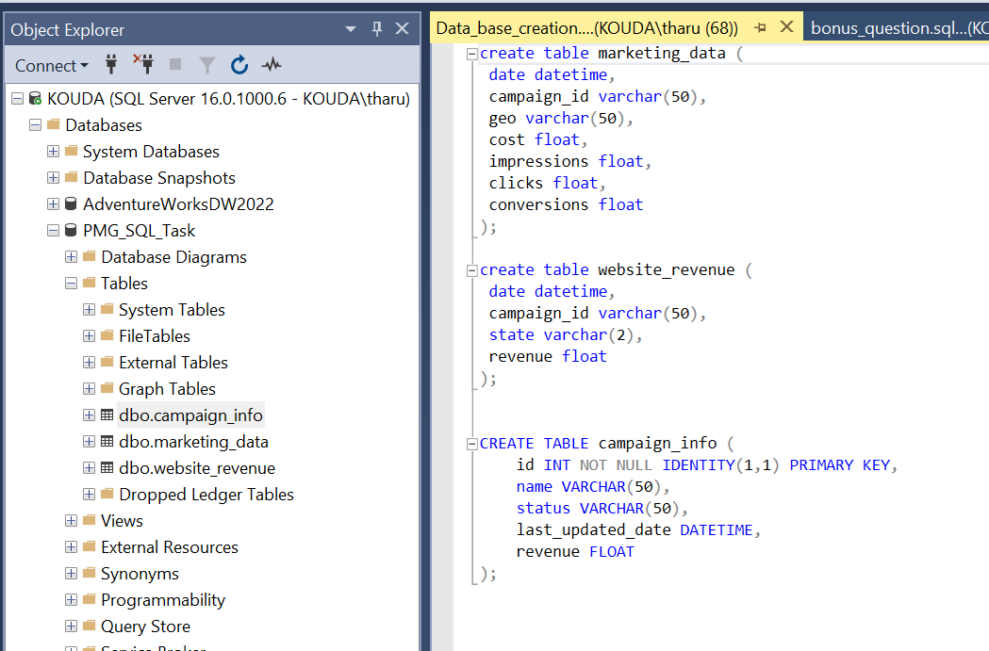
Database Creation.
Using the SQL script provided in the challenge statement, the following “PMG_SQL_Task” data base is created then Campaign_info, marketing_data, and Website_revenue tables are created.
Campaign_id is not same data type for all the tables I am assuming all the ids are integer data type.

Slide 4
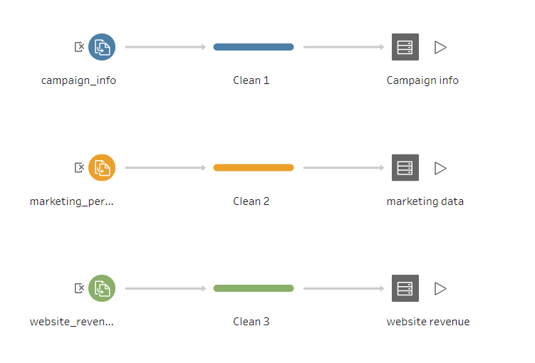
Data Flow from CSV files to SSMS DB servers

Slide 5
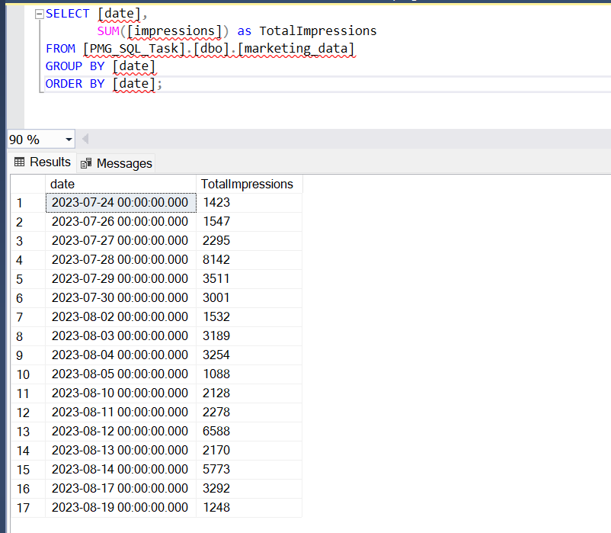
1. Write a query to get the sum of impressions by day.
SELECT [date],
SUM([impressions]) as TotalImpressions
FROM [PMG_SQL_Task].[dbo].[marketing_data]
GROUP BY [date]
ORDER BY [date];
Notes:
Group by functions are used to aggregate the impressions for each date.

Slide 6
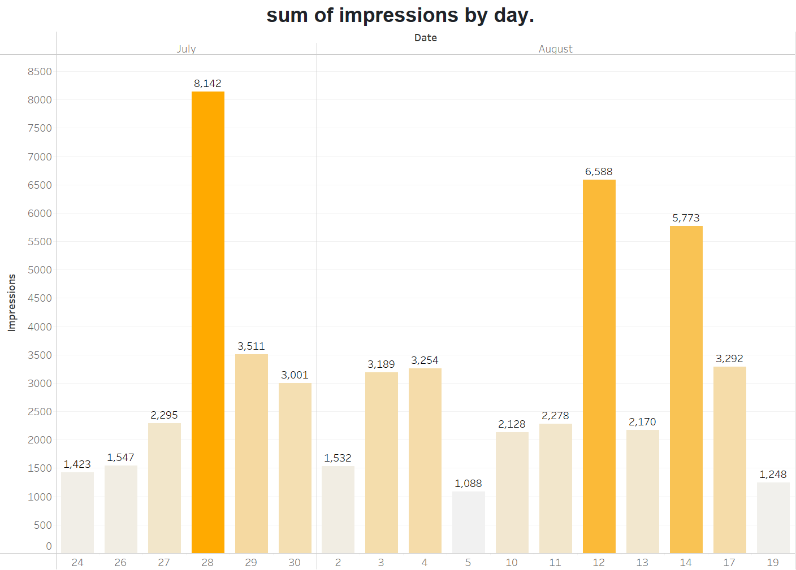
1.Write a query to get the sum of impressions by day.
The following image shows the Impression for each day of the marketing.

Slide 7
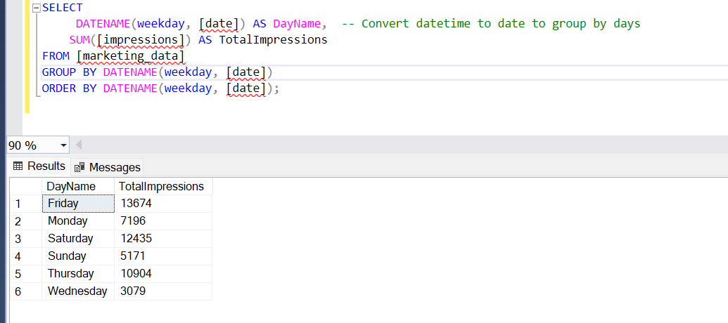
1. Write a query to get the sum of impressions by day.(alternative solution)
SELECT
DATENAME(weekday, [date]) AS DayName, -- Convert datetime to date to group by days
SUM([impressions]) AS TotalImpressions
FROM [marketing_data]
GROUP BY DATENAME(weekday, [date])
ORDER BY DATENAME(weekday, [date]);

Slide 8
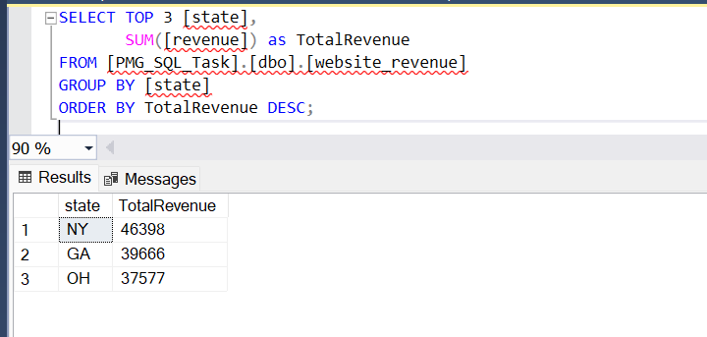
2. Write a query to get the top three revenue-generating states in order of best to worst. How much revenue did the third best state generate?
Ohio is the third best revenue collected state with 37577 USD.
SELECT TOP 3 [state],
SUM([revenue]) as TotalRevenue
FROM [PMG_SQL_Task].[dbo].[website_revenue]
GROUP BY [state]
ORDER BY TotalRevenue DESC;

Slide 9
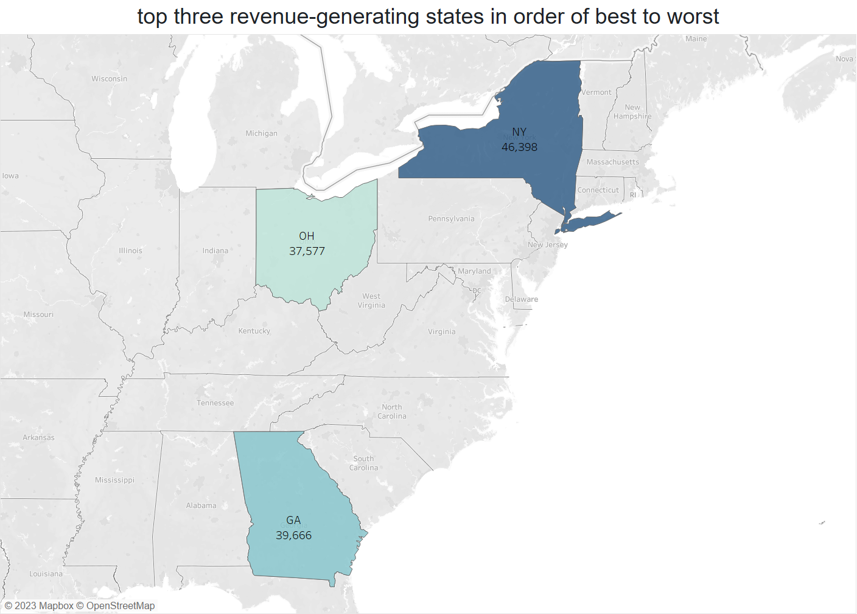
2. Write a query to get the top three revenue-generating states in order of best to worst. How much revenue did the third best state generate?
Geo- Heat map showing the revenue generated, from the image it is evident that ohio is the third best revenue collected state.
link for sql script

Slide 10
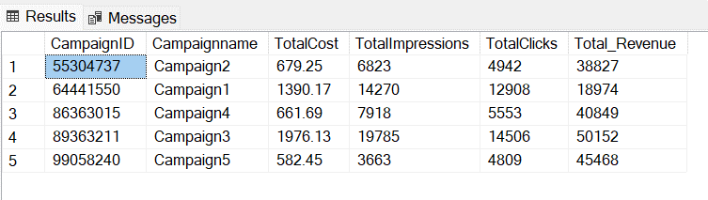
3.Write a query that shows total cost, impressions, clicks, and revenue of each campaign. Make sure to include the campaign name in the output.
with table_1 as
(SELECT
md.campaign_id AS CampaignID,
ci.name as Campaignname,
SUM(md.[cost]) AS TotalCost,
SUM(md.[impressions]) AS TotalImpressions,
SUM(md.[clicks]) AS TotalClicks
FROM [marketing_data] md
inner join campaign_info as ci on ci.id=md.campaign_id
GROUP BY md.campaign_id ,ci.name
),
table_2 as
(SELECT wr.campaign_id AS CampaignID,
ci.name as Campaignname,
SUM(wr.revenue) as Total_Revenue
FROM [website_revenue] wr
inner join campaign_info as ci on ci.id=wr.campaign_id
GROUP BY wr.campaign_id ,ci.name
)
select t1.CampaignID,t1.Campaignname,TotalCost,TotalImpressions,TotalClicks,Total_Revenue
from table_2 t2
inner join table_1 t1 on t1.CampaignID=t2.CampaignID
order by t1.CampaignID ;
For the query, I used CTEs instead of using joins because campaign ids are not primary keys in marketing data and website revenue tables, if we join then end result make n*m combinations.
Notes:
The SQL query consolidates campaign performance data from two primary sources: marketing_data and website_revenue. Initially, it aggregates key metrics from marketing_data such as cost, impressions, and clicks for each campaign, pairing these metrics with their respective campaign names using a join operation with the campaign_info table, resulting in the intermediate table_1. Concurrently, it computes the total revenue for each campaign from website_revenue, again linking it with campaign_info for naming, resulting in the intermediate table_2. In the final segment of the query, these two intermediate tables are joined on their campaign IDs, creating a consolidated view that combines both marketing metrics and revenue for each campaign.

Slide 11
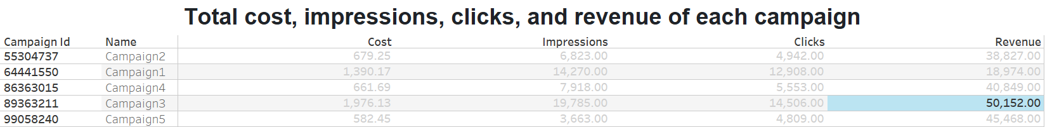
3.Write a query that shows total cost, impressions, clicks, and revenue of each campaign. Make sure to include the campaign name in the output.
The above chart shows the KPI of the campaign that is cost, impressions, clicks and revenue generated. From the chart it is evident that campaign 3 is the highest revenue generated campaign.

Slide 12
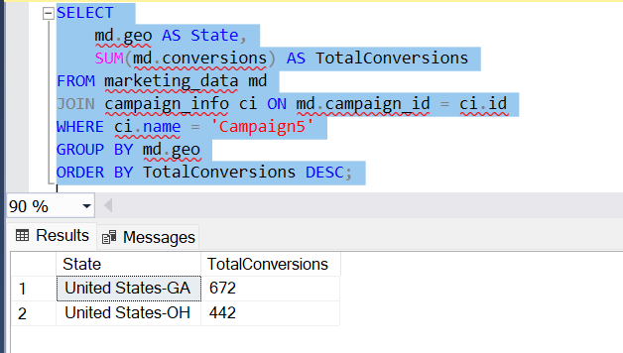
4. Write a query to get the number of conversions of Campaign5 by state. Which state generated the most conversions for this campaign?
From the output we can see that Georgia state has the highest conversions for the “campaign-5” with 672 conversions.

Slide 13
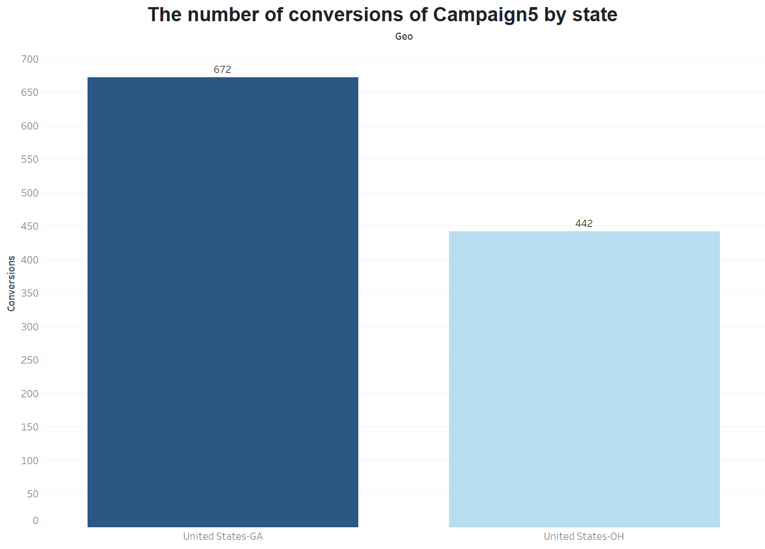
4. Write a query to get the number of conversions of Campaign5 by state. Which state generated the most conversions for this campaign?
The following bar graph shows the number of conversions made

Slide 14
5.In your opinion, which campaign was the most efficient, and why?
To solve this question, I used two KPIs t decide
Return on Investment (ROI) % :It indicates how much revenue you earn for each dollar spent. A higher ROI indicates a more efficient campaign.
ROI=(Total Revenue−Total Cost)/Total Cost​*100 %.
2. Cost Per Acquisition (CPA): It is calculated as the total cost of the campaign divided by the number of conversions. A lower CPA indicates higher efficiency, as it means you're spending less for each conversion
CPA=Total Cost/Total Conversions.​

Slide 15
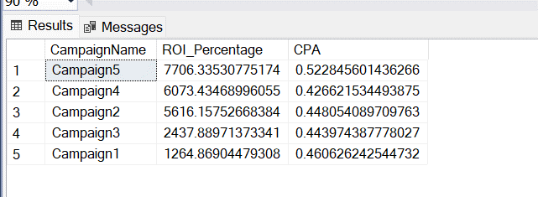
5.In your opinion, which campaign was the most efficient, and why?
WITH CampaignCPA AS (
SELECT
ci.id AS CampaignID,
ci.name AS CampaignName,
SUM(md.cost) / NULLIF(SUM(md.conversions), 0) AS CPA
FROM campaign_info ci
LEFT JOIN marketing_data md ON ci.id = md.campaign_id
GROUP BY ci.id, ci.name
),
CampaignRevenue AS (
SELECT
campaign_id,
SUM(revenue) as TotalRevenue
FROM website_revenue
GROUP BY campaign_id
)
SELECT
cpa.CampaignName,
(cr.TotalRevenue - SUM(md.cost)) / NULLIF(SUM(md.cost), 0) * 100 AS ROI_Percentage,cpa.CPA
FROM CampaignCPA cpa
LEFT JOIN marketing_data md ON cpa.CampaignID = md.campaign_id
LEFT JOIN CampaignRevenue cr ON cpa.CampaignID = cr.campaign_id
GROUP BY cpa.CampaignName, cpa.CPA, cr.TotalRevenue
ORDER BY ROI_Percentage DESC, CPA ASC; -- Prioritize higher ROI and then lower CPA

Slide 16
5.In your opinion, which campaign was the most efficient, and why?
From the result you can see that “campaign-5” is having the highest ROI percentage of 7706.
If we consider the Cost per acquisition “campaign-4” is having the lowest CPA, so we can consider “campaign-4” is the better campaign.
Based on the business requirements we have to choose KPI to be considered.

Slide 17
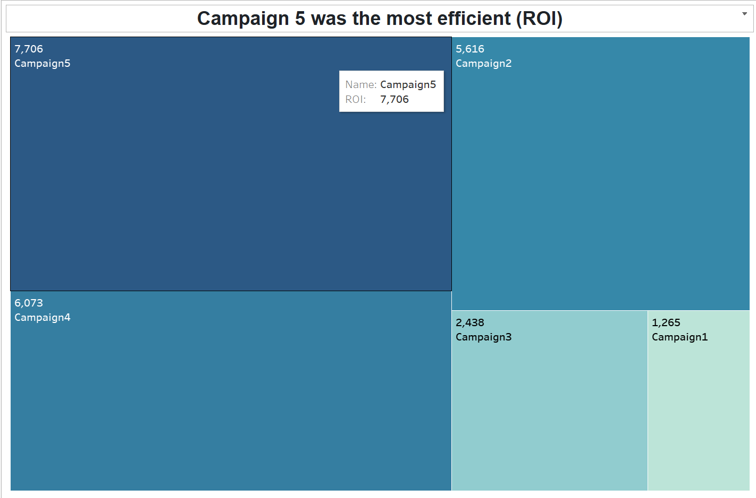
5.In your opinion, which campaign was the most efficient, and why?
The following Tree graph shows the ROI percentage for each campaign.
From the graph it is evident that the campaign-5 is having the highest ROI and campaign-1 is having the lowest ROI.
The most efficient one will be the campaign-5 and least efficient is campaign-1

Slide 18
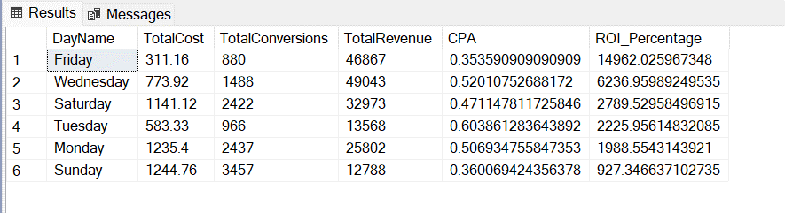
6.Write a query that showcases the best day of the week (e.g., Sunday, Monday, Tuesday, etc.) to run ads
WITH DaywiseData AS (
SELECT
DATEPART(weekday, md.date) AS DayOfWeek,
SUM(md.cost) AS TotalCost,
SUM(md.conversions) AS TotalConversions
FROM marketing_data md
GROUP BY DATEPART(weekday, md.date)
),
DaywiseRevenue AS (
SELECT
DATEPART(weekday, date) AS DayOfWeek,
SUM(revenue) as TotalRevenue
FROM website_revenue
GROUP BY DATEPART(weekday, date)
)
SELECT
DATENAME(weekday, dd.DayOfWeek) AS DayName,
dd.TotalCost,
dd.TotalConversions,
dr.TotalRevenue,
dd.TotalCost/dd.TotalConversions AS CPA,
(dr.TotalRevenue - dd.TotalCost) / NULLIF(dd.TotalCost, 0) * 100 AS ROI_Percentage
FROM DaywiseData dd
LEFT JOIN DaywiseRevenue dr ON dd.DayOfWeek = dr.DayOfWeek
ORDER BY ROI_Percentage DESC;

Slide 19
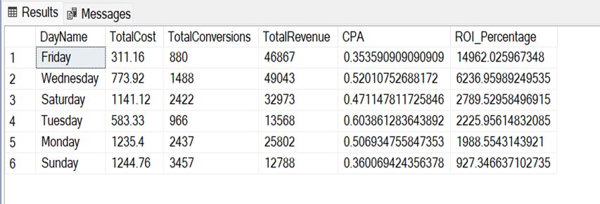
6.Write a query that showcases the best day of the week (e.g., Sunday, Monday, Tuesday, etc.) to run ads
From the result you can see that “Friday” is having the highest ROI percentage of 14962.
If we consider the Cost per acquisition “Friday” is having the lowest CPA, so we can consider “Friday” is the better campaign day.
As per the result “ Friday” is the most efficient day to conduct the campaigns.

Slide 20
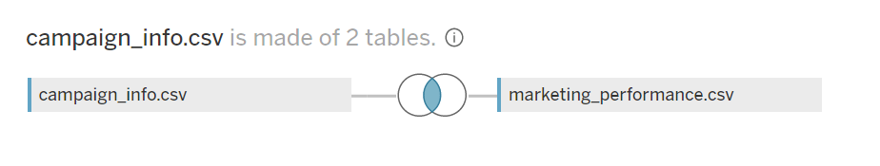
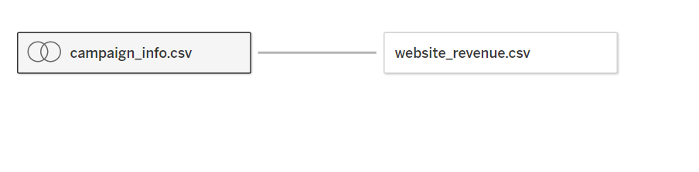
Data source configuration in tableau
Here is the image how the csv files are joined to solve the challenge.
“id” from campaign info file is equated to campaign id of marketing performance csv file.
Then one to one cardinal relation is established between the campaign id for website revenue and campaign info table.

Slide 21

Thank you

