Slide 1
E-COMMERCE RETAIL
SALES ANALYSIS
End-to-end Data Analytics Project
Presented by: Tharun Kumar Reddy

Slide 2
Project Overview
• Analyzes e-commerce retail sales data to understand business performance.
• Explores revenue, profit, products, customers, regions, and payment methods.
• Combines Python, SQL, and Power BI in an end-to-end analytics workflow.
• Transforms raw datasets into business insights for data-driven decisions.
2

Slide 3
Problem Statement
• E-commerce businesses generate data from customers, orders, products, payments, and marketing channels.
• Raw data alone does not clearly reveal sales trends, product profitability, customer retention, or regional performance.
• This project analyzes the data and presents key findings through an interactive dashboard.
• Goal: support better business decisions using sales and customer insights.
3

Slide 4
Project Objectives
• Measure total revenue, profit, orders, and average order value.
• Identify top-performing products and categories.
• Study monthly sales trends and state-wise revenue.
• Understand repeat purchasing behaviour and acquisition channels.
• Compare payment methods and evaluate product profit margins.
4

Slide 5
Tools & Technologies
• Python – Pandas, NumPy, Matplotlib, and Seaborn for data preparation and exploration.
• Google Colab – Python development environment.
• SQL – querying and business analysis.
• Power BI – interactive dashboard and data visualization.
• DAX – KPI and measure calculations; Excel and GitHub – data inspection and version control.
5

Slide 6
Project Workflow
• Raw data loading and dataset preparation.
• Data cleaning and exploratory data analysis.
• SQL queries for business-focused analysis.
• DAX measures for KPIs and profitability metrics.
• Power BI dashboard development and insight generation.
6

Slide 7
SQL Business Analysis
• Sales & Revenue – total revenue, average order value, and monthly performance.
• Product & Profitability – top products, category performance, and profit margins.
• Customer Behaviour – top customers and repeat purchase patterns.
• Regional Analysis – revenue contribution by state.
• Payment, Orders, Discounts & Acquisition – payment preferences, order status, discount impact, and channel performance.
7

Slide 8
Dataset Overview
• cleaned_customers – customer details, state, signup date, and acquisition channel.
• cleaned_orders – order dates, status, payment method, and customer reference.
• cleaned_products – product names, categories, list prices, and unit costs.
• cleaned_order_items – product quantities, selling prices, and discount amounts.
8

Slide 9
Dashboard Components
• KPIs: Total Revenue, Total Profit, Total Orders, Average Order Value, Repeat Purchase Rate.
• Monthly Revenue Trend and Revenue by Category.
• Top 10 Products by Revenue and Revenue by State.
• Payment Method Distribution and Product Profit Margin.
• Customer Acquisition Channel.
• Filters: Order Date, Category, State, and Payment Method.
9

Slide 10
Business Insights
• Track how revenue changes over time.
• Identify products and categories contributing most to sales.
• Compare product profitability and state-wise revenue.
• Understand customer repeat purchasing behaviour.
• Explore payment preferences and acquisition channels.
• Quantify final findings using validated analysis results.
10

Slide 11
Future Development – Machine Learning
• Sales Forecasting – predict future revenue from historical sales.
• Customer Segmentation – group customers using purchasing behaviour and K-Means.
• Repeat Purchase Prediction – estimate the likelihood of another purchase.
• Product Demand Forecasting – support inventory and demand planning.
• Profit Prediction – estimate future product profitability.
11

Slide 12
Conclusion
• The project combines data preparation, SQL analysis, and interactive visualization.
• It provides a structured view of sales, products, customers, and regional performance.
• The dashboard supports exploration of business metrics through filters and visual reports.
• Machine Learning is a planned next step to introduce predictive capabilities.
12

Slide 13
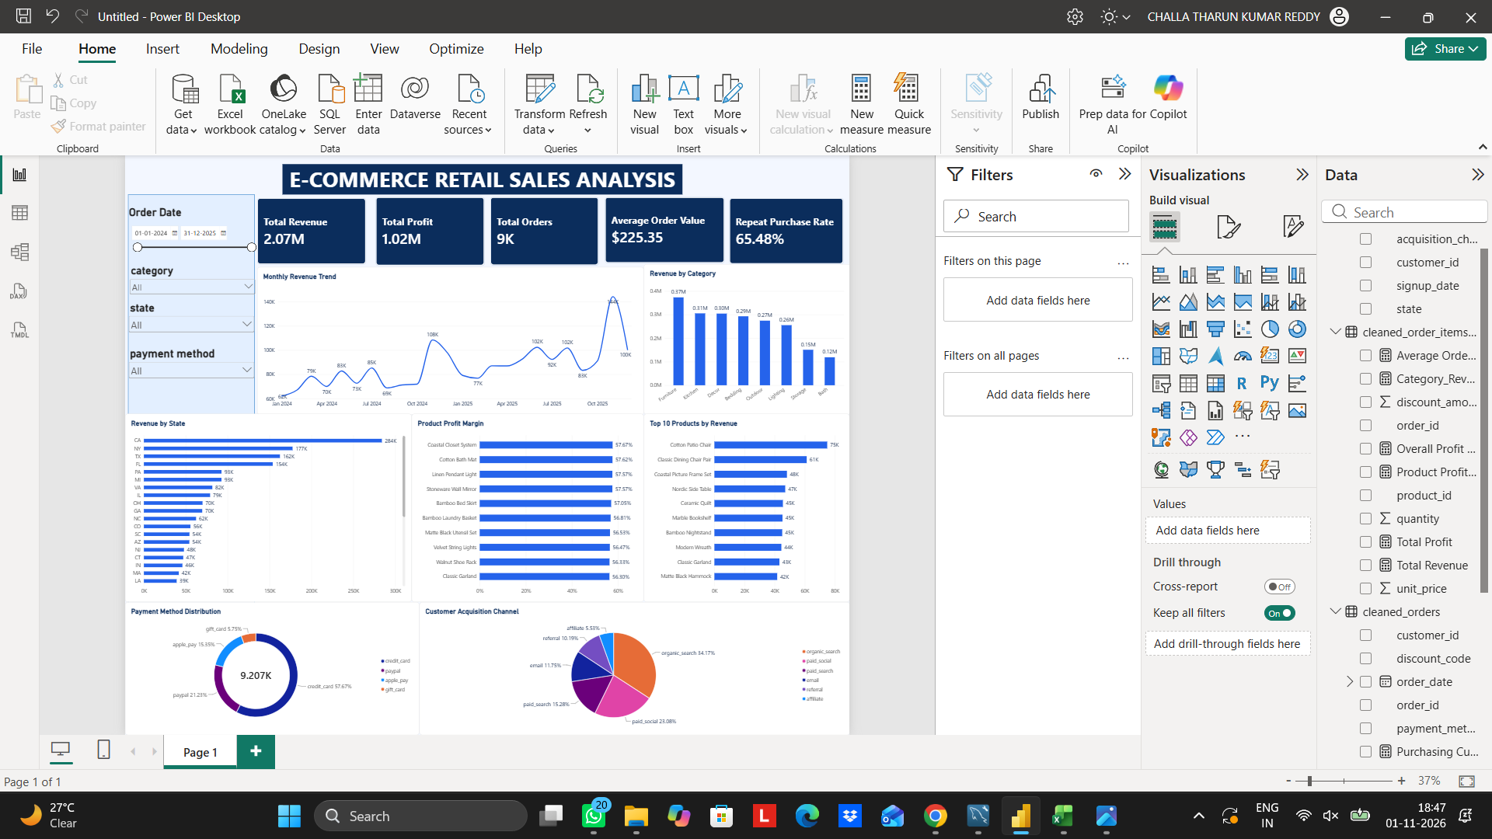
Power BI Dashboard
Executive overview with interactive KPIs, charts, and slicers
13

Slide 14
THANK YOU
E-commerce Retail Sales Analysis

