Slide 1

Code Refactoring and Bug Fixing
B. THARUN KUMAR

Slide 2
About me
Introduction
B. Tharun Kumar
Why you want to learn Data Science
Data science enables organizations to make better decisions by analyzing and interpreting data quickly and accurately. It helps streamline processes and optimize operations by analyzing data to identify areas of improvement. So as a data enthusiast , I chosen this field as a main career domain.

Slide 3
Scenario:
A team of enthusiastic data scientists embarked on a mission to develop a Note Taking Application using Python, Flask, and HTML. However, their lack of experience in backend development has led to challenges in making the application fully functional. Recognizing your proficiency in backend development, you have been tasked with fixing the broken code and ensuring the application works seamlessly.
Task:
Refactor the existing codebase and ensure the proper functioning of the Note Taking Application. Document all identified bugs during the debugging process. Remember, the task is not about recreating the app from scratch. Your goal is to fix the already existing codebase and make the application work as intended.
More Details:
The application's home route contains a text field and a button. Users can add a note, and all the notes should be displayed as an unordered list below the text field on the same page.

Slide 4
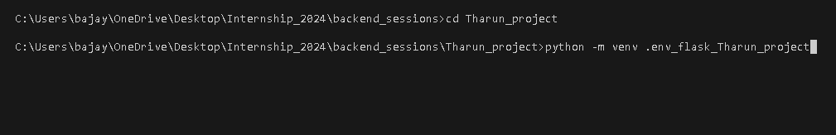
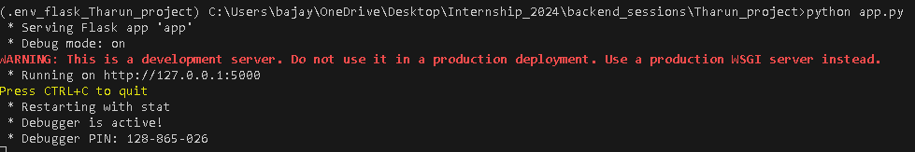
On Visual Studio to fix bugs by using Python and Flask frame work.
Mandatory steps:
Create a Virtual environment in app folder by using this code.
Activate the virtual environment by using this below code.
Run python app.py file to check how was web interface.

Slide 5
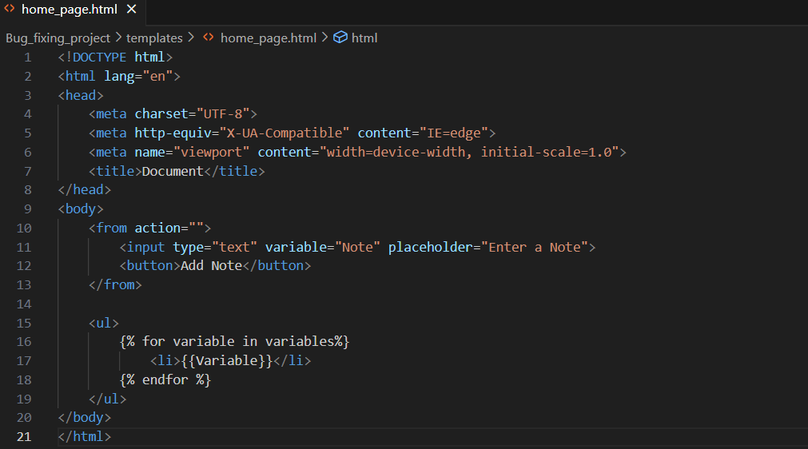
HTML code Before Fixing Bugs

Slide 6
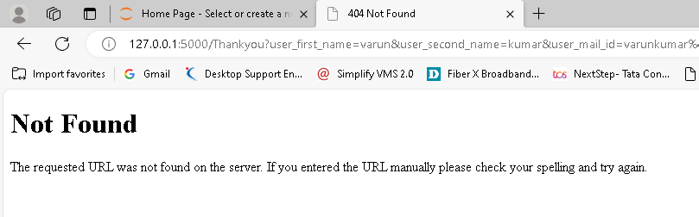
Web Page before fixing the bug

Slide 7
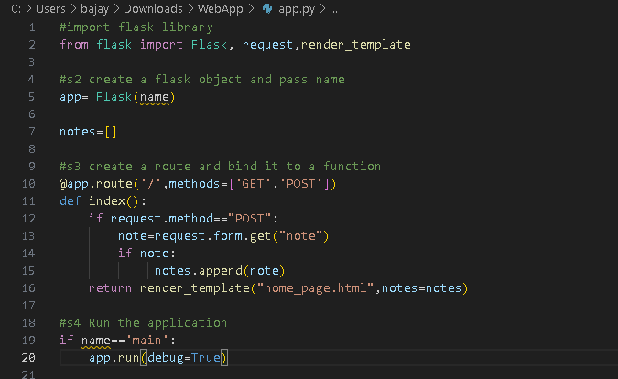
After Fixing The Bug
2 Methods – GET, POST

Slide 8
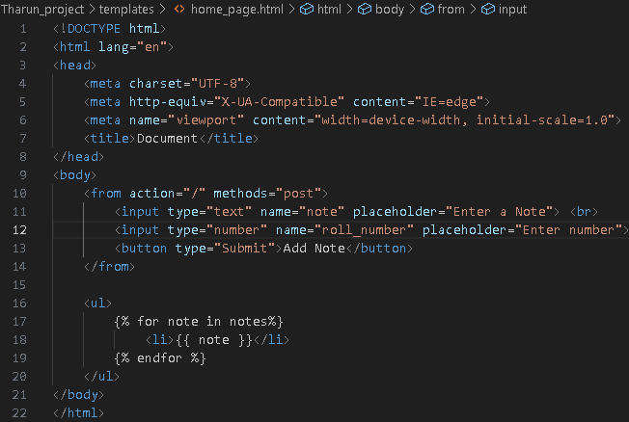
HTML code after bug fix

Slide 9
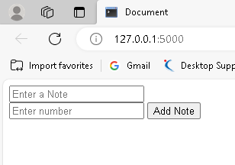
Web Page after Bug fixation

Slide 10

THANK YOU

