Slide 1
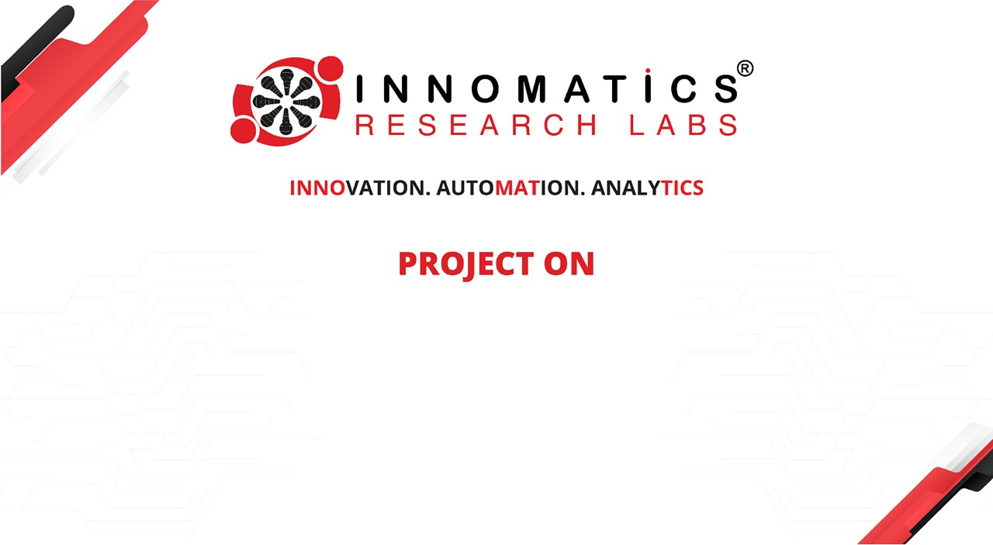
Transformers, GPT and the roadmap to the rapid progress
B THARUN KUMAR

Slide 2

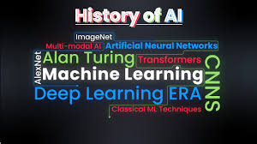
Introduction
The journey of AI's evolution in language understanding, transitioning from Deep Neural Networks (DNNs) and Long Short-Term Memory (LSTM) networks to transformers such as BERT and GPT models, is captivating and dynamic.
This progression signifies a thrilling advancement in machine communication, revolutionizing the way machines comprehend and generate human-like language.

Slide 3
Deep Neural Networks
Deep Neural Networks (DNNs) are complex artificial neural networks composed of multiple layers of interconnected neurons.
They excel in learning hierarchical representations of data through non-linear transformations.
DNNs are trained using optimization algorithms to adjust their parameters and minimize the difference between predicted and actual outputs.
They are universal function approximators capable of modeling intricate relationships in various domains, including image and speech recognition, natural language processing, and pattern recognition.

Slide 4
Limitations of Deep Neural Networks
1. Fixed-dimensional Inputs and Targets:
- DNNs struggle with fixed-dimensional inputs and targets, which can limit their flexibility in handling variable data structures.
2. Overfitting:
- DNNs are prone to overfitting, especially when dealing with complex datasets, leading to poor generalization performance on unseen data.
3. Limited Interpretability:
- Understanding the internal workings of DNNs and interpreting their decisions can be challenging due to their complex architectures and large number of parameters.
4. Computational Complexity:
- Training and inference with DNNs can be

Slide 5
computationally intensive, requiring significant computational resources and time.
5. Data Dependence:
- DNNs heavily rely on large volumes of labeled data for training, making them less suitable for tasks with limited or sparse data availability.
6. Gradient Vanishing and Exploding:
- DNNs can suffer from the vanishing or exploding gradient problem, particularly in deep networks, affecting the stability and convergence of the training process.
7. Hyperparameter Sensitivity:
- DNN performance is highly sensitive to hyperparameter settings, requiring careful tuning to achieve optimal results.
8. Difficulty in Capturing Long-term Dependencies:
-DNNs may struggle to capture long-term dependencies in sequential data, limiting their effectiveness in tasks such as natural language processing

Slide 6
Introduction of sequence-sequence learning:
The concept of "Sequence to Sequence Learning with Neural Networks" introduced the Encoder-Decoder architecture, specifically tailored for sequence-to-sequence (seq2seq) tasks such as machine translation.
Strengths in handling variable length sequences:
By encoding the input sequence into a fixed-length vector representation, they enable the generation of corresponding output sequences of variable lengths.
Challenges with longer sequences:
Despite their effectiveness, these architectures encounter challenges when dealing with longer sequences. The reliance on a fixed-length context vector poses limitations, particularly in scenarios where the input or output sequences are lengthy. This constraint may lead to information loss and hinder the model's ability to capture nuanced dependencies within the data.

Slide 7
LSTM
Recurrent Neural Networks (RNNs) are widely used for sequential data processing, yet they encounter difficulties when dealing with variable input and output lengths. To overcome these challenges, Long Short-Term Memory (LSTM) architectures have emerged as a solution, offering enhanced capabilities in sequence learning tasks.
Transformers
Introduced in the landmark paper "Attention is All You Need," transformers have revolutionized various NLP tasks, including machine translation, text summarization, and language generation. Transformers are a type of deep learning model architecture introduced in 2017. They rely on self-attention mechanisms to weigh the importance of different input tokens, enabling them to capture long-range dependencies in data effectively. Transformers have become the state-of-the-art architecture in natural language processing tasks such as machine translation and text generation.

Slide 8
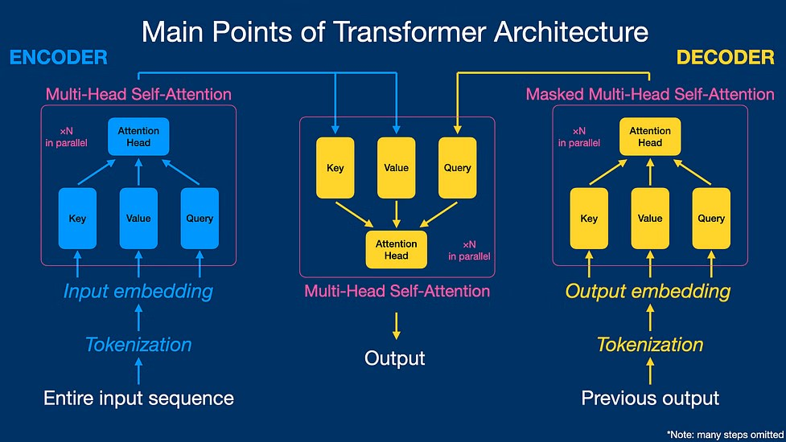
Key Components of the Transformer Architecture:
Encoder-Decoder Architecture
Self-Attention Mechanism
Multi-Head Attention
Feed-Forward Network
Skip/Residual Connections
Positional Encoding
7.Parallelization and Scalability

Slide 9
1.Self attention mechanism:
This mechanism allows the model to weigh the importance of each word in the input sequence concerning every other word, capturing long-range dependencies effectively.
2.Encoder:
The encoder module processes the input sequence and generates a series of hidden representations using multiple layers of self-attention and feed-forward neural networks.
3.Decoder:
The decoder module takes the encoder's output and generates the output sequence by attending to relevant parts of the input sequence and previously generated tokens.

Slide 10
4.Multi-head attention:
It enables the model to focus on different parts of the input sequence simultaneously, enhancing its ability to capture diverse patterns and relationships.
5.Feed-Forward Neural Networks:
These networks are employed within each layer of the encoder and decoder to process the intermediate representations and generate the final output.
6.Positional Encoding:
Positional encoding is added to the input embeddings to provide information about the position of each token in the sequence, enabling the model to understand the sequential order of the input.
7.Residual Connections and Layer Normalization:
Residual connections facilitate the flow of information through the network, while layer normalization helps stabilize the training process by normalizing the activations within each layer.

Slide 11
BERT
BERT, an abbreviation for Bidirectional Encoder Representations from Transformers, has made significant contributions to the field of natural language processing since its introduction by Google in 2018. Its importance stems from several key factors:
1.Contextual Understanding: BERT employs a transformer-based architecture that allows it to capture the contextual meaning of words and phrases in a given text.
2. Pre-training and Fine-tuning: BERT is pre-trained on vast amounts of text data, allowing it to learn general language representations.
3. State-of-the-art Performance: BERT has achieved state-of-the-art performance on various benchmark NLP tasks, including question answering, sentiment analysis, and named entity recognition.
4. Open-source Availability: BERT is open-source, allowing researchers and developers worldwide to access and build upon its architecture. This accessibility has facilitated widespread adoption and contributed to the rapid advancement of NLP research.
5. Influence on Research: BERT's introduction has sparked significant research interest and innovation in the field of NLP. It has inspired the development of numerous follow-up models and techniques aimed at further improving language understanding and generation capabilities.

Slide 12
CONCLUSIONS
1. Evolution of AI in Language Understanding:
Progression from DNNs and LSTMs to transformers (BERT, GPT) signifies advancement in language understanding.
Journey showcases rapid innovation for better human-machine communication.
2. Impact on Machine Communication:
Adoption of advanced models enhances machine's language comprehension and generation.
Facilitates smoother human-machine interactions.
3. Enhancing Human-Machine Interactions:
Models like BERT and GPT foster natural communication channels.
Contribute to intelligent systems for precise responses.
4. Limitations of DNNs:
DNNs face constraints with fixed-dimensional inputs and targets.
5. Role of LSTM Architectures:
LSTMs handle variable-length sequences effectively.
Captures complex patterns in sequential data.

Slide 13
6. Introduction to Sequence-to-Sequence Learning:
Encoder-Decoder architecture enables seamless translation across domains.
7. Strengths in Handling Variable-Length Sequences:
LSTM adapts to diverse data types with fixed-length vector representations.
8. Challenges with Longer Sequences and Refinement:
LSTM faces challenges with longer sequences, driving refinement efforts.
9. Importance of Transformers:
Transformers offer superior performance, scalability, and efficiency.
Revolutionize NLP and sequential data modeling.
10. Impact of BERT:
BERT influences NLP research, showcasing state-of-the-art performance and inspiring innovation.

Slide 14


