Slide 1

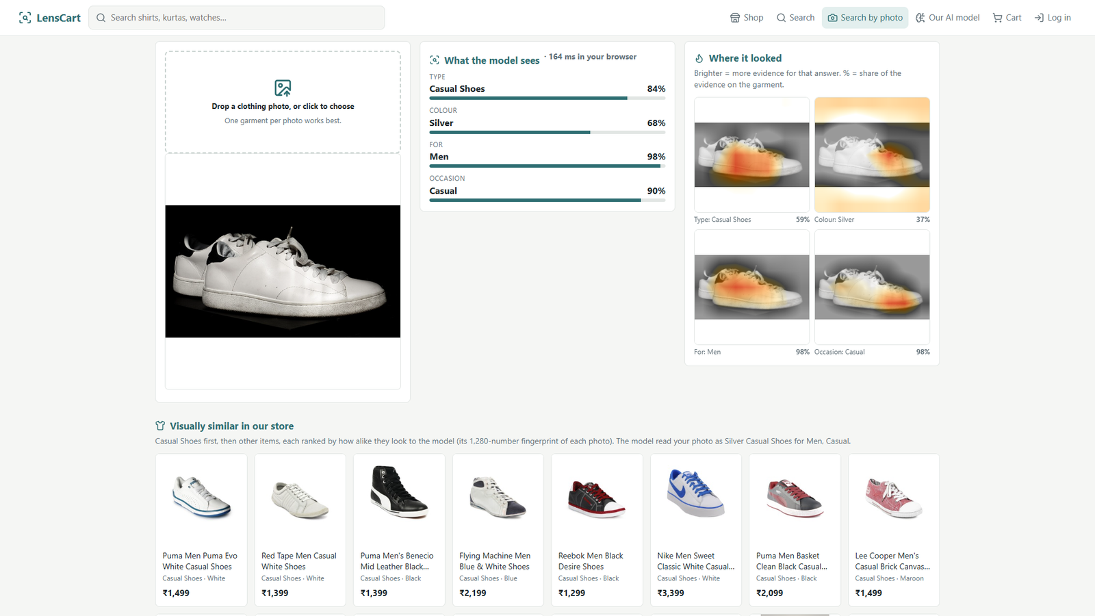
LensCart
A fashion store whose own vision model reads every product photo
Type, colour, who it is for and occasion from pixels alone, with a heat map of where it looked. Used for photo search, seller auto-tagging and catalogue checks.
Our model on an outside photo (Wikimedia Commons, CC BY 2.0)
Team Code Explorers
Vinay G (20241CSE0759) · M Tharun (20241CSE0692)
Notes:
LensCart is an online fashion store. Its core is a computer-vision model we trained: it reads any product photo and predicts the article type, colour, who it is for, and the occasion, and it shows where in the image it looked. The store uses it three ways: shoppers search by photo, sellers get product tags filled in automatically, and the catalogue gets checked for wrong labels.

Slide 2

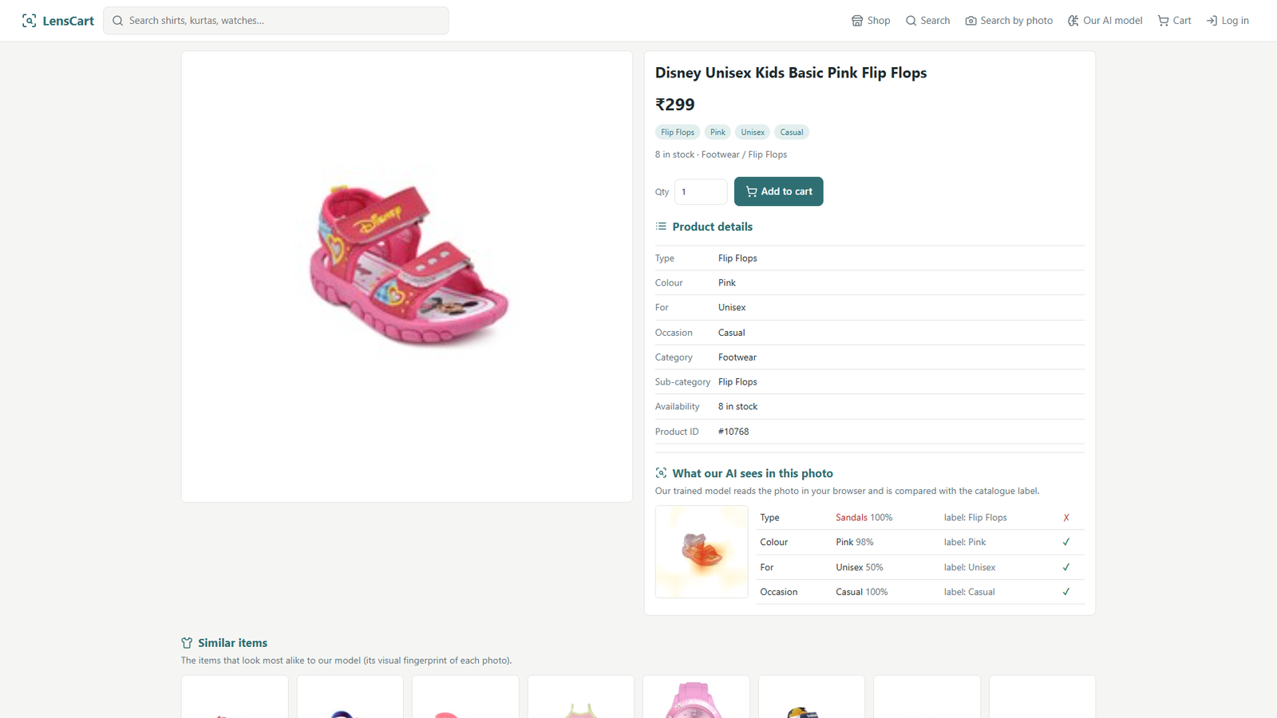


Product photos carry the information; catalogues lose it
Sellers tag every product by hand
Type, colour, gender and occasion are typed in, one listing at a time.
Wrong tags hide products
Search and filters only find what the tags say, so mislabelled items go unseen.
Shoppers think in pictures
They know what they want to look like, not what the catalogue calls it.
Our model flagged this catalogue label: listed as Flip Flops, it sees Sandals
Who pays
Online fashion sellers and marketplace catalogue teams: auto-tagging cuts listing work. Example: Vue.ai reports 90% faster product onboarding for Diesel (company's own claim).
It caught a real label error
Test-set product #10768 is labelled "Flip Flops". The model says Sandals at 100% and, by eye, it is a strapped sandal.
Notes:
The problem: in fashion e-commerce the photo has the information, but the catalogue depends on tags people type by hand. Wrong tags hide products from search. Who pays: sellers and catalogue teams, because auto-tagging cuts listing work. Vue.ai, a company in this space, reports 90 percent faster onboarding for Diesel; that is their own claim. The example on the right is real: our model disagreed with the dataset's own label, and the model is right.

Slide 3
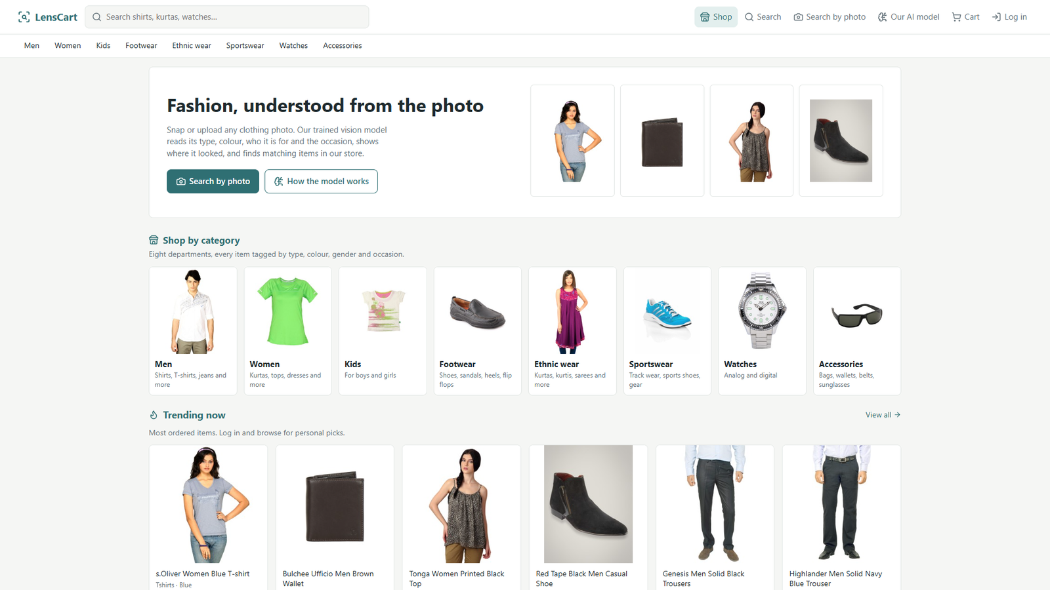



What we built: a full store around the model
Search by photo
Upload a photo, get its tags, heat maps and matching items.
AI auto-fill for sellers
Adding a product? The model fills type, colour, gender, occasion.
Personalised picks
Recommendations from each shopper's browsing history.
Admin analytics
Revenue, orders, order value, customers, top products, stock.
Home page, local XAMPP: 1,500 real products in 45 types, 8 departments
Notes:
Around the model we built a complete store: login and registration, eight departments, search with filters, cart and checkout, and an admin panel. The model powers search by photo, auto-fill when a seller adds a product, and an AI card on every product page. Prices, stock and orders are demo data and labelled as such.

Slide 4
One network, four answers, and where it looked
Type · 49 classes
Photo
padded to a white square, 224 × 224 px
EfficientNet-B0
ImageNet pre-trained, fine-tuned on our data (transfer learning)
1,280 features
one shared summary of the image
Colour · 18
Gender · 5
Usage · 4
Heat maps (CAM)
Each head is one linear layer on averaged features, so the class score splits exactly into a contribution from every image region. That map is what we draw.
Runs in the browser
Exported to ONNX (16.4 MB), run by ONNX Runtime Web. About 0.2 s per photo after the first load. No Python server, so it works on XAMPP and on the live host.
Notes:
The model: a photo is padded to a white square, resized to 224 pixels, and passed through EfficientNet-B0, which we started from ImageNet weights and fine-tuned on our data. It produces 1,280 features shared by four small heads: type, colour, gender and usage. Because each head is a single linear layer on averaged features, the score splits exactly into contributions from each region of the image: that is the class activation map we draw. We exported the model to ONNX so it runs inside the browser.

Slide 5



Data: 44,446 product photos, cleaned with no leakage
Fashion Product Images
Public Kaggle dataset of Indian e-commerce photos with labels.
Split without leakage
70/15/15, stratified by type, grouped by product name, fixed seed.
Near-duplicates removed
2,468 val/test photos within hash distance 4 of a training photo.
Classes with too few images were dropped; unknown labels are skipped by that head only.
Notes:
Data: the public Fashion Product Images dataset from Kaggle, 44,446 Indian e-commerce photos. We kept apparel, footwear and accessories, and article types with at least 100 images. The split is 70/15/15, stratified by type and grouped by product name so the same product never appears in both training and test. We also removed 2,468 validation and test photos that were near-duplicates of training photos, using perceptual hashing. That leaves 28,270 for training and 4,824 for the final test.

Slide 6
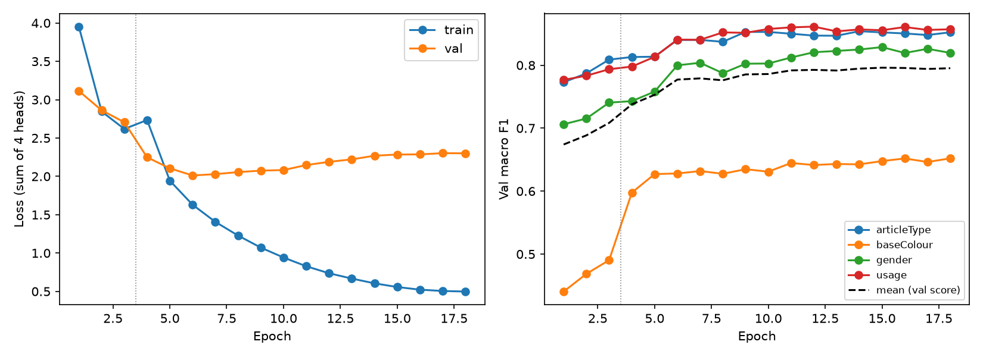
Results on 4,824 test photos the model never saw
Article type
90.4%
95% CI 89.5–91.1%
macro F1 0.859 · top-3 98.6%
Colour
70.7%
95% CI 69.4–72.1%
macro F1 0.640 · top-3 92.3%
Gender
93.1%
95% CI 92.4–93.8%
macro F1 0.818
Usage
92.4%
95% CI 91.6–93.1%
macro F1 0.859
How we measured
Test set used once, after all choices were made on validation. Macro F1 weighs rare classes equally. Intervals from 1,000 bootstrap resamples. Trained in 20.5 minutes on one laptop GPU.
Notes:
Results on 4,824 test photos the model never saw during training: 90.4 percent for article type, 70.7 for colour, 93.1 for gender, 92.4 for usage, each with a 95 percent bootstrap confidence interval. We used the test set exactly once, after every decision was made on the validation set. We report macro F1 because classes are very unbalanced. Colour is the hardest: shades like navy and black, or blue and grey, overlap. The curves show training and validation per epoch; training took 20.5 minutes.

Slide 7
Explainable: it shows where it looked
Brighter = more evidence
One map per answer. For "Casual Shoes" the heat sits on the shoe itself; ignored areas fade to white.
Garment-focus score
Share of the heat that falls on the garment, so "is it looking at the right thing?" becomes a number.
Honest limit
Heat maps show where the evidence was, not proof of reasoning. Two-tone clothes can split the colour answer.
Search by photo on an outside image: tags, heat maps, visually similar store items
Notes:
Every answer comes with a heat map. On this outside photo the model says T-shirt and the heat sits on the shirt, not on the hanger. We turn that into a number, the garment-focus score: the share of the heat that lands on the garment. The limit we state ourselves: a heat map shows where the evidence was, not a full explanation, and two-tone clothes like this one can split the colour answer.

Slide 8

Every design choice was tested, on validation only
Fine-tuning matters
Unfreezing the backbone: 0.715 → 0.778 mean F1.
Small and fast wins
EfficientNet-B0 beats ResNet50 with 4.1 M vs 23.7 M weights; 15.7 vs 36.5 ms per photo on CPU.
Training beats prompting
Zero-shot FashionCLIP scores 0.576 on the same labels.
Short 6-epoch runs; augmentation and class weights differ by under 0.01, which is within noise.
Notes:
We justified each choice with short runs scored on validation, never on test. Fine-tuning the backbone matters most. EfficientNet-B0 beats ResNet50 while being six times smaller and twice as fast on a CPU, which is what lets it run in a browser. A trained model clearly beats zero-shot FashionCLIP. Augmentation and class weights changed the score by less than 0.01, which is within noise, and we say so.

Slide 9
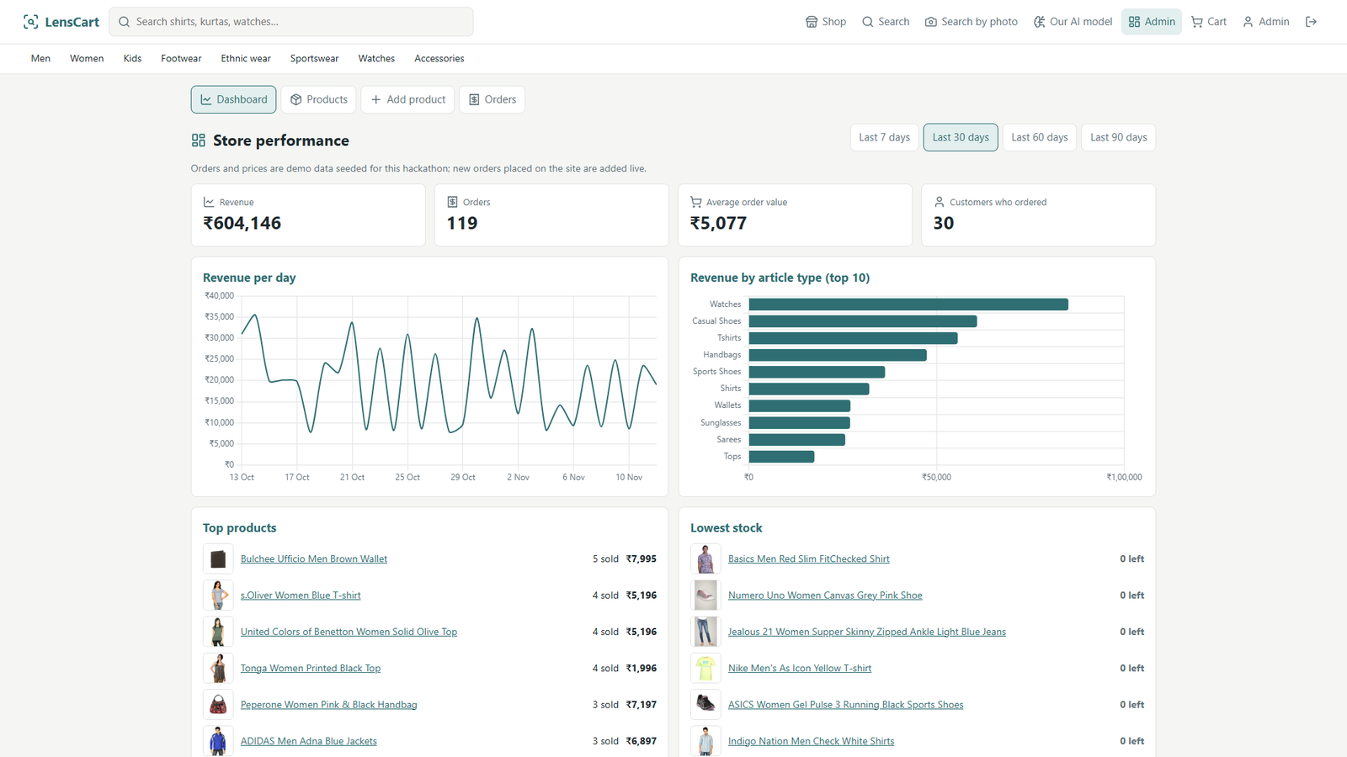


Analytics and the stack
Web
PHP 8 + MySQL on XAMPP; same files on the live host.
AI
PyTorch training; ONNX Runtime Web in the browser.
Security
Hashed passwords, CSRF tokens, prepared statements, upload checks.
Deployment
Local XAMPP, then www.web-a2z.com; code on GitHub.
Admin dashboard: revenue, orders, average order value, customers (demo orders)
Notes:
The admin dashboard tracks revenue, orders, average order value and customers over 7 to 90 days, plus revenue by type, top products and low stock. The orders are seeded demo data; new orders placed on the site are added live. The stack: PHP and MySQL on XAMPP, the same files deployed to the live host, PyTorch for training and ONNX Runtime Web for inference in the browser.

Slide 10



What it can't do yet, and what's next
Limits
Next
Trained on clean catalogue photos; real-world photos are harder
Colour is the weakest head (70.7%); two-tone clothes split it
One public dataset; prices and orders in the store are demo data
Fine-tune on real-world photos and detect each garment in full-body shots
Flag likely catalogue label errors for sellers automatically
Learn similarity directly (triplet loss) for better "similar items"
github.com/VinayG759/LensCart
AI tools used: Claude (Anthropic) for coding assistance
Notes:
What it can't do yet: it was trained on clean catalogue photos, so real-world photos are harder; colour is the weakest head; and it is one public dataset, with demo prices and orders in the store. Next: fine-tune on real-world photos and add garment detection for full-body shots, automatically flag likely catalogue label errors for sellers, and train similarity directly for better similar-item search. The code is on GitHub, and per the rules we disclose that we used Claude for coding assistance.

