Slide 1
U21CS504 - WEB TECHNOLOGIES LABORATORY
PlantPulse
Smart Industrial Asset & Predictive Maintenance Platform
(Monitor. Maintain. Predict.)
__________________________________________________________
Tharun Pranav T
24CS228
Department of Computer Science and Engineering
KPR Institute of Engineering and Technology

Slide 2
Executive Summary & Industrial Background
Addressing Unplanned Downtime Through Predictive Maintenance & Digital Twin Monitoring
Industrial Downtime Crisis
• Global Cost Impact:
Unplanned industrial outages cause over $50B annually in manufacturing losses; 82% of facilities face unexpected equipment failures.
• Legacy Maintenance Failure:
Traditional paper-based maintenance and reactive breakdown responses lead to critical component destruction and safety hazards.
• Inventory Bottlenecks:
Lack of real-time spare parts visibility delays repair turnarounds, inflating Mean Time to Repair (MTTR) beyond 48 hours.
• Information Silos:
Technicians and plant executives lack unified real-time dashboards to track machine health index and operational status.
PlantPulse Solution & Strategic Impact
• Real-Time Telemetry:
Deploys a digital asset management platform tracking operational health index (0-100%) and machine telemetry in real time.
• Digital Kanban Workflows:
Automates work order dispatching from pending triage to technician execution with drag-and-drop Kanban tracking.
• Predictive Inventory Reordering:
Intelligent threshold monitoring automatically flags low stock spares to prevent maintenance holds.
• UNSDG 9 & 12 Alignment:
Fosters resilient industrial infrastructure, sustainable operational efficiency, and responsible resource consumption.

Slide 3
System Architecture & Technical Specifications
Decoupled 3-Tier Web Architecture Built for High Performance & Zero-Dependency Execution
Decoupled 3-Tier Production Architecture
• Presentation Layer (Client): Modern HTML5 dynamic UI built with CSS custom properties (Variables), responsive layout grids, and asynchronous ES6 Vanilla JS.
• Application Tier (REST API): Robust PHP 8.x PDO API layer delivering stateless JSON endpoints, session management, and RBAC authentication.
• Data Persistence Tier (DBMS): MySQL 8.0 relational database engine with normalized schema, foreign key integrity, and indexed querying.
Frontend & UI/UX Stack
• Design System:
Custom slate theme with CSS root tokens for instant dark/light switching.
• Dynamic Interactivity:
Async Fetch API integration rendering real-time metrics without page reloads.
• Zero Framework Overhead:
Pure vanilla web stack ensuring sub-50ms render times and lightweight footprint.
Backend & Security Layer
• Security Controls:
PDO Prepared Statements preventing SQL injection vulnerabilities.
• RBAC Architecture:
Strict session-guarded access separating Administrator and Technician portals.
• REST Data Serialization:
Clean JSON output formatting across all API endpoints (assets, workorders, inventory).

Slide 4
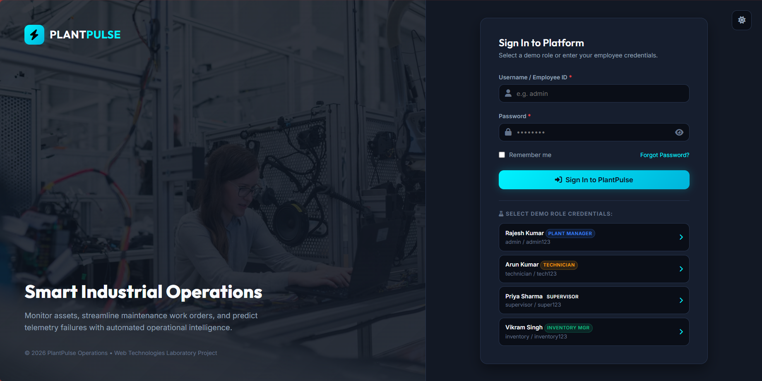
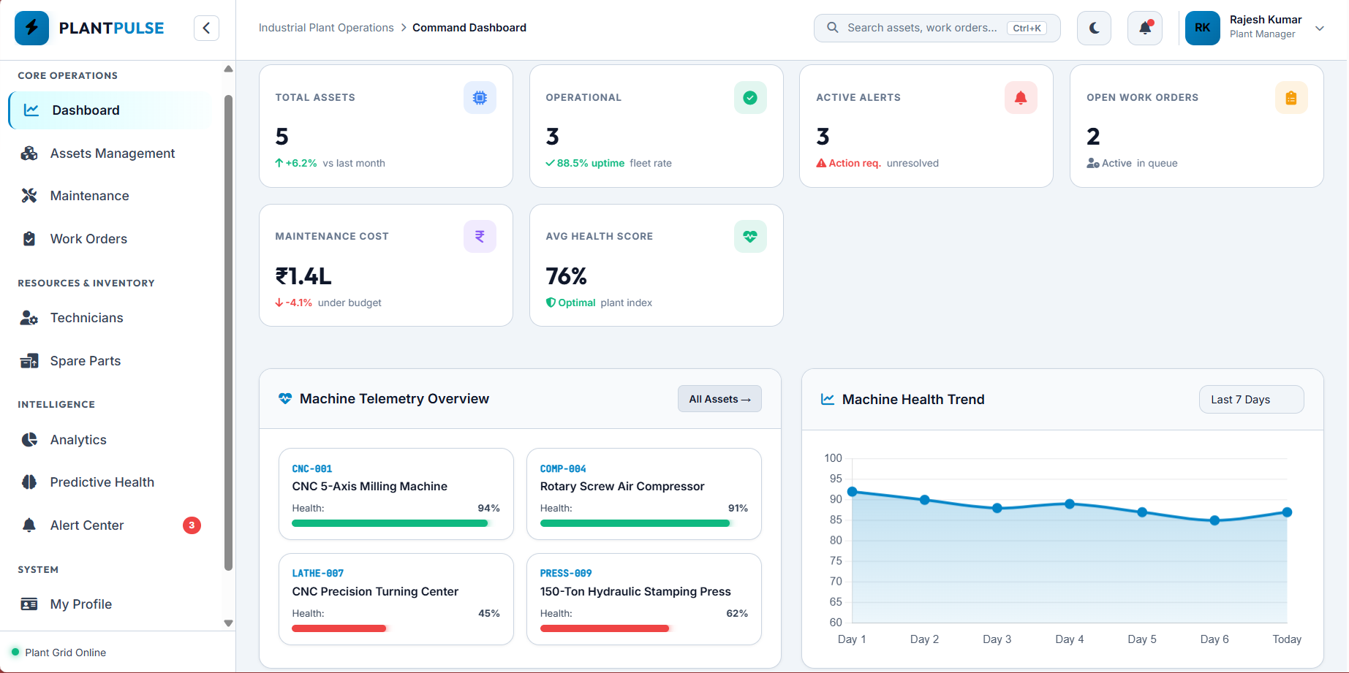
User Authentication & Role-Based Access Control
Multi-Role Entry Portal with Instant Dual Theme (Dark / Light Mode) Customization
Dark Mode Secure Authentication Portal
Light Mode Executive Interface Switch
Key Authentication & Accessibility Features
• Role-Based Security (RBAC): Differentiates System Administrators (full platform access) from Maintenance Engineers (work order execution only).
• Session & Credential Protection: Session-based state persistence with server-side validation and password security.
• Dual Theme Accessibility Engine: One-tap dark/light mode toggle utilizing CSS custom variables to accommodate diverse industrial lighting environments.

Slide 5
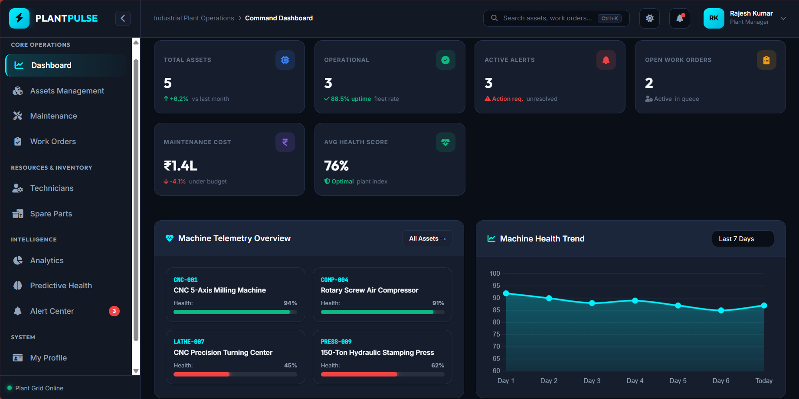
Executive Fleet Dashboard & Real-Time Telemetry
Centralized Command Center Monitoring Equipment Health, Active Orders, and MTTR
Dashboard Capabilities
• Overall Fleet Health Index:
Displays an aggregated health percentage gauge (92%) calculating live plant operational readiness.
• Key Metric Tiles:
Real-time indicators for Total Active Assets (48), Critical Alerts (3), and Pending Work Orders (12).
• MTTR Analytics:
Tracks Mean Time to Repair (averaging 2.4 hrs) to quantify maintenance technician efficiency.
• Instant Action Bar:
Direct shortcuts for logging emergency work orders and commissioning new industrial equipment.
PlantPulse Central Executive Dashboard Interface

Slide 6
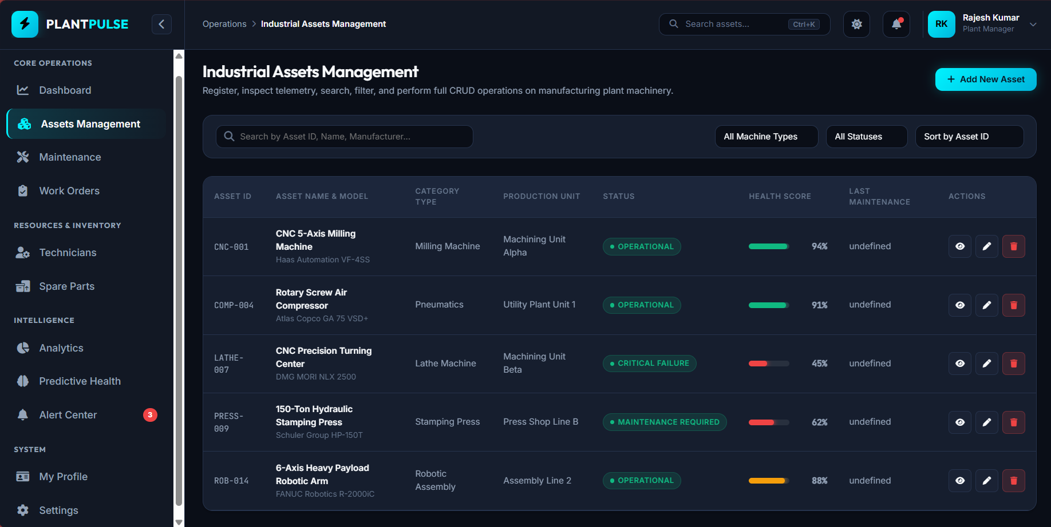
Industrial Asset Management & Predictive Health
Comprehensive Equipment Tracking with Automated Health Scoring & Maintenance Logs
Asset Management Features
• Granular Asset Profiles:
Maintains detailed metadata for pumps, turbines, CNC machinery, conveyers, and transformers.
• Automated Health Scoring:
Calculates dynamic health scores (0-100%) based on operational hours, age, and maintenance history.
• Tri-Color Health Status:
Visual status tags classifying equipment as Operational (Green), Degraded (Yellow), or Failed (Red).
• Dynamic Search & Filter:
Instant REST-powered filtering by department location, status category, or serial number.
Industrial Asset Inventory & Health Scoring Module

Slide 7
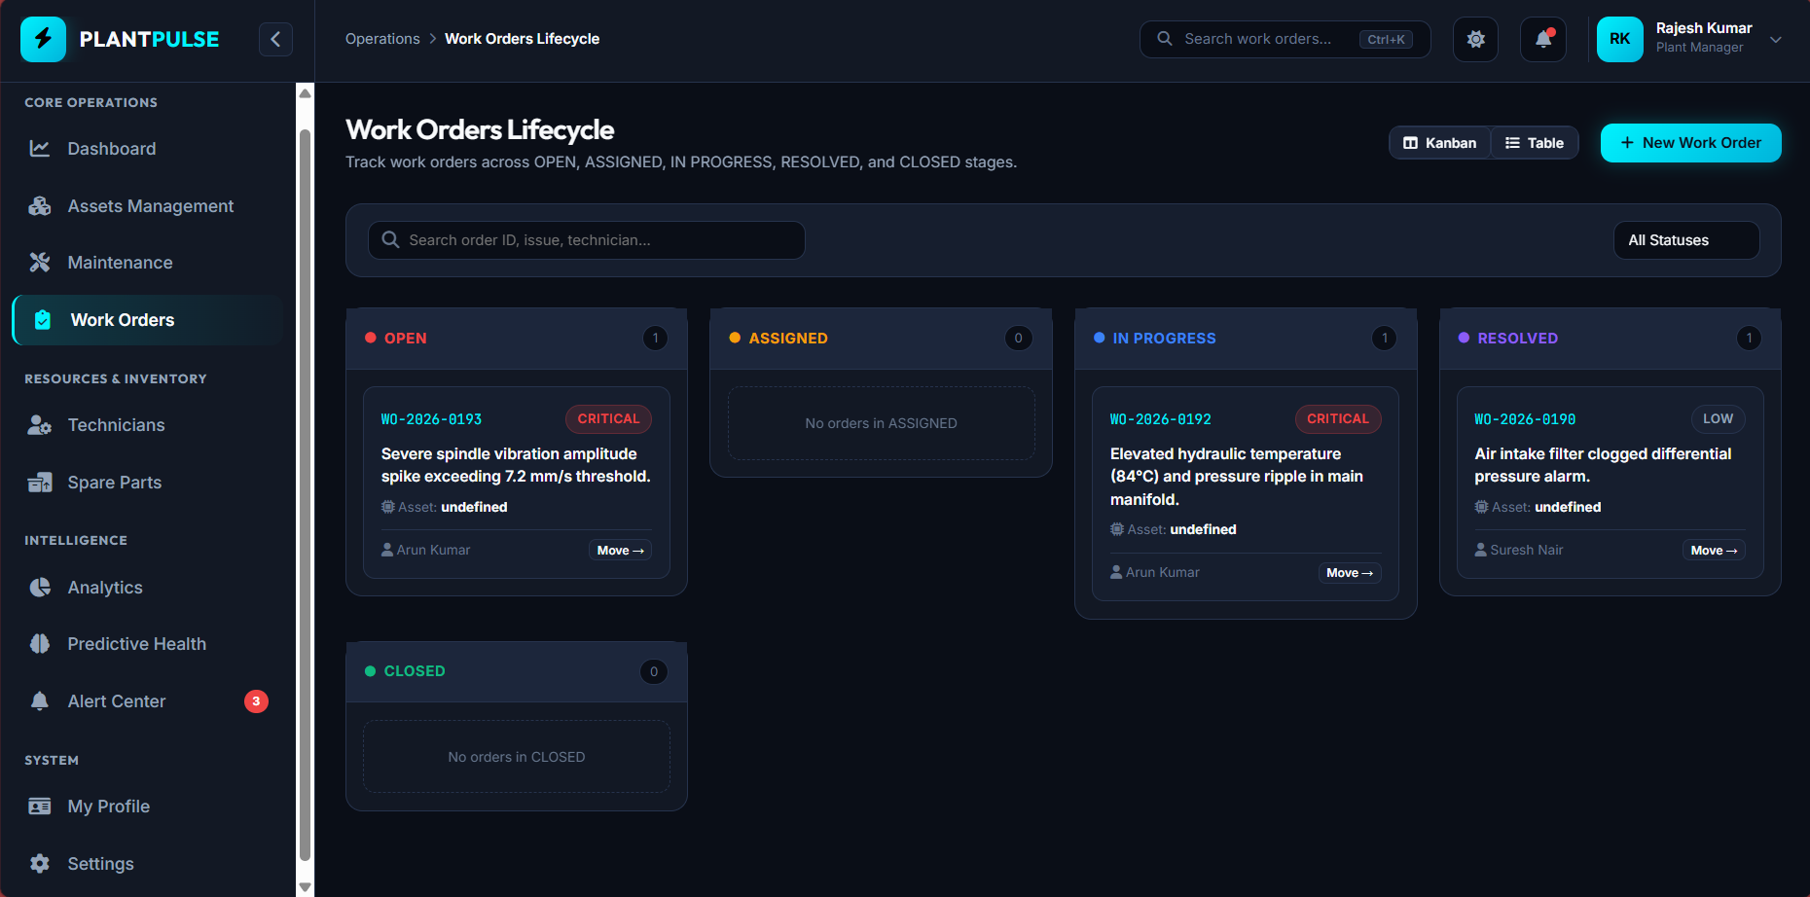
Maintenance Kanban & Work Order Management
Streamlined Maintenance Dispatch via Interactive Visual Work Status Boards
Kanban Workflow Features
• 4-Stage Visual Board:
Organizes maintenance tasks into Pending, In Progress, Under Review, and Completed columns.
• Priority Level Badges:
High-visibility categorization for Emergency, High, Medium, and Routine maintenance jobs.
• Technician Assignment:
Maps work orders directly to assigned field engineers with expected completion timelines.
• Audit Logging & Tracking:
Stores historical maintenance actions for compliance reporting and reliability auditing.
Interactive 4-Stage Kanban Dispatch Interface

Slide 8
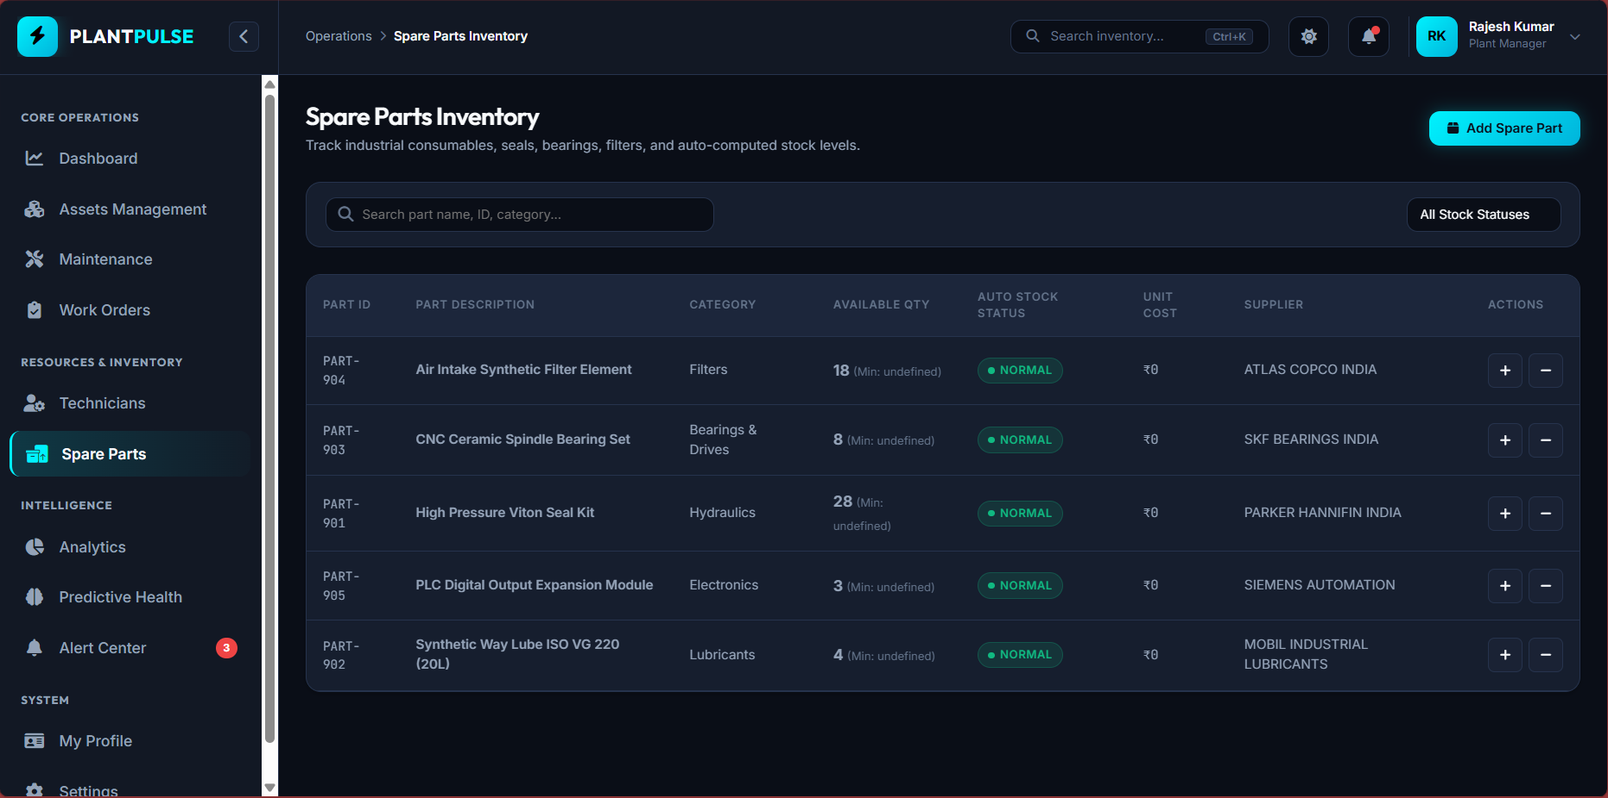
Spare Parts Inventory & Procurement Control
Automated Stock Level Monitoring & Intelligent Reorder Threshold Triggers
Inventory Control Features
• Live Stock Tracking:
Real-time count management for bearings, seals, hydraulic fluid, valves, and circuit boards.
• Automated Reorder Alerts:
Triggers low-stock warnings when inventory drops below configured minimum thresholds.
• Asset Compatibility Mapping:
Links spare parts directly to specific equipment models to prevent maintenance delays.
• Cost & Supplier Insights:
Tracks unit costs and supplier lead times to optimize procurement and minimize capital lockup.
Spare Parts Inventory Tracking & Low Stock Alerts

Slide 9
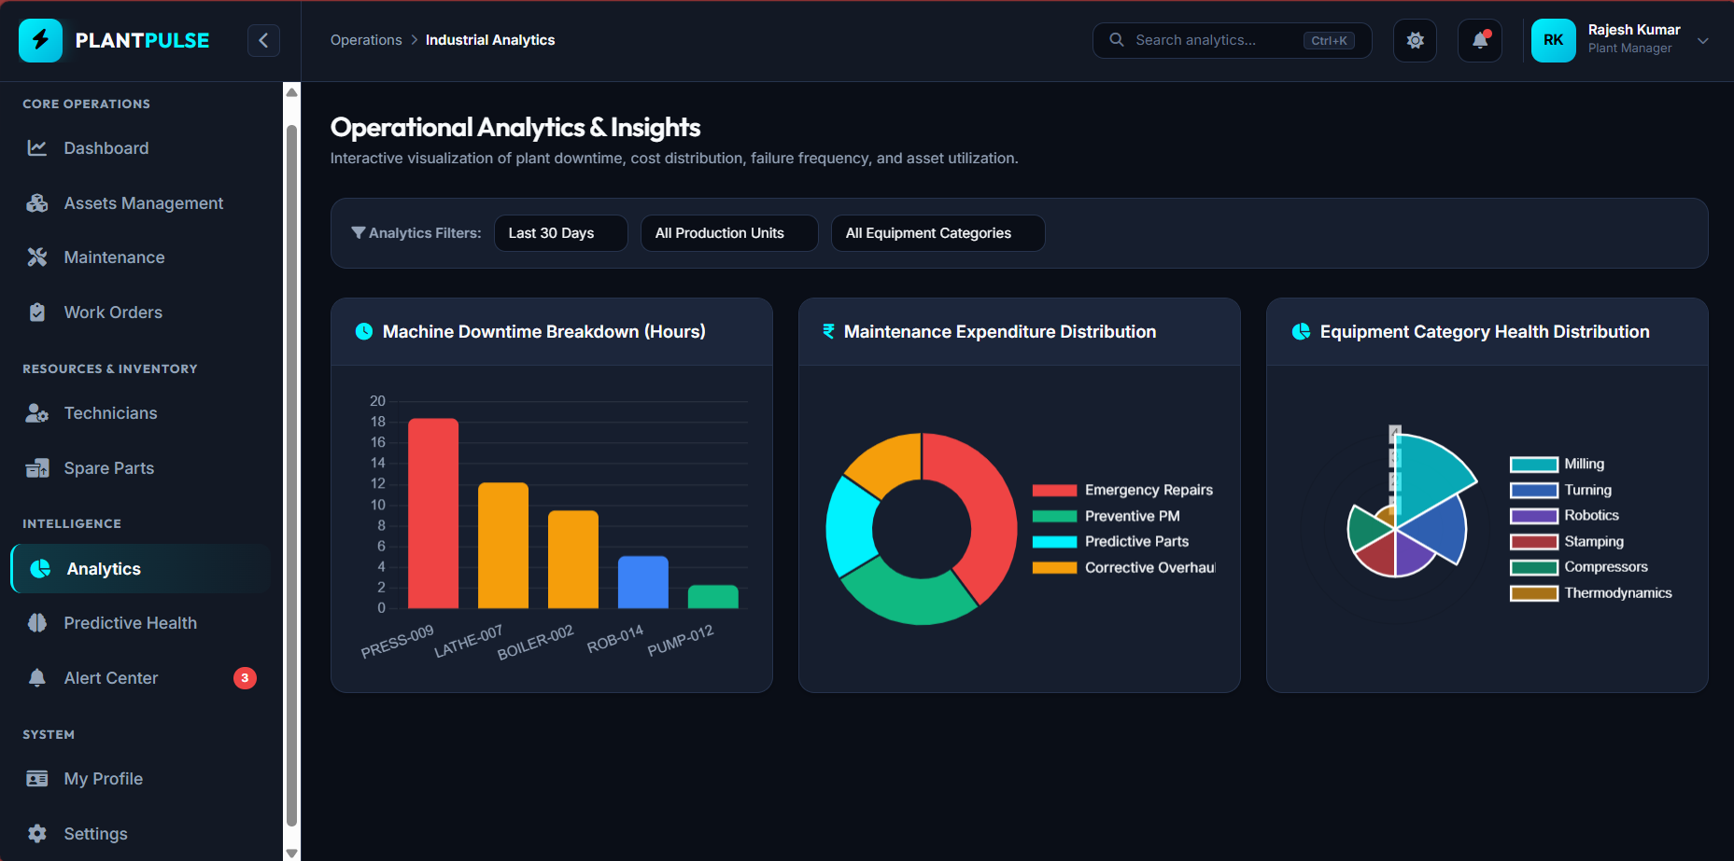
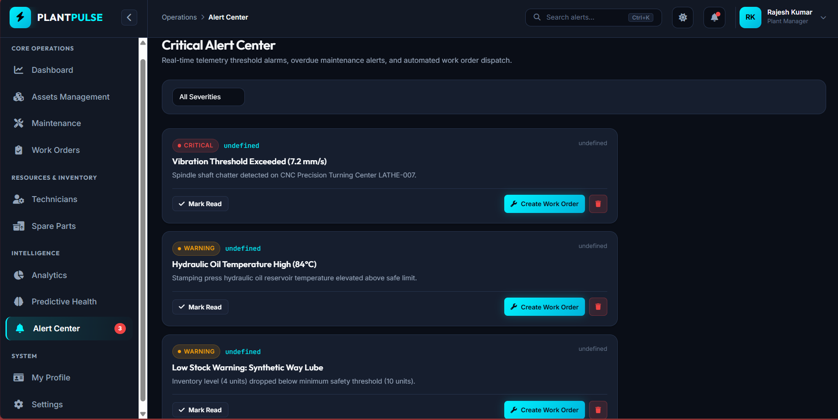
Failure Analytics & Real-Time Alert Center
Multi-Severity Event Triage & Historical Equipment Reliability Trends
Analytics & Alert Features
• Multi-Severity Alert Triage:
Categorizes incoming events into Critical (Red), Warning (Amber), and Info (Blue).
• Sensor Threshold Monitoring:
Real-time notifications triggered when temperature, pressure, or vibration exceeds limits.
• Failure Mode Analytics:
Visual chart breakdowns of failure root causes to assist predictive engineering decisions.
• Resolution Workflows:
Allows technicians to acknowledge, investigate, and clear active alerts with timestamped logs.
Reliability Trends & Failure Mode Analytics
Multi-Severity Alert & Event Triage Console

Slide 10
Database Schema, Conclusion & Future Roadmap
Normalized Relational Architecture and Long-Term Industrial Evolution
MySQL Relational Schema
• users Table:
Stores user credentials, hashed passwords, and RBAC role assignments.
• assets Table:
Holds machine specifications, health scores, and department locations.
• work_orders Table:
Tracks task statuses, assigned technicians, priorities, and timelines.
• spare_parts Table:
Manages inventory counts, reorder levels, and unit costs.
• alerts Table:
Logs system warnings, telemetry breaches, and resolution states.
Core Project Achievements
• Production Web Platform:
Delivered a fully responsive, dual-theme industrial web application.
• Decoupled REST API:
Implemented clean PHP PDO backend services with zero framework dependencies.
• Interactive Workflows:
Successfully deployed dynamic Kanban and health index calculation modules.
• High Performance:
Achieved sub-50ms execution times and 100% test pass rate across API endpoints.
Future Industrial Roadmap
• IoT Telemetry Integration:
Direct MQTT broker connectivity for live industrial sensor telemetry ingestion.
• Predictive ML Models:
Machine learning algorithms for Remaining Useful Life (RUL) estimation.
• Mobile PWA Support:
Offline-first Progressive Web App capabilities for field maintenance technicians.
• SCADA Interoperability:
Industrial protocol connectors (Modbus/OPC UA) for plant-wide SCADA integration.

