Slide 1
DISTRIBUTED CLOUD COMPUTING MINI PROJECT
Project Title
CloudPulse: A Cloud Cost Monitoring and Optimization Platform
Name of the Student
TAMIL MANI B
VISHNU VARDHAN S
YUVARAJ U
Register Number
111624102217
111624102240
111624102247
Year / Semester
3 / 5
Academic Year
2026-2027
Project Guide
Dr. Sheela Rani, Associate Professor, Dept. of CSE
Notes:
Introduce the team, the project title and the guide.

Slide 2
TABLE OF CONTENTS
1
Abstract
7
System Architecture
2
Problem Statement
8
Methodology
3
Objectives
9
Implementation / Modules
4
Task and Outcomes
10
Results
5
Plan of the Project
11
Conclusion
6
Tools and Technologies
12
References

Slide 3
Abstract
CloudPulse is a cloud cost monitoring and optimization platform for Azure (AWS optional). Every cost problem travels one loop: signal, context, finding, ownership, action, verification.
It connects through a read-only service principal (Reader and Cost Management Reader) and never creates, changes or deletes cloud resources.
Transparent rules and statistics (weekday-aware z-score, Holt smoothing, percentile verdicts) produce priced, de-duplicated findings scored P1 to P4 and assigned to the resource creator.
A saving is counted only after 7 days of billed cost confirm the drop.
$262.94
$33.44
open waste per month
verified savings per month
94%
27
estimate accuracy
automated tests passed
Built with
Python, FastAPI, SQLAlchemy and a framework-free JavaScript interface; secrets encrypted with Fernet.
Notes:
Figures are from the bundled FOCUS sample bill used in demo mode.

Slide 4





Problem Statement
Native cost consoles show how much was spent. They do not answer:
Which resources are wasted?
A list of expensive services does not say which individual resources are idle.
Who created each resource?
Tags are often missing, so the person who can switch it off is unknown.
What should be fixed first?
Without a single score, every item looks equally urgent.
Was it really fixed?
A closed ticket is not evidence; only a lower bill proves a saving.
Did the waste come back?
Resources recreated after clean-up silently erase the benefit.

Slide 5
Existing Systems vs CloudPulse
Capability | Native consoles | Commercial FinOps | Ad-hoc scripts | CloudPulse
Spend dashboards | Yes | Yes | Rarely | Yes
Idle / oversized detection | Partial | Yes | Partial | Yes
Creator from audit log | Manual | Varies | No | Automatic
Task workflow | No | Varies | No | Yes
Single priority score | No | Varies | No | Yes, explainable
Saving checked on next bill | No | Rarely | No | Yes, 7-day
Saving withdrawn if waste returns | No | Rarely | No | Yes
Read-only account access | n/a | Varies | Depends | Yes, by design

Slide 6
Objectives
Aim: build a transparent, read-only platform that detects wasted Azure spend, assigns each problem to its creator, tracks the fix, and counts a saving only after the bill proves it.
1
Collect cost, inventory, usage and audit data with a least-privilege identity.
6
Rank findings with one explainable P1 to P4 priority score.
2
Detect idle disks, unused IPs, orphaned snapshots and idle or oversized VMs.
7
Run a role-based finding lifecycle with comments and audit trail.
3
Flag abnormal daily spend with a weekday-aware robust z-score.
8
Verify each saving on the bill; withdraw it if the waste returns.
4
Forecast month-end spend and predict the budget breach date.
9
Protect credentials and passwords with modern cryptography.
5
Attribute every resource to its creator from the Activity Log.
10
Provide a reproducible Azure test environment and automated tests.

Slide 7
Task and Outcomes
Tasks
Expected Outcomes
Analyse the gaps in native cost consoles.
Build a read-only Azure collector (custom REST client).
Implement detection, anomaly, forecast and priority algorithms.
Build the findings engine, lifecycle and API.
Develop the web interface with SVG charts.
Create an Azure test workload and run 27 tests.
All 27 automated tests pass.
Consistent figures on every page: spend, waste, savings, budget.
Planted waste appears as findings with the creator identified, without tags.
A fix is verified only after billed data confirms a drop.
Safe to connect: read-only access, encrypted secrets.
Runs on a laptop, Docker, Render or Azure App Service.

Slide 8
Plan of the Project
1
Phase 1
2
Phase 2
3
Phase 3
Algorithms
Azure Collector
Findings Engine and API
Pure Python functions with hand-calculated unit tests
Custom REST client, tested against a fake cloud
De-duplication, lifecycle, roles, verification
4
Phase 4
5
Phase 5
6
Phase 6
User Interface
Azure Test Environment
Validation
Framework-free JavaScript single-page app
Scripts that plant real waste in a subscription
27 tests, headless-browser review, live checks
Notes:
Incremental, test-first approach; each stage kept the previous tests passing.

Slide 9
Tools and Technologies Used
Technology | Purpose
Python 3.12 | Back end, statistics and cryptography
FastAPI, Pydantic, Uvicorn | Async JSON API with validated requests
SQLAlchemy 2.0 | ORM: SQLite in development, PostgreSQL in production
APScheduler | Background sync of every workspace (6 h default)
Azure ARM REST + azure-identity | Custom ~135-line client; OAuth 2.0 tokens only
Fernet (cryptography), scrypt | Encrypt cloud secrets; hash passwords
HTML, CSS, JavaScript | Framework-free SPA; charts drawn as SVG
Docker, Render, Azure App Service | Packaging and hosting targets
pytest, GitHub Actions, Playwright | 27 tests, CI on every push, headless-browser checks

Slide 10




System Architecture
Client Tier
Server Tier
Data Tier
Single-page app, no build step
10 pages: Overview, Cost explorer, Anomalies, Budgets, Findings and more
Roles: admin, owner, viewer, demo visitor
FastAPI routers: auth, admin, API
Collector, detectors, findings engine, owner resolver
APScheduler sync, sessions, CSRF, rate limit
SQLAlchemy ORM
SQLite by default, PostgreSQL ready
Findings, costs, owners, audit log; Fernet-encrypted credentials
Microsoft Azure (external, read-only)
Entra ID, Cost Management, Resource Graph, Monitor, Activity Log, Advisor

Slide 11
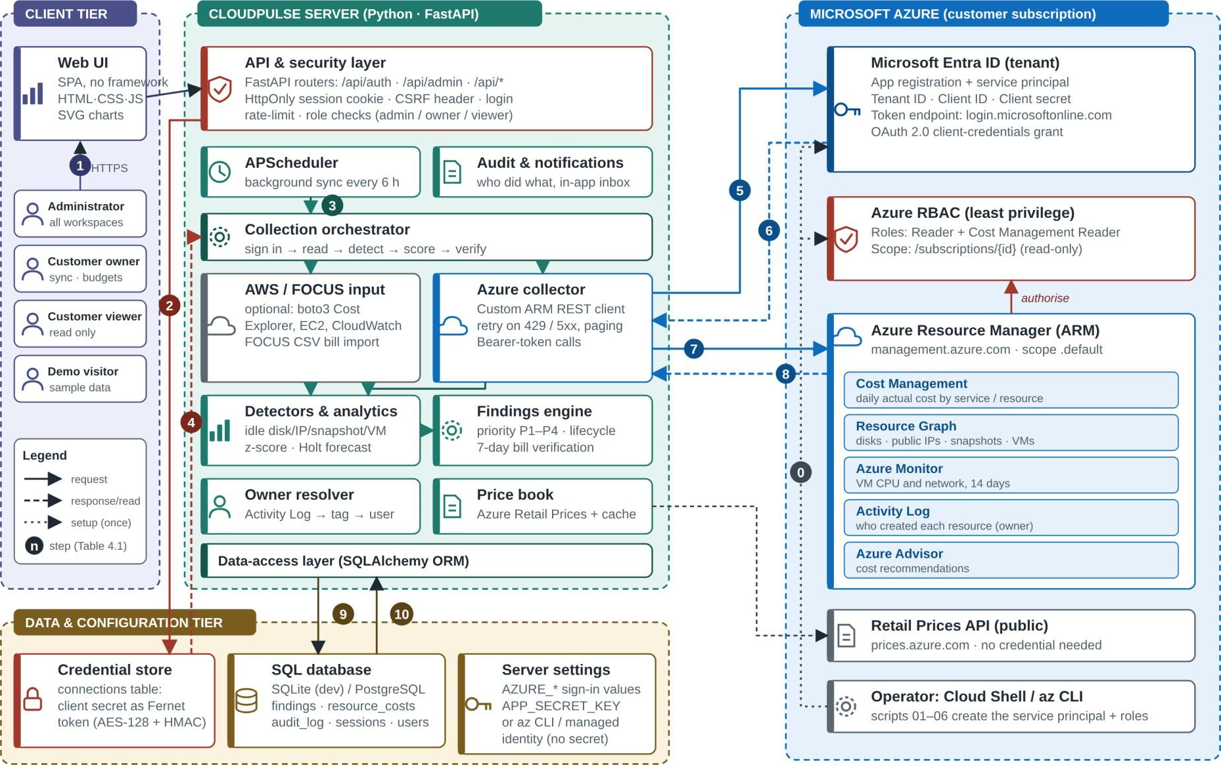
System Architecture Diagram

Slide 12
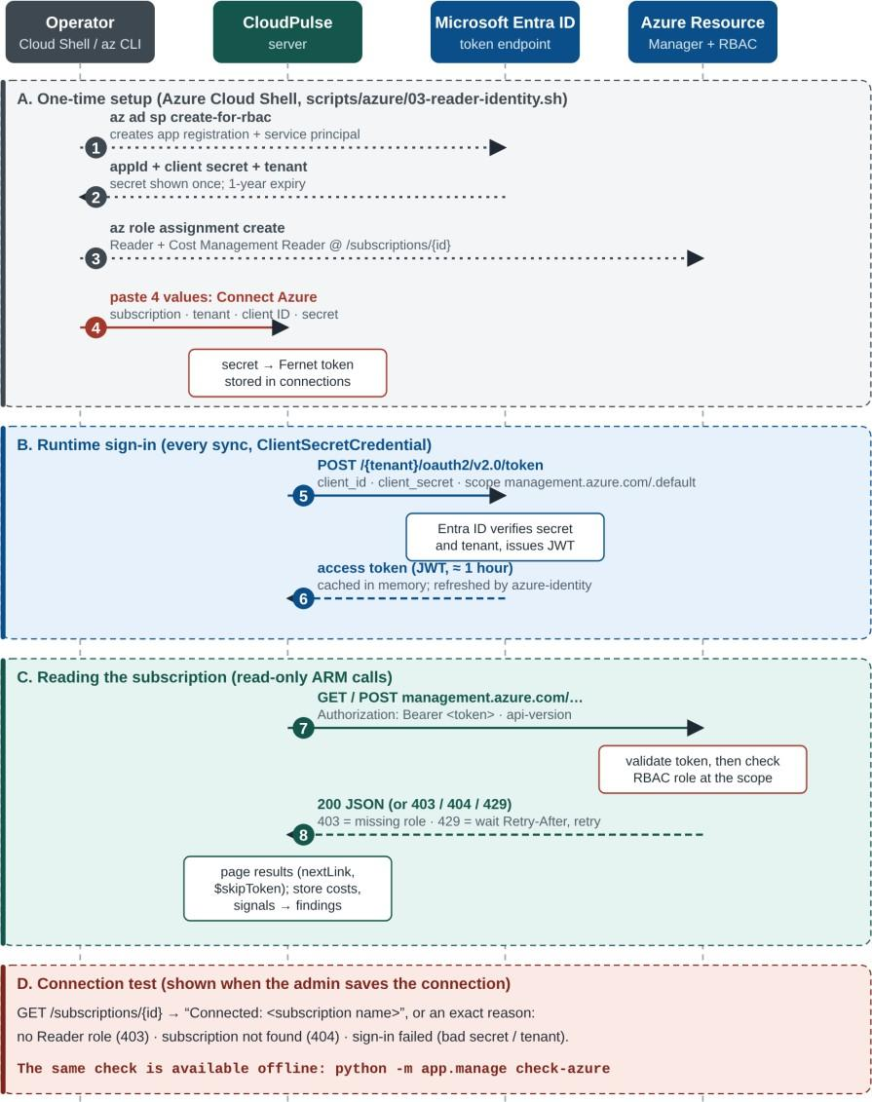



Azure Credential Architecture
Least privilege
Reader and Cost Management Reader roles on one subscription; nothing can be changed.
Short-lived tokens
OAuth 2.0 client-credentials grant returns a JWT valid for about one hour.
Encrypted at rest
Client secret stored as a Fernet token; the API never returns it.
Three sign-in modes
Service principal, Azure CLI, or App Service managed identity with no stored secret.

Slide 13
Methodology: Cost-to-Action Loop
1. Signal
Read the bill, inventory, VM metrics, Advisor and Activity Log on every sync.
2. Context
Price each signal per month: actual billed cost, else list price.
3. Finding
One de-duplicated, scored task with its evidence attached.
4. Ownership
Creator from the Activity Log (tags second) is matched to a user.
5. Action
Owner starts, fixes, dismisses with a reason or snoozes.
6. Verification
7 days of billed cost before and after; only then is the saving recorded.

Slide 14
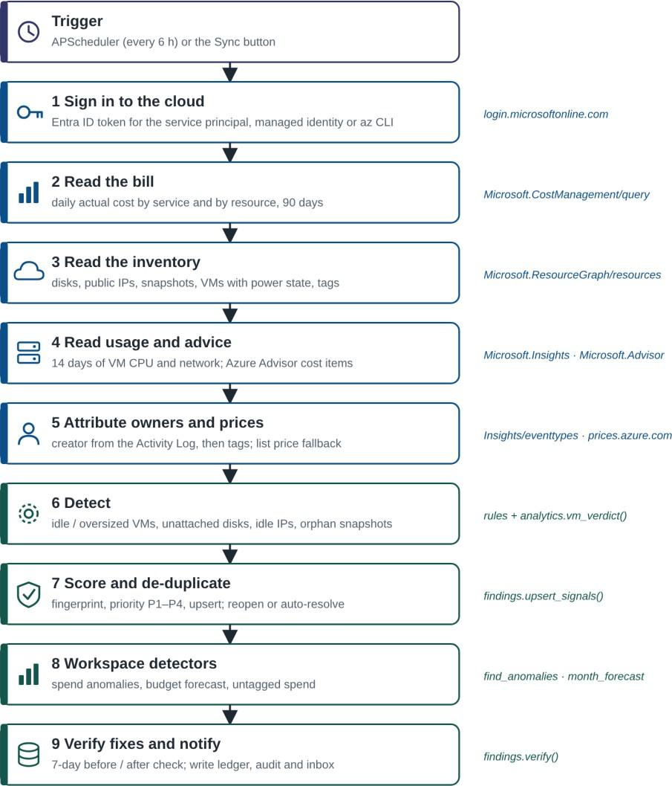
Methodology: Data Collection
One fault-tolerant call: sync_workspace
Cost: daily ActualCost by service and resource; 90-day back-fill, then the last 10 days.
Inventory: Resource Graph lists disks, IPs, snapshots and VMs, paged with $skipToken.
Usage: 14 days of hourly CPU and network from Azure Monitor.
Advice: Azure Advisor cost items merged in as evidence.
Resilience: each step records its own error, so one failure never stops the sync.

Slide 15
Methodology: Detection Rules
Finding | Rule | Confidence
Unattached disk | diskState = Unattached | 0.95
Idle public IP | Static, no IP configuration or NAT | 0.95
Orphaned snapshot | Source disk deleted, or older than 30 days | 0.90 / 0.60
VM stopped but billed | Stopped, not deallocated | 0.90
Deallocated VM | Power off, but disks still billed | 0.60
Idle VM | p95 CPU < 5 % and p95 network < 5 MB/h | 0.85
Oversized VM | p95 CPU < 20 %, peak < 80 %, smaller size exists | 0.70
Where Cost Management reports the billed cost of a resource, that actual cost replaces the list-price estimate. Memory is not measured, so oversized verdicts are 0.15 less confident.

Slide 16
Methodology: Anomaly and Forecast
Anomaly: weekday-aware z-score
Forecast: Holt smoothing
m = median(same weekday,
previous 4 weeks)
s = max(1.4826*MAD, 5% of m)
z = (x - m) / s
flag when z > 3.5
forecast(h) = (level + h*trend)
* weekday_factor
month_end = to_date + sum
80% range = +/-1.2816*RMSE
*sqrt(days_left)
Example, 24 Sep 2024: day cost $169.26 against a usual $73.55 gives z = 7.9. EC2 explains 99.1 % of the rise; the spike is ongoing, projected at $2,909.55 a month.
Example, September 2024: the $2,600 budget was passed on 28 Sep and the month ended at $2,829.99, 9 % over. This raises a P1 budget-risk finding.

Slide 17
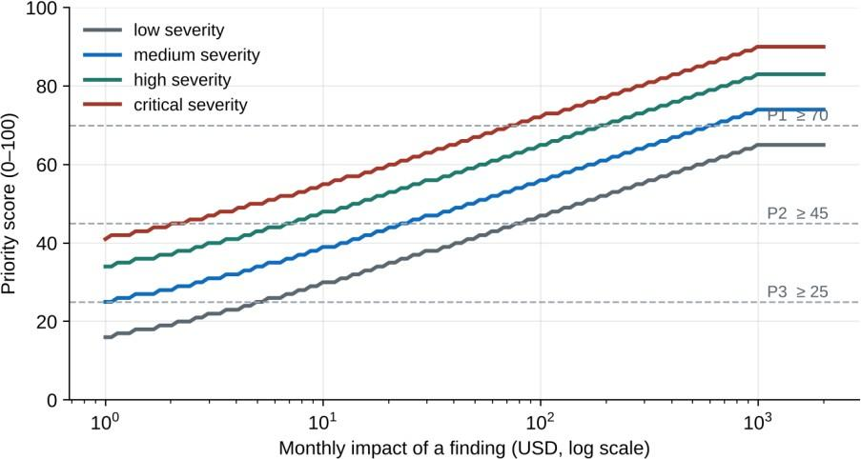
Methodology: Priority Score
score = 100*(0.6*impact + 0.4*severity)
* confidence * age_factor
impact = min(1, log10(1+$)/log10(1001))
age_factor = 1 + min(0.3, days_open/100)
P1
70 +
P2
45 +
P3
25 +
P4
other
The logarithm stops one large item from hiding the rest; the age factor slowly lifts forgotten findings.
Worked example
A stopped VM costing $70.08 a month with confidence 0.9: impact = 0.617, medium severity 0.55, score = 100 x (0.6 x 0.617 + 0.4 x 0.55) x 0.9 = 53 (P2). After 30 days open the age factor is 1.3 and the score becomes 69, still P2.

Slide 18
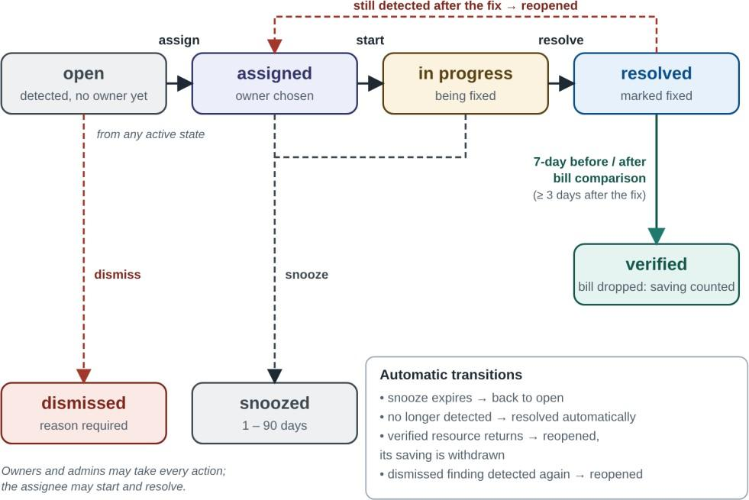
Methodology: Lifecycle and Verification
7-day bill check
before = mean daily cost,
7 days before the fix
after = mean daily cost,
up to 7 days after
saved = max(0, before-after)
* 30.4
needs >= 3 billed days
If a verified resource appears again, the finding reopens and the saving is withdrawn.
Owners and admins may take every action; the assignee may start and resolve; viewers only read. Dismissing needs a written reason; snoozing lasts 1 to 90 days.

Slide 19


Implementation / Modules
Module 1
Module 2
Module 3
Azure Collector
Detectors and Analytics
Findings Engine
Custom ARM REST client: cost, inventory, metrics, Activity Log, Advisor
Idle and oversized rules, z-score anomalies, Holt forecast
Fingerprints, priority score, lifecycle, 7-day verification
azure_collector.py
analytics.py
findings.py
Module 4
Module 5
Module 6
Owner Resolver
API and Security
Web Interface
Creator from the Activity Log, then owner tags; cached
FastAPI routers, roles, sessions, CSRF header, audit log
10 pages, SVG charts, notifications, CSV export
owners.py
routers/
static/

Slide 20
Security Architecture
Threat | Control in CloudPulse
Stolen password database | scrypt hashes with a random salt per user
Password guessing | 8 failures per 15 minutes; generic error text
Session theft | Hashed random token; HttpOnly, SameSite cookie; 12 h life
Cross-site request forgery | Custom X-CloudPulse header required on every write
Leaked cloud credential | Read-only roles, Fernet encryption, managed identity
Cross-tenant access | Every query scoped to the user's workspace membership
Accidental cloud change | Collector issues only GETs and two query POSTs
Clickjacking and sniffing are blocked with X-Frame-Options DENY, nosniff and a same-origin referrer policy.

Slide 21
Testing and Validation
27 / 27
Real Azure validation
Scripts plant four untagged wasted resources; CloudPulse must find the creator from the Activity Log.
automated tests passed (pytest)
Unattached 4 GB disk
→
Unattached disk
Unused static IP
→
Idle public IP
Snapshot of deleted disk
→
Orphaned snapshot
Stopped VM
→
Stopped but billed
A headless-browser review of every page also caught a mistyped colour that made text almost transparent; it was fixed and covered by a test.

Slide 22
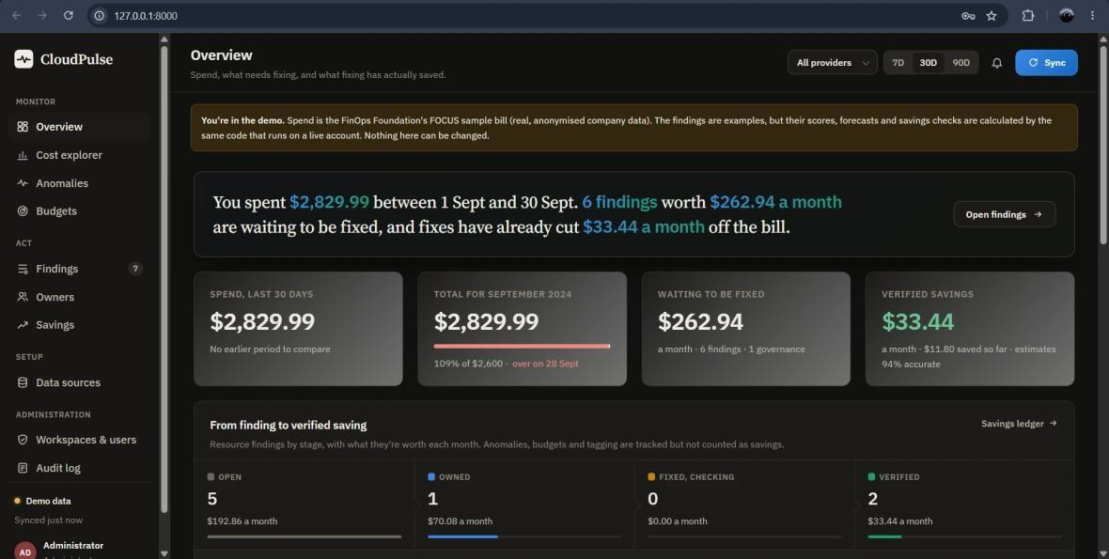
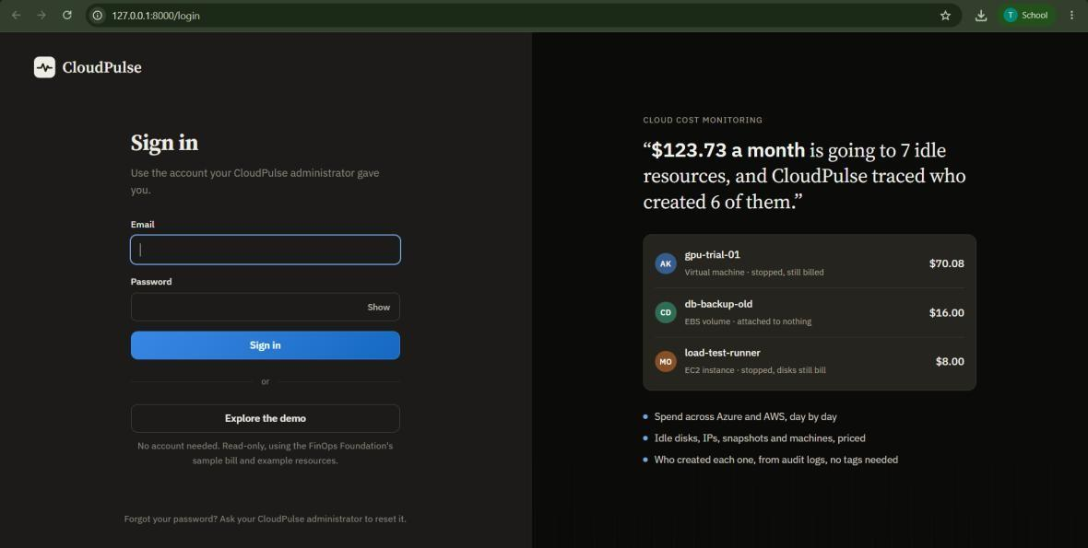
Results: Sign-in and Overview
$2,829.99
$262.94
spend, 30 days
waiting to be fixed / month
$33.44
109%
verified savings / month
of the $2,600 budget
Overview answers three questions on one page: what was spent, what needs fixing, and what fixing already saved.
Sign-in
uses administrator-created accounts; "Explore the demo" opens the read-only sample workspace.

Slide 23
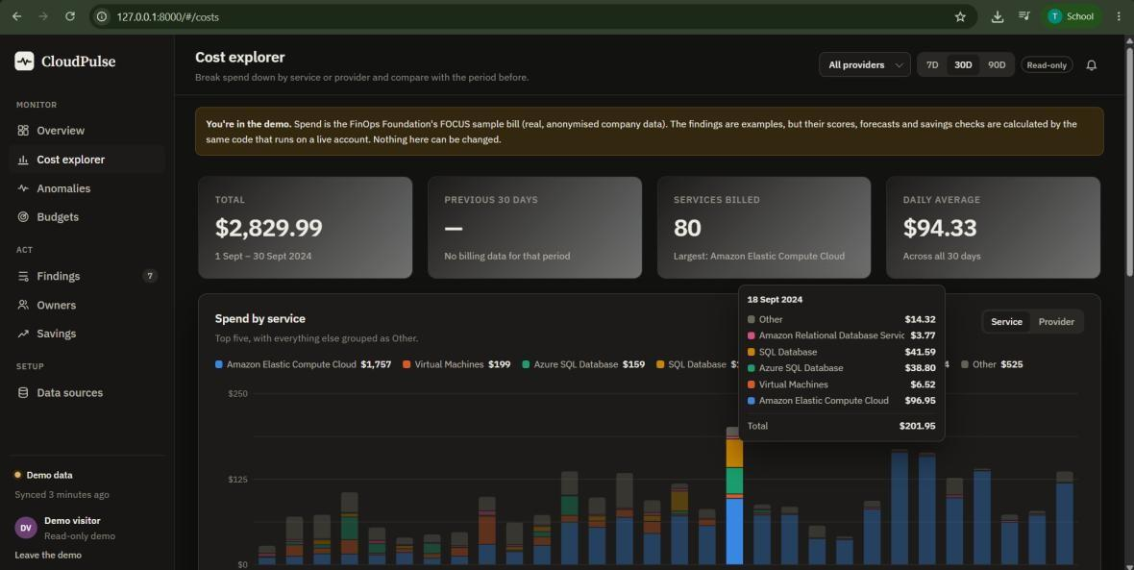
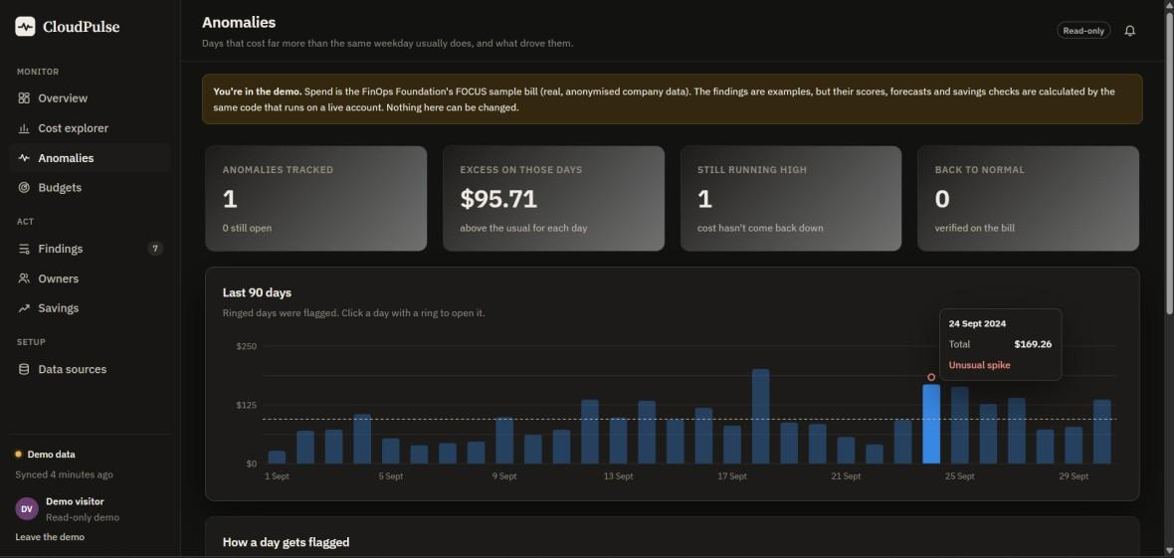
Results: Cost Explorer and Anomalies
$2,829.99 over 30 days across 80 services
Stacked daily bars by service or provider
AWS and Azure normalised with FOCUS
18 Sep total: $201.95
24 Sep flagged: $169.26 vs $73.55 usual (z = 7.9)
EC2 drives 99.1 % of the increase
Ongoing spike: $2,909.55 a month, tracked, not counted as saving
Other tall days are not flagged against their own weekday baseline

Slide 24
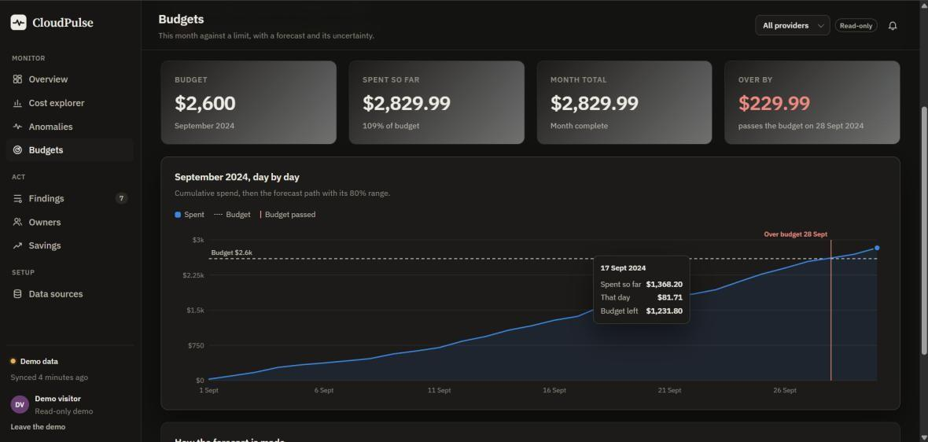
Results: Budget Forecast
$2,600
$229.99
September budget
over budget
28 Sep
P1
budget breached
budget-risk finding, score 75
Cumulative spend line, dashed budget line and a red breach marker.
For a month in progress, the Holt forecast and 80 % range extend the line and the marker moves to the predicted day.
Tooltip arithmetic checks out: $2,600 - $1,368.20 = $1,231.80 left on 17 Sep.

Slide 25
Results: Findings and Savings
Finding | $ / mo | Score | Status
Budget risk: Sep ended 9 % over | 230.00 | 75 (P1) | Open
VM gpu-trial-01 stopped, still billed | 70.08 | 69 (P2) | In progress
VM reporting-vm idle | 70.08 | 65 (P2) | Open
VM api-prod-01 oversized | 70.08 | 54 (P2) | Open
Disk web-01_OsDisk_old unattached | 19.71 | 43 (P3) | Verified
EBS db-backup-old unattached | 16.00 | 39 (P3) | Verified
Verified savings ledger
Estimated
$35.71 / mo
Realised
$33.44 / mo
Accuracy
93.6 %
Two fixed resources, confirmed by the before/after bill.
Top six of 12 findings in the demo workspace, ranked by score.

Slide 26
Conclusion
CloudPulse treats a cost problem as a task to be owned and proven fixed, not as a number on a chart.
Read-only access, transparent algorithms and bill-based verification make every figure explainable and safe to connect.
All objectives met: 27 of 27 tests passed; the demo reported $262.94 a month of open waste and $33.44 a month of verified savings at 94 % accuracy.
Signal
Context
Finding
Ownership
Action
Verification

Slide 27
Limitations and Future Enhancements
Limitations
Future Enhancements
Verification takes about a week, because billing data lags.
Right-sizing uses CPU and network only; memory is not measured.
Creators older than 90 days are known only through tags.
Scheduler, login throttle and SQLite make it single-instance.
AWS and FOCUS support are less deep than Azure.
Sign-in with Microsoft Entra ID (OpenID Connect).
E-mail, Teams and Slack notifications.
Google Cloud collector and deeper AWS coverage.
Reservation and savings-plan analysis.
Tag-compliance policies and showback reports.
Approval-gated remediation; PostgreSQL with a shared job queue.

Slide 28
References
Microsoft, "Azure Cost Management and Billing documentation," Microsoft Learn.
FinOps Foundation, "What is FinOps?" and "FOCUS: FinOps Open Cost and Usage Specification."
S. Ramírez, "FastAPI framework documentation"; SQLAlchemy Project, "SQLAlchemy 2.0 documentation."
B. Iglewicz and D. C. Hoaglin, How to Detect and Handle Outliers, ASQC Quality Press, 1993.
C. C. Holt, "Forecasting seasonals and trends by exponentially weighted moving averages," Int. J. Forecasting, vol. 20, no. 1, 2004.
D. Hardt, Ed., "The OAuth 2.0 authorization framework," RFC 6749, IETF, 2012.
Microsoft, "Azure Resource Manager REST API reference," Microsoft Learn.
J. R. Storment and M. Fuller, Cloud FinOps, 2nd ed., O'Reilly Media, 2023.

