Slide 1

R.M.K. College of Engineering and Technology
Department of Computer Science and Engineering
TEAM
REVIEW II
Tamil Mani B
CloudPulse
111624102217
Theja J G
111624102225
A cloud cost monitoring and optimisation platform that proves its savings
Varunesh D
111624102235
Viswajith R
Product Development Lab III · 24AI511
Review date: [DD / 10 / 2026] Supervisor: [name]
111624102242
October 2026

Slide 2
AGENDA
What we will walk through
01
Abstract
p. 3
05
System architecture
p. 7
02
Objectives
p. 4
06
Azure credential architecture
p. 8
03
Literature review
p. 5
07
Module description
p. 9 – 11
04
Pain points and design answers
p. 6
08
What the system reports
p. 12
CloudPulse · Product Development Lab III · Review 2
2 / 12

Slide 3
SUMMARY
Abstract
Organisations and students who run workloads on Azure and AWS keep paying for resources nobody uses: virtual machines shut down the wrong way that still bill for compute, disks left behind after a project, public IPs attached to nothing. Cost consoles show how much was spent, but not who owns the waste, what to fix first, or whether a fix really saved money.
IN NUMBERS (DEMO WORKSPACE)
$262.94
a month of open waste, 6 findings
$33.44
a month verified on the bill
CloudPulse connects to an Azure subscription with a read-only identity, finds the waste and spend anomalies, forecasts budget breaches, assigns every finding to the person who created the resource, and counts a saving only after seven days of billed cost confirm it. In the demo workspace it reports $262.94 a month still to fix and $33.44 a month already verified.
94 %
estimate accuracy of verified savings
27
automated tests passing
CloudPulse · Product Development Lab III · Review 2
3 / 12

Slide 4
WHAT WE SET OUT TO DO
Objectives
1
Collect cost, inventory, usage, advice and audit data from Azure with a least-privilege, read-only identity.
2
Detect unattached disks, unused public IPs, orphaned snapshots, stopped-but-billed, idle and oversized VMs.
3
Explain abnormal daily spend and forecast month-end spend and the day a budget will be breached.
4
Assign every finding to the person who created the resource, using the Activity Log and tags.
5
Verify each saving against the next bill, and withdraw it if the waste comes back.
6
Prove the result with an Azure test environment that plants real waste and 27 automated tests.
CloudPulse · Product Development Lab III · Review 2
4 / 12

Slide 5
BACKGROUND
Literature review in one page
What exists
What we borrow
What is missing
Native consoles report cost; commercial platforms add allocation behind closed scoring; scripts give one-off lists [3], [4].
Robust z-score with a weekday baseline [5], [6]; Holt smoothing for forecasts [7], [8]; the FinOps loop [3], [9]; OAuth 2.0 and RBAC for access [10], [11].
Owner attribution, one explainable priority and savings verified on the bill, in a read-only tool.
Full review with sources was presented in Review I.
CloudPulse · Product Development Lab III · Review 2
5 / 12

Slide 6
WHY IT IS BUILT THIS WAY
Pain points and how the design answers them
PAIN POINT IN PRACTICE | DESIGN ANSWER
Billing data arrives 8 to 24 hours late | Verify only after 3 billed days; waste findings do not wait for the bill
Resources are created without tags | Creator read from the Activity Log (earliest successful write), tag as fallback
A long list gives no order | One score: money, severity, confidence and age; bands P1 to P4
Tools ask for broad write access | Reader and Cost Management Reader only; the app never writes to the cloud
Savings are claimed, not proven | Before / after bill comparison; reopen and withdraw if the resource returns
Failures are silent | Per-step errors, a check-azure command and a start-up message that says why
CloudPulse · Product Development Lab III · Review 2
6 / 12

Slide 7
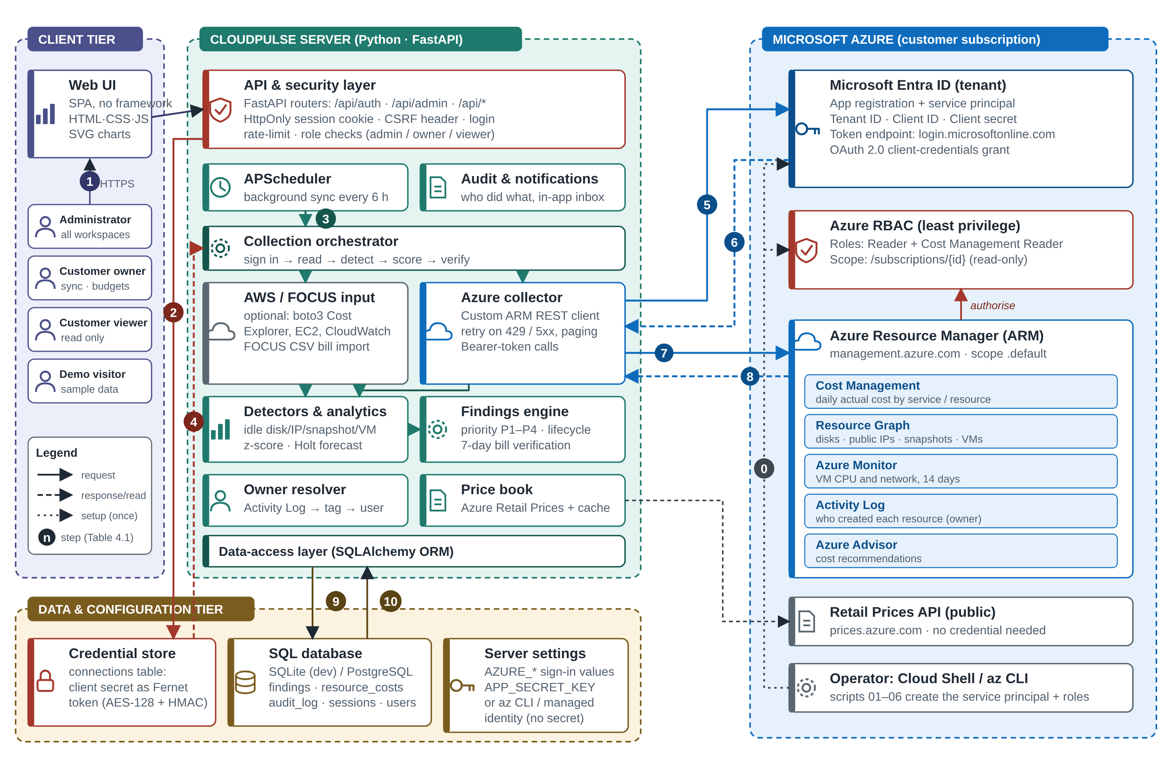
DESIGN
System architecture
Client. Single-page browser app.
Server. One Python process: API, scheduler, analytics.
Data. SQL database, encrypted credential store.
Azure. Only read, with a Bearer token.
Numbered flows: sign-in, credential storage, scheduled sync, token request, token response, ARM reads, results stored.
CloudPulse · Product Development Lab III · Review 2
7 / 12

Slide 8
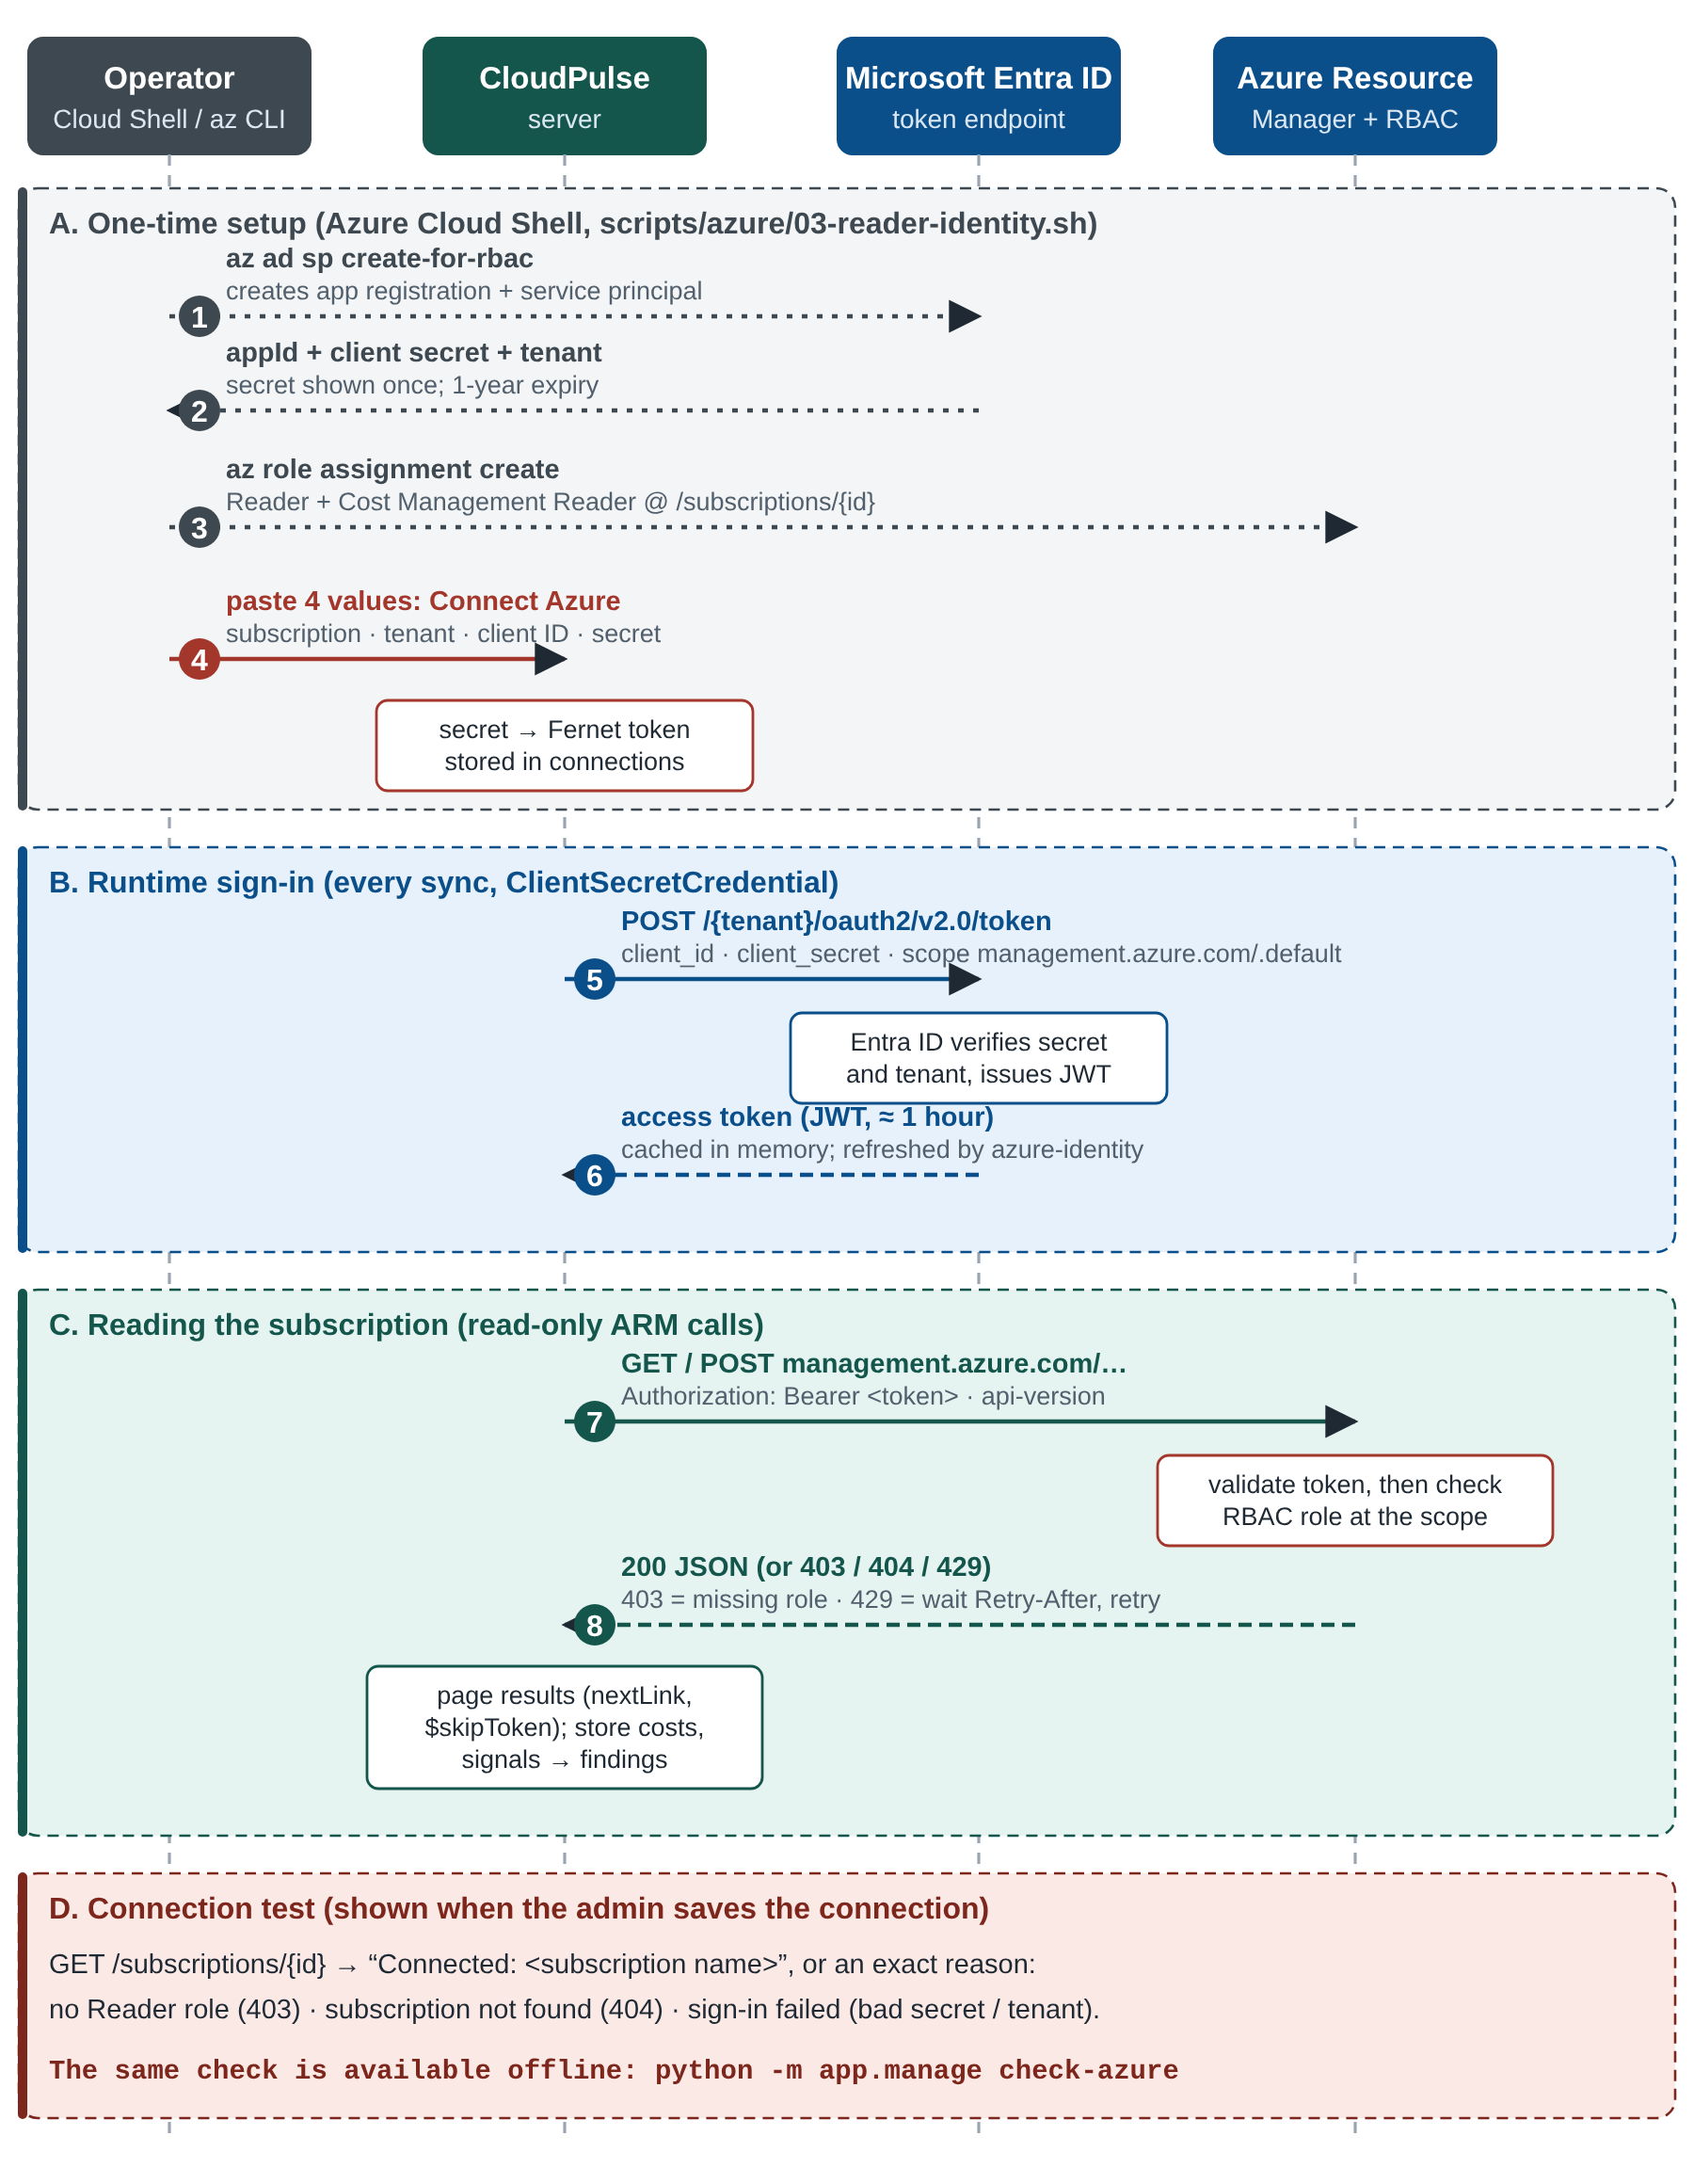
AZURE CREDENTIAL ARCHITECTURE
How CloudPulse gets into Azure
Identity. An app registration with a service principal in Microsoft Entra ID. Three values: tenant ID, client ID, client secret.
Permission. Reader and Cost Management Reader on the subscription only. No role can create, change or delete.
Token. Client-credentials request returns a JWT valid about an hour; sent as a Bearer token on every read.
Storage. A secret entered in the UI is encrypted with Fernet and never returned by the API.
Alternatives. Managed identity on App Service (no secret at all) or an az CLI login on a laptop.
Diagnosis. python -m app.manage check-azure prints Connected or the exact reason it failed.
CloudPulse · Product Development Lab III · Review 2
8 / 12

Slide 9
MODULES
Module description (1 of 3): access and data
A Azure access
Builds a credential from stored or server settings; custom ARM REST client with retry on 429 / 5xx, Retry-After and $skipToken paging.
connections.py, azure_rest.py
B Data collection
Cost Management query, Resource Graph inventory, Monitor metrics (14 days), Activity Log, Advisor, Retail Prices. Optional AWS and FOCUS import.
azure_collector.py, collection_orchestrator.py
C Ownership resolver
Earliest successful write in the Activity Log; GUID callers shown as service identities; then owner tags; cached 24 h when unknown.
owners.py
CloudPulse · Product Development Lab III · Review 2
9 / 12

Slide 10
MODULES
Module description (2 of 3): detection and analytics
MODULE | WHAT IT DOES | INPUT
D Waste detectors | Unattached disk, static IP on nothing, orphaned snapshot, stopped-but-billed VM | Rules on inventory; confidence 0.90 to 0.95
E VM verdict | Idle: p95 CPU < 5 % and network < 5 MB / h. Oversized: p95 CPU < 20 %, peak < 80 % | 14 days of hourly metrics
F Anomaly detector | z = (x − median) / (1.4826 × MAD) > 3.5 against the same weekday of 4 weeks | Daily cost series
G Forecast | Holt smoothing + weekday factors; 80 % range; first day the total passes the budget | Month-to-date cost
H Priority score | 100 × (0.6 × impact + 0.4 × severity) × confidence × age; P1 ≥ 70, P2 ≥ 45, P3 ≥ 25 | Finding evidence
CloudPulse · Product Development Lab III · Review 2
10 / 12

Slide 11
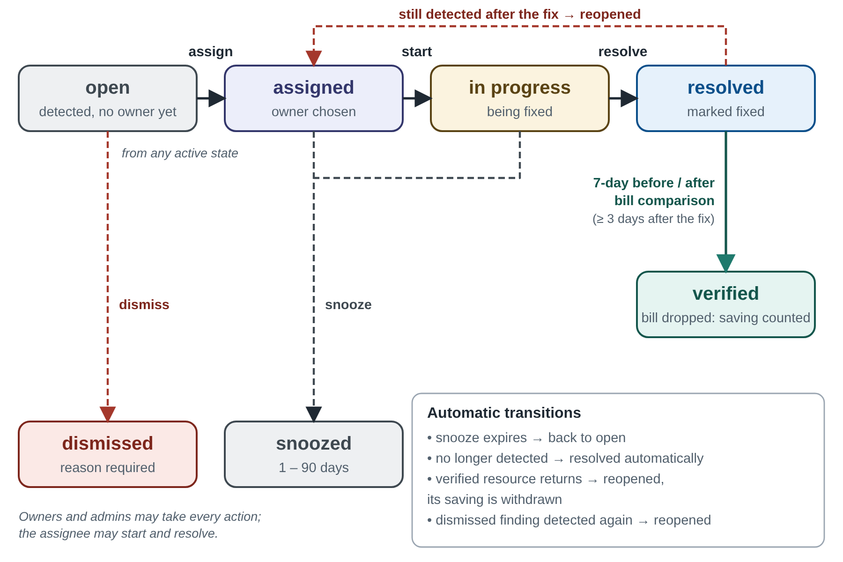
MODULES
Module description (3 of 3): findings, security and interface
I Findings engine. Fingerprint de-duplication, scoring, lifecycle, 7-day verification, savings ledger.
J API and security. scrypt passwords, server-side sessions, CSRF header, login rate limit, role checks, audit log.
K Web interface. Ten pages with SVG charts: overview, costs, anomalies, budgets, findings, owners, savings, sources, admin, audit.
L Azure scripts. Create workload, plant four leaks, read-only identity, deploy, cost spike, clean-up.
Finding lifecycle: open, assigned, in progress, resolved, verified.
Roles: admin and owner can do everything; the assignee can start and resolve; viewers read.
CloudPulse · Product Development Lab III · Review 2
11 / 12

Slide 12
OUTPUTS
What the system reports
REPORT | WHAT IT SHOWS
Overview | Spend, findings to fix, verified savings, loop by stage
Cost explorer | Spend by service or provider with a period comparison
Anomalies | Flagged days, excess, drivers, ongoing or one-off
Budgets | Cumulative spend, forecast with 80 % range, breach date
Findings and owners | Ranked inbox, filters, CSV export; who owns what
Savings ledger | Estimate against realised saving, accuracy, saved to date
Audit log | Every sign-in, change and action, newest first
Next, Review III: results from the running system, testing, conclusion and future enhancements.
CloudPulse · Product Development Lab III · Review 2
12 / 12

