Slide 1

R.M.K. College of Engineering and Technology
Department of Computer Science and Engineering
TEAM
REVIEW III
Tamil Mani B
CloudPulse
111624102217
Theja J G
111624102225
A cloud cost monitoring and optimisation platform that proves its savings
Varunesh D
111624102235
Viswajith R
Product Development Lab III · 24AI511
Review date: [DD / 10 / 2026] Supervisor: [name]
111624102242
October 2026

Slide 2
AGENDA
What we will walk through
01
Abstract
p. 3
06
Results
p. 8 – 9
02
Objectives and outcome
p. 4
07
Testing and validation
p. 10
03
Literature review
p. 5
08
Conclusion
p. 11
04
System architecture
p. 6
09
Future enhancements
p. 12
05
Module description
p. 7
CloudPulse · Product Development Lab III · Review 3
2 / 12

Slide 3
SUMMARY
Abstract
Organisations and students who run workloads on Azure and AWS keep paying for resources nobody uses: virtual machines shut down the wrong way that still bill for compute, disks left behind after a project, public IPs attached to nothing. Cost consoles show how much was spent, but not who owns the waste, what to fix first, or whether a fix really saved money.
IN NUMBERS (DEMO WORKSPACE)
$262.94
a month of open waste, 6 findings
$33.44
a month verified on the bill
CloudPulse connects to an Azure subscription with a read-only identity, finds the waste and spend anomalies, forecasts budget breaches, assigns every finding to the person who created the resource, and counts a saving only after seven days of billed cost confirm it. In the demo workspace it reports $262.94 a month still to fix and $33.44 a month already verified.
94 %
estimate accuracy of verified savings
27
automated tests passing
CloudPulse · Product Development Lab III · Review 3
3 / 12

Slide 4
OUTCOME AGAINST PLAN
Objectives and what we achieved
OBJECTIVE | OUTCOME
Collect read-only Azure data | Service principal, CLI or managed identity; Cost, Graph, Monitor, Activity Log, Advisor
Detect waste | Four resource rules plus idle / oversized VM verdict; 12 findings in the demo
Explain spend | 24 Sep flagged ($169.26 vs usual $73.55, z = 7.9); budget breach on 28 Sep
Assign owners | Creator from the Activity Log, tags second; 6 of 7 idle resources traced
Verify savings | 2 findings verified: $33.44 realised against $35.71 estimated
Prove it | 27 automated tests pass; Azure scripts plant four leaks
CloudPulse · Product Development Lab III · Review 3
4 / 12

Slide 5
BACKGROUND
Literature review and the gap
What exists
What we used
What we added
Consoles report, platforms allocate behind closed scoring, scripts give one-off lists [3], [4].
Robust z-score [5], [6]; Holt smoothing [7], [8]; the FinOps loop [3], [9]; OAuth 2.0 and RBAC [10], [11].
Owner from the audit log, one explainable priority and savings verified on the bill, read-only.
CloudPulse · Product Development Lab III · Review 3
5 / 12

Slide 6
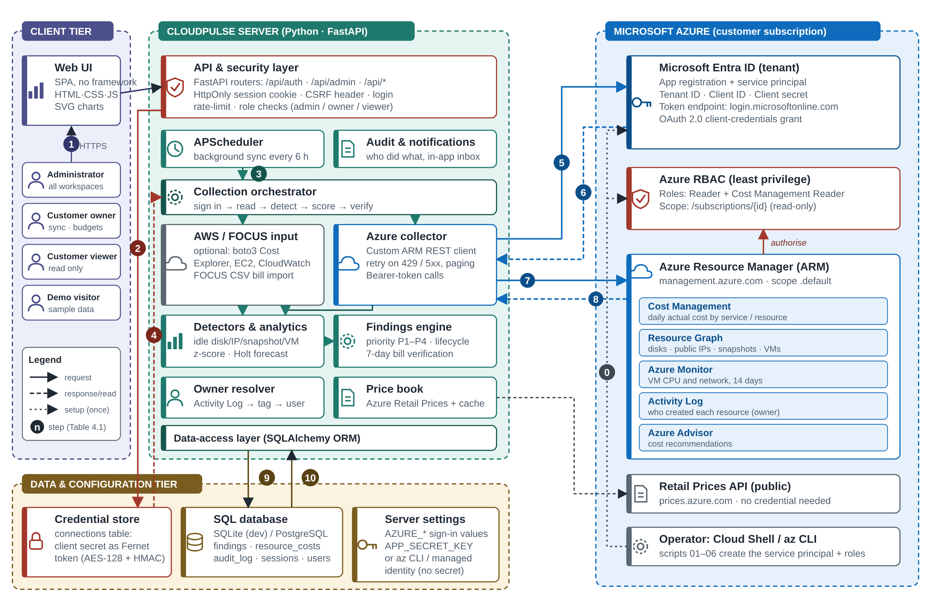
DESIGN
System architecture
Client. Single-page browser app.
Server. One Python process: API, scheduler, analytics.
Data. SQL database, encrypted credential store.
Azure. Only read, with a Bearer token.
Numbered flows: sign-in, credential storage, scheduled sync, token request, token response, ARM reads, results stored.
CloudPulse · Product Development Lab III · Review 3
6 / 12

Slide 7
DESIGN
Module description
MODULE | FILES | RESPONSIBILITY
Access | connections, azure_rest | Credential, token, retry, paging
Collection | azure_collector, orchestrator | Bill, inventory, metrics, advice, audit log
Ownership | owners | Activity Log, tags, cache
Detection | azure_collector, analytics | Waste rules, VM verdict
Analytics | analytics | Anomaly, forecast, priority score
Findings | findings | Fingerprint, lifecycle, verification, ledger
API and security | routers, security, audit | Sessions, roles, CSRF, audit trail
Interface | static/app.js, charts.js | Ten pages, SVG charts, light and dark themes
CloudPulse · Product Development Lab III · Review 3
7 / 12

Slide 8
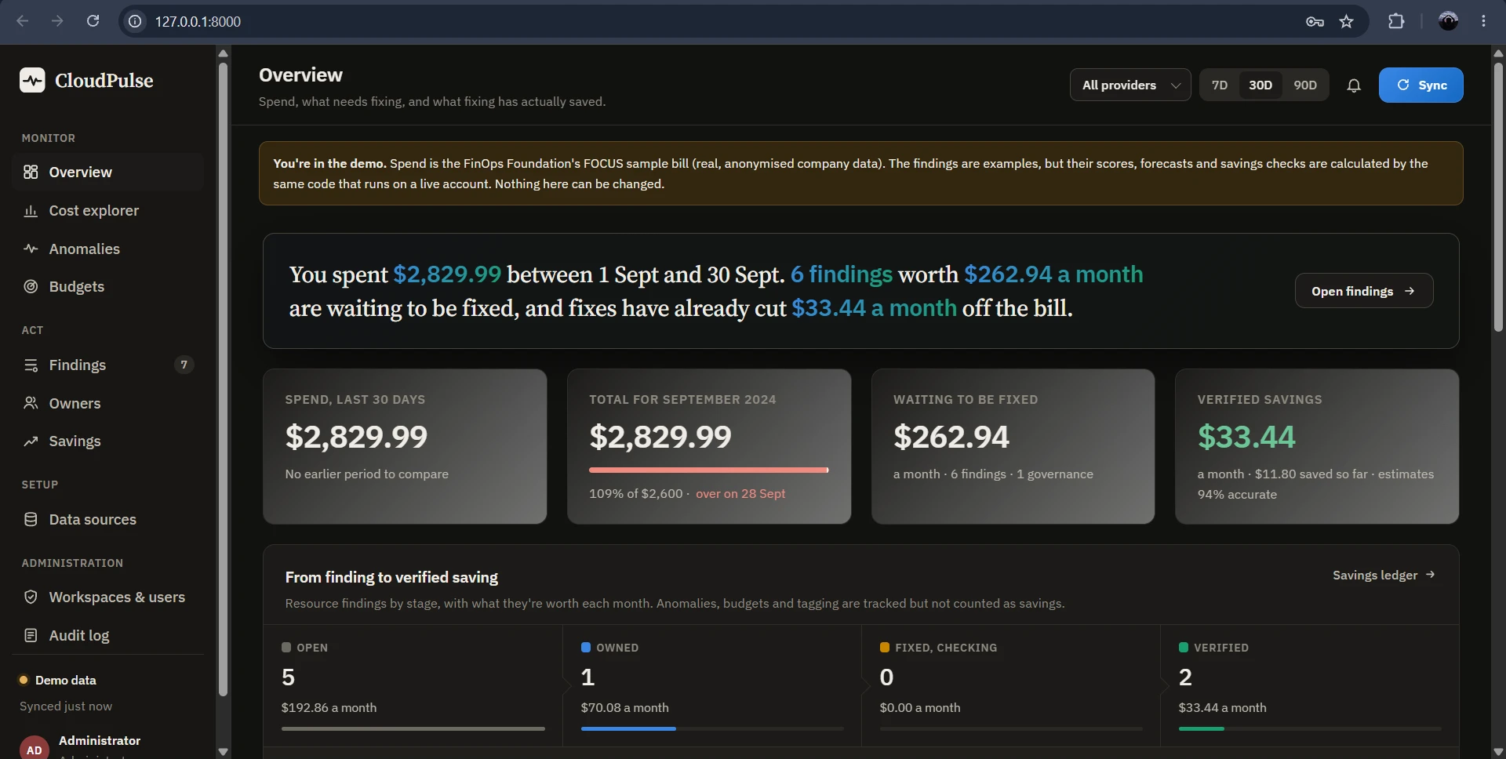
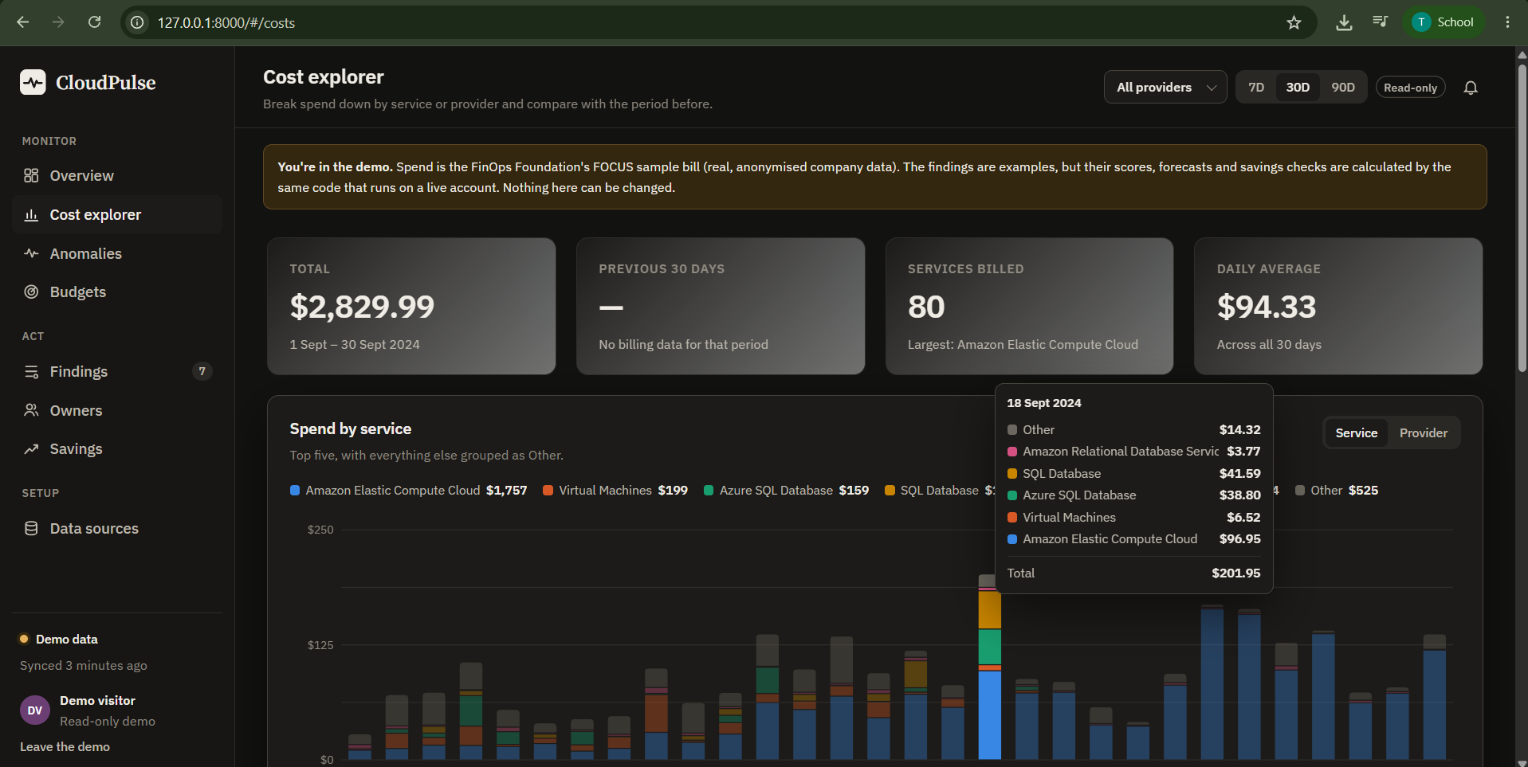
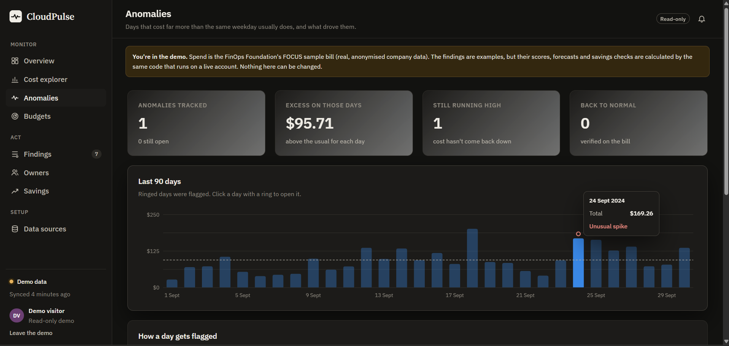
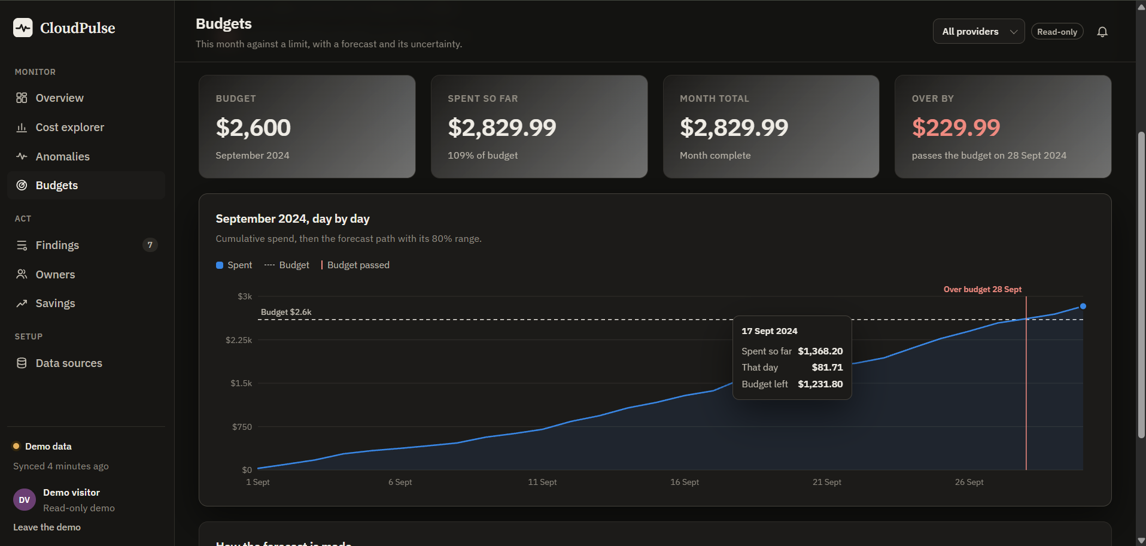
RESULTS 1 / 2
Results: the running system
What to notice
– The same totals appear on every page
– Tooltips go down to one day and one service
– The budget breach is marked on the chart, not only in a number
Overview: $2,829.99 spend; $262.94 to fix; $33.44 verified
Cost explorer: 80 services, daily average $94.33
Anomalies: 24 Sep, excess $95.71, 99 % from EC2
Budgets: $2,600 passed on 28 Sep, $229.99 over
CloudPulse · Product Development Lab III · Review 3
8 / 12

Slide 9
RESULTS 2 / 2
Results: findings and verified savings
# | FINDING (TOP OF 12) | USD / MO | SCORE | STATUS
1 | September 2024 ended 9 % over budget | 230.00 | 75 P1 | Open
2 | VM gpu-trial-01 stopped but still billed | 70.08 | 69 P2 | In progress
3 | VM reporting-vm runs but does almost nothing | 70.08 | 65 P2 | Open
4 | VM api-prod-01 larger than it needs to be | 70.08 | 54 P2 | Open
5 | Disk web-01_OsDisk_old attached to nothing | 19.71 | 43 P3 | Verified
6 | EBS volume db-backup-old attached to nothing | 16.00 | 39 P3 | Verified
VERIFIED SAVINGS
$33.44
a month, from an estimate of $35.71
93.6 %
estimate accuracy
All figures are from the demo workspace on the FOCUS sample bill (21 Mar to 30 Sep 2024), not a customer account.
Verification showed estimates are slightly optimistic, which a plain report would never reveal.
CloudPulse · Product Development Lab III · Review 3
9 / 12

Slide 10
EVIDENCE
Testing and validation
SUITE | TESTS | WHAT IS CHECKED
Algorithms | 23 | Median / MAD, anomaly, forecast, priority, VM verdict, before / after
Full loop | 1 | Fake Azure: sync, owners, workflow, verify, reappearing resource, permissions, audit
Front end and diagnostics | 3 | CSS colour tokens, page renderers, Azure setup messages
Planted leaks (live check)
– leftover-disk, 4 GB
– unused-ip, static
– old-backup-snap, disk deleted
– forgotten-vm, stopped not deallocated
Found by a browser review: a mistyped colour value made the main text nearly invisible. Fixed, and a regression test was added.
Not yet measured: results on a customer subscription; Azure bills arrive 8 to 24 hours late.
CloudPulse · Product Development Lab III · Review 3
10 / 12

Slide 11
WRAP-UP
Conclusion
CloudPulse carries a cost problem from the first signal to a saving proven on the bill. It reads Azure with a read-only identity, finds waste and anomalies, forecasts budget breaches, names the owner, tracks the fix and withdraws the saving if the problem returns.
WHAT WE TAKE AWAY
– Cloud billing, IAM and monitoring applied in one product
– Explainable algorithms are easier to defend
– Proof beats estimates
– Every figure is explainable and recomputable from stored evidence.
– 27 automated tests and a scripted Azure environment back the results.
– Known limits: billing delay, no VM memory metrics, creators older than 89 days only by tag.
CloudPulse · Product Development Lab III · Review 3
11 / 12

Slide 12
WHAT COMES NEXT
Future enhancements
ENHANCEMENT | WHY
Sign in with Microsoft Entra ID | Use existing organisation accounts
E-mail, Teams and Slack alerts | Reach owners outside the app
Google Cloud and deeper AWS | Idle load balancers, NAT gateways
Reservation and savings-plan analysis | Purchase recommendations
Tag-compliance policies, showback | Cost by team
Approval-gated remediation | Deallocate a stopped VM after the owner confirms
PostgreSQL default, shared job queue | Multi-instance deployment
VM memory and disk metrics | More accurate right-sizing
Thank you. Questions are welcome.
CloudPulse · Product Development Lab III · Review 3
12 / 12

